Slide 1

01
Alzheimer’s Disease Detection
Topic - I

Slide 2
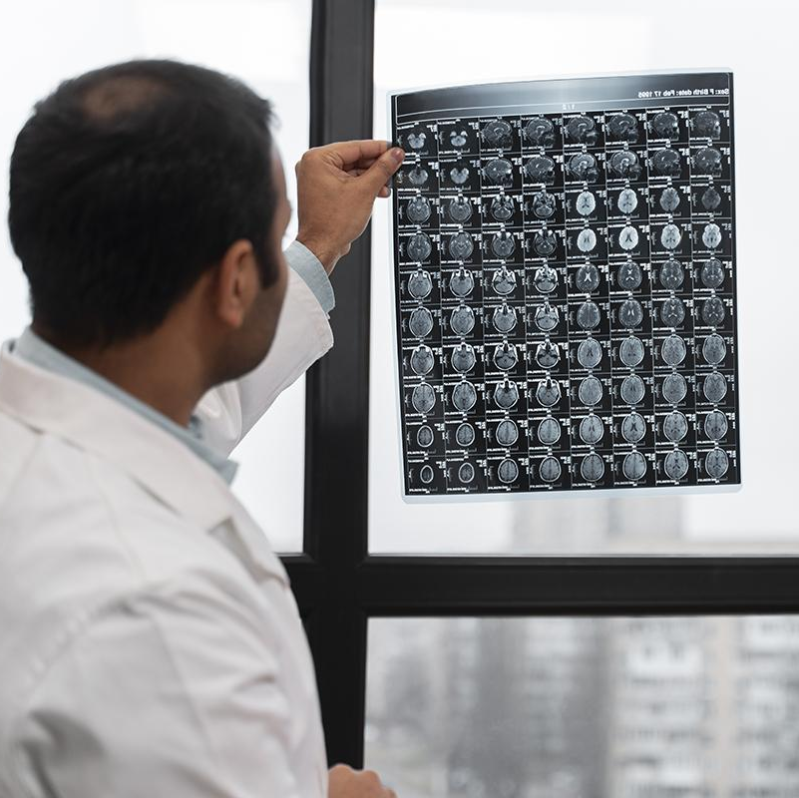
Introduction
Over 55 million people worldwide are affected by Alzheimer's, with no cure currently available.
Early diagnosis is vital to manage symptoms.
Leveraging machine learning to analyze MRI scans and accurately classify dementia stages

Slide 3

Dataset Details
Dataset Source:
Over 85,000 MRI scans from the OASIS study.
Class Labels:
Classification of Alzheimer’s severity into four ordinal classes:
None: 67,222 scans
Very Mild: 13,725 scans
Mild: 5,002 scans
Moderate: 488 scans

Slide 4
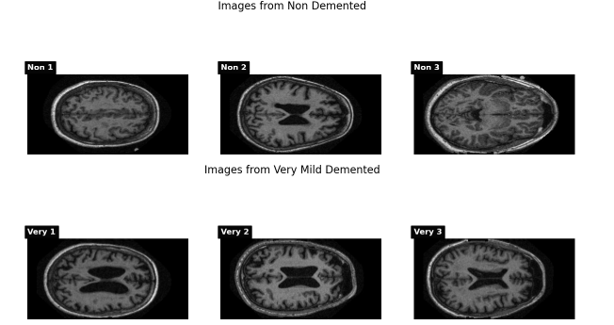
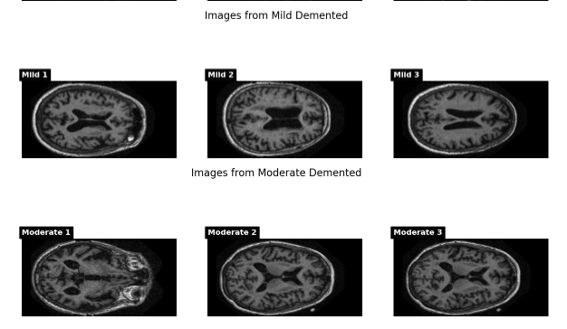
Case presentation

Slide 5
Methodology
MRI images were normalized and resized to ensure compatibility
Oversampling techniques were applied to underrepresented classes
A Convolutional Neural Network (CNN) was designed and implemented
The dataset was split into training (70%), validation (15%), and testing (15%) subsets
Applied techniques such as rotation, flipping, and zooming to artificially expand the dataset

Slide 6
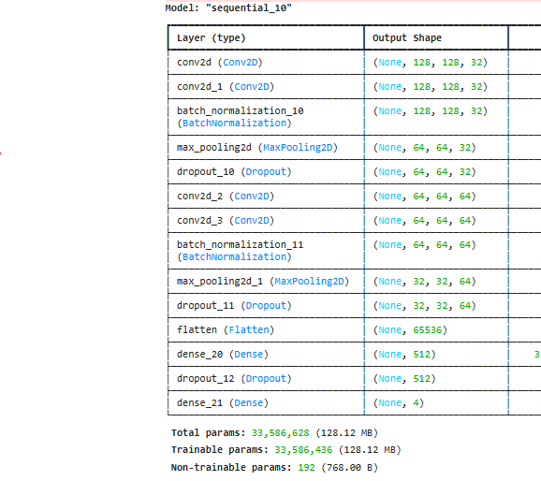
Model Architecture
Model Design: A CNN with convolution, batch normalization, pooling, dropout, flatten, and dense layers.
Parameters:
Total: 33.6M
Trainable: 33.6M
Layers:14

Slide 7
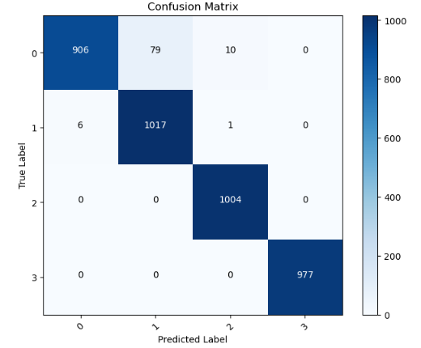
Confusion Matrix
The model performs robustly, with most errors limited to adjacent classes, particularly in lower severity stages, and excels in classifying critical cases.

Slide 8
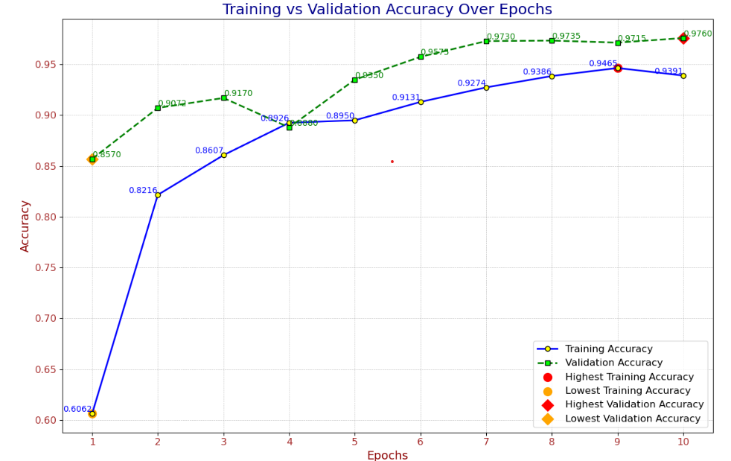
Train Vs Validation
The model achieved a training accuracy of 0.9760 and a validation accuracy of 0.9465 by epoch 10, with minimal overfitting and strong generalization.

