Slide 1
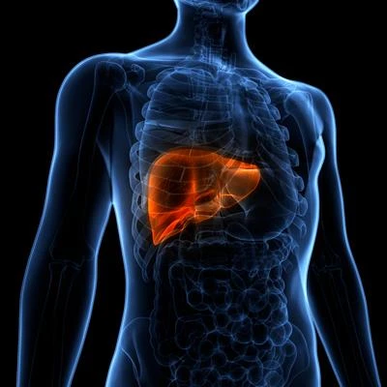
Liver Cirrhosis Stage Classification

Slide 2
Dataset Summary
Cirrhosis Overview: Cirrhosis is caused by prolonged liver damage, often due to hepatitis or alcohol consumption, leading to scarring and liver failure.
Dataset Source: Sourced from a Mayo Clinic study on primary biliary cirrhosis (PBC)
Attributes: 19 features with 25000 Datapoints

Slide 3
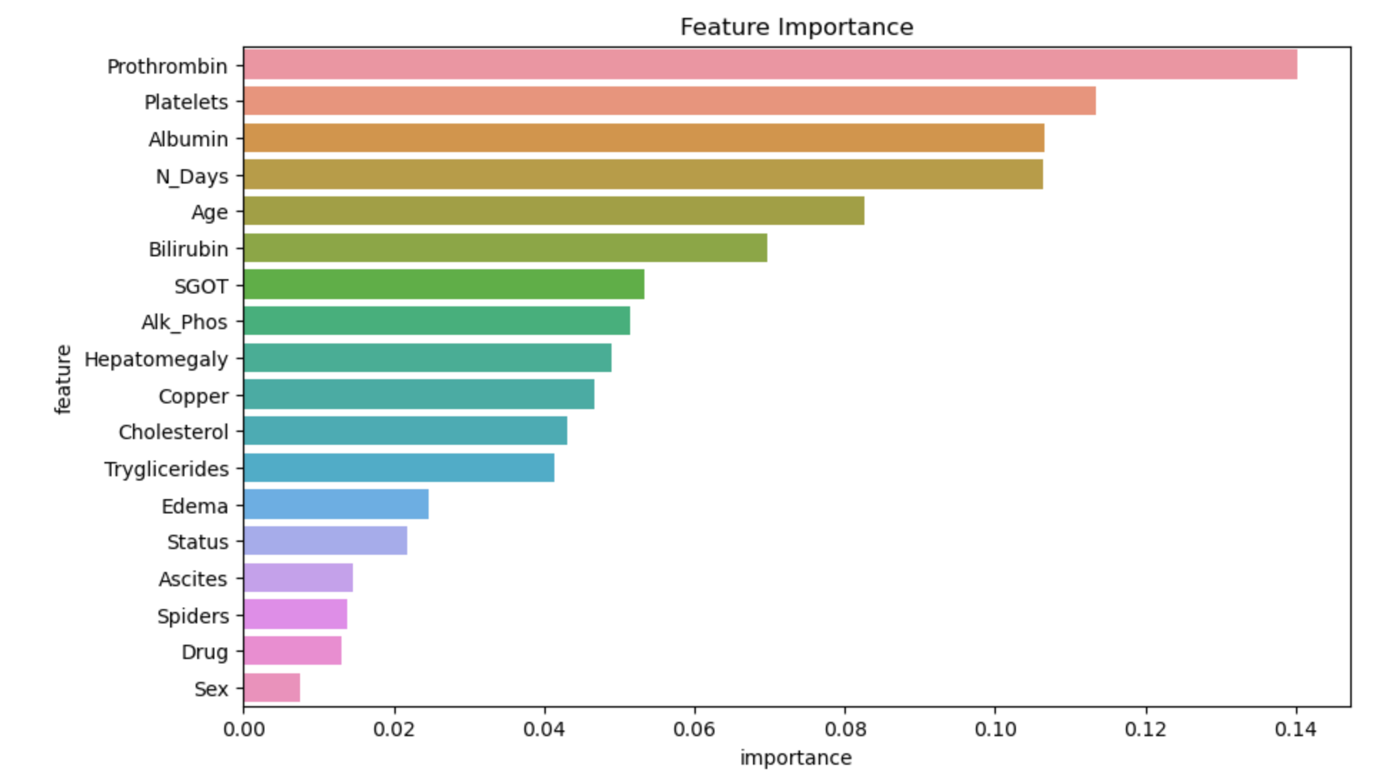
Data Visualization

Slide 4
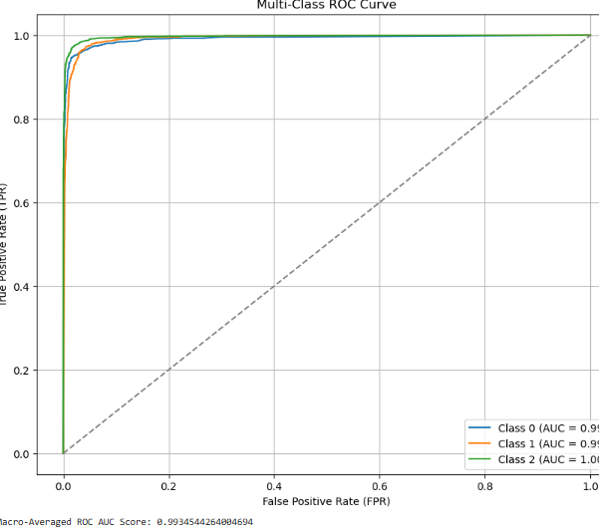
Model Building : Random Forest
Overall Performance: High AUC scores indicate excellent classification.
Class-Specific AUCs: Class 0: 0.99, Class 1: 0.99, Class 2: 1.00 (perfect separation).

Slide 5
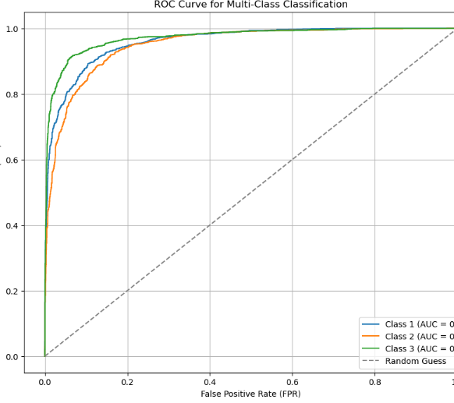
Deep learning Model Building
Model Performance:
Class 1 (AUC = 0.96), Class 2 (AUC = 0.95), Class 3 (AUC = 0.97):
Overall Observation:
The model demonstrates strong classification ability for multi-class tasks

Slide 6
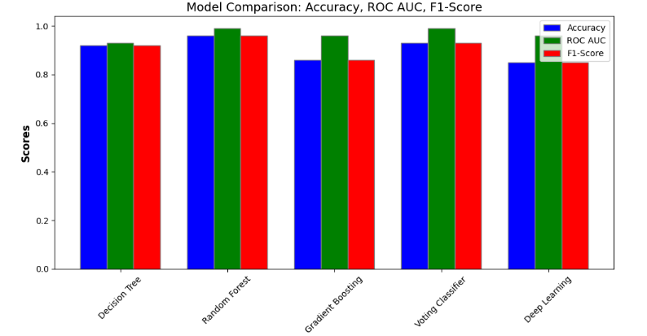
Comparison Between ML Models and Deep Learning
The Random Forest model outperforms all others with the highest accuracy (96%) and AUC (0.992), excelling in generalization
Deep Learning (Accuracy: 85%, AUC: 0.960) are competitive but less effective than the ensemble methods.

Slide 7

Thank You

