Slide 1

Orientation for New Users

Slide 2

Learning Goals
In this orientation you should learn:
How to access the Head Start Coaching Companion
How to navigate the basic menu items and find further assistance on the Help Menu

Slide 3
Invitation to Join
You must have received an email invitation with a message like this one:
An OHS Coaching Companion account has been created for you. To access the site, you need to register for an ECLKC login. If you have not already done so, please follow the instructions located here: How to access the Coaching Companion Once you are registered with the ECLKC, you can access the OHS Coaching Companion here: Coaching Companion Home Thank you, Your OHSCC Administrator
Select this hyperlink

Slide 4
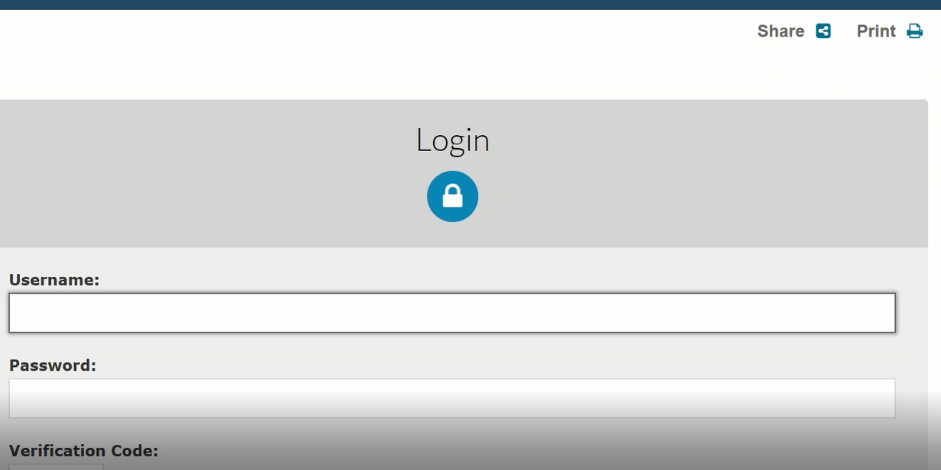
Login to ECLKC
The hyperlink will take you to the ECLKC Login. If you already have an account with the same email address, you can use it. Otherwise, on the next slide you will see how to register for an account, scrolling down to the page until you see Register Now.
Log in with your account

Slide 5
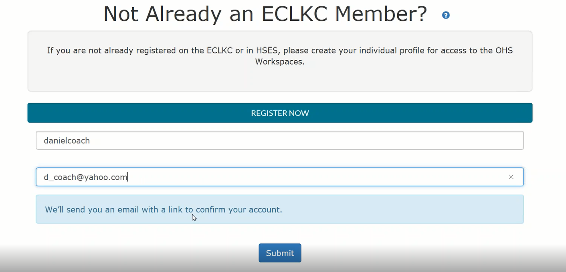
Register to ECLKC
Type an user name and the same email address from where you received your invitation.
Select Submit when completed

Slide 6
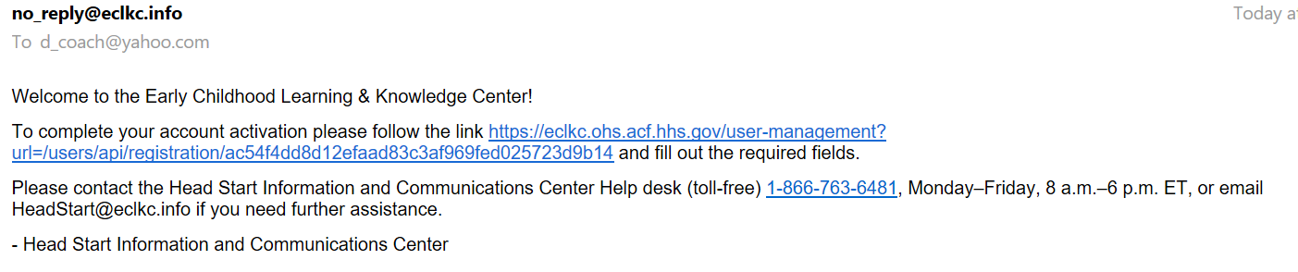
Selecting the Activation Link
Go back to your email to select the activation link
Activation Link

Slide 7
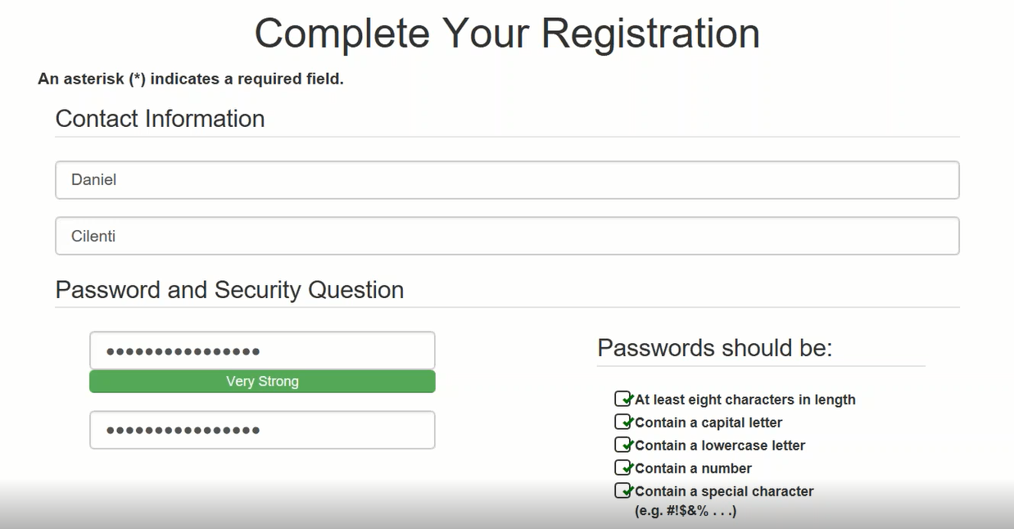
Complete your Registration
Type first and last name, password (following requirements), and a security question with the corresponding answer. Once registered, return to the Login page.

Slide 8
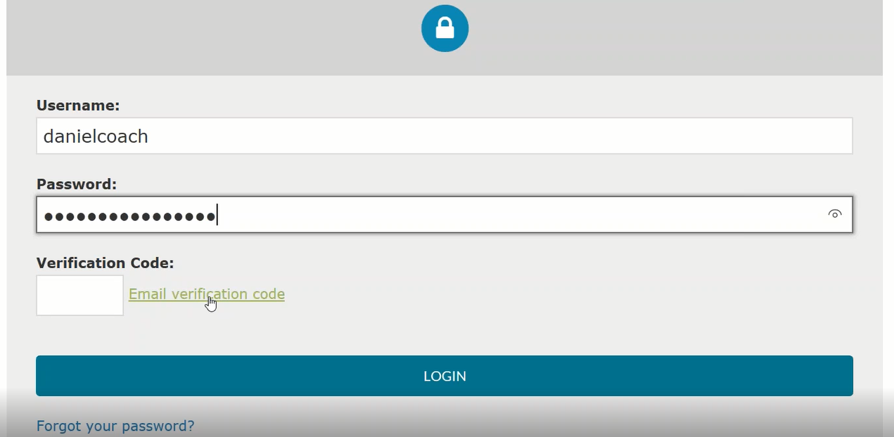
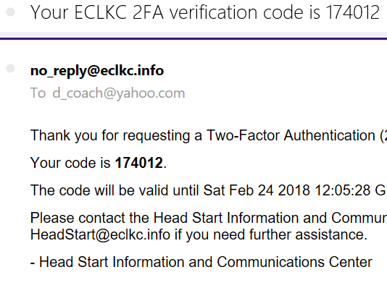
Verification Code
After entering username and password, you must enter a verification code that will be sent to your email. Then select Login.
Look for the verification code and enter it on the white cell

Slide 9
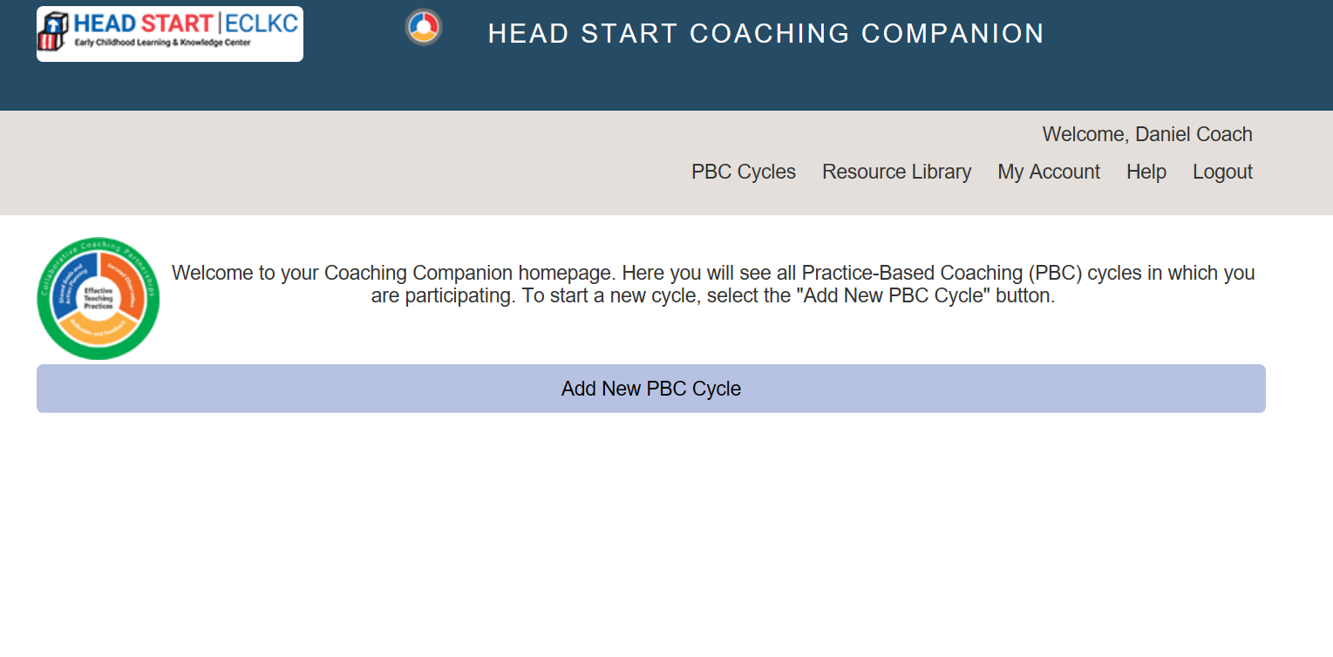
Landing Page
Now you arrive to the Coaching Companion landing page. Here you can…
Manage PBC Cycles
Log out
Access the Resource Library
Verify information on your account
Read Orientation Documents

Slide 10
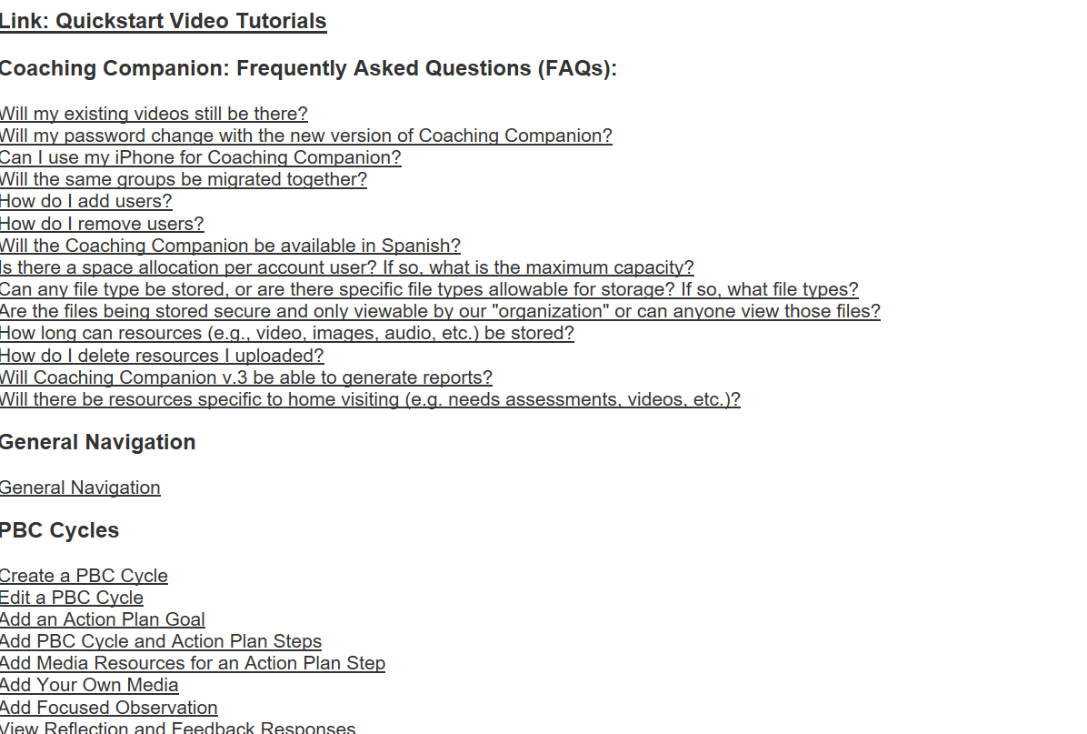
Help
It is strongly recommended to visit the Help Section and read the guidance before start using the Head Start Coaching Companion.
Watch the video tutorials

Slide 11
Thank you
If you have further questions please email to:
coachingcompanion@eclkc.info
Or call 1-866-763-6481

