Slide 1
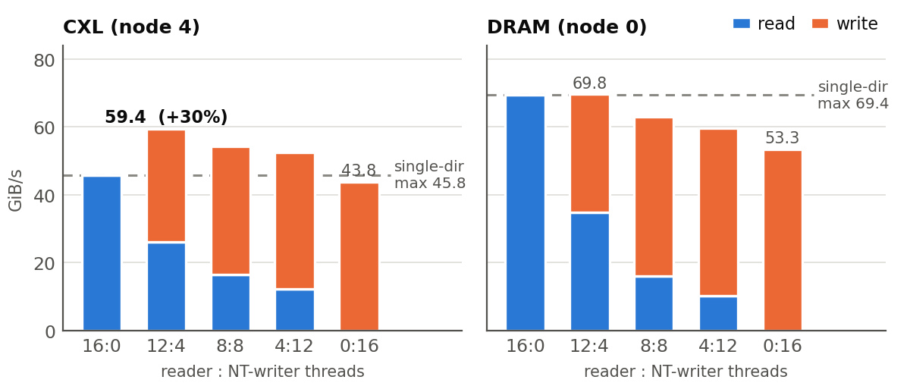
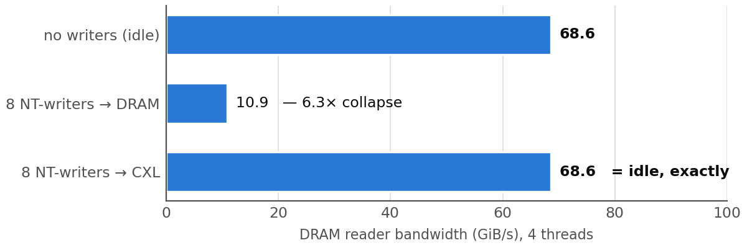
DIRECTION GATES · MEASURED 2026-08-25 · C28, 4× CZ120 (PAIR A = NUMA NODE 4)
CXL is a write-preferred tier: two experiments
Premise: CXL rides a full-duplex link and stores are asynchronous — so write traffic should be cheap on CXL and expensive on DRAM. Both predictions tested.
GATE 1 — do the two link directions add capacity?
GATE 2B — does moving writes to CXL protect DRAM readers?
▪ Writers aimed at DRAM starve the DRAM reader 6.3× (68.6→10.9). Verified: ±0.5% over reps, read+write sums to the pipe ceiling, reproduced by Gate 1 independently; plain stores show 4.1× — not an NT artifact.
▪ The same writers aimed at CXL: reader identical to idle (68.6 GiB/s, 177.8 ns) — total isolation — while writers keep 80% of their throughput (54.9→43.7).
▪ The only cost lands on CXL-resident readers (−41% bandwidth, 2.2× chase latency): co-location is the knob.
▪ Mixed 12:4 hits 59.4 GiB/s = +30% over the best single direction — the write direction is real added capacity.
▪ DRAM control: pinned at its 69.4 one-pipe ceiling, and mixing writes only degrades it (→53.3).
▪ Partial duplex: co-located CXL reads sag (45.8→26.0) — the pair’s internal media is shared.
NEXT ① direction-aware placement — objects declare read / write / RMW streams ② planner with separate read & write budgets + this measured frontier ③ NT-store staging API for checkpoint & eviction streams (VeloC demo first) ④ keep hot reads off write-heavy CXL devices (per-card, once unlocked)

