Slide 1
Thiruppugazh-KG Dataset
A Manually Annotated Resource for
jpUg;Gfo;
Computational Analysis of Tamil Devotional Literature
Thiruppugazh
Garthigan Kumarasamy · Jubeerathan Thevakumar · Sathurgini Uthayakumar Disne Kajanath · Narthana Sivalingam · Uthayasanker Thayasivam
1,335 hymns 15th century CE Tamil · Low-resource
Department of Computer Science and Engineering University of Moratuwa, Sri Lanka
ACL 2026 — Workshop Presentation
Notes:
Good morning / afternoon, everyone. I'm Garthigan Kumarasamy from the University of Moratuwa. Today I'll be presenting Thiruppugazh-KG — the first semantically annotated knowledge graph dataset for Tamil devotional literature. Thiruppugazh is a 15th-century corpus of 1,335 hymns composed by the saint-poet Arunagirinathar, dedicated to Lord Murugan. It is one of the richest surviving works in classical Tamil, yet until now no machine-readable, structured resource existed for computational analysis. That gap is what this work addresses.

Slide 2
Motivation
Why build a knowledge graph for Tamil devotional literature?
The Gap
▸ Tamil is a low-resource language with limited NLP tools
▸ Thiruppugazh is one of the richest devotional corpora — 1,335 hymns, 15th century
▸ No structured, machine-readable representation exists for computational analysis
▸ Scholars rely on manual reading; no way to query across the full corpus at scale
The Opportunity
▸ Knowledge graphs model entities & relationships — ideal for literary corpora
▸ Graph analytics (PageRank, community detection) reveal hidden cultural patterns
▸ Enables semantic search, thematic clustering, and sacred geography mapping
▸ Creates a reusable framework for other classical texts in low-resource languages
We introduce Thiruppugazh-KG — the first semantically annotated knowledge graph dataset for Tamil devotional literature, enabling computational analysis of mythology, themes, and sacred geography.
Kumarasamy et al. · Thiruppugazh-KG · ACL 2026
Notes:
Tamil is a low-resource language with very limited NLP infrastructure. Thiruppugazh is an extraordinary literary corpus — spiritually significant, linguistically complex, and historically rich — but scholars can only access it through manual, text-by-text reading. There is no way to query across all 1,335 hymns systematically. Knowledge graphs are a natural fit here: they model entities and relationships explicitly, and they enable graph analytics such as PageRank and community detection that can surface cultural patterns invisible to manual reading. Our contribution fills this gap and creates a reusable framework for other classical texts in low-resource languages.

Slide 3
The Thiruppugazh Corpus
A 15th-century Tamil devotional masterpiece
1,335
15th CE
Murugan
Tamil
Bhakti Poetry
Total Hymns
Century
Primary Deity
Language
Genre
About the Corpus
▸ Composed by saint-poet Arunagirinathar (mUzfpupehju;) in the 15th century CE
▸ Dedicated to Lord Murugan (Karthikeya), a central deity in Tamil Shaivism
▸ Renowned for its complex rhythmic structure (chandas), vivid symbolism, and philosophical depth
▸ Combines mythology, spiritual philosophy, and sacred temple geography across 1,335 hymns
▸ Data sourced from the Kaumaram Thiruppugazh Digital Archive — includes original Tamil text, explanatory notes, and English interpretations
Annotation Categories
🏛 Entities
Deities, saints, named persons
🌿 Themes
Devotional & philosophical themes
⚔️ Mythological Events
Stories & battles from Hindu mythology
🔮 Philosophy
Spiritual & metaphysical concepts
🌸 Imagery
Poetic & symbolic imagery
📍 Sacred Places
Temples & pilgrimage locations
Kumarasamy et al. · Thiruppugazh-KG · ACL 2026
Notes:
Let me briefly introduce the corpus. Thiruppugazh was composed by Arunagirinathar in the 15th century CE. It is dedicated to Lord Murugan — also known as Karthikeya — the central deity of Tamil Shaivism. The text is renowned for its complex chandas rhythmic structure, vivid imagery, and philosophical depth. We sourced our data from the Kaumaram Thiruppugazh Digital Archive, which provides the original Tamil text, explanatory notes, and English interpretations for all 1,335 hymns. We then annotated six semantic categories: Entities, Themes, Mythological Events, Philosophy, Imagery, and Sacred Places.

Slide 4
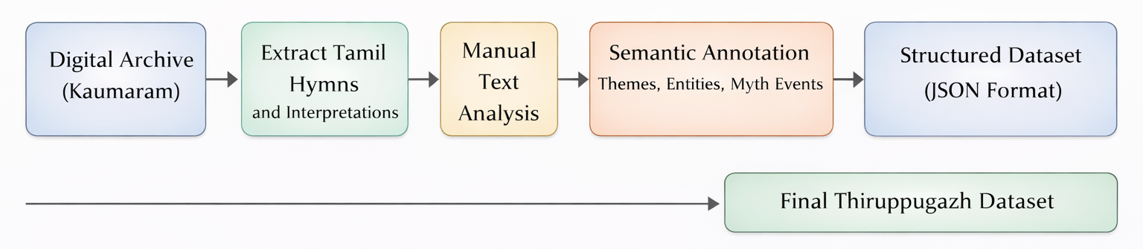
Dataset Construction Pipeline
From digital archive to structured knowledge graph
Step 1
Step 2
Step 3
Step 4
Step 5
Digital Archive (Kaumaram)
Extract Tamil Hymns & Notes
Manual Text Analysis
Semantic Annotation
Structured JSON Dataset
Each of 1,335 hymns was manually reviewed and annotated with: entities · themes · mythological events · philosophy · imagery · sacred places. Inter-annotator agreement was measured using Cohen's Kappa (κ).
Kumarasamy et al. · Thiruppugazh-KG · ACL 2026
Notes:
The construction pipeline has five steps. We start from the Kaumaram digital archive, extract the Tamil hymns and accompanying notes, manually analyze each hymn, apply semantic annotation across six dimensions, and store the result as structured JSON that is directly importable into Neo4j. The critical point is that all annotation was done by hand — every one of the 1,335 hymns was individually reviewed. We measured inter-annotator agreement using Cohen's Kappa to validate the annotation quality.

Slide 5
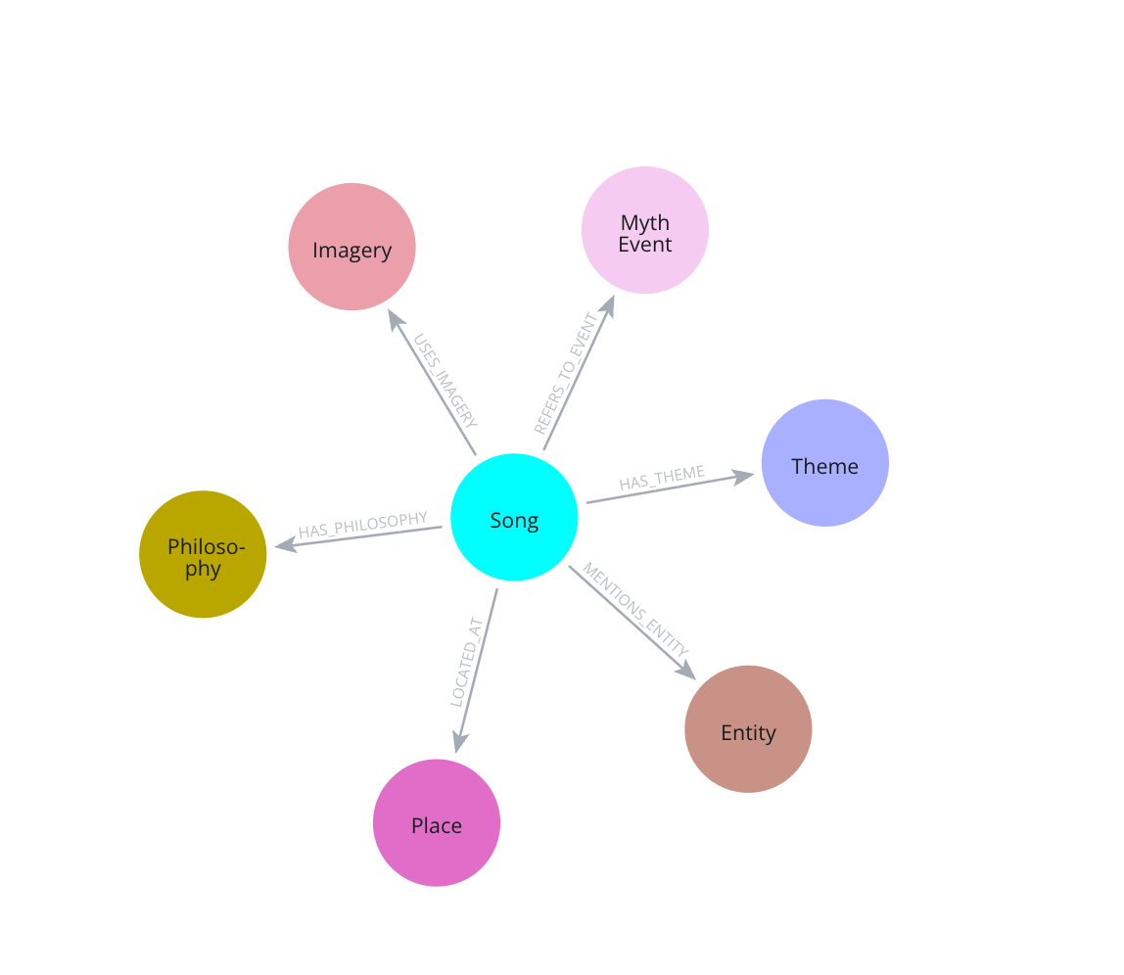
Knowledge Graph Schema
Song nodes connect to six semantic node types via typed edges
Relationship Types
Relationship
Count
Meaning
MENTIONS_ENTITY
8,564
Song → Entity (deity / person)
USES_IMAGERY
6,166
Song → Imagery (poetic symbol)
HAS_THEME
5,544
Song → Theme (devotional concept)
HAS_PHILOSOPHY
4,104
Song → Philosophy (spiritual idea)
REFERS_TO_EVENT
2,515
Song → MythEvent (battle / story)
LOCATED_AT
1,335
Song → Place (temple / location)
TOTAL EDGES
28,228
Kumarasamy et al. · Thiruppugazh-KG · ACL 2026
Notes:
The schema uses a hub-and-spoke design. Every Song node — representing one hymn — connects outward through six typed relationship types. MENTIONS_ENTITY covers deities and named persons: 8,564 edges. USES_IMAGERY covers poetic symbols: 6,166 edges. HAS_THEME captures devotional concepts: 5,544 edges. HAS_PHILOSOPHY represents spiritual ideas: 4,104 edges. REFERS_TO_EVENT links to mythological stories and battles: 2,515 edges. LOCATED_AT connects each song to its associated temple location — one per song — giving exactly 1,335 edges. Across all relationship types the graph has 28,228 typed edges in total.

Slide 6
Dataset at a Glance
Key statistics of the Thiruppugazh-KG
1,335
11,992
28,228
9,758
4.70
Hymns Annotated
KG Nodes
KG Edges
Communities
Avg. Degree
Dataset Highlights
▸ 1,335 hymns fully annotated — 100% corpus coverage
▸ 6 semantic node types: Song, Entity, Theme, MythEvent, Philosophy, Imagery, Place
▸ Annotations created through careful manual review by domain experts
▸ Inter-annotator agreement verified with Cohen's Kappa (κ)
▸ Data stored in structured JSON format, Neo4j-importable
Node Type Breakdown
Song
1,335
Entity
~4,200
Imagery
~2,400
MythEvent
~1,600
Philosophy
~1,400
Place
~1,300
Theme
~650
* Entity, Theme etc. counts are distributed across 10,657 semantic nodes
Kumarasamy et al. · Thiruppugazh-KG · ACL 2026
Notes:
The full graph has 11,992 nodes and 28,228 edges, with an average node degree of 4.70. All 1,335 hymns are annotated — that is 100% corpus coverage. The 10,657 semantic nodes span the six non-song types. We also ran Louvain community detection and found 9,758 distinct communities, suggesting rich thematic sub-structure in the graph. Song nodes are the most numerous single type at 1,335; Entity nodes are the largest semantic category at approximately 4,200.

Slide 7
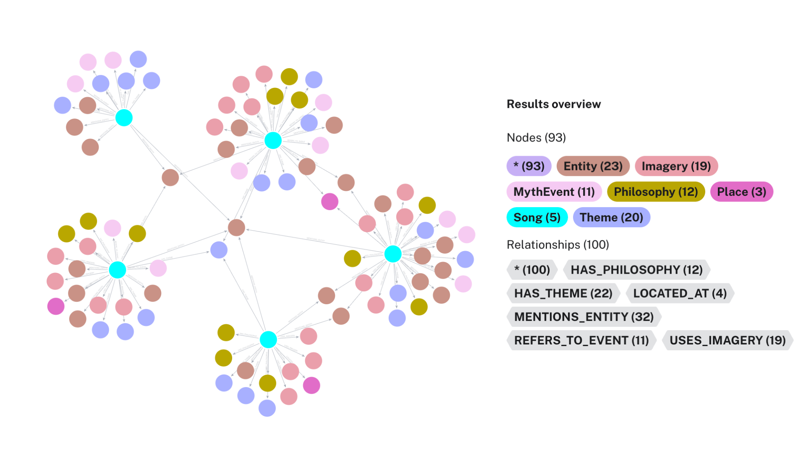
Thiruppugazh Knowledge Graph
Multi-cluster graph with colour-coded node types — Neo4j Graph Data Science
Node Types
Song (1,335)
Imagery (~2,400)
Theme (~650)
MythEvent (~1,600)
Philosophy (~1,400)
Entity (~4,200)
Place (~1,300)
Graph Statistics
11,992 nodes · 28,228 edges · avg degree 4.70 · 9,758 communities
Kumarasamy et al. · Thiruppugazh-KG · ACL 2026
Notes:
This is the full Thiruppugazh-KG visualized in Neo4j Graph Data Science. Each color represents a different node type — cyan for songs, red for entities, pink for imagery, orange for mythological events, and so on. Notice the multi-cluster structure. This is not a single undifferentiated hairball; there are clearly separated thematic communities. This visual alone demonstrates the richness of structure within the corpus that would be impossible to see from reading individual hymns.

Slide 8
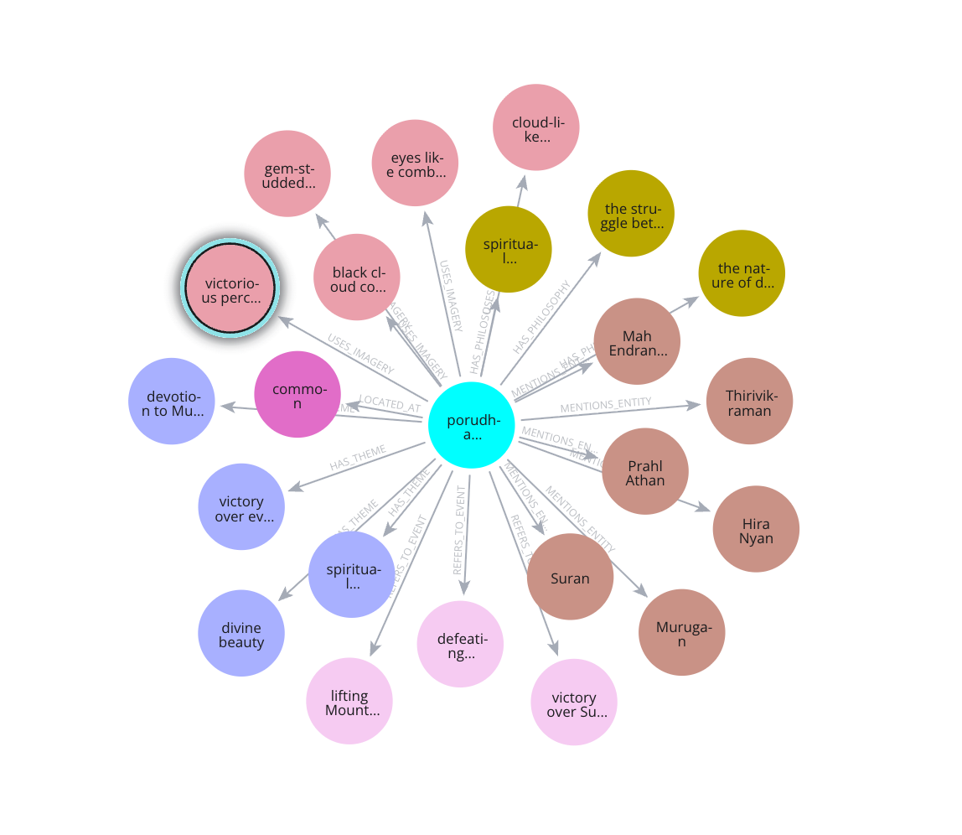
Graph Analytics — PageRank
Identifying the most influential entities in the devotional network
PageRank Results (Normalized)
Damping factor = 0.85 · Min-Max normalized · Neo4j GDS Library
Entity
PageRank
Significance
Murugan
1.00
Central deity of the corpus
Siva
0.32
Father of Murugan — mythological hub
Valli
0.30
Consort — recurring narrative motif
Brahma
0.19
Hindu cosmological reference
Vishnu
0.14
Broader Hindu tradition
Indra
0.11
Battle mythology connections
Insight: Murugan's score (1.0) is 3× higher than Siva's (0.32), reflecting the corpus's devotional focus. Siva and Valli's prominence reveals recurring mythological sub-networks centered on Murugan's family.
Kumarasamy et al. · Thiruppugazh-KG · ACL 2026
Notes:
We ran PageRank with a damping factor of 0.85 on the full graph and applied min-max normalization to the scores. Murugan scores 1.0 — the maximum — by a large margin, confirming his centrality across essentially the entire corpus. Siva and Valli come next at 0.32 and 0.30 respectively. This is expected: they are Murugan's father and one of his consorts, forming secondary narrative hubs in the mythology. Brahma, Vishnu, and Indra appear at lower scores, reflecting references from the broader Hindu mythological tradition rather than being core subjects of the corpus.

Slide 9
Key Results
Themes · Sacred places · Mythological events
Dominant Themes
Most Referenced Sacred Places
Devotion to Murugan
969
Pazhani
98
Spiritual Longing
234
Thiruchchendhur
83
Enlightenment
168
Thiruvarunai
81
Divine Intervention
164
Chidambaram
67
Spiritual Awakening
149
Thiruththanigai
64
Divine Protection
131
Top Mythological Events
Murugan defeats Suran (45)
Victory over demons (41)
Destruction of Suran (33)
Marriage to Valli (28)
Churning of the ocean (22)
Kumarasamy et al. · Thiruppugazh-KG · ACL 2026
Notes:
Looking at the thematic analysis: "Devotion to Murugan" dominates with 969 hymns, well ahead of Spiritual Longing at 234 and Enlightenment at 168. This confirms that the corpus is overwhelmingly devotional in character. For sacred places, Pazhani is the most referenced temple at 98 hymns, followed by Thiruchchendhur at 83. Both are famous Murugan temples in Tamil Nadu. The most frequent mythological event is Murugan's defeat of the demon Suran, appearing in 45 hymns, followed by his marriage to Valli at 28 hymns.

Slide 10
Murugan-Centered Devotional Network
Murugan as the central hub — direct connections to hymn nodes and their associated semantic attributes
Network Structure
Murugan node connects to all 1,335 Song nodes via MENTIONS_ENTITY
Each Song links outward to Theme, MythEvent, Imagery, Place, and Philosophy nodes
Siva and Valli form secondary hubs — dense sub-clusters around Murugan's family
Louvain community detection found 9,758 communities — thematic clusters including battle mythology, sacred geography, and devotional philosophy
PageRank confirms Murugan's centrality score = 1.0 (normalized)
Kumarasamy et al. · Thiruppugazh-KG · ACL 2026
Notes:
This slide shows the Murugan-centered sub-network in detail. Murugan connects directly to all 1,335 Song nodes through the MENTIONS_ENTITY relationship. Each Song then fans out to Theme, MythEvent, Imagery, Place, and Philosophy nodes. Siva and Valli form visible secondary clusters around Murugan. The Louvain algorithm detected 9,758 communities — groupings that naturally cluster around themes like battle mythology, sacred temple geography, and devotional philosophy. This community structure opens up possibilities for systematic thematic analysis that would be infeasible through manual reading.

Slide 11
Limitations & Future Work
What we learned and where we go next
Current Limitations
▸ Manual annotation limits scalability to larger corpora
▸ Current schema covers 6 node types; poetic structure and linguistic features not yet modeled
▸ No automated NLP pipeline — dependency on human annotators for Tamil text
▸ Graph embeddings and link prediction not yet applied
▸ Interactive visualization tools for scholars not yet built
Future Directions
▸ Automated Tamil NLP for entity & event extraction (NER, relation extraction)
▸ Extend schema with poetic meter (chandas), linguistic features, intertextual references
▸ Apply knowledge graph embeddings (TransE, RotatE) for link prediction
▸ Develop interactive visualization dashboard for digital humanities scholars
▸ Generalize framework to other classical Tamil/South Asian devotional texts
▸ Release benchmark tasks: theme classification, entity linking, place disambiguation
Long-term goal: establish Thiruppugazh-KG as a benchmark resource for computational analysis of low-resource classical languages in the digital humanities.
Kumarasamy et al. · Thiruppugazh-KG · ACL 2026
Notes:
We want to be transparent about current limitations. Manual annotation does not scale easily to larger corpora. Our schema does not yet capture the chandas (poetic meter) system or detailed linguistic features. And we have no automated NLP pipeline — everything depends on human annotators with domain expertise in classical Tamil. On the future side: we plan to develop Tamil NER and relation extraction to automate annotation, extend the schema to include chandas and linguistic features, apply knowledge graph embeddings such as TransE and RotatE for link prediction, and build interactive visualization dashboards for digital humanities scholars. The long-term goal is to generalize this methodology to other classical Tamil and South Asian devotional texts.

Slide 12
Conclusion
Thiruppugazh-KG: bridging classical Tamil literature and computational humanities
First KG Dataset
Rich Annotation Schema
Graph Analytics
Thiruppugazh-KG is the first semantically annotated knowledge graph for Tamil devotional literature — 1,335 hymns fully annotated.
Six semantic dimensions: Entities, Themes, Mythological Events, Philosophy, Imagery, Sacred Places — 28,228 typed edges.
PageRank confirms Murugan's centrality (score = 1.0). Siva and Valli emerge as secondary hubs. 9,758 Louvain communities detected.
Cultural Insights
Reusable Framework
Pazhani (98) and Thiruchchendhur (83) are the most referenced temples. 'Devotion to Murugan' appears in 969 hymns.
Methodology generalizes to other classical texts — advancing NLP for low-resource languages in digital humanities.
Kumarasamy et al. · Thiruppugazh-KG · ACL 2026
Notes:
To summarize our five main contributions: First — the first semantically annotated knowledge graph for Tamil devotional literature: 1,335 hymns, fully annotated. Second — a rich six-dimension annotation schema producing 28,228 typed edges across entities, themes, mythology, philosophy, imagery, and sacred places. Third — graph analytics confirming Murugan's normalized centrality score of 1.0 and revealing 9,758 Louvain communities. Fourth — concrete cultural insights: Pazhani is the most referenced temple, and "Devotion to Murugan" appears in 969 of 1,335 hymns. Fifth — a reusable methodology that can be applied to other classical low-resource texts, advancing NLP for digital humanities.

Slide 13
Thank You
Questions & Discussion
jpUg;Gfo;
Thiruppugazh-KG
Garthigan Kumarasamy
garthigank.25@cse.mrt.ac.lk
1,335 hymns · 11,992 nodes 28,228 edges · 9,758 communities
Department of Computer Science and Engineering University of Moratuwa, Sri Lanka
Dataset: github.com/Garthigan/Thiruppugazh-KG-Dataset
ACL 2026 Workshop
Notes:
Thank you. I'm happy to take any questions. The dataset is publicly available on GitHub at the link shown on screen. If you are interested in collaborating — whether on applying this to other South Asian classical texts, contributing to the NLP benchmarks we plan to release, or extending the annotation schema — please reach out. My contact details are on screen.

