Slide 1
ASTLI
Advanced
Smart
Traffic Lights
Andrea Leganza
Ghenadie Artic
Alberto Coluzzi

Slide 2
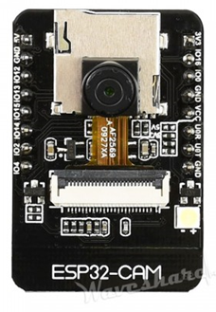
ASTLI
POWER
We expect to draw current from the grid to power our project, so it would be more stable, since we don’t want to have malfunction on the microcontroller and on the Wi-Fi connection
CONNECTIVITY
The ESP32-CAM will be connected to the main ESP32 with a stream on wifi
COST
This module cost 12€, and it’s a very cheap way to obtain a video stream, we also would like to reduce as much the number of camera to reduce cost and reduce current needs
ESP32-CAM

Slide 3
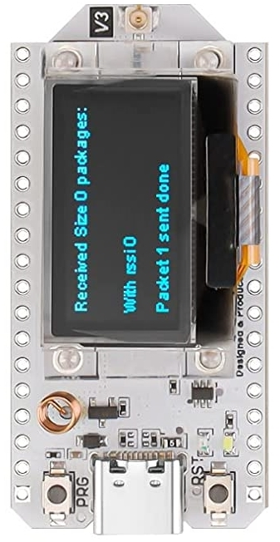
ASTLI
POWER
The esp32 would also be connected to the grid and would be placed in the electrical box so it could power directly the road junction
CONNECTIVITY
We choose to use lora to connect back to the main hub, and use wifi to connect with other esp32
COST
The choice of only one esp32 with lora for junction is to reduce cost
ESP32-LORA

Slide 4
ASTLI
LATENCY DETECTION
The response time in which the system understand the passage of a car is important to build a reliable system
DETECTION ACCURACY
How much the system can detect accurately, with influence from external factors (such as bright and low light condition)
OTHER MEASURING
We can evaluate our product also on number of accident on the junction, pollutants in the air and time spent in the junction
END-USER
EXPERIENCE

