Slide 1
Corona-Update 30.05.2022 PW

Slide 2
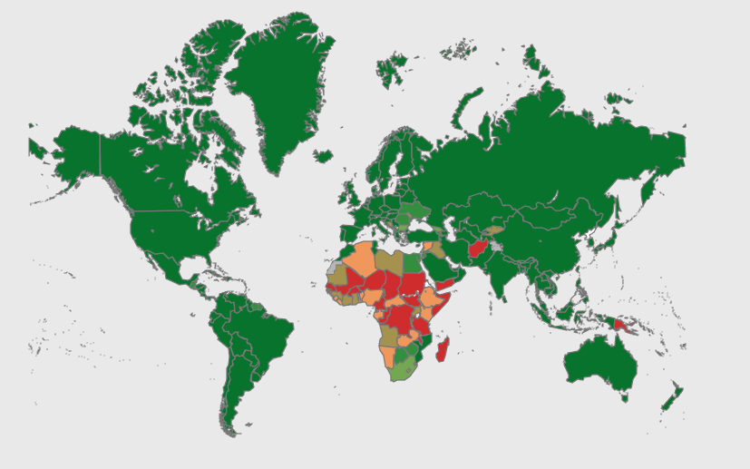
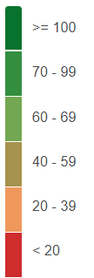
Vaccination per 100 population
covid19.who.int

Slide 3
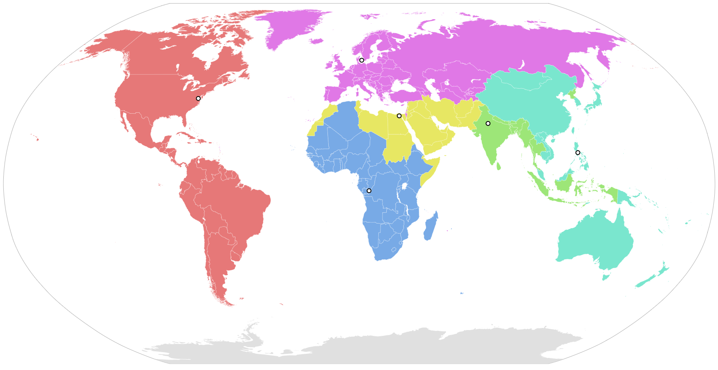
WHO - Regions
Europe
EM
EP
Americas
WP
Africa
en.wikipedia.org/wiki/List_of_WHO_regions

Slide 4
WHO - Regions
Europe
EM
EP
Americas
WP
Africa
en.wikipedia.org/wiki/List_of_WHO_regions

Slide 5
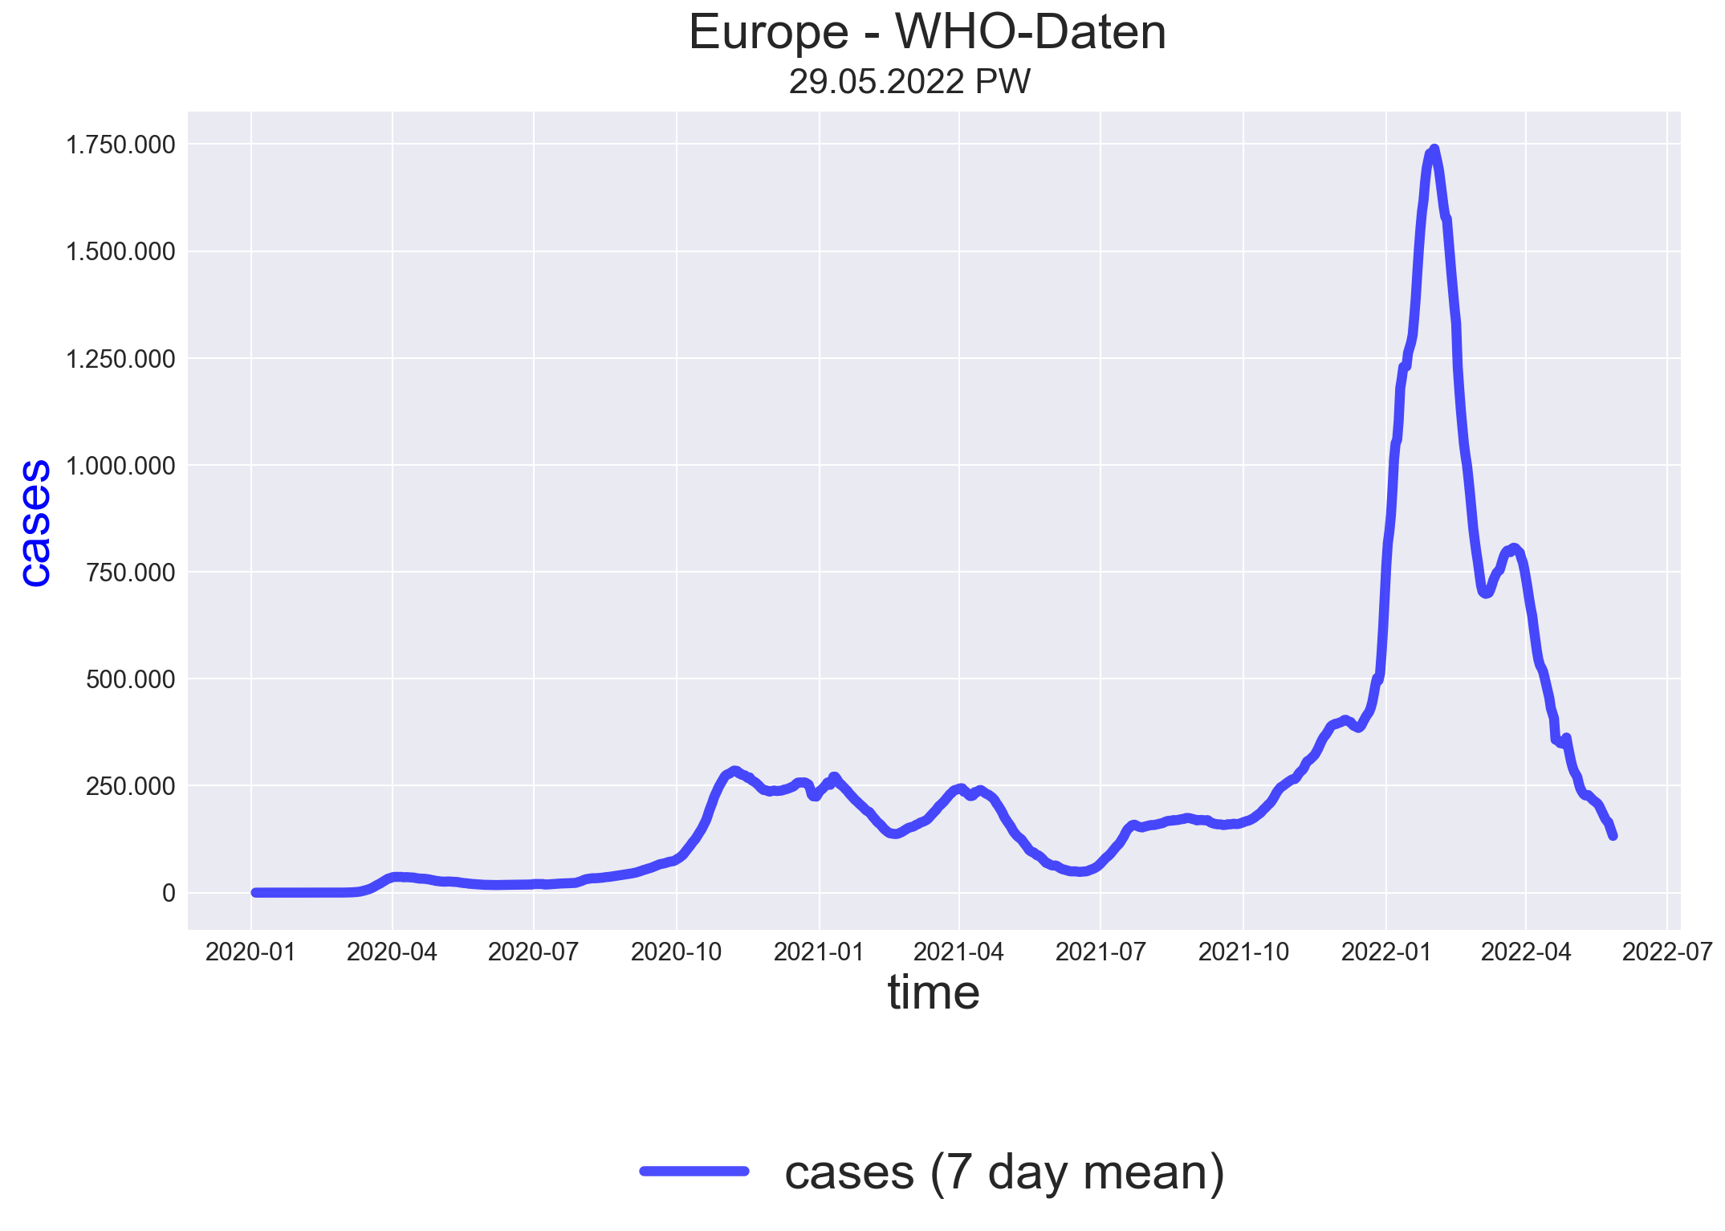

Slide 6
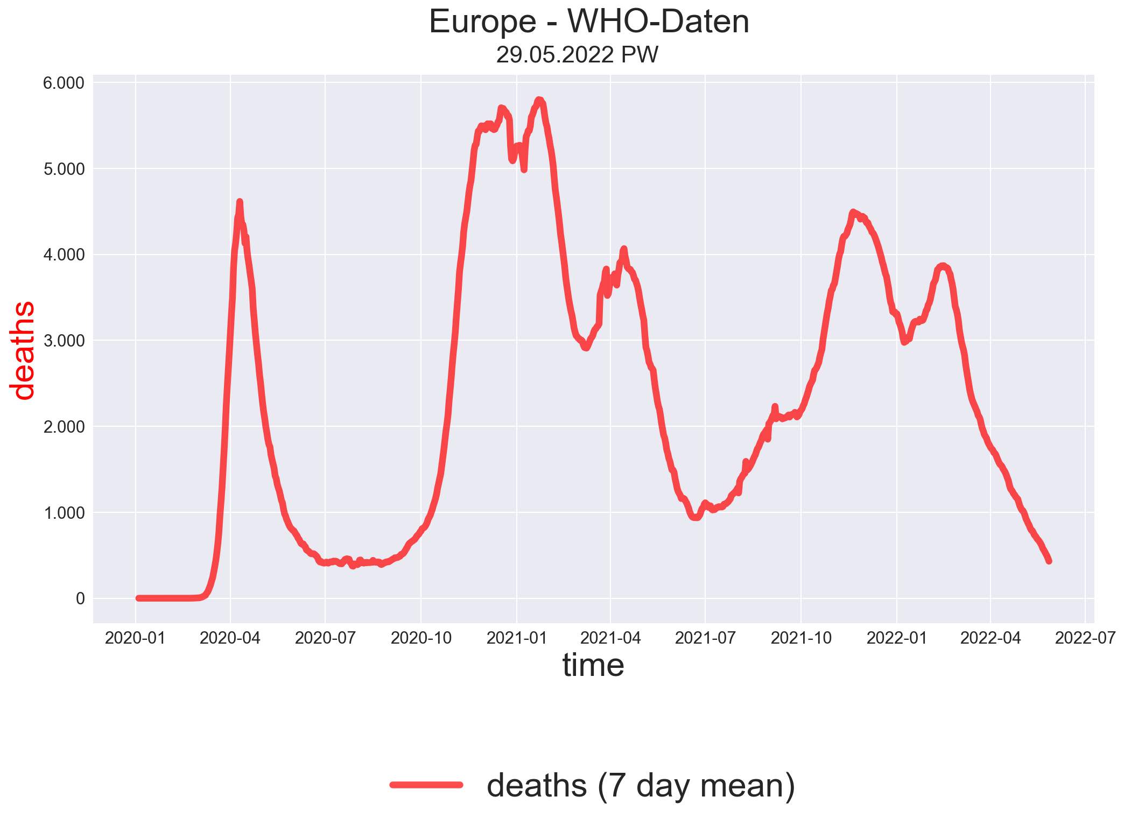

Slide 7
WHO - Regions
Europe
EM
EP
Americas
WP
Africa
en.wikipedia.org/wiki/List_of_WHO_regions

Slide 8
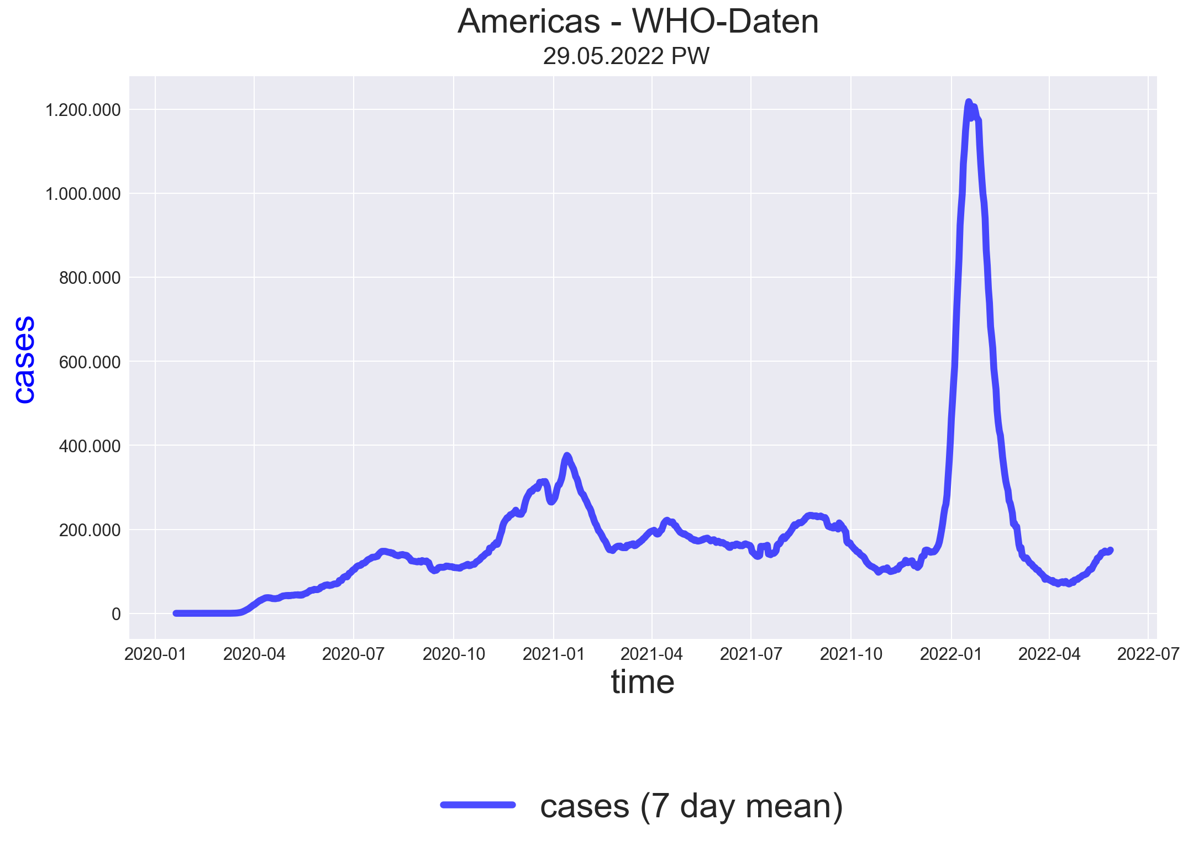

Slide 9
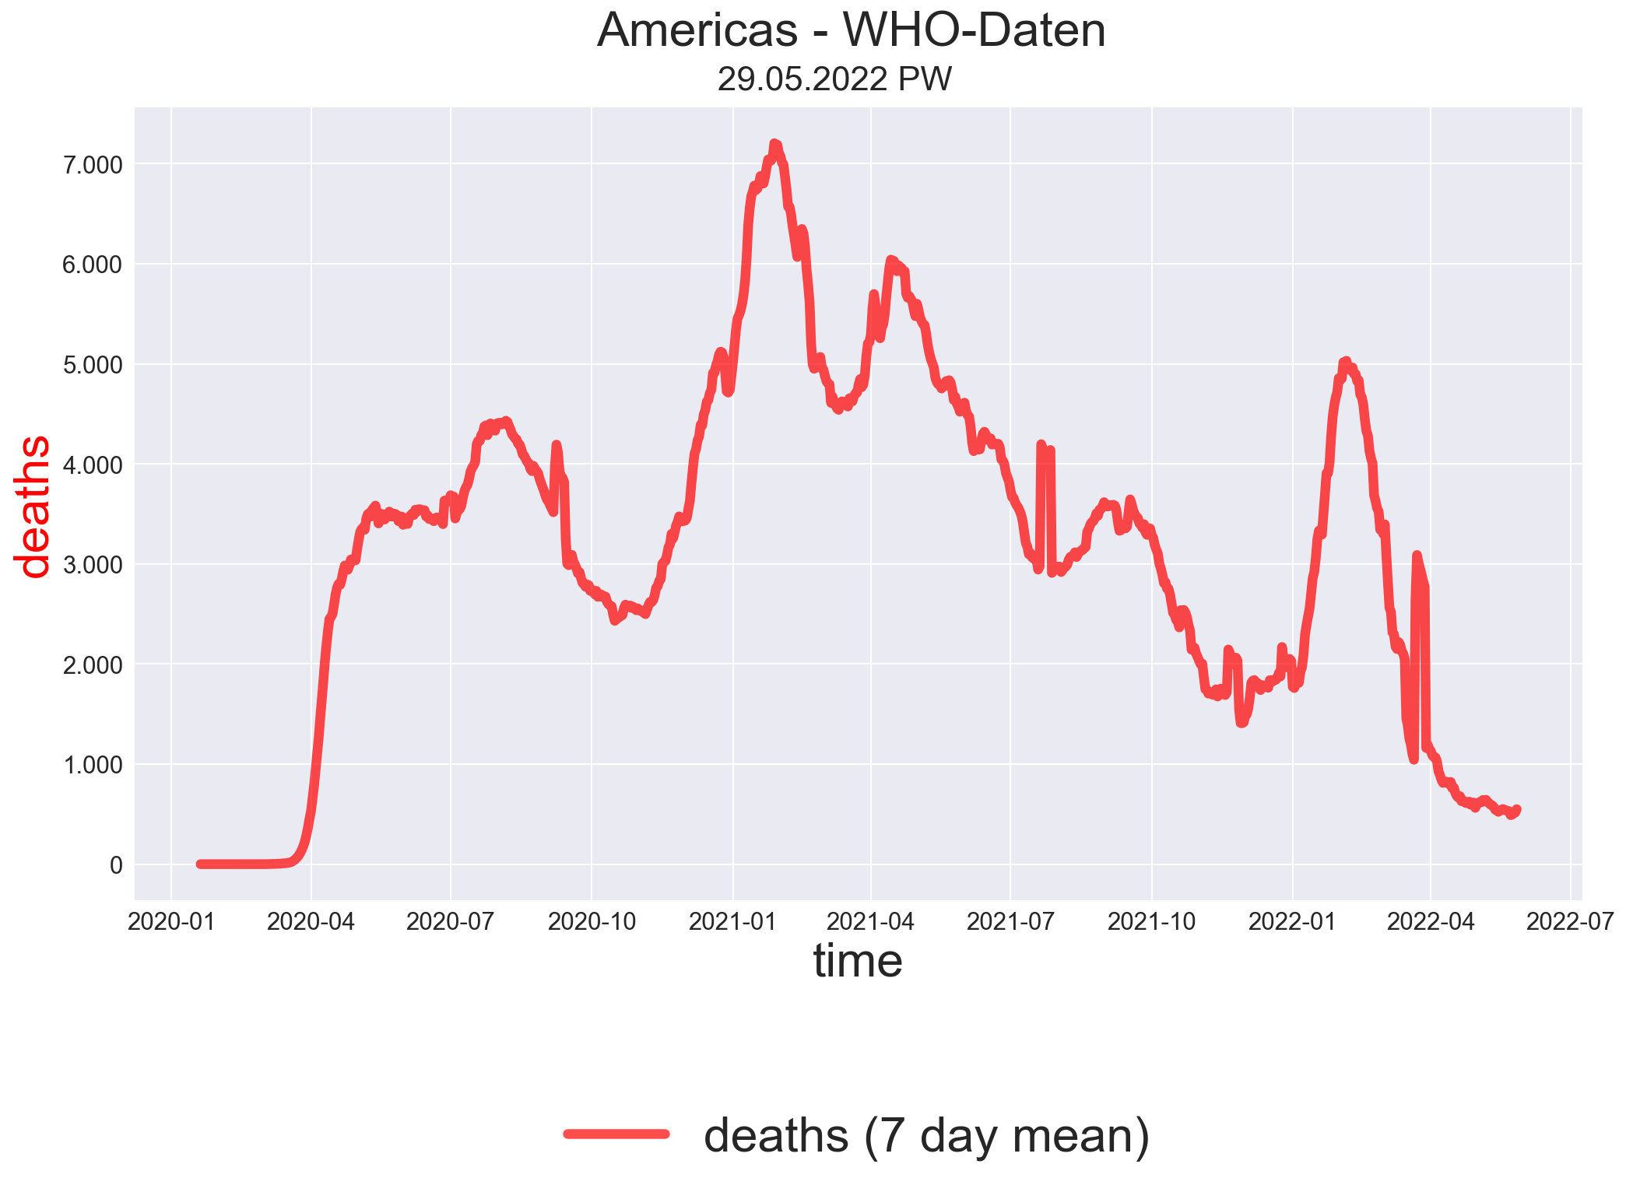

Slide 10
WHO - Regions
Europe
EM
EP
Americas
WP
Africa
en.wikipedia.org/wiki/List_of_WHO_regions

Slide 11
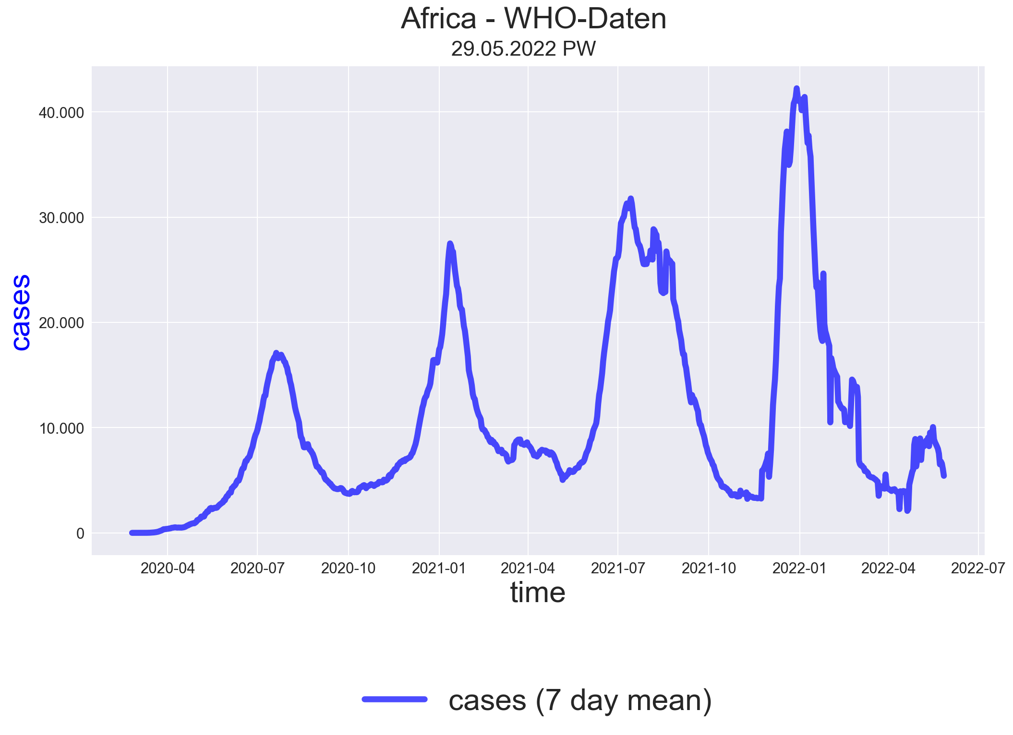

Slide 12
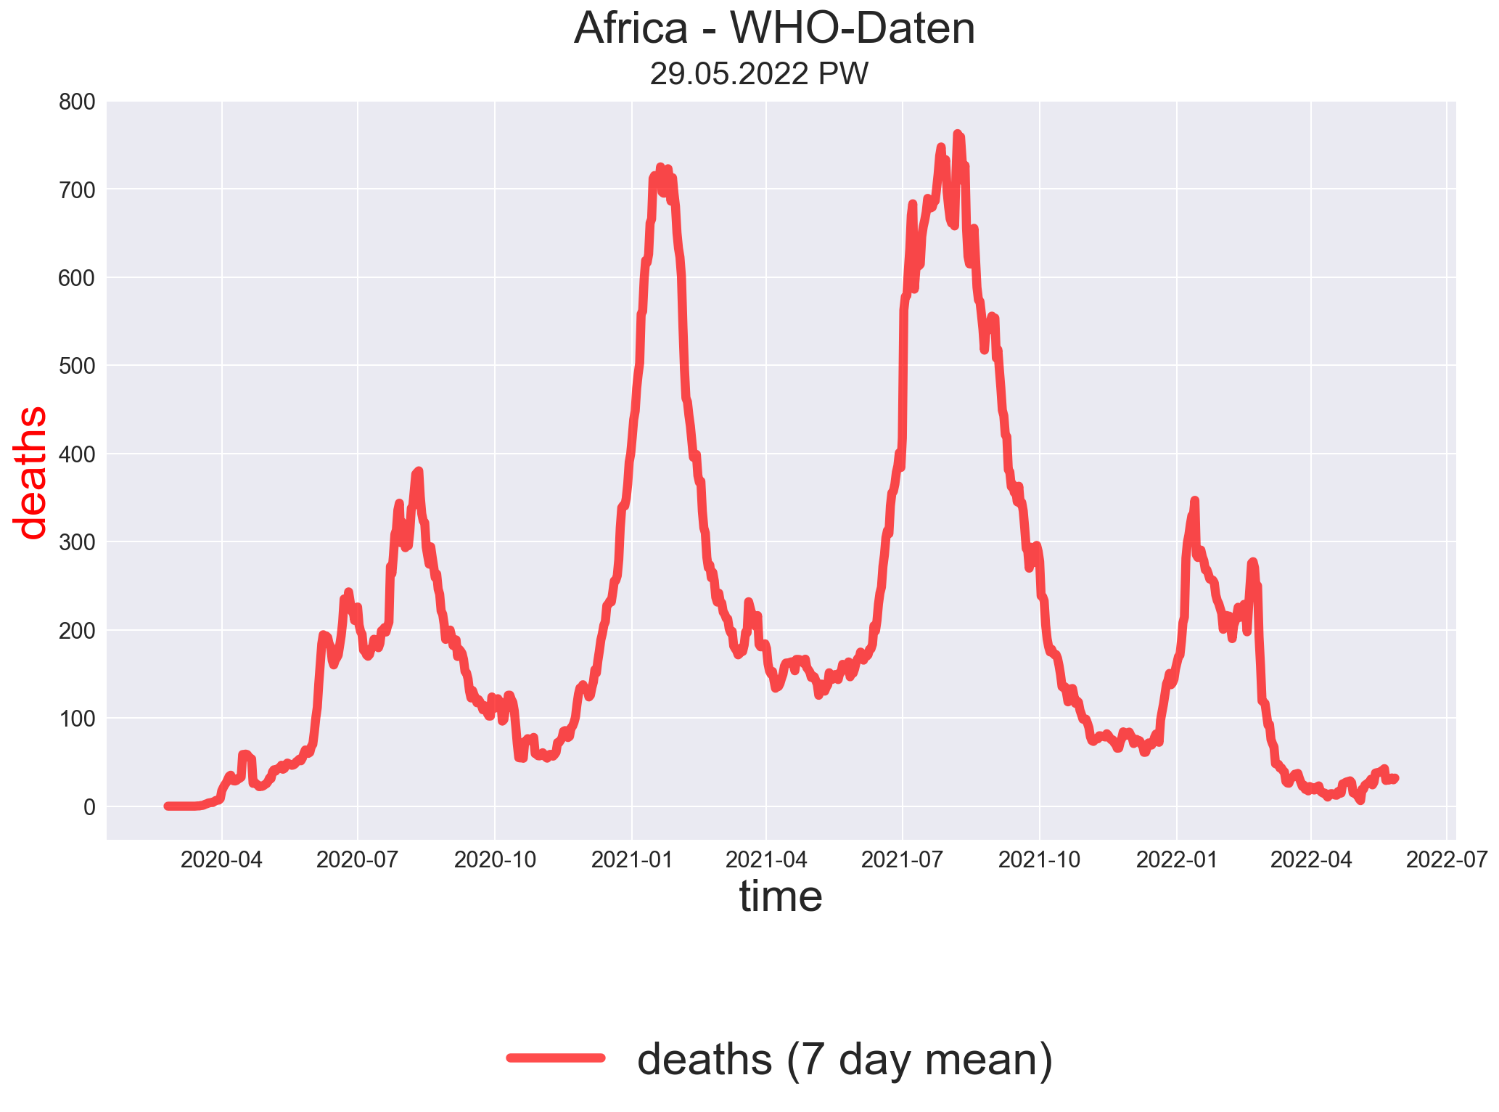

Slide 13
WHO - Regions
Europe
EM
EP
Americas
WP
Africa
en.wikipedia.org/wiki/List_of_WHO_regions

Slide 14
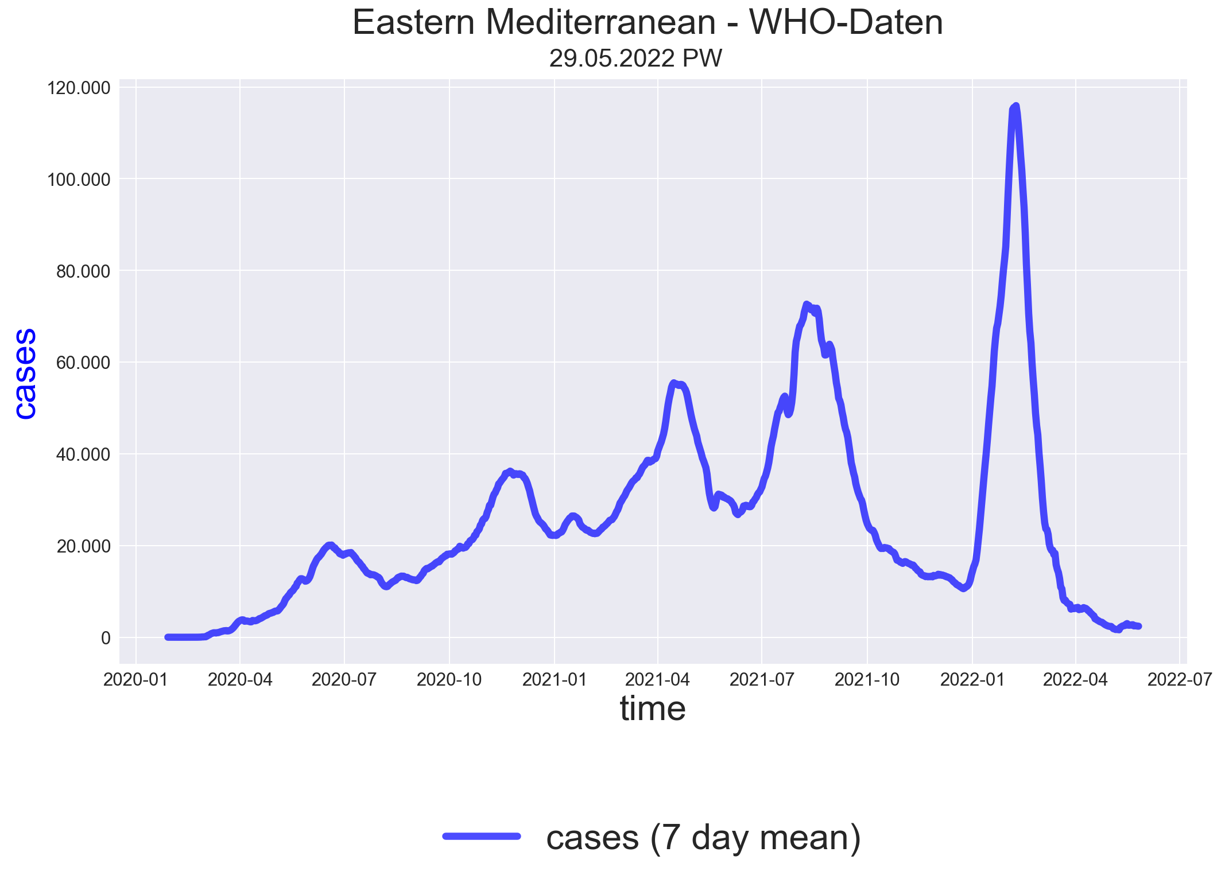

Slide 15
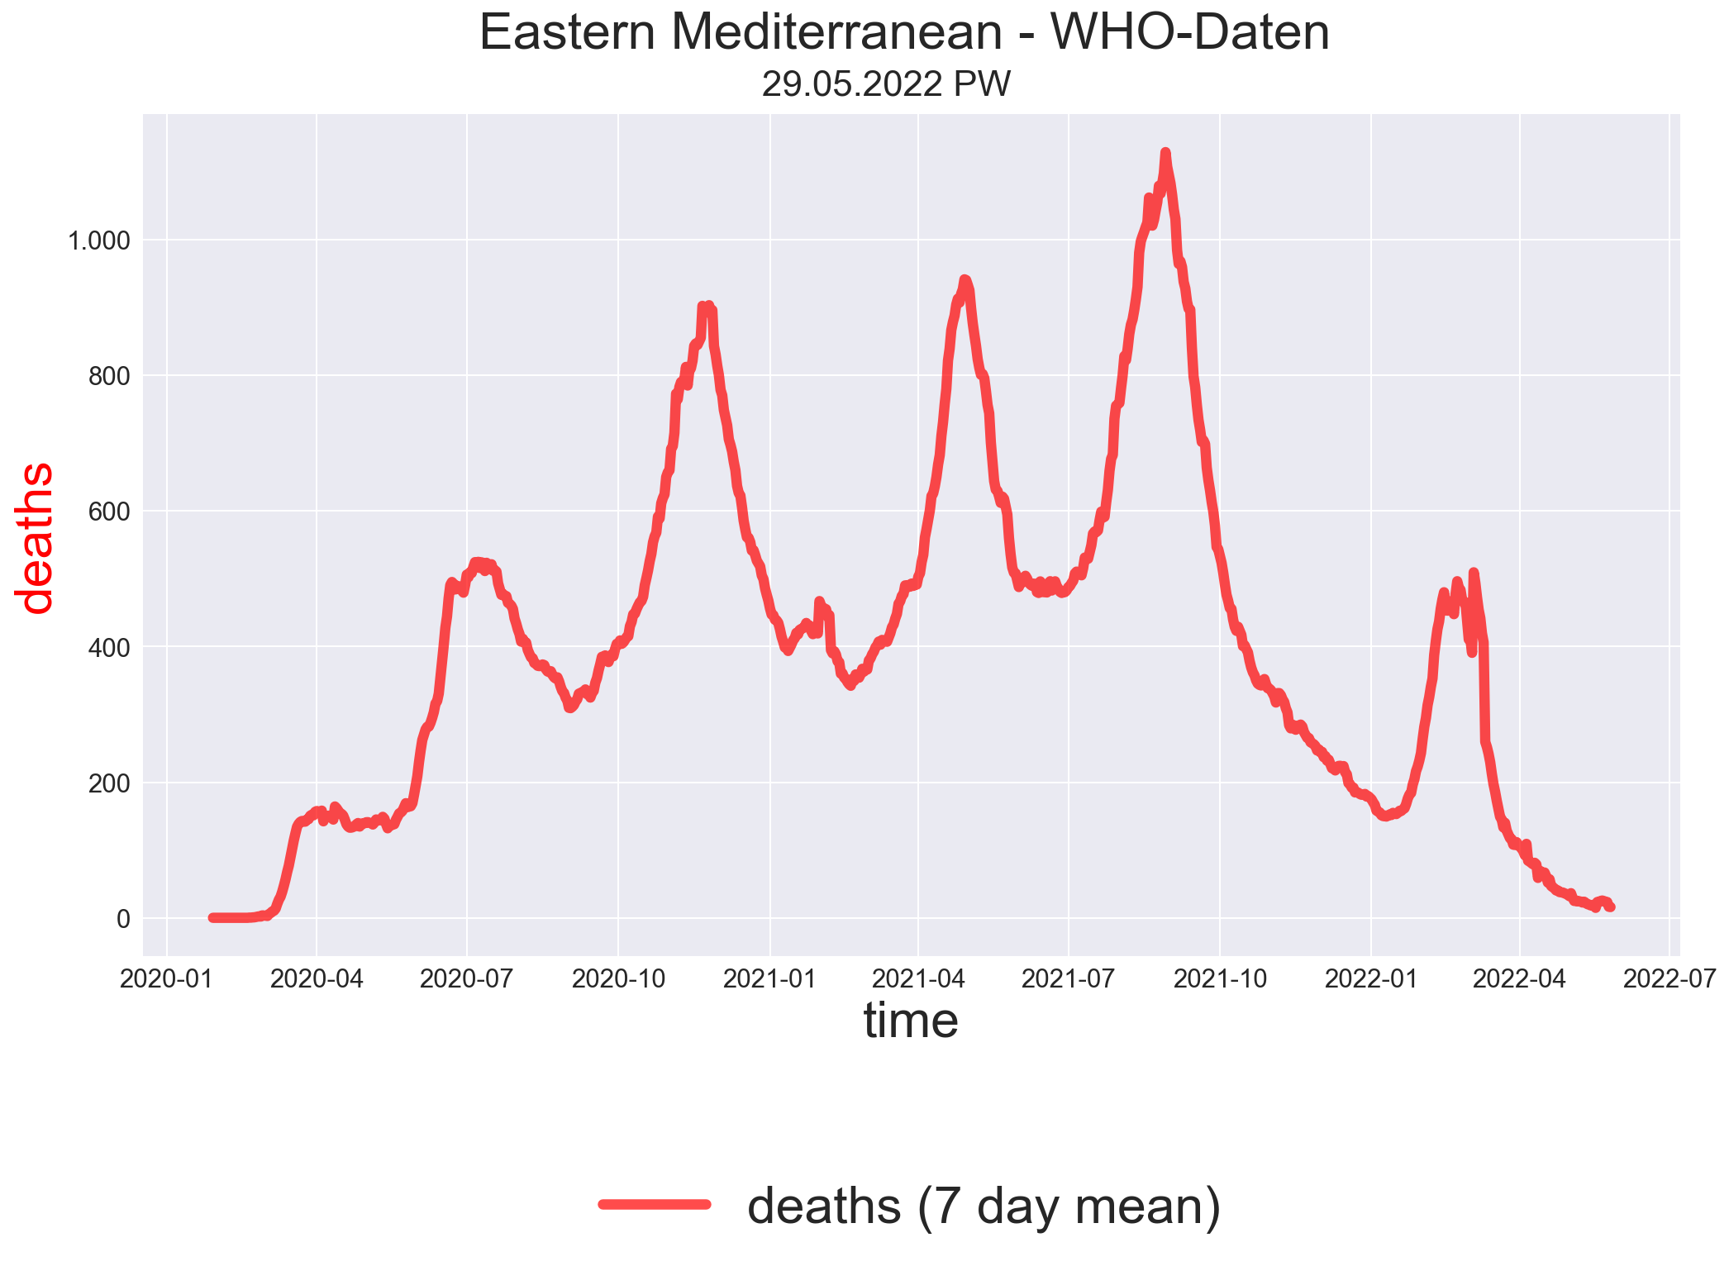

Slide 16
WHO - Regions
Europe
EM
EP
Americas
WP
Africa
en.wikipedia.org/wiki/List_of_WHO_regions

Slide 17
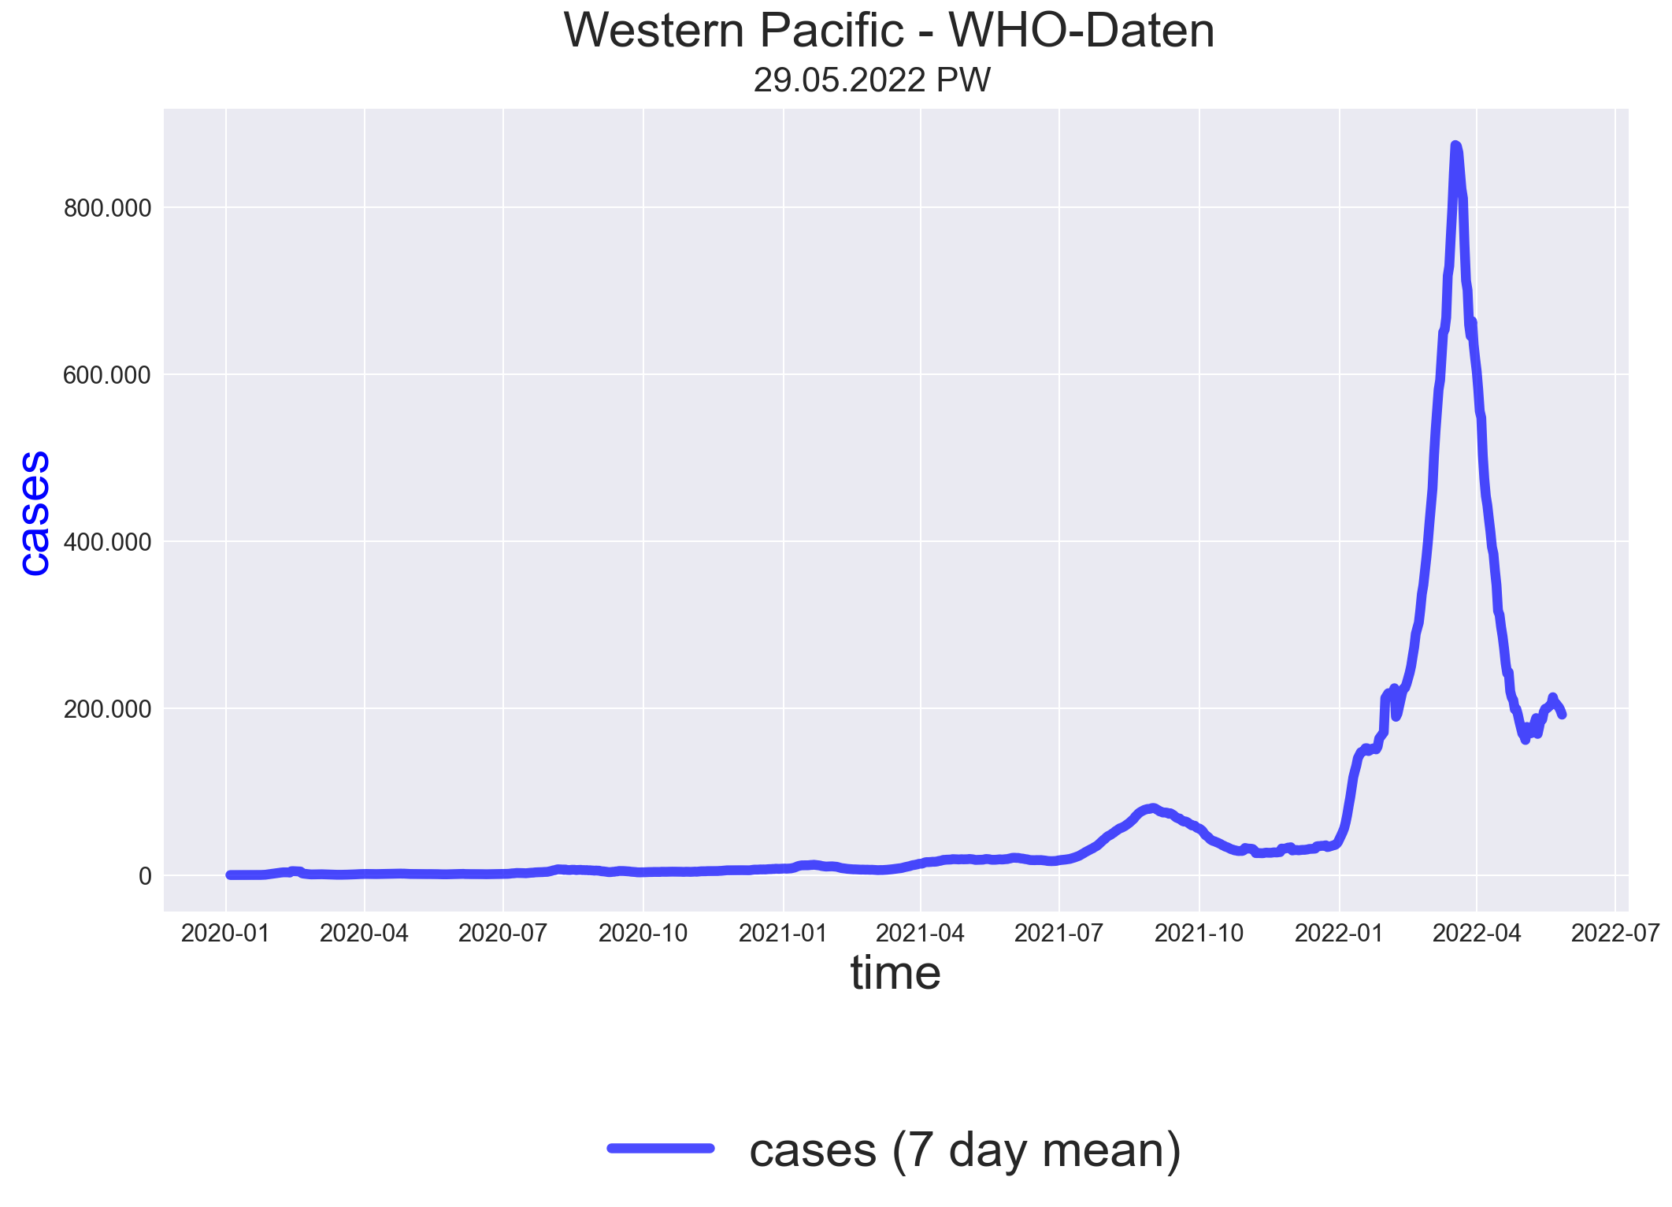

Slide 18
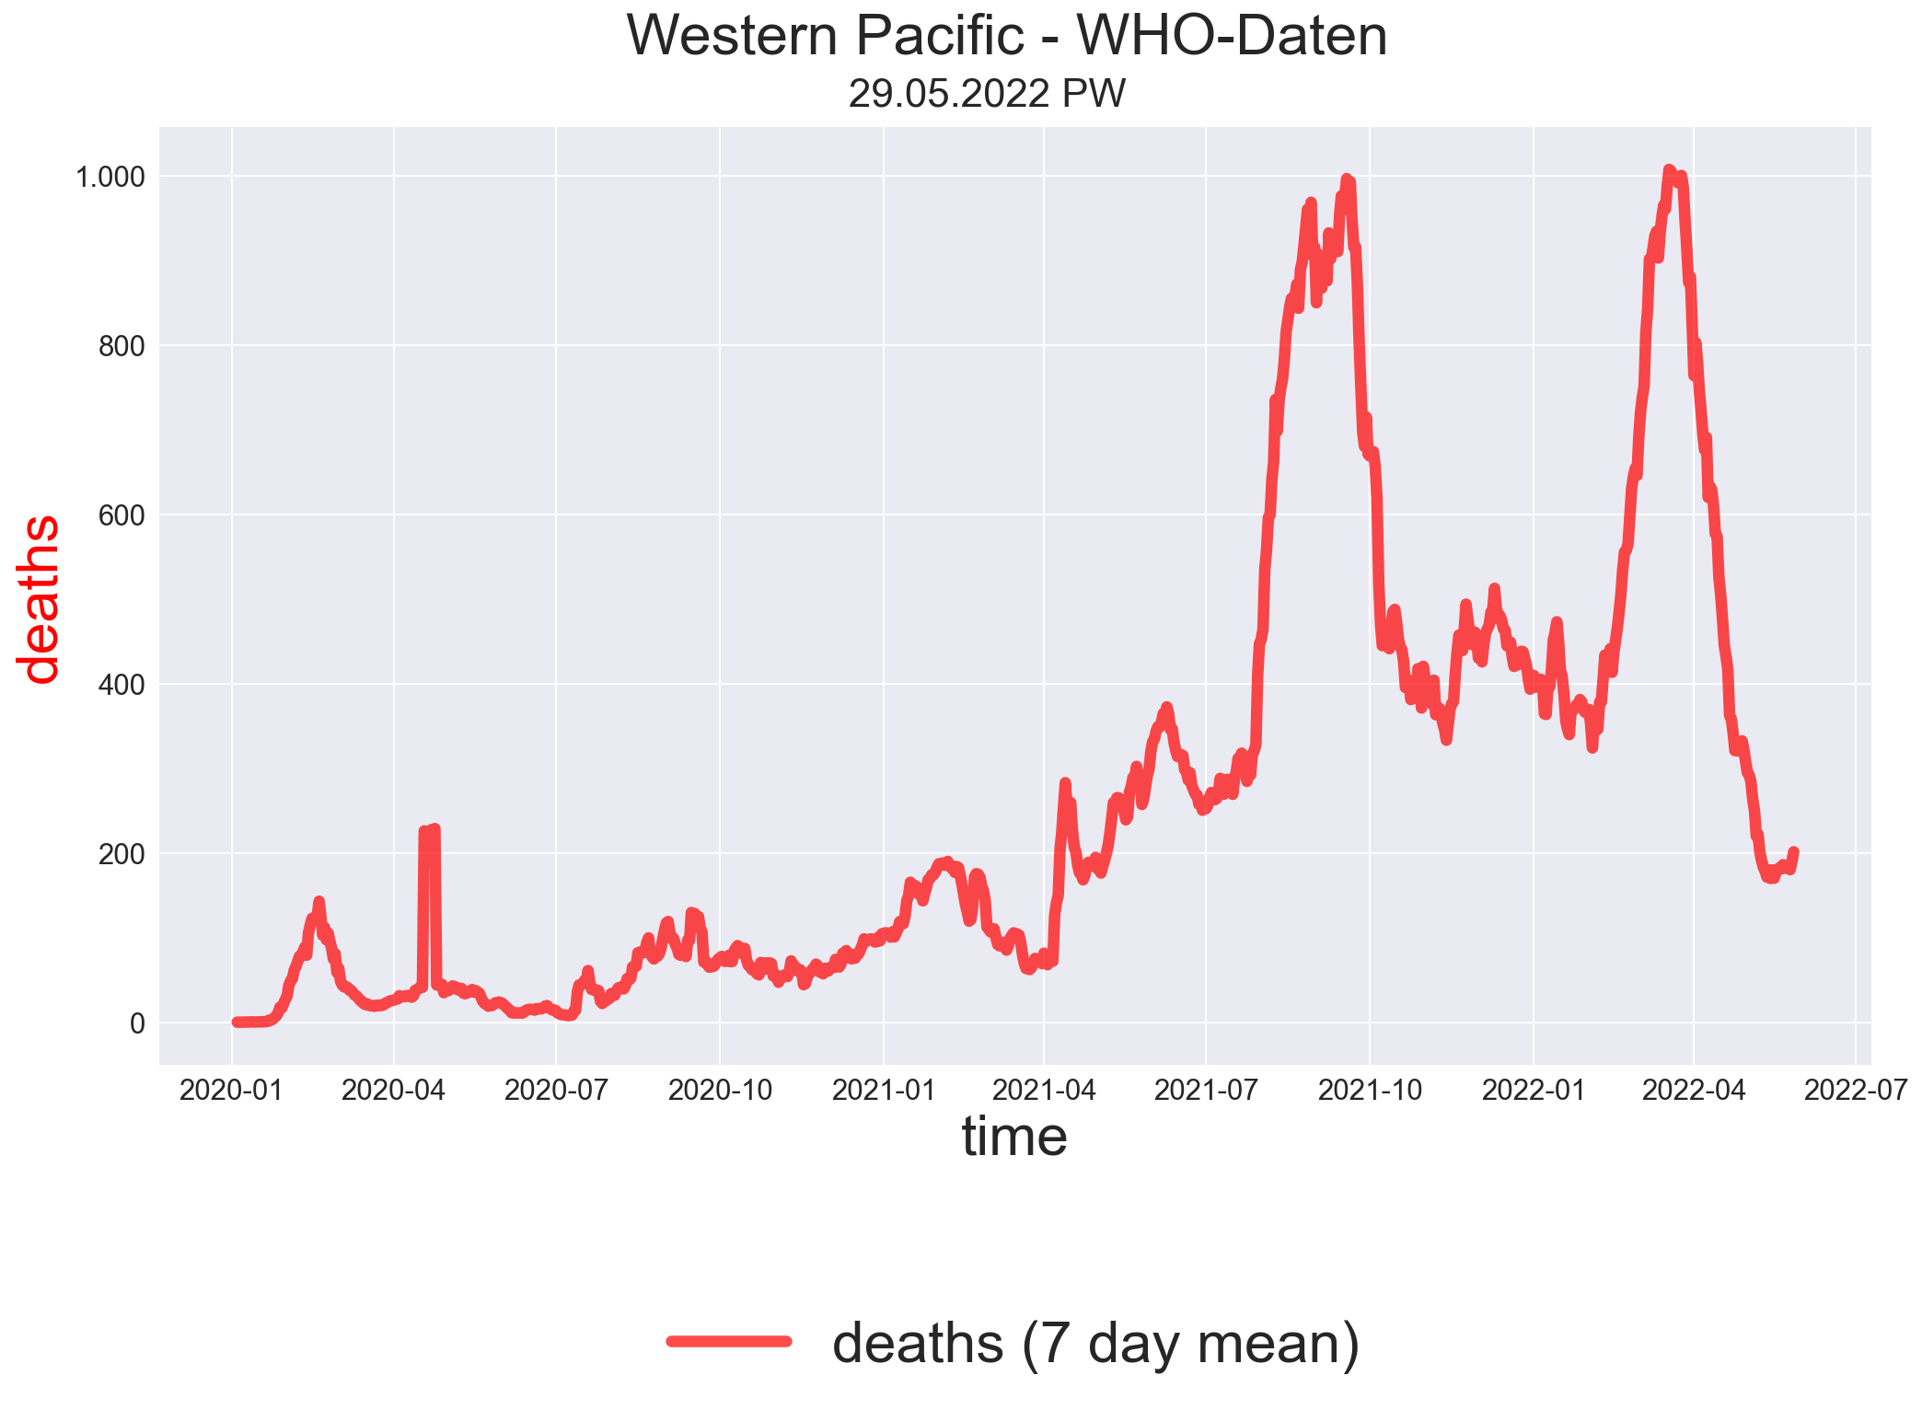

Slide 19
WHO - Regions
Europe
EM
EP
Americas
WP
Africa
en.wikipedia.org/wiki/List_of_WHO_regions

Slide 20
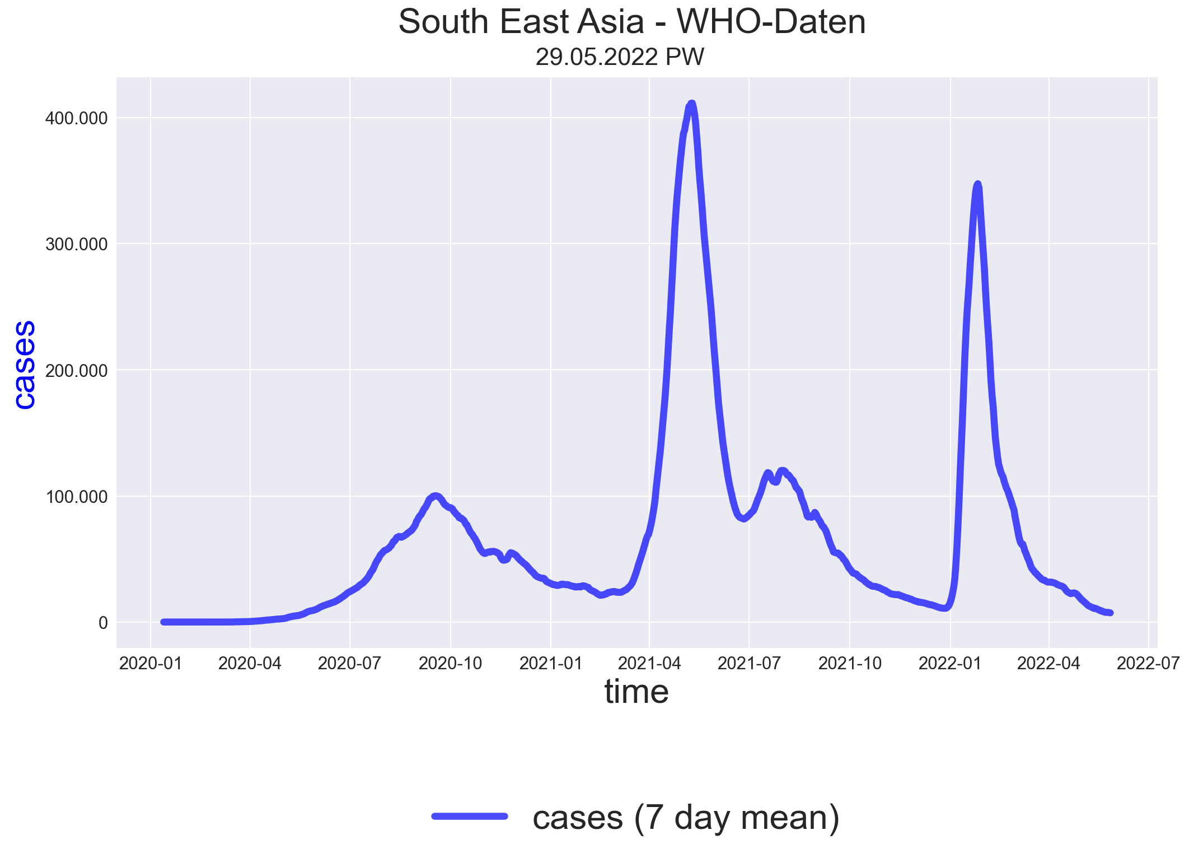

Slide 21
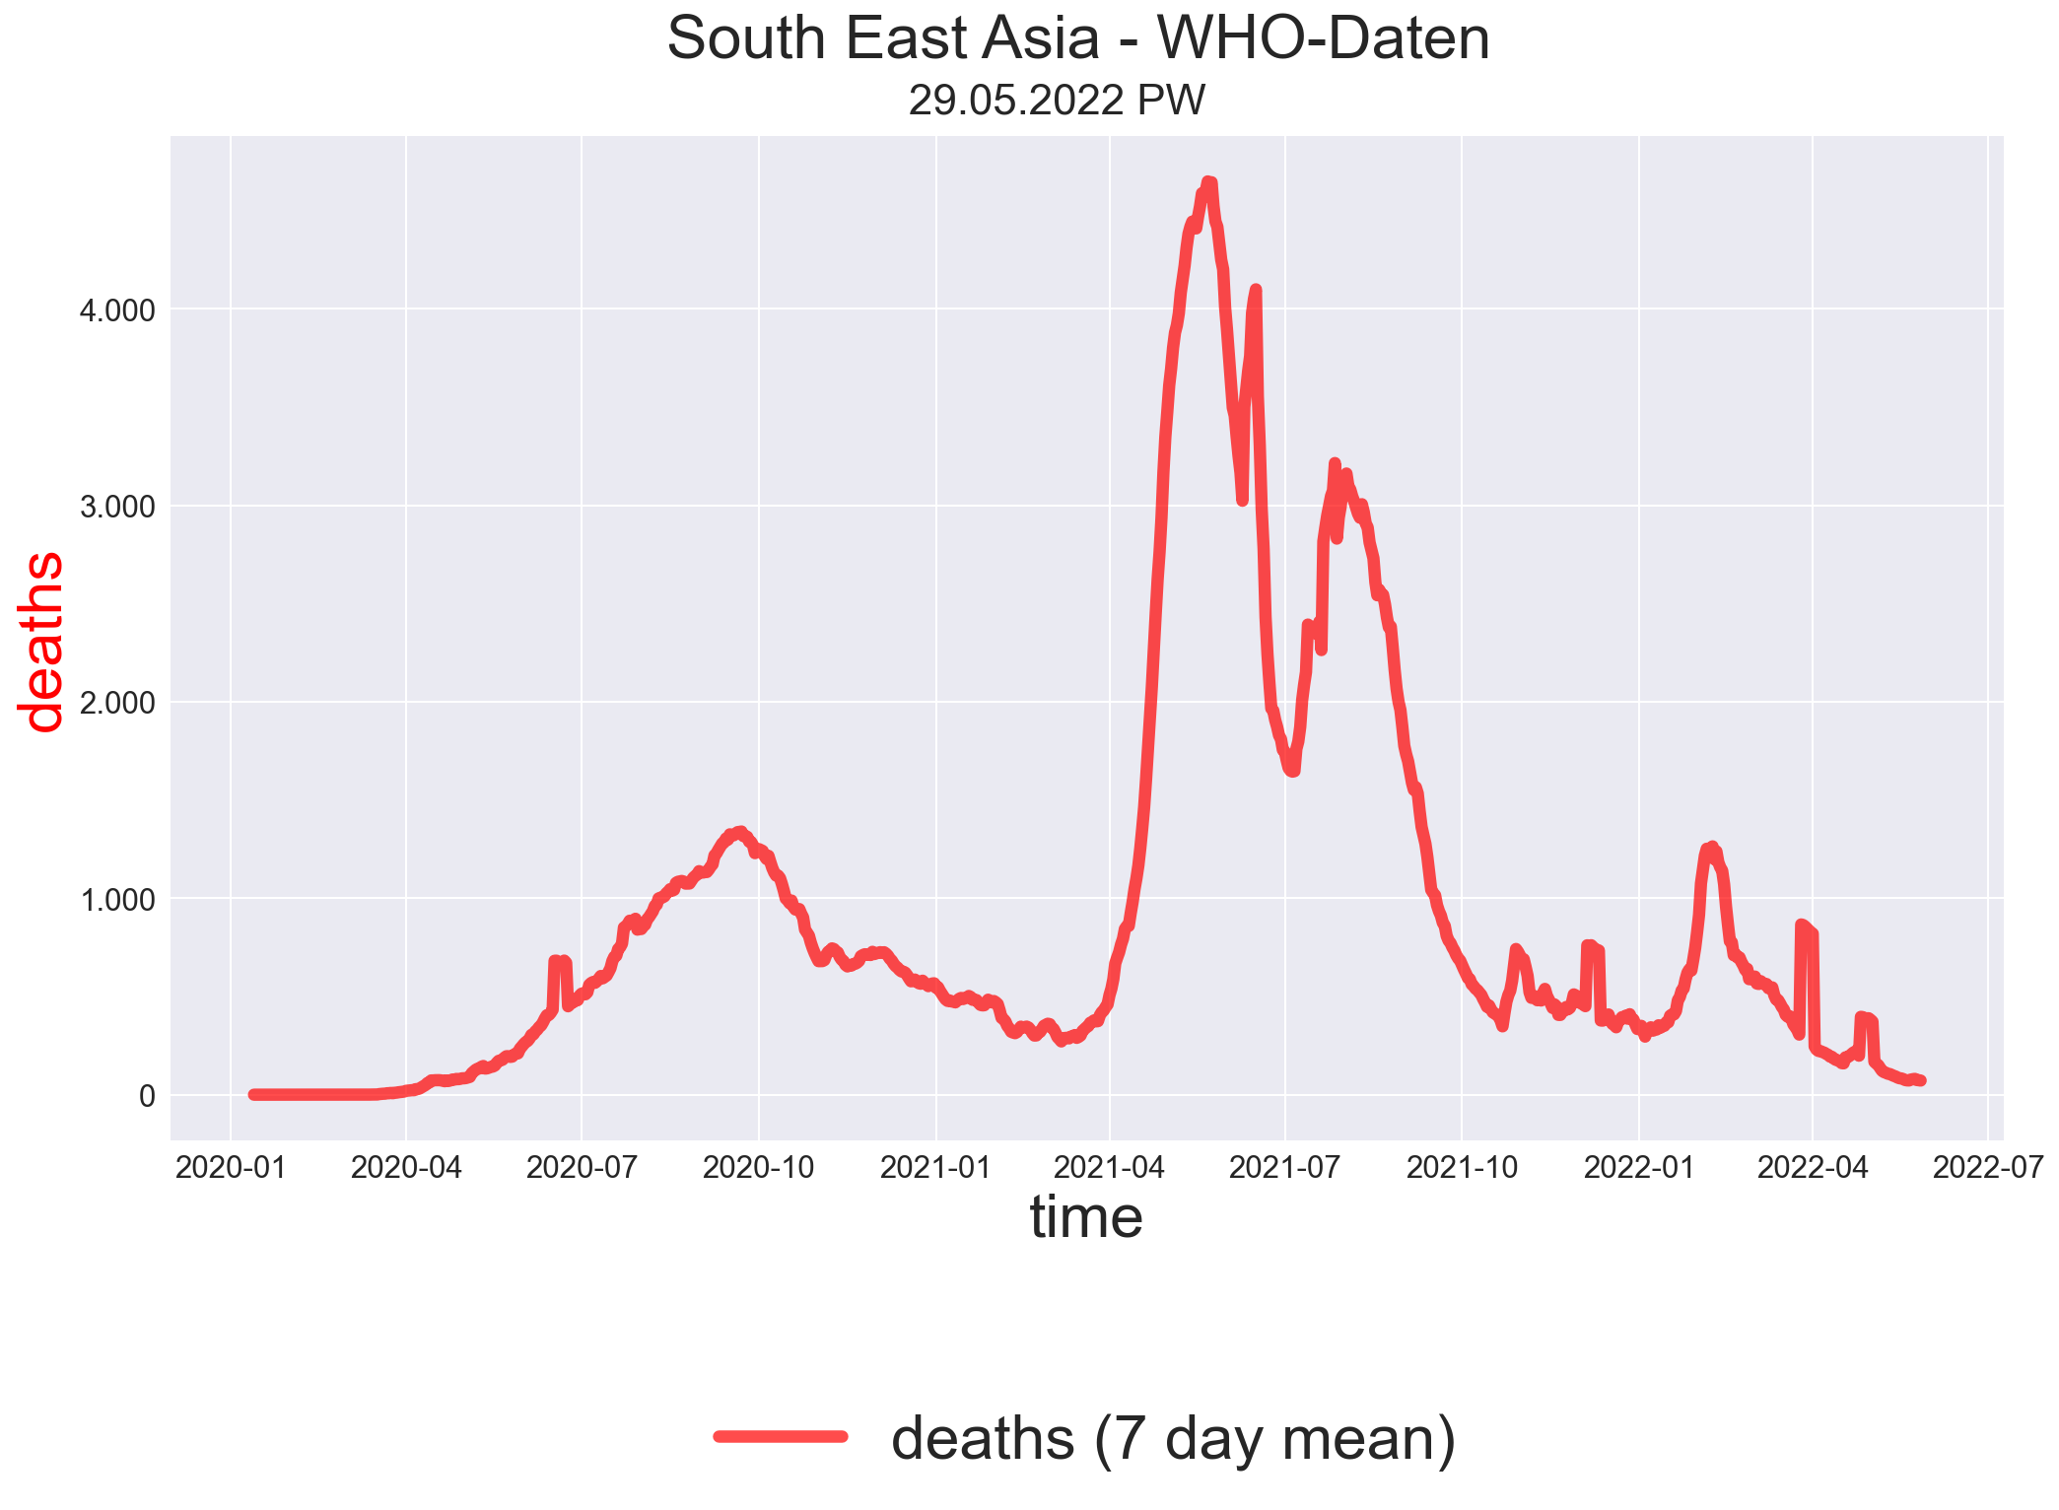

Slide 22
Fazit

Slide 23
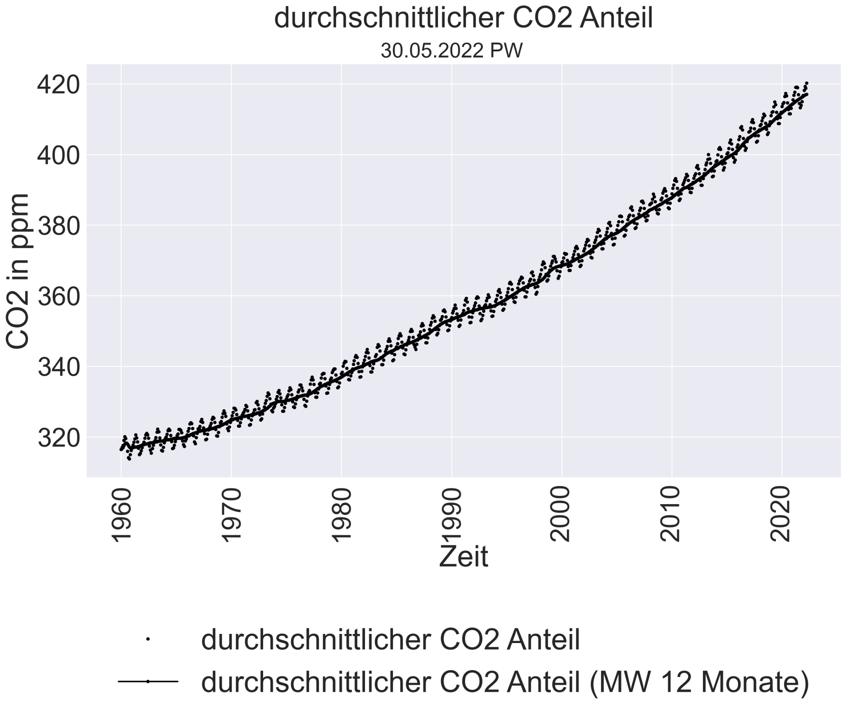

Slide 24
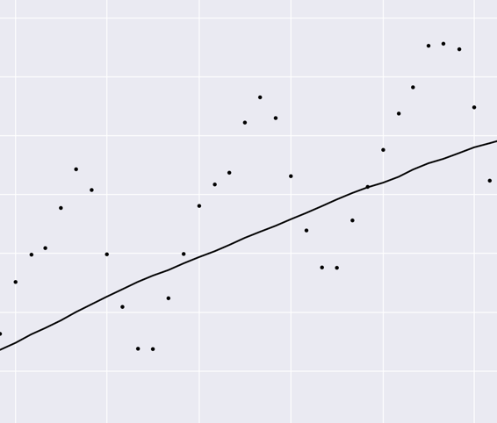
1) Änderung Vorjahresmonat
2) Abstand zum Mittelwert

Slide 25
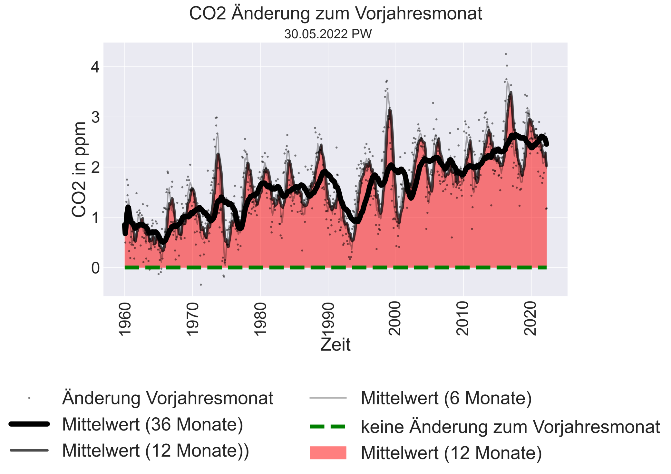

Slide 26
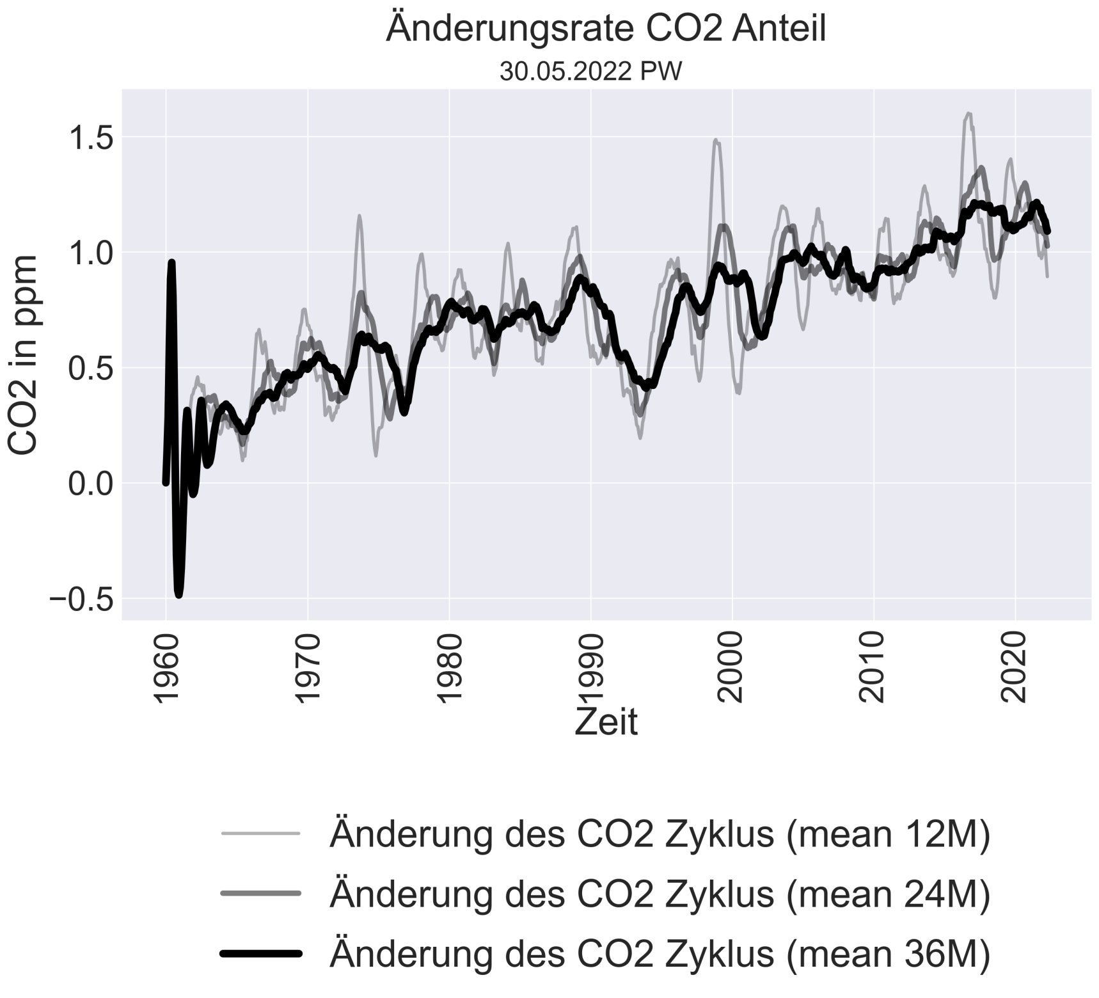

Slide 27
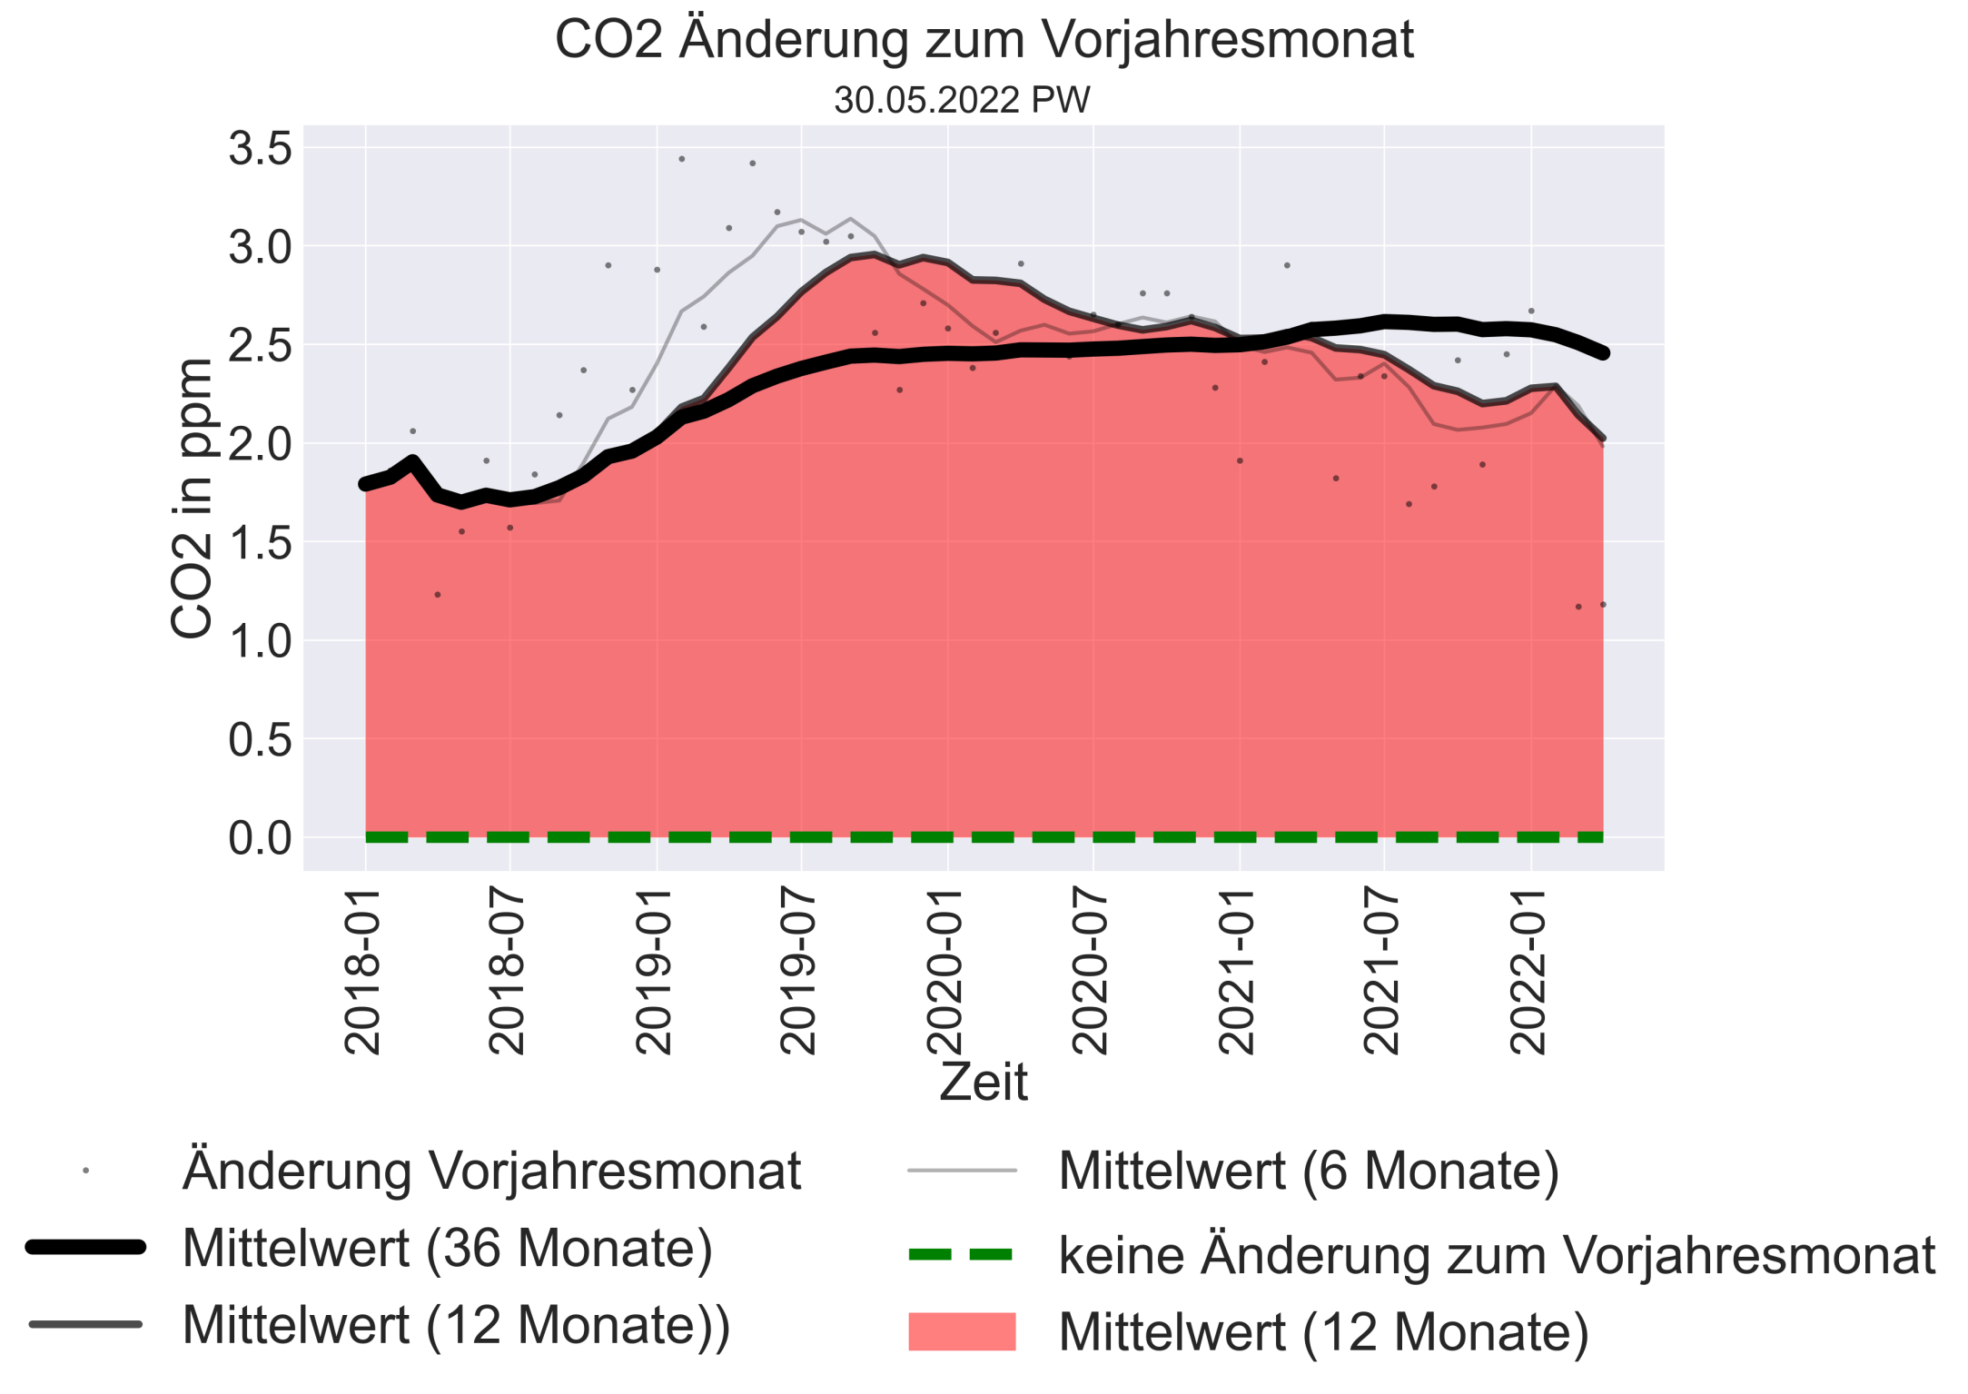

Slide 28
Vielen Dank

