Slide 1
Universal Sompo
For Universal Sompo technical + claims investigation stakeholders
AI Claim
Evidence Finder
Quest Claim Input
Evidence Search
Fraud Signals
Technical build plan for fraud-risk evidence discovery
Build objective
Automate the first-pass evidence finding workflow: extract claim facts, search public sources, rank evidence, flag mismatches, and generate investigator-ready output.
₹8L PILOT SCOPE
Notes:
Reference inputs include Universal Sompo public claims/navigation pages and uploaded internal workflow PDF describing Quest input, FIR extraction, news/image search, FIR-vs-news mismatch, map validation and final findings.

Slide 2
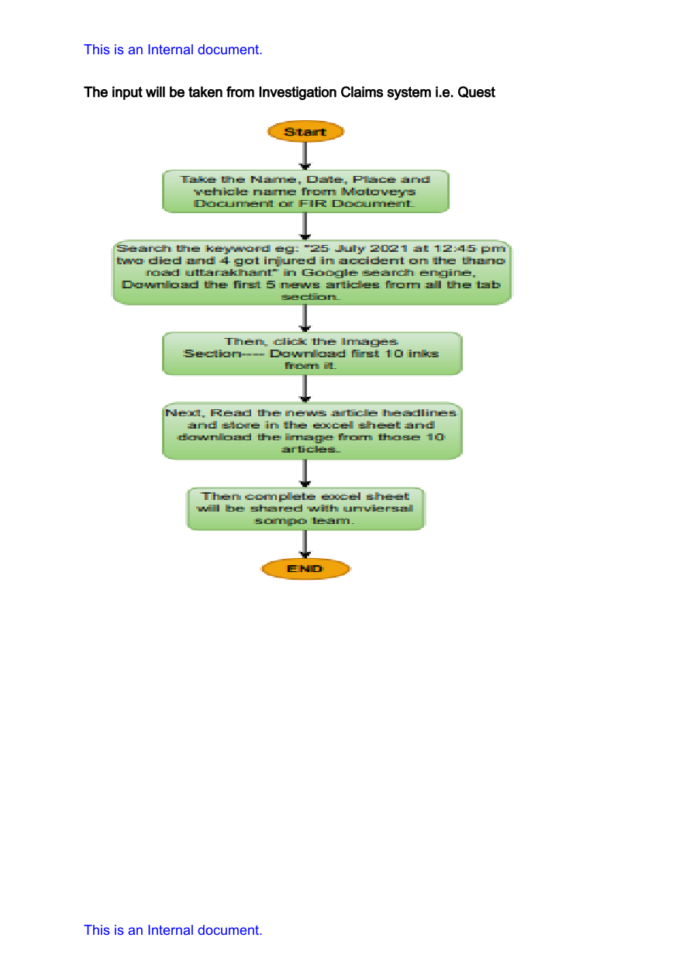
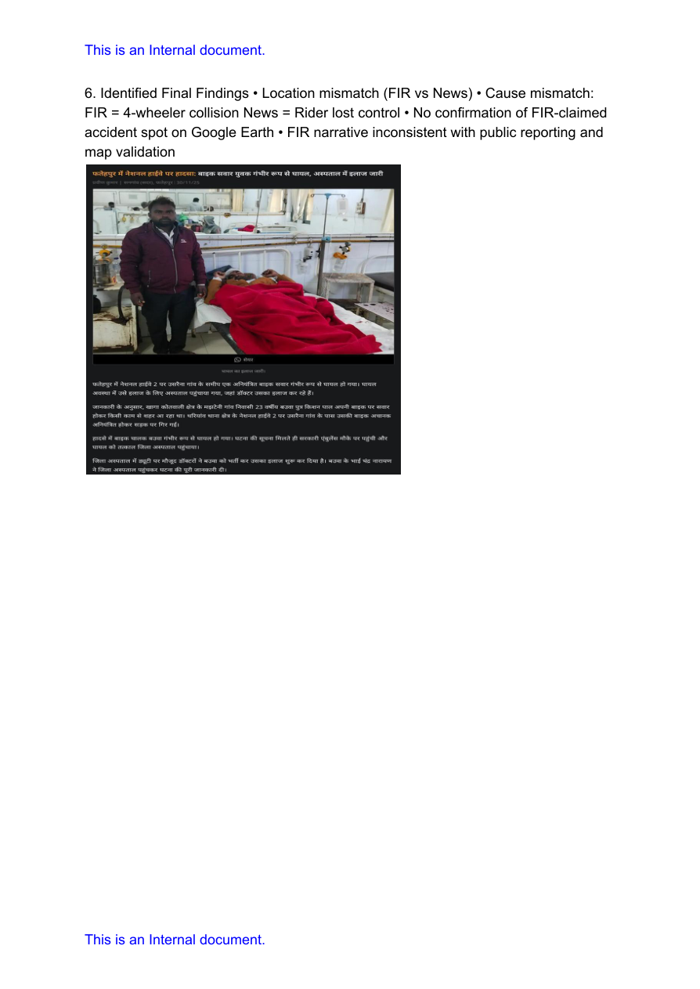
Universal Sompo
TECHNICAL BUILD PLAN
What Universal Sompo is doing today
Manual RCU workflow observed in sample cases
Input is taken from Investigation Claims system “Quest”.
FIR / initial documents are read to extract date, time, vehicle, location and parties.
Investigator searches news sources, downloads articles/images and shares Excel output.
Current fraud triggers are mismatches: FIR vs news, cause, spot, road feasibility.
AS-IS PROCESS
CASE EVIDENCE
Source: uploaded internal workflow document, pages 1–4
Notes:
Reference inputs include Universal Sompo public claims/navigation pages and uploaded internal workflow PDF describing Quest input, FIR extraction, news/image search, FIR-vs-news mismatch, map validation and final findings.

Slide 3
Universal Sompo
TECHNICAL BUILD PLAN
Pilot scope: what the model will actually do
01
02
03
04
Input Normalization
Evidence Discovery
Mismatch Scoring
Output Packaging
Parse FIR + Quest fields into a structured accident object: date, time, place, vehicles, parties, cause.
Generate multiple queries; run web/news/image search; extract article text, headlines, source, date, URL.
Compare FIR narrative against public evidence and maps; score cause, location, date, vehicle and entity consistency.
Generate an investigator report: evidence links, relevance scores, mismatch flags, summary and next action.
Not a black-box “fraud decision engine”. It is an evidence assistant that makes RCU faster, more consistent, and auditable.
Notes:
Reference inputs include Universal Sompo public claims/navigation pages and uploaded internal workflow PDF describing Quest input, FIR extraction, news/image search, FIR-vs-news mismatch, map validation and final findings.

Slide 4
Universal Sompo
TECHNICAL BUILD PLAN
Target architecture: retrieval + ranking + summarization
Quest / FIR Docs
Claim Fact Extractor
Query Generator
Search Aggregator
Evidence Extractor
Scoring Engine
Processing pattern
Async workers run search + extraction in parallel. Redis caches repeated searches and URLs. PostgreSQL stores claim objects, evidence metadata, scores, and audit logs. LLM is used only for extraction/summarization; deterministic ranking remains explainable.
FastAPI
API layer
Redis
cache
PostgreSQL
case store
LLM
summary
Embeddings
similarity
Notes:
Reference inputs include Universal Sompo public claims/navigation pages and uploaded internal workflow PDF describing Quest input, FIR extraction, news/image search, FIR-vs-news mismatch, map validation and final findings.

Slide 5
Universal Sompo
TECHNICAL BUILD PLAN
Claim understanding layer: from FIR text to structured facts
Claim schema
Extraction logic
Why this is critical
claim_id
accident_date_time
loss_location
vehicle_numbers
vehicle_types
parties_involved
injury_or_death
FIR_cause_narrative
police_station
district_state
OCR / text read for FIR PDFs
LLM extraction with JSON schema
Entity normalization: place, date, vehicle no.
Confidence scores for every field
Human correction before final run
If the claim facts are wrong, every downstream search and fraud signal becomes garbage. We will make fact extraction reviewable before evidence search.
QUALITY GATE
No scoring until minimum fields pass confidence threshold.
Notes:
Reference inputs include Universal Sompo public claims/navigation pages and uploaded internal workflow PDF describing Quest input, FIR extraction, news/image search, FIR-vs-news mismatch, map validation and final findings.

Slide 6
Universal Sompo
TECHNICAL BUILD PLAN
Evidence discovery engine: search broad, dedupe hard
Claim facts
5–8 queries
News / Web / Images
URL dedupe
Text + metadata
Evidence pack
Query expansion
“FIR location + accident date”, “vehicle no + district”, “victim name + road accident”, Hindi/local-language variants.
Extraction
Article body, title, source, publication date, image result URL, snippet, search query used.
Controls
Rate limiters, retry with backoff, URL canonicalization, same-domain duplicate removal, source whitelist/blacklist.
Notes:
Reference inputs include Universal Sompo public claims/navigation pages and uploaded internal workflow PDF describing Quest input, FIR extraction, news/image search, FIR-vs-news mismatch, map validation and final findings.

Slide 7
Universal Sompo
TECHNICAL BUILD PLAN
Fraud-risk scoring: explainable, weighted, evidence-first
Score composition
Mismatch flags surfaced
Semantic similarity
35%
CAUSE
FIR: truck hit bike | News: bike hit truck
Keyword / entity match
20%
LOCATION
FIR spot not aligned with public report / map road structure
Date proximity
15%
TIME
Claim accident date/time far from article timestamp
Location feasibility
15%
VEHICLE
Vehicle number / vehicle type absent or contradictory
Source reliability
15%
ENTITY
Victim / driver names conflict with public source
Notes:
Reference inputs include Universal Sompo public claims/navigation pages and uploaded internal workflow PDF describing Quest input, FIR extraction, news/image search, FIR-vs-news mismatch, map validation and final findings.

Slide 8
Universal Sompo
TECHNICAL BUILD PLAN
Investigator output: fast, auditable, non-black-box
Result API response
Investigator report sections
{
"case_id": "TP-FLP-RCU-UP-00517/2025",
"risk_level": "High Review",
"top_mismatches": ["cause", "location"],
"evidence": [{
"source": "local news",
"score": 0.82,
"why_relevant": "same victim + district + date"
}]
}
Claim facts extracted from FIR/Quest
Evidence table with URL, source, date, score
Mismatch analysis: FIR vs News vs Map
Recommended next verification: CCTV / IO / spot survey
Export to Excel/PDF for RCU handoff
HUMAN-IN-LOOP
System gives evidence + rationale. Universal Sompo investigator makes the final decision.
Notes:
Reference inputs include Universal Sompo public claims/navigation pages and uploaded internal workflow PDF describing Quest input, FIR extraction, news/image search, FIR-vs-news mismatch, map validation and final findings.

Slide 9
Universal Sompo
TECHNICAL BUILD PLAN
8L pilot delivery plan: 6 weeks, usable not theatrical
W1
W2
W3
W4
W5
W6
Discovery + schema
Ingestion MVP
Search engine
Scoring engine
Report/API
UAT + handover
Quest fields, FIR formats, sample cases, acceptance criteria
OCR/text parsing, structured JSON extraction, human review screen
Query expansion, Serp/Bing integration, async fetch, dedupe
Similarity, keyword, date, source, location flags
FastAPI endpoints, Excel/PDF output, audit log
Test cases, calibration, deployment package, tech docs
Pilot success metrics: ≥70% reduction in manual evidence search time, ≥80% precision on top-3 evidence relevance, 100% audit trail for outputs, no auto-claim rejection.
Notes:
Reference inputs include Universal Sompo public claims/navigation pages and uploaded internal workflow PDF describing Quest input, FIR extraction, news/image search, FIR-vs-news mismatch, map validation and final findings.

Slide 10
Universal Sompo
TECHNICAL BUILD PLAN
Implementation risks + decisions needed from Universal Sompo
Risks
Controls
Decisions needed
Sparse public data for rural accidents
Messy Hindi/local news extraction
Search API latency / quota cost
FIR OCR errors and inconsistent formats
False positives if evidence is treated as proof
Confidence score per extracted field
Source + query audit trail
Human approval before final report
Calibration with historical cases
PII redaction and access controls
Confirm Quest integration mode: API / export / manual upload
Approve search API vendor
Provide sample cases + ground truth
Nominate RCU reviewer for weekly UAT
Confirm deployment: cloud or on-prem
Notes:
Reference inputs include Universal Sompo public claims/navigation pages and uploaded internal workflow PDF describing Quest input, FIR extraction, news/image search, FIR-vs-news mismatch, map validation and final findings.

