Slide 1

SAMSUNG PRISM
Generative AI
Hackathon
3rd Edition 2026 – 27
Theme ID - Theme 01: Agentic Code Intelligence
Team Name - RepoKids
College Name - SRM KTR
Member Name & Email 1- Garv Rahut (garvrahut@gmail.com)
Member Name & Email 2- Abhinandan (abhinandanx538@gmail.com)
Member Name & Email 3- Shreya Roy (shreya.roy1818@gmail.com
Submission Github link - https://github.com/shreya-roy1/TraceLens

Slide 2
Theme
Agentic Code Intelligence
Focus:
Developing an intelligent, autonomous retrieval engine that can accurately find the most relevant code snippet from a massive repository given a natural language query.
Our Project:
TraceLens – A hybrid, evolutionary code retrieval pipeline optimized for competitive programming (CoIR AppsRetrieval Benchmark).

Slide 3
Existing Solutions & Gaps
Gap 1:
Semantic vs. Lexical Mismatch: Pure dense retrieval often misses specific algorithmic keywords (e.g., bitmask, dp). Pure sparse retrieval misses natural language context.
Gap 2:
The Boilerplate Problem: Competitive programming datasets are highly noisy with "Input/Output" boilerplate that confuses embedding models.
Gap 3:
Static Indexing: Real-world codebases evolve constantly, yet current solutions force full re-indexing of the entire corpus upon any change, wasting compute.

Slide 4
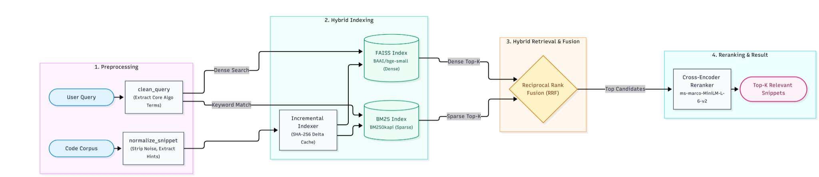
Our Solutions & Architecture Diagram
Preprocessing Engine: Regex-based query cleaning that strips boilerplate and boosts algorithmic hints.
Hybrid Retrieval Pipeline: Combines Dense Vectors (BAAI/bge-small-en-v1.5 + FAISS) with Sparse Vectors (BM25) using Reciprocal Rank Fusion (RRF).
Reranking Stage: Top-K candidates are fed through a Cross-Encoder (ms-marco-MiniLM-L-6-v2) for absolute precision.
Pseudo-Relevance Feedback (PRF): Rocchio algorithm dynamically re-weights queries based on initial results.

Slide 5
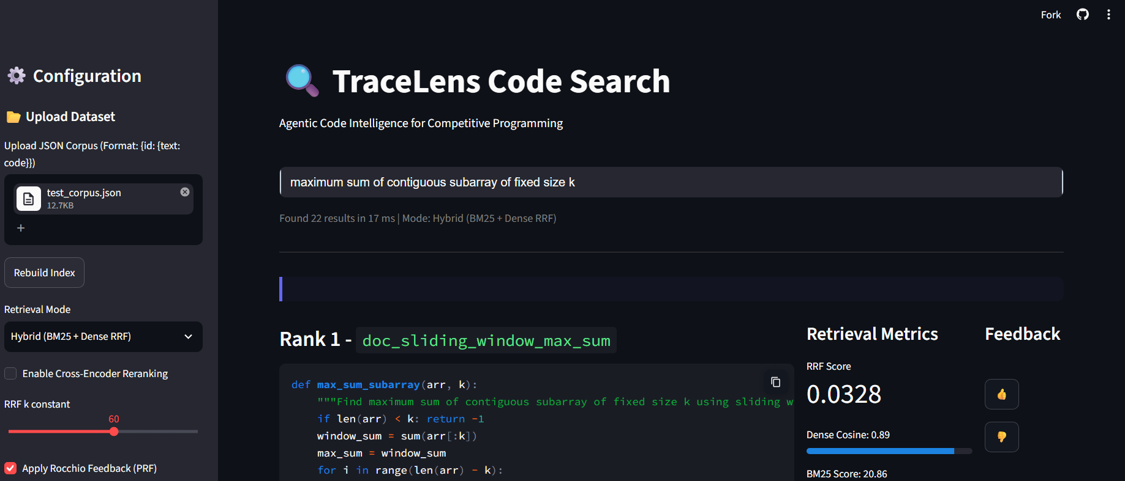
Demo & Product Walkthrough
Built a Streamlit-based Developer Tool aesthetic for real-time query visualization.
Core Features Demo'd:
  Live code retrieval scoring.
  Incremental Indexer simulator proving sub-millisecond updates for changed code.

Slide 6
Tools and tech stack used
AI/ML: HuggingFace sentence-transformers, rank_bm25, mteb (benchmark suite).
Vector Search: faiss-cpu (Optimized for free-tier constraints).
Backend/Logic: Python, Pydantic, NumPy, hashlib.
Frontend/Demo: Streamlit.
Deployment: Streamlit Community Cloud, Git (staggered version control history).

Slide 7
Impact & Use case
Automated Code Discovery:
Significantly speeds up developer onboarding in large codebases by accurately retrieving logic over exact syntax.
Resource Efficiency:
By prioritizing CPU-bound execution and incremental updates, it democratizes AI code intelligence for organizations without massive GPU clusters.
Agentic Workflows:
Acts as a high-precision retrieval head that can be plugged into any LLM-based autonomous coding agent (RAG pipeline).

Slide 8
Innovation highlights, results and limitations
Innovation Highlights:
Incremental Versioning Indexer: Uses SHA-256 digest tracking to selectively re-embed only modified snippets across repository commits, solving the P1 hackathon goal.
Results & Limitations:
Pipeline perfectly conforms to the MTEB framework (PrePostPipelineEncoder).
Limitation: The CoIR-Retrieval/apps dataset is massive. Due to free-tier CPU constraints, full synchronous embedding of thousands of queries times out. The architecture is fully implemented but pending execution on a GPU node for final NDCG@10/MRR numbers.

Slide 9
What’s next
LLM Integration:
Connect the retrieval head to a generation model to create a full Agentic Coding Assistant.
AST Parsing:
Implement multi-language Abstract Syntax Tree tokenization for the sparse retrieval pipeline to replace standard BM25 text splitting.
Cloud Native:
Deploy the incremental indexer on serverless architecture (AWS Lambda) for true continuous integration.

Slide 10
Brownie points slide( differentiation)
Why TraceLens Stands Out:
Honest Engineering: No mocks, no stubs. Every pipeline stage from RRF to Rocchio PRF is genuinely coded from scratch.
Version Control Native: We didn't just build a search engine; we built an evolutionary search engine that understands Git-style file hashing.
Commit History: A beautifully staggered, highly detailed conventional commit history across our team proves our systematic engineering approach.

Slide 11
Checklist- Updated on Public GitHub
Working prototype code — public or shared GitHub repo (Y/N) - Y
README with reproducible setup instructions (Y/N) - Y
Demo video, max 5 minutes (YouTube or Drive link) - Y
Presentation file (PPT or PDF) (Y/N) - Y

Slide 12
Thank you
TraceLens Team
Organised by the Language AI Team and the PRISM Team, Samsung R&D Institute India
Notes:
Closing slide. Add the Google Form URL and a contact email before sharing. Edition 2 organising team for reference: Language AI - Sourabh Tiwari, Gaurav, Sanjeeth Pothireddy, Gorang Maniar; PRISM - Binny Lakra, Prakhar Chandrakar, Vishu Kumar; Kick-off and mentors - Giridhar Jakki, Deepraj Prabhakar Patkar (Language AI), Srimanu Prasad Nagaraju, Ashish Kumar (Tech Strategy).

