Slide 1


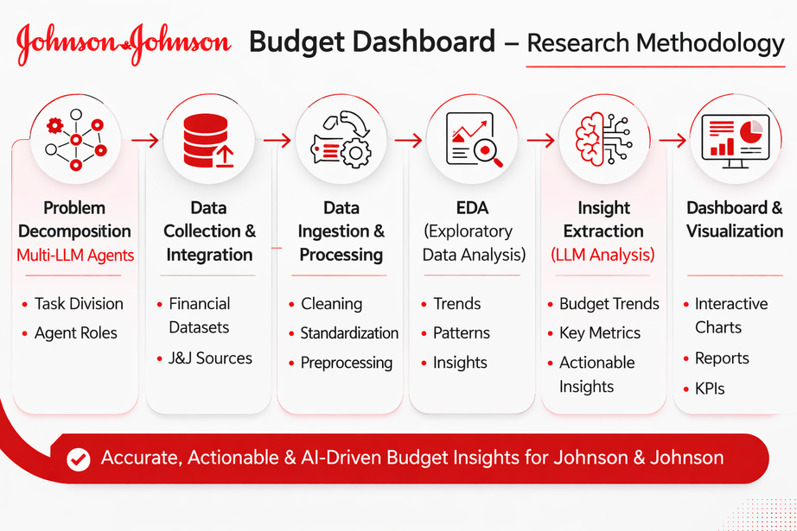
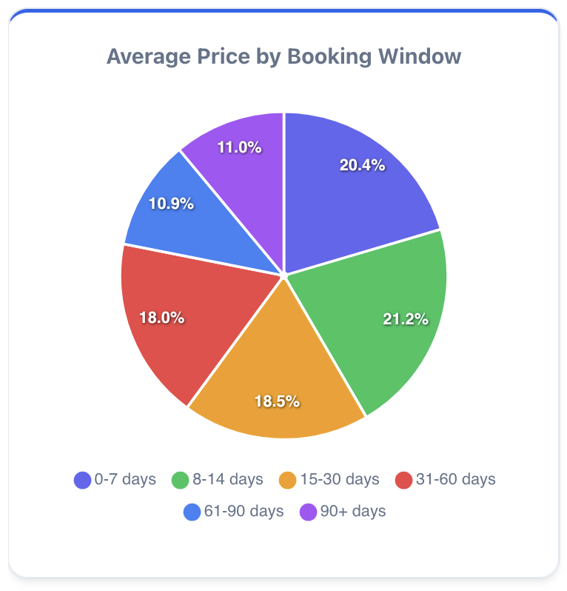
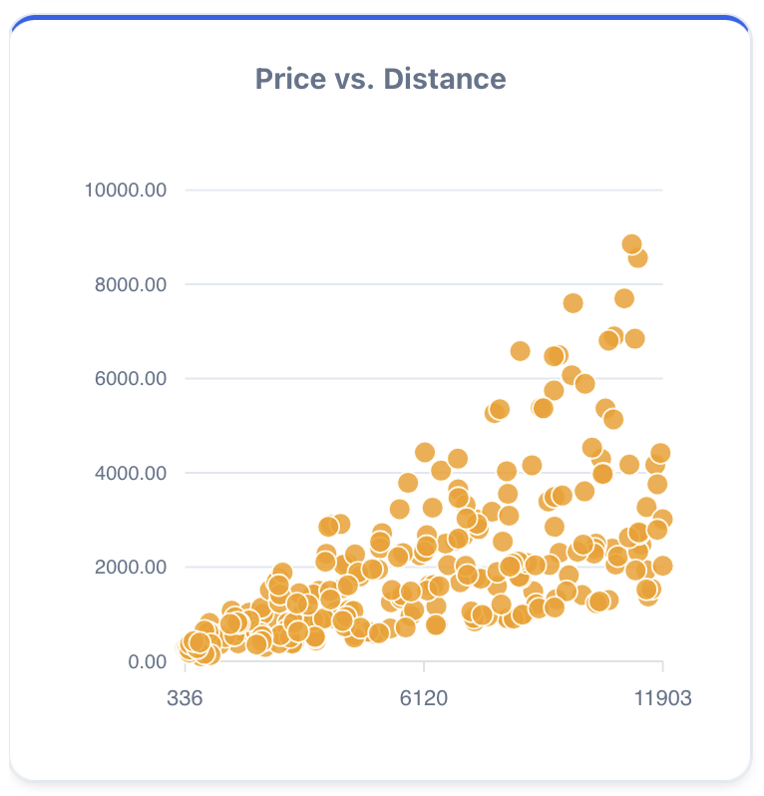
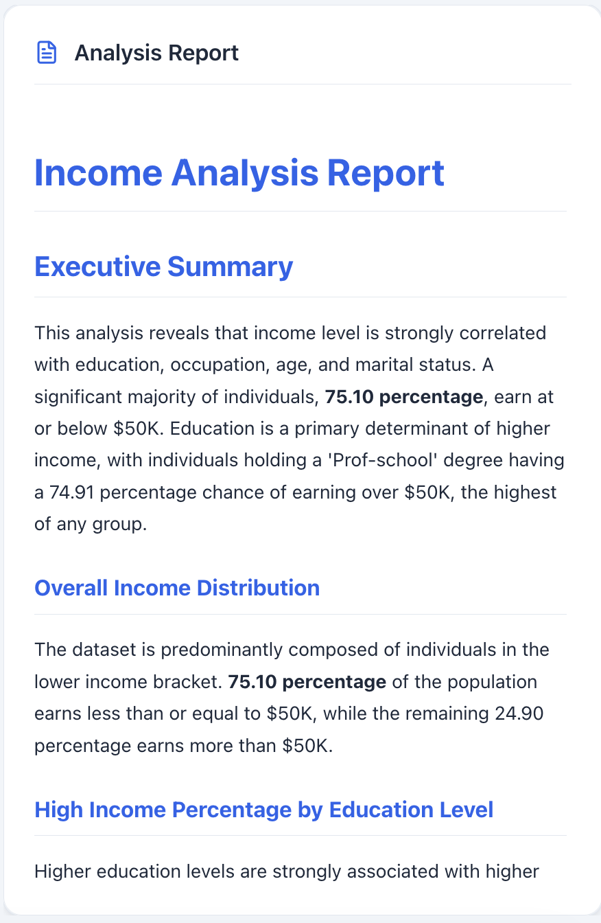
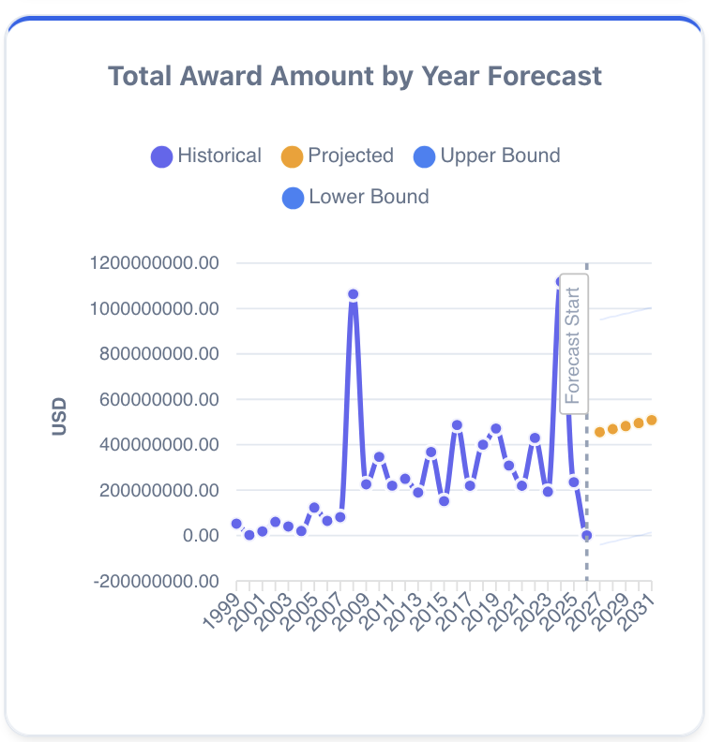
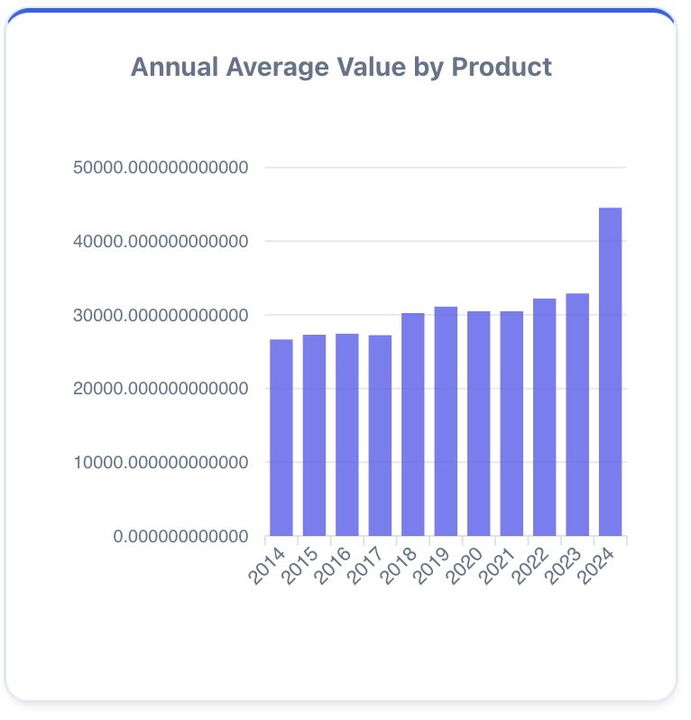
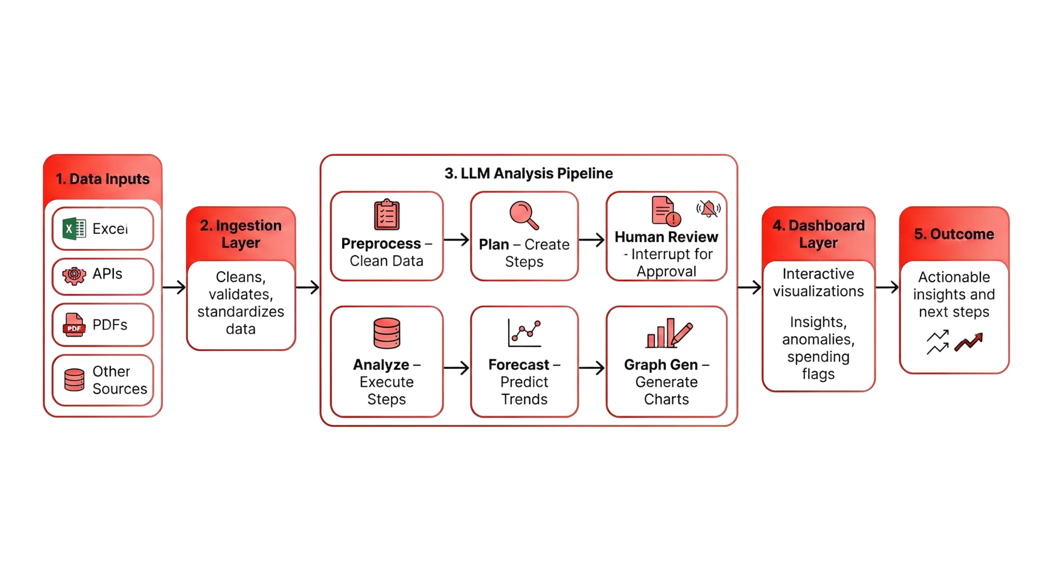

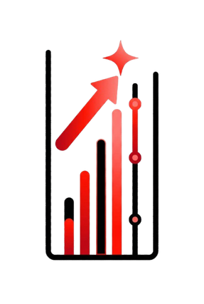




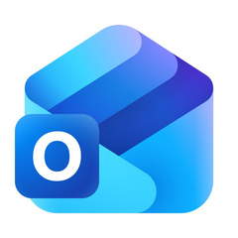




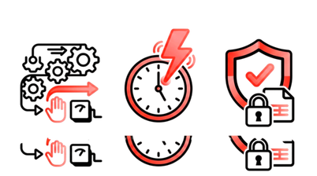
LLM Budget Dashboard System
Members: Jose M. Pitt, Manasi Indalkar, Maxwell Miler, Alex Qu, Andres Alban, Rohit Sattuluri, Garv Atri, Pragathi Rao, Sanketh Patil
Introduction
Research methodology
Dashboard Snapshot
Johnson and Johnson is a global healthcare company specializing in pharmaceuticals and medical technology
Project objectives
Build an interactive budget dashboard to discover and leverage insights
Leverage LLM-assisted analysis to support faster resource allocation and financial insights
Create an automation process to seamlessly transfer data from IBM Cognos to PowerBI
Workflow Diagram
Tool Features
Fall 25 Project
Multi-Agent AI Analytics Platform
Built with LangGraph, Flask, and React
Accepts natural-language questions about datasets
LLM Processing Pipeline
Stages: preprocessing, checklist generation, analysis, graph generation, forecasting, summary
Interactive Data Visualizations
Automatically generates charts, graphs, and tables
Helps users quickly identify patterns and insights
Forecasting & Trend Analysis
Displays projected trends in visual dashboards
Automation Pipeline
Built pipeline transferring data from IBM Cognos Cloud into Power BI
Enabled daily automated dashboard refresh
Process & Documentation
Created documentation outlining the full automation workflow
Data Quality Improvements
Identified and resolved errors in Open PO and Spend Excel reports
Future Plans
Real‑time analytics that reacts instantly to streaming data.
Stored insights so LLMs can reuse past analysis with vector database.
More efficient LLMs for faster, deeper reasoning.
Auto‑generated reports/PPTs
~30 seconds to retrieve detailed, actionable insights from data
Adaptable analysis pipeline for any data domain
Automated forecasting with built-in confidence metrics
Natural language queries that enable non-technical users to ask questions in plain English
Conclusion & Learning Outcomes
Acknowlegments
Real World Impact
Developed an AI-powered tool for automated Exploratory Data Analysis (EDA) that identifies key patterns, trends, and anomalies in datasets. Integrated natural-language to enhance accessibility and support data-driven decision-making.
Gained hands-on experience using Gemini CLI, Claude, and Python to build an AI-powered data analysis tool for automated exploration and insights.
Thank you to the JNJ Mentors - Fei Chen, and Sudheer Rani, Jonathan Nycz, Danny Paiz​, Eric Lawrence​, Min Zhou​, for their support and guidance throughout the project
Thank you to our team members from last semester
Thank you to our TA Pranav Singh, Nicholas Lenfestey, and the Data Mine Team for their help and resources
Notes:
Introduction (motivation)​ (Alex)
Fall 25​ (Rohit)
Research Methodology​
Workflow diagram​ - Jose
Image of Tool​
Pictures of tools used​
Features of the tool​ (Max)
Real world Impact​-( pragathi)
Conclusion (learning outcome, acknowledgments, references)​ ( Manasi)
​
Color scheme​
Red, white,

