Slide 1

INSTITUTE OF ENGINEERING AND TECHNOLOGY, DAVV
Submitted By: Garv Jain
Submitted To: Dr. Shashi Prakash Sir
Roll No. : 22E3020
Branch: Electronics and Instrumentation Engineering
Subject: Analog Electronics

Slide 2
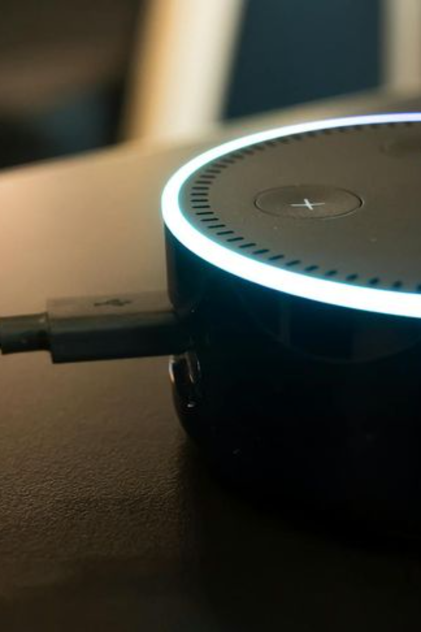
Introducing VoiceRetailer: The Future of Seamless Shopping Experiences
Our innovative voice assistant device simplifies retail transactions by converting spoken orders into accurate invoices within seconds. Imagine a world where manual order recording is a thing of the past.

Slide 3
Title: VoiceRetailer
Our groundbreaking voice assistant device, VoiceRetailer, is set to revolutionize the retail industry by simplifying the way orders are processed and invoices are generated. Say goodbye to time-consuming manual input and hello to effortless voice-activated transactions.

Slide 4
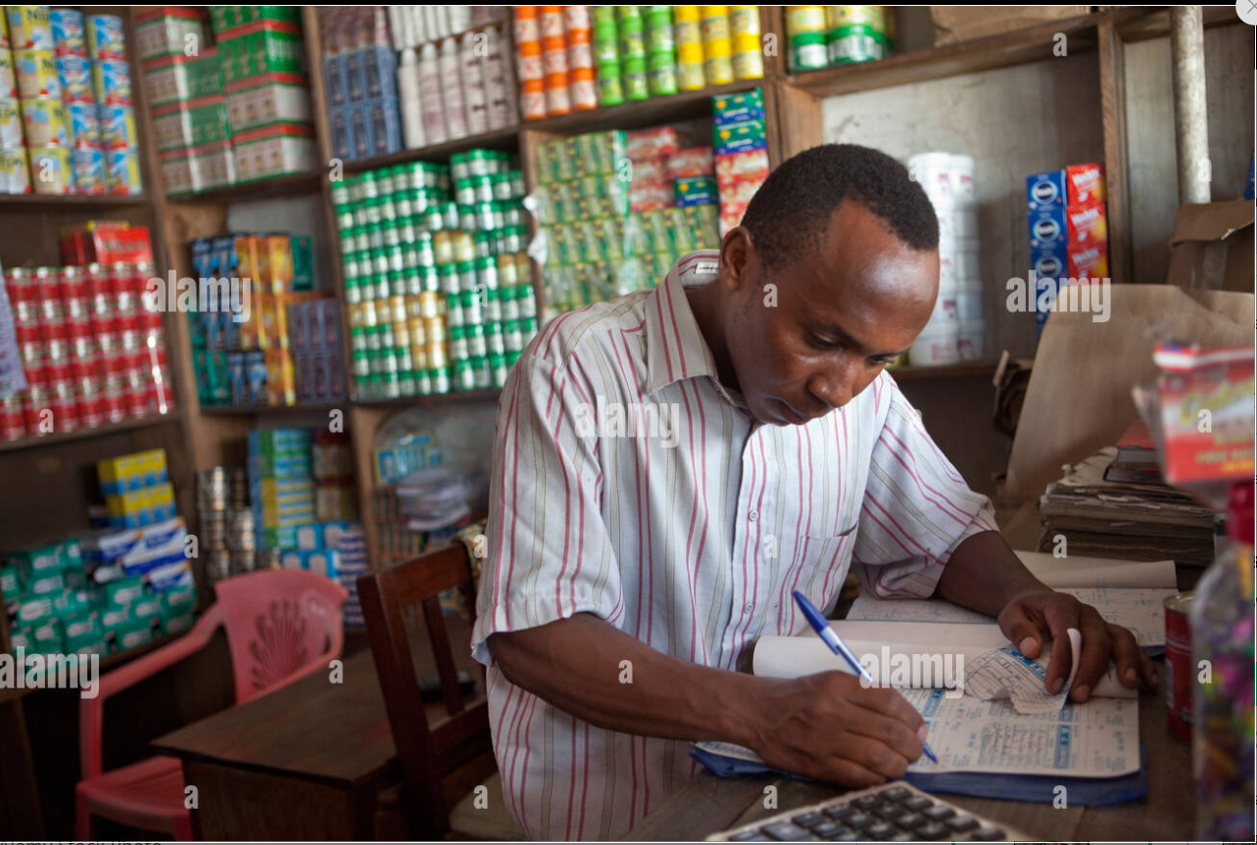
Definition of Problem
Retailers face challenges with manual order recordings, which can lead to errors and waste valuable time. VoiceRetailer aims to eliminate this problem by providing a seamless and efficient solution for order processing.

Slide 5
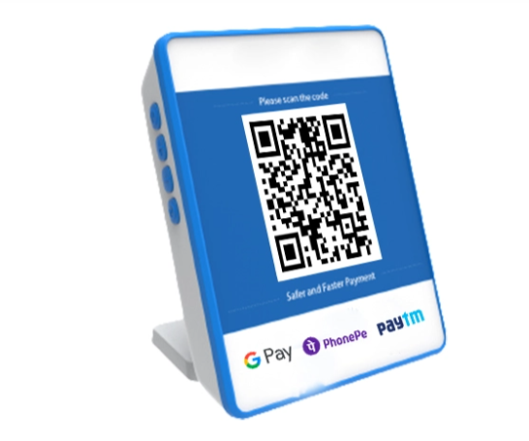
Solution Suggested
A cutting-edge voice assistant device revolutionizing the retail experience. Customers can effortlessly place orders by simply speaking their requests, leveraging our advanced voice recognition technology. This innovative device ensures swift and accurate conversion of spoken words into invoices and bills within seconds, streamlining and enhancing the entire shopping process for a seamless and efficient retail encounter
We can Integrate this into the Paytm/PhonePe/Bhartpe QR code box . Which can maintain both online and offline pay record with this Electronics Voice Assistance device.
We will also add key words of the available Products with Machine Learning (M.L) algorithm which will take records of specific Talk/Word only .

Slide 6
Voice Input
Speech Recognition
Order Processing
Converts requests into accurate invoices and bills
Block Diagram :
Receives user's spoken requests
Translates voice commands into text
VoiceRetailer comprises several key functional blocks that work together to ensure efficient order processing. These blocks include:
Voice Recognition
Invoice Generation
User Interface
Connectivity Modules

Slide 7
Business Model
Device Sales: Generate revenue by selling VoiceRetailer devices to retailers. The pricing model can be based on the scale of the business, with different packages tailored to small, medium, and large enterprises.
Subscription Model: Introduce a subscription-based pricing model for ongoing support, updates, and access to advanced features. This can be a recurring revenue stream for continuous improvements and customer support.
Licensing and Integration Fees : Charge licensing fees for the use of the voice recognition technology and integration into existing POS systems or e-commerce platforms. This can be a one-time fee or a recurring payment based on usage.
Data Analytics Services: Offer retailers insights into customer preferences and buying patterns through data analytics services. This additional service can provide valuable information for targeted marketing and inventory management.
Maintenance and Support: Provide maintenance services and customer support, ensuring that the devices run smoothly. Charge fees for ongoing support, troubleshooting, and software updates.
Partnerships and Collaborations: Explore partnerships with POS system providers, e-commerce platforms, and other retail technology companies. Collaborate to integrate VoiceRetailer into their systems, creating mutually beneficial relationships.
Customization Services :Charge fees for customizing the voice recognition technology to suit the specific product catalog and requirements of individual retailers.By combining these revenue streams, VoiceRetailer can establish a sustainable and profitable business model while offering a transformative solution to enhance the retail experience for both businesses and customers.

