Slide 1
WHAT IS APEX?
APEX
A context-aware cognitive OS that uses the iQOO phone as a real-time sensor array and the laptop as the adaptive execution environment — connected via the iQOO Office Kit bridge.
PHONE
Cognitive Input Layer
Reads tap cadence, app-switching & ambient audio to detect cognitive state in real time.
Adaptive Presence &
Execution Intelligence
BRIDGE
iQOO Office Kit
iQOO Phone × Laptop Ecosystem
Sub-100ms bidirectional command passing between phone and laptop.
LAPTOP
Adaptive Execution Layer
Reshapes workspace — closes tabs, enables DND, pins docs — in under 4 seconds.
CONFIDENTIAL · 2025

Slide 2
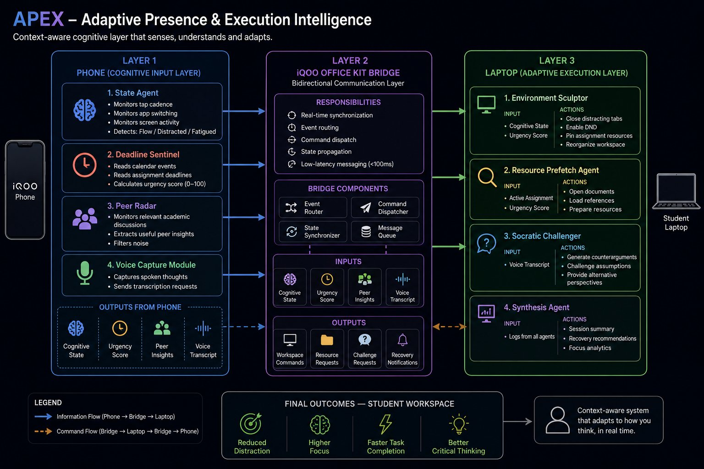
SYSTEM ARCHITECTURE
Three-Layer Multi-Agent OS
THE FIVE AGENTS
01
State Agent
PHONE
Monitors tap cadence & app-switching. Classifies: Flow / Distracted / Fatigued.
02
Deadline Sentinel
PHONE
Reads calendar data. Computes urgency score 0–100. Flags no-buffer scenarios.
03
Environment Sculptor
LAPTOP
Closes distracting tabs, enables DND, pins docs. Reshapes workspace in <4s.
04
Peer Radar
PHONE
Monitors academic group chats. Surfaces key peer insights without breaking focus.
05
Socratic Challenger
LAPTOP
Takes voice transcripts and generates adversarial counterarguments in real time.
PHONE LAYER (Cognitive Input) → iQOO OFFICE KIT BRIDGE (<100ms) → LAPTOP LAYER (Adaptive Execution)

Slide 3
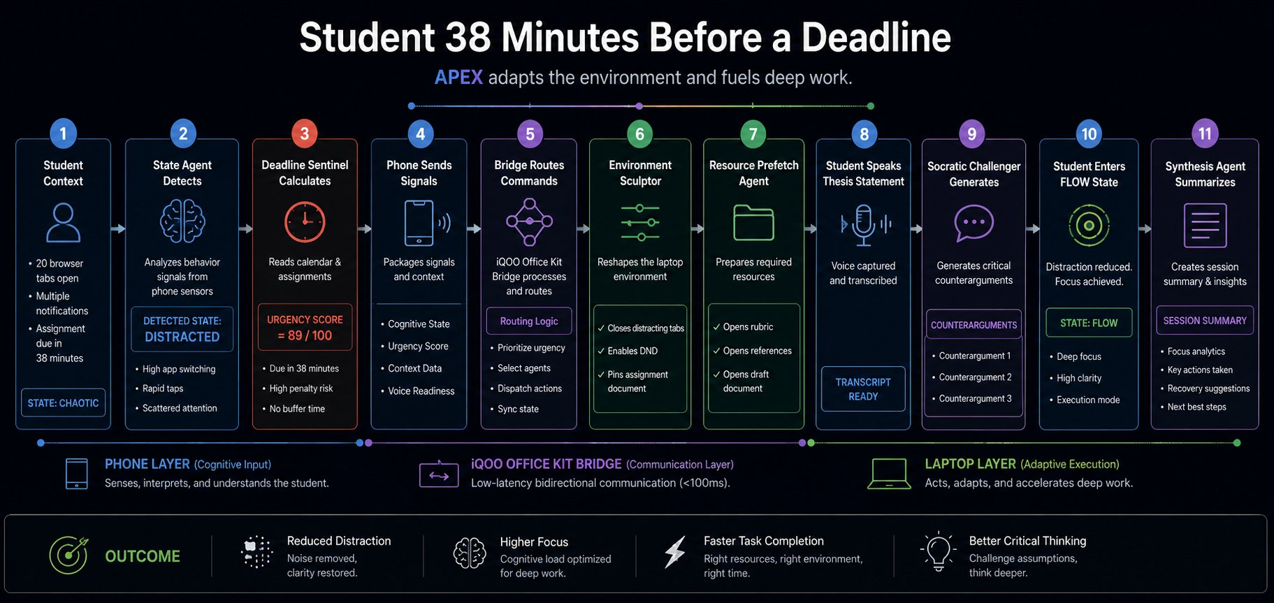
EXECUTION FLOW & COMPETITIVE EDGE
COMPETITIVE POSITIONING
OUTCOMES
Capability | Notion / Cal | Focus Apps | APEX
Cognitive State Detection | ✗ | ✗ | ✓
Deadline Urgency Scoring | ~ | ✗ | ✓
Real-time Workspace Reshape | ✗ | ~ | ✓
Peer Insight Filtering | ✗ | ✗ | ✓
↓ Chaos
↑ Flow
Reduced Distraction
Higher Focus
Noise removed, clarity restored automatically.
Environment built around mental state in real time.
Faster Completion

