Slide 1
BEE Project
Movie Ticket Website
Team Details:
Garvish (2310990257)
Devansh(2310990322)
Garima(2310990333)
Garvit (2310990334)
Trainer’s Name : Mr. Rahul Singh
:
Chitkara University Institute of Engineering and Technology,
Chitkara University, Punjab

Slide 2
Table of Contents
Introduction
Problem Statement
Technical Details
Challenges Faced
Key Features
Future Scope
Project Highlights
Conclusion
References

Slide 3
Introduction
In today's fast-paced digital era, the demand for convenient online shopping has grown exponentially. This project presents Drip Sole, a modern e-commerce website that simplifies the process of exploring and purchasing a wide range of products online. The platform provides a user-friendly interface where customers can easily browse product categories, view detailed information, and make secure purchases. By offering a convenient and seamless shopping experience, Drip Sole aims to meet the needs of today's digital consumer.

Slide 4
Problem Statement
Traditional retail often involves limited product choices, long queues, and geographical constraints, leading to inconvenience for customers. Many existing e-commerce platforms may not provide a seamless or intuitive experience for browsing products, managing a cart, and completing a secure transaction. There is a need for an efficient, user-friendly online platform that allows customers to conveniently explore a diverse product catalog, check product details, and purchase items anytime, anywhere.

Slide 5
Technical Details
Frontend:
React.js – For building a dynamic and responsive user interface.
CSS / Bootstrap – For styling and creating a modern UI design.
Backend:
Node.js – For server-side scripting and handling requests.
Express.js – For building APIs and managing routing efficiently.
Database:
MongoDB – For storing details, user information and orders .
Additional Tools:
RESTful APIs for communication between frontend and backend.
Git/GitHub for version control.

Slide 6
Challenges Faced
Integrating seat selection and real-time availability to avoid wrong orders.
Designing a responsive and user-friendly interface for various devices.
Ensuring secure user authentication and data handling.
Connecting frontend React components smoothly with backend APIs.
Managing database operations efficiently for order listings.
Handling errors and edge cases during orders, such as full shows or invalid inputs.

Slide 7
Key Features
For Users:
Browse products by category and search for specific items. Add products to a shopping cart and manage quantities. View order history for past and upcoming purchases..
For Admin:
Add, edit, or delete products in the system. Upload product images and provide detailed descriptions. Manage product listings and ensure inventory data is up-to-date.

Slide 8
Future Scope
Online Payment Integration: Allow users to pay securely via credit/debit cards, UPI, or digital wallets.
User Reviews and Ratings: Enable users to rate products and write reviews.
Personalized Recommendations: Suggest items based on user preferences and history.
Mobile App Development: Launch a mobile version for Android and iOS for wider accessibility.
Promotions and Discounts: Implement offers, coupons, and loyalty points for users.
Multi-City Support: Expand the platform to support multiple cities.

Slide 9
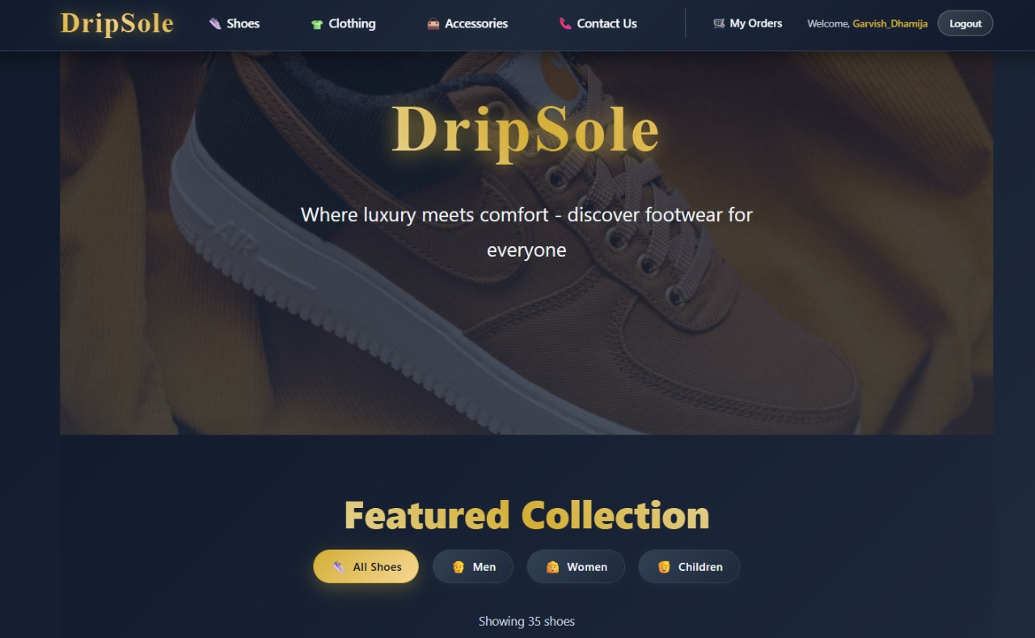
Fig 1. Main Page

Slide 10
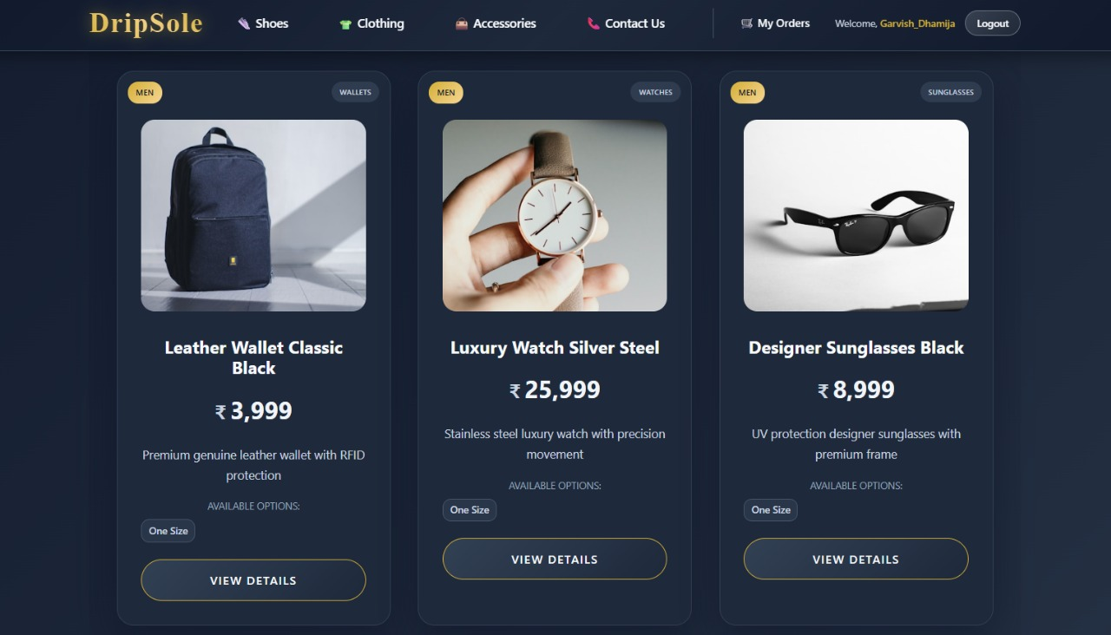
Fig 2. Item Details & Booking

Slide 11
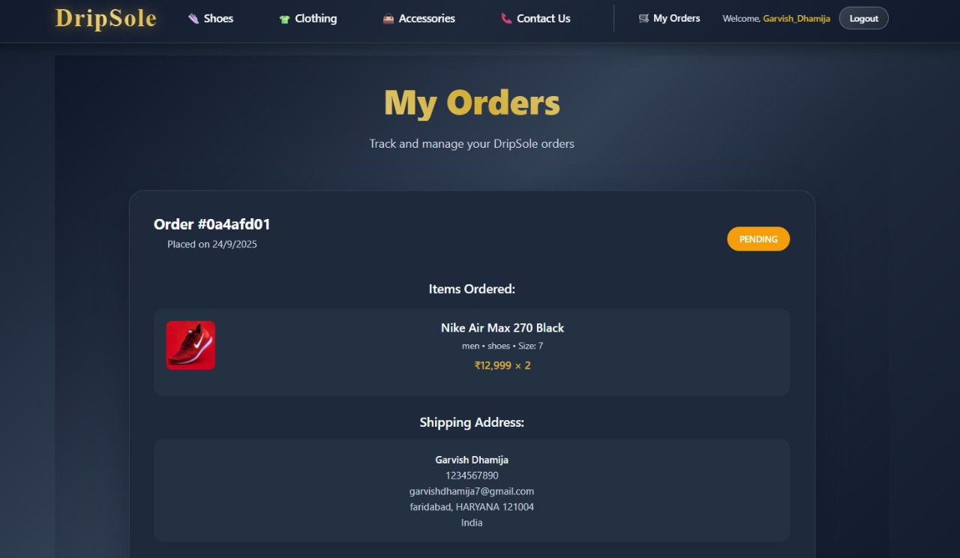
Fig 3. Your Orders

Slide 12
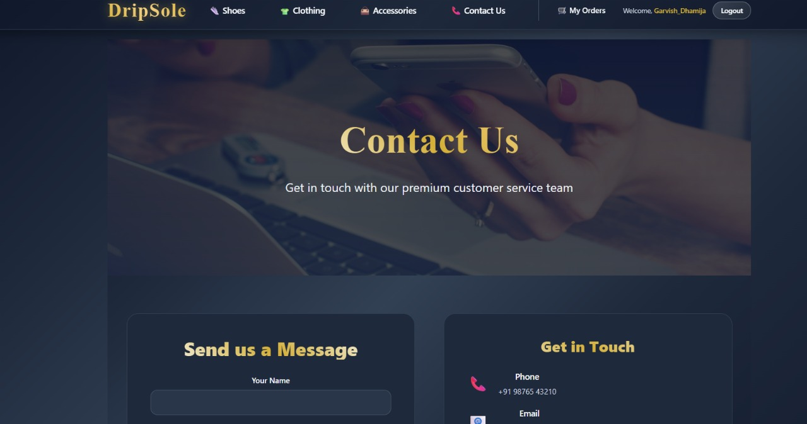
Fig 4. Contact us

Slide 13
Conclusion
The Drip Sole e-commerce website provides a convenient and efficient way to shop for products online. It simplifies the process of exploring items, managing a cart, and completing secure transactions. The platform ensures secure data handling and maintains a user-friendly interface. Admins can manage product listings and inventory, keeping the system updated. Overall, the project enhances the online shopping experience for both customers and administrators.

Slide 14
References
Official React.js Documentation – https://reactjs.org/docs/getting-started.html
Node.js and Express.js Documentation – https://nodejs.org/en/docs/ & https://expressjs.com/
MongoDB Documentation – https://www.mongodb.com/docs/
Bootstrap Official Documentation – https://getbootstrap.com/docs/
Online tutorials and guides from W3Schools – https://www.w3schools.com/
YouTube tutorials for MERN Stack Projects

Slide 15


