Slide 1
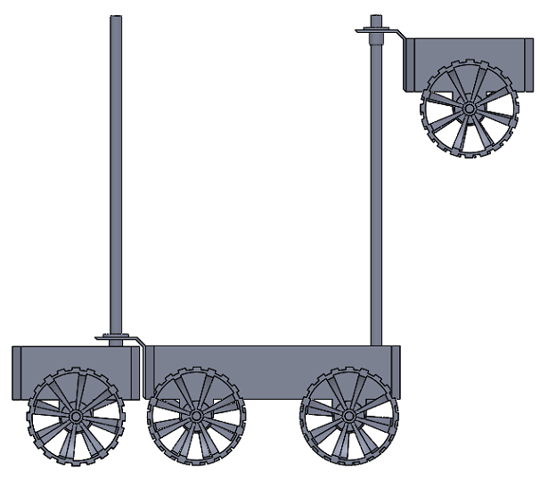
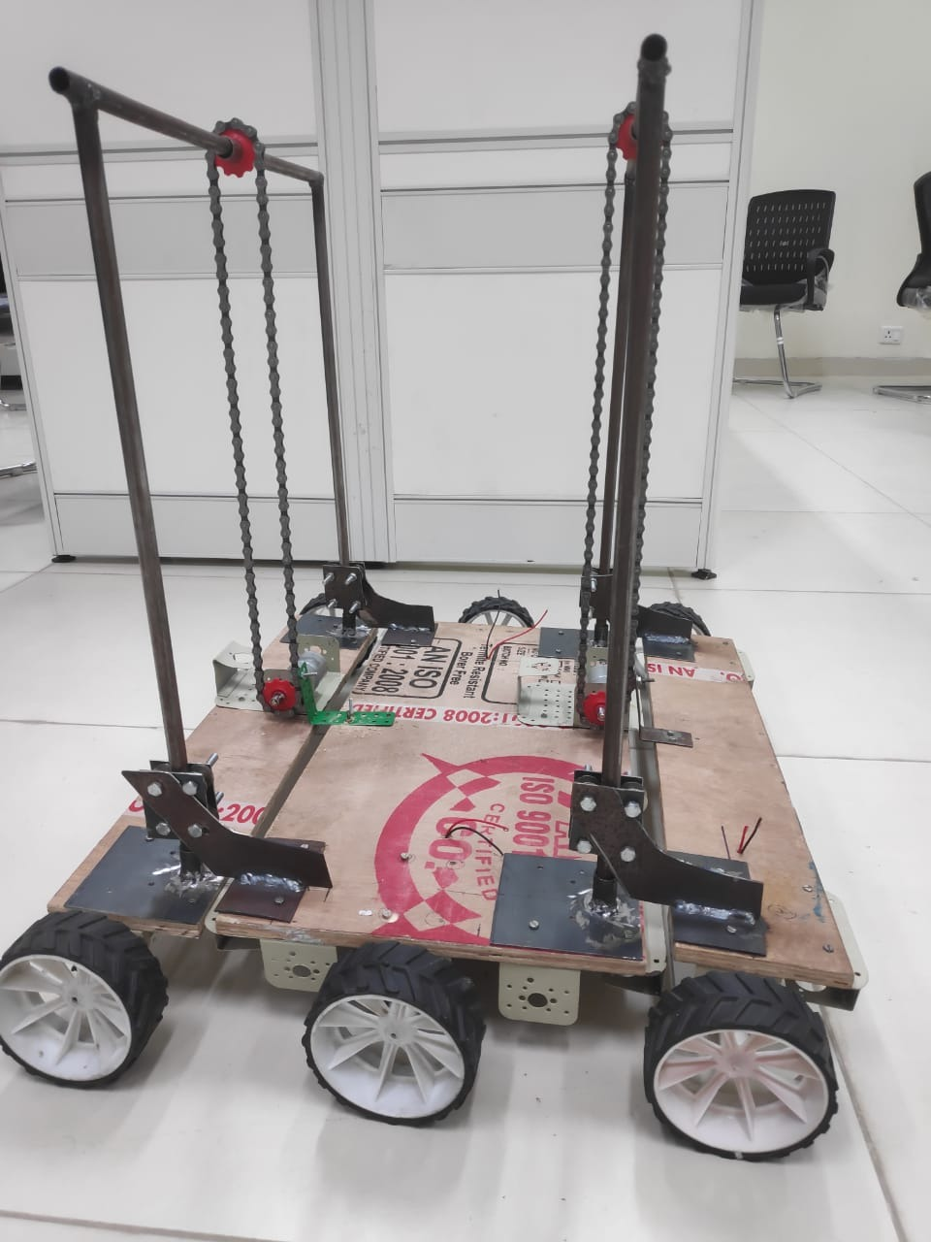
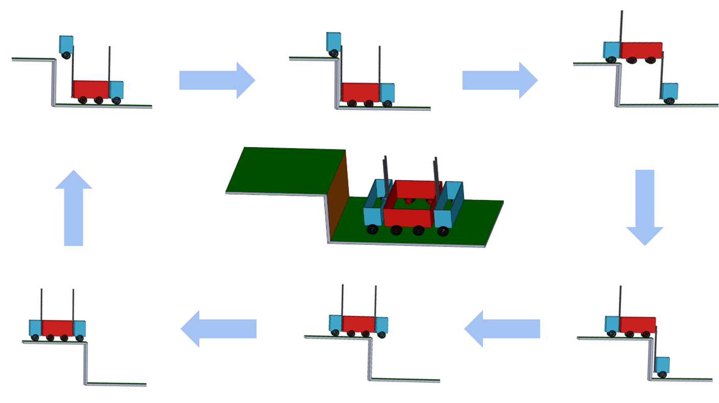
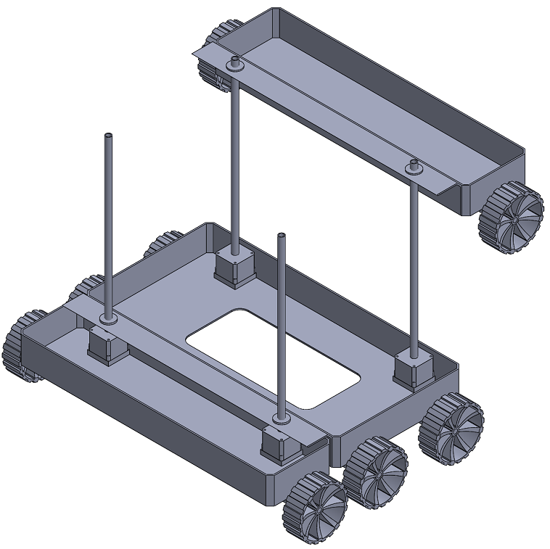


DIC’S TERRACE FARMING ROBOT
Prathamesh Apte, Aksh Chordia, Kaustubh Dixit, Navdeep Goyal, Dipendra Singh, Hritu Raj, Kartik Aggarwal, Aryan Garg, Aditya Gadhavi, Garvit Garg
IIT JODHPUR
Abstract
Design
Future Work
The team’s aim is to design and build a robot that can be used for terrace farming in areas having hilly terrain.
Our design aims to :
Be an all-in-one solution for various farming requirements by having activity-specific modules that can fitted onto a robot.
Perform agricultural tasks in all weather conditions
Perform agricultural activities, without or with less human involvement.
Perform on narrow and steep paths, preventing the use of heavy machinery and animal power
Specifications:
Mechanism inspired by Forklift in order to facilitate faster and efficient climbing on the terrace steps
The body of the robot is divided into three compartments to aid the climbing process.
Analysis:
The lead screw mechanism is used to convert the rotational motion of the motor into a linear motion of bars and to convert the rotational motion of the motor into a linear motion of bars.
As the robot approaches the step wall, the motors of the middle part powers the front lead screws and the front segment starts ascending.
Automation using Robot Vision
Kinect would be used for image capture, the Robot Operating System (ROS) was selected as the operating system
Using descriptor and contour algorithms
Background Research
General Challenges Of Terrace Farming:
Narrow And Limited Land For Agriculture.
Restricted Access To Heavy Machineries.
Increased labour: Difficult mechanization
Drawbacks Of Other Designs:
1.Rocker Bogie Mechanism-
Robot undergoes head-on collisions with obstacles which may damage the components on long run.
2.Caterpillar Track Mechanism-
It is difficult to maintain a grip on the stairs due to less area of contact and the variation in frictional forces cause it to topple.
3.House Stair Cleaning Robot Mechanism-
This robot require sufficient friction to climb up as it directly lands upon the step.
4.Lead Screw Extending Design-
Dependence on friction for initial climbing and a complicated design makes it disadvantageous.
Fig. 2 Side View of the design
Fig. 4 Prototype
Budget
Expenditure of prototype: Rs.17000 (approx)
Expenditure per product: Rs.12000 (approx)
Major Components used:
Mechanix, and Wood Planks, Iron plates and pipes, chains, gears and other supports and brackets.
Sensors: IR, Camera, Sonar
Microcontrollers: Arduino, Raspberry Pi, Node MCU
Geared motors and battery.
Fig. 3 Mechanism of the Proposed Design
References
https://2019.robotix.in/tutorial/mechanical/rockerbogie/
https://www.hindawi.com/journals/ijae/2016/5181097/
https://onlinelibrary.wiley.com/doi/full/10.1002/rob.21550
Fig. 1 Isometric View
INTER IIT TECH MEET 2019
20-22 December 2019 | IIT Roorkee

