Slide 1
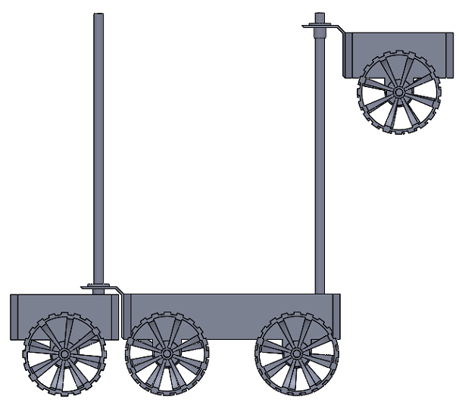
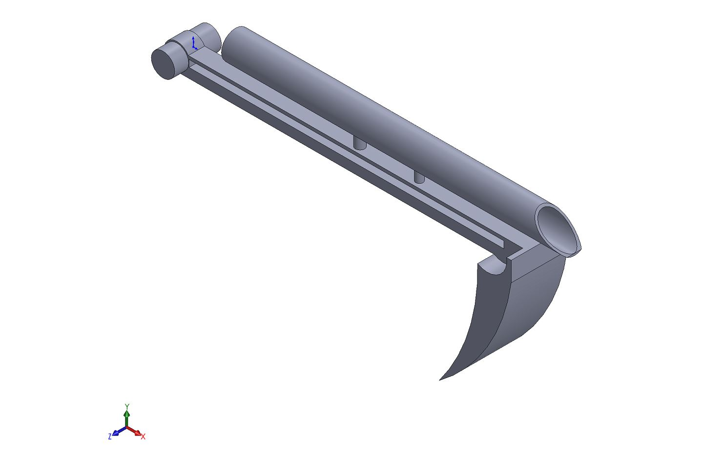
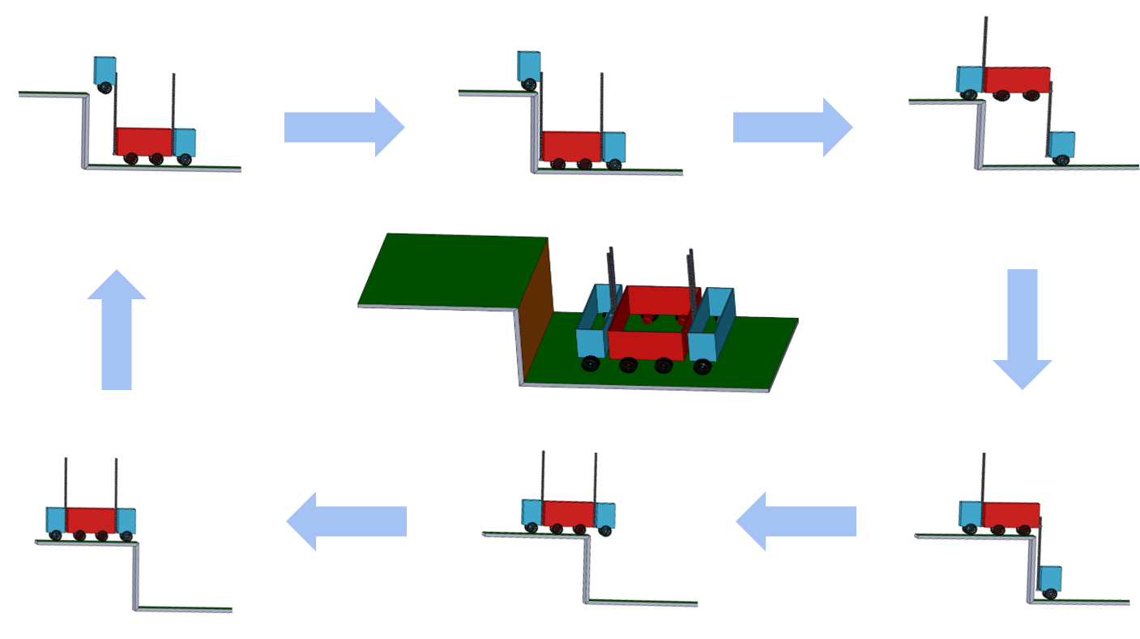
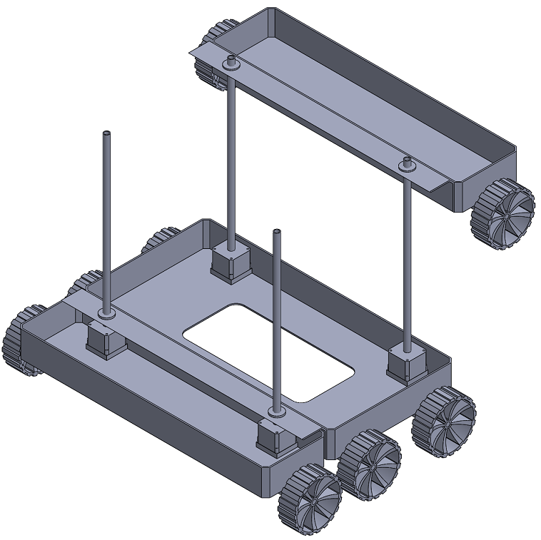


DIC’S TERRACE FARMING ROBOT
Prathamesh Apte, Aksh Chordia, Kaustubh Dixit, Navdeep Goyal, Dipendra Singh, Hritu Raj,
Kartik Aggarwal, Aryan Garg, Aditya Gadhavi, Garvit Garg
IIT JODHPUR
Abstract
Design
Future Work
The aim of our team is to design and build a light-weight robot that can be used for terrace farming in areas having hilly terrain.
Our design aims at the following:
Be an all-in-one solution for various farming requirements by having activity-specific modules that can fitted onto a robot
Perform agricultural tasks in all weather conditions
Perform agricultural activities, without or with less human involvement
Perform on narrow and steep paths, preventing the use of heavy machinery and animal power
Specifications:
The mechanism is inspired by Forklift in order to facilitate faster and efficient climbing on the terrace steps.
The body of the robot is divided into three compartments to aid the climbing process.
The robot can perform the activities of seeding and watering.
Mechanism:
The lead screw mechanism is used to convert the rotational motion of the motor into a translational motion of bars/screws. The working and mechanism can be seen in the Fig.3.
Design Optimization
Use the tool of Topology Optimization to optimize the design according to the needs
To explore various novel materials for the main body of the robot
To include the dynamic analysis of the robot in the design optimization process
To explore the idea of Roll cage for the main body
Automation using Robot Vision
Kinect would be used for image capture, the Robot Operating System (ROS) was selected as the operating system
Using descriptor and contour algorithms to implement accurate object tracking process.----
Background Research
General Challenges Of Terrace Farming:
Narrow and limited land for agriculture
Restricted access to heavy machineries
Increased labour: Difficult mechanization
Explored Designs:
1.Rocker Bogie Mechanism-
Robot undergoes head-on collisions with obstacles which may damage the components in long run.
2.Caterpillar Track Mechanism-
It is difficult to maintain a grip on the stairs due to less area of contact and the variation in frictional forces cause it to topple.
3.House Stair Cleaning Robot Mechanism-
It has a very high probability of toppling while climbing the stairs.
4.Lead Screw Extending Design-
Dependence on friction for initial climbing, a complicated design and a long body prone to frequent moments may cause an early failure of the components.
Fig. 2 Side View of the design
Fig. 4 Design of the Seeding mechanism
Budget
Expenditure per prototype: Rs.17000 (approx)
Expenditure per product: Rs.12000 (approx)
Major Components used:
Mechanix, and Wood Planks, Iron plates and pipes, chains, gears and other supports and brackets.
Sensors: IR, Camera, Sonar
Microcontrollers: Arduino, Raspberry Pi, Node MCU
Geared motors and battery.
Fig. 3 Mechanism of the proposed Design
Automation
Automation is achieved using a combination of IR sensors, ultrasonic sensors and proximity sensors using Arduino Uno as the microcontroller.
Moreover, Sober Feldman edge detection is used to feed the data of edges along with the depth sensing data from the aforementioned sensors to automate the navigation.
References
https://2019.robotix.in/tutorial/mechanical/rockerbogie/
https://www.hindawi.com/journals/ijae/2016/5181097/
https://onlinelibrary.wiley.com/doi/full/10.1002/rob.21550
Fig. 1 Isometric View
INTER IIT TECH MEET 2019
20-22 December 2019 | IIT Roorkee

