Slide 1
Numpy

Slide 2
What is NumPy?
NumPy (Numerical Python) is a fundamental package for scientific computing in Python.
NumPy is a powerful open-source Python library used for:
Efficient numerical computations
Performing mathematical, logical, statistical, and algebraic operations on data
Provides support for large, multi-dimensional arrays and matrices.
Contains a collection of mathematical functions to operate on these arrays.
Forms the base for many other scientific libraries (like Pandas, SciPy, Matplotlib).

Slide 3

Installing NumPy
Prerequisites: Python (version 3.5 or above) and pip (Python package installer) should be installed.
Method 1: Using pip
1. Open a terminal/command prompt.
2. Run:
3. Wait for the installation to complete.
4. Verify by trying to import in Python

Slide 4
Method 2:
Using conda (for Anaconda users)
1. Open Anaconda Prompt.
2. Run:
conda install numpy
3. Confirm the installation if prompted.

Slide 5
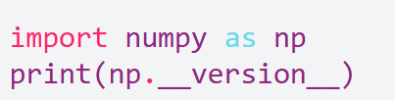
Verifying the Installation
After installing NumPy, verify the installation by running the following in a Python shell or script:
This should print the installed version of NumPy without errors.

Slide 6
Importing NumPy
Import NumPy with the alias `np` for convenience:
import numpy as np

Slide 7
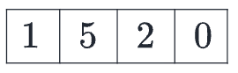
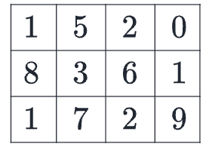
What is an “array”?
In computer programming, an array is a structure for storing and retrieving data.
one-dimensional Array
two-dimensional array would be like a table:

Slide 8
A three-dimensional array would be like a set of tables.
In NumPy, this idea is generalized to an arbitrary number of dimensions, and so the fundamental array class is called ndarray
it represents an “N-dimensional array”.
Most NumPy arrays have some restrictions. For instance:
All elements of the array must be of the same type of data.
Once created, the total size of the array can’t change.
The shape must be “rectangular”, not “jagged”; e.g., each row of a two-dimensional array must have the same number of columns.

Slide 9
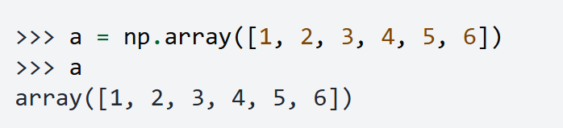

Array fundamentals
One way to initialize an array is using a Python sequence, such as a list. For example:
Elements of an array can be accessed.
NumPy arrays index start from 0.

Slide 10
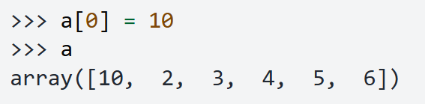
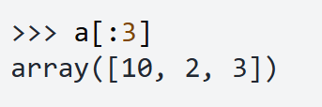
Like the original list, the array is mutable.
Also like the original list, Python slice notation can be used for indexing.

Slide 11
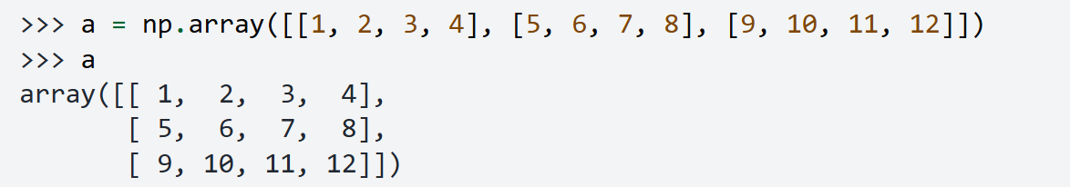

Two- and higher-dimensional arrays can be initialized from nested Python sequences:
In NumPy, a dimension of an array is sometimes referred to as an “axis”.

Slide 12
Note:
0-D (zero-dimensional) array referred to as a “scalar”
1-D (one-dimensional) array as a “vector”
2-D (two-dimensional) array as a “matrix”
an N-D (N-dimensional, where “N” is typically an integer greater than 2) array as a “tensor”

Slide 13
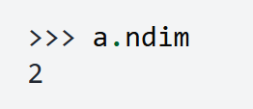

Array attributes
The number of dimensions of an array is contained in the ndim attribute.
The shape of an array is a tuple of non-negative integers that specify the number of elements along each dimension

Slide 14

total number of elements in array is contained in the size attribute.
Arrays are typically “homogeneous”, meaning that they contain elements of only one “data type”.
The data type is recorded in the dtype attribute.

Slide 15
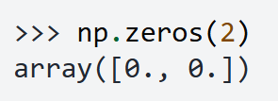
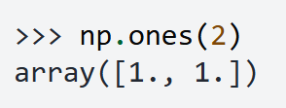
How to create a basic array
creating an array from a sequence of elements, you can easily create an array filled with 0’s
Or an array filled with 1’s

Slide 16
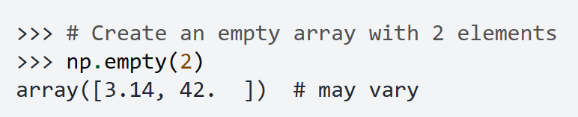
The function empty creates an array whose initial content is random and depends on the state of the memory.

Slide 17
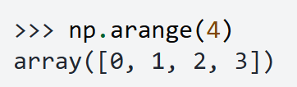
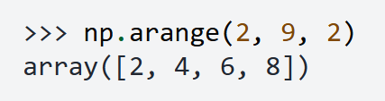
You can create an array with a range of elements:
And even an array that contains a range of evenly spaced intervals. To do this, you will specify the first number, last number, and the step size.

Slide 18
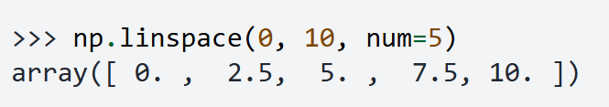
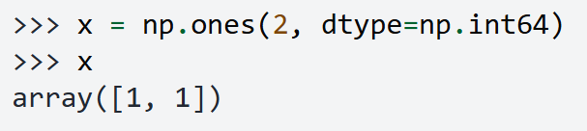
You can also use np.linspace() to create an array with values that are spaced linearly in a specified interval:
Specifying your data type
While the default data type is floating point (np.float64), you can explicitly specify which data type you want using the dtype keyword.

Slide 19
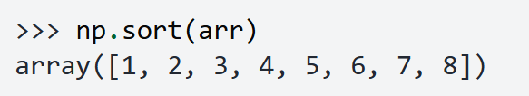
Adding, removing, and sorting elements
Sorting an array is simple with np.sort()
You can specify the axis, kind, and order when you call the function.
If you start with this array:
You can quickly sort the numbers in ascending order with:

Slide 20
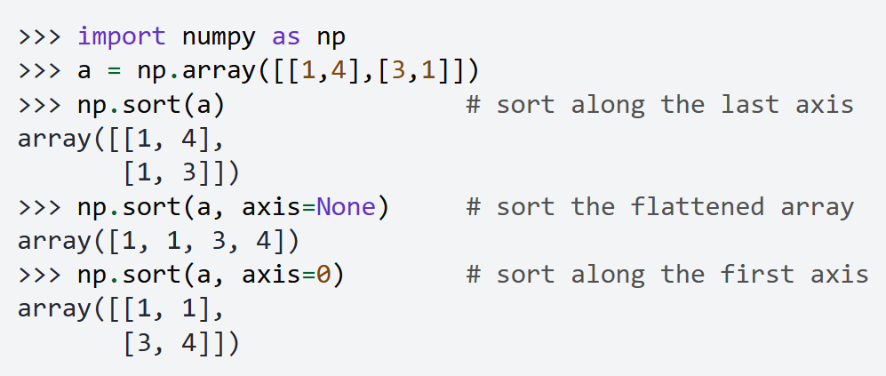

Slide 21

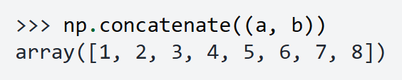
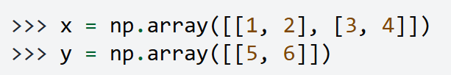
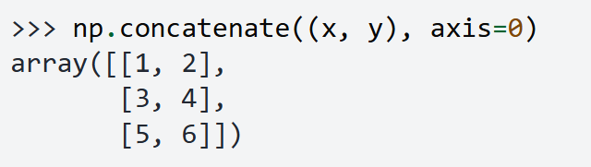
You can concatenate them with np.concatenate().

Slide 22
ndarray.ndim will tell you the number of axes, or dimensions, of the array.
ndarray.size will tell you the total number of elements of the array. This is the product of the elements of the array’s shape.
ndarray.shape will display a tuple of integers that indicate the number of elements stored along each dimension of the array. If, for example, you have a 2-D array with 2 rows and 3 columns, the shape of your array is (2, 3).

Slide 23
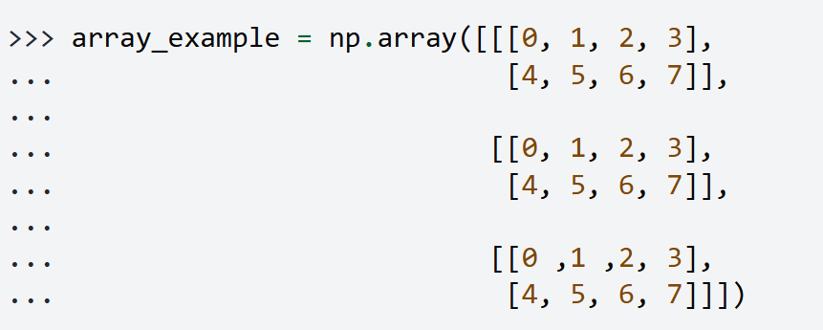

Slide 24
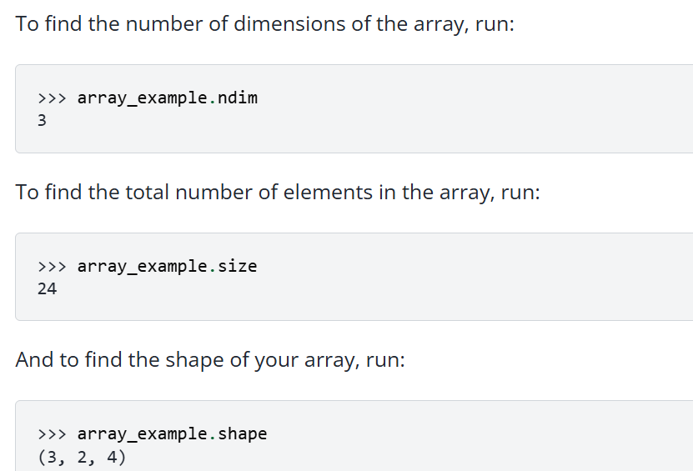

Slide 25
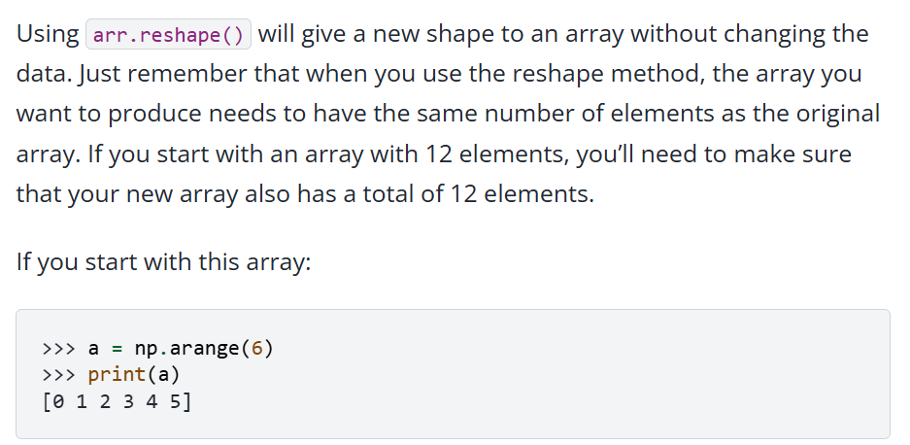

Slide 26
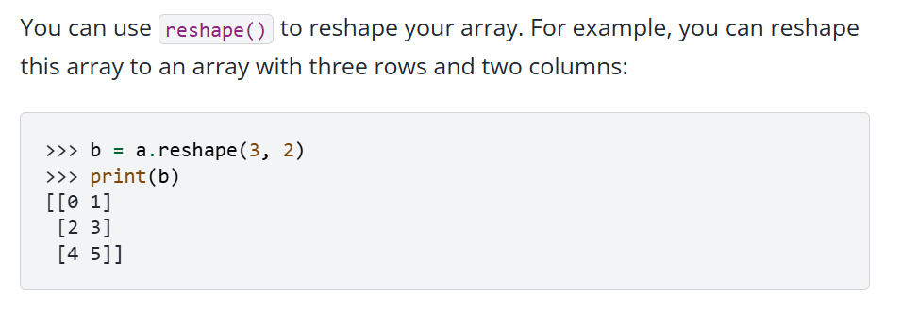

Slide 27
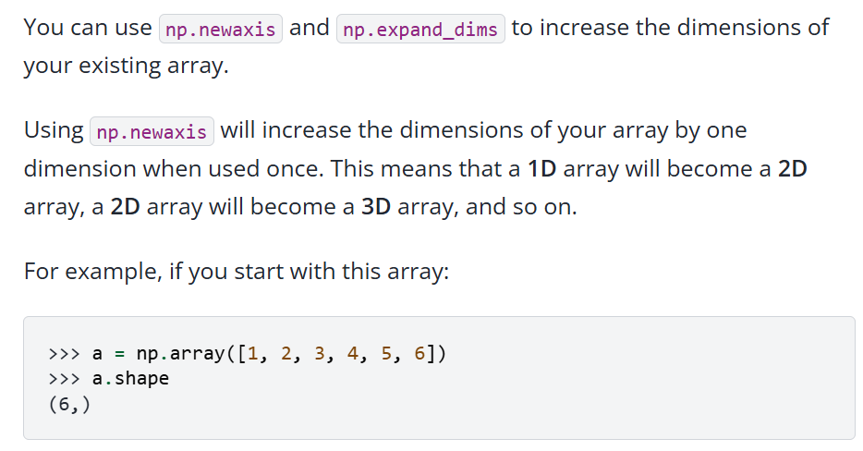
How to convert a 1D array into a 2D array (how to add a new axis to an array)

Slide 28
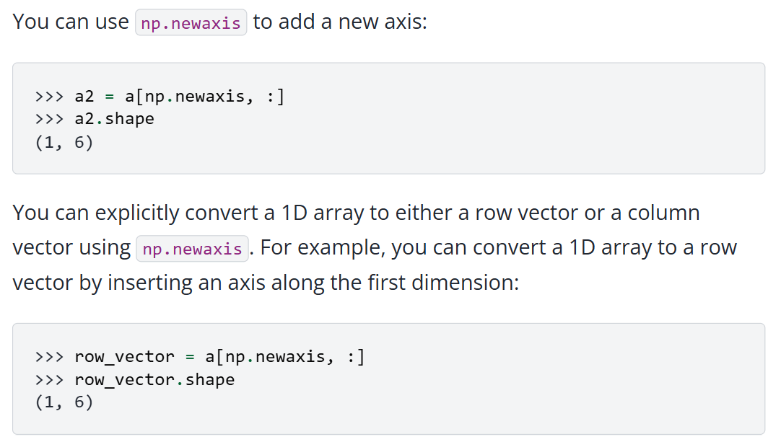

Slide 29
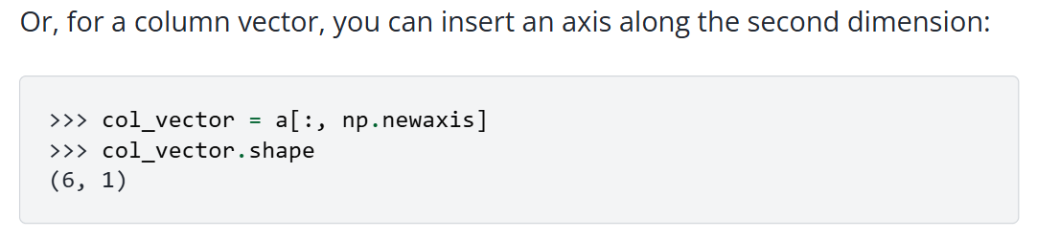
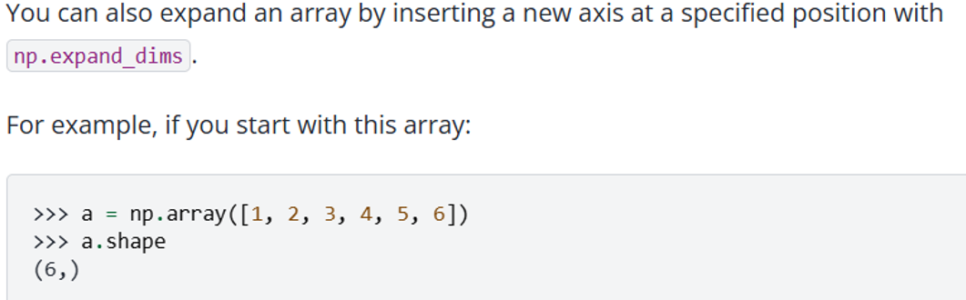

Slide 30
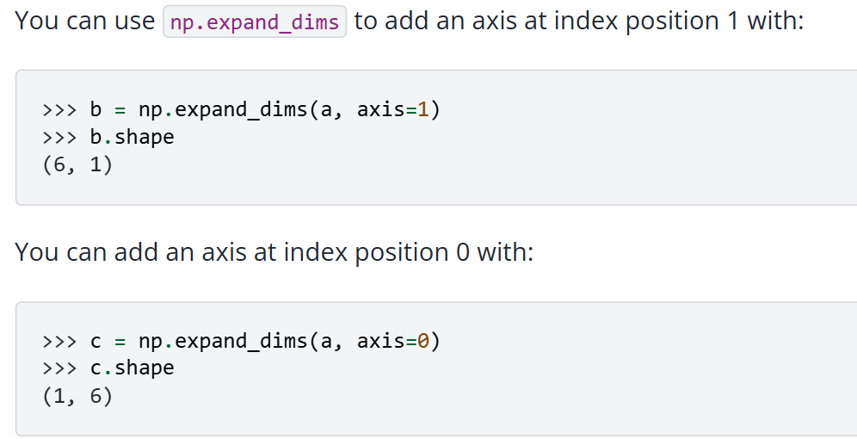

Slide 31
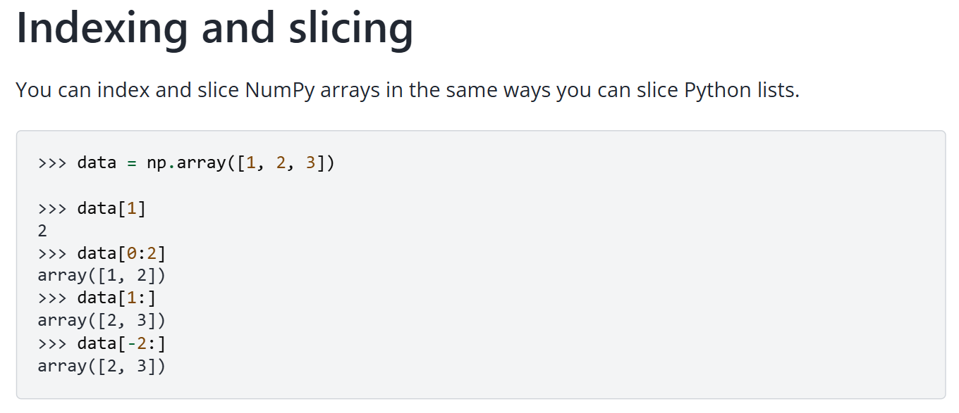

Slide 32
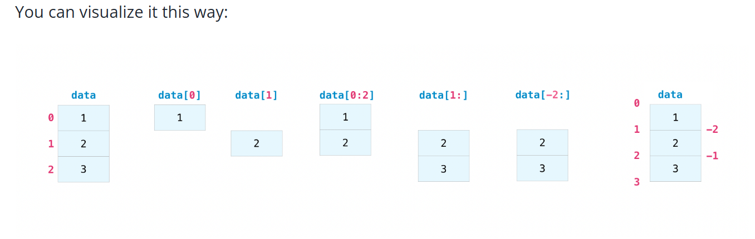

Slide 33
If you want to select values from your array that fulfill certain conditions, it’s straightforward with NumPy.
For example, if you start with this array:
a = np.array([[1, 2, 3, 4], [5, 6, 7, 8], [9, 10, 11, 12]])
You can easily print all of the values in the array that are less than 5.
print(a[a < 5])
You can also select, for example, numbers that are equal to or greater than 5, and use that condition to index an array.
five_up = (a >= 5)
print(a[five_up])

Slide 34
You can select elements that are divisible by 2:
divisible_by_2 = a[a%2==0]
print(divisible_by_2)
Or you can select elements that satisfy two conditions using the & and | operators:
c = a[(a > 2) & (a < 11)]
print(c)

Slide 35
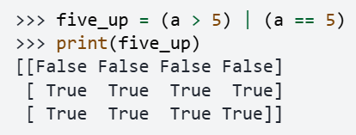
You can also make use of the logical operators & and | in order to return boolean values that specify whether or not the values in an array fulfill a certain condition. This can be useful with arrays that contain names or other categorical values.

Slide 36
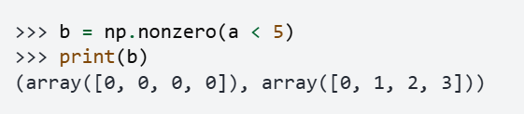
You can also use np.nonzero() to select elements or indices from an array. Starting with this array:
a = np.array([[1, 2, 3, 4], [5, 6, 7, 8], [9, 10, 11, 12]])
You can use np.nonzero() to print the indices of elements that are, for example, less than 5:

Slide 37

You can also use np.nonzero() to print the elements in an array that are less than 5 with:

Slide 38
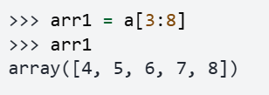
How to create an array from existing data
You can easily create a new array from a section of an existing array.
You can create a new array from a section of your array any time by specifying where you want to slice your array.
Reminder: Array indexes begin at 0. This means the first element of the array is at index 0, the second element is at index 1, and so on.

Slide 39
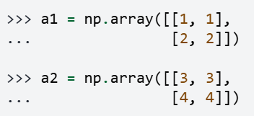
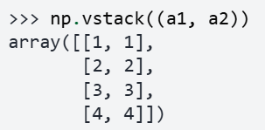
You can also stack two existing arrays, both vertically and horizontally. Let’s say you have two arrays, a1 and a2:
You can stack them vertically with vstack:

Slide 40

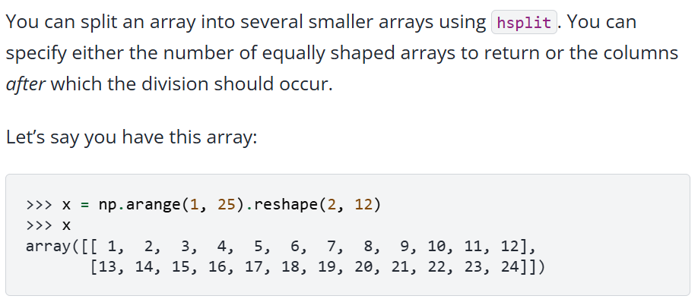
Or stack them horizontally with hstack:

Slide 41
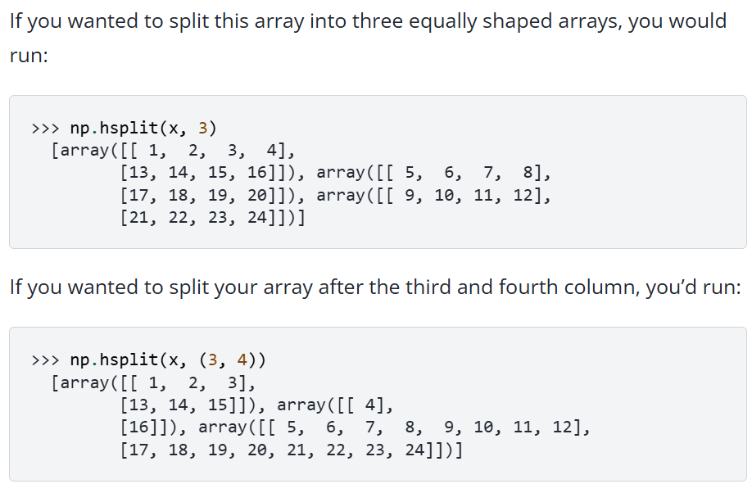

Slide 42
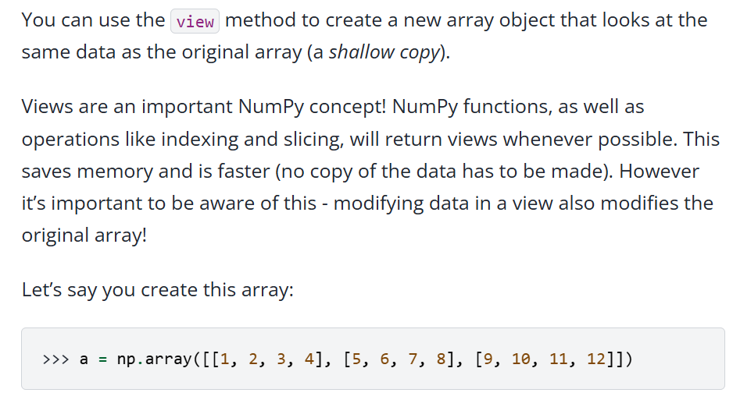

Slide 43
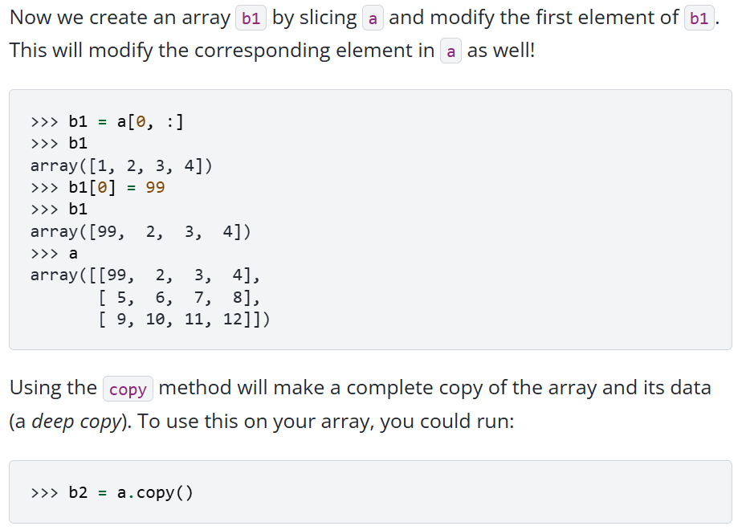

Slide 44
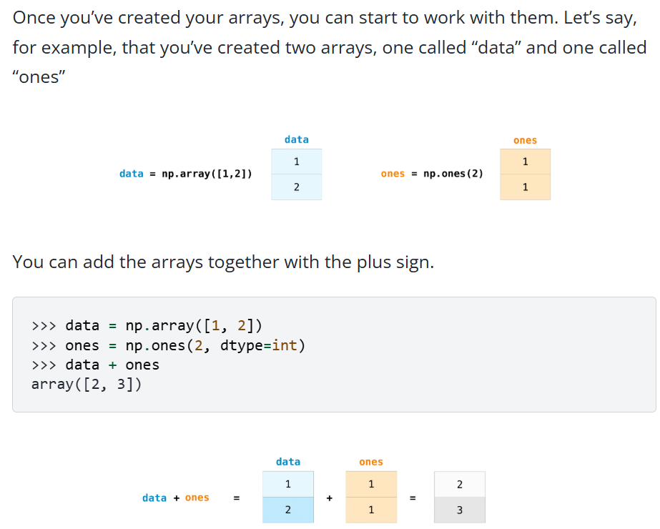

Slide 45
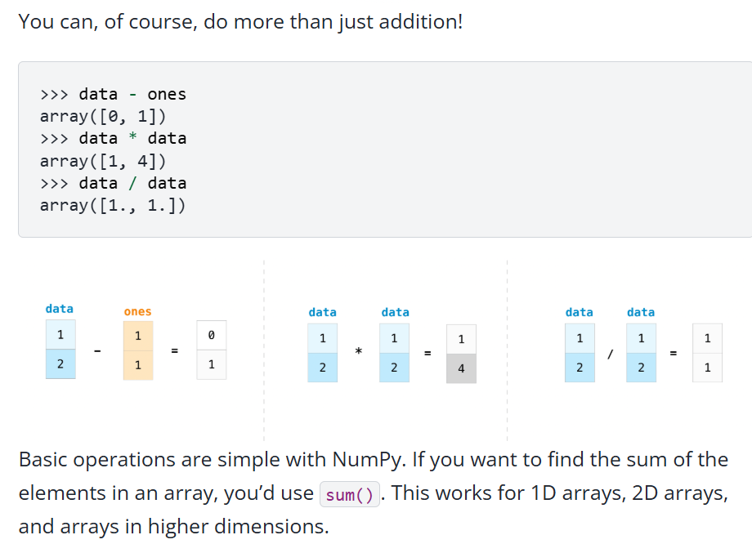

Slide 46
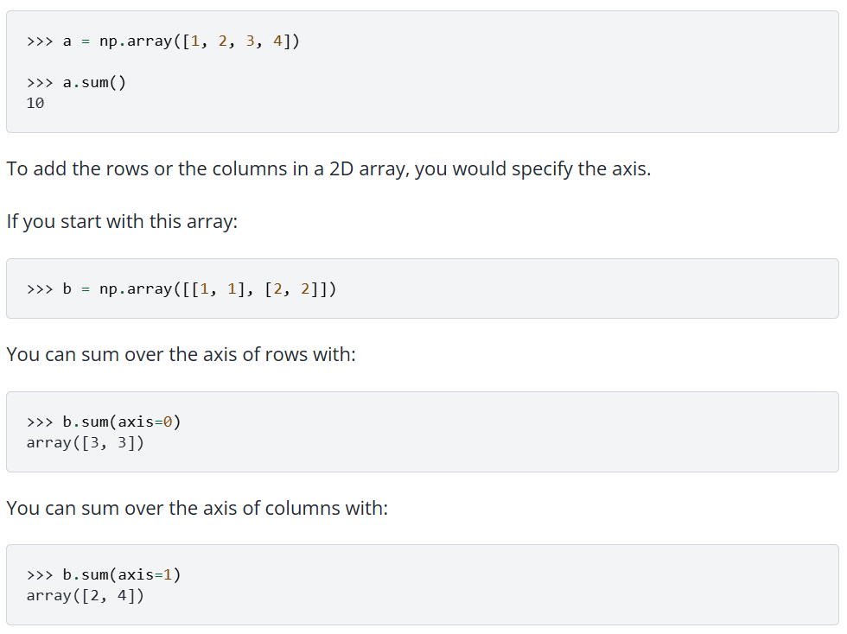

Slide 47
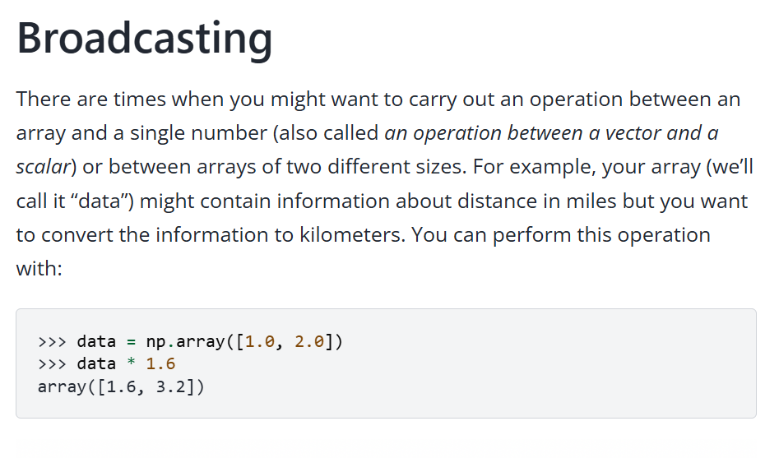

Slide 48
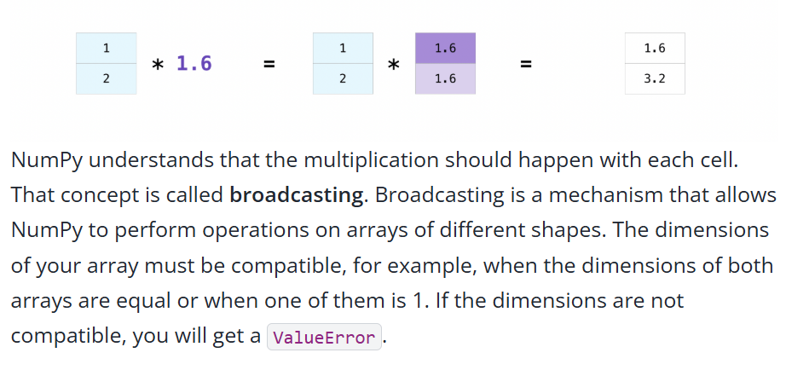

Slide 49
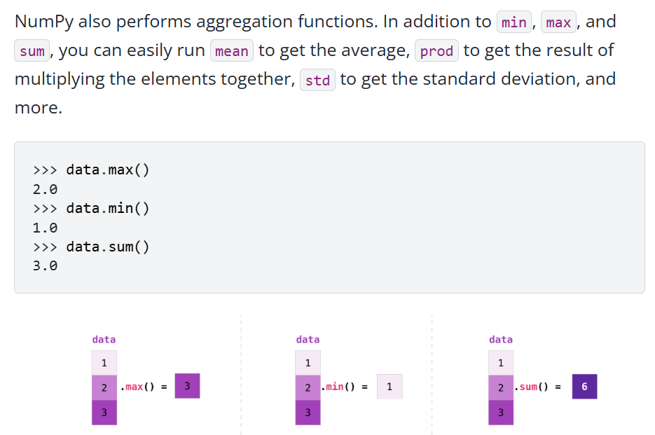
Useful array operations

Slide 50
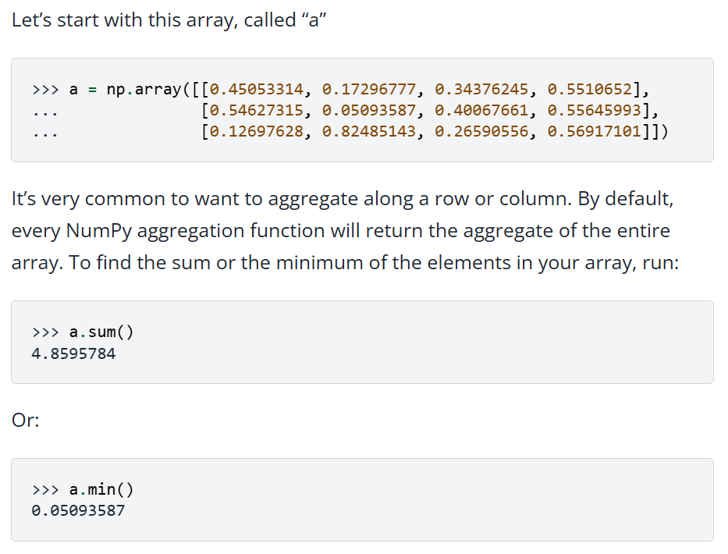

Slide 51
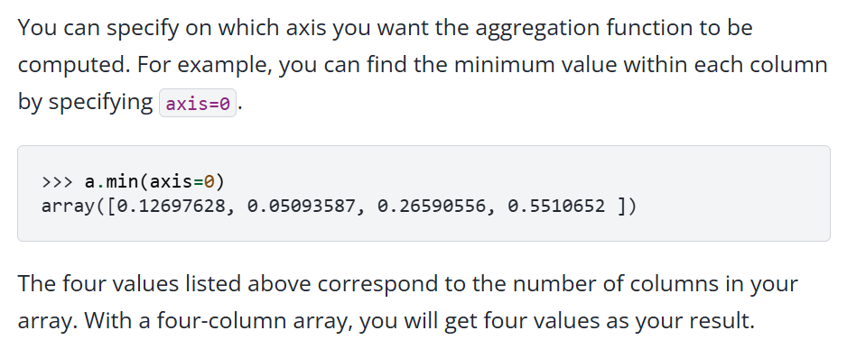

Slide 52
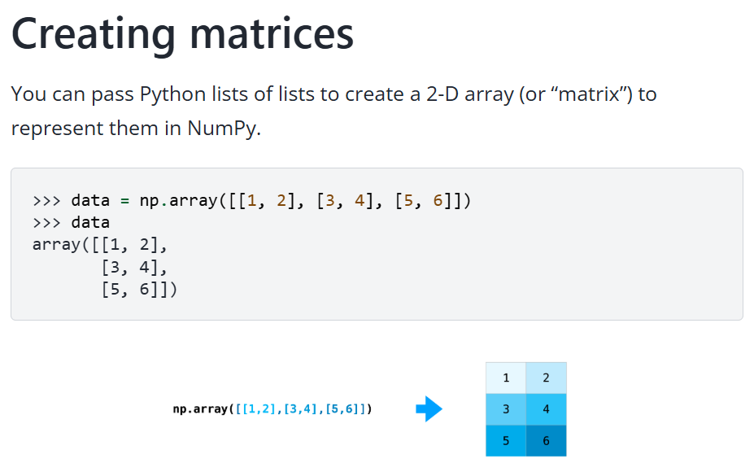

Slide 53
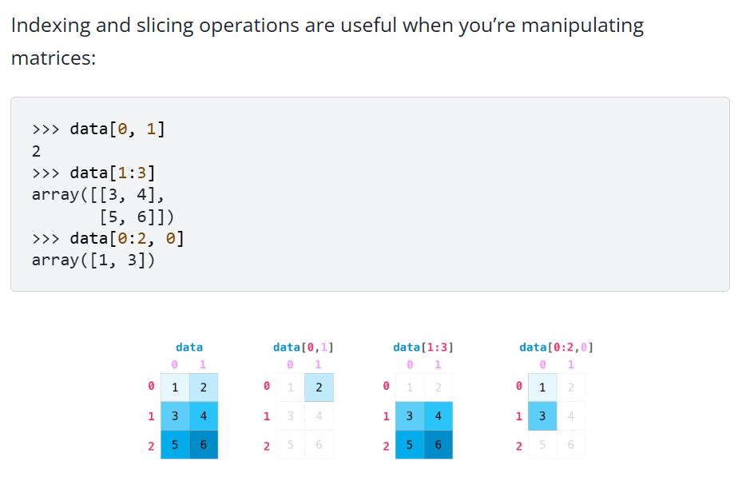

Slide 54


Slide 55


Slide 56


Slide 57


Slide 58


Slide 59



Slide 60


Slide 61


Slide 62

How to get unique items and counts
You can find the unique elements in an array easily with np.unique.
For example, if you start with this array:
a = np.array([11, 11, 12, 13, 14, 15, 16, 17, 12, 13, 11, 14, 18, 19, 20])

Slide 63


Slide 64


Slide 65


Slide 66

Transposing and reshaping a matrix

Slide 67


Slide 68


Slide 69

How to reverse an array

Slide 70


Slide 71


Slide 72


Slide 73

Reshaping and flattening multidimensional arrays

Slide 74


Slide 75


