Slide 1



Slide 2
Installing Pandas
Installing Pandas is very similar to installing NumPy. To install Pandas from command line, we need to type in:
pip install pandas

Slide 3
Data Structure in Pandas
A data structure is a collection of data values and operations that can be applied to that data. It enables efficient storage, retrieval and modification to the data.
Two commonly used data structures in Pandas are:
• Series
• DataFrame

Slide 4
Series
A Series is a one-dimensional array containing a sequence of values of any data type (int, float, list, string, etc) which by default have numeric data labels starting from zero. The data label associated with a particular value is called its index.
We can also assign values of other data types as index. We can imagine a Pandas Series as a column in a spreadsheet. Example of a series containing names of students is given below:
Index Value
0 Arnab
1 Samridhi
2 Ramit
3 Divyam
4 Kritika

Slide 5
Creation of Series
There are different ways in which a series can be created in Pandas. To create or use series, we first need to
Import the Pandas library.
(A) Creation of Series from Scalar Values
A Series can be created using scalar values as shown in the example below:
import pandas as pd
series1 = pd.Series([10,20,30])
print(series1)
Output:
0 10
1 20
2 30
dtype: int64

Slide 6
Creation of Series
We can also assign user-defined labels to the index and use them to access elements of a Series.
The following example has a numeric index in random order.
Import pandas as pd
series2 = pd.Series(["Kavi","Shyam","Ravi"], index=[3,5,1])
print(series2)
Output:
3 Kavi
5 Shyam
1 Ravi
dtype: object
Here, data values Kavi, Shyam and Ravi have index values 3, 5 and 1, respectively.

Slide 7
Creation of Series
We can also use letters or strings as indices, for example:
Import pandas as pd
series2 = pd.Series([2,3,4],index=["Feb","Mar","Apr"])
print(series2)
Output:
Feb 2
Mar 3
Apr 4
dtype: int64
Here, data values 2,3,4 have index values Feb, Mar and Apr, respectively

Slide 8
Creation of Series
(B) Creation of Series from NumPy Arrays We can create a series from a one-dimensional (1D)
NumPy array, as shown below:
import numpy as np
import pandas as pd
array1 = np.array([1,2,3,4])
series3 = pd.Series(array1)
print(series3)
Output:
0 1
1 2
2 3
3 4
dtype: int32

Slide 9
Creation of Series
The following example shows that we can use letters or strings as indices:
series4 = pd.Series(array1, index = ["Jan","Feb", "Mar", "Apr"])
print(series4)
Jan 1
Feb 2
Mar 3
Apr 4
dtype: int32
When index labels are passed with the array, then the length of the index and array must be of the same size, else it will result in a
ValueError. In the Example shown below, array1 contains 4 values whereas there are only 3 indices, hence ValueError is displayed.
series5 = pd.Series(array1, index = ["Jan","Feb", "Mar"])
ValueError: Length of passed values is 4, index implies 3

Slide 10
Creation of Series
(C) Creation of Series from Dictionary
Recall that Python dictionary has key: value pairs and a value can be quickly retrieved when its key is known. Dictionary keys can be
used to construct an index for a Series, as shown in the following example. Here, keys of the dictionary dict1 become indices in the
series.
dict1 = {'India': 'NewDelhi', 'UK':'London', 'Japan': 'Tokyo'}
print(dict1) #Display the dictionary
{'India': 'NewDelhi', 'UK': 'London', 'Japan':'Tokyo'}
series8 = pd.Series(dict1)
print(series8) #Display the series
India NewDelhi
UK London
Japan Tokyo
dtype: object

Slide 11
Accessing Elements of a Series
There are two common ways for accessing the elements
of a series: Indexing and Slicing.
(A) Indexing
Indexing in Series is similar to that for NumPy arrays, and is used to access elements in a series. Indexes are of two types: positional index and labelled index.
Positional index takes an integer value that corresponds to its position in the series starting from 0, whereas labelled index takes any user-defined label as index.
• Following example shows usage of the positional
index for accessing a value from a Series.
seriesNum = pd.Series([10,20,30])
seriesNum[2]
30
Here, the value 30 is displayed for the positional index 2.

Slide 12
Accessing Elements of a Series
When labels are specified, we can use labels as indices while selecting values from a Series, as shown below.
Here, the value 3 is displayed for the labelled index Mar.
J = pd.Series([2,3,4],index=["Feb","Mar","Apr"])
J["Mar"]
3
In the following example, value NewDelhi is displayed for the labelled index India.
K = pd.Series(['NewDelhi','WashingtonDC', 'London', 'Paris'],
index=['India', 'USA', 'UK', 'France’])
K['India']
'NewDelhi'

Slide 13
Accessing Elements of a Series
We can also access an element of the series using the positional index:
print(seriesCapCntry[1])
'WashingtonDC’
More than one element of a series can be accessed using a list of positional integers or a list of index labels as shown in the following examples:
import pandas as pd
seriesCapCntry = pd.Series(['NewDelhi','WashingtonDC', 'London', 'Paris'],
index=['India', 'USA', 'UK', 'France'])
print(seriesCapCntry[[1,3]])
Output
USA WashingtonDC
France Paris
dtype: object
print(seriesCapCntry[['UK','USA’]])
UK London
USA WashingtonDC
dtype: object

Slide 14
Accessing Elements of a Series
The index values associated with the series can be altered by assigning new index values as shown in the following example:
seriesCapCntry.index=[10,20,30,40]
print(seriesCapCntry)
Output
10 NewDelhi
20 WashingtonDC
30 London
40 Paris
dtype: object

Slide 15
Accessing Elements of a Series
(B) Slicing
Sometimes, we may need to extract a part of a series. This can be done through slicing. This is similar to slicing
used with NumPy arrays. We can define which part of the series is to be sliced by specifying the start and end
parameters [start :end] with the series name.
When we use positional indices for slicing, the value at the endindex position is excluded, i.e., only (end -
start) number of data values of the series are extracted.
Consider the following series seriesCapCntry:
seriesCapCntry = pd.Series(['NewDelhi', 'WashingtonDC', 'London','Paris'], index=['India', 'USA', 'UK', 'France’])
print(seriesCapCntry[1:3]) #excludes the value at index position 3
Output
USA WashingtonDC
UK London
dtype: object

Slide 16
Accessing Elements of a Series
As we can see that in the above output, only data values at indices 1 and 2 are displayed. If labelled indexes are used for slicing, then
value at the end index label is also included in the output, for example:
seriesCapCntry['USA' : 'France']
USA WashingtonDC
UK London
France Paris
dtype: object
We can also get the series in reverse order, for example:
seriesCapCntry[ : : -1]
France Paris
UK London
USA WashingtonDC
India NewDelhi
dtype: object

Slide 17
Accessing Elements of a Series
We can also use slicing to modify the values of series elements as shown in the following example:
import numpy as np
seriesAlph = pd.Series(np.arange(10,16,1),
index = ['a', 'b', 'c', 'd', 'e', 'f’])
print(seriesAlph)
a 10
b 11
c 12
d 13
e 14
f 15
dtype: int32

Slide 18
Accessing Elements of a Series
seriesAlph[1:3] = 50
print(seriesAlph)
a 10
b 50
c 50
d 13
e 14
f 15
dtype: int32
Observe that updating the values in a series using slicing also excludes the value at the end index position. But, it changes the value at the end index label when slicing is done using labels.
seriesAlph['c':'e'] = 500
print(seriesAlph)
a 10
b 50
c 500
d 500
e 500
f 15
dtype: int32

Slide 19
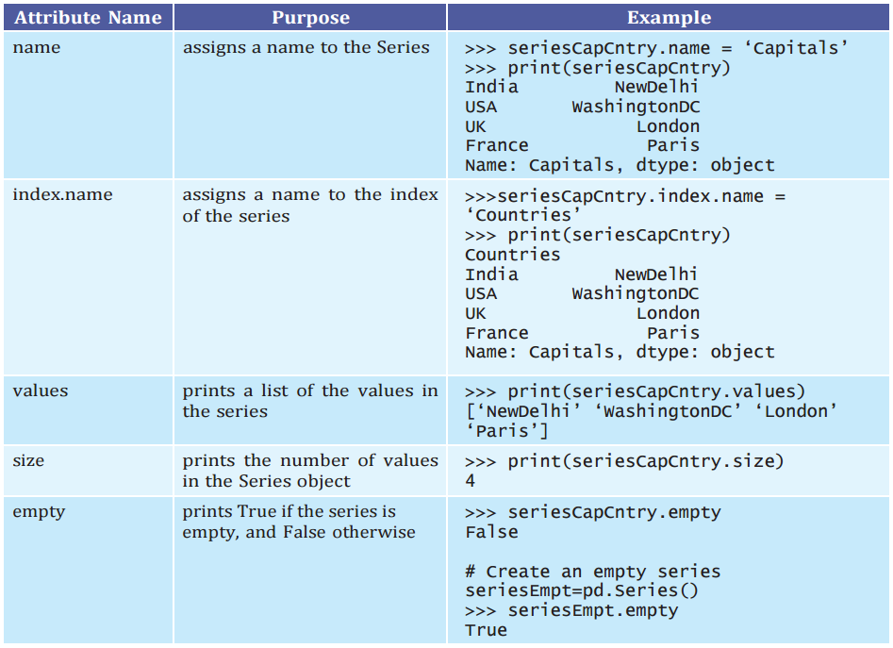
Attributes of Series
We can access certain properties
Called attributes of a series by
using that property with the
series name. Table lists some
Attributes of Pandas series
Using seriesCapCntry as an example:

Slide 20
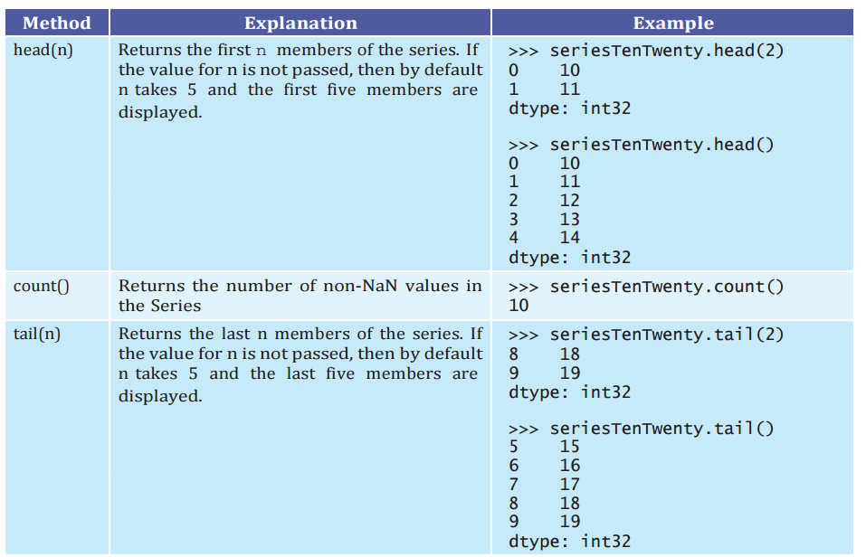
Methods of Series

Slide 21
Mathematical Operations on Series
If we perform basic mathematical operations like addition, subtraction, multiplication, division, etc., on two NumPy arrays, the
operation is done on each corresponding pair of elements. Similarly, we can perform mathematical operations on two series in
Pandas. While performing mathematical operations on series, index matching is implemented and all missing values are filled in with
NaN by default.
Consider the following series: seriesA and seriesB for understanding mathematical operations on series in Pandas.
seriesA = pd.Series([1,2,3,4,5], index =['a', 'b', 'c', 'd', 'e’])
print(seriesA)
A 1
b 2
c 3
d 4
e 5
dtype: int64
seriesB = pd.Series([10,20,-10,-50,100],
index = ['z', 'y', 'a', 'c', 'e’])
print(seriesB)
z 10
y 20
a -10
c -50
e 100
dtype: int64

Slide 22
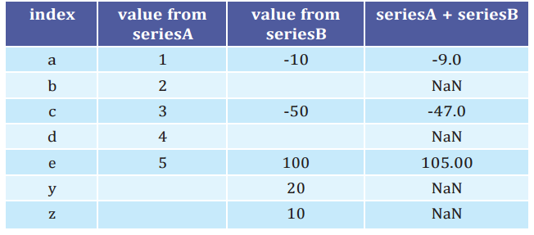







Mathematical Operations on Series
(A) Addition of two Series
It can be done in two ways. In the first method, two series are simply added together, as shown in the following
code. Table 2.2 shows the detailed values that were matched while performing the addition. Note here that
the output of addition is NaN if one of the elements or both elements have no value.
seriesC=seriesA + seriesB
a -9.0
b NaN
c -47.0
d NaN
e 105.0
y NaN
z NaN
dtype: float64

Slide 23
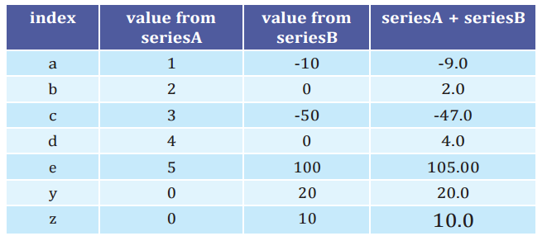
Mathematical Operations on Series
seriesA.add(seriesB, fill_value=0)
a -9.0
b 2.0
c -47.0
d 4.0
e 105.0
y 20.0
z 10.0
dtype: float64

Slide 24
Mathematical Operations on Series
(B) Subtraction of two Series
Again, it can be done in two different ways, as shown in
the following examples:
seriesC=seriesA – seriesB #using subtraction operator
a 11.0
b NaN
c 53.0
d NaN
e -95.0
y NaN
z NaN
dtype: float64

Slide 25
Mathematical Operations on Series
Let us now replace the missing values with 1000 before subtracting seriesB from seriesA using explicit subtraction method sub().
seriesA.sub(seriesB, fill_value=1000)
# using fill value 1000 while making explicit
# call of the method”
a 11.0
b -998.0
c 53.0
d -996.0
E -95.0
Y 980.0
Z 990.0
dtype: float64

Slide 26
Mathematical Operations on Series
(C) Multiplication of two Series
seriesC=seriesA * seriesB
seriesA.mul(seriesB, fill_value=0)
(D) Division of two Series
seriesC=seriesA/seriesB
seriesA.div(seriesB, fill_value=0)

Slide 27
DATAFRAME
Sometimes we need to work on multiple columns at a time, i.e., we need to process the tabular data. For example, the result of a class, items in a restaurant’s menu, reservation chart of a train, etc.
Pandas store such tabular data using a DataFrame. A DataFrame is a two-dimensional labelled data structure like a table of MySQL. It contains rows and columns, and therefore has both a row and column index.
Each column can have a different type of value such as numeric, string,boolean, etc., as in tables of a database.

Slide 28
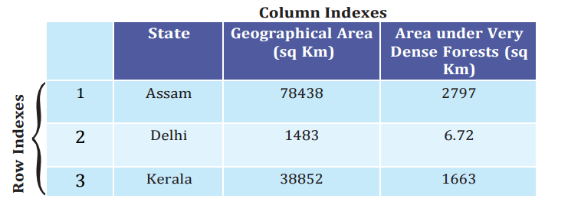
DATAFRAME

Slide 29
Creation of DataFrame
There are a number of ways to create a DataFrame. Some of them are listed in this section.
Creation of an empty DataFrame
import pandas as pd
dFrameEmt = pd.DataFrame()
print(dFrameEmt)
Output
Empty DataFrame
Columns: []
Index: []

Slide 30
Creation of DataFrame
(B) Creation of DataFrame from NumPy ndarrays
Consider the following three NumPy ndarrays. Let us create a simple DataFrame without any column labels,
using a single ndarray:
import numpy as np
array1 = np.array([10,20,30])
array2 = np.array([100,200,300])
array3 = np.array([-10,-20,-30, -40])
dFrame4 = pd.DataFrame(array1)
print(dFrame4)
output
0
0 10
1 20
2 30

Slide 31
Creation of DataFrame
We can create a DataFrame using more than one ndarrays, as shown in
the following example:
dFrame5 = pd.DataFrame([array1, array3, array2], columns=[ 'A', 'B', 'C', 'D’])
print(dFrame5)
A B C D
0 10 20 30 NaN
1 -10 -20 -30 -40.0
2 100 200 300 NaN

Slide 32
Creation of DataFrame
(C) Creation of DataFrame from List of Dictionaries
We can create DataFrame from a list of Dictionaries, for example:
# Create list of dictionaries
listDict = [{'a':10, 'b':20}, {'a':5,'b':10, 'c':20}]
dFrameListDict = pd.DataFrame(listDict)
print(dFrameListDict)
a b c
0 10 20 NaN
5 10 20.0
Here, the dictionary keys are taken as column labels, and the values corresponding to each key are taken as rows. There will be as many rows as the number of dictionaries present in the list. In the above example there are two dictionaries in the list. So, the DataFrame consists of two rows. Number of columns in a DataFrame is equal to the maximum number of keys in any dictionary of the list. Hence, there are three columns as the second dictionary has three elements. Also, note that NaN (Not a Number) is inserted if a corresponding value for a column is missing.

Slide 33
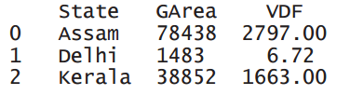
Creation of DataFrame
(D) Creation of DataFrame from Dictionary of Lists
DataFrames can also be created from a dictionary of lists. Consider the following dictionary consisting of the keys ‘State’, ‘GArea’ (geographical area) and ‘VDF’ (very dense forest) and the corresponding values as list.
dictForest = {'State': ['Assam', 'Delhi','Kerala'], 'GArea': [78438, 1483, 38852] ,'VDF' : [2797, 6.72,1663]}
dFrameForest= pd.DataFrame(dictForest)
print(dFrameForest)
Note that dictionary keys become column labels by default in a DataFrame, and the lists become the rows.Thus, a DataFrame can be thought of as a dictionary of lists or a dictionary of series.

Slide 34
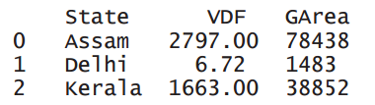
Creation of DataFrame
We can change the sequence of columns in a DataFrame. This can be done by assigning a particular sequence of the dictionary keys as columns parameter, for example:
dFrameForest1 = pd.DataFrame(dictForest,
columns = ['State','VDF', 'GArea’])
print(dFrameForest1)
In the output, VDF is now displayed as the middle column instead of last.

Slide 35

Creation of DataFrame
(E) Creation of DataFrame from Series Consider the following three Series:
seriesA = pd.Series([1,2,3,4,5],index = ['a', 'b', 'c', 'd', 'e'])
seriesB = pd.Series ([1000,2000,-1000,-5000,1000], index = ['a', 'b', 'c', 'd', 'e’])
seriesC = pd.Series([10,20,-10,-50,100],index = ['z', 'y', 'a', 'c', 'e'])
dFrame6 = pd.DataFrame(seriesA)
print(dFrame6)
Here, the DataFrame dFrame6 has as many numbers of rows as the numbers of elements in the series, but has only one column.

Slide 36

Creation of DataFrame
To create a DataFrame using more than one series, we need to pass multiple series in the list as shown below:
dFrame7 = pd.DataFrame([seriesA, seriesB])
print(dFrame7)
The labels in the series object become the column names in the DataFrame object and each series becomes a row in the DataFrame.

Slide 37

Creation of DataFrame
dFrame8 = pd.DataFrame([seriesA, seriesC])
print(dFrame8)
Here, different series do not have the same set of labels. But, the number of columns in a DataFrame equals to distinct labels in all the series. So, if a particular series does not have a corresponding value for a label, NaN is inserted in the DataFrame column.

Slide 38
Creation of DataFrame
(D) Creation of DataFrame from Dictionary of Lists
DataFrames can also be created from a dictionary of lists. Consider the following dictionary consisting of the keys ‘State’, ‘GArea’ (geographical area) and ‘VDF’ (very dense forest) and the corresponding values as list.
dictForest = {'State': ['Assam', 'Delhi','Kerala'],
'GArea': [78438, 1483, 38852] ,'VDF' : [2797, 6.72,1663]}
dFrameForest= pd.DataFrame(dictForest)
Print(dFrameForest)
State GArea VDF
0 Assam 78438 2797.00
1 Delhi 1483 6.72
Kerala 38852 1663.00
Note that dictionary keys become column labels by default in a DataFrame, and the lists become the rows. Thus, a DataFrame can be thought of as a dictionary of lists or a dictionary of series.

Slide 39
Creation of DataFrame
We can change the sequence of columns in a DataFrame. This can be done by assigning a particular sequence of the dictionary keys as columns parameter, for example:
dFrameForest1 = pd.DataFrame(dictForest,
columns = ['State','VDF', 'GArea’])
print(dFrameForest1)
State VDF GArea
0 Assam 2797.00 78438
1 Delhi 6.72 1483
2 Kerala 1663.00 38852
In the output, VDF is now displayed as the middle column instead of last

Slide 40
Creation of DataFrame
(E) Creation of DataFrame from Series Consider the following three Series:
seriesA = pd.Series([1,2,3,4,5],index = ['a', 'b', 'c', 'd', 'e'])
seriesB = pd.Series ([1000,2000,-1000,-5000,1000],index = ['a', 'b', 'c', 'd', 'e’])
seriesC = pd.Series([10,20,-10,-50,100],index = ['z', 'y', 'a', 'c', 'e'])
dFrame6 = pd.DataFrame(seriesA)
Print(dFrame6)
0
a 1
b 2
c 3
d 4
e 5
Here, the DataFrame dFrame6 has as many numbers of rows as the numbers of elements in the series, but has only one column.

Slide 41
Creation of DataFrame
To create a DataFrame using more than one series, we need to pass multiple series in the list as shown below:
dFrame7 = pd.DataFrame([seriesA, seriesB])
Print(dFrame7)
a b c d e
0 1 2 3 4 5
1000 2000 -1000 -5000 1000
Observe that the labels in the series object become the column names in the DataFrame object and each series becomes a row in the DataFrame.
dFrame8 = pd.DataFrame([seriesA, seriesC])
print(dFrame8)
a b c d e z y
0 1.0 2.0 3.0 4.0 5.0 NaN NaN
1 -10.0 NaN -50.0 NaN 100.0 10.0 20.0

Slide 42
Creation of DataFrame
(F) Creation of DataFrame from Dictionary of Series
ResultSheet={'Arnab': pd.Series([90, 91, 97], index=['Maths','Science','Hindi']),
'Ramit': pd.Series([92, 81, 96],index=['Maths','Science','Hindi']),
'Samridhi': pd.Series([89, 91, 88], index=['Maths','Science','Hindi']),
'Riya': pd.Series([81, 71, 67],index=['Maths','Science','Hindi']),
'Mallika': pd.Series([94, 95, 99],index=['Maths','Science','Hindi'])}
ResultDF = pd.DataFrame(ResultSheet)
Print(ResultDF)
Arnab Ramit Samridhi Riya Mallika
Maths 90 92 89 81 94
Science 91 81 91 71 95
Hindi 97 96 88 67 99

Slide 43
Creation of DataFrame
When a DataFrame is created from a Dictionary of Series, the resulting index or row labels are a union of all series indexes used to
create the DataFrame. For example:
dictForUnion = { 'Series1’ : pd.Series([1,2,3,4,5], index = ['a', 'b', 'c', 'd', 'e']) ,
'Series2’ : pd.Series([10,20,-10,-50,100], index = ['z', 'y', 'a', 'c', 'e']),
'Series3’ : pd.Series([10,20,-10,-50,100], index = ['z', 'y', 'a', 'c', 'e']) }
dFrameUnion = pd.DataFrame(dictForUnion)
Print(dFrameUnion)
Series1 Series2 Series3
a 1.0 -10.0 -10.0
b 2.0 NaN NaN
c 3.0 -50.0 -50.0
d 4.0 NaN NaN
e 5.0 100.0 100.0
Y NaN 20.0 20.0
z NaN 10.0 10.0

Slide 44
Creation of DataFrame
dictForUnion = { 'Series1' :pd.Series([1,2,3,4,5],index = ['a', 'b', 'c', 'd', 'e']) ,'Series2’
:pd.Series([10,20,-10,-50,100],index = ['z', 'y', 'a', 'c', 'e']),'Series3' :pd.Series([10,20,-10,-50,100],
index = ['z', 'y', 'a', 'c', 'e']) }
dFrameUnion = pd.DataFrame(dictForUnion)
print(dFrameUnion)
Series1 Series2 Series3
a 1.0 -10.0 -10.0
b 2.0 NaN NaN
c 3.0 -50.0 -50.0
d 4.0 NaN NaN
e 5.0 100.0 100.0
y NaN 20.0 20.0
z NaN 10.0 10.0

Slide 45
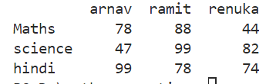
Creation of data frame by dictionary
import pandas as pd
D={"arnav":{"Maths":78,"science":47,"hindi":99},"ramit":{"Maths":88,"science":99,"hindi":78},
"renuka":{"Maths":44,"science":82,"hindi":74}}
df=pd.DataFrame(D)
print(df)

Slide 46
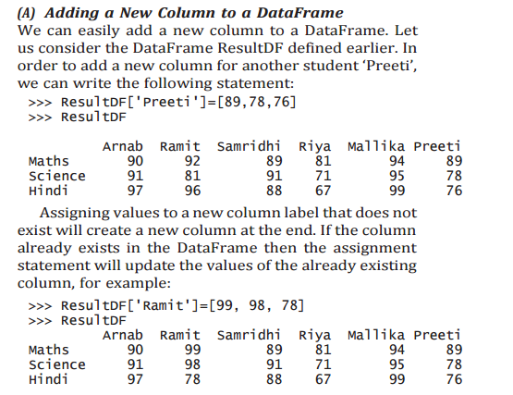
Operations on rows and columns in DataFrames

Slide 47
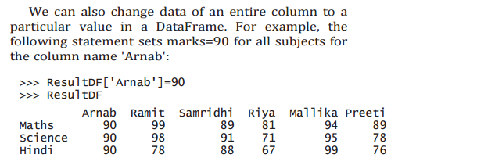
Operations on rows and columns in DataFrames

Slide 48
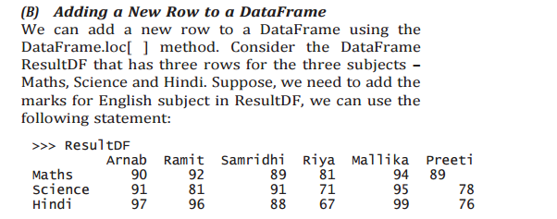
Operations on rows and columns in DataFrames

Slide 49
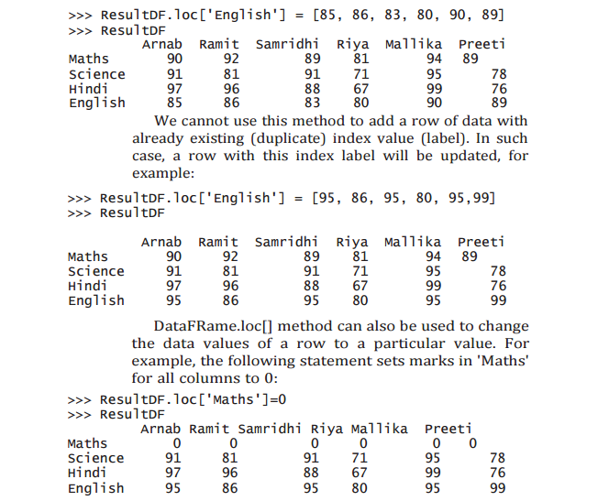
Operations on rows and columns in DataFrames

Slide 50
Operations on rows and columns in DataFrames
If we try to add a row with lesser values than the number of columns in the DataFrame, it results in a ValueError, with the error message: ValueError: Cannot set a row with mismatched columns.
Similarly, if we try to add a column with lesser values than the number of rows in the DataFrame, it results in a ValueError, with the error message: ValueError: Length of values does not match length of index.

Slide 51
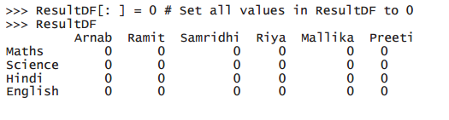
Operations on rows and columns in DataFrames
Further, we can set all values of a DataFrame to a particular value, for example:

Slide 52
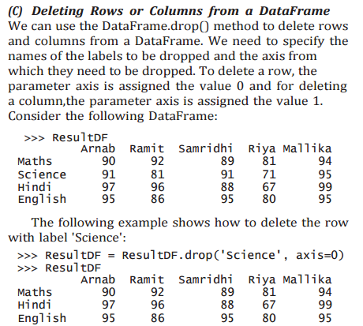
Operations on rows and columns in DataFrames

Slide 53
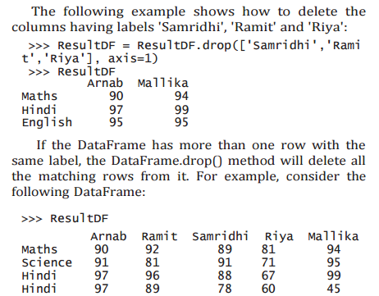
Operations on rows and columns in DataFrames

Slide 54


Operations on rows and columns in DataFrames

Slide 55
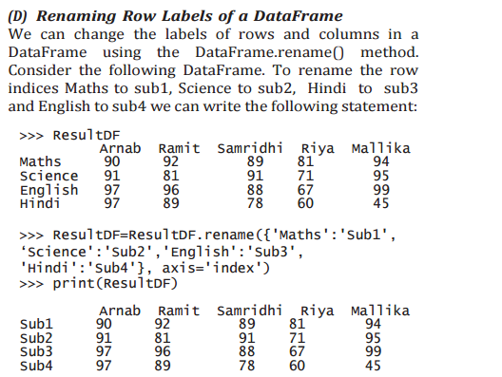
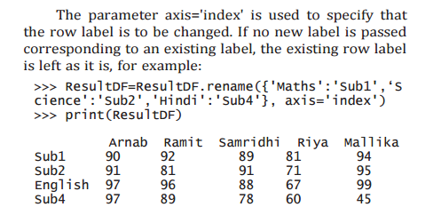
Operations on rows and columns in DataFrames

Slide 56
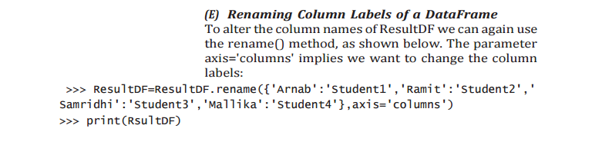

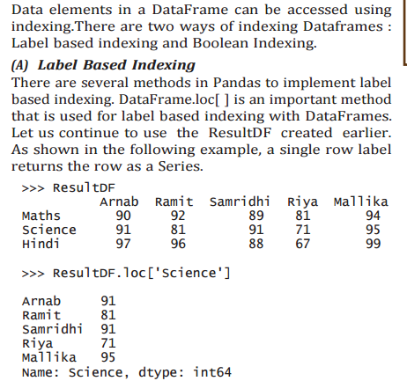
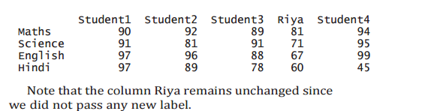
Operations on rows and columns in DataFrames

Slide 57
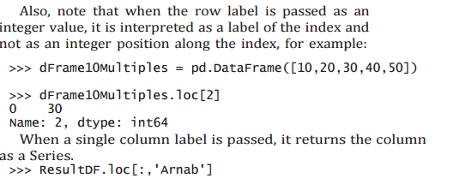
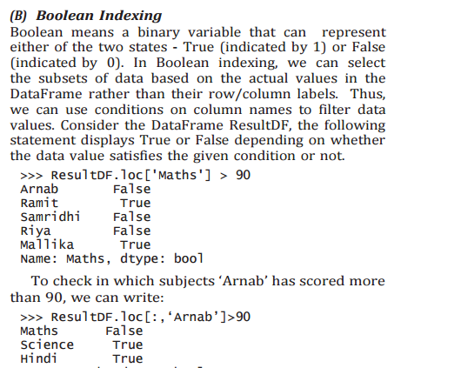
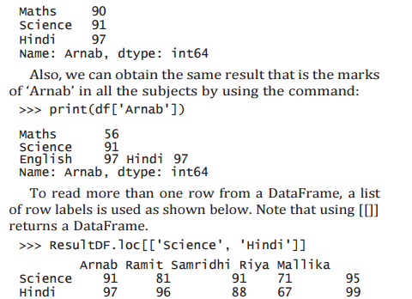
Operations on rows and columns in DataFrames

Slide 58
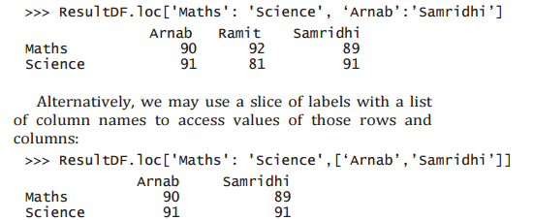
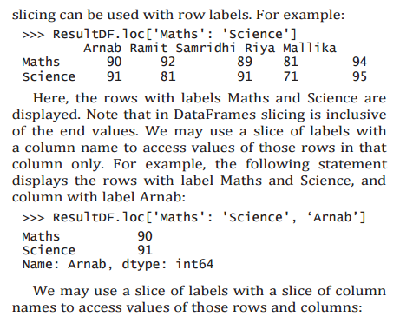
Operations on rows and columns in DataFrames

Slide 59
Operations on rows and columns in DataFrames
df.loc[['row_label1', 'row_label2']] # Selects multiple rows
df.loc[:, ['column_label1', 'column_label2']] # Selects multiple columns
ResultDF.loc['Maths','Ramit':'Riya':1]=1000
ResultDF.loc[['Maths','Science'],'Ramit':'Riya':1]=1000
ResultDF.loc['Maths':'Hindi','Ramit':'Riya':1]=1000
ResultDF['Arnab']['Maths']=1000
print(ResultDF[['Arnab', 'Riya']]['Maths']) #Error
ResultDF[['Arnab', 'Riya']]['Maths’]=10 #Error

Slide 60
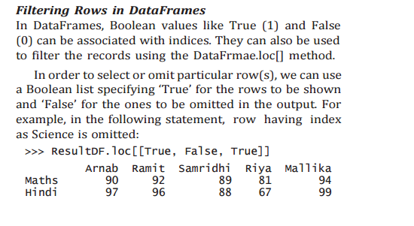
Operations on rows and columns in DataFrames

Slide 61

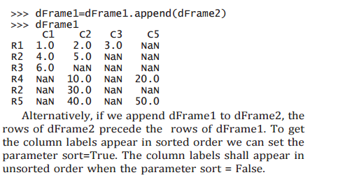
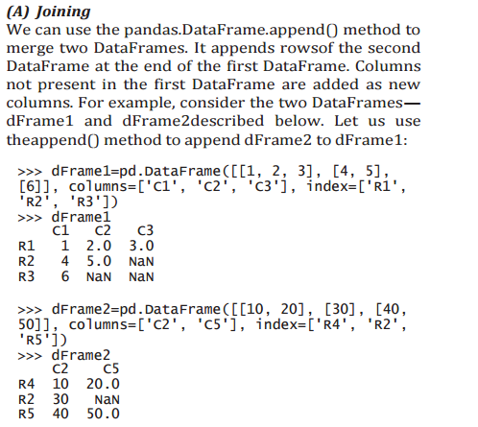
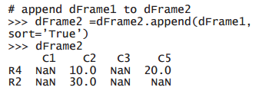

Operations on rows and columns in DataFrames

Slide 62
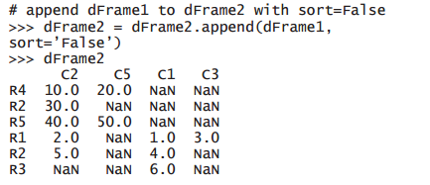
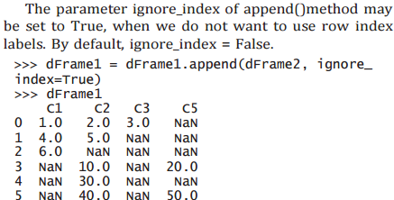
Operations on rows and columns in DataFrames

Slide 63
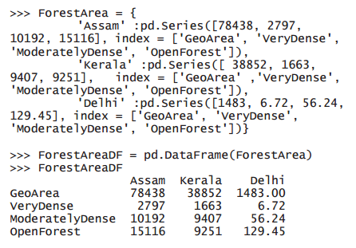
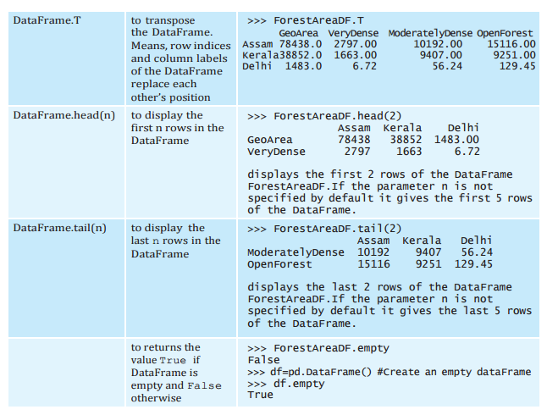
Operations on rows and columns in DataFrames

Slide 64

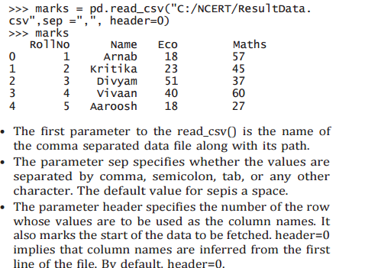
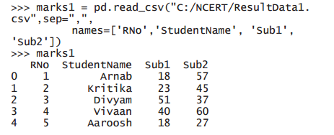
Operations on rows and columns in DataFrames

Slide 65

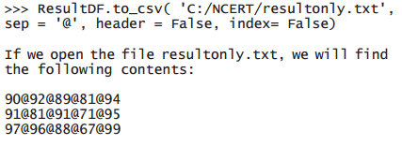
Operations on rows and columns in DataFrames

