Slide 1


Slide 2


Slide 3


Slide 4


Slide 5


Slide 6


Slide 7


Slide 8


Slide 9
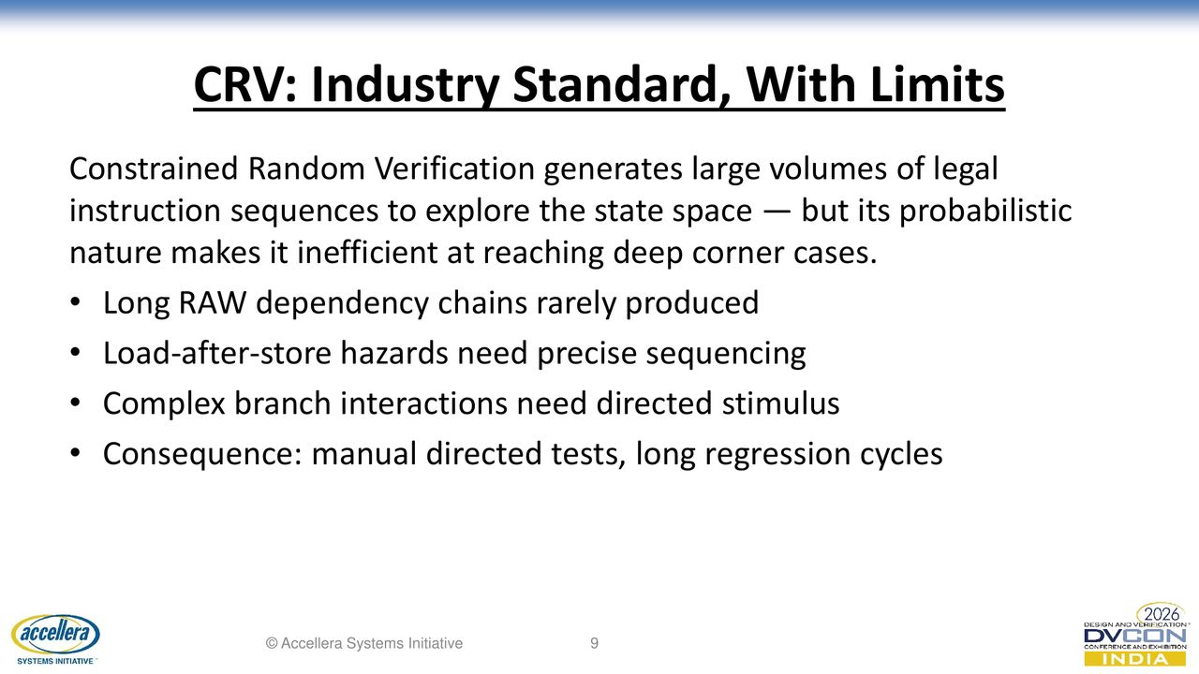

Slide 10
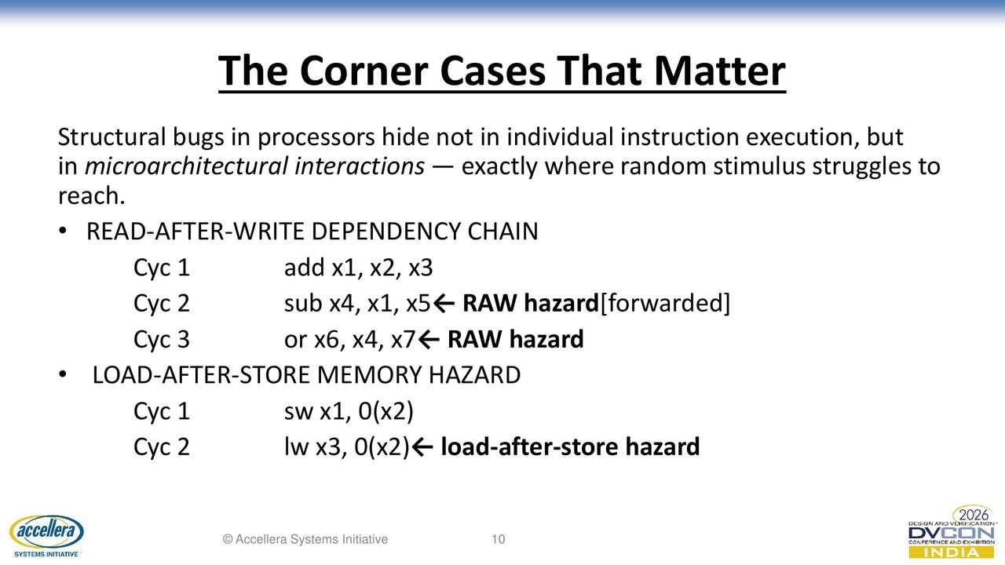

Slide 11
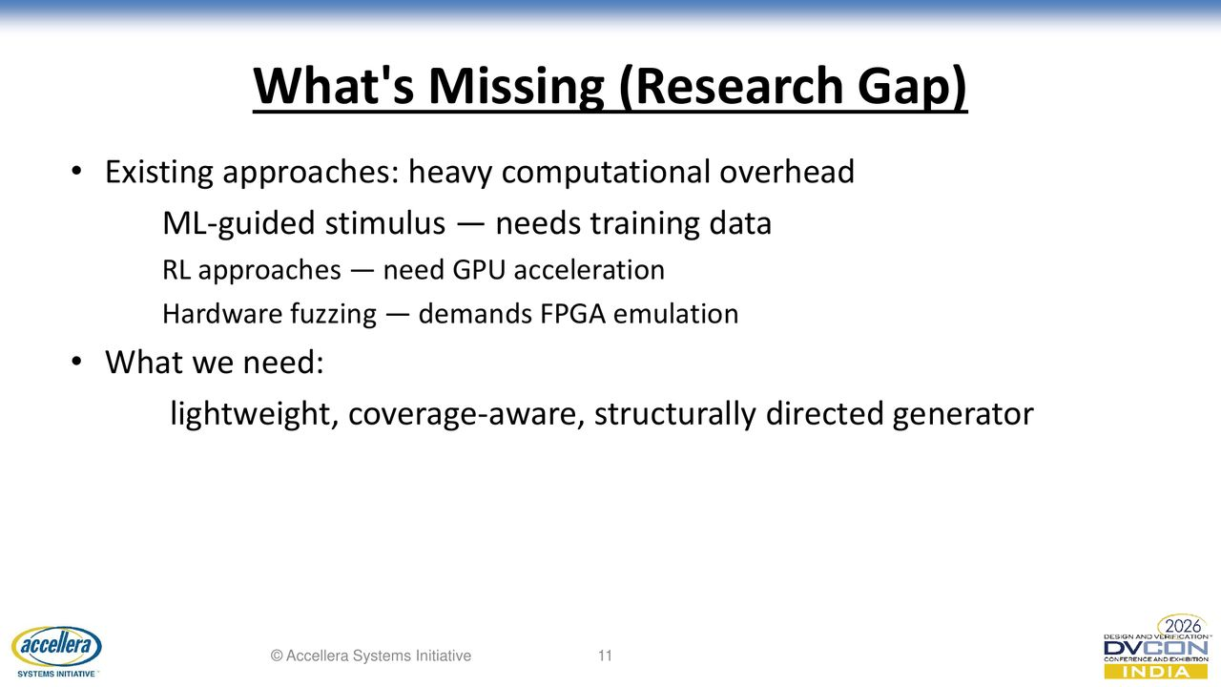

Slide 12


Slide 13
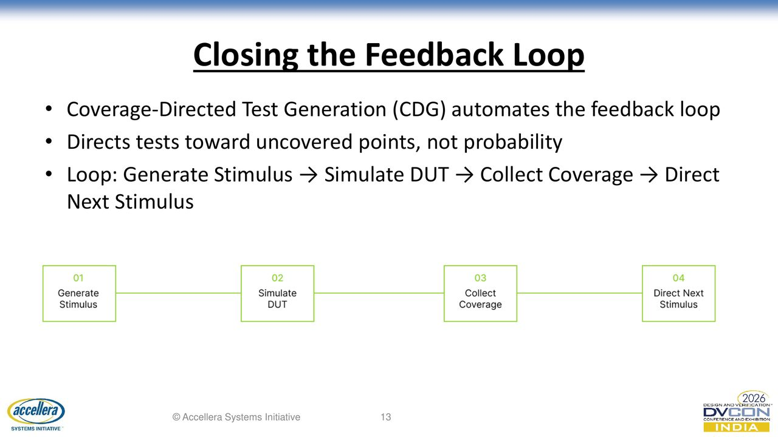

Slide 14


Slide 15
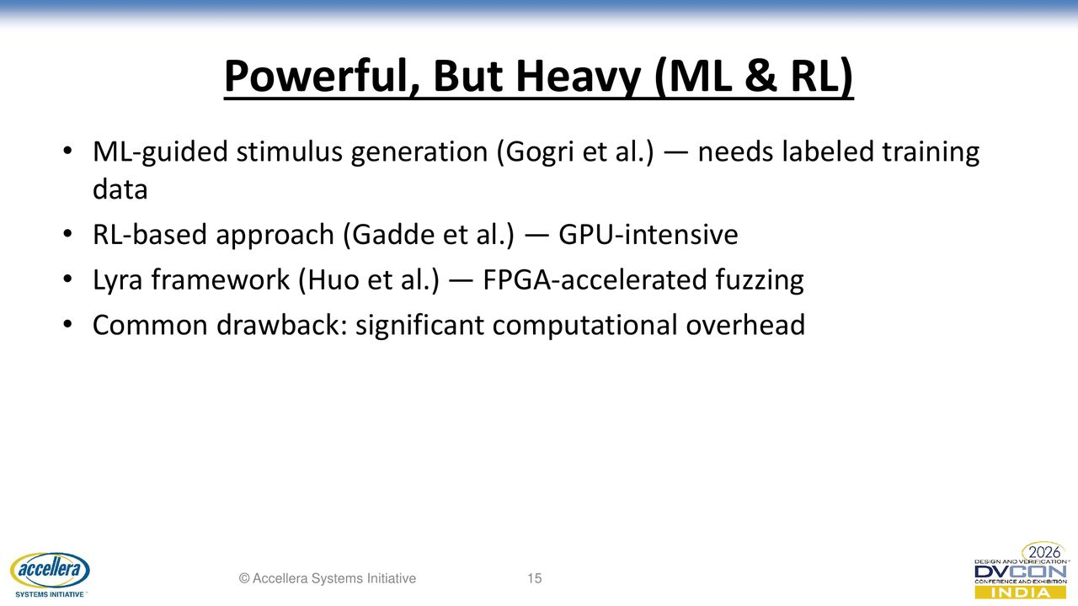

Slide 16


Slide 17
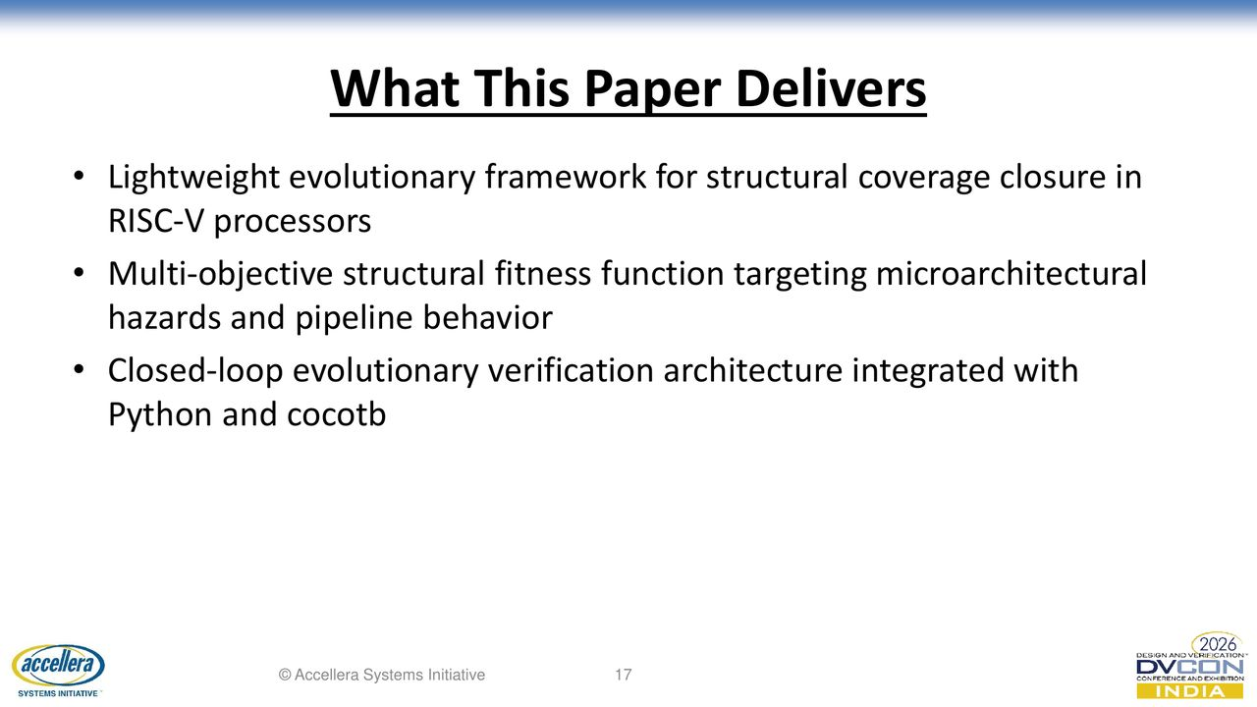

Slide 18
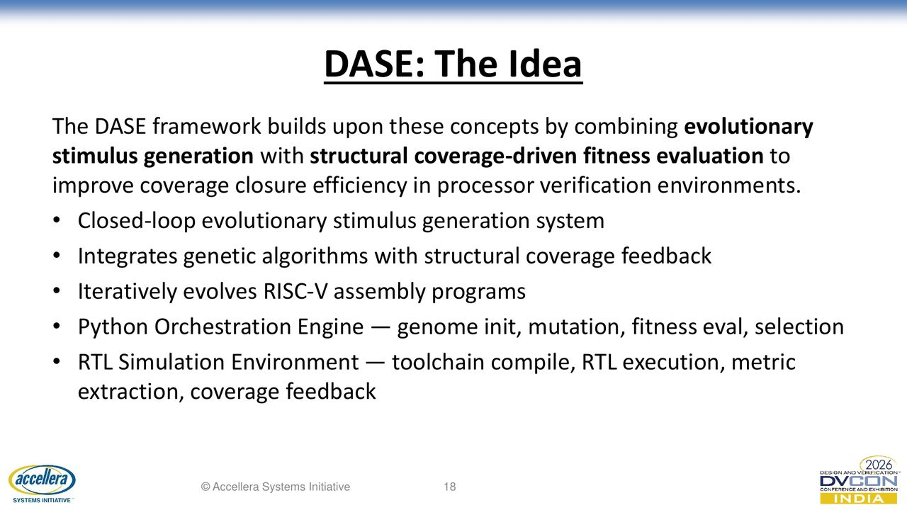

Slide 19
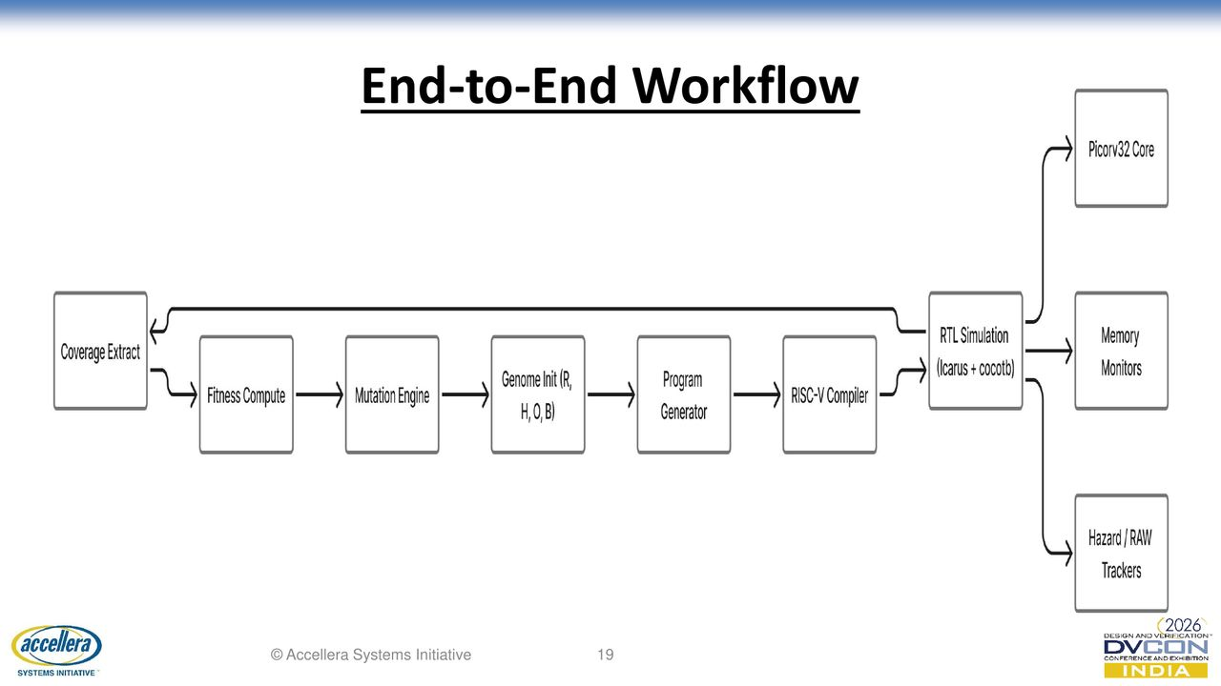

Slide 20


Slide 21
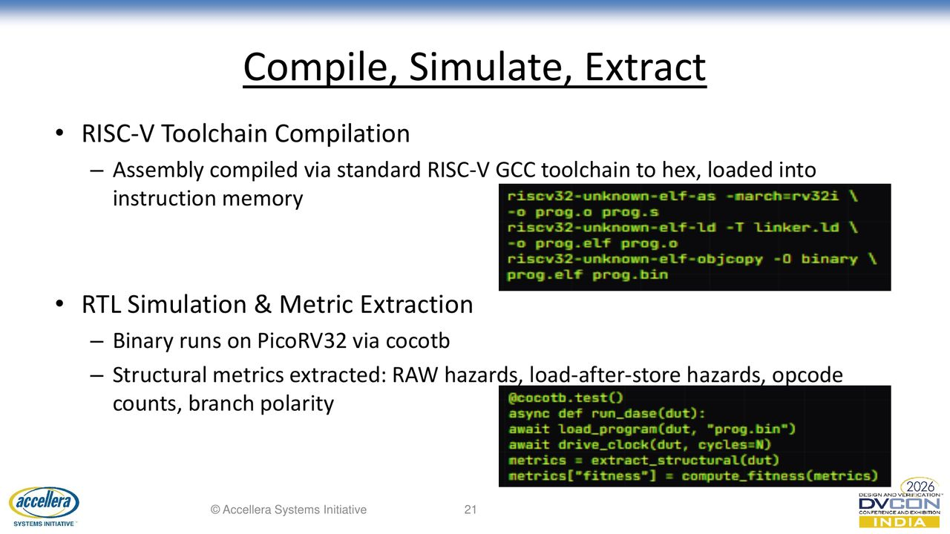

Slide 22
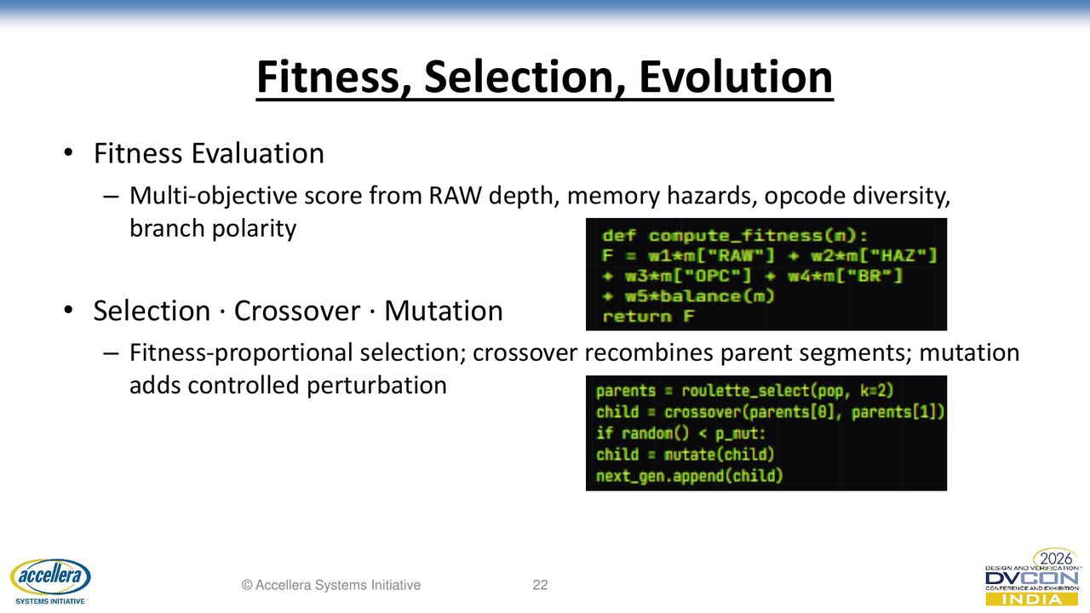

Slide 23
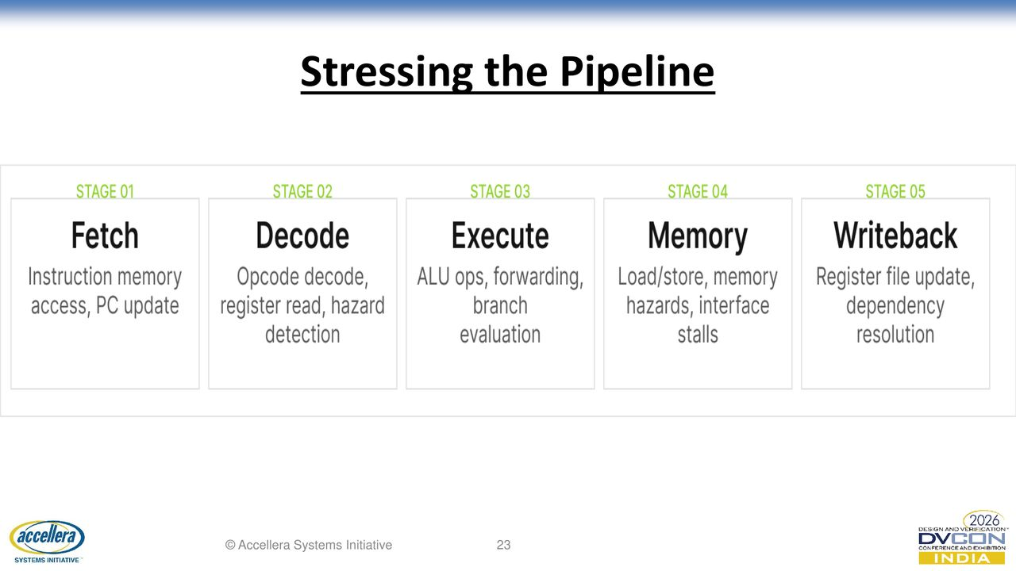

Slide 24
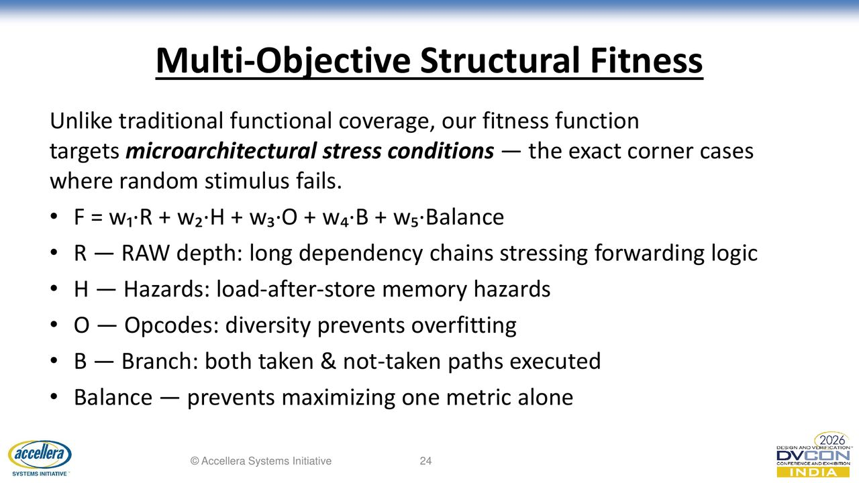

Slide 25
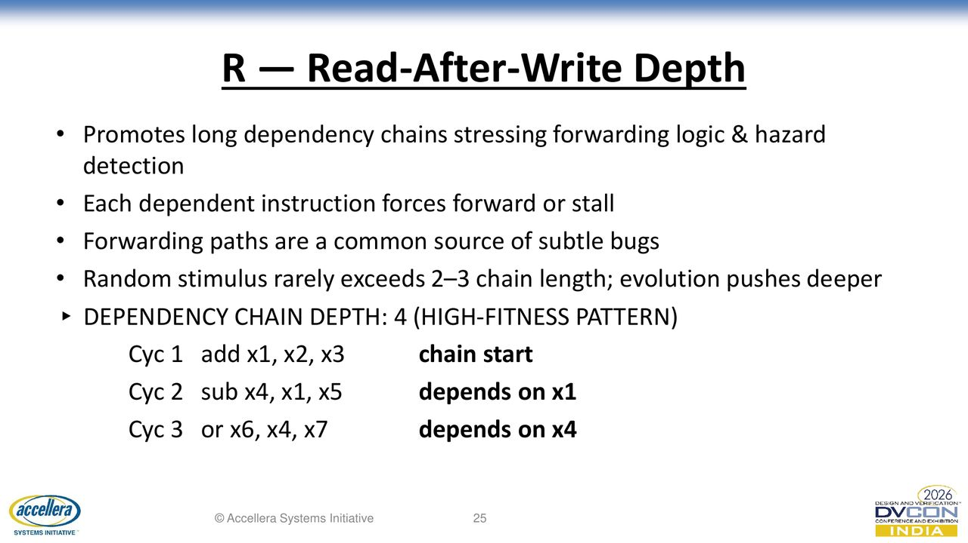

Slide 26
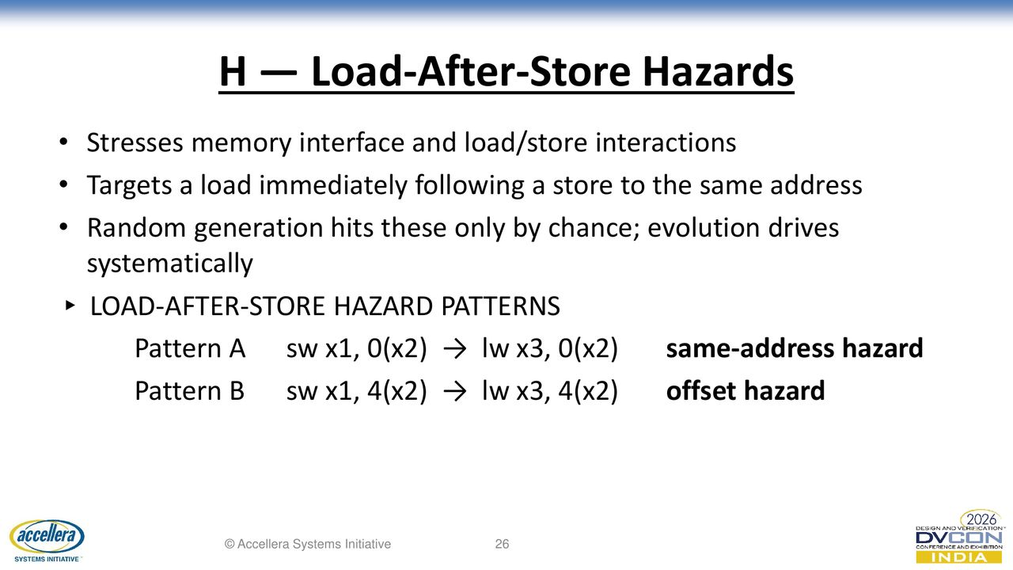

Slide 27


Slide 28
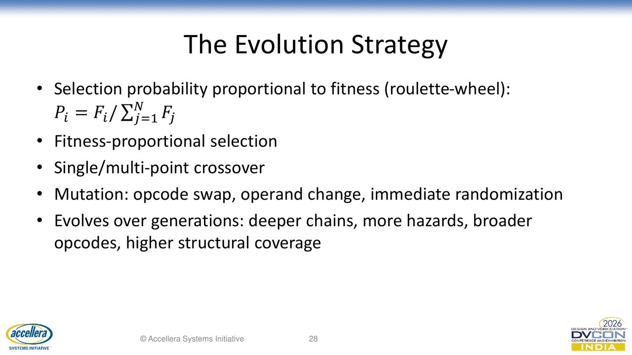

Slide 29
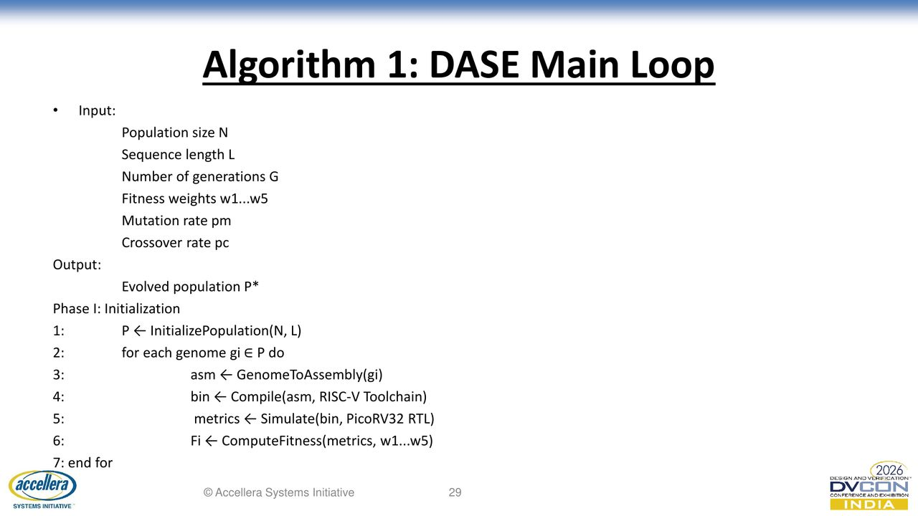

Slide 30


Slide 31
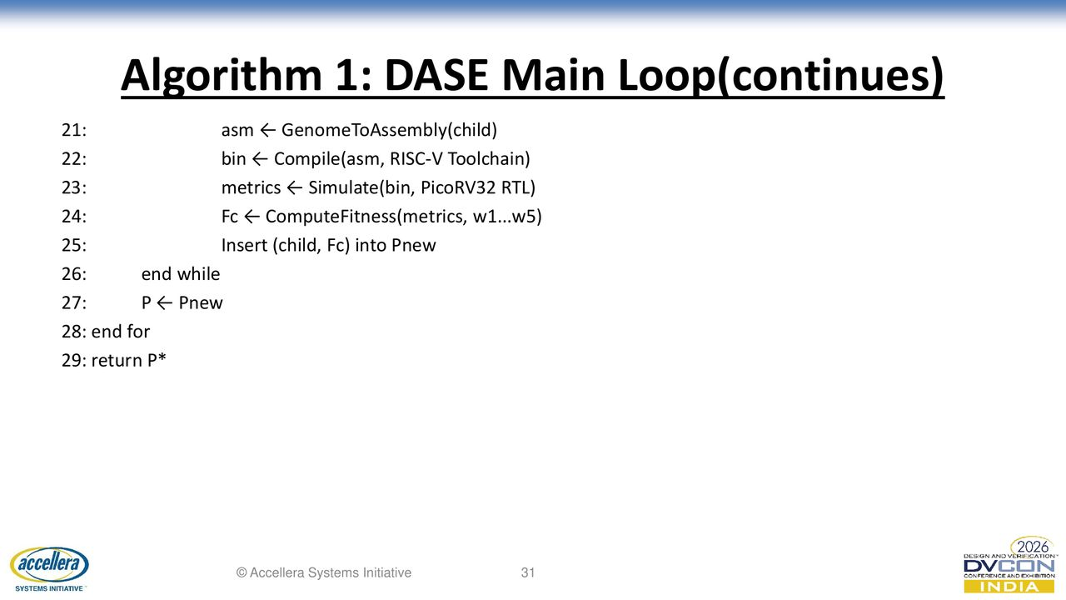

Slide 32
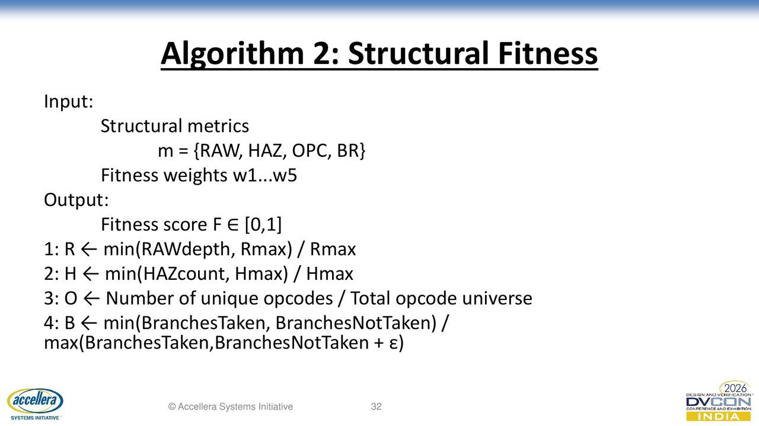

Slide 33
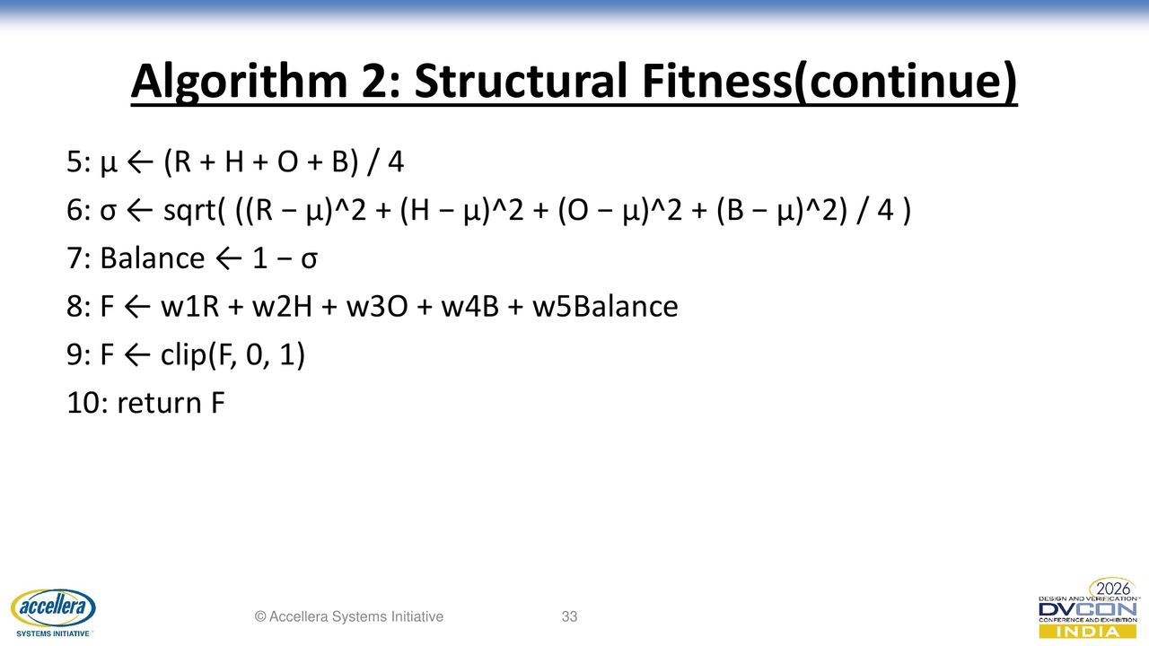

Slide 34
Self-Tuning Extension: The Weight Problem
The fitness weights [0.40, 0.25, 0.15, 0.10, 0.10] were originally hardcoded
Problem: hand-tuned weights are hard to defend, different CPUs need different weights, no principled way to choose ceilings
Solution (v1.2): CMA-ES self-tuning
Outer loop evolves the 5 weights + 3 ceilings
Meta-fitness = Cohen's d (effect size)
8-parameter continuous optimization
No hardcoded values — all evolved

Slide 35
Layer 2: CMA-ES Weight Tuning
Bilevel optimization: outer CMA-ES + inner GA (roulette + crossover)
CMA-ES searches 8 dimensions:
5 weights: softmax -> simplex, clipped to [0.05, 0.60]
3 ceilings: sigmoid -> [20,150], [5,40], [4,16]
Meta-fitness = Cohen's d (NOT mean DASE fitness):
d = (mean_DASE - mean_RAND) / pooled_std
Invariant to gaming (lowering ceilings inflates both equally)
Forces search to maximize DASE-vs-Random separation
Configuration: max_fevals=100, meta_seeds=6, sigma0=0.6

Slide 36
How CMA-ES Works
CMA-ES = Covariance Matrix Adaptation Evolution Strategy
Algorithm:
1. Sample lambda offspring from multivariate Gaussian
2. Evaluate each (run inner GA with proposed weights)
3. Rank offspring by meta-fitness (Cohen's d)
4. Update mean and covariance based on successful offspring
5. Repeat until convergence
Key property: covariance adaptation
Learns which directions correlate with good fitness
Elongates search along productive directions
State-of-the-art for continuous parameter optimization

Slide 37
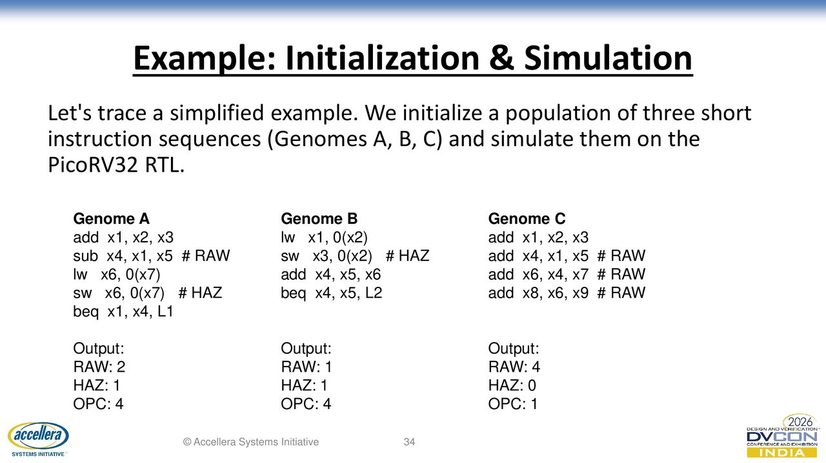

Slide 38
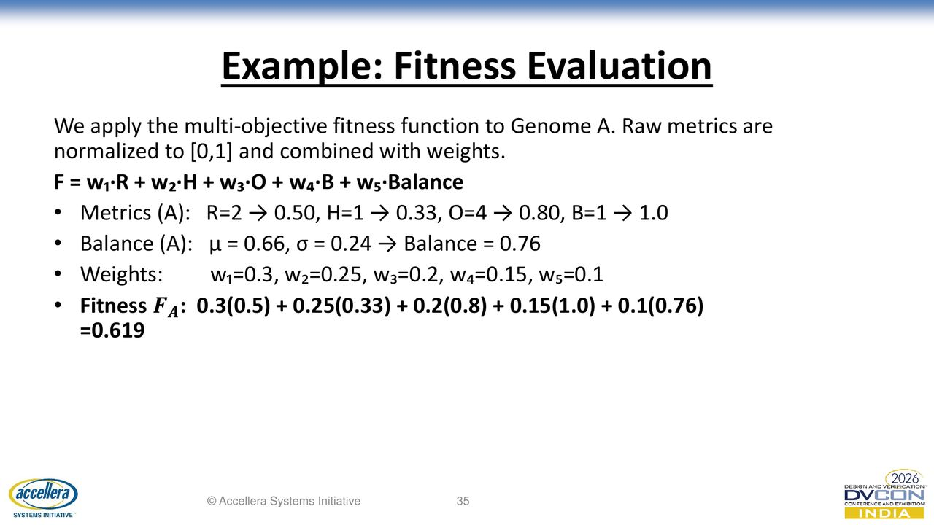

Slide 39
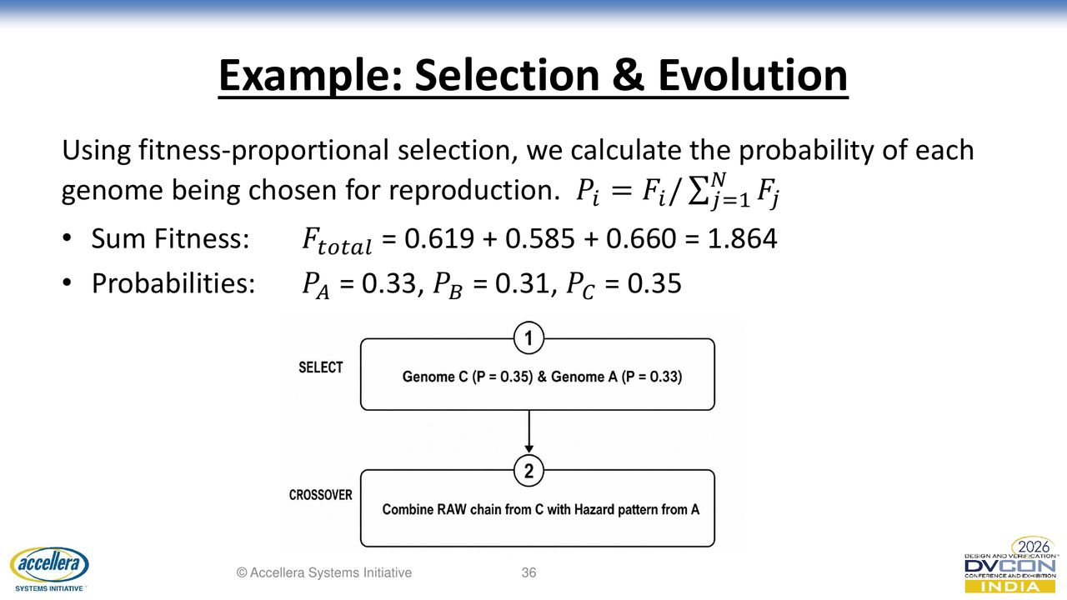

Slide 40
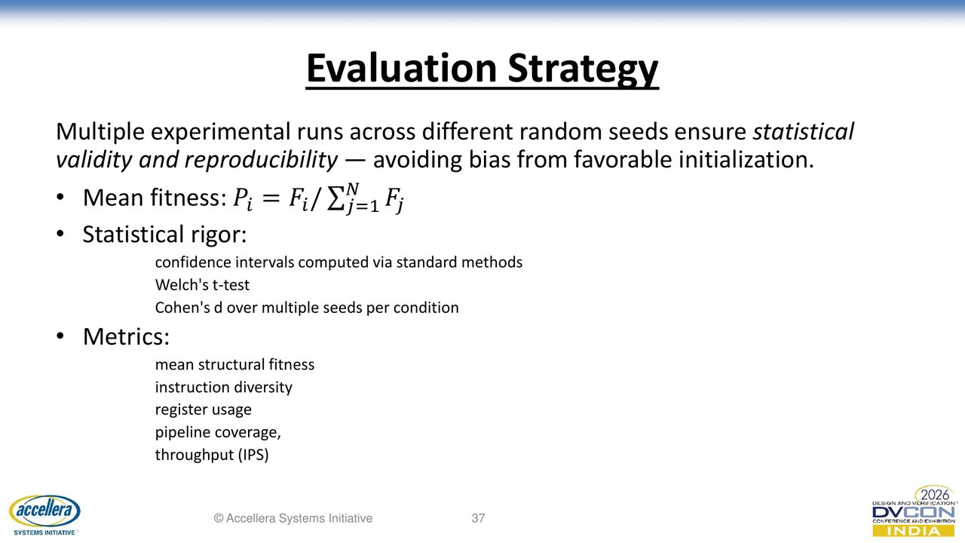

Slide 41
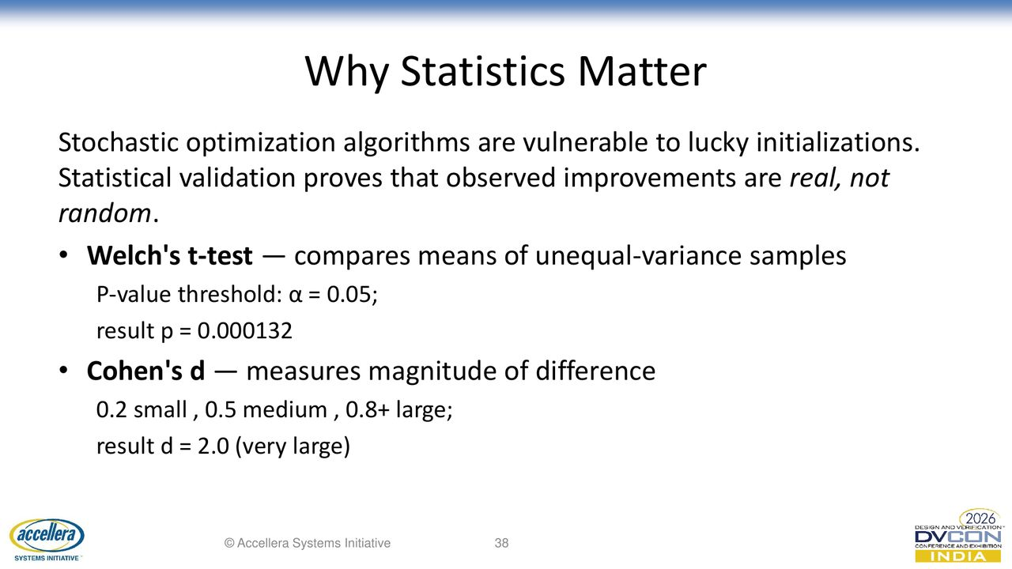

Slide 42
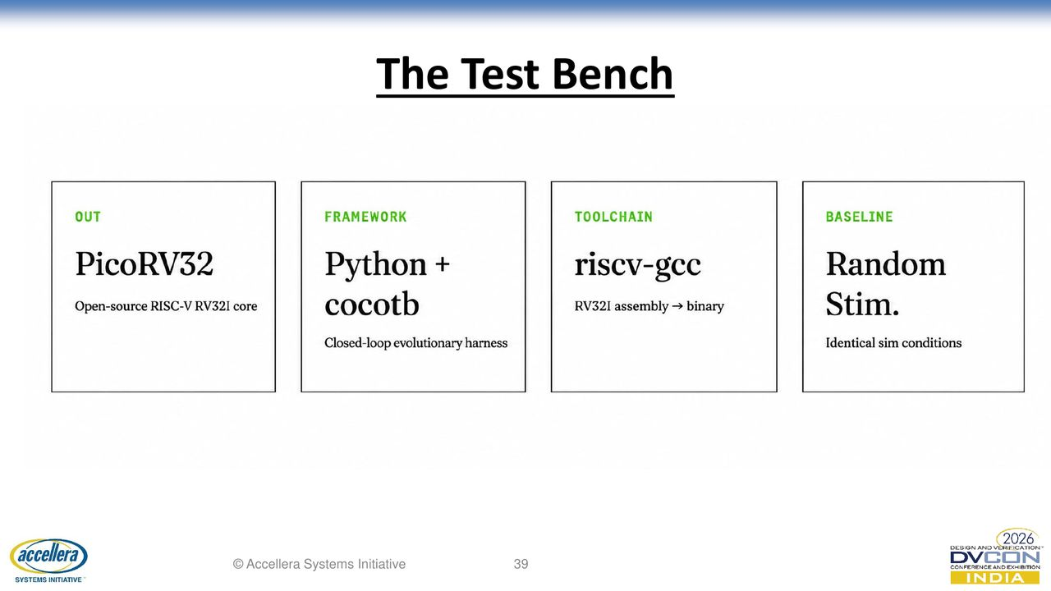

Slide 43
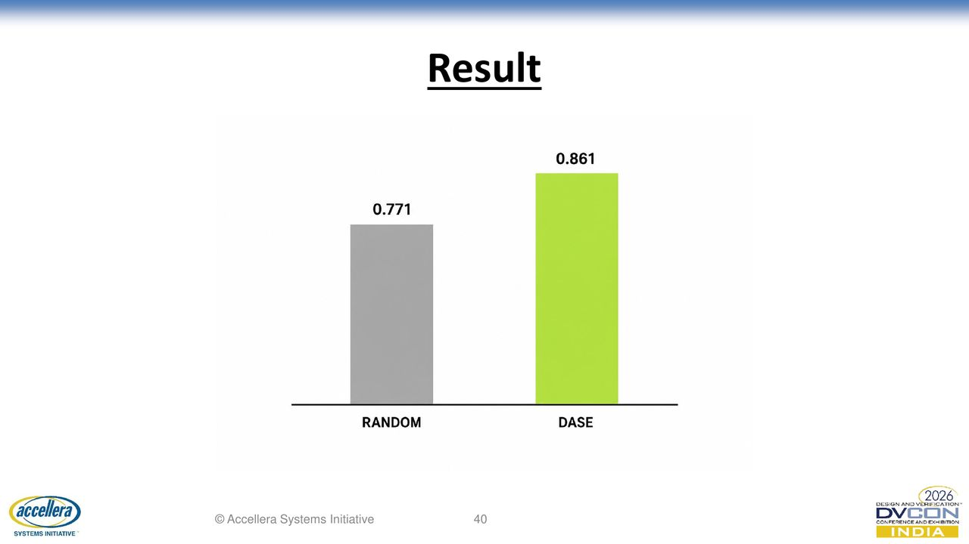

Slide 44
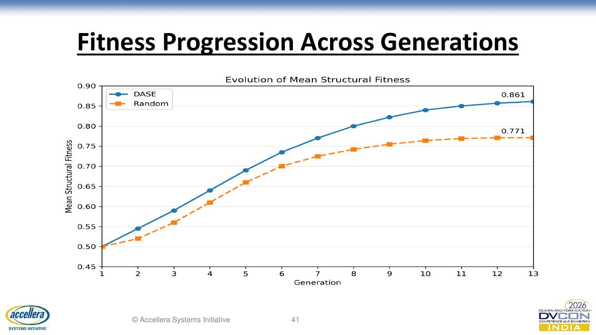

Slide 45
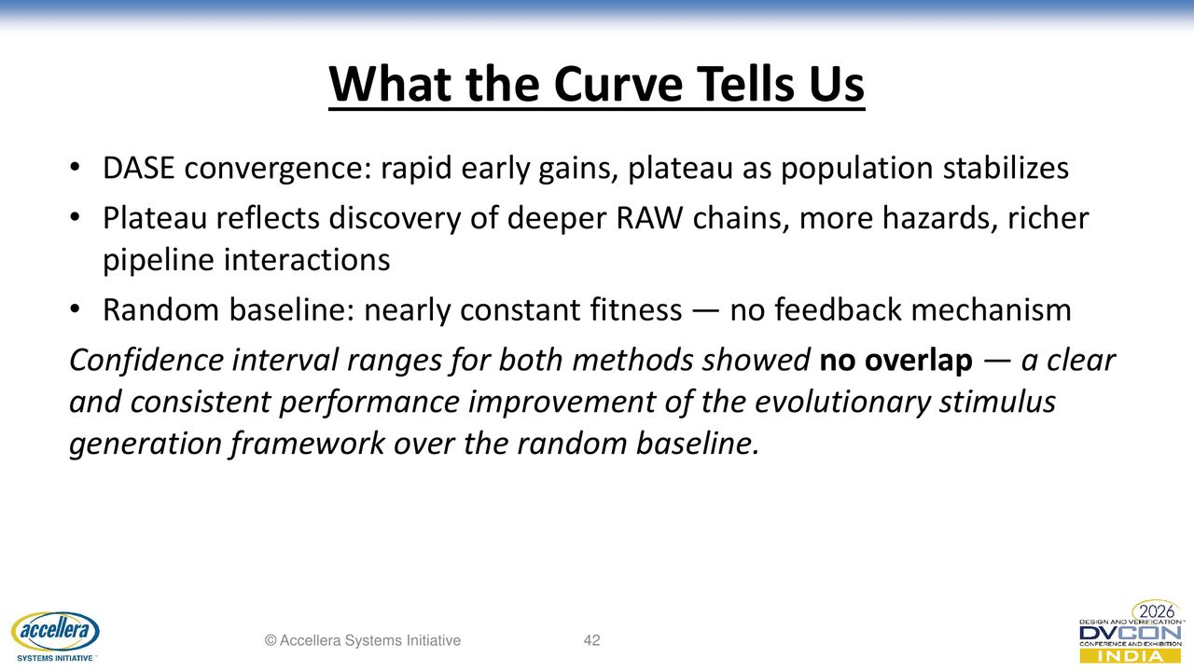

Slide 46
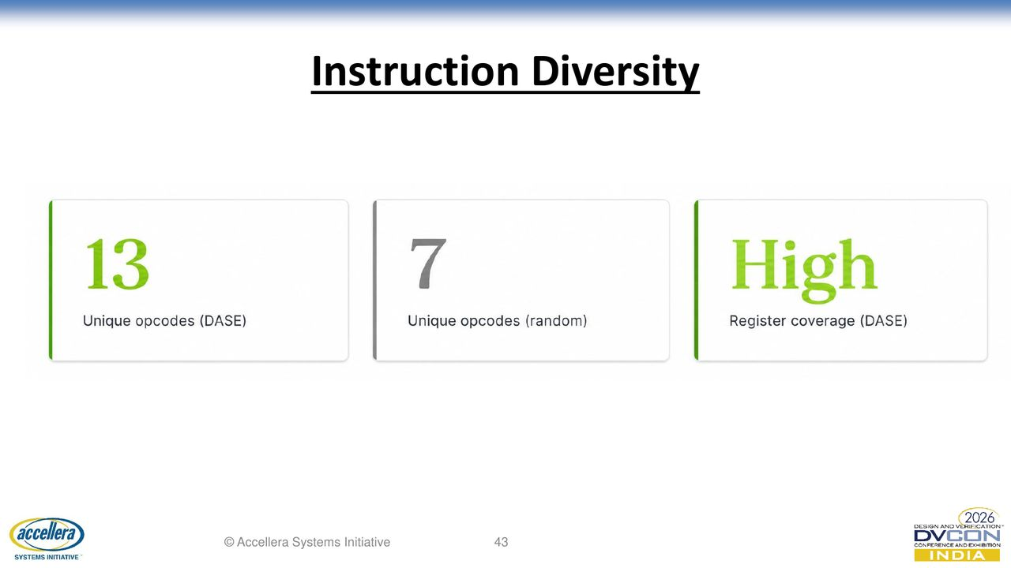

Slide 47
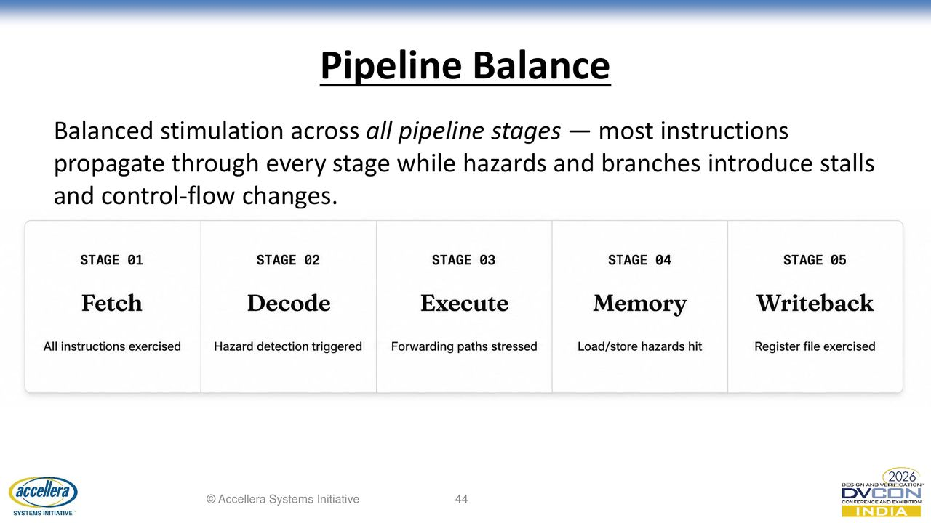

Slide 48
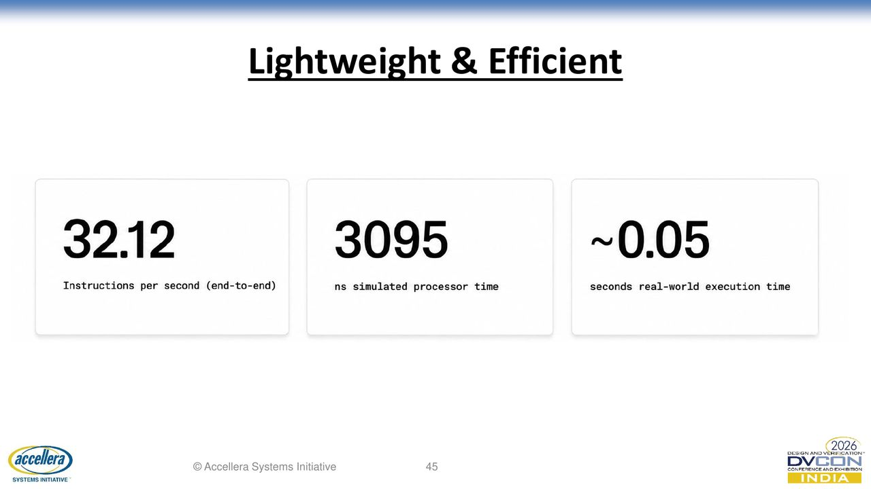

Slide 49
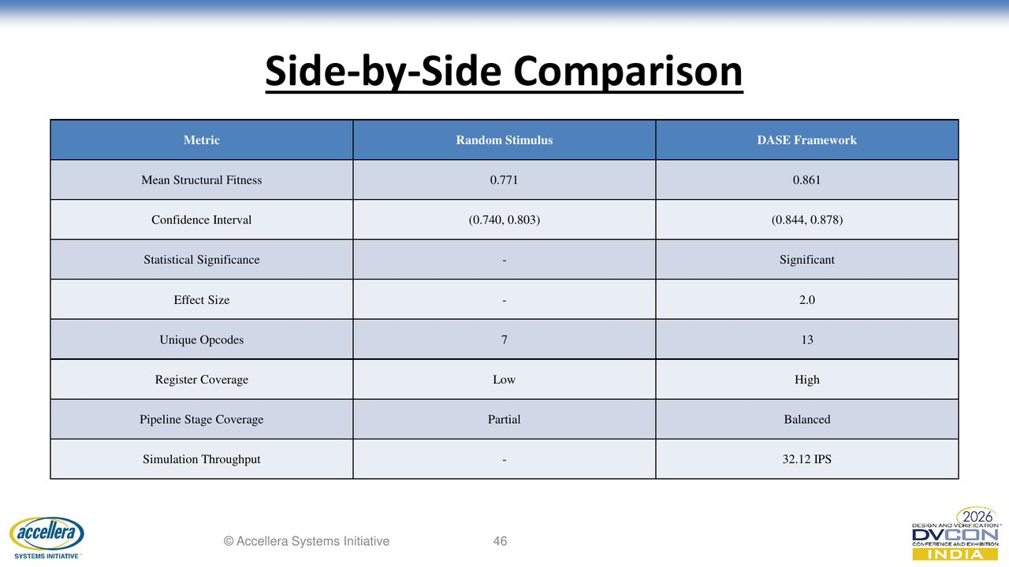

Slide 50
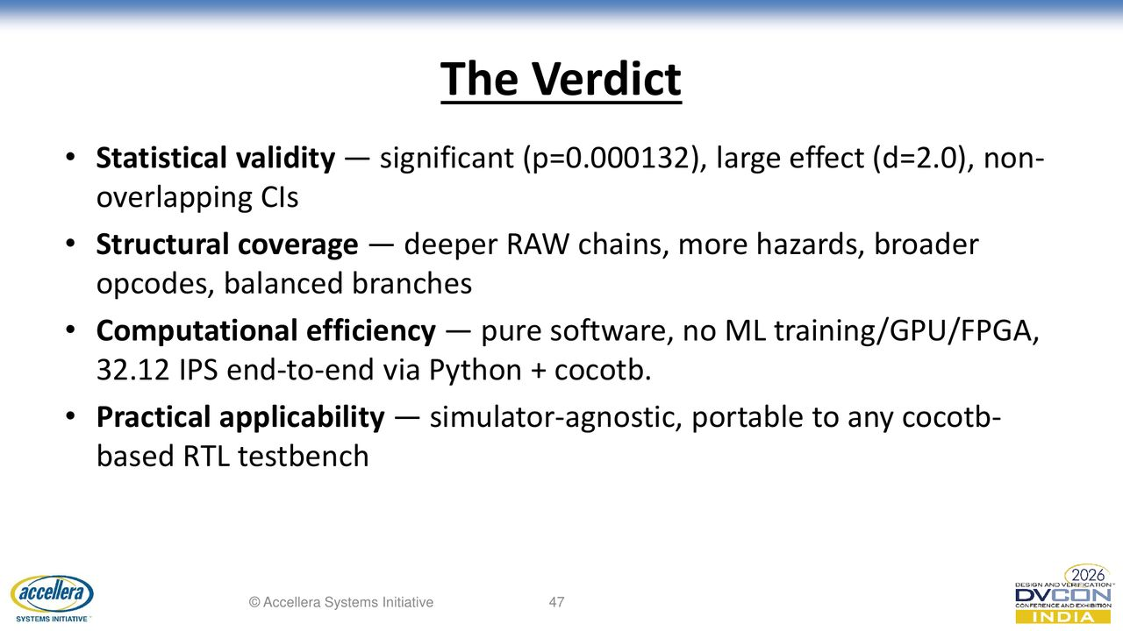

Slide 51
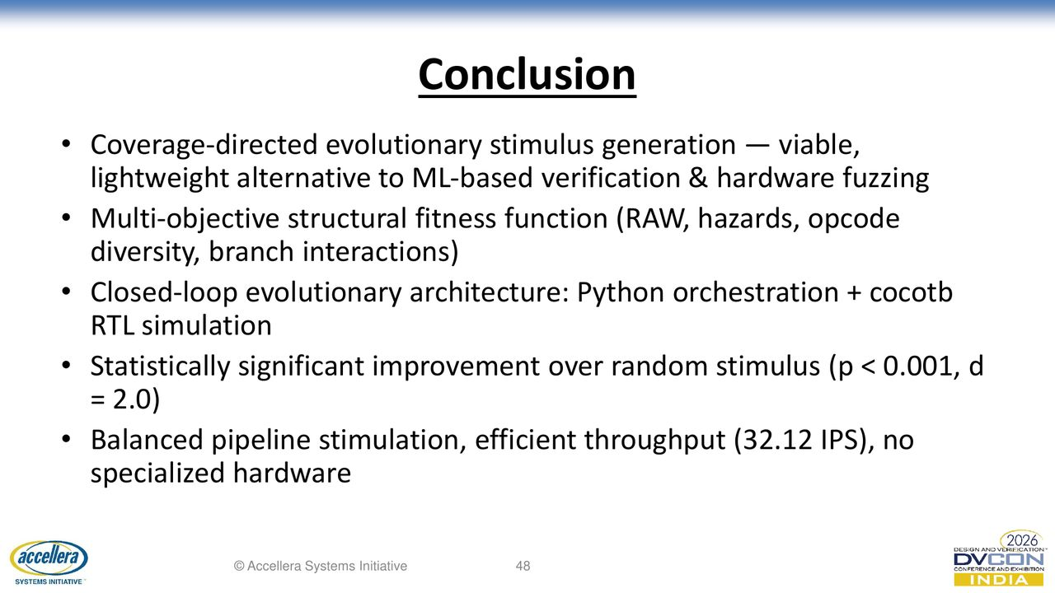

Slide 52


Slide 53


Slide 54
Self-Tuning Results: CMA-ES Evolved Weights
CMA-ES meta-optimization — validated across multiple seeds:
Weight Locked (default) CMA-ES Evolved
w_raw 0.400 0.376
w_hazard 0.250 0.444 <- increased
w_opcode 0.150 0.074 <- decreased
w_branch 0.100 0.057
w_balance 0.100 0.049
CMA-ES discovered: hazards are stronger discriminator, balance was overweighted
Effect size improved: d = 2.0 -> 2.11

Slide 55
No Hardcoded Values: Self-Tuning Architecture
The fitness function has 8 parameters: 5 weights + 3 ceilings
Layer 1 — Empirical validation (locked weights):
Weights [0.40, 0.25, 0.15, 0.10, 0.10] validated across 12 seeds
Produces DASE=0.861, d=2.0 (paper Table 1)
Layer 2 — CMA-ES self-tuning:
Outer loop evolves the 8 parameters
Meta-fitness = Cohen's d
Evolved weights: [0.376, 0.444, 0.074, 0.057, 0.049]
Improves d from 2.0 to 2.11
No hardcoded weights — all self-tuned by CMA-ES

