Slide 1
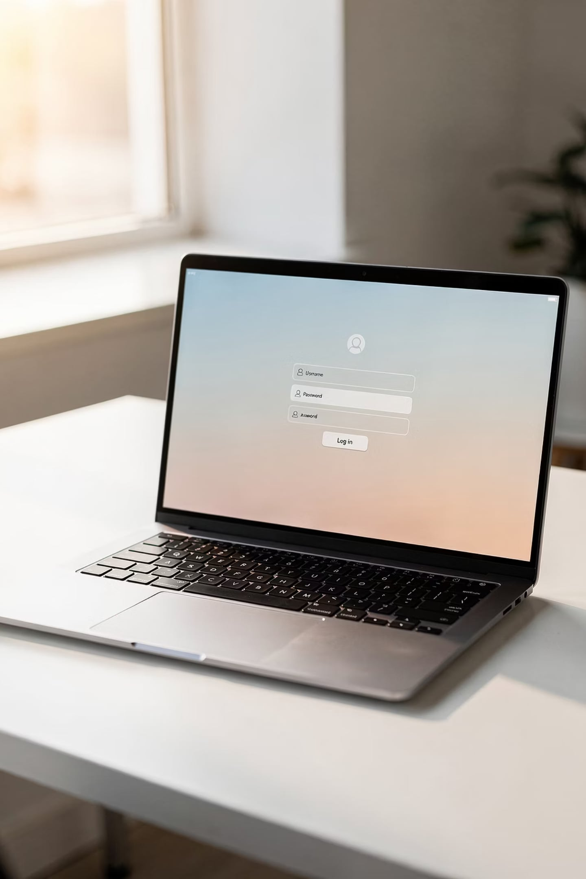

Day 11: Building a Secure Login System
Protecting Your Application — Full Stack Bootcamp
🛠️ Format
Hands-On Workshop
🎯 Goal
Secure Your App

Slide 2


OPENING HOOK
Can Anyone Access Your Student Management System?
👤 Person A
👤 Person B
Should every person on the internet have access to your Student Management System? Right now… they probably do. Let's fix that today.
Opens browser → types your URL → lands directly on the Dashboard.
No account. No password. Same result — full access to all student data.
Your app works — but it's wide open. Any anonymous user can view, edit, or delete student records. Today we close that door, build a login system, and protect every page behind a session.

Slide 3
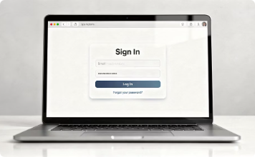
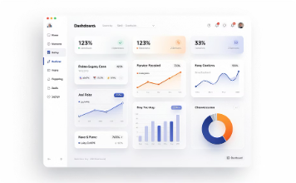
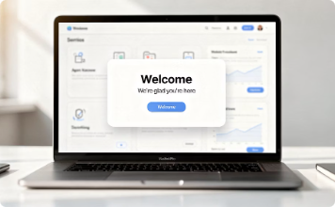
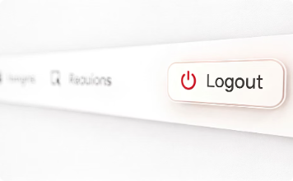
TODAY'S MISSION
What We're Building Today
By the end of this session, your Student Management System will be fully protected by a real login system. Here's the complete feature set we'll ship together.
🔐 Login Page
🏠 Protected Dashboard
👋 Welcome User
🚪 Logout
A polished Bootstrap login form with email and password fields.
The dashboard only loads if the user is authenticated via session.
Display the logged-in user's name on the dashboard after authentication.
Safely destroy the session and redirect back to the login page.

Slide 4
⚡ RAPID FIRE RECAP — Pairs Activity (5 min)
Before We Code — Let's Warm Up
Turn to your partner. Discuss these five questions. You have 60 seconds each. Be ready to share your answers with the class.
1. INSERT vs. UPDATE
2. Why Primary Key?
3. WHERE Clause
What's the difference? When do you use each one?
What happens to your table if there's no Primary Key?
What's the purpose of WHERE? What happens if you forget it in a DELETE?
4. Why Validate?
5. Purpose of a Database
What could go wrong if you skip form validation entirely?
Why not just store data in a PHP array instead of MySQL?

Slide 5
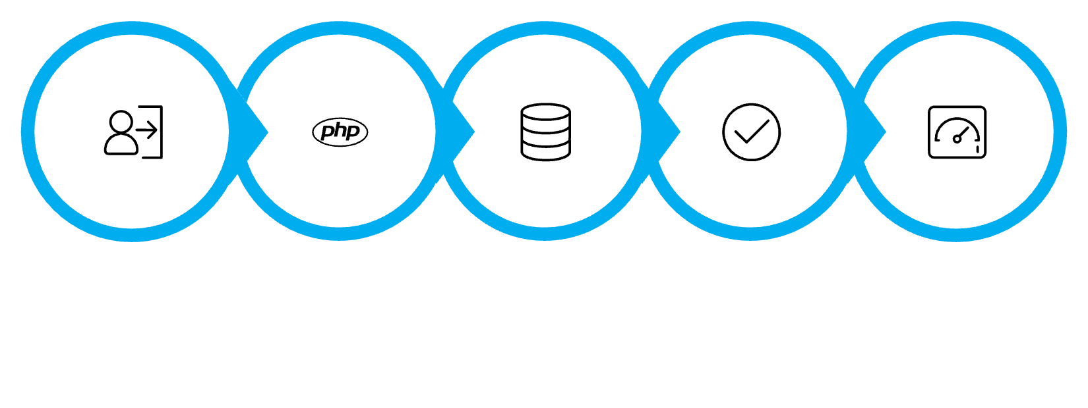
MODULE 1
Login System — Concept
A login system has one job: verify who you are before letting you in. The flow is straightforward — the user submits a form, PHP checks the credentials against MySQL, and if they match, the user is granted access. No match? Show an error.
Step 1
Step 2
User fills login form with email + password
PHP receives $_POST data
Step 3
Step 4
Run SQL: SELECT * FROM users WHERE email = ?
Row found + password matches → access granted
Login Form
Receive Data
Query MySQL
Credentials Match?
Redirect Dashboard
Keep it simple. Username + password. One SQL query. One redirect. That's the entire concept.

Slide 6
MODULE 1 — LIVE CODING
Follow Along in VS Code
Building the Login Form
Open VS Code. Create login.php. We'll use Bootstrap 5 to build a clean, centered login card. Here's the structure we're coding right now:
🎯 MISSION 1
Create a Bootstrap Login Page with the following fields:
<!-- login.php -->
<form method="POST" action="login.php">
<div class="mb-3">
<label>Email Address</label>
<input type="email" name="email"
class="form-control"
placeholder="you@example.com">
</div>
<div class="mb-3">
<label>Password</label>
<input type="password" name="password"
class="form-control">
</div>
<button type="submit"
class="btn btn-primary w-100">
Login
</button>
</form>
Email Address input
Password input
Login button (full width)
Card centered on the page
🏆 CHALLENGE
Display an "Invalid Credentials" Bootstrap Alert in red when the form is submitted empty.
⭐ BONUS
Add a Show Password toggle button using a small JavaScript snippet.

Slide 7



MODULE 2
Authentication — Concept
Authentication means confirming the user is who they claim to be. We do this by looking up their email in the database, then checking if the stored password matches what they typed. If both match — they're in.
The SQL query we use:
<?php
$email = $_POST['email'];
$sql = "SELECT * FROM users
WHERE email = '$email'
LIMIT 1";
$result = mysqli_query($conn, $sql);
$user = mysqli_fetch_assoc($result);
if ($user &&
$user['password'] == $_POST['password']) {
// Success!
header("Location: dashboard.php");
} else {
$error = "Invalid credentials.";
}
?>
Valid Login
Invalid Login
Email ✓ + Password ✓ → Redirect to Dashboard
No match found → Show error message, stay on login page
We'll improve password security with hashing in a future session. For now, keep it simple and focus on the flow.

Slide 8
MODULE 2 — MISSION + CHALLENGE
Authenticate Your Users
🎯 MISSION 2
Create the users table in MySQL
Authenticate users against your MySQL users table. On success, redirect to dashboard.php. On failure, show a red Bootstrap Alert.
Fields: id, name, email, password
🏆 CHALLENGE
Write the PHP authentication logic
After a successful login, display: "Welcome, [Student Name]!" on the dashboard using the name from the database.
Query the database with the submitted email. Check password. Redirect on success.
⭐ BONUS
Test both paths
Store the last login timestamp in the database. Display it on the dashboard: "Last login: Dec 10, 2024 at 2:34 PM"
Valid credentials → Dashboard. Invalid → Error message stays visible.

Slide 9
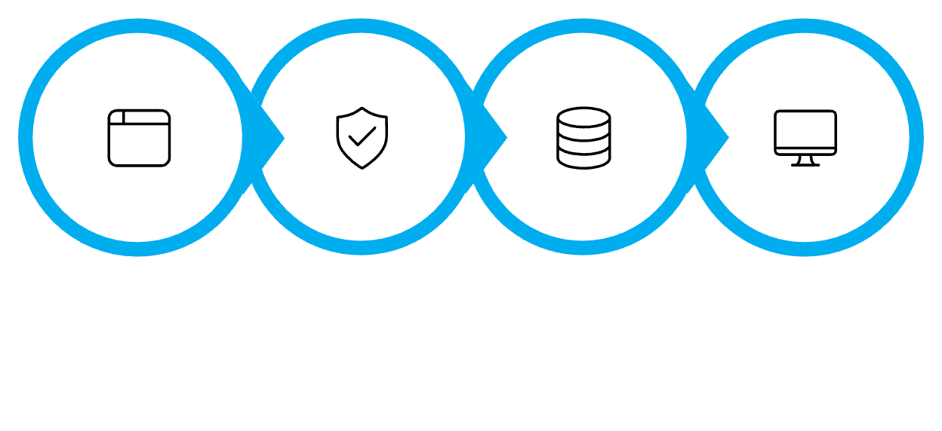

MODULE 3
Sessions — Concept
A session is PHP's way of remembering a logged-in user across multiple pages. Without sessions, the user would have to log in on every single page. With sessions, PHP creates a unique ID stored in the browser, and ties it to data stored on the server.
<?php
// After successful login:
session_start();
$_SESSION['user_id'] = $user['id'];
$_SESSION['user_name'] = $user['name'];
$_SESSION['user_email']= $user['email'];
header("Location: dashboard.php");
exit();
?>
Browser Login
PHP Verify
Start Session
Dashboard Read
Two key tools: session_start() must be called at the top of every PHP page that uses sessions. $_SESSION is the superglobal array where you store and read session data.
<?php
// On dashboard.php:
session_start();
echo "Welcome, "
. $_SESSION['user_name']
. "!";
?>
Always call session_start() before any HTML output — even a single blank line before <?php will break it.

Slide 10
MODULE 3 — MISSION + CHALLENGE
Create a Session After Login
Now it's your turn. After a successful login, start a session and store the user's data. Then read that data on the dashboard page to confirm the session is working correctly.
🎯 MISSION 3
After a successful login, start a session and store the user's name, ID, and email. Navigate to the dashboard — confirm you can display the stored session data.
1
2
Call session_start()
Store session data
🏆 CHALLENGE
Add it to the very top of both login.php and dashboard.php
Save user_id, user_name, and email into $_SESSION
Display a personalized greeting on the dashboard: "Welcome back, Mohit! 👋"
3
⭐ BONUS
Read on dashboard
Store and display the login timestamp: "Session started at 2:45 PM"
Echo the user's name from $_SESSION['user_name']

Slide 11


MODULE 4
Protected Pages — Concept
Protecting a page means checking for a valid session before showing any content. If the session exists, load the page. If not, immediately redirect the user back to the login page. This check must happen at the very top of every protected page — before any HTML is rendered.
<?php
session_start();
// Guard clause — protect this page
if (!isset($_SESSION['user_id'])) {
header("Location: login.php");
exit(); // Always exit after redirect!
}
// Safe to render the page now
?>
<!DOCTYPE html>
<html>
...dashboard content here...
</html>
Always call exit() immediately after header("Location: ..."). Without it, PHP continues executing the rest of the page even though the browser redirects.

Slide 12
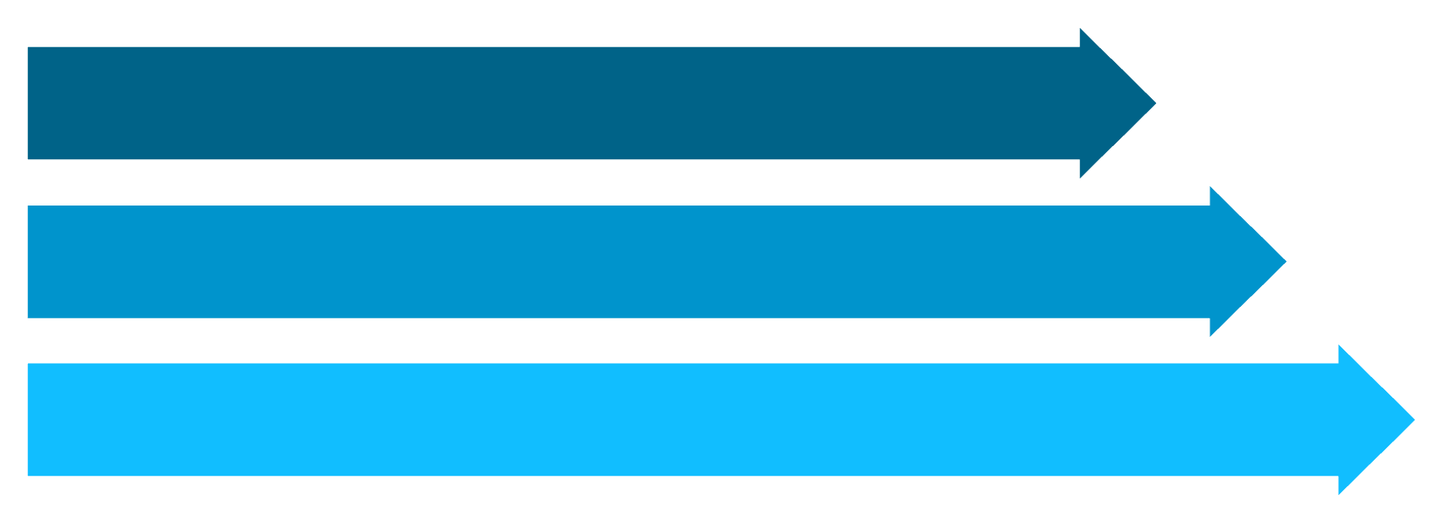
MODULE 4 — MISSION + CHALLENGE
Protect Your Dashboard
🎯 MISSION 4
Visit Dashboard
Add a session guard to dashboard.php. Open the URL directly without logging in — confirm you get redirected to login.php automatically.
Check Session
Show or Redirect
🏆 CHALLENGE
This pattern — check session → redirect or proceed — is the core of every protected web application. You'll use it on every single page of your Student Management System.
Test all protected pages: try accessing students.php, add_student.php, and edit_student.php directly. Every one should redirect unauthorized users.
⭐ BONUS
Build a friendly "Access Denied" page (403.php) with a Bootstrap card, a lock icon, and a "Back to Login" button.

Slide 13
MODULE 4 — LOGOUT
Logging Out — Clean Session Destroy
Logout means destroying the session completely so no trace of the user's data remains on the server. A proper logout does three things: unsets all session variables, destroys the session, and redirects to login.
Add a logout button to your navigation bar. Link it to logout.php:
<!-- navbar logout button --> <a href="logout.php" class="btn btn-outline-danger btn-sm">
<?php
// logout.php
session_start();
// Step 1: Clear all session data
$_SESSION = array();
// Step 2: Destroy the session
session_destroy();
// Step 3: Send user back to login
header("Location: login.php");
exit();
?>

Slide 14
🐛 BUG HUNT
Spot the Bug — Broken Login System
The code below is a login system with 5 bugs hidden in it. Work in pairs. Find them all before the reveal. Go!
🔍 Bugs to Find:
<?php
// login.php — Find the bugs!
$email = $_POST['email'];
$password = $_POST['password'];
$sql = "SELECT * FROM users
WHERE email = '$email'";
$result = mysqli_query($conn, $sql);
$user = mysqli_fetch_assoc($result);
if ($user['password'] == $password) {
$_SESSION['user_id'] = $user['id'];
header("Location: dashboard.php");
}
echo "Invalid credentials.";
?>
Bug 1
Bug 2
Missing session_start() at the top of the file
No exit() after the redirect — page keeps executing
Bug 3
Bug 4
SQL returns multiple rows — no LIMIT 1
Error message always shows — even on a successful login
Bug 5
No database connection ($conn) included or defined

Slide 15

🚀 BUILD SPRINT — 30 MINUTES
Secure Your Student Management System
Requirements Checklist
⏱️ Timer: 30 Minutes — Build as much as you can. Bonus points for a polished UI and showing the logged-in user's name in the navbar.
🔐 Login Page
🔑 Authentication
Bootstrap form with email + password
Verify credentials against MySQL
⭐ Bonus Goals
Show logged-in user's name in the top navbar
Professional Bootstrap UI with sidebar navigation
Friendly "Access Denied" page for unauthorized access
Display last login time on the dashboard card
🧠 Sessions
🛡️ Protected Pages
Start session, store user data after login
Guard every CRUD page with session check
Files You'll Need
🚪 Logout
login.php — form + authentication
dashboard.php — protected home page
logout.php — session destroy
db.php — database connection (include on all pages)
Destroy session and redirect to login

Slide 16


🎤 DEMO DAY
Student Showcase — Present Your Work
Present These 4 Things:
Login
Show a successful login with real credentials from your database
Dashboard
Show the protected dashboard with the user's name displayed
Logout
Click logout — confirm you're redirected and session is gone
Biggest Challenge
Share one bug you hit and how you fixed it
Each team gets 2 minutes on stage. Walk us through your working login system. Be proud — you built this from scratch today.
Trainer will ask each team one authentication question. Be ready!

Slide 17
🧠 INTERVIEW QUIZ
5 Questions — Answer Without Notes
These are real interview questions. Answer them out loud with your partner first, then we'll discuss as a class.
1
What is Authentication?
Define it in one sentence. What exactly does PHP verify during login?
2
Why Use Sessions?
What problem do sessions solve? What would happen without them?
3
Login vs. Session
What's the difference between the login process and a session? Are they the same thing?
4
What Happens After Logout?
Walk through exactly what logout.php does, step by step.
5
Predict the Output
If session_start() is missing from dashboard.php, what happens when a logged-in user visits it?

Slide 18
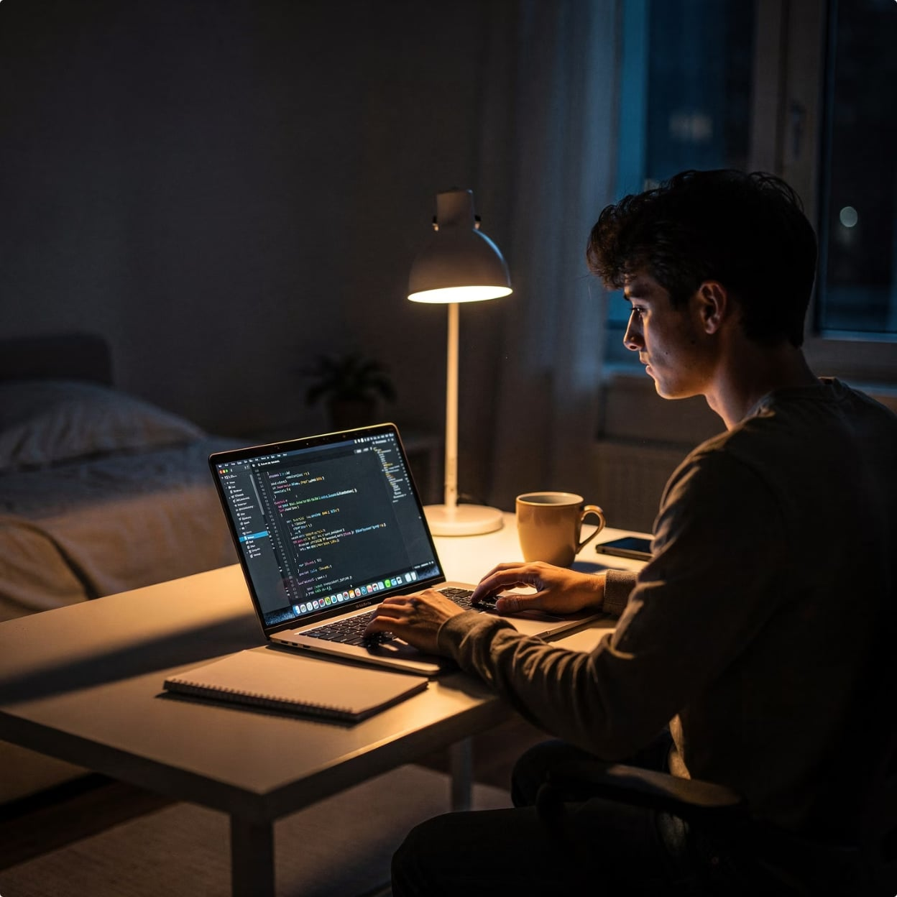
📋 ASSIGNMENT
Take It Further — Improve Your Project
Forgot Password UI
Build the UI for a forgot password flow — form with email input and a confirmation message. (No email sending required — just the interface.)
Profile Picture
Add a profile picture column to the users table. Display the avatar in the navbar and on a profile page.
Change Password UI
Build a "Change Password" form that accepts current password, new password, and confirm password fields.
Push to GitHub
You have a working secure login system. Now push it further. These improvements will make your project look production-ready — the kind of portfolio piece that impresses in interviews.
Commit all changes with a meaningful message and push to your GitHub repo. Share the link with your trainer.

Slide 19
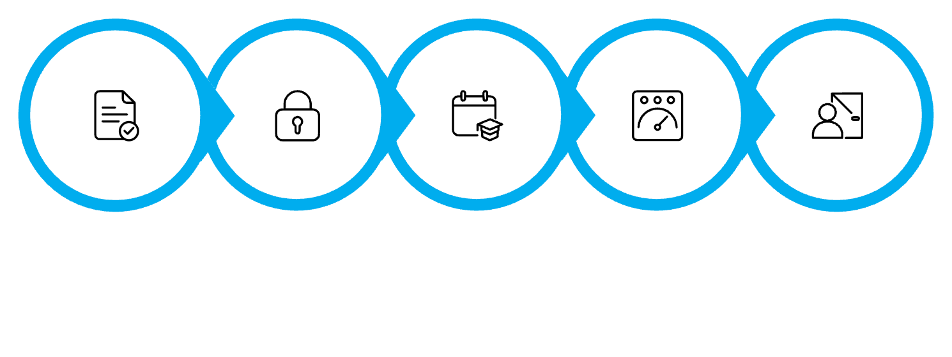
🏁 DAY RECAP
Today's Achievement — You Built This
✅ Login Page
Bootstrap form, POST submission, clean UI
✅ Authentication
SQL query against MySQL users table
Login Form
PHP Auth
Session Created
Protected Dashboard
Logout
✅ Sessions
"Before today, your Student Management System was open to the world. Right now, it's protected. You built that from scratch in under 3 hours. That's real engineering."
session_start(), $_SESSION, user data stored
✅ Protected Pages
Session guard on every CRUD page
✅ Logout
Session destroyed, redirect to login

Slide 20



COMING TOMORROW — DAY 12 OF 13
Making Your Project Production Ready
🔍 Search
Add live search to your student list — filter records in real time
📄 Pagination
Handle large datasets gracefully with MySQL LIMIT and OFFSET
📊 Dashboard
Add stats cards — total students, recent additions, summary metrics
✨ Final Polish
Professional navigation, responsive layout, portfolio-ready finish
Today you secured your application. Tomorrow you'll transform it into a professional project you can proudly show to any employer. 🚀

