Slide 1


Day 12: Making Your Project Production Ready
File Uploads, Search & Project Polish
📸 Profile Photos
✨ Project Polish
Upload & display student images
Professional UI & dashboard
🔍 Search
🚀 Demo Ready
Filter records in real time
Ship a production-grade app

Slide 2

Opening Hook
Why Do LinkedIn & Facebook Allow Profile Photos?
Think about the last time you visited a student portal, a company directory, or a social profile. The first thing your eye goes to is the photo. A face makes a record feel real — it builds trust and professionalism instantly.
Before
Raw table of names, no faces, no identity
Would your Student Management System feel complete without profile pictures? Right now it's a list of names. Today, we turn it into a professional application.
After
Photo + name + branch — a real student profile

Slide 3

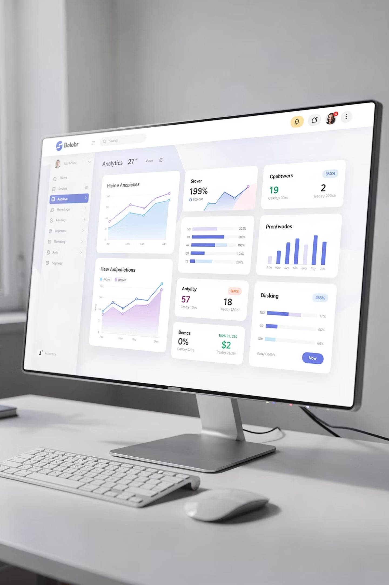
Today's Mission
Build a Professional Student Management System
Profile Photo Upload
Let users upload & display images
Student Search
Filter by name, branch, or course
Better Dashboard
Stats cards, icons, responsive layout
Project Review
Validate, test, and polish before demo day

Slide 4

⚡ Rapid Fire Recap
Pair Discussion — 5 Minutes
Turn to your partner. Answer these five questions out loud. If you can explain it clearly, you own it.
1
2
3
Sessions
Login vs Auth
CRUD
What is the purpose of PHP sessions? When do they start and end?
What is the difference between logging in and authentication?
Name the four operations and give one SQL example for each.
4
5
Primary Keys
Form Validation
Why does every table need a primary key?
Why validate on the server side, not just the browser?
Students should NEVER go 10 minutes without writing code. Keep this to 5 minutes max — then jump straight into Module 1.

Slide 5

MODULE 1 — FILE UPLOAD
How File Uploads Work in PHP
HTML Form
Receive $_FILES
Save File
Store Filename
3 Things You Must Know
Minimum Viable Upload Form
enctype="multipart/form-data" — required on the form tag or the file never arrives
$_FILES['photo'] — PHP's superglobal that holds the uploaded file data
move_uploaded_file() — moves the temp file to your uploads/ folder
<form method="POST"
enctype="multipart/form-data">
<input type="file"
name="photo">
<button>Upload</button>
</form>

Slide 6

MODULE 1 — FILE UPLOAD
Live Code: PHP File Upload Handler
Type this out — do NOT copy-paste. Understanding comes from typing it yourself.
<?php
if ($_SERVER['REQUEST_METHOD'] == 'POST') {
$allowed_types = ['image/jpeg', 'image/png', 'image/gif'];
$file = $_FILES['photo'];
// Basic validation
if (!in_array($file['type'], $allowed_types)) {
die("Error: Only JPG, PNG, GIF allowed.");
}
if ($file['size'] > 2 * 1024 * 1024) {
die("Error: File too large (max 2MB).");
}
// Generate unique filename
$ext = pathinfo($file['name'], PATHINFO_EXTENSION);
$filename = uniqid('student_') . '.' . $ext;
$dest = 'uploads/' . $filename;
if (move_uploaded_file($file['tmp_name'], $dest)) {
// Save $filename to DB ← your next step
echo "Upload successful!";
}
}
?>
Always validate file type AND file size server-side. Never trust the browser's file picker alone.

Slide 7
🎯 MISSION + 🏆 CHALLENGE
Module 1 Mission: Upload Profile Picture
🎯 Mission Requirements
🏆 Challenge
Add a file input to the Add/Edit Student form
Upload the image file to the uploads/ folder
Save the filename to a photo column in your students table
Display the photo in the student list and profile view
Show a default avatar when no photo is uploaded — use a placeholder image from assets/
Bonus: Display a Bootstrap success alert after a successful upload
Super Bonus: Preview the image in the browser before the form submits using JavaScript
SQL Hint
Display Hint
Default Hint
ALTER TABLE students ADD photo VARCHAR(255);
<img src="uploads/<?= $row['photo'] ?>">
$photo = $row['photo'] ?: 'assets/default.png';

Slide 8
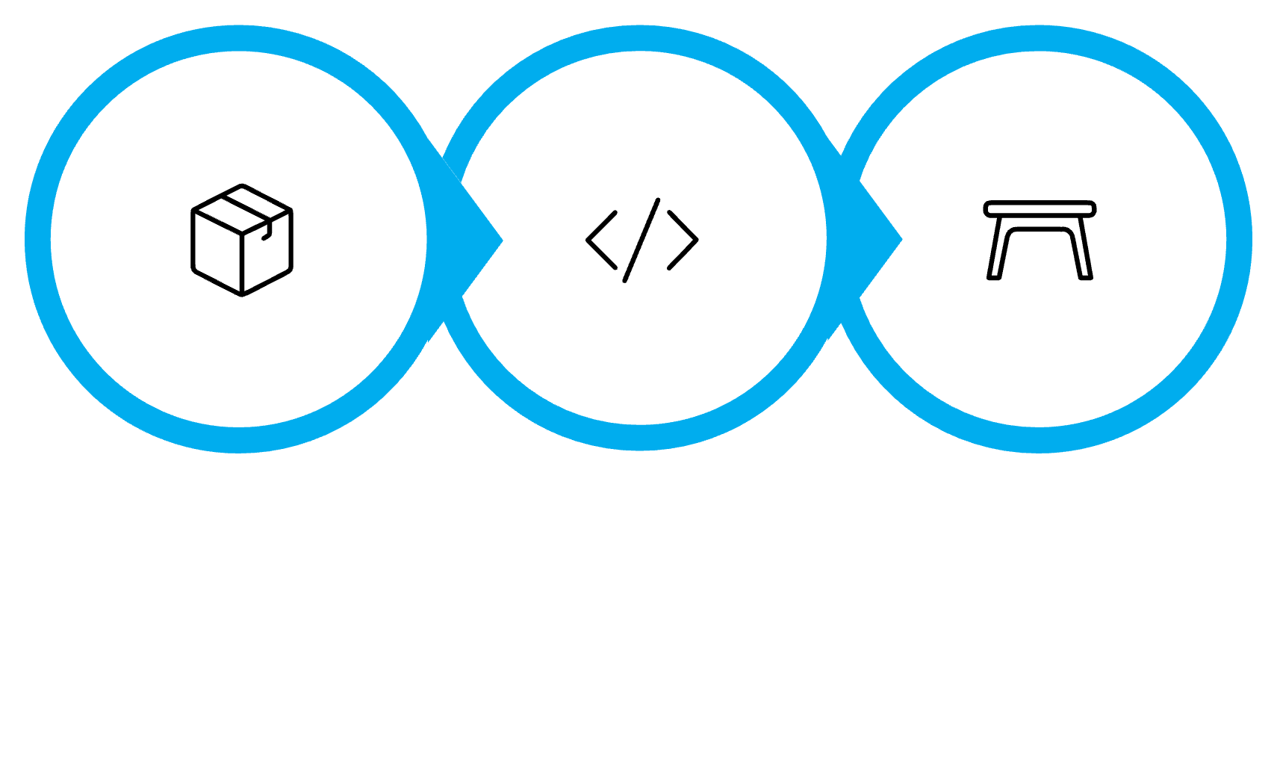
MODULE 2 — SEARCH
How Student Search Works
Enter Query
Build SQL
Show Results
The SQL Pattern
PHP: Capture & Sanitize
SELECT * FROM students
WHERE name LIKE '%search%'
OR branch LIKE '%search%'
OR course LIKE '%search%';
$search = '';
if (isset($_GET['q'])) {
$search = trim($_GET['q']);
}
$like = '%' . $search . '%';
$stmt = $pdo->prepare(
"SELECT * FROM students
WHERE name LIKE ?
OR branch LIKE ?
OR course LIKE ?"
);
$stmt->execute([$like,$like,$like]);

Slide 9

MODULE 2 — SEARCH
Live Code: Search Form HTML
Add this search bar above your student table. It submits via GET so the query stays in the URL — bookmarkable and shareable.
<!-- Search Bar (Bootstrap 5) -->
<form method="GET" action="students.php" class="d-flex mb-3">
<input
type="search"
name="q"
class="form-control me-2"
placeholder="Search by name, branch or course..."
value="<?= htmlspecialchars($search) ?>"
>
<button class="btn btn-primary" type="submit">
<i class="bi bi-search"></i> Search
</button>
</form>
<!-- Show result count -->
<?php if ($search): ?>
<p class="text-muted">
Results for: <strong><?= htmlspecialchars($search) ?></strong>
(rowCount() ?> found)
</p>
<?php endif; ?>
Always use htmlspecialchars() when echoing user input back into HTML to prevent XSS attacks.

Slide 10
🎯 MISSION + 🏆 CHALLENGE
Module 2 Mission: Implement Student Search
🎯 Mission Requirements
Empty State
Add the search form above your student list table
Write the PHP + SQL to filter results using LIKE
Show a "no results found" message when the query returns zero rows
Persist the search term in the input field after submission
When no rows returned, show: "No students found matching your search."
🏆 Challenge
Highlight Hint
str_replace($search, "<mark>$search</mark>", $row['name'])
Search across name, branch, and course simultaneously using a single query
Bonus: Highlight the matching keyword inside the table results using <mark>
Count Hint
Use $stmt->rowCount() to show total results found

Slide 11
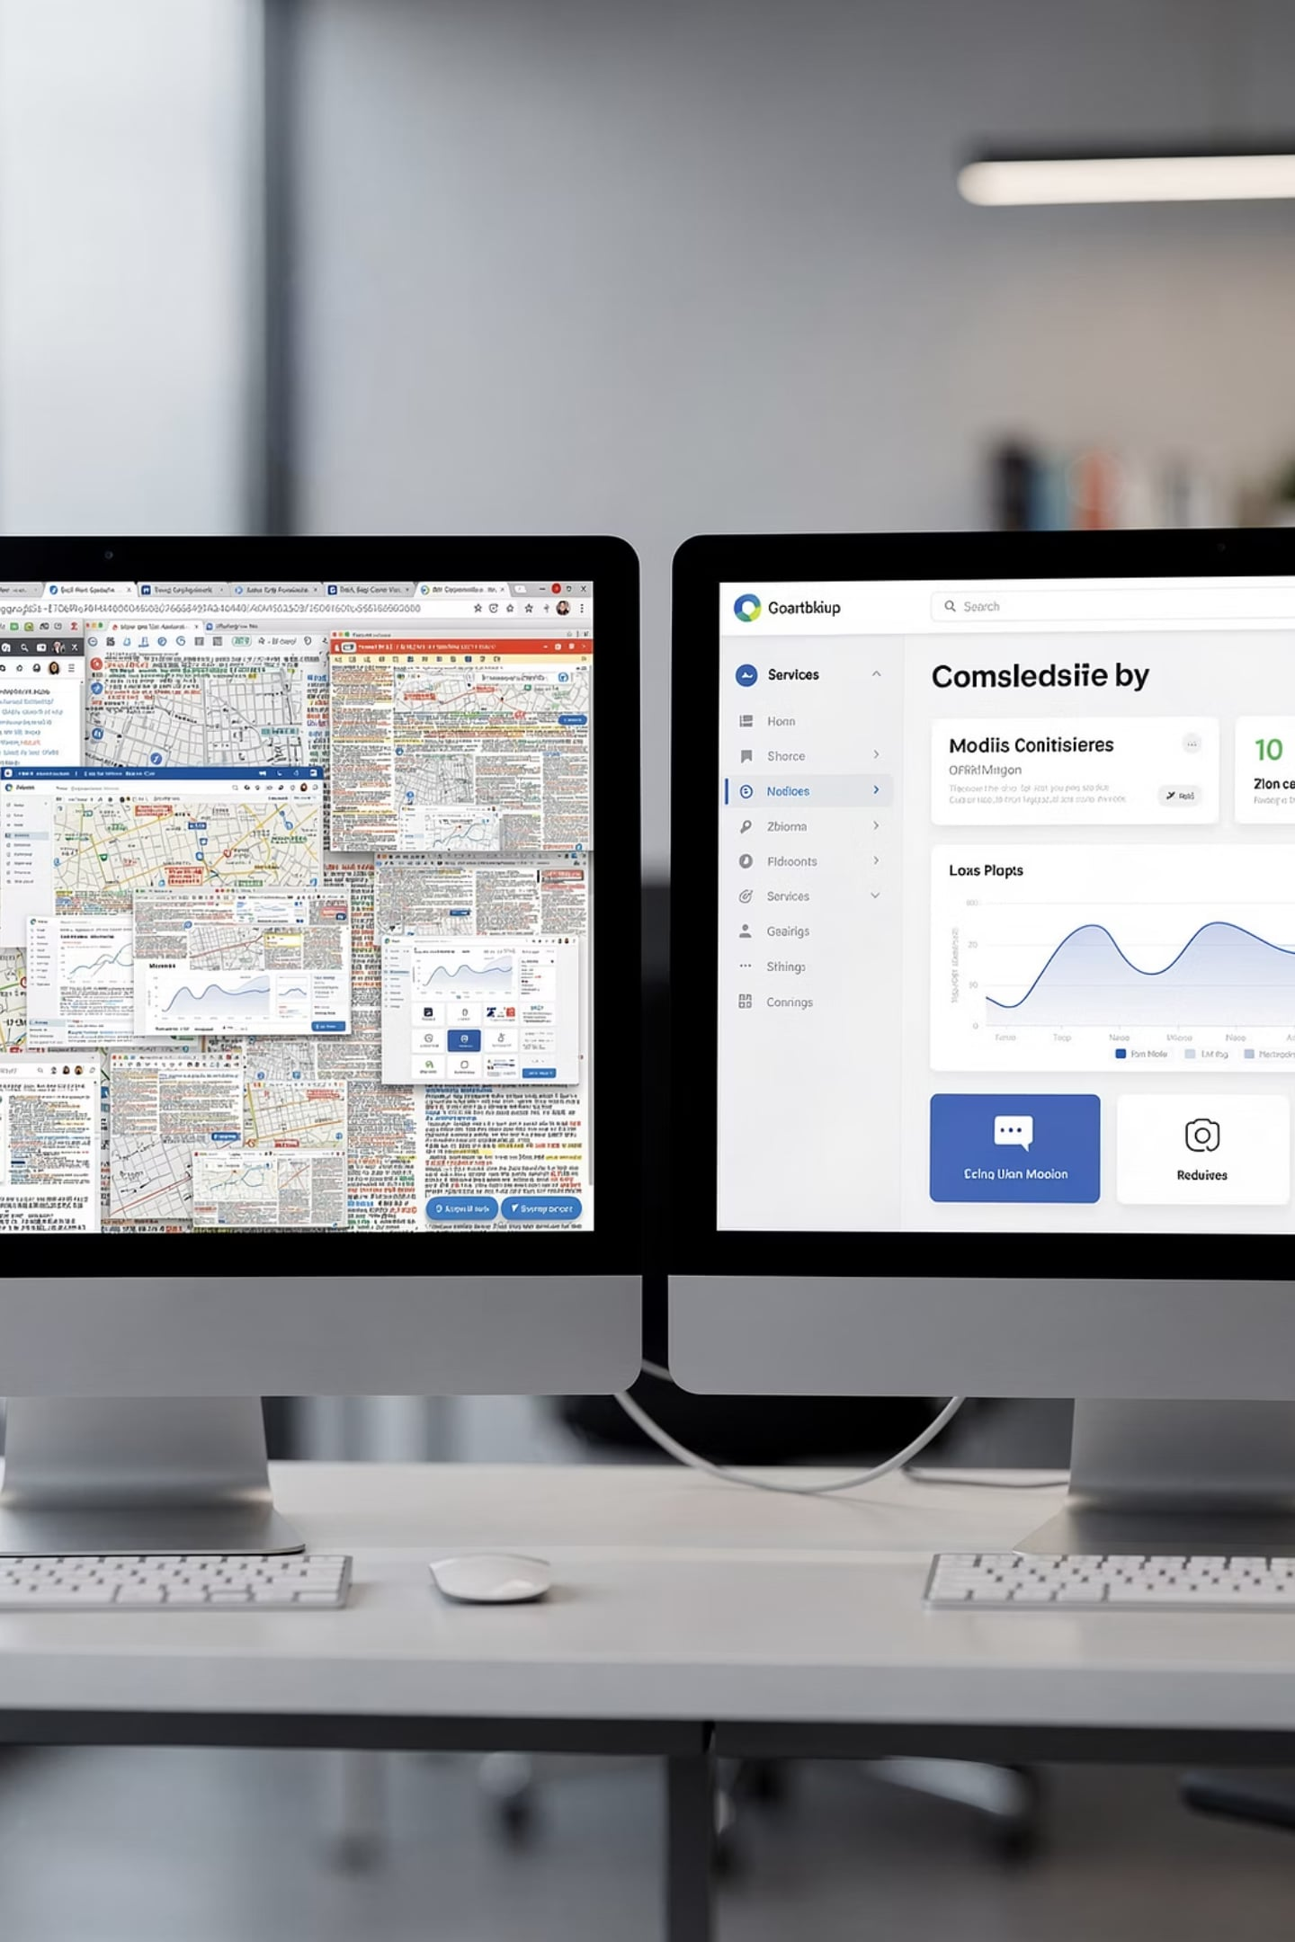
MODULE 3 — PROJECT POLISH
UI Polish: Before vs. After
❌ Before
Plain HTML table, no Bootstrap classes
No icons anywhere on the page
Blue default hyperlinks as nav items
No dashboard stats — just a raw list
No empty-state messages
✅ After
table-striped table-hover with avatar column
Bootstrap Icons on every button and nav link
Navbar with active states and dropdown
Stats cards at top: Total Students, New This Week
Friendly empty state with a call-to-action button

Slide 12
MODULE 3 — LIVE CODING
Live Code: Dashboard Stats Cards
Add this Bootstrap card row at the top of your dashboard. It's the first thing the client sees — make it count.
<!-- Fetch total count -->
<?php
$total = $pdo->query("SELECT COUNT(*) FROM students")->fetchColumn();
$recent = $pdo->query(
"SELECT COUNT(*) FROM students
WHERE created_at >= DATE_SUB(NOW(), INTERVAL 7 DAY)"
)->fetchColumn();
?>
<div class="row g-3 mb-4">
<div class="col-md-4">
<div class="card border-0 shadow-sm">
<div class="card-body">
<h6 class="text-muted">Total Students</h6>
<h2 class="fw-bold text-primary"><?= $total ?></h2>
</div>
</div>
</div>
<div class="col-md-4">
<div class="card border-0 shadow-sm">
<div class="card-body">
<h6 class="text-muted">Added This Week</h6>
<h2 class="fw-bold text-success"><?= $recent ?></h2>
</div>
</div>
</div>
</div>

Slide 13
🎯 MISSION + 🏆 CHALLENGE
Module 3 Mission: Improve the Student Dashboard
🎯 Mission Requirements
🏆 Challenge
Add a Bootstrap 5 navbar with active link highlighting
Add Bootstrap Icons to all buttons: Add, Edit, Delete, Search
Replace raw table with table-striped table-hover
Add student avatar thumbnail in the table's first column
Make the layout responsive on mobile using col-md-*
Display a "Total Students" stat card on the dashboard using COUNT(*)
Bonus: Add a "Recent Registrations" widget showing the last 5 students added
Super Bonus: Add a CSS fade-in animation when the dashboard loads
Bootstrap Icons CDN: https://cdn.jsdelivr.net/npm/bootstrap-icons/font/bootstrap-icons.css

Slide 14
MODULE 4 — PROJECT REVIEW
How to Review a Project Before Delivery
Professional developers don't just build — they review. Before any demo or client handoff, run through this checklist systematically.
Form Validation
No Broken Links
Empty States
Every form has server-side validation. Empty fields and wrong types show clear error messages.
Click every nav item, every button. A broken link in a demo kills credibility instantly.
What does the page look like with zero students? Show a friendly message, not a blank table.
Mobile View
Session Guard
Open DevTools → Toggle Device Toolbar. Does it still look good on a phone?
Log out and try accessing dashboard.php directly. You must be redirected to login.

Slide 15
🎯 MISSION + 🏆 CHALLENGE
Module 4 Mission: Review Another Team's Project
🎯 Mission — Exchange Laptops
🏆 Challenge: Find 5 Improvements
Swap your laptop with another team. You have 10 minutes to review their project as if you were the client receiving it for the first time.
Write down exactly 5 specific improvements the other team should make before tomorrow's demo. Be constructive and precise:
Test every page and every link
Try to break the search with special characters
Upload an oversized or wrong file type
Attempt to access the dashboard without logging in
Check mobile responsiveness
1
What's broken?
2
What's missing?
3
What could be clearer?
Hand back the laptop with your written feedback. The other team has 5 minutes to fix the top priority item.

Slide 16

🐛 BUG HUNT
Spot the Bug — 5 Broken Things
This Student Management System has five real bugs. Can you find them all before the reveal?
1
Broken Upload
File uploads silently fail. No error. No file saved. What's missing from the form tag?
2
Wrong Search
Search returns every student regardless of the keyword. What's wrong with the SQL query?
3
Missing Image
Student profile shows a broken image icon. Why doesn't the fallback default image appear?
4
Broken Navigation
The "Edit Student" link throws a 404. What's wrong with the URL construction?
5
Missing Session
You can access dashboard.php without logging in. What single line is missing at the top of the file?
Trainer reveals each bug with the corrected code snippet after students have had 5 minutes to discuss in pairs.

Slide 17







🚀 BUILD SPRINT
30-Minute Build Sprint — Client Demo Tomorrow
This is your final window to polish your project before the big day. Work fast, work smart.
Fix Bugs
Address the issues found during peer review first
Polish UI
Icons, cards, spacing, colors — make it look professional
Test Everything
CRUD, login, upload, search, mobile view
Push to GitHub
Commit with a meaningful message before time is up
⏱ 30-minute timer is running. Your project must be demo-ready when it ends. No extensions tomorrow.

Slide 18
🎤 DEMO PREPARATION
Prepare Tomorrow's 3-Minute Demo
Every team prepares a structured walkthrough. The trainer will review your demo flow before you present. Think of it as a product pitch, not just a code show-and-tell.
Demo Day Rules
3 minutes max — practice to a timer
Every team member must speak at least once
Live demo on localhost — no slides allowed
Be ready to answer technical questions
Trainer will ask: "How would you add X feature?"
01
02
Project Story
Feature Walkthrough
What problem does it solve? Who is it for?
Live demo: login → CRUD → upload → search
03
04
Architecture
Challenges & Learning
Briefly explain your file structure and DB schema
One thing that was hard and how you solved it

Slide 19
🧠 INTERVIEW QUIZ
Quick-Fire Interview Questions
These are real questions you'll face in internship and job interviews. Answer in 30 seconds each — no notes.
Q1
Q2
What is the purpose of file uploads in a web application? Give one real-world example.
Why must you validate uploaded files on the server? What could go wrong if you don't?
Q3
Q4
What is the purpose of PHP sessions? How do you start and destroy one?
What is the difference between CRUD operations and authentication?
🔮 Predict the Output
$search = "Ali";
$like = "%" . $search . "%";
echo $like;
What does this print? Why does it matter in a SQL LIKE query?

Slide 20
📋 ASSIGNMENT
Tonight's Assignment: Final Project Preparation
📋 Required — Due Before Demo
🏆 Bonus Points
Complete all features: CRUD + Login + Upload + Search
Fix every bug identified during peer review today
Improve your UI — use Bootstrap cards, icons, and responsive layout
Add session guards to every protected page
Push final code to GitHub with a clean commit message
Prepare your 3-minute demo script — practice it aloud at least twice
Add a CSS fade-in or slide-up animation to cards
Build a better dashboard with a "Recent Registrations" table widget
Add Bootstrap Icons throughout the entire application
Implement client-side image preview before upload
Your GitHub commit history IS your portfolio. Push clean, descriptive commits — future employers will read them.

Slide 21

🏁 DAY 12 RECAP
Today's Achievement — You Built Something Real
✅ Profile Photos
File upload with type & size validation, stored in uploads/
✅ Student Search
SQL LIKE query filtering across name, branch, and course
✅ Better Dashboard
Stats cards, Bootstrap Icons, responsive Bootstrap 5 layout
✅ Project Review
Peer testing, bug hunting, and pre-demo quality checklist
Tomorrow you'll present your project like a professional software engineer. You're not a student anymore — you're a developer with a live, working application. Own it.

