Slide 1


Day 13: Project Showcase & Graduation
From Learning to Building
Building Confidence, Celebrating Success — Full Stack Web Development Bootcamp

Slide 2

Look How Far You've Come
Thirteen days ago, you opened a text editor for the first time. Today, you walk away as a full-stack web developer. Every concept, every bug, every late-night debugging session — it all led to this moment. Take a breath and celebrate the journey.
Day 1
HTML Foundations
CSS & Bootstrap
Design & Layout
JavaScript
Interactivity & Logic
PHP & MySQL
Backend & Database
CRUD & Auth
Full-Stack Systems
Day 12–13
Final Project 🎓

Slide 3
Today's Agenda
Two and a half hours of celebration, reflection, and recognition. Here's what's in store for Day 13.
Final Project Demo
Code Review
Awards
Each team presents their Student Management System live to the group.
Instructor walkthrough of standout patterns, best practices, and improvements.
Recognizing outstanding achievement across creativity, teamwork, and execution.
Certificates
Group Photo
Official certificate distribution to every graduate in the cohort.
Capture the memory — a photo of the full cohort together.

Slide 4
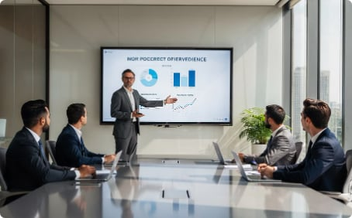

Project Showcase
Each team gets 5 minutes on stage. Walk the room through your project with confidence — you built something real.
Project overview and purpose
Key features and demo
Biggest challenge you faced
How your team solved it
One improvement for the future
Live demonstrations are encouraged — show your project running in the browser. Own the room!

Slide 5
Judging Criteria
Projects are evaluated holistically across six dimensions. Every team has the opportunity to shine in their own way.
1
2
Functionality
UI / UX
Does the application work as intended? Are core features complete and bug-free?
Is the interface clean, intuitive, and visually polished for the end user?
3
4
Code Quality
Creativity
Is the code readable, organized, and following best practices?
Did the team go beyond the baseline to add something unique or unexpected?
5
6
Teamwork
Presentation
Did the team collaborate effectively and share responsibilities?
Was the demo clear, confident, and well-structured?

Slide 6
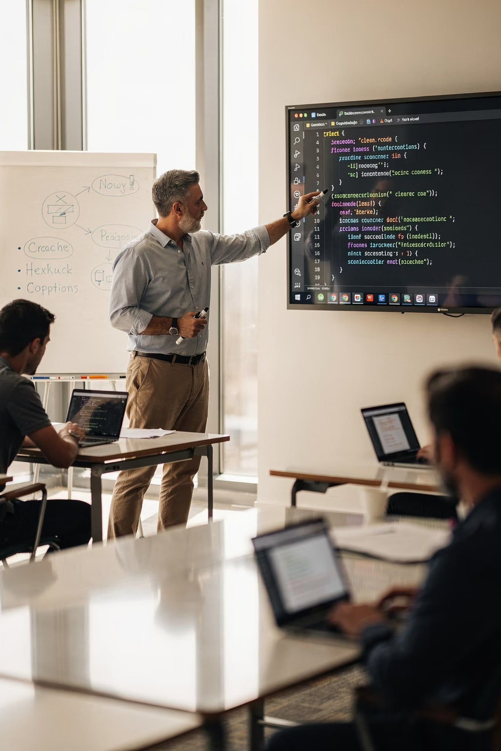
Live Code Review
This isn't about finding mistakes — it's about leveling everyone up together. The instructor will walk through selected code snippets from the projects, celebrating what was done well and demonstrating how small refinements make a big difference.
Good Practices Highlighted
Naming conventions, separation of concerns, and clean logic flow.
Common Patterns Explained
Recurring issues turned into teachable moments for the whole group.
Improvement Suggestions
Constructive ideas for refactoring and extending the projects further.

Slide 7
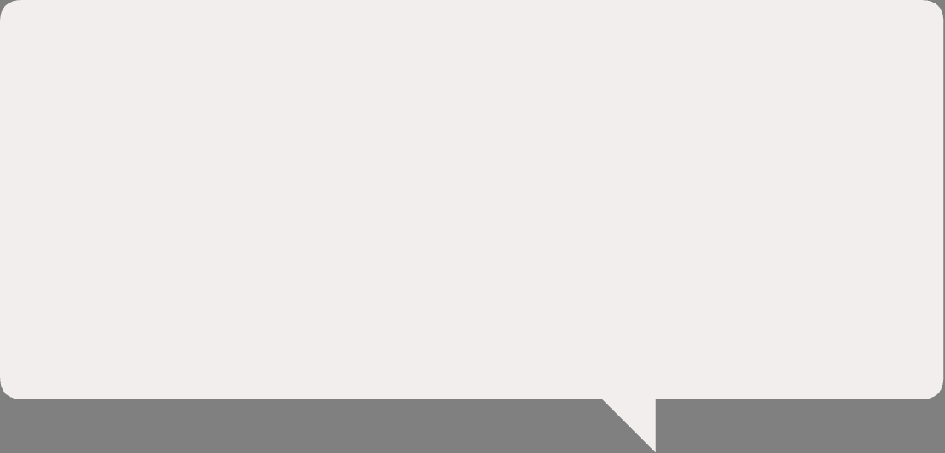

Let's Reflect Together
Before we celebrate, let's take a moment to look back. Open discussion — there are no wrong answers here.
💡 Biggest Learning
🧱 Hardest Topic
🚀 What's Next?
What concept or skill had the most impact on how you think about building software?
Which day or concept challenged you the most — and how did you push through it?
If you had two weeks free, what would you build? Dream big — then go build it.

Slide 8
Your Roadmap After Bootcamp
Graduation is not the finish line — it's the starting block. Here's a clear path to keep growing, building credibility, and landing your first opportunity in tech.
Build More Projects
Apply everything you've learned by creating original projects that solve real problems.
Push to GitHub Daily
Keep your contribution graph green. Employers look at your GitHub activity closely.
Build Your Portfolio
A polished portfolio site with 3–5 projects is your most powerful job-search tool.
Learn Laravel & React
Deepen your backend skills with Laravel and unlock modern frontend development with React.
Apply for Internships
You're ready. Start applying for junior roles and internships — confidence comes from action.

Slide 9

Congratulations, Graduates! 🎓
Keep Building. Keep Learning. Keep Growing.
To every student who showed up, struggled, persisted, and shipped — this certificate is yours. You didn't just learn to code. You learned to think like a developer. That changes everything.

Slide 10
Thank You
A heartfelt thank you to every student, facilitator, and supporter who made this cohort extraordinary.
🙌 To the Students
👨‍🏫 To the Trainers
🌍 To the Community
Your curiosity, resilience, and energy made every day worth showing up for. You are the reason this works.
Thank you for your patience, creativity, and dedication to making complex ideas feel approachable.
Every project you build from here adds value to the world. Go build something amazing.
"The best time to start was Day 1. The second best time is right now." — Keep coding. 🚀

