Slide 1

FOODTRENDS UNDERSTANDING CUSTOMER PREFERENCES IN FB
Submitted By: Vanshika
TEAM B

Slide 2
PROJECT OBJECTIVE & DESCRIPTION
Objective:
To analyse 138,000+ transaction records to bridge the gap between "Customer Demand" (what they order) and "Operational Supply" (how we deliver).
Description:
The FB industry operates on thin margins. This project utilises Power BI to transform raw transactional data into a strategic decision-support system, focusing on Menu Optimisation, Logistics Efficiency, and Customer Segmentation.

Slide 3
SYSTEM DESIGN & WORKFLOW
Data Architecture:
Implemented a Star Schema Data Model connecting a central Fact_Orders table to 5 Dimension tables (Dim_Customer, Dim_Restaurant, etc.).
ETL:
Cleaned null ratings and standardised city names using Power Query to ensure data integrity.
Modelling:
Established active One-to-Many relationships for accurate filtering and robust data analysis.
Visualisation:
Built 7 interactive dashboards for end-to-end analysis, providing comprehensive insights.

Slide 4
PROJECT EXECUTION MILESTONES
  Milestone 3: Deep Dive
  Added Menu Analysis and Sentiment Analysis pages.
  Updated documentation to include new DAX measures for product performance
Milestone 1: Data Discovery
  Collected raw datasets from Kaggle and performed extensive cleaning.
  Created technical documentation for all preprocessing steps (handling nulls in ratings, fixing date formats, and normalizing text).
  Milestone 2: Core Analysis
  Built foundational views: Market Demand, Customer Segments, and Service Quality.
  Completed first set of Team and Individual documentation to track design choices
  Milestone 4: Advanced Strategy
  Developed the final complex pages: Operational Efficiency and Growth & Loyalty.
  Finalized all project docs, including individual analysis of business "friction points

Slide 5
TOP VISUALISATIONS USED
Operational Stress Test (Line & Column Chart):
Service Friction Map (Bubble Chart):
Purpose: To map the relationship between distance and delivery time to find our "Maximum Service Radius."
Purpose: To identify the exact time when delivery speed "breaks" due to high order volume.

Slide 6
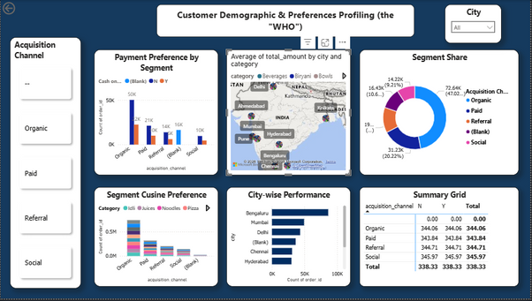
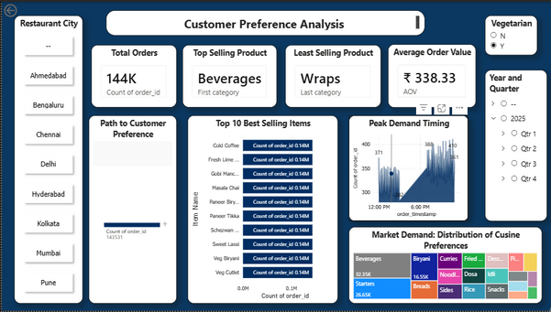
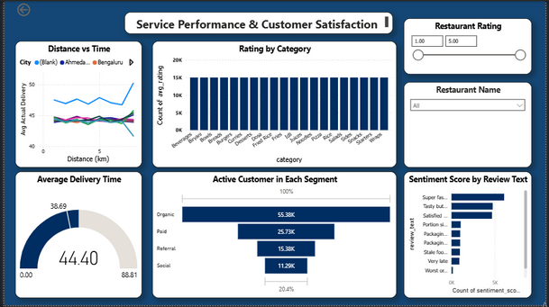
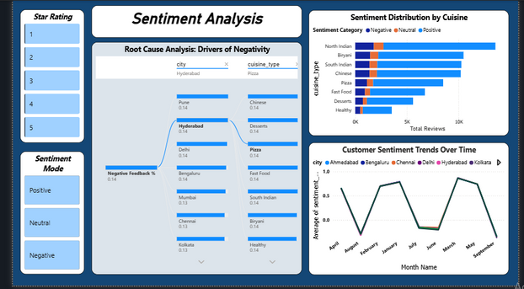
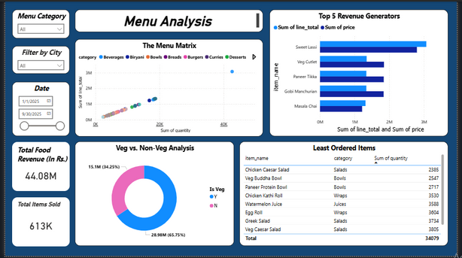
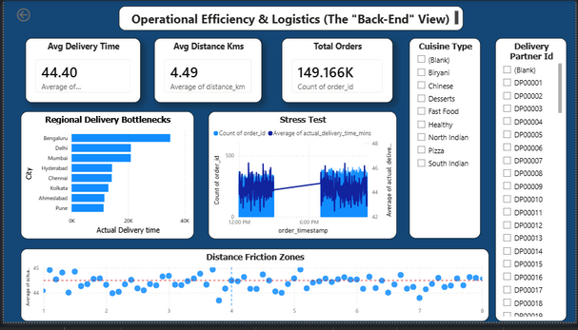
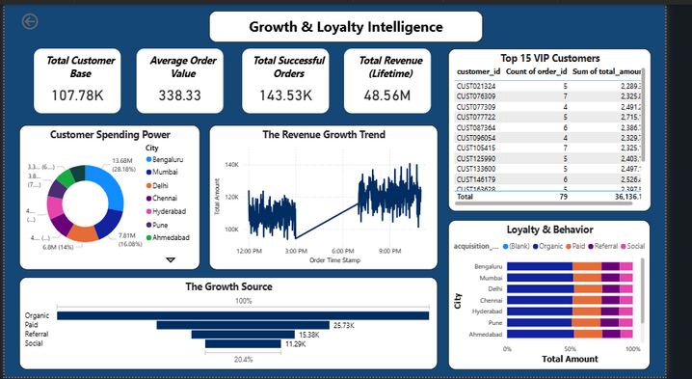
DASHBOARD SHOWCASE

Slide 7

CHALLENGES & RESOLUTIONS
Challenge 1: Visual Performance Lag
Plotting 138k individual points on a Scatter Plot caused system crashes.
Resolution:
Aggregated the data by "Restaurant Name" to optimise rendering speed and maintain system stability.
Challenge 2: Inactive Relationships
Revenue visuals flat-lined due to disconnected tables, leading to inaccurate reporting.
Resolution:
Rebuilt the Star Schema to ensure proper cross-filtering between Dimensions and Facts, restoring data integrity.

Slide 8
TECHNOLOGIES & SKILLS GAINED
This internship provided an invaluable opportunity to apply and enhance a diverse set of technical skills, utilising industry-standard tools to deliver a robust analytics solution.
Core Tech Stack
Power BI Desktop
Primary tool for data visualisation and report creation.
Power Query Editor
Essential for data extraction, transformation, and loading processes.
DAX
Data Analysis Expressions for complex calculations and measures.
Key Skills Gained
Data Modelling
Mastery in designing efficient Star Schema relationships for optimal performance
Advanced Analytics
Ability to create dynamic measures for SLA Adherence and Customer Retention metrics.
Soft Skills Development
Developed critical Data Storytelling abilities to present complex insights effectively to stakeholders and drive action.

Slide 9
KEY BUSINESS INSIGHTS:
  Logistics is the Bottleneck: The 39% On-Time Delivery Rate is a critical operational failure. Immediate fleet expansion is required in Hyderabad and Mumbai to stop customer churn.
  The "Organic" Engine: Organic users make up 52% of the customer base and show higher retention. Shift marketing to "Retention Rewards" for this loyal segment.
  The Volume Trap: "Beverages" have low individual profit margins despite high volume. Implement "Combo Meals" to increase Average Order Value (AOV).
FUTURE ENHANCEMENTS:
  Row-Level Security (RLS): Implement security roles to restrict access, allowing Branch Managers to view only their specific City's data.
  What-If Parameters: Add interactive sliders to simulate business scenarios (e.g., "If we discount Biryani by 10%, how much will Revenue increase?").
  Mobile Layout Optimisation: Design a specific "Mobile View" of the Logistics Dashboard for Area Managers to monitor live fleet performance on their smartphones.

Slide 10
CONCLUSION, ACKNOWLEDGEMENT & REFERENCES
Conclusion:
The project successfully identified that whilst the Menu is profitable, Last-Mile Delivery requires restructuring. The data proves that speed is the strongest predictor of customer satisfaction.
References:
  Infosys Springboard Virtual Internship Course Materials.
  Microsoft Power BI Documentation.
  Food Industry Logistics Case Studies.
  Kaggle Dataset: Zomato Food Delivery Data.
Acknowledgement:
I would like to express my heartfelt gratitude to:
  Infosys Springboard Team for organizing this valuable internship opportunity.
  My Mentor (Nityasree Ma’am)– for her continuous support and feedback.
  My Teammates (Shashank,Garvit) – for collaboration, encouragement, and insights.
This internship has been a significant step in my professional growth and technical journey.

Slide 11
Thank You vanshikawadhwa20@gmail.com

