Slide 1

INFOSYS SPRINGBOARD VIRTUAL INTERNSHIP 6.0 FOODTRENDS UNDERSTANDING CUSTOMER PREFERENCES IN FB Group 1 – Batch 11 TEAM B
Submitted By: Vanshika
Submitted To: Nityasree

Slide 2
PROJECT OBJECTIVE & DESCRIPTION
Objective:
To analyze over 138,000 transaction records and transform raw data into a strategic decision-support system. The primary objective is to bridge the gap between Customer Demand and Operational Supply by moving beyond simple reporting to Root Cause Analysis. This involves pinpointing specific logistics bottlenecks, optimizing menu pricing strategies to boost Average Order Value (AOV), and identifying retention risks within the customer base to drive sustainable revenue growth.
Description:
In the competitive FB landscape, operational efficiency is directly tied to profitability. This project deploys Microsoft Power BI to engineer a full-scale analytical solution. Starting with raw data ingestion and ETL transformation, we constructed a Star Schema data model to simulate real-world business scenarios. The final dashboard ecosystem focuses on Menu Optimization (identifying "Cash Cows" vs. "Dogs"), Logistics Performance, and Customer Sentiment, providing stakeholders with the actionable intelligence needed to reduce churn and increase Average Order Value (AOV).

Slide 3
SYSTEM DESIGN & WORKFLOW
Data
collection & pre-
processing
Visulaization and Insights
Business understand
Data Modeling
Business Understanding:
Implemented a Star Schema Data Model connecting a central Fact_Orders table to 5 Dimension tables (Dim_Customer, Dim_Restaurant, etc.).
Data Collection & pre-processing:
Cleaned null ratings and standardised city names using Power Query to ensure data integrity.
Modelling:
Established active One-to-Many relationships for accurate filtering and robust data analysis.
Visualisation:
Built 7 interactive dashboards for end-to-end analysis, providing comprehensive insights.

Slide 4
PROJECT EXECUTION MILESTONES
Milestone 3: Deep Dive
Added Menu Analysis and Sentiment Analysis pages.
Updated documentation to include new DAX measures for product performance
Milestone 1: Data Discovery
Collected raw datasets from Kaggle and performed extensive cleaning.
Created technical documentation for all preprocessing steps (handling nulls in ratings, fixing date formats, and normalizing text).
Milestone 2: Core Analysis
Built foundational views: Market Demand, Customer Segments, and Service Quality.
Completed first set of Team and Individual documentation to track design choices
Milestone 4: Advanced Strategy
Developed the final complex pages: Operational Efficiency and Growth & Loyalty.
Finalized all project docs, including individual analysis of business "friction points

Slide 5
TOP VISUALISATIONS USED
Operational Stress Test (Line & Column Chart):
Service Friction Map (Bubble Chart):
Purpose: To map the relationship between distance and delivery time to find our "Maximum Service Radius."
Purpose: To identify the exact time when delivery speed "breaks" due to high order volume.

Slide 6
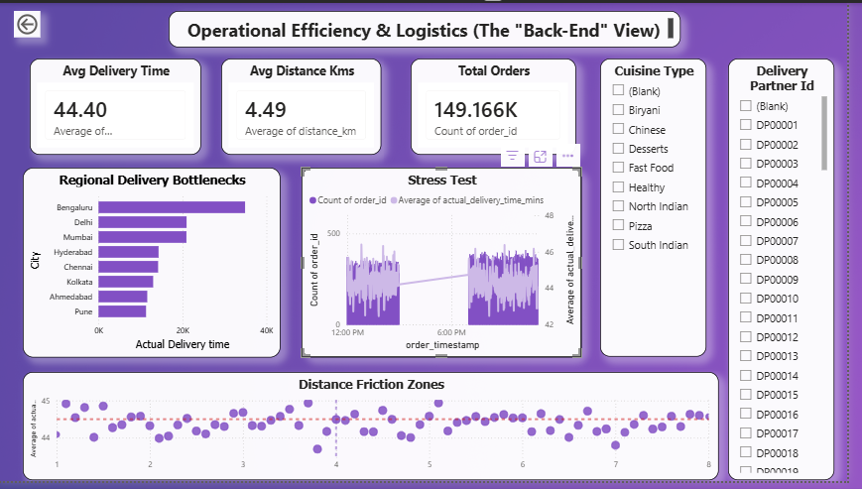
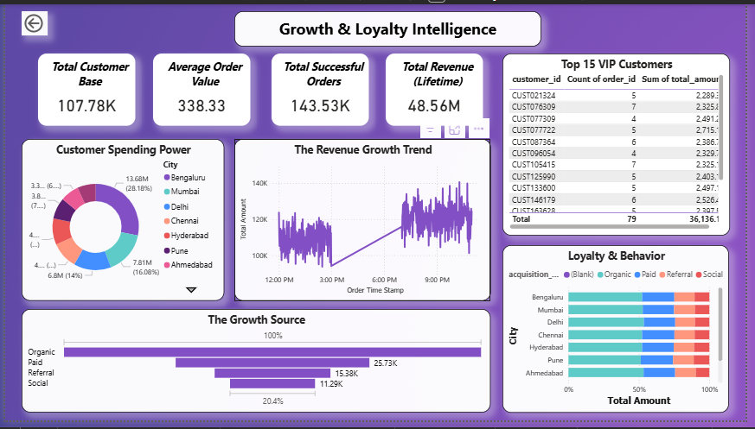
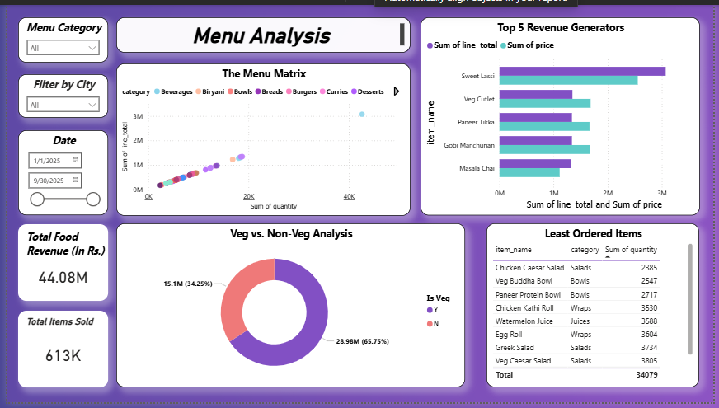
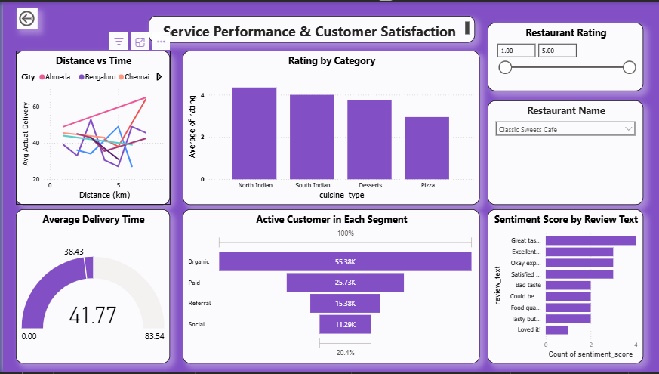
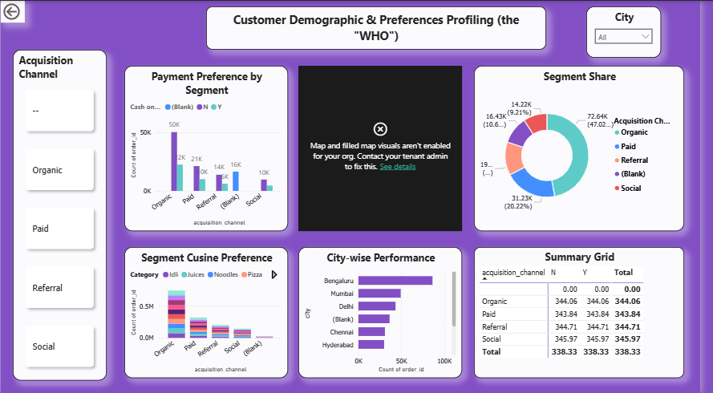
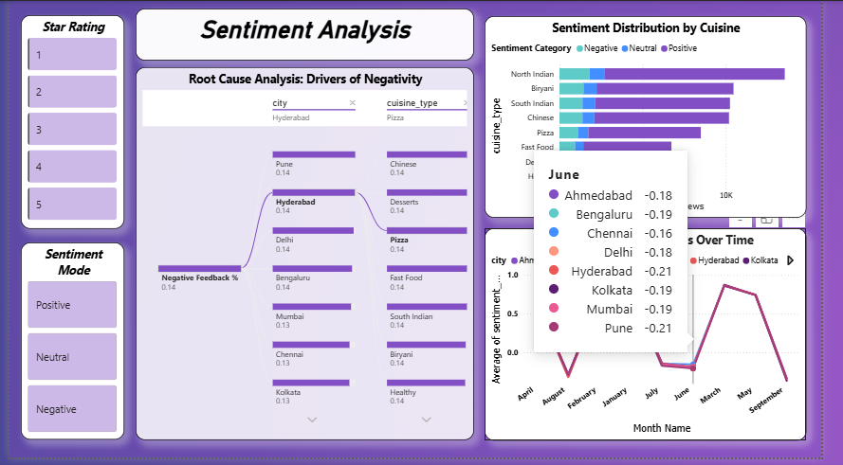
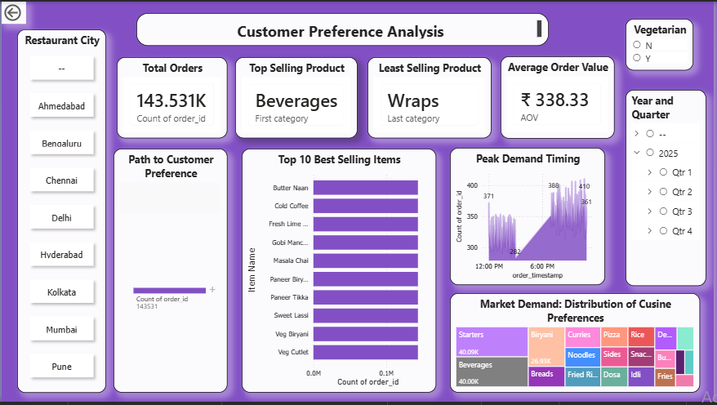
DASHBOARD SHOWCASE

Slide 7
CHALLENGES & RESOLUTIONS
Challenge 1: Visual Performance Lag
Plotting 138k individual points on a Scatter Plot caused system crashes.
Resolution:
Aggregated the data by "Restaurant Name" to optimise rendering speed and maintain system stability.
Challenge 2: Inactive Relationships
Revenue visuals flat-lined due to disconnected tables, leading to inaccurate reporting.
Resolution:
Rebuilt the Star Schema to ensure proper cross-filtering between Dimensions and Facts, restoring data integrity.

Slide 8
TECHNOLOGIES & SKILLS GAINED This internship provided an invaluable opportunity to apply and enhance a diverse set of technical skills, utilising industry-standard tools to deliver a robust analytics solution.
Core Tech Stack
Power BI Desktop
Primary tool for data visualisation and report creation.
Power Query Editor
Essential for data extraction, transformation, and loading processes.
DAX
Data Analysis Expressions for complex calculations and measures.
Github ,Gitlab,Microsoft team etc.
Key Skills Gained
Data Modelling
Mastery in designing efficient Star Schema relationships for optimal performance
Advanced Analytics
Ability to create dynamic measures for SLA Adherence and Customer Retention metrics.
Soft Skills Development
Developed critical Data Storytelling abilities to present complex insights effectively to stakeholders and drive action.

Slide 9
KEY BUSINESS INSIGHTS:
Logistics is the Bottleneck: The 39% On-Time Delivery Rate is a critical operational failure. Immediate fleet expansion is required in Hyderabad and Mumbai to stop customer churn.
The "Organic" Engine: Organic users make up 52% of the customer base and show higher retention. Shift marketing to "Retention Rewards" for this loyal segment.
The Volume Trap: "Beverages" have low individual profit margins despite high volume. Implement "Combo Meals" to increase Average Order Value (AOV).
FUTURE ENHANCEMENTS:
Row-Level Security (RLS): Implement security roles to restrict access, allowing Branch Managers to view only their specific City's data.
What-If Parameters: Add interactive sliders to simulate business scenarios (e.g., "If we discount Biryani by 10%, how much will Revenue increase?").
Mobile Layout Optimisation: Design a specific "Mobile View" of the Logistics Dashboard for Area Managers to monitor live fleet performance on their smartphones.

Slide 10
CONCLUSION, ACKNOWLEDGEMENT & REFERENCES
Conclusion:
Operational Gap: The analysis reveals a critical disconnect between product strength and service execution. While the menu is highly profitable, a 39% delay rate in last-mile delivery is the primary bottleneck.Customer Retention: Data indicates that speed, not price, is the strongest predictor of customer loyalty. Immediate restructuring of logistics SLAs is required to reduce churn among "Organic" users.Business Impact: The project confirms that data-driven decision-making can transform raw numbers into actionable strategies for Menu Engineering and cost optimization.
References:
Infosys Springboard Virtual Internship Course Materials.
Microsoft Power BI Documentation.
Food Industry Logistics Case Studies.
Kaggle Dataset: Zomato Food Delivery Data.
Acknowledgement:
I would like to express my heartfelt gratitude to:
Infosys Springboard Team for organizing this valuable internship opportunity.
My Mentor (Nityasree Ma’am)– for her continuous support and feedback.
My Teammates (Shashank,Garvit) – for collaboration, encouragement, and insights.
This internship has been a significant step in my professional growth and technical journey.

Slide 11
Thank You vanshikawadhwa20@gmail.com

