Slide 1
Strategic Portfolio Analysis and Investment Consultation for Clients
BY
GARVIT SUNEJA
SHIVANI SIDDHU

Slide 2
01
objective
02
Key discovery
Table of contents
03
Portfolio analysis
04
methodology

Slide 3
OBJECTIVE
We'll be analyzing a collection of stocks within a portfolio to provide tailored investment guidance for two distinct investors: Mr. Patrick Jyenger and Mr. Peter Jyenger.
Mr. Patrick Jyenger's Profile:
Investment Allocation: $500,000 to equities.
Investment Approach: Conservative.
Financial Objective: Double capital within a 5-year period while minimizing risk.
Mr. Peter Jyenger's Profile:
Investment Allocation: $1 million to equities.
Investment Approach: High-risk.
Financial Objective: Double capital within a 5-year timeframe, embracing higher risk for potential high returns.
For Mr. Patrick Jyenger, we will focus on stable and established companies with consistent performance and dividends, aiming to mitigate risk while targeting modest growth to achieve his capital doubling objective.
For Mr. Peter Jyenger, we'll explore opportunities in growth stocks, emerging markets, and potentially high-risk, high-reward ventures, considering his appetite for risk and his goal of aggressive capital growth within the same 5-year period.

Slide 4
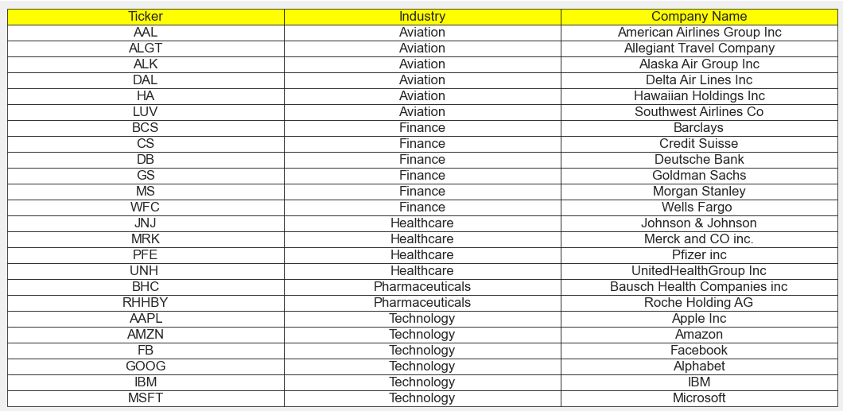
KEY DISCOVERY
STOCK DATA
We have a total of 24 stocks, evenly distributed across four sectors, with 6 stocks in each sector.
We can compare the performance of these stocks against an index. The S&P500 is a compilation of the top 500 stocks in the US stock market.
Here's the list of stocks along with their abbreviations, industries, and company names.

Slide 5
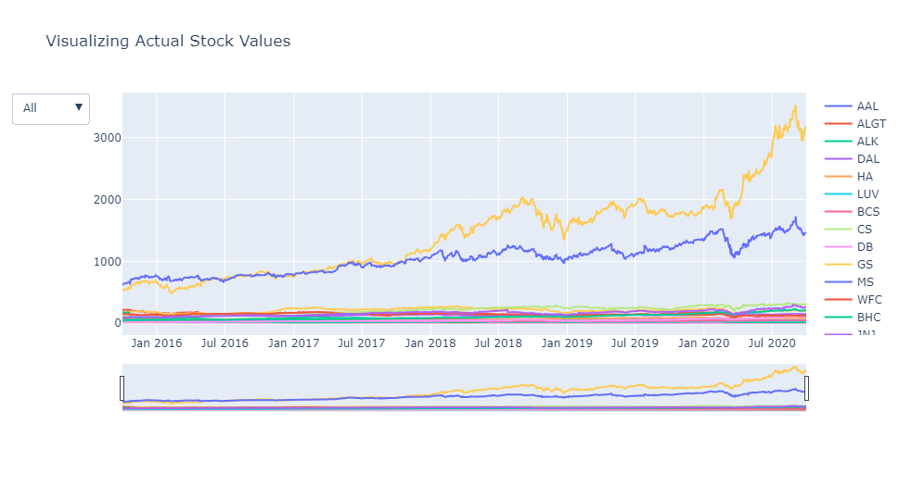
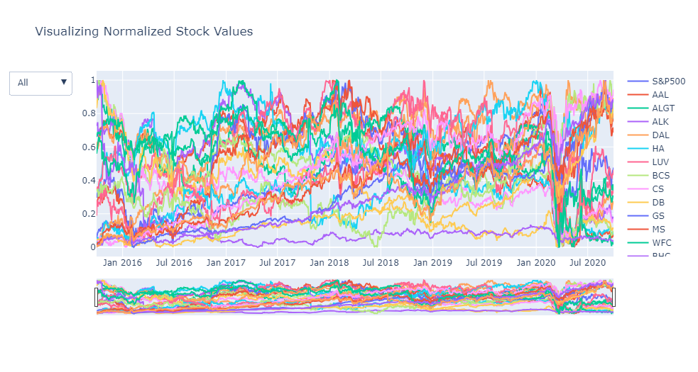
VISUALIZATION OF ACTUAL STOCK VALUES
VISUALIZATION OF NORMALIZED STOCK VALUES
The graph presented here showcases the performance of different stocks over the last five years. It's clear from the graph that Amazon and Google have shown superior performance compared to other stocks during this period.
The graph displayed illustrates the performance of all stocks relative to the S&P500 index. It's worth noting that eight stocks have shown returns exceeding 80% by the end of the 5-year period.

Slide 6
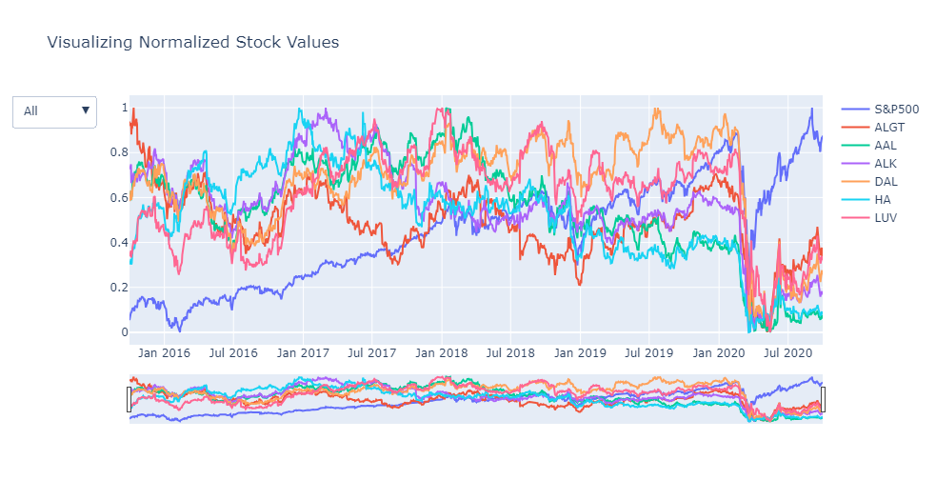
AVIATION SECTOR
The market experienced a significant downturn in 2020 due to the coronavirus pandemic, leading to a bear market.
Although the market recovered afterward, the Aviation Sector performed below expectations.
Despite the overall market recovery, the aviation sector struggled to regain its pre-pandemic strength.
Factors such as travel restrictions, reduced passenger demand, and ongoing uncertainties in the industry contributed to the underperformance of aviation-related stocks.

Slide 7
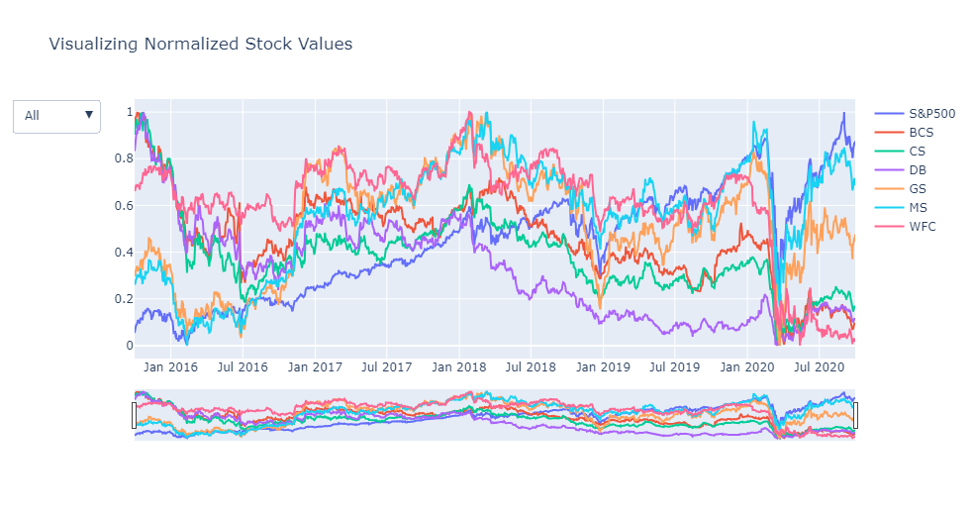
FINANCE SECTOR
Despite the market's significant downturn in 2020 due to the COVID-19 pandemic, both Morgan Stanley and Goldman Sachs not only recovered but also outperformed the sector.
While these two financial institutions bounced back strongly, most stocks felt negative impacts from the pandemic-induced market challenges.

Slide 8
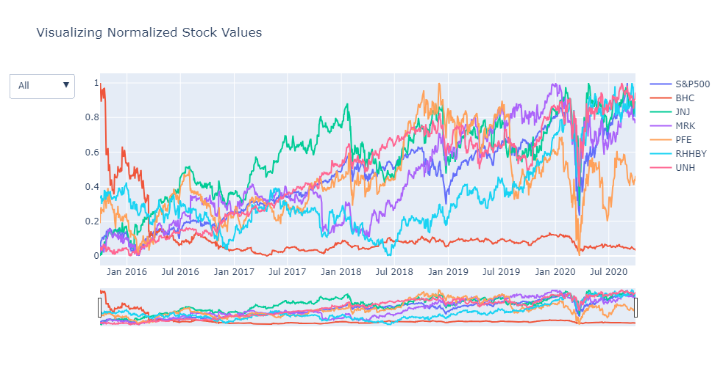
PHARMA & HEALTHCARE SECTOR
The health and pharmaceutical sector experienced rapid growth following the market crash caused by the COVID-19 pandemic, outpacing other industries.
UnitedHealth and Johnson & Johnson have shown strong performance compared to the S&P Index.
Bausch Health has consistently performed poorly over the years compared to other stocks in the same sector.

Slide 9
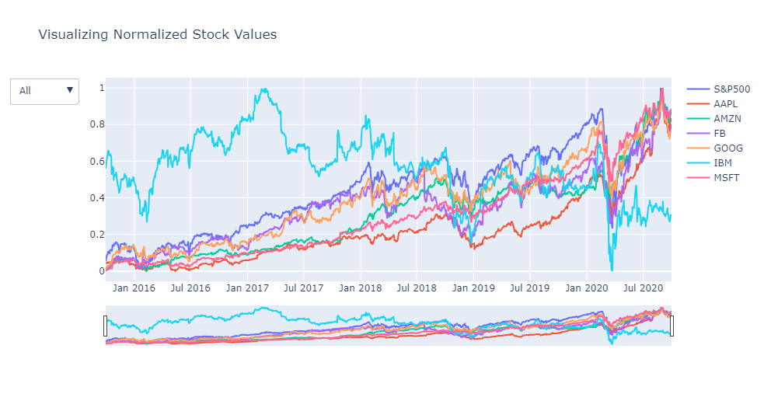
TECHNOLOGY SECTOR
Microsoft, Amazon, Apple, Facebook, and Google have performed well, along with the market index.
IBM has consistently performed poorly over the years compared to other stocks in the same sector.
During the pandemic, the tech sector was one of the few sectors to bounce back sharply compared to others.

Slide 10
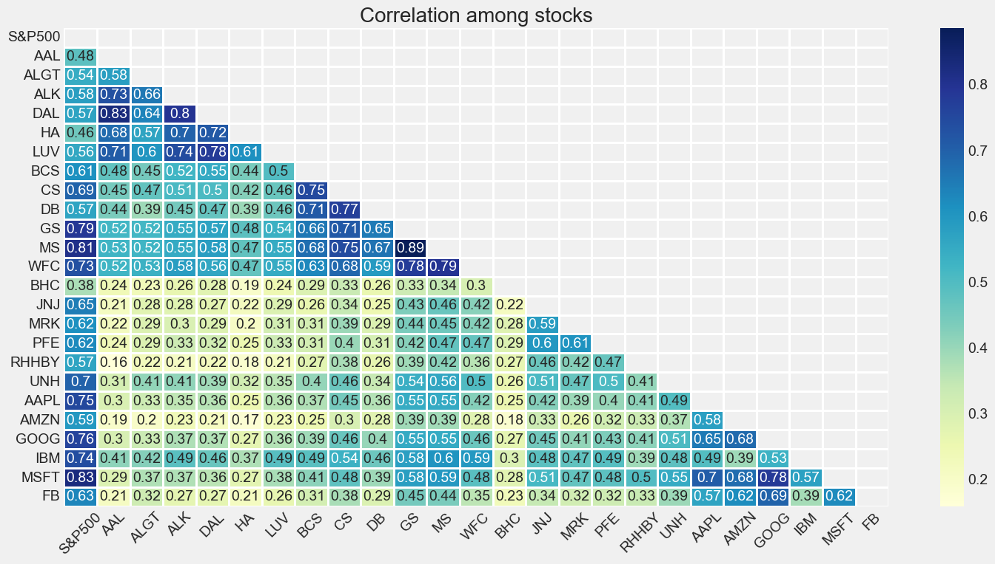
CORRELATION AMONG STOCKS
Microsoft and Google stocks show a high correlation in the Technology sector.
Goldman Sachs, Morgan Stanley, and Wells Fargo are correlated in the Finance sector.
American Airlines and Delta Airlines have a higher correlation than Alaska Air Group in the Aviation sector.
Pharma sector stocks exhibit lower correlation compared to stocks in other sectors.

Slide 11
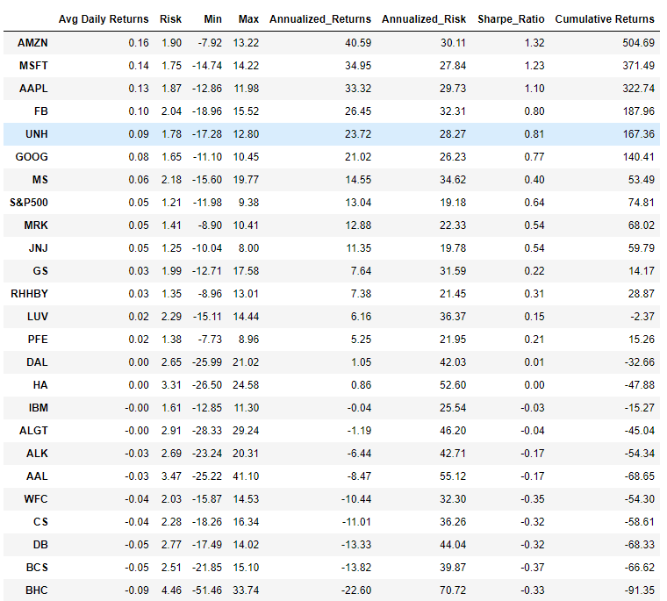
KEY METRICS
At the end of 5 years we can see that top 7 stocks having returns greater than S&P500
AMZN gives 40.59% annual returns
MSFT gives 34.95% annual returns
AAPL gives 33.32% annual returns
FB gives 26.45% annual returns
UNH gives 23.72% annual returns
GOOG gives 21.02% annual returns
MS gives 14.55% annual returns
S&P500 gives 13.04% annual returns
Stocks like Amazon (AMZN), Microsoft (MSFT), and Apple (AAPL) demonstrate relatively high annualized returns, low volatility, and positive Sharpe Ratios, reflecting strong risk-adjusted performance.
Stocks like Wells Fargo (WFC), Credit Suisse (CS), and Deutsche Bank (DB) have negative cumulative returns, indicating a loss over the specified period. These stocks also possess negative Sharpe Ratios, indicating poor risk-adjusted performance.
Bausch Health Companies Inc (BHC) and American Airlines (AAL) exhibit the most substantial negative cumulative returns, indicating significant losses.

Slide 12
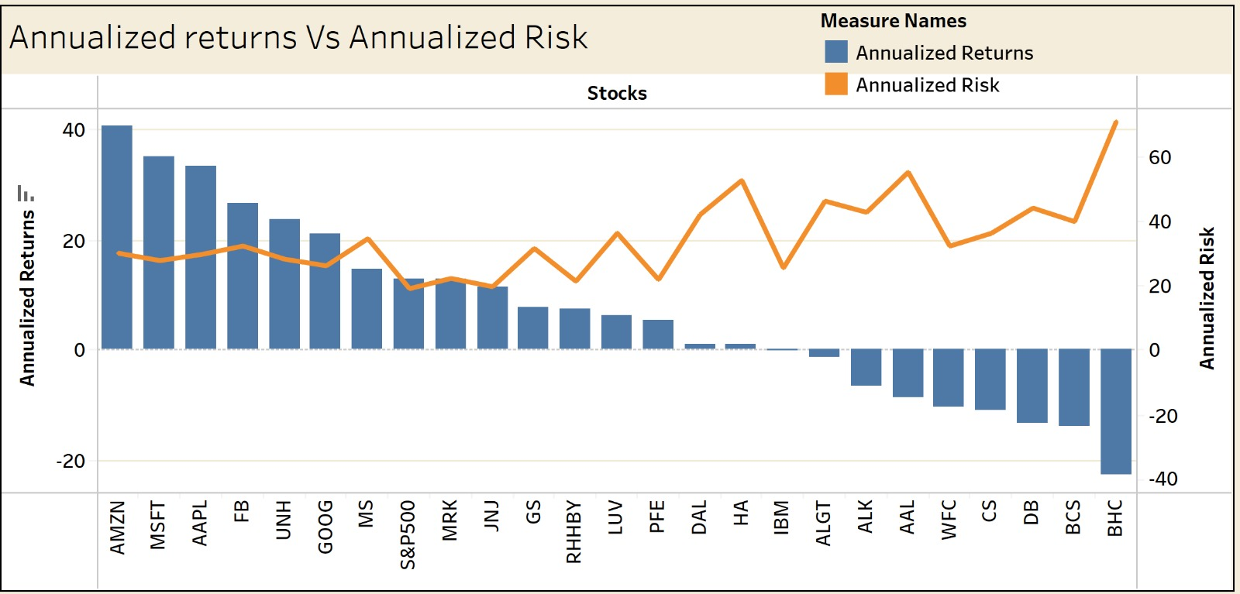
ANNUALIZED RISK & RETURN
AMZN, MSFT, AAPL, FB, and UNH demonstrate robust annualized returns, all exceeding the 20% mark.
These top five stocks are associated with a moderate level of risk compared to their counterparts in the market.
Stocks with lower annualized returns, such as BHC, BCS, DB, CS, and WFC, pose a higher risk as they fail to generate returns on the initial investment.
Conversely, JNJ and MRK are identified as stocks offering comparatively lower risk while still providing stable returns.

Slide 13
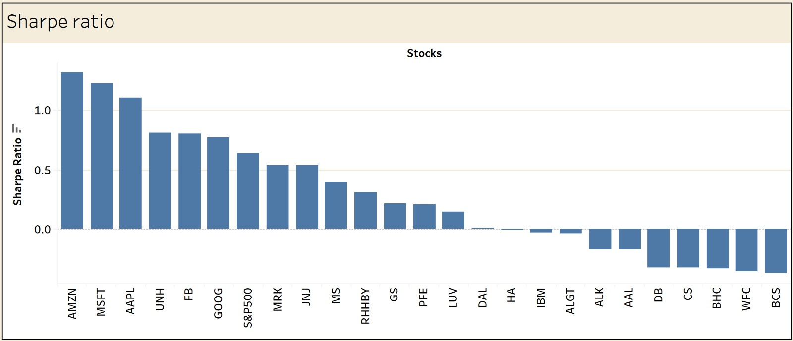
SHARPE RATIO
A higher Sharpe ratio indicates better risk-adjusted performance, while negative Sharpe ratios suggest that the returns may not justify the level of risk associated with those investments.
AMZN (1.32), MSFT (1.23), AAPL (1.10), FB (0.80), and UNH (0.81) have positive Sharpe ratios, indicating that these stocks have provided returns that exceed the risk-free rate per unit of risk.
The S&P500 (0.64) is used as a benchmark. Stocks with Sharpe ratios close to the S&P500 may be considered to have risk-adjusted performance in line with the broader market.
IBM, ALGT, ALK, AAL, WFC, CS, DB, and BHC have negative Sharpe ratios, indicating that the returns are not compensating enough for the associated risks.

Slide 14

PORTFOLIO ANALYSIS

Slide 15
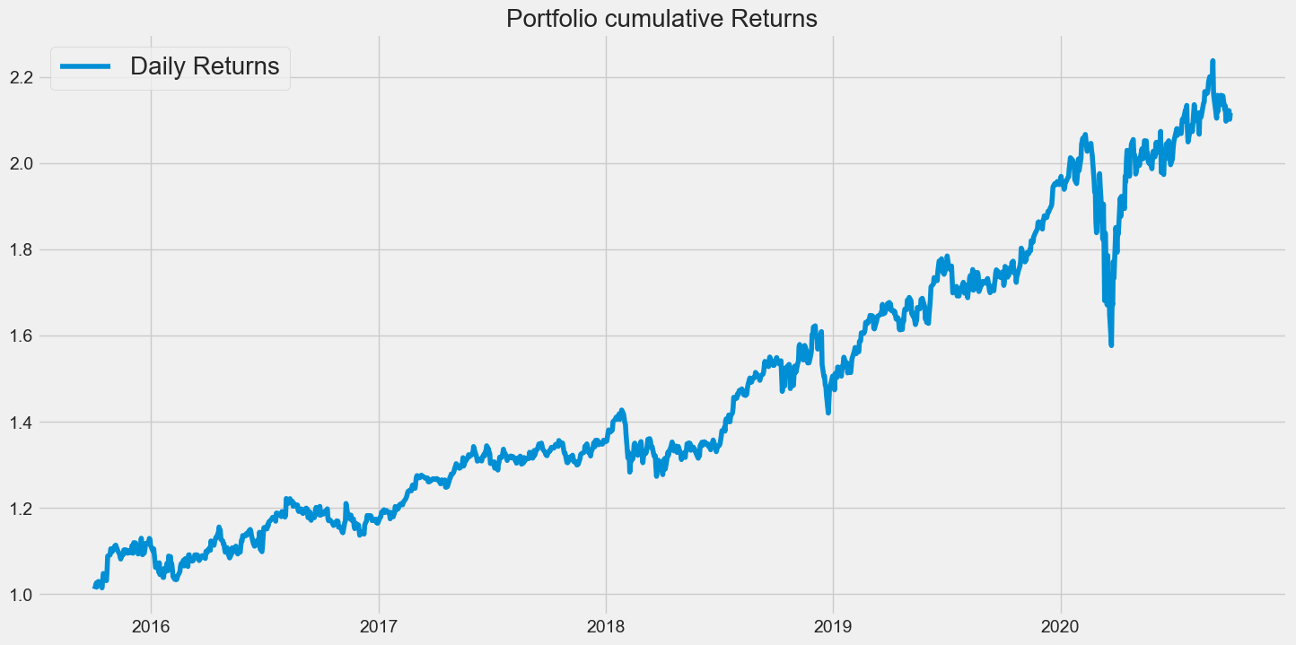
PATRICK JYENGER PORTFOLIO
Mr. Patrick Jyengar aims to double his investment within 5 years by focusing on low-risk stocks with decent returns. According to his profile, stocks like JNJ, RHHBY, and MRK are suitable for investment due to their low risk. However, investing solely in these three stocks wouldn't reach his target.
To achieve his goal, a portion of his investment can be allocated to MSFT, which offers higher returns. Keeping the weightage of all stocks equal at 0.25 across the portfolio:
$125,000 (0.25 * $500,000) is invested in JNJ, RHHBY, MRK, and MSFT each.
After 5 years, Mr. Jyengar's investment would yield $1.05 million, with a gain of $558.23 thousand:
The total investment would grow to $1.05 million, with a gain of $558.23 thousand.

Slide 16
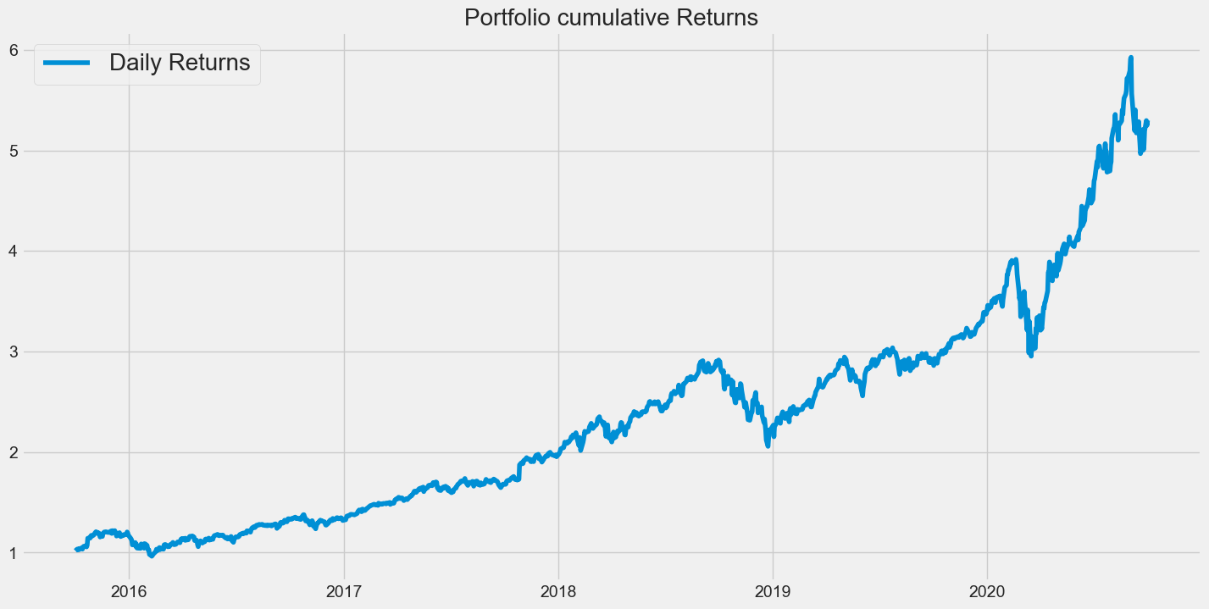
PETER JYENGER PORTFOLIO
Mr. Peter Jyengar, consistent with his high-risk tolerance, prefers investments with high returns. He believes he can recover from occasional losses and aims for significant returns within 5 years to fuel his company's inorganic expansion.
As per his profile, stocks like AMZN, MSFT, and AAPL are suitable for investment, offering maximum returns while managing risk.
Mr. Jyengar invests $1 million in equities, allocating it equally among AMZN, MSFT, and AAPL, resulting in $333,333.33 for each stock.
After 5 years, Mr. Jyengar's investment would yield more than $5 million, with a gain of over $4 million:
The total investment would grow to more than $5 million, with a gain of over $4 million.

Slide 17
METHODOLOGY
EXPLORATORY DATA ANALYSIS:
Examined the dataset for null values and confirmed that no columns contained missing data.
Conducted an outlier analysis on the dataset to identify and evaluate any data points significantly deviating from the overall pattern.
Imputed missing values with "0" for Facebook (FB) data, taking into account its listing on the NYSE on May 18, 2012
DATA ANALYSIS:
Applied diverse calculations, including daily and cumulative returns, Sharpe ratios, portfolio risk, and ROI, for in-depth stock data analysis
Identified top-performing stocks for various portfolios based on rigorous performance metrics.
Used Tableau for better visualizations.
Performed sector wise analysis to get a better view of each sector.
Extracted valuable insights to support informed decision-making in stock selection and portfolio managementA

Slide 18
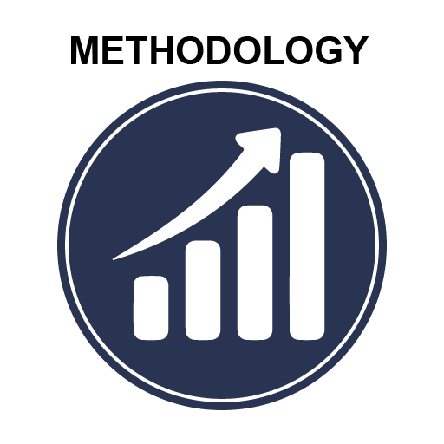
INFERENCES AFTER ANALYSING THE DATA:
As we found out that there are 7 stocks which gives more than 80% in last five years of stock market.
The stocks that gives best return among all stocks are AMZN, MSFT, AAPL, FB, UNH, GOOG and MS.
Conducted a detailed analysis of each stock, considering factors such as Annualized risk, Sharpe ratio, and cumulative returns
We found out that AMZN gives highest return among all stock
We also found that stocks like JNJ, RHHBY, MRK and MSFT have good returns with less risk.
By observing the sectors we understand that the best performing sector is Technology followed by Health and Pharma and the worst is Aviation
So after doing all the analysis we have finalized the portfolio for both of our customers.

Slide 19


