Slide 1
BlockChain Decentraliszed Currency ExchangeApplication：DEX
Project Group 27
Yiming Ge (z5341323)
Haohua Fang（z5338678）
Dongfei Fan (z5211565)
Faith Ko (z5437801)

Slide 2
Contribution
Yiming Ge: User Register Backend
Haohua Fang: User Register Smart Contract
Faith Ko: Currency Swap Smart Contract
Dongfei Fan: Currency Swap Smart Contract

Slide 3
Demo2: Token Swap
Intro & Solution Design
01
04
Implementation Details
02
05
Code Walkthrough
03
Demo1: User Registration

Slide 4
01: Intro & Solution Design

Slide 5
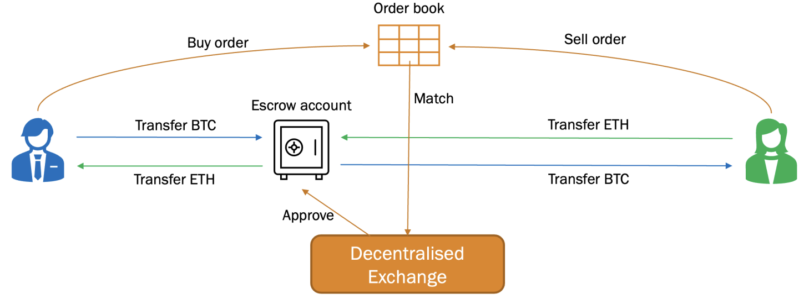
Introduction
why not traditional stock exchange?
difficulty to check traders’ stock inventory
difficulty to interact with the 2 smart contracts
difficulty to tokenize the stock

Slide 6
Introduction
So we made the virtual currency exchange Dapp.
(e.g. Link, Weth)
Functional Requirement
User Registration and Authentication
Order Placement and Execution (Partial realized)
Fund Deposits and Withdrawals

Slide 7
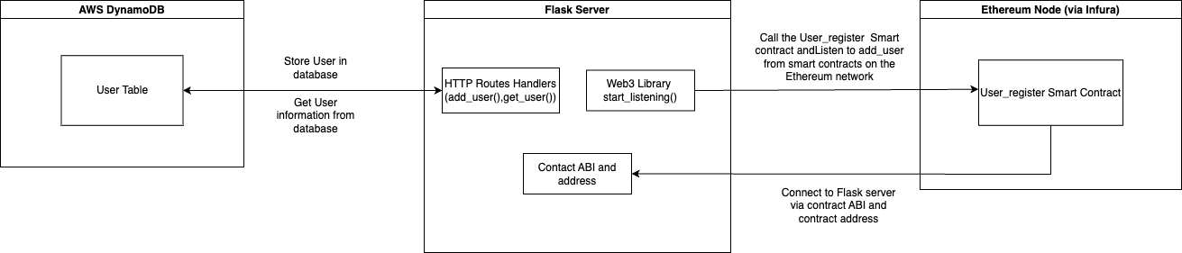
User Registration Structure

Slide 8
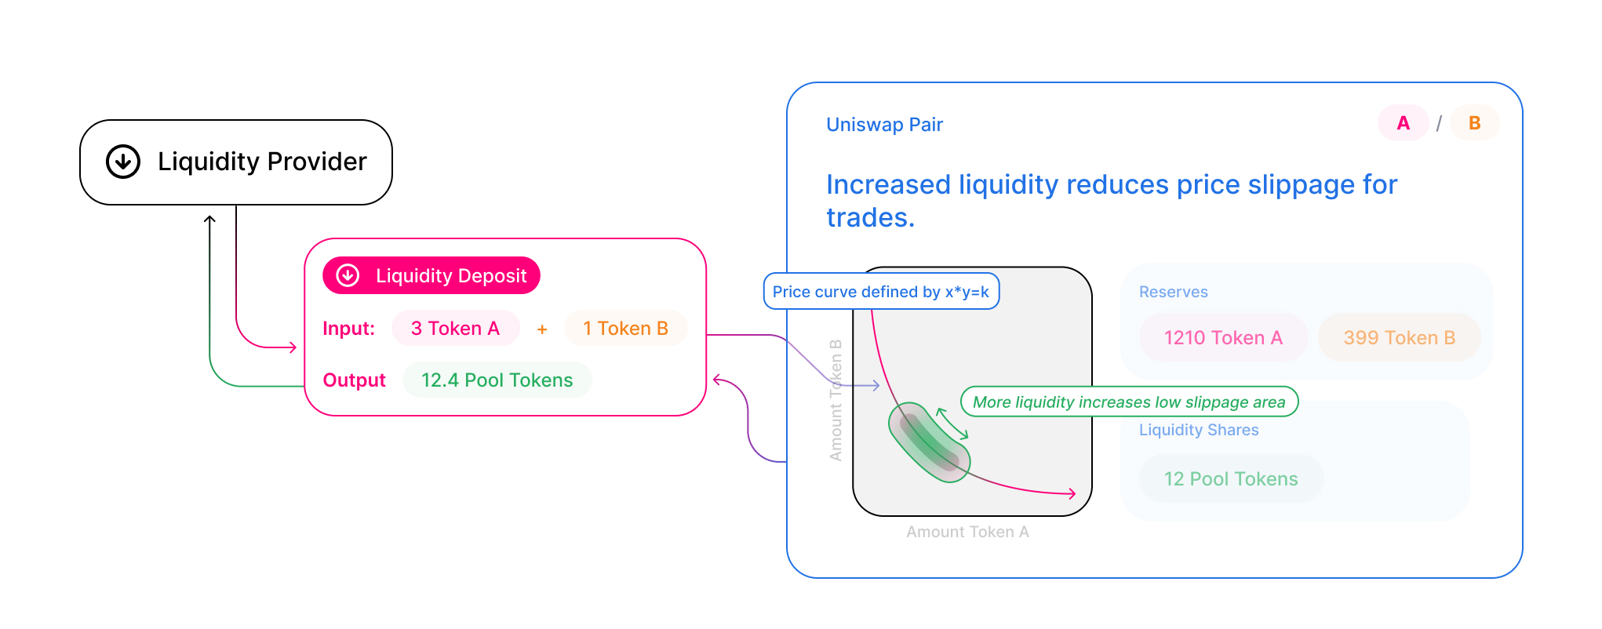
Currency Swap Structure

Slide 9
02: Implementation Details

Slide 10
Implementation details
Blockchain platform
Ethereum
Off-chain components
database for user information
Tools used
metamask (wallet)
AWS DynamoDB (database)
Remix Ethereum (develop & deploy)

Slide 11
Demo 1: User Registration

Slide 12
Demo2: Token Swap

Slide 13
code walkthrough

Slide 14
Q & A

Slide 15
Thank you!

