Slide 1
Measuring Potential Opportunity Gaps
Cherie Gary Rachel H. Rachel T.

Slide 2
Impact of Exposure to Violence at an Early Age
Hypothesis: If exposure to violence is an indicator of an individual’s future success, then those exposed to violence at an early age will be less likely to enroll in college and have a higher chance of incarceration.
Data Sets – Data.gov (My Brother Keeper’s Program) Exposure to Violence Rates (2000 -2012) College Enrollment Rates (2000 -2012) Incarceration Rates for Ages 18-24 (2000 -2012)
Notes:
RT - My Brothers Keeper Program

Slide 3
The data we used did not provide enough information to answer our question to our satisfaction.
Challenges
Raw data unavailable
Data already aggregated
Method of data reporting/analysis unknown
Notes:
RT

Slide 4
Are Rates Higher Based on an Individual’s Race and Sex?
Exposure to violent crime at an early age
College Enrollment
Incarceration
*Examined trends between these groups
Notes:
Rachel H.

Slide 5
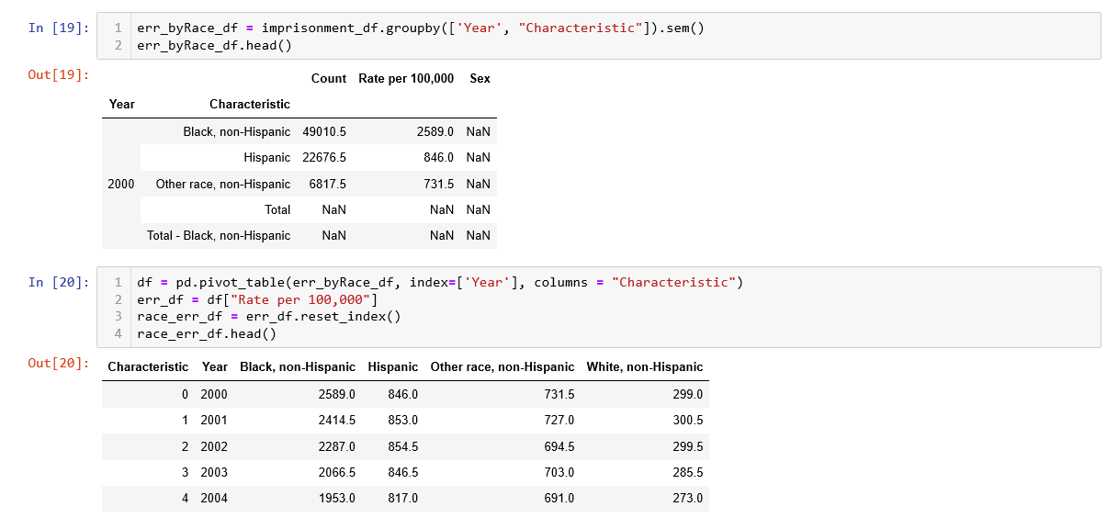
Data Analysis
Data Cleanup & Exploration
Steps:
Notes:
Rachel H.

Slide 6
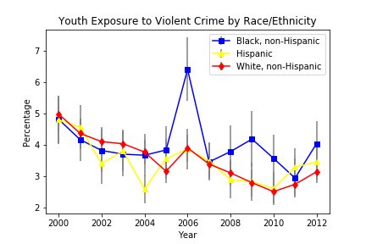
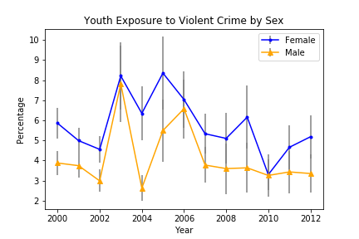
ANOVA Test p-Value= 0.11
T-Test p-Value= 0.003
Notes:
Cherie

Slide 7
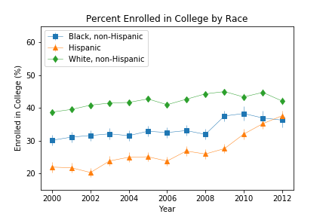
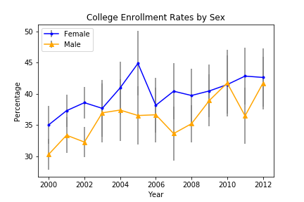
College Enrollment Rates higher for White, non-Hispanic population;
College Enrollment Rates are primarily higher among females
Notes:
Cherie

Slide 8
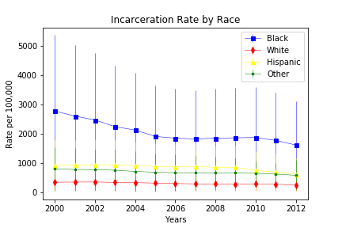
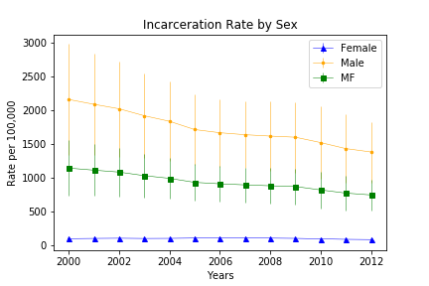
Incarceration rates higher in black population; Incarceration rates higher among males
Notes:
Gary

Slide 9
Discussion
Find more individualized data
How is the violence reported
Types of violent crime
Additional Analysis
Notes:
Gary

Slide 10
Q&A

