Slide 1
Exposure to Violence at Early Age
Group 4: Cherie, Gary, Rachel H. and Rachel T.

Slide 2
Impact of Exposure to Violence at an Early Age
Hypothesis
Data Sets
Exposure to Violence Rate (2000 -2012)
College Enrollment Rates (2000 -2012)
Incarceration Rates (2000 -2012)
Variables
Race and Sex
Notes:
Define the core message or hypothesis of your project.
Describe the questions you asked, and why you asked them
Describe whether you were able to answer these questions to your satisfaction, and briefly summarize your findings

Slide 3
Questions & Data
My Brother’s Keeper Program Data
Data broken down by race and sex
Notes:
Elaborate on the questions you asked, describing what kinds of data you needed to answer them, and where you found it

Slide 4
Describe whether you were able to answer these questions to your satisfaction, and briefly summarize your finding

Slide 5
Data Cleanup & Exploration
Describe the exploration and cleanup process
Discuss insights you had while exploring the data that you didn't anticipate
Discuss any problems that arose after exploring the data, and how you resolved them
*Difficult to get access to raw data; most data already aggregated; ideally track an individual’s stats
Present and discuss interesting figures developed during exploration, ideally with the help of Jupyter Notebook
Notes:
Describe the exploration and cleanup processDiscuss insights you had while exploring the data that you didn't anticipateDiscuss any problems that arose after exploring the data, and how you resolved themPresent and discuss interesting figures developed during exploration, ideally with the help of Jupyter Noteboo

Slide 6
Data Analysis
Discuss the steps you took to analyze the data and answer each question you asked in your proposal
Present and discuss interesting figures developed during analysis, ideally with the help of Jupyter Notebook

Slide 7
Scatter / line graphs

Slide 8
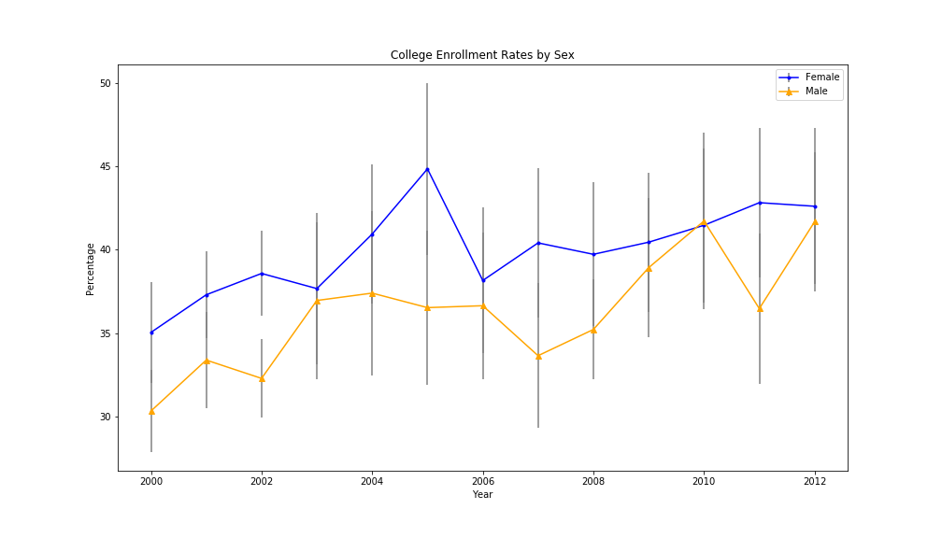

Slide 9
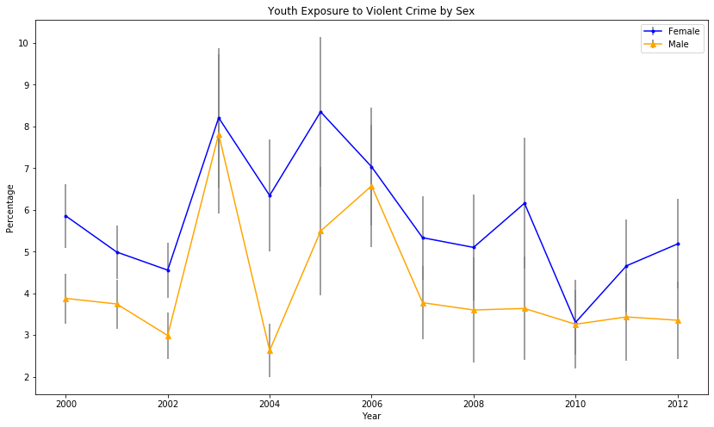

Slide 10
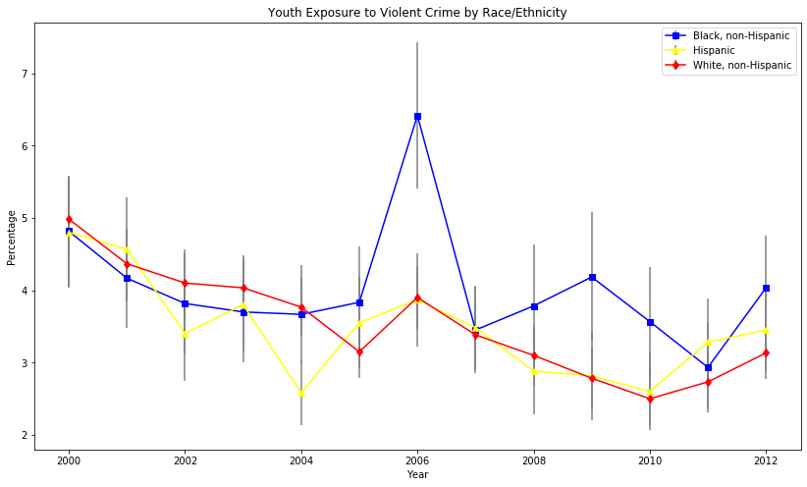

Slide 11
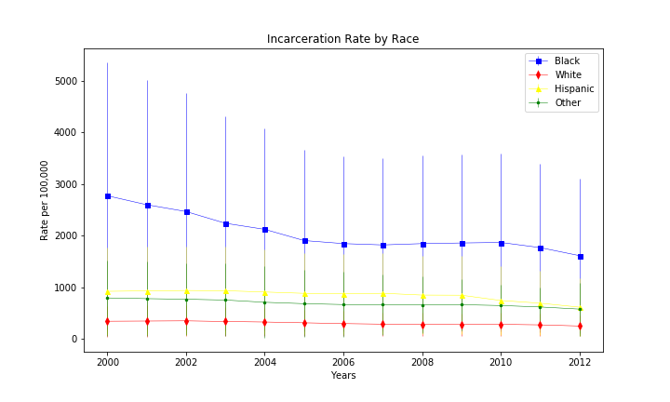

Slide 12
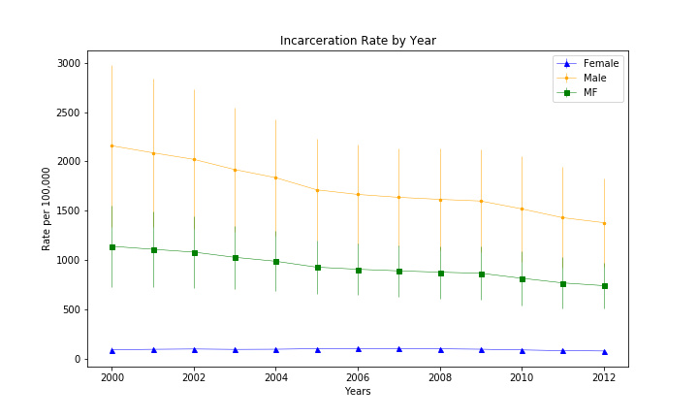

Slide 13
Discussion
Discuss any difficulties that arose, and how you dealt with them
Discuss any additional questions that came up, but which you didn't have time to answer:
What would you research next, if you had two more weeks?

Slide 14
Q&A

