Slide 1
Synthetic Native Template
Redistributable test fixture — not laboratory data

Slide 2
Representative content layout
Native title/content placeholders

Slide 3
Progress / Previous Commitments
Commitment｜NS101; NS201; NS301
Current｜H003
Parallel｜interface-mechanism; interface-mechanism; interface-mechanism
Notes:
[Sources]
E101
E201
E301
[/Sources]
Compiled from persisted ledger materialization.

Slide 4
H001｜Hypothesis
Hypothesis｜Bulk conductivity drives the positional signal gradient.
Falsifier｜Matched conditions do not change the predicted CV or resistance.
Question｜提升 bulk conductivity 是否足以降低位置依賴的訊號變異？
Notes:
[Sources]
E002
E102
[/Sources]
Compiled from persisted ledger materialization.

Slide 5
H001｜Problem
Prior｜含水量與導電度存在位置梯度
Conflict｜導電度提高是否足以修復重複性仍未知。
Question｜提升 bulk conductivity 是否足以降低位置依賴的訊號變異？
Notes:
[Sources]
E002
[/Sources]
Compiled from persisted ledger materialization.

Slide 6
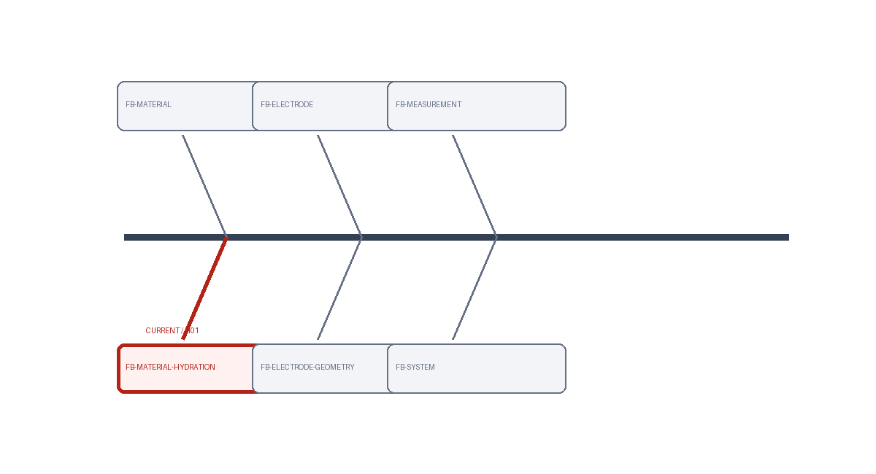
H001｜Total Fishbone / Research Map
History｜FB001 rev1
Focus｜FB-MATERIAL-HYDRATION
Notes:
[Sources]
E103
[/Sources]
Compiled from persisted ledger materialization.

Slide 7

H001｜Observation → Literature → Mechanism
Question｜提升 bulk conductivity 是否足以降低位置依賴的訊號變異？
Observation｜位置依賴缺陷與訊號變異已觀察到。
Notes:
[Sources]
E002
E102
[/Sources]
Compiled from persisted ledger materialization.

Slide 8
H001｜Literature → Mechanism → Strategy
Consensus｜transport gradient 可產生位置效應。
Alternatives｜interface contact remains alternative
Gap｜缺少控制比較隔離機制。
Implication｜需匹配條件後比較。
Mechanism｜bulk transport
Evidence｜C102; C103; E103
Notes:
[Sources]
E103
[/Sources]
Compiled from persisted ledger materialization.

Slide 9
H001｜Experiment Design
IV｜含水量
Controls｜電極幾何; 接觸壓力
Baseline｜原始配方
Sample｜replicates: 3; samples: 15
N｜3
Outputs｜導電度 (mS/cm)
Units｜導電度 (mS/cm)
Method｜synthetic-four-probe
Prediction｜導電度提升
Rule｜go: mean conductivity increases >=20%; partial_go: 10-20%; no_go: <10%
Notes:
[Sources]
E002
[/Sources]
Compiled from persisted ledger materialization.

Slide 10
H001｜Experiment Design
IV｜位置
Controls｜配方; 電極; 接觸壓力
Baseline｜原始位置分布
Sample｜replicates: 3; samples: 15
N｜3
Outputs｜訊號 CV (%)
Units｜訊號 CV (%)
Method｜synthetic-signal-test
Prediction｜CV 下降
Rule｜go: CV decreases >=30%; partial_go: 10-30%; no_go: <10%
Notes:
[Sources]
E002
E102
[/Sources]
Compiled from persisted ledger materialization.

Slide 11
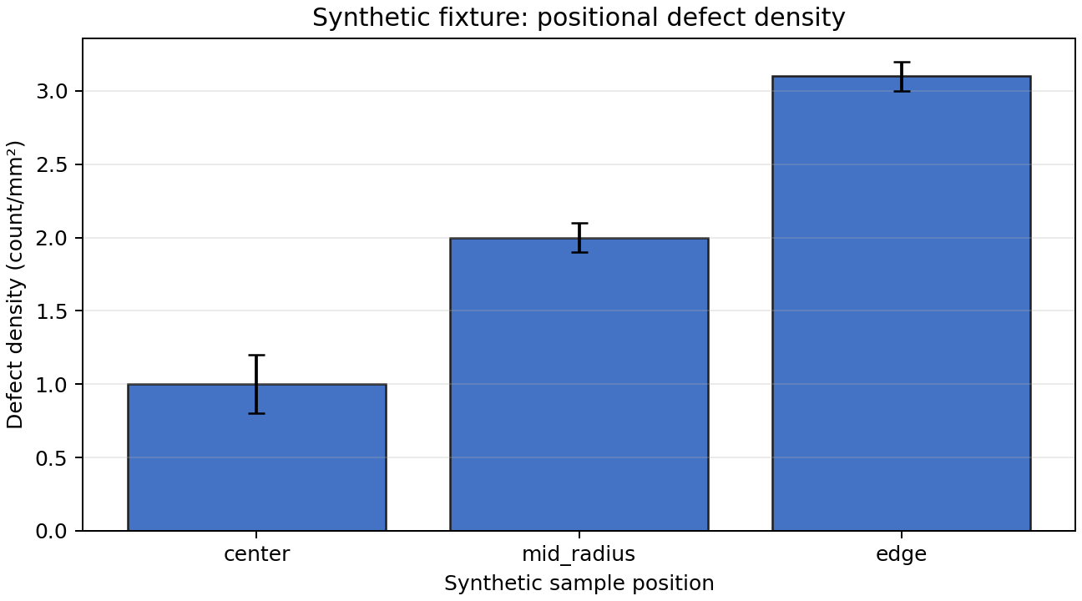
H001｜Result
ID｜RES101
Result｜平均導電度增加 24% ± 5% SD
Metric｜mean conductivity increase: 24% ± 5% SD
Figure｜RES101｜平均導電度增加 24% ± 5% SD
Notes:
[Sources]
E101
[/Sources]
Compiled from persisted ledger materialization.

Slide 12
H001｜Result
ID｜RES102
Result｜訊號 CV 僅下降 4% ± 6% SD，屬 No-Go
Metric｜signal CV decrease: 4% ± 6% SD
Figure｜RES102｜訊號 CV 僅下降 4% ± 6% SD，屬 No-Go
Notes:
[Sources]
E101
[/Sources]
Compiled from persisted ledger materialization.

Slide 13
H001｜Integrated Discussion
Support｜RES101
Conflict｜RES102
Non-disc.｜none
Pattern｜導電度提升成立，但重複性沒有同步改善。
Mechanism｜bulk conductivity 是部分機制，不足以解釋 interface-sensitive variation。
Alternatives｜接觸電阻; 局部壓力差; 電極幾何
Uncertainty｜contact interface 是否為主導因素仍需匹配導電度後檢驗。
Notes:
[Sources]
E101
E102
E103
[/Sources]
Compiled from persisted ledger materialization.

Slide 14
H001｜Layer Summary / Decision
Answer｜bulk conductivity 影響缺陷梯度，但不足以單獨解釋重複性。
Status｜partial_support
Decision｜Partial-Go; Bulk conductivity is contributory but insufficient.
Unresolved｜interface contact 的貢獻尚未量化。
Next question｜匹配 bulk conductivity 後，contact resistance 是否主導變異？
Next step｜NS101
Notes:
[Sources]
E101
[/Sources]
Compiled from persisted ledger materialization.

Slide 15
H001｜Hypothesis Transition
Prior H｜C101
Key results｜RES101; RES102
Precursor｜E104
New H｜C201
Unresolved｜導電度增加後訊號重複性沒有改善。
Rationale｜剩餘變異隨電極接觸位置改變，因此核心解釋由 bulk transport 轉向 interface contact。
Notes:
[Sources]
E104
E101
[/Sources]
Compiled from persisted ledger materialization.

Slide 16
H002｜Hypothesis
Hypothesis｜Contact resistance drives instability at low pressure.
Falsifier｜Matched conditions do not change the predicted CV or resistance.
Question｜低接觸壓力下，contact resistance 是否主導訊號不穩定？
Notes:
[Sources]
E204
[/Sources]
Compiled from persisted ledger materialization.

Slide 17
H002｜Problem
Prior｜H01 支持導電度梯度存在; H01 未支持導電度單獨主導重複性
Conflict｜bulk transport 與 interface contact 的相對貢獻尚未區分。
Question｜低接觸壓力下，contact resistance 是否主導訊號不穩定？
Notes:
[Sources]
E204
[/Sources]
Compiled from persisted ledger materialization.

Slide 18
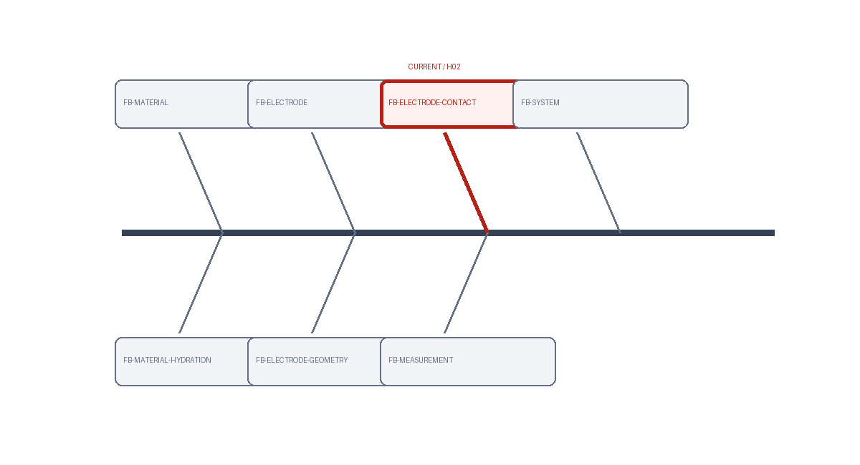
H002｜Total Fishbone / Research Map
History｜FB001 rev2
Focus｜FB-ELECTRODE-CONTACT
Notes:
[Sources]
E204
[/Sources]
Compiled from persisted ledger materialization.

Slide 19
H002｜Observation → Literature → Mechanism
Observation｜位置依賴缺陷與訊號變異已觀察到。
Consensus｜transport gradient 可產生位置效應。
Alternatives｜interface contact remains alternative
Gap｜缺少控制比較隔離機制。
Implication｜需匹配條件後比較。
Mechanism｜contact resistance
Evidence｜C202; C203; E202
Strategy｜匹配導電度並改變接觸壓力
Criterion｜預測指標跨過 decision threshold
Question｜低接觸壓力下，contact resistance 是否主導訊號不穩定？
Registered observation visual.
Notes:
[Sources]
E204
E202
[/Sources]
Compiled from persisted ledger materialization.

Slide 20
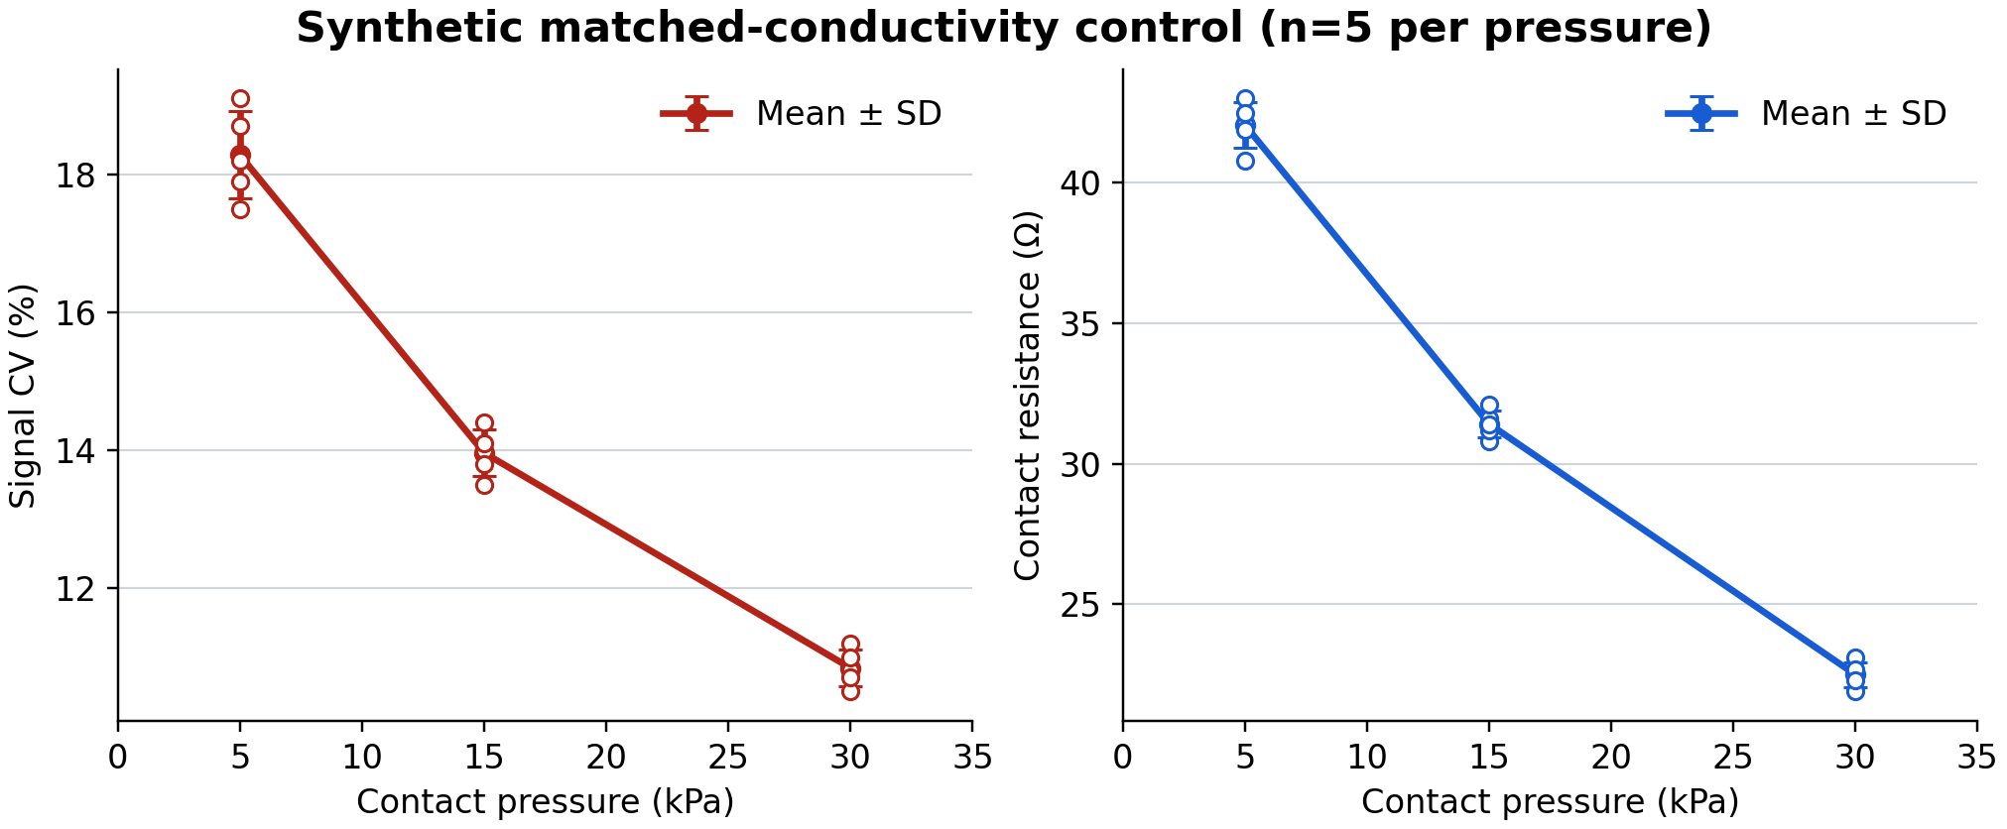
H002｜Results
IV｜contact pressure
Controls｜bulk conductivity; 電極幾何
Baseline｜low-pressure control
Sample｜replicates: 5; samples: 15
N｜5
Outputs｜訊號 CV (%); contact resistance (ohm)
Units｜訊號 CV (%); contact resistance (ohm)
Method｜synthetic-pressure-fixture
Prediction｜CV and resistance decrease
Rule｜go: both metrics improve; partial_go: one metric improves; no_go: neither improves
Figure｜RES201｜高壓條件 CV 下降 38% ± 7% SD，contact resistance 同步下降
ID｜RES201
Result｜高壓條件 CV 下降 38% ± 7% SD，contact resistance 同步下降
Metric｜signal CV decrease: 38% ± 7% SD
Notes:
[Sources]
E204
E201
[/Sources]
Compiled from persisted ledger materialization.

Slide 21
H002｜Layer Summary / Decision
Support｜RES201
Conflict｜none
Non-disc.｜none
Cross-experiment pattern｜匹配導電度後，提高接觸壓力明顯降低變異。
Mechanism assessment｜contact resistance 在低壓條件下主導不穩定。
Alternatives｜電極幾何仍可能調節壓力分布
Pattern｜匹配導電度後，提高接觸壓力明顯降低變異。
Mechanism｜contact resistance 在低壓條件下主導不穩定。
Alternatives｜電極幾何仍可能調節壓力分布
Uncertainty｜高壓長期循環是否造成新的 wear mechanism 尚未知。
Unresolved｜高壓循環的耐久性與 wear 尚未測試。
Answer｜低接觸壓力下 contact resistance 是主導不穩定來源。
Status｜supported
Decision｜Go; Contact-pressure control discriminates the interface mechanism.
Next question｜接觸壓力改善能否在長期循環下維持？
Next step｜NS201
Notes:
[Sources]
E201
[/Sources]
Compiled from persisted ledger materialization.

Slide 22
H002｜Hypothesis Transition
Prior H｜C201
Key results｜RES201
Precursor｜E304
New H｜C301
Unresolved｜Cycling durability remains unknown.
Rationale｜The pressure result resolves the static interface mechanism but not cyclic stability.
Notes:
[Sources]
E304
E201
[/Sources]
Compiled from persisted ledger materialization.

Slide 23
H003｜Hypothesis
Hypothesis｜Cycling history controls the remaining interface instability.
Falsifier｜Matched conditions do not change the predicted CV or resistance.
Question｜Does cyclic loading explain the remaining instability?
Notes:
[Sources]
E302
[/Sources]
Compiled from persisted ledger materialization.

Slide 24
H003｜Problem
Prior｜H01 支持導電度梯度存在; H01 未支持導電度單獨主導重複性
Conflict｜bulk transport 與 interface contact 的相對貢獻尚未區分。
Question｜Does cyclic loading explain the remaining instability?
Notes:
[Sources]
E204
[/Sources]
Compiled from persisted ledger materialization.

Slide 25
H003｜Total Fishbone / Research Map
History｜FB001 rev3
Focus｜FB-ELECTRODE-CONTACT
Notes:
[Sources]
E302
[/Sources]
Compiled from persisted ledger materialization.

Slide 26
H003｜Observation → Literature → Mechanism
Observation｜位置依賴缺陷與訊號變異已觀察到。
Consensus｜transport gradient 可產生位置效應。
Alternatives｜interface contact remains alternative
Gap｜缺少控制比較隔離機制。
Implication｜需匹配條件後比較。
Mechanism｜contact resistance
Evidence｜C301; E302
Strategy｜匹配導電度並改變接觸壓力
Criterion｜預測指標跨過 decision threshold
Question｜低接觸壓力下，contact resistance 是否主導訊號不穩定？
Registered observation visual.
Notes:
[Sources]
E302
[/Sources]
Compiled from persisted ledger materialization.

Slide 27
H003｜Results
IV｜contact pressure
Controls｜bulk conductivity; 電極幾何
Baseline｜low-pressure control
Sample｜replicates: 5; samples: 15
N｜5
Outputs｜訊號 CV (%); contact resistance (ohm)
Units｜訊號 CV (%); contact resistance (ohm)
Method｜synthetic-pressure-fixture
Prediction｜CV and resistance decrease
Rule｜go: both metrics improve; partial_go: one metric improves; no_go: neither improves
Figure｜RES301｜Cycling test retains 91% response after 100 cycles.
ID｜RES301
Result｜Cycling test retains 91% response after 100 cycles.
Metric｜signal CV decrease: 38% ± 7% SD
Notes:
[Sources]
E302
E301
[/Sources]
Compiled from persisted ledger materialization.

Slide 28
H003｜Layer Summary / Decision
Support｜RES301
Conflict｜none
Non-disc.｜none
Cross-experiment pattern｜匹配導電度後，提高接觸壓力明顯降低變異。
Mechanism assessment｜contact resistance 在低壓條件下主導不穩定。
Alternatives｜電極幾何仍可能調節壓力分布
Pattern｜匹配導電度後，提高接觸壓力明顯降低變異。
Mechanism｜contact resistance 在低壓條件下主導不穩定。
Alternatives｜電極幾何仍可能調節壓力分布
Uncertainty｜高壓長期循環是否造成新的 wear mechanism 尚未知。
Unresolved｜高壓循環的耐久性與 wear 尚未測試。
Answer｜低接觸壓力下 contact resistance 是主導不穩定來源。
Status｜supported
Decision｜Go; Contact-pressure control discriminates the interface mechanism.
Next question｜接觸壓力改善能否在長期循環下維持？
Next step｜NS301
Notes:
[Sources]
E301
[/Sources]
Compiled from persisted ledger materialization.

