Slide 1
Synthetic Native Template
Redistributable test fixture — not laboratory data

Slide 2
Representative content layout
Native title/content placeholders

Slide 3

Synthetic observation
Synthetic microscopy shows position-dependent defect density.
The spatial trend is not explained by the current process model.
Notes:
[Sources]
E002
[/Sources]
Synthetic fixture — verify evidence provenance.

Slide 4
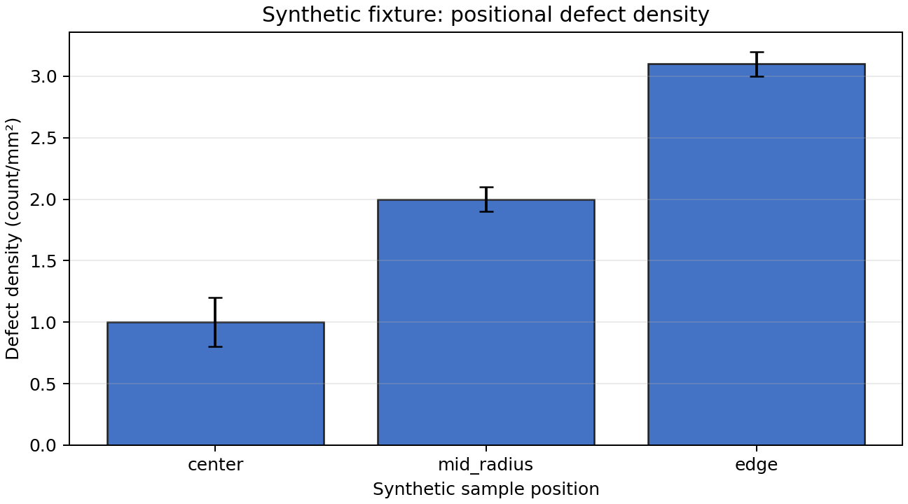
Synthetic results
Result / Discussion
The trend is reproducible but remains only partial support; run a matched-position tracer control before Go.
Decision: Reproducible trend remains non-discriminating.
Next Step: Run matched-position tracer control; status in_progress; due 2026-09-10T09:00:00Z
Notes:
[Sources]
E001
E003
[/Sources]
Synthetic fixture — verify evidence provenance.

