Slide 1
Population Graph 2021-2022 Term 1
Dhairya Shah 8B

Slide 2
Population
Population of an area depicts the total amount of people living in a region, state or a country.
Census
An official count of the people who live in a country, including information about their ages, jobs & etc.

Slide 3
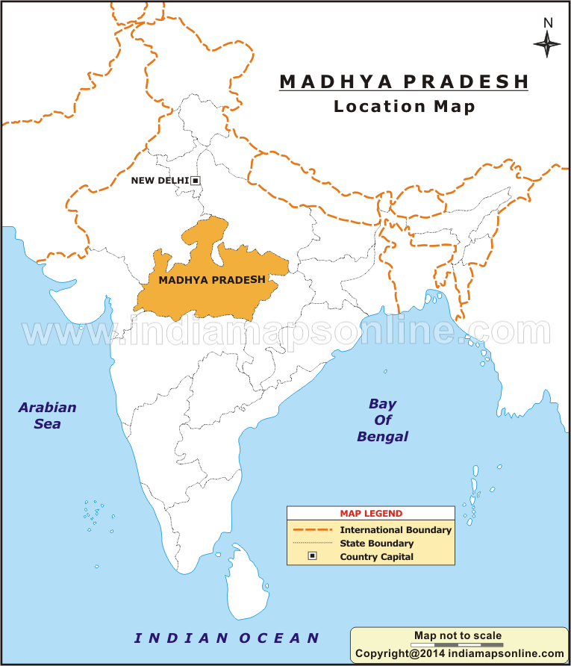
Madhya Pradesh
Madhya Pradesh, a large state in central India, retains landmarks from eras throughout Indian history. Madhya Pradesh is the second largest Indian state by area and the fifth largest state by population with over 72 million residents.
Area: 308,245 km²
Capital: Bhopal

Slide 4
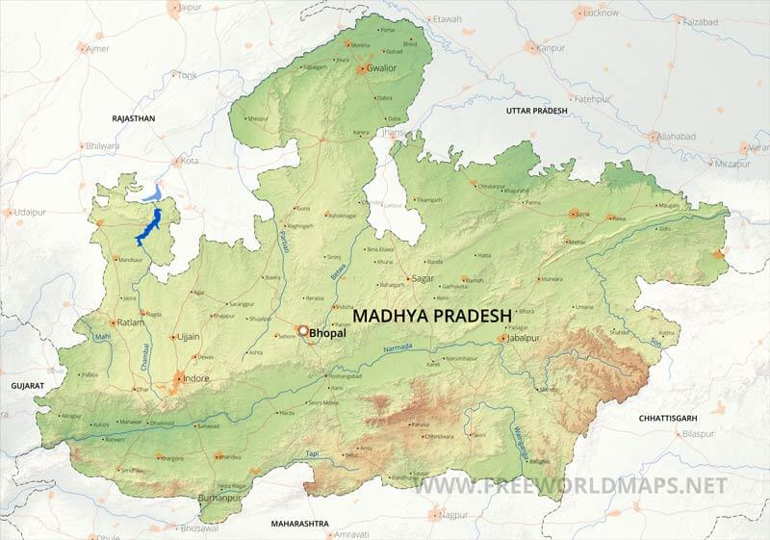
Madhya Pradesh borders the states of Uttar Pradesh to the northeast, Chhattisgarh to the southeast, Maharashtra to the south, Gujarat to the west, and Rajasthan to the northwest.

Slide 5
Size of Population in Madhya Pradesh in 2021
Madhya Pradesh population in 2021 is estimated to be 86.4 Million (8.64 Crores)
Size of Population
A state needs people who are useful as human resources to utilize its available resources. A state can support a particular amount of population which can live comfortably but if the population increases, there is scarcity of basic necessities like water, electricity, shelter for all people. Based on their size of population and the availability of resources, some countries in the world are overpopulated whereas some are underpopulated.

Slide 6
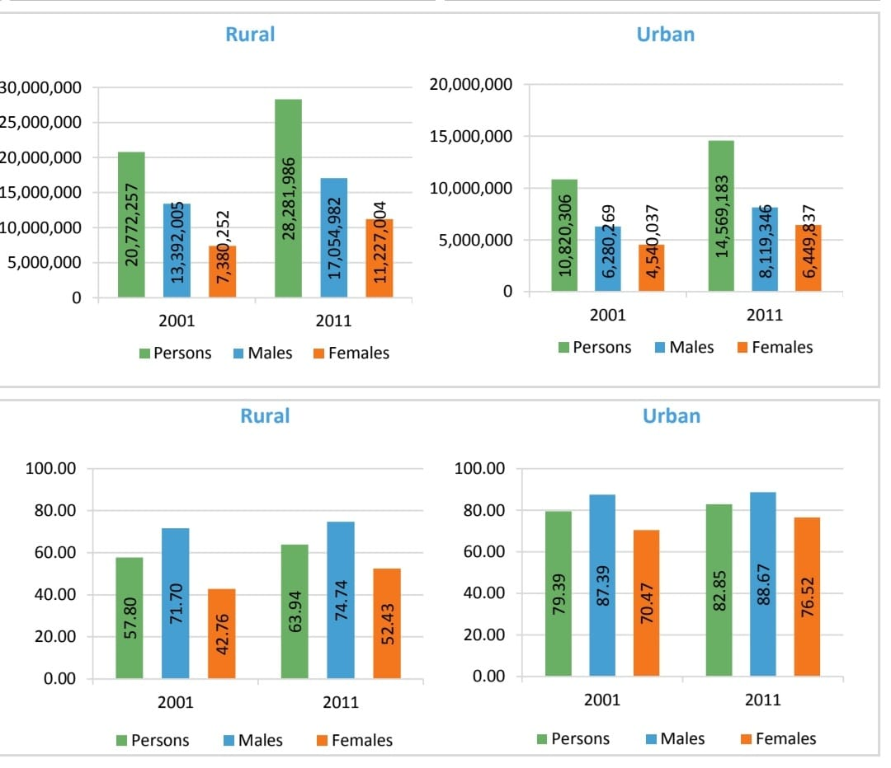
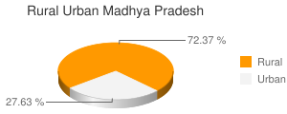
Distribution of Population
The spatial distribution of population on the surface of the Earth. is called population distribution.

Slide 7
Composition of Population
Age-Composition: The population of a country is normally divided into three categories:
People below 15 years of age.
People between 15 to 65 years of age.
People above 65 years of age.
The age composition tells us about the independent or earning population as well as dependent population, who are not working.
Children are supposed to be entirely dependent on their parents Adult group consists of workers who are supposed to be economically independent Group of Above 65 years comprises old people who become non workers on retirement.
So, the first and the third group together forms the dependent population. They are dependent on productive group.
Sex Ratio: Sex ratio is defined as the number of females per thousand males. In most Asian countries, including India. the sex ratio has been showing declining trend over the years.
According to 2011census, sex ratio is 940 which has slightly improved.
Preferential treatment is given to a male child and female children get neglected in most Indian homes Women generally have lower social, political and economic status in the Indian Society.

Slide 9
Impact of Population on Madhya Pradesh
Almost 40% of the population in Madhya Pradesh lives below the poverty line and the rates of malnutrition, child and maternal mortality are high in the state. The population of Madhya Pradesh has grown from 600 Crore in 2001 to 8.64 Crore in 2021, An increase of almost 20% in a decade.

Slide 10
Bibliography and Acknowledgement
Acknowledgements:
My younger cousin Meet helped me making the presentation
Bibliography:
Books and websites

