Slide 1
Clockless Federated Adaptation
Asynchronous Medical-Image Federated Learning Without a Global Clock
Group 4: Asynchronous Distributed ML Adaptation
Distributed Systems Final Proposal Deck

Slide 2
02 01 Motivation | Start from Hospital Collaboration
Multiple hospitals want to train a shared medical-image model, but raw patient images cannot be centralized.
Hospitals have different hardware, networks, and workloads.
Some updates arrive quickly; others arrive much later.
Patient populations and image distributions differ across hospitals.
Question: async training is faster because it does not wait for slow hospitals, but can late updates still be trusted?

Slide 3
03 01 Motivation | The Core Distributed-Systems Tension
Sync FL: wait for all clients -> the slowest node determines progress Async FL: do not wait -> receive stale / out-of-order updates
This project focuses on:
throughput vs consistency / convergence correctness
This is a distributed-systems problem about time, ordering, and consistency, not only an image-classification problem.

Slide 4
04 02 Preliminary | Sync vs Async FL
Setting | System behavior | Main risk
Sync FedAvg | round barrier; wait for clients | straggler bottleneck
Naive Async | apply each update on arrival | stale-update instability
Buffered Async | aggregate after B updates | conflicts may still exist inside the buffer

Slide 5
05 02 Preliminary | Logical Staleness
We do not assume a synchronized physical clock.
server_version = current global model version client_start_version = version received by the client staleness = server_version - client_start_version
This is the FL-simulator counterpart of Lamport logical time: logical model versions replace wall-clock ordering.

Slide 6
06 03 Problem Formulation | Fair Comparison
Async may look worse simply because it used fewer client updates.
Sync update budget = rounds x clients Async update budget = events Fair comparison = events = rounds x clients
Official experiment matrix:
9 datasets x 6 methods x 3 seeds = 162 official runs

Slide 7
07 03 Problem Formulation | Evaluation Metrics
ML metrics:
best_acc, final_acc, stability_drop = best_acc - final_acc
Distributed-systems metrics:
p95 staleness, simulated time, effective alpha, client contribution Gini, time-to-accuracy
Accuracy tells us what happened; staleness / delay / imbalance explain why.

Slide 8
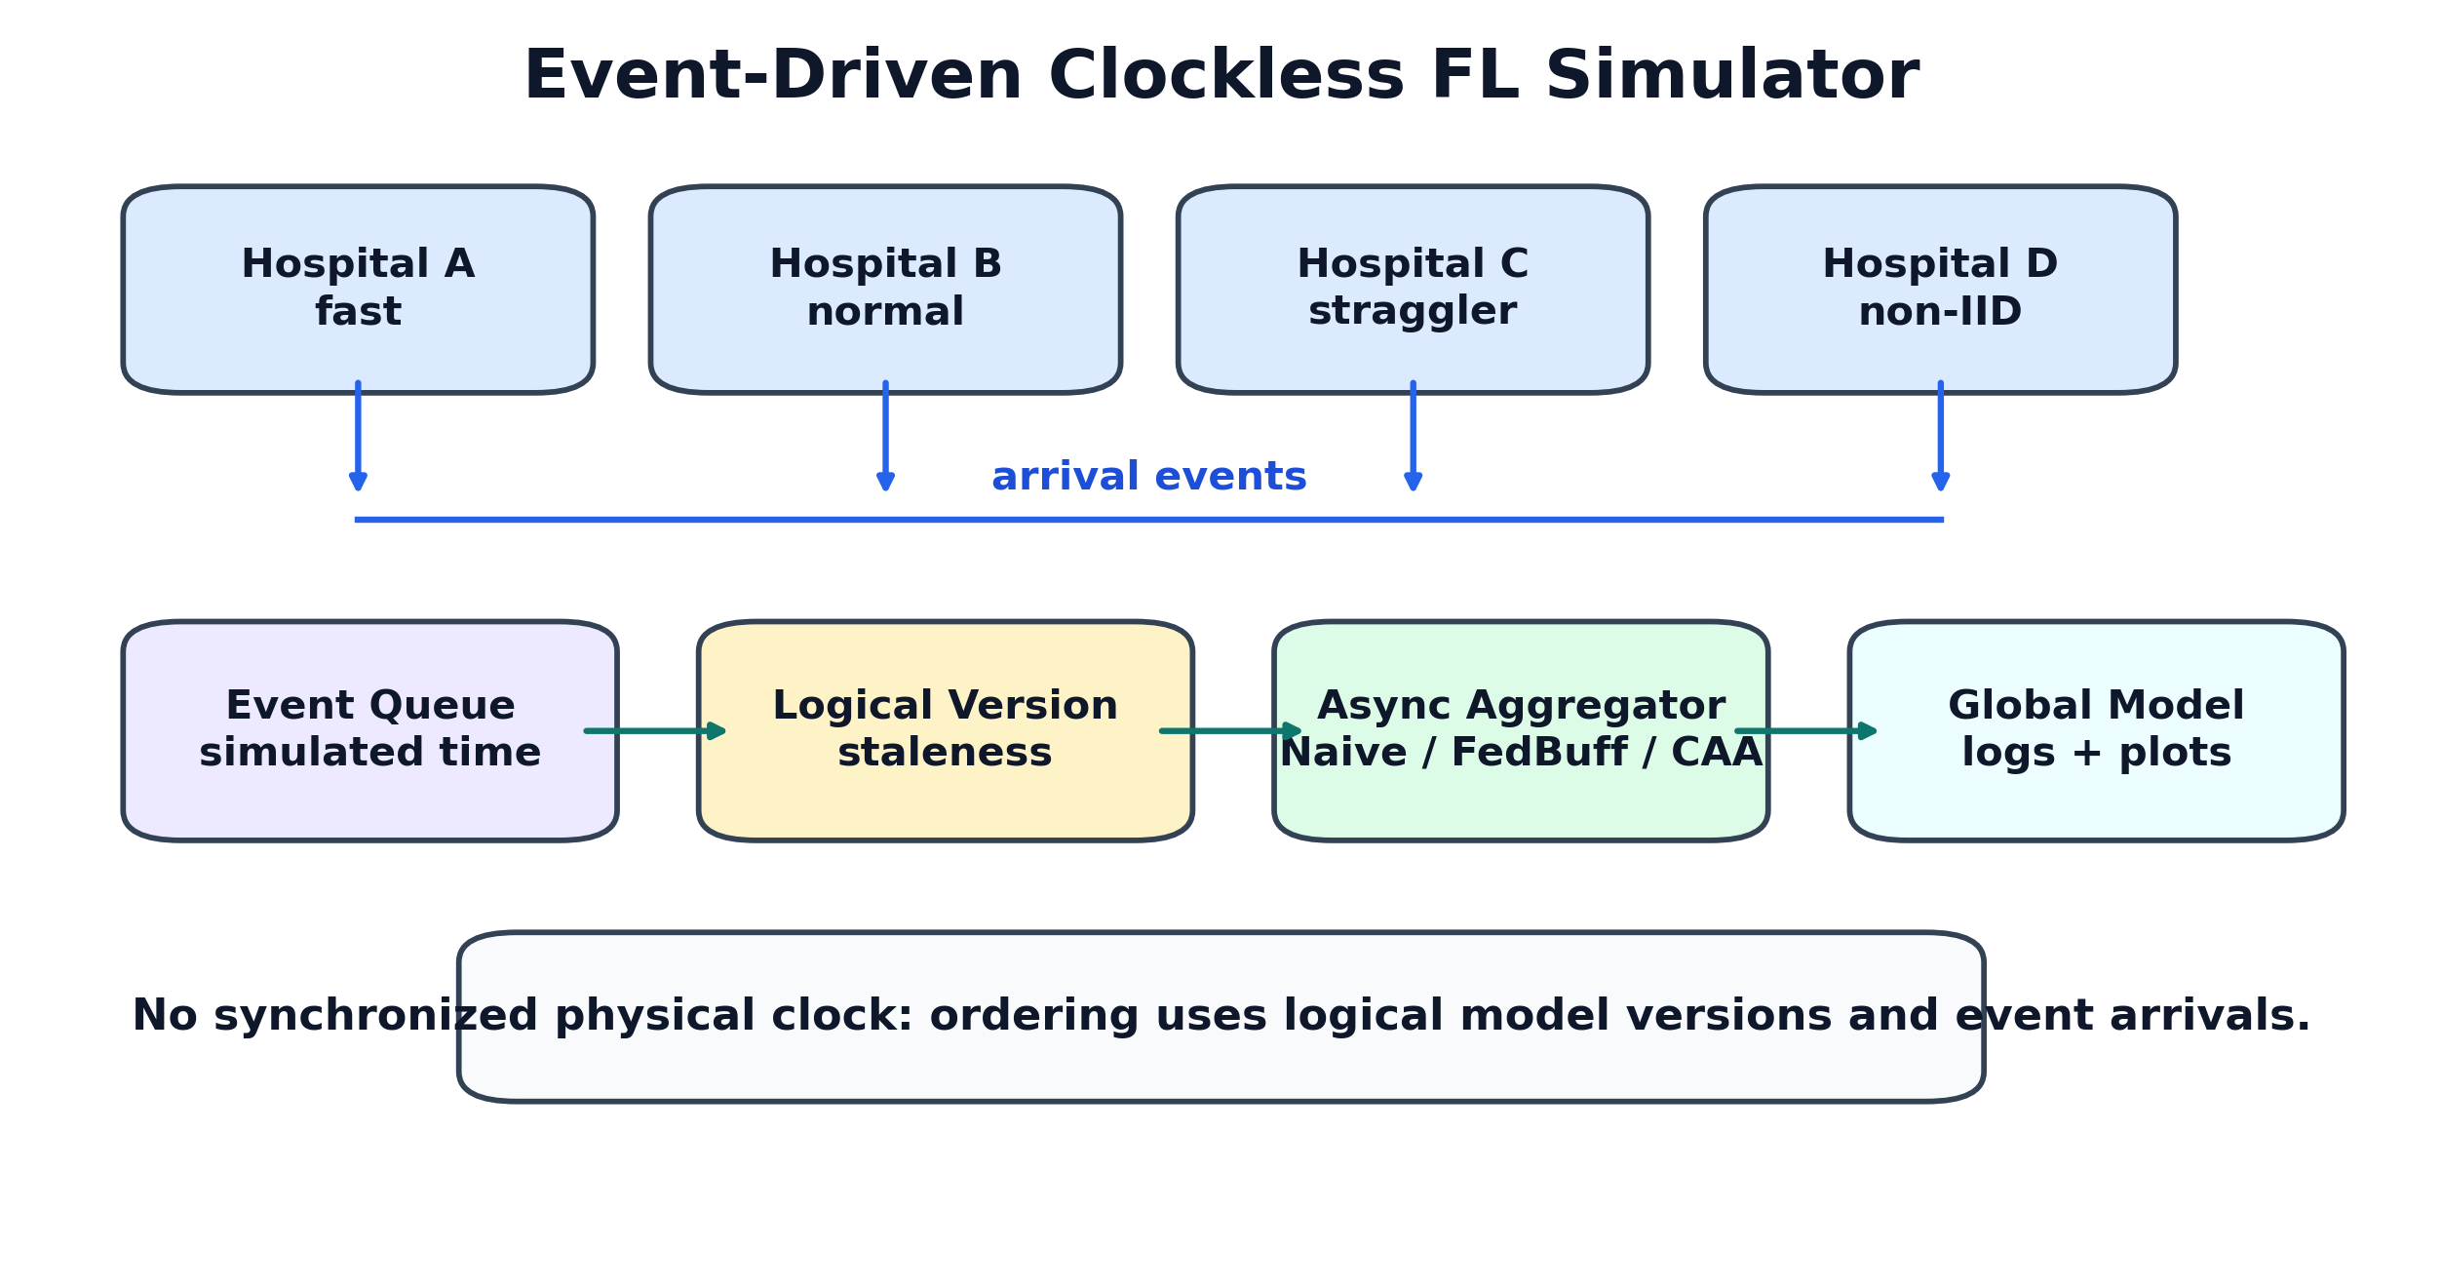
08 03 Architecture | Event-Driven Clockless Simulator

Slide 9
09 04 Methodology | Baseline Map
Method | Role | What it tests
Sync | upper reference | no async staleness, but has a barrier
Naive Async | stateless async | throughput without correction
Staleness | logical-age correction | whether age alone is enough
FedBuff | buffered async baseline | whether buffering stabilizes
CAA-v1 | agreement-aware | whether direction helps
CAA-v2 | final method | direction + trajectory + fairness

Slide 10
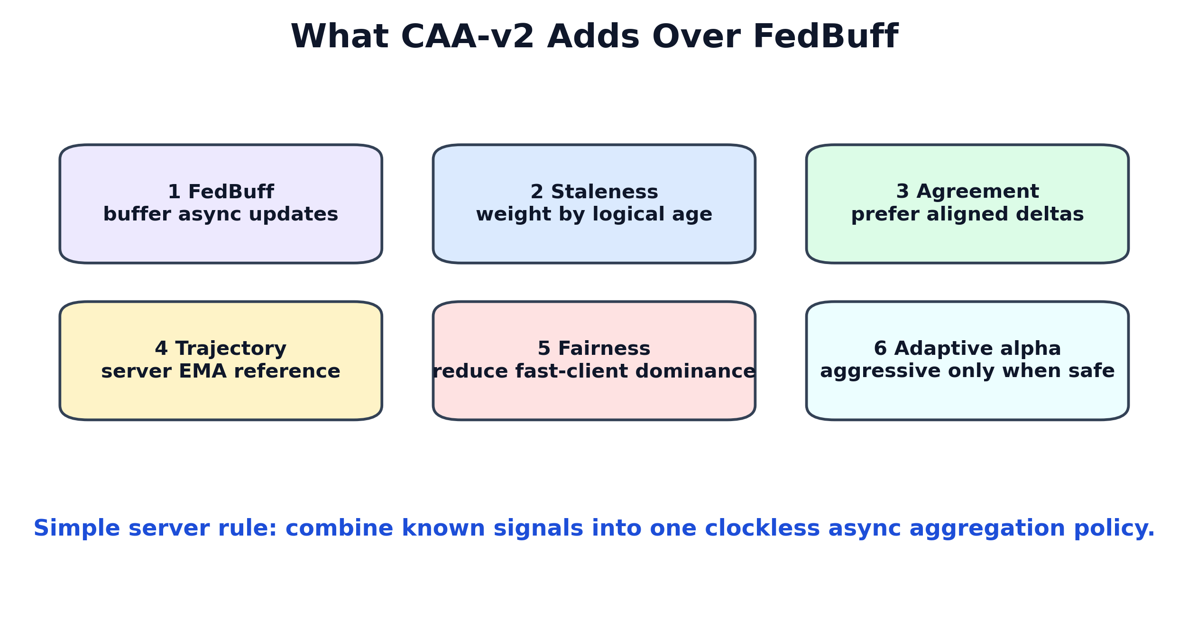
10 04 Methodology | CAA-v2 Is More Than FedBuff

Slide 11
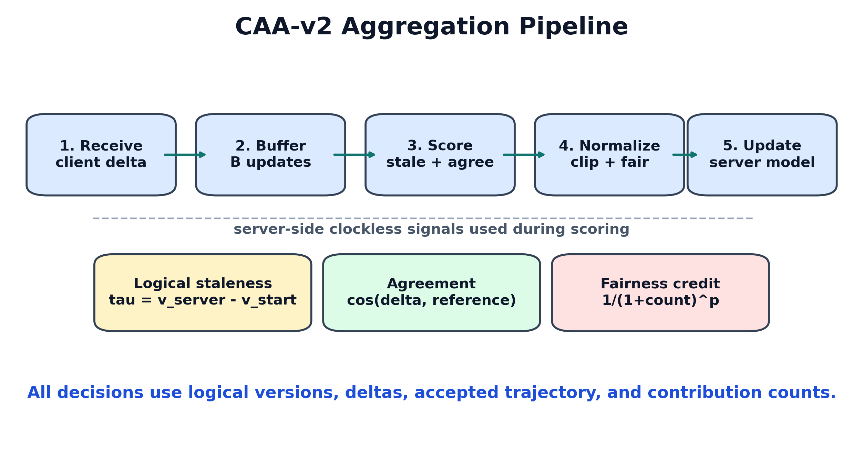
11 04 Methodology | CAA-v2 Server Pipeline

Slide 12
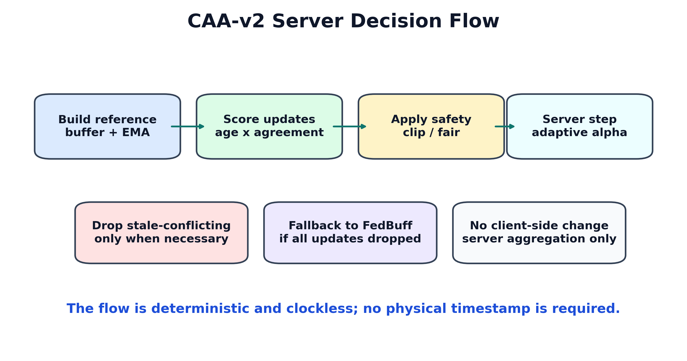
12 04 Methodology | Server Decision Flow

Slide 13
13 04 Methodology | Core Equations
For each client update:
delta_i = client_model_i - model_at_client_start_i tau_i = server_version - client_start_version_i
CAA-v2 weight:
raw_weight_i = n_i x staleness_decay(tau_i) x agreement(delta_i, ref) x fairness_i
Server update:
w <- w + alpha_buffer x weighted_average(delta_i)

Slide 14
14 04 Methodology | Reference Direction
buffer_ref = weighted_average(delta_i, n_i x age_i) server_ema = EMA(previous accepted server deltas) ref = blend(buffer_ref, server_ema)
Intuition:
buffer_ref: the group direction of the current buffered updates.
server_ema: where the global model has recently been moving.
A stale update pointing against this direction should not be blindly amplified.

Slide 15
15 04 Methodology | Clockless Signals
Signal | Source | Uses physical clock?
staleness | server/client logical version | No
agreement | delta dot product | No
server trajectory | accepted server deltas | No
fairness credit | accepted contribution count | No
adaptive alpha | mean staleness + agreement | No

Slide 16
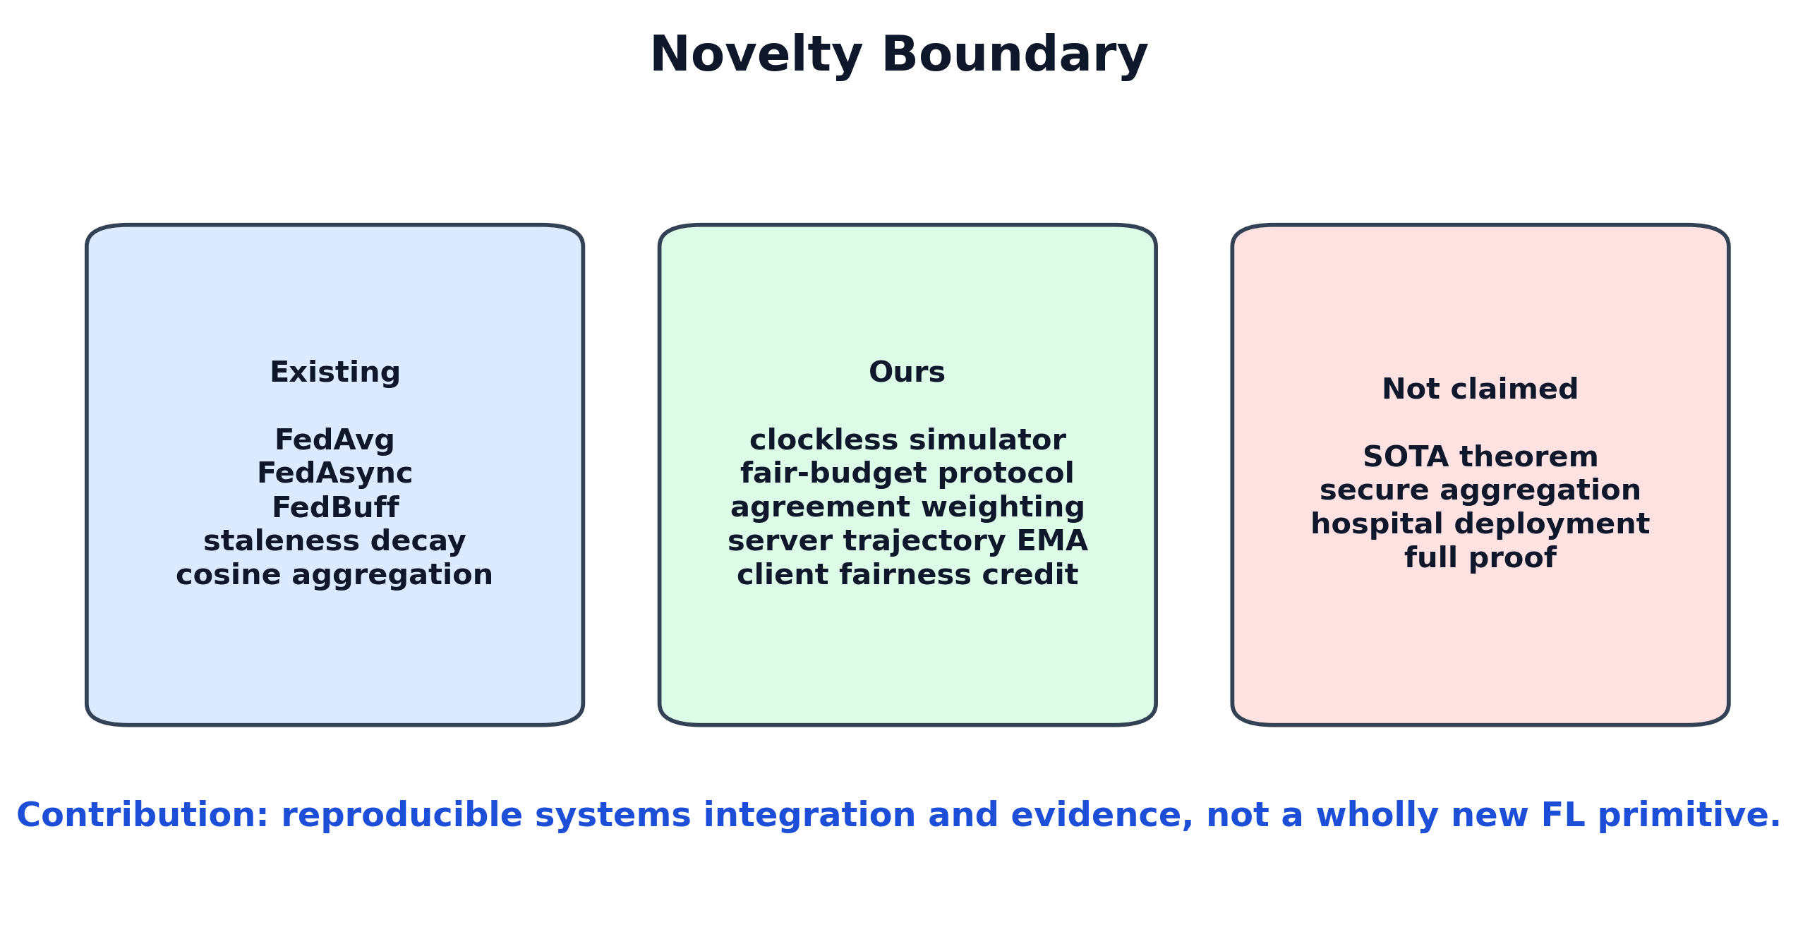
16 04 Methodology | Novelty Boundary

Slide 17
17 05 Experiment Results | Fairness Protocol
clients = 10 local_epochs = 1 batch_size = 128 lr = 0.01, cosine scheduler seeds = 42, 43, 44 async delay = same heterogeneous setting fair budget = async events = sync rounds x clients
Official comparisons do not mix different backbones, delay settings, seeds, local epochs, or update budgets.

Slide 18
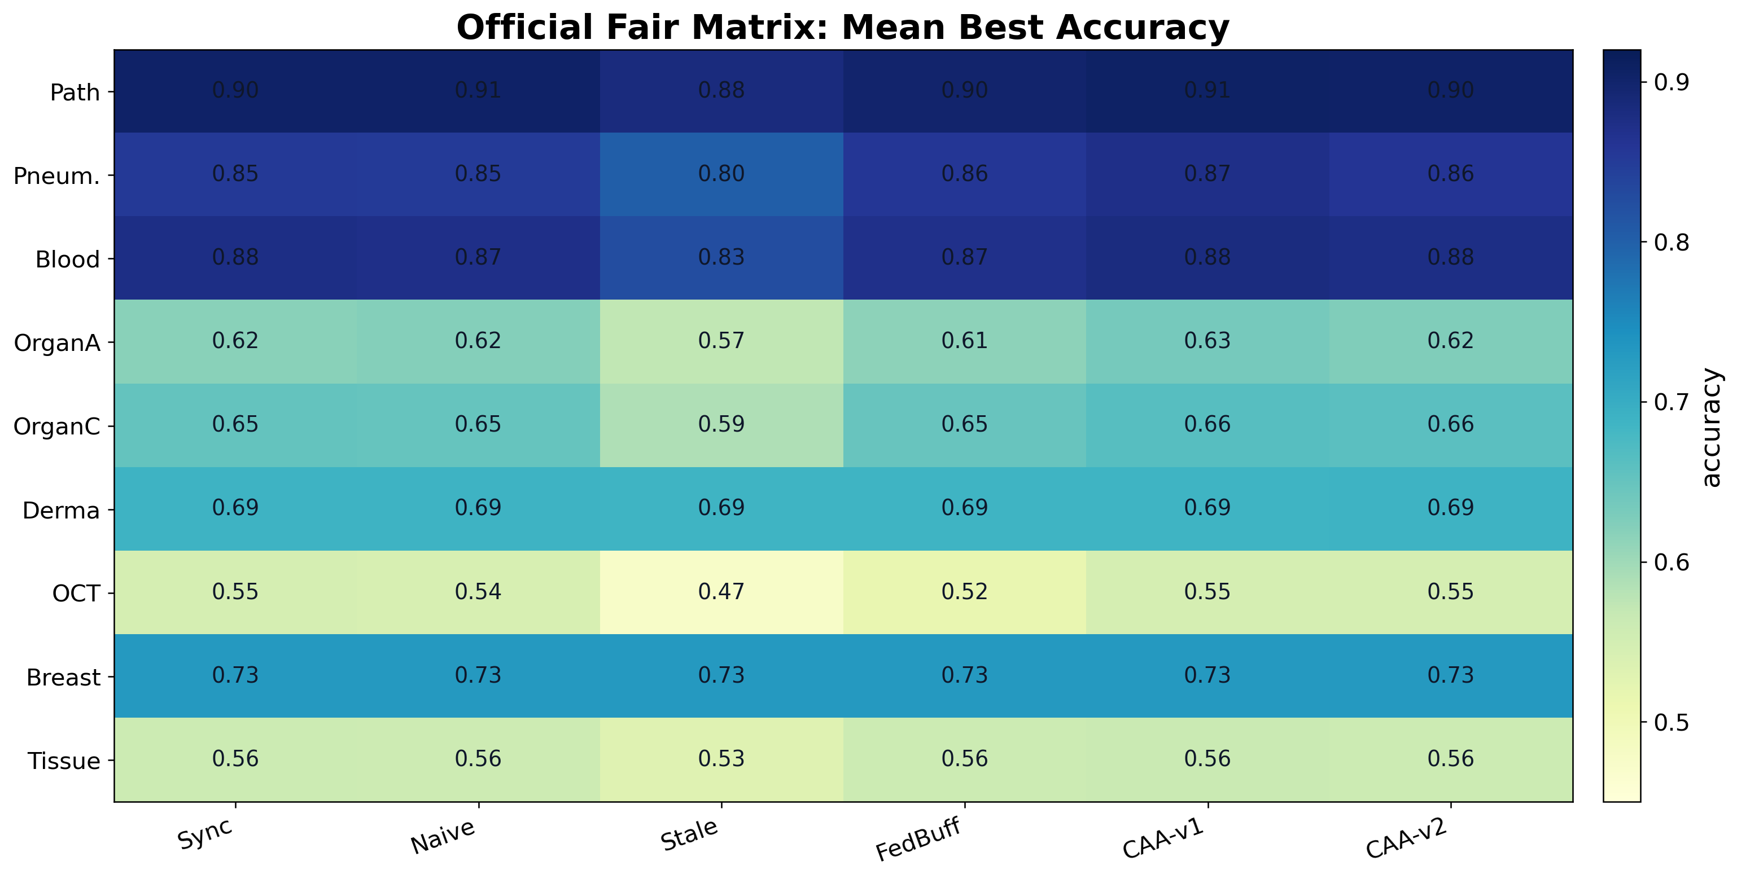
18 05 Experiment Results | Coverage

Slide 19
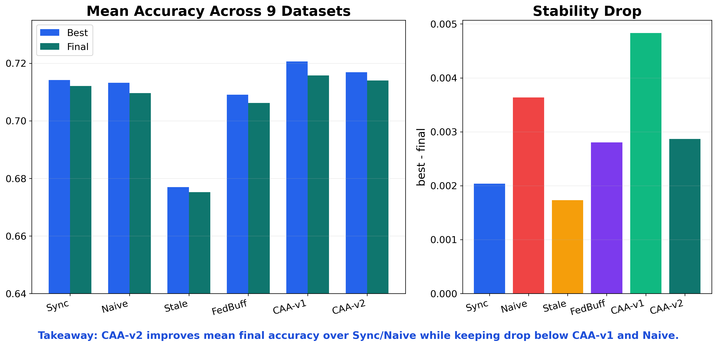
19 05 Experiment Results | Overall Dashboard

Slide 20
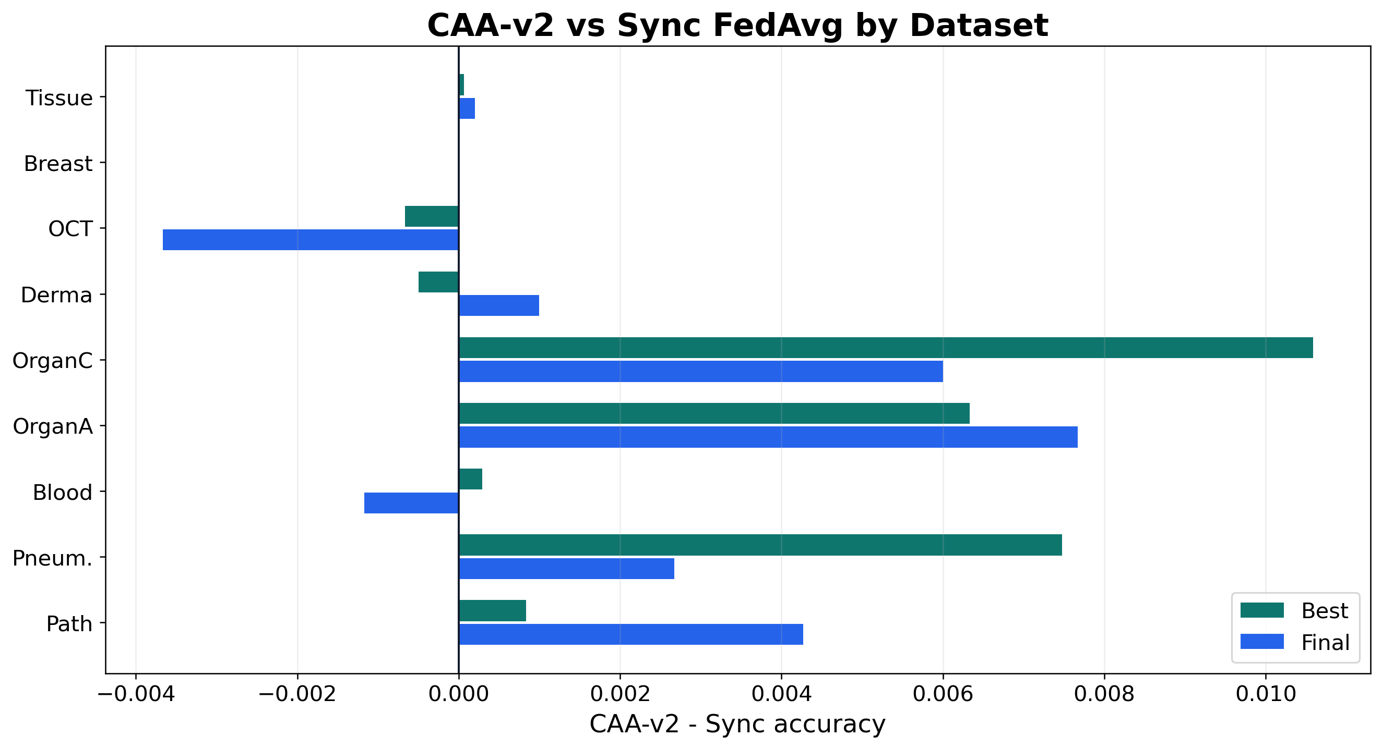
20 05 Experiment Results | CAA-v2 vs Sync

Slide 21
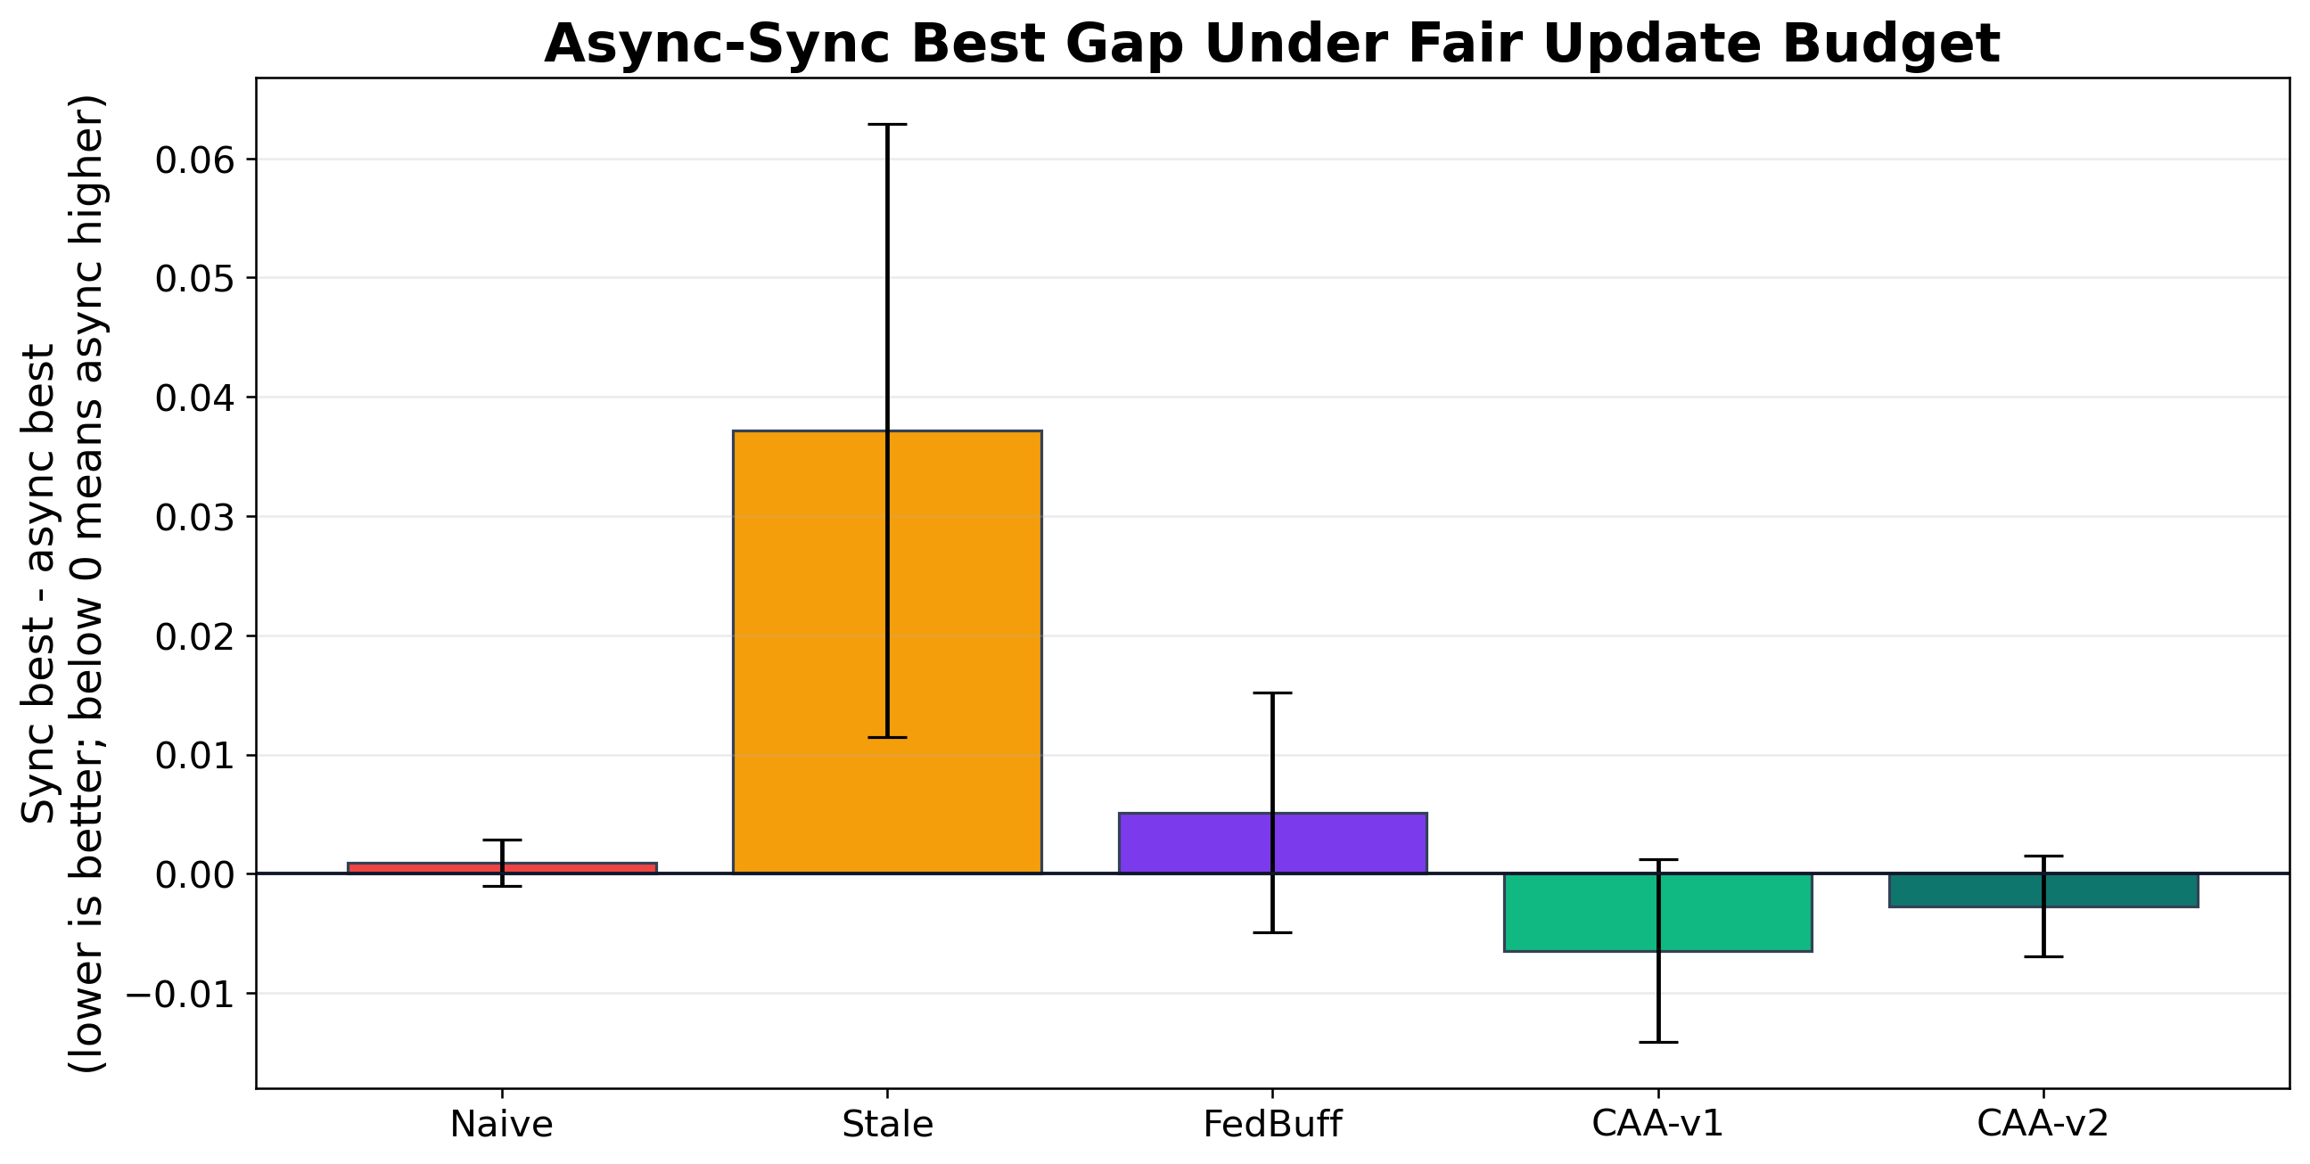
21 05 Experiment Results | Async-Sync Gap

Slide 22
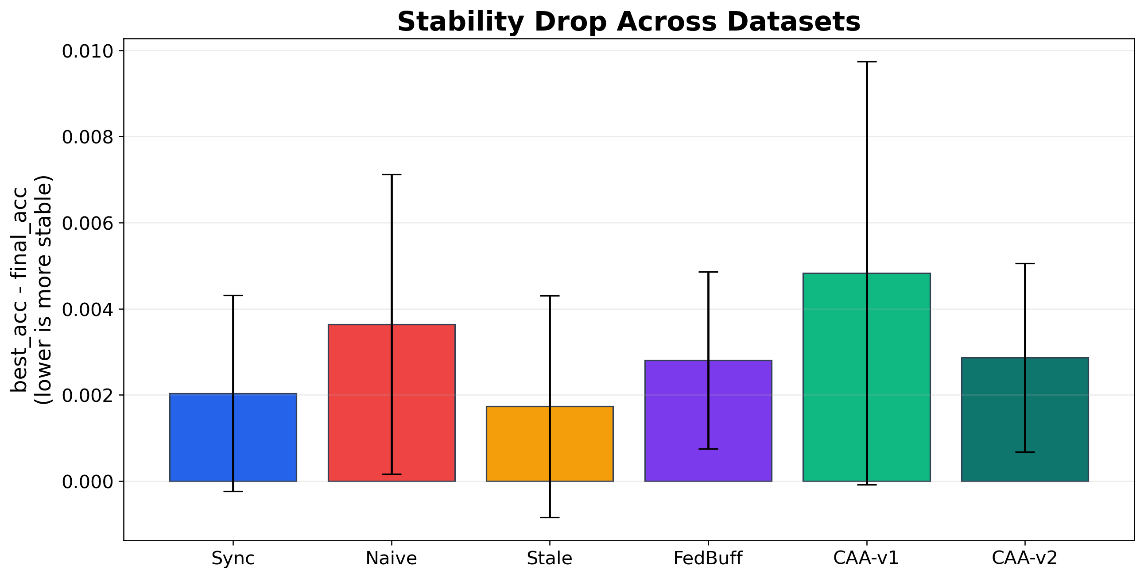
22 05 Experiment Results | Stability Drop

Slide 23
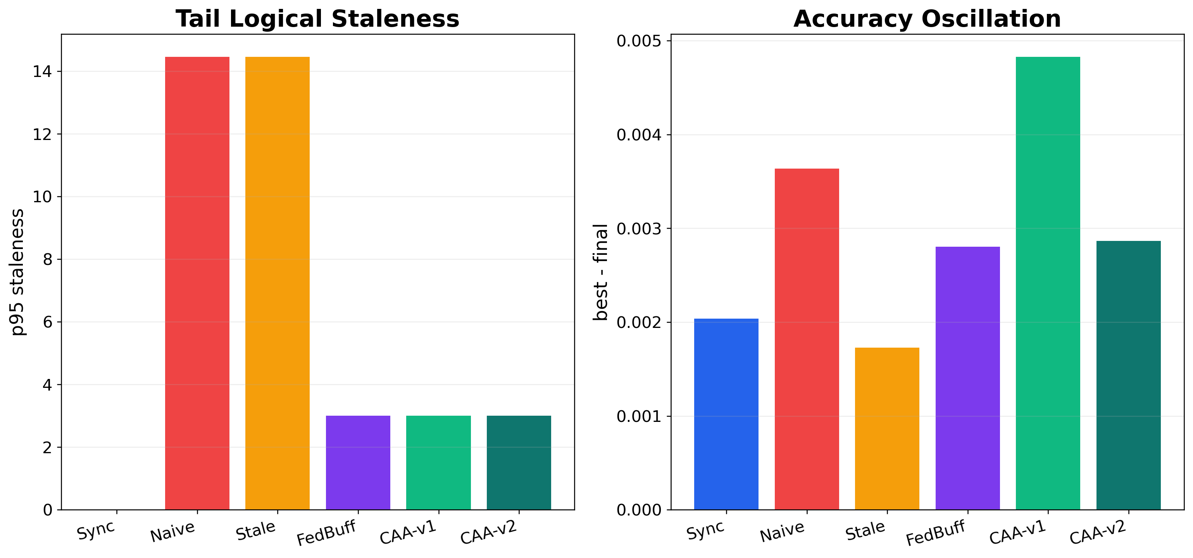
23 05 Experiment Results | System Metrics

Slide 24
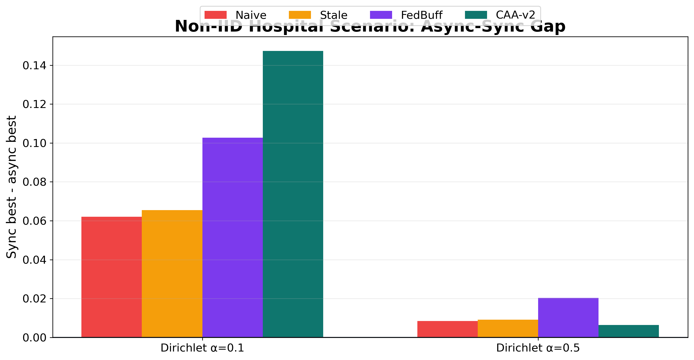
24 05 Experiment Results | Non-IID Hospital Scenario

Slide 25
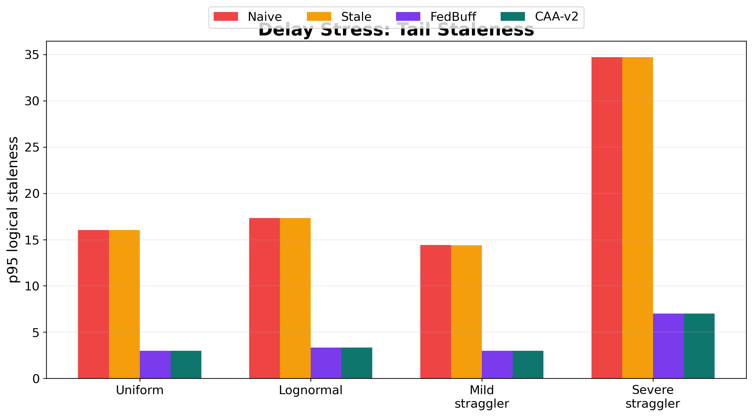
25 05 Experiment Results | Straggler Stress

Slide 26
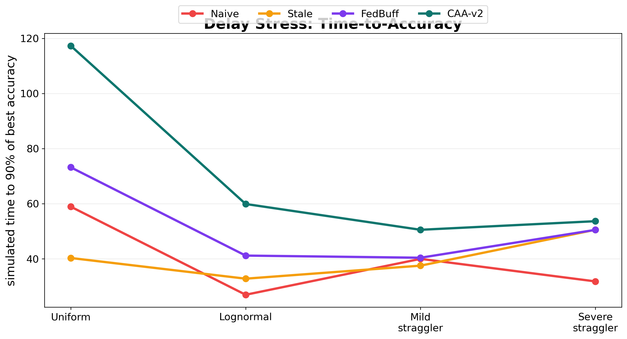
26 05 Experiment Results | Simulated Time

Slide 27
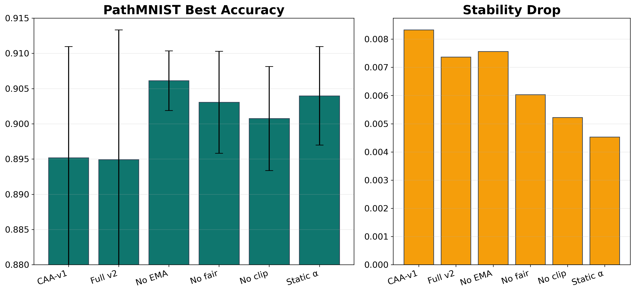
27 05 Experiment Results | Ablation

Slide 28
28 05 Experiment Results | Final Interpretation
Official fair matrix:
CAA-v2 best = 0.7169 CAA-v2 final = 0.7140 Sync final = 0.7121 Naive final = 0.7096
Conclusion: CAA-v2 is not a universal winner, but it is more stable than Naive Async, less conservative than staleness-only, and close to or better than Sync on most datasets.

Slide 29
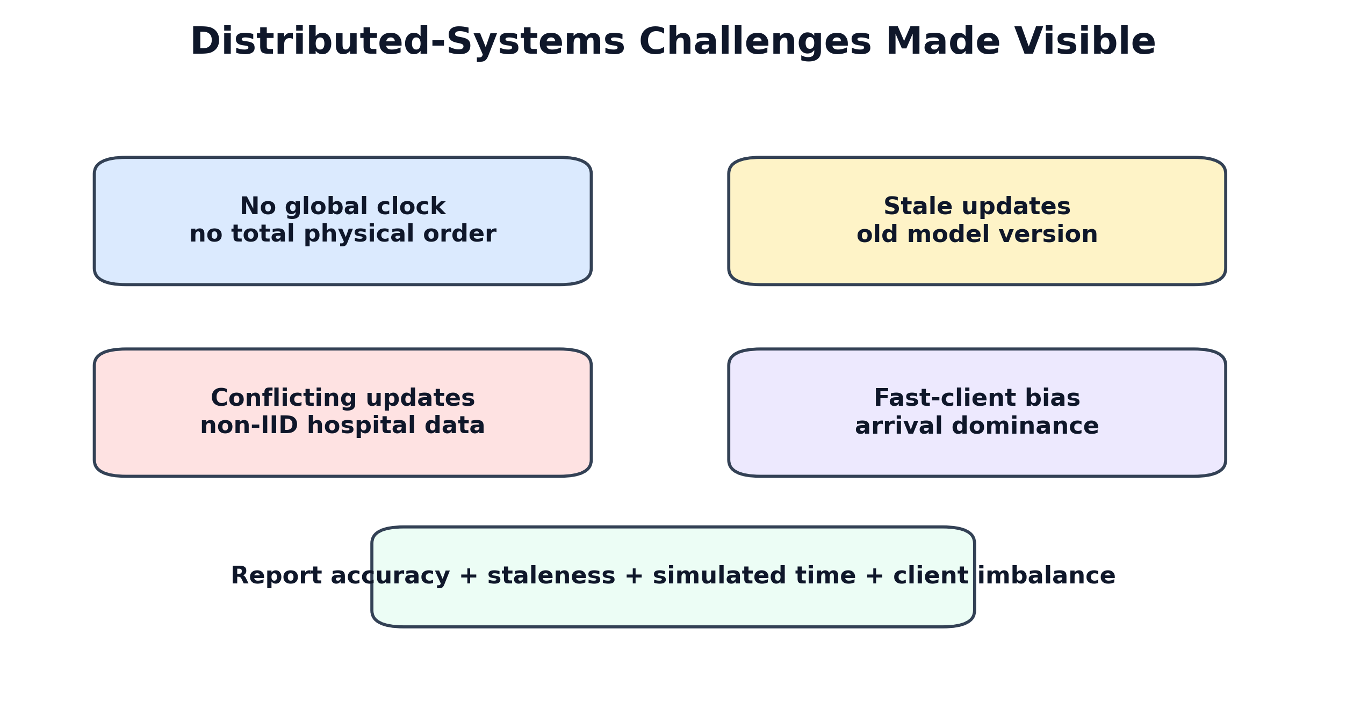
29 06 Challenges | Overview

Slide 30
30 06 Challenges | No Global Clock, Stale, Conflict
Three issues happen at the same time:
No global clock -> cannot totally order distributed events Stale update -> trained from an old global model Conflict update -> non-IID direction differs from others
CAA-v2 design: logical staleness + direction agreement + server trajectory.

Slide 31
31 06 Challenges | Fast Clients and Privacy Tension
Fast-client domination:
higher arrival rate from fast hospitals -> possible long-term model dominance
Privacy tension:
CAA-v2 needs delta direction / norm statistics secure-aggregation compatibility still requires future design
Therefore, our current claim is a system simulator / design extension, not a complete privacy solution.

Slide 32
32 07 Conclusion | Contributions
Build a no-global-clock async FL simulator using logical versions.
Add a fair update-budget protocol.
Propose CAA-v2: agreement + server trajectory + fairness credit.
Evaluate with 9 datasets x 6 methods x 3 seeds.
Add distributed-systems analysis through staleness, simulated time, and client Gini.

Slide 33
33 07 Conclusion | Final Claim
Under a fair update budget, CAA-v2 makes clockless asynchronous FL approach Sync FedAvg across diverse MedMNIST datasets, while reducing the instability of Naive Async and avoiding the over-conservatism of staleness-only aggregation.
Aligned Chinese wording:
CAA-v2 讓無全域時鐘的非同步 FL 接近 Sync FedAvg，同時比 Naive Async 穩、比 staleness-only 不保守。

Slide 34
34 07 Future Work
Compare against FedStaleWeight, SEAFL, FedPSA, and FedCompass.
Add more multi-seed non-IID / straggler stress tests.
Add real network traces or hospital-like traces.
Add balanced accuracy, macro-F1, minority recall, and AUROC.
Design secure-aggregation-compatible agreement statistics.
Add a simplified convergence / stability analysis.

Slide 35
35 References
Lamport, Time, Clocks, and the Ordering of Events in a Distributed System, CACM 1978.
McMahan et al., Communication-Efficient Learning of Deep Networks from Decentralized Data, AISTATS 2017.
Xie et al., Asynchronous Federated Optimization, 2019.
Nguyen et al., Federated Learning with Buffered Asynchronous Aggregation, 2021.
Ma et al., FedStaleWeight, 2024.
Yang et al., MedMNIST v2, Scientific Data 2023.

