Slide 1
Clockless Federated Adaptation
無全域時鐘下的非同步醫學影像聯邦學習
Group 4：Asynchronous Distributed ML Adaptation
分散式系統期末 Proposal Deck

Slide 2
02 01 Motivation｜從醫院合作訓練開始
多家醫院想共同訓練醫學影像模型，但原始資料不能集中。
醫院設備、網路、工作負載不同。
有些 update 很快，有些 update 很晚。
病人族群與影像分布不同。
問題：不等慢醫院會比較快，但晚到的 update 還可信嗎？

Slide 3
03 01 Motivation｜分散式系統核心矛盾
Sync FL: 等所有 client -> 最慢節點決定速度 Async FL: 不等慢 client -> 收到 stale / out-of-order update
本專案聚焦：
throughput vs consistency / convergence correctness
這是 distributed systems 的時間、順序與一致性問題，不只是分類模型問題。

Slide 4
04 02 Preliminary｜Sync vs Async FL
Setting | System behavior | Main risk
Sync FedAvg | round barrier，等待 clients | straggler bottleneck
Naive Async | update 到就套用 | stale update instability
Buffered Async | 收 B 個 updates 再聚合 | buffer 中仍可能有 conflict

Slide 5
05 02 Preliminary｜Logical Staleness
不假設 synchronized physical clock。
server_version = current global model version client_start_version = version received by the client staleness = server_version - client_start_version
這是 Lamport logical time 在 FL simulator 裡的對應：用 logical version 取代 wall-clock ordering。

Slide 6
06 03 Problem Formulation｜公平比較
Async 以前表現差，可能只是 update budget 少。
Sync update budget = rounds × clients Async update budget = events Fair comparison = events = rounds × clients
正式矩陣：
9 datasets × 6 methods × 3 seeds = 162 official runs

Slide 7
07 03 Problem Formulation｜評估指標
ML 指標：
best_acc, final_acc, stability_drop = best_acc - final_acc
Distributed systems 指標：
p95 staleness, simulated time, effective alpha, client contribution Gini, time-to-accuracy
accuracy 是結果；staleness / delay / imbalance 解釋原因。

Slide 8
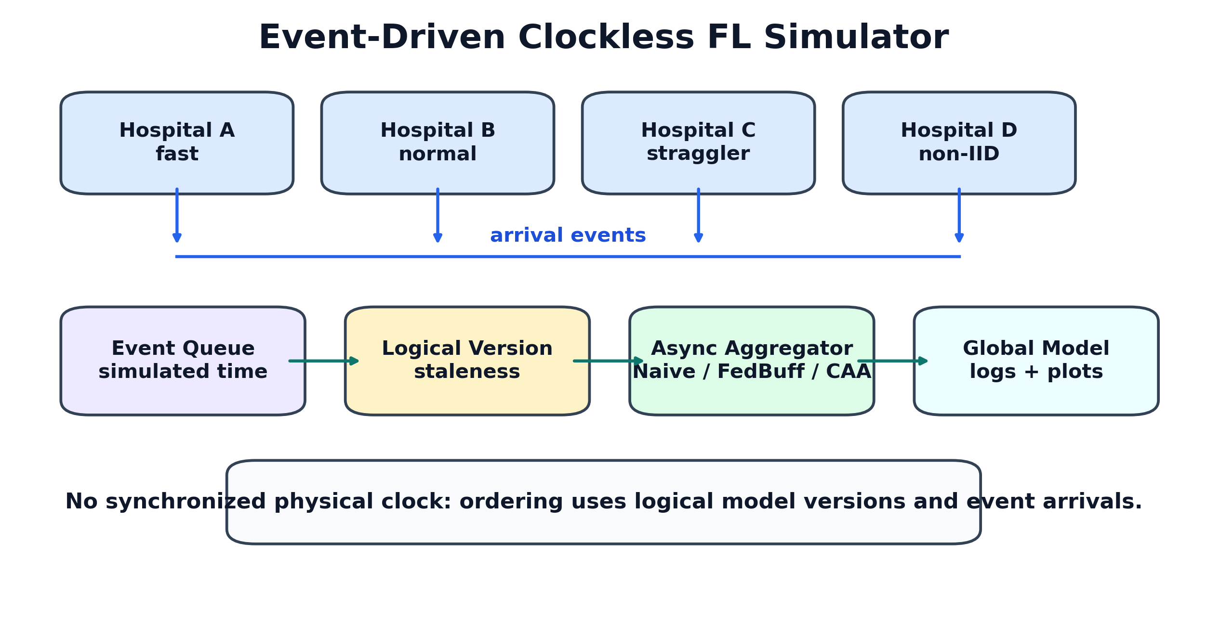
08 03 Architecture｜Event-Driven Clockless Simulator

Slide 9
09 04 Methodology｜Baseline Map
Method | Role | What it tests
Sync | upper reference | no async staleness, but barrier
Naive Async | stateless async | throughput without correction
Staleness | logical-age correction | whether age alone is enough
FedBuff | buffered async baseline | whether buffering stabilizes
CAA-v1 | agreement-aware | whether direction helps
CAA-v2 | final method | direction + trajectory + fairness

Slide 10
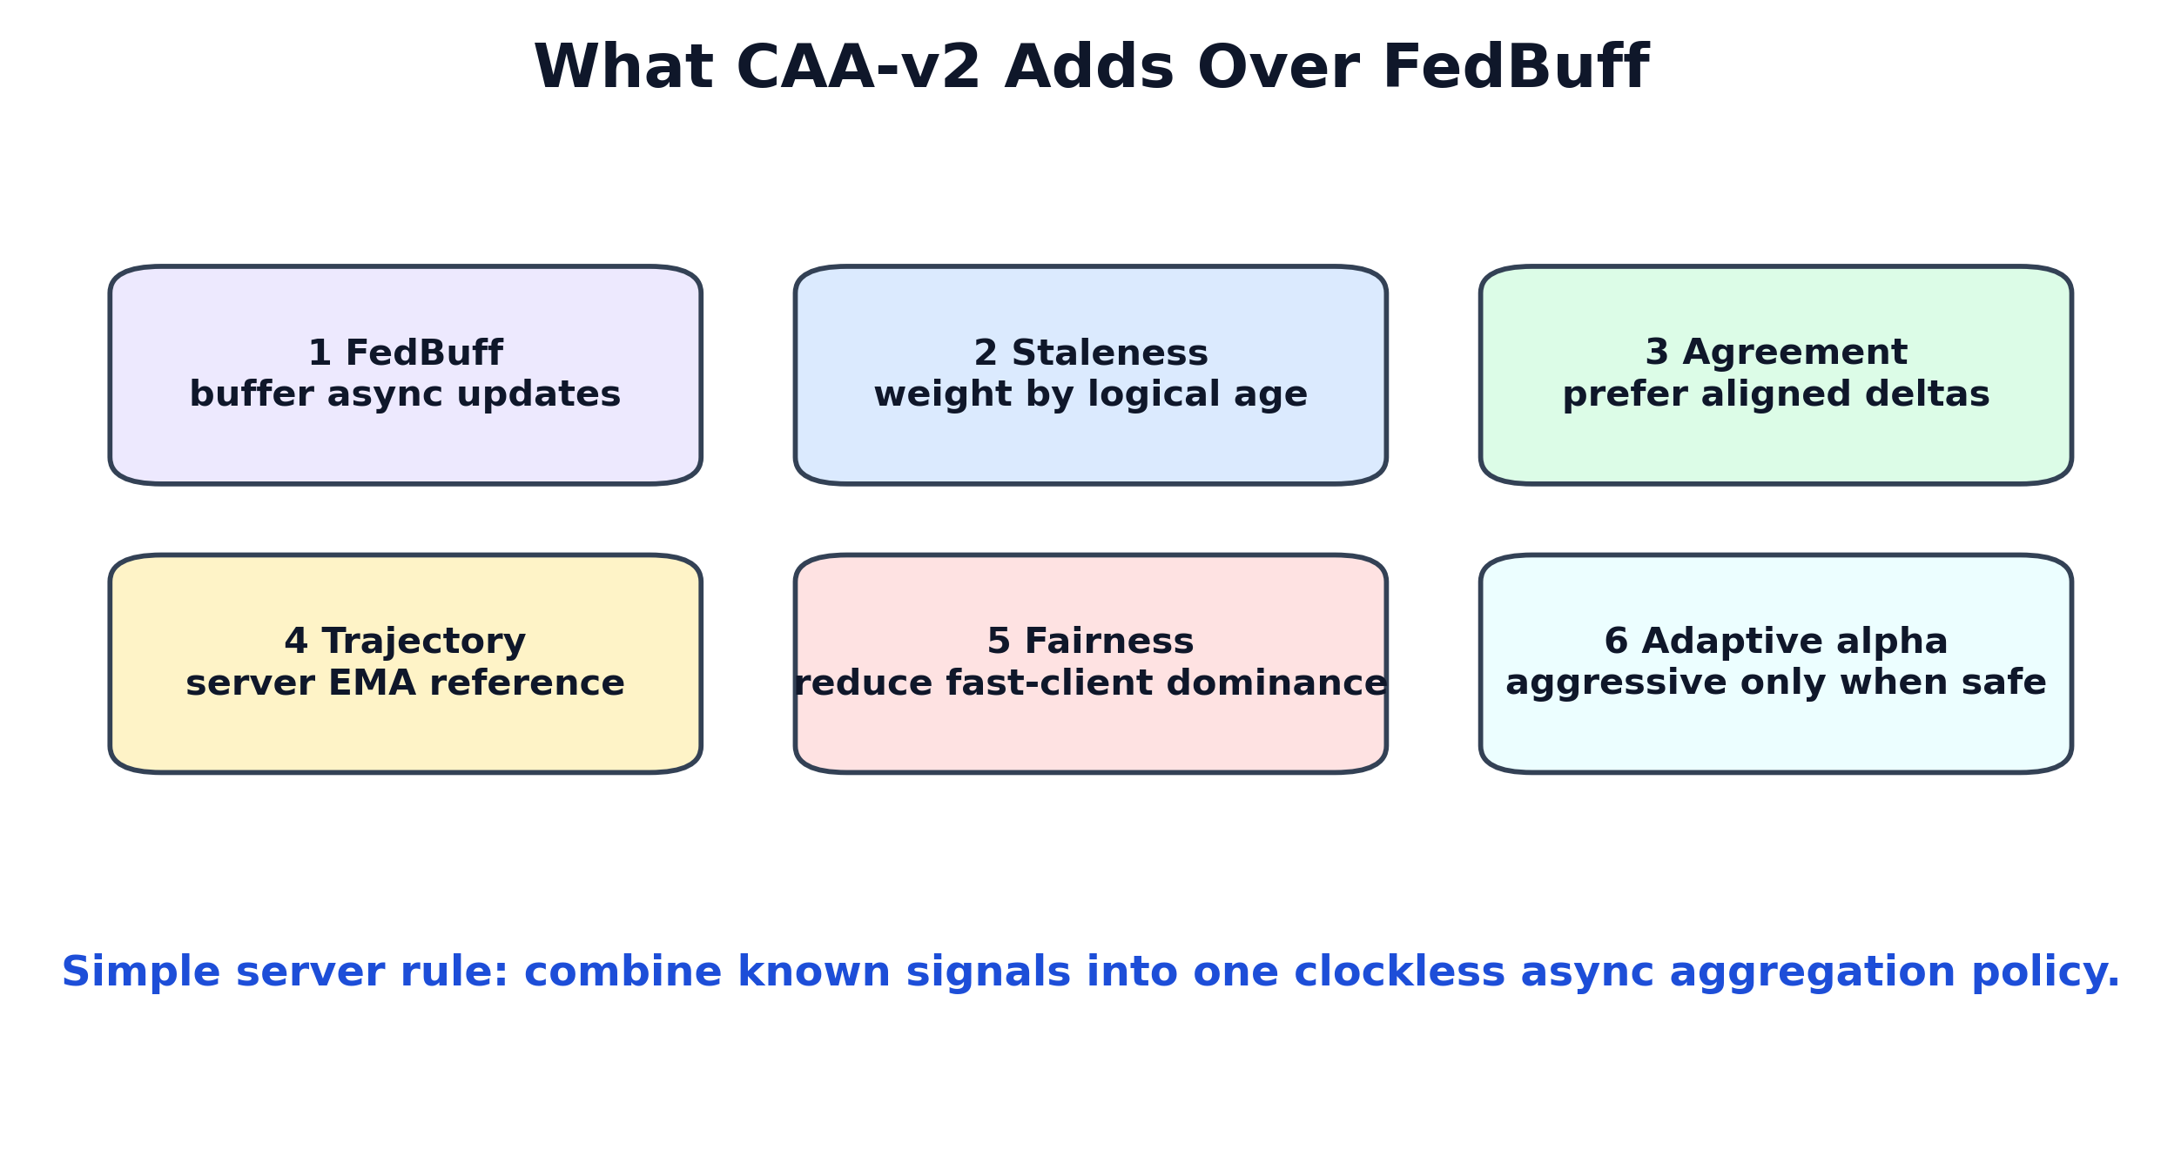
10 04 Methodology｜CAA-v2 不只是 FedBuff

Slide 11
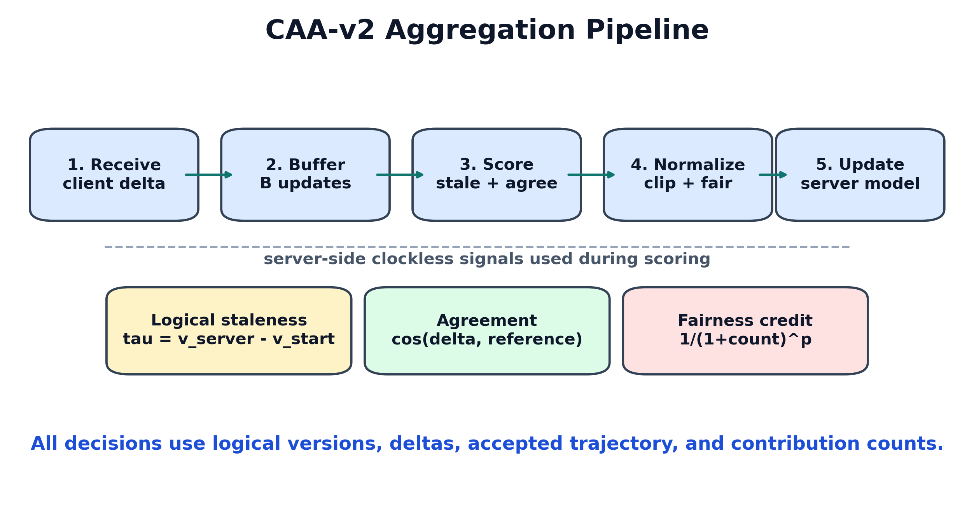
11 04 Methodology｜CAA-v2 Server Pipeline

Slide 12
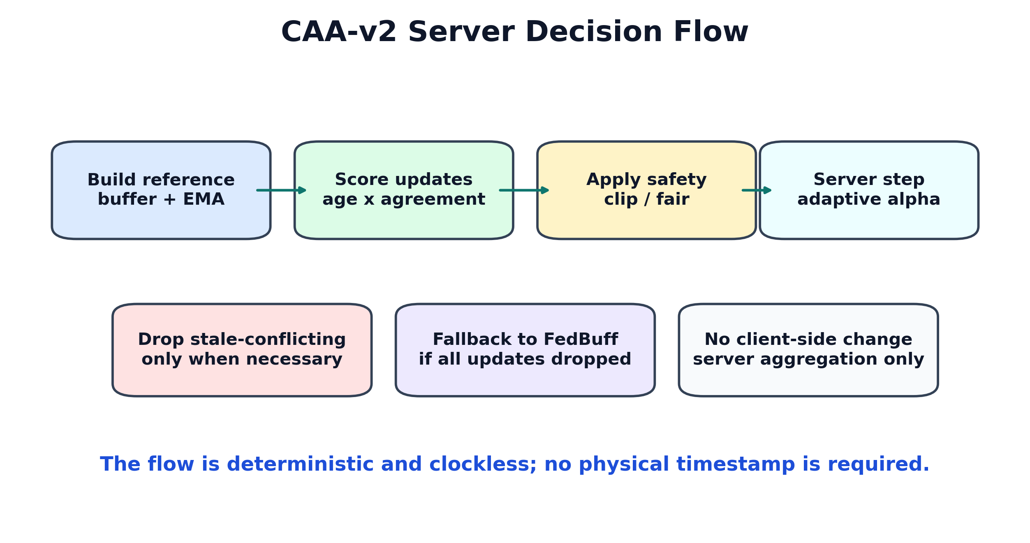
12 04 Methodology｜Server Decision Flow

Slide 13
13 04 Methodology｜核心數學式
每個 client update：
delta_i = client_model_i - model_at_client_start_i tau_i = server_version - client_start_version_i
CAA-v2 權重：
raw_weight_i = n_i × staleness_decay(tau_i) × agreement(delta_i, ref) × fairness_i
Server update：
w <- w + alpha_buffer × weighted_average(delta_i)

Slide 14
14 04 Methodology｜Reference Direction
buffer_ref = weighted_average(delta_i, n_i × age_i) server_ema = EMA(previous accepted server deltas) ref = blend(buffer_ref, server_ema)
直覺：
buffer_ref：這批 updates 的群體方向。
server_ema：近期 global model 真的往哪裡走。
stale 且反向的 update 不應被盲目放大。

Slide 15
15 04 Methodology｜Clockless Signals
Signal | Source | Uses physical clock?
staleness | server/client logical version | No
agreement | delta dot product | No
server trajectory | accepted server deltas | No
fairness credit | accepted contribution count | No
adaptive alpha | mean staleness + agreement | No

Slide 16
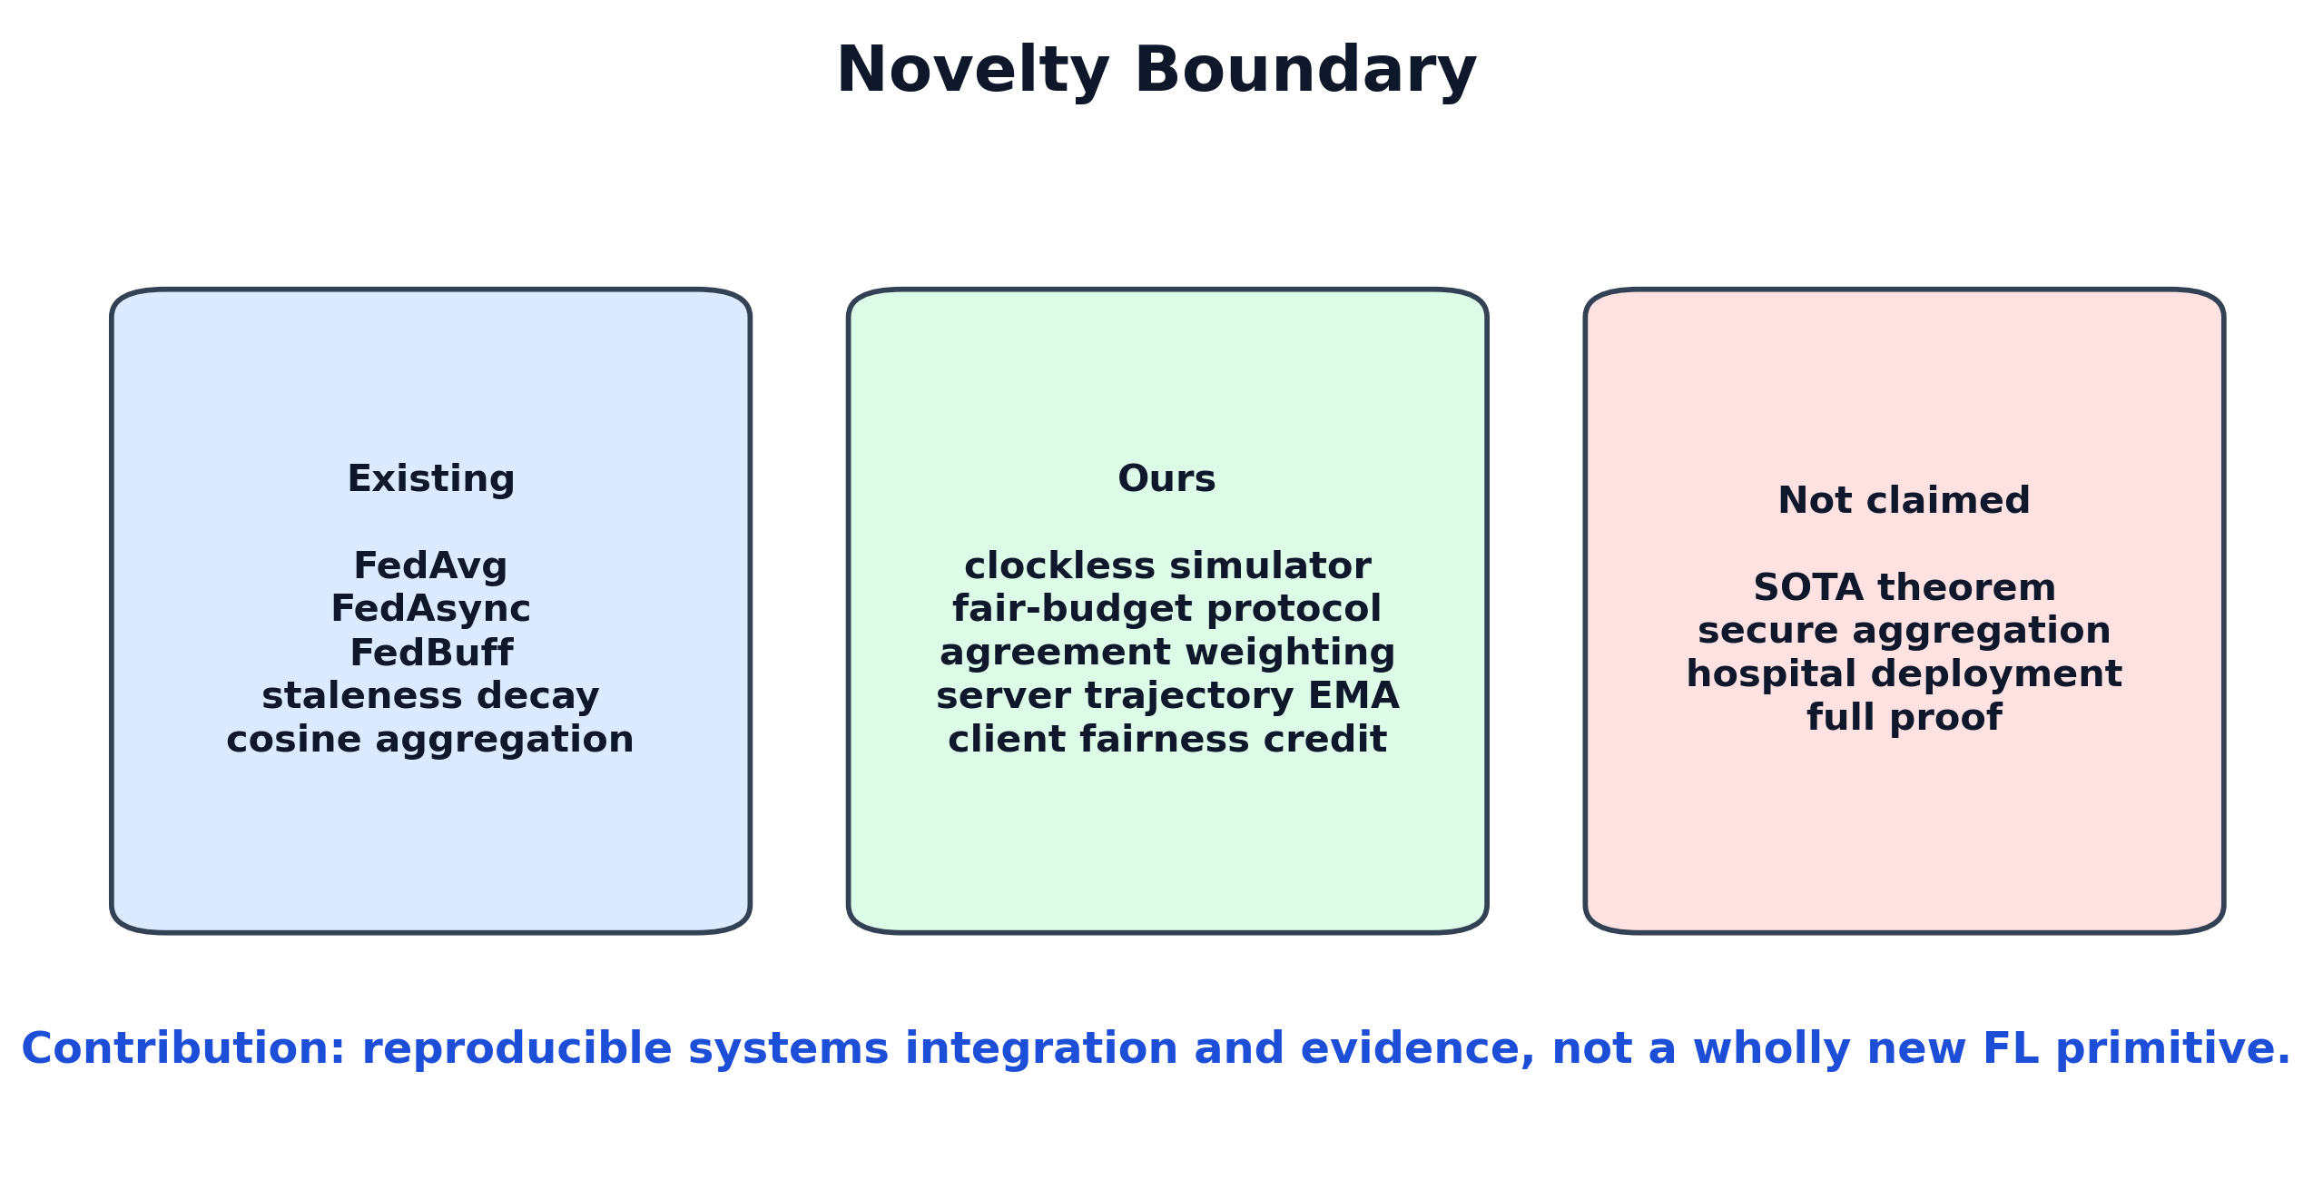
16 04 Methodology｜Novelty Boundary

Slide 17
17 05 Experiment Results｜Fairness Protocol
clients = 10 local_epochs = 1 batch_size = 128 lr = 0.01, cosine scheduler seeds = 42, 43, 44 async delay = same heterogeneous setting fair budget = async events = sync rounds × clients
正式比較不混用不同 backbone、delay、seed、local epochs 或 update budget。

Slide 18
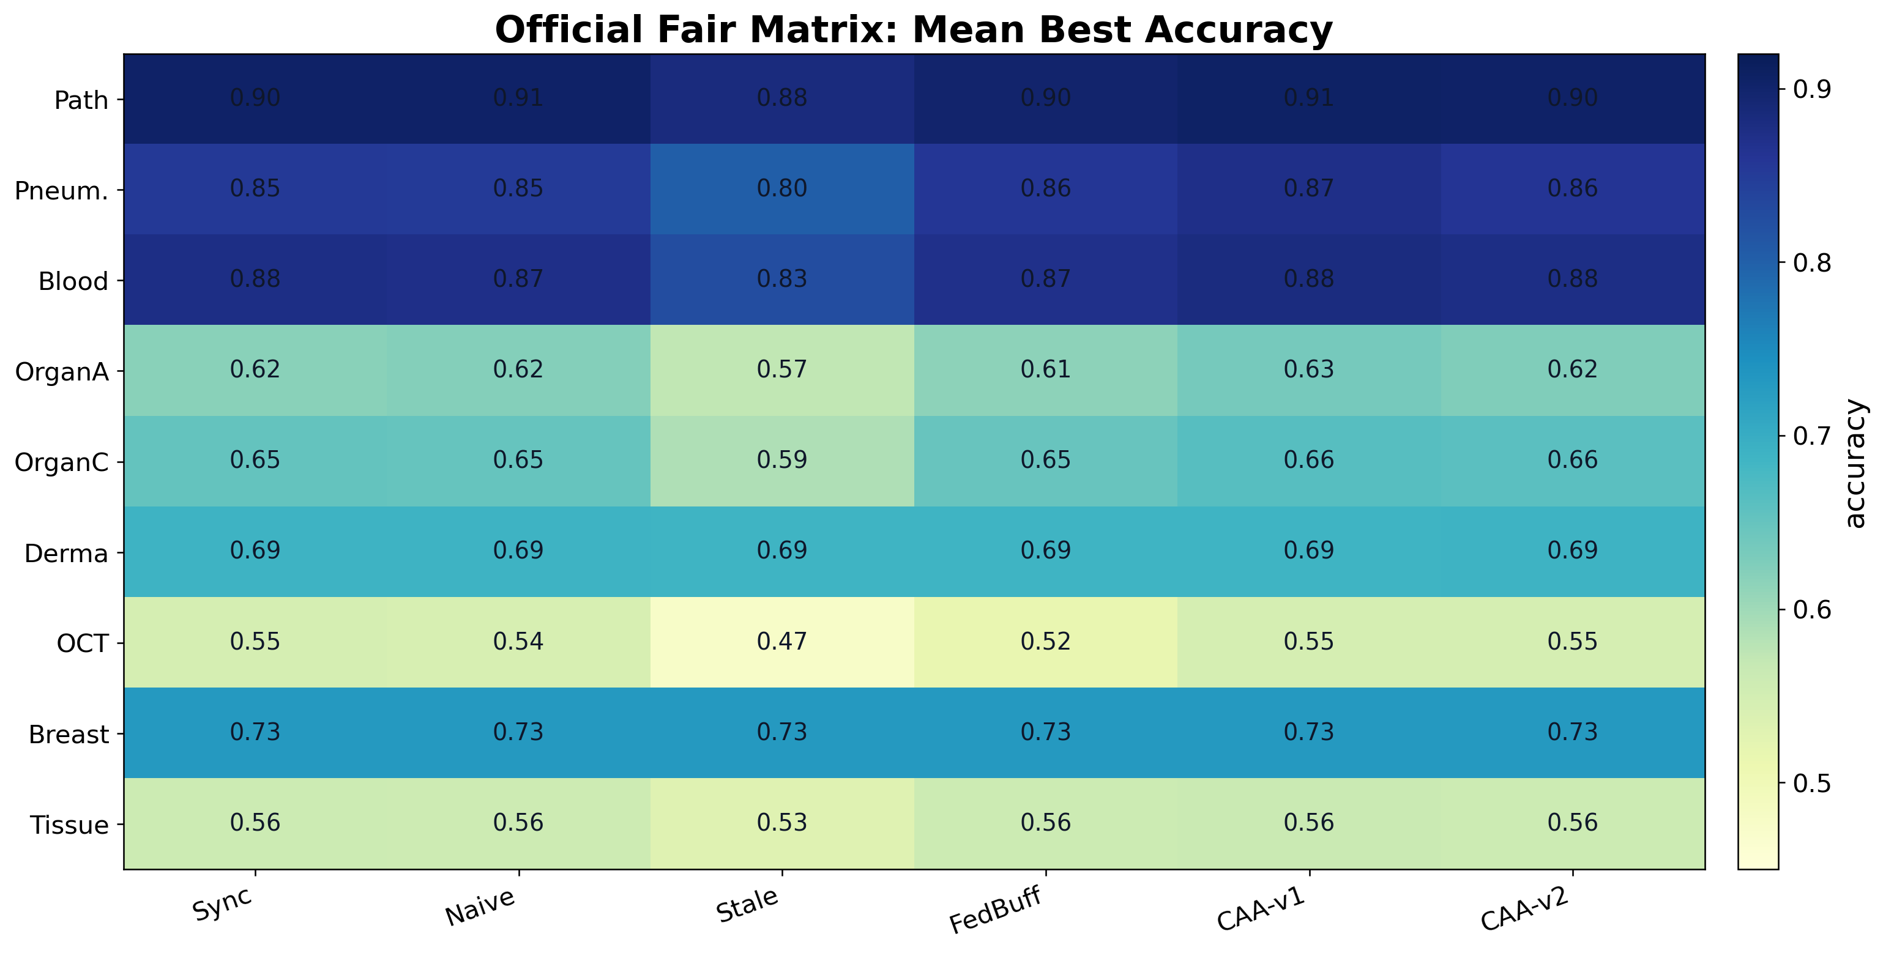
18 05 Experiment Results｜Coverage

Slide 19
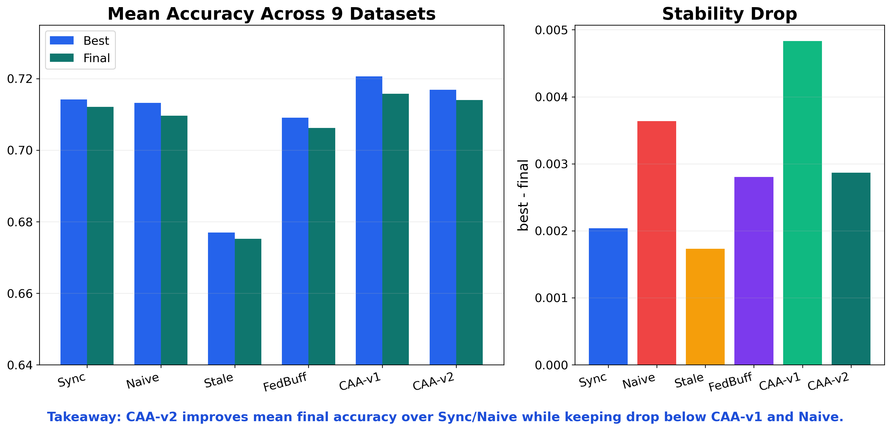
19 05 Experiment Results｜Overall Dashboard

Slide 20
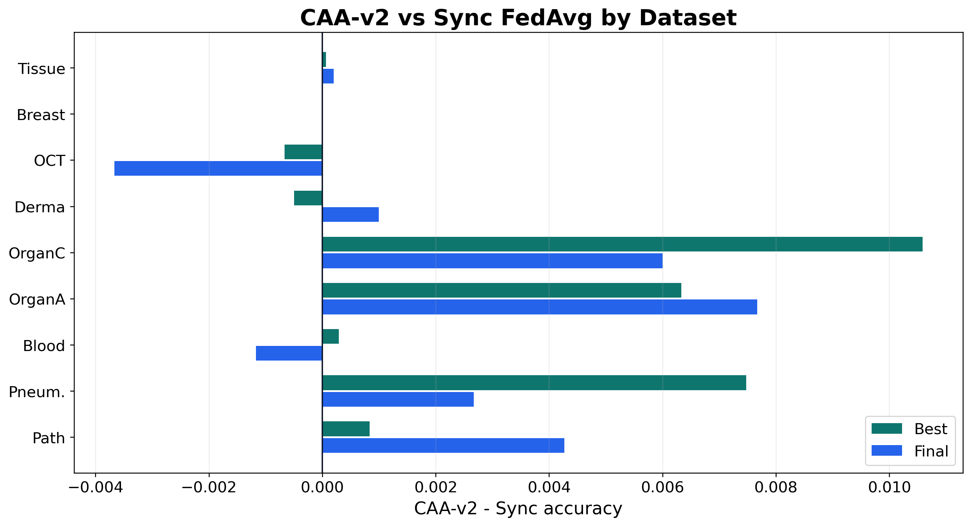
20 05 Experiment Results｜CAA-v2 vs Sync

Slide 21
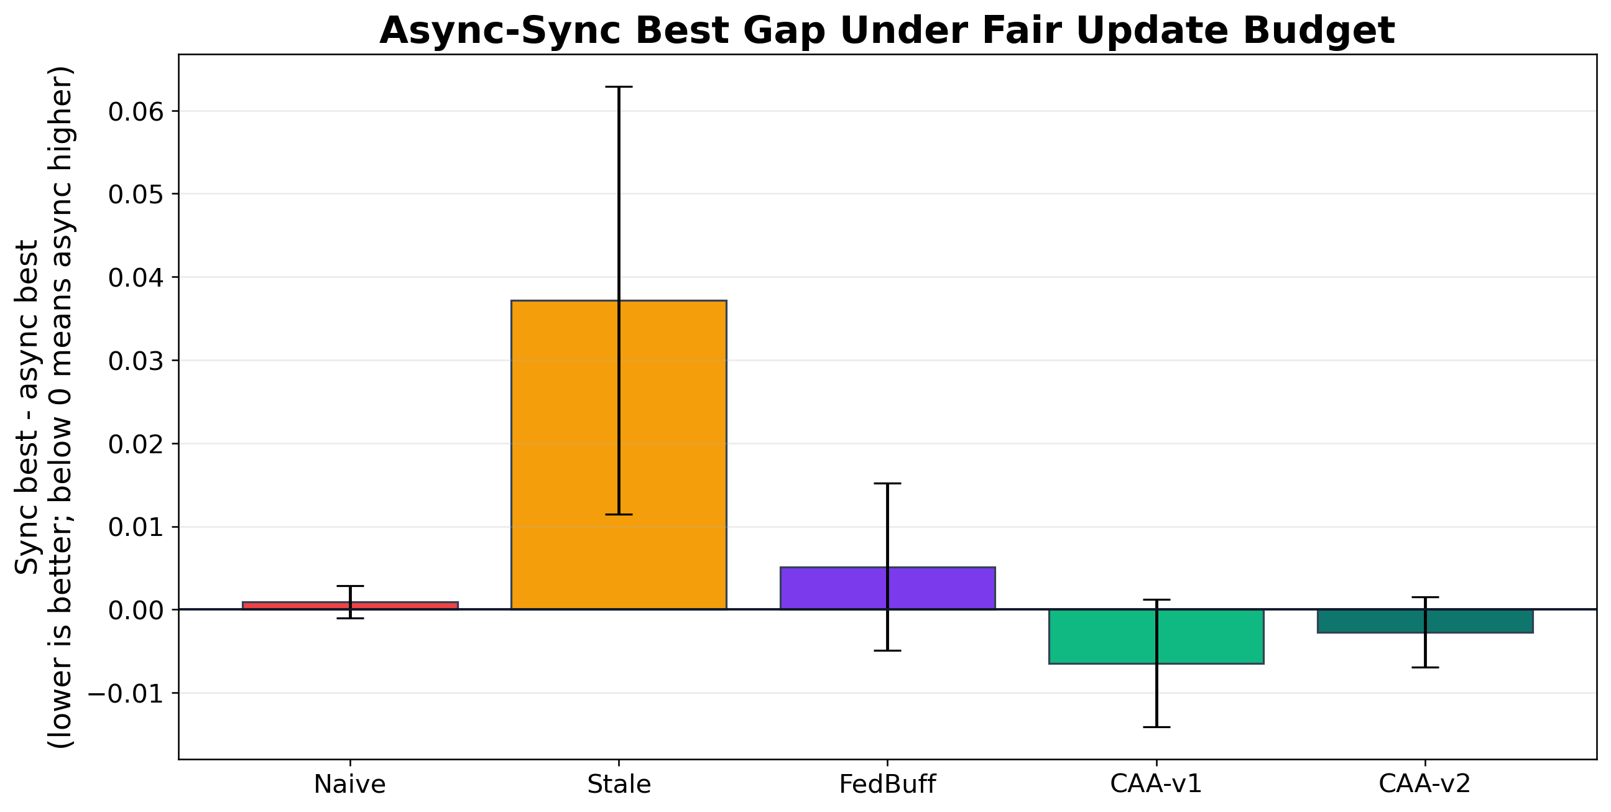
21 05 Experiment Results｜Async-Sync Gap

Slide 22
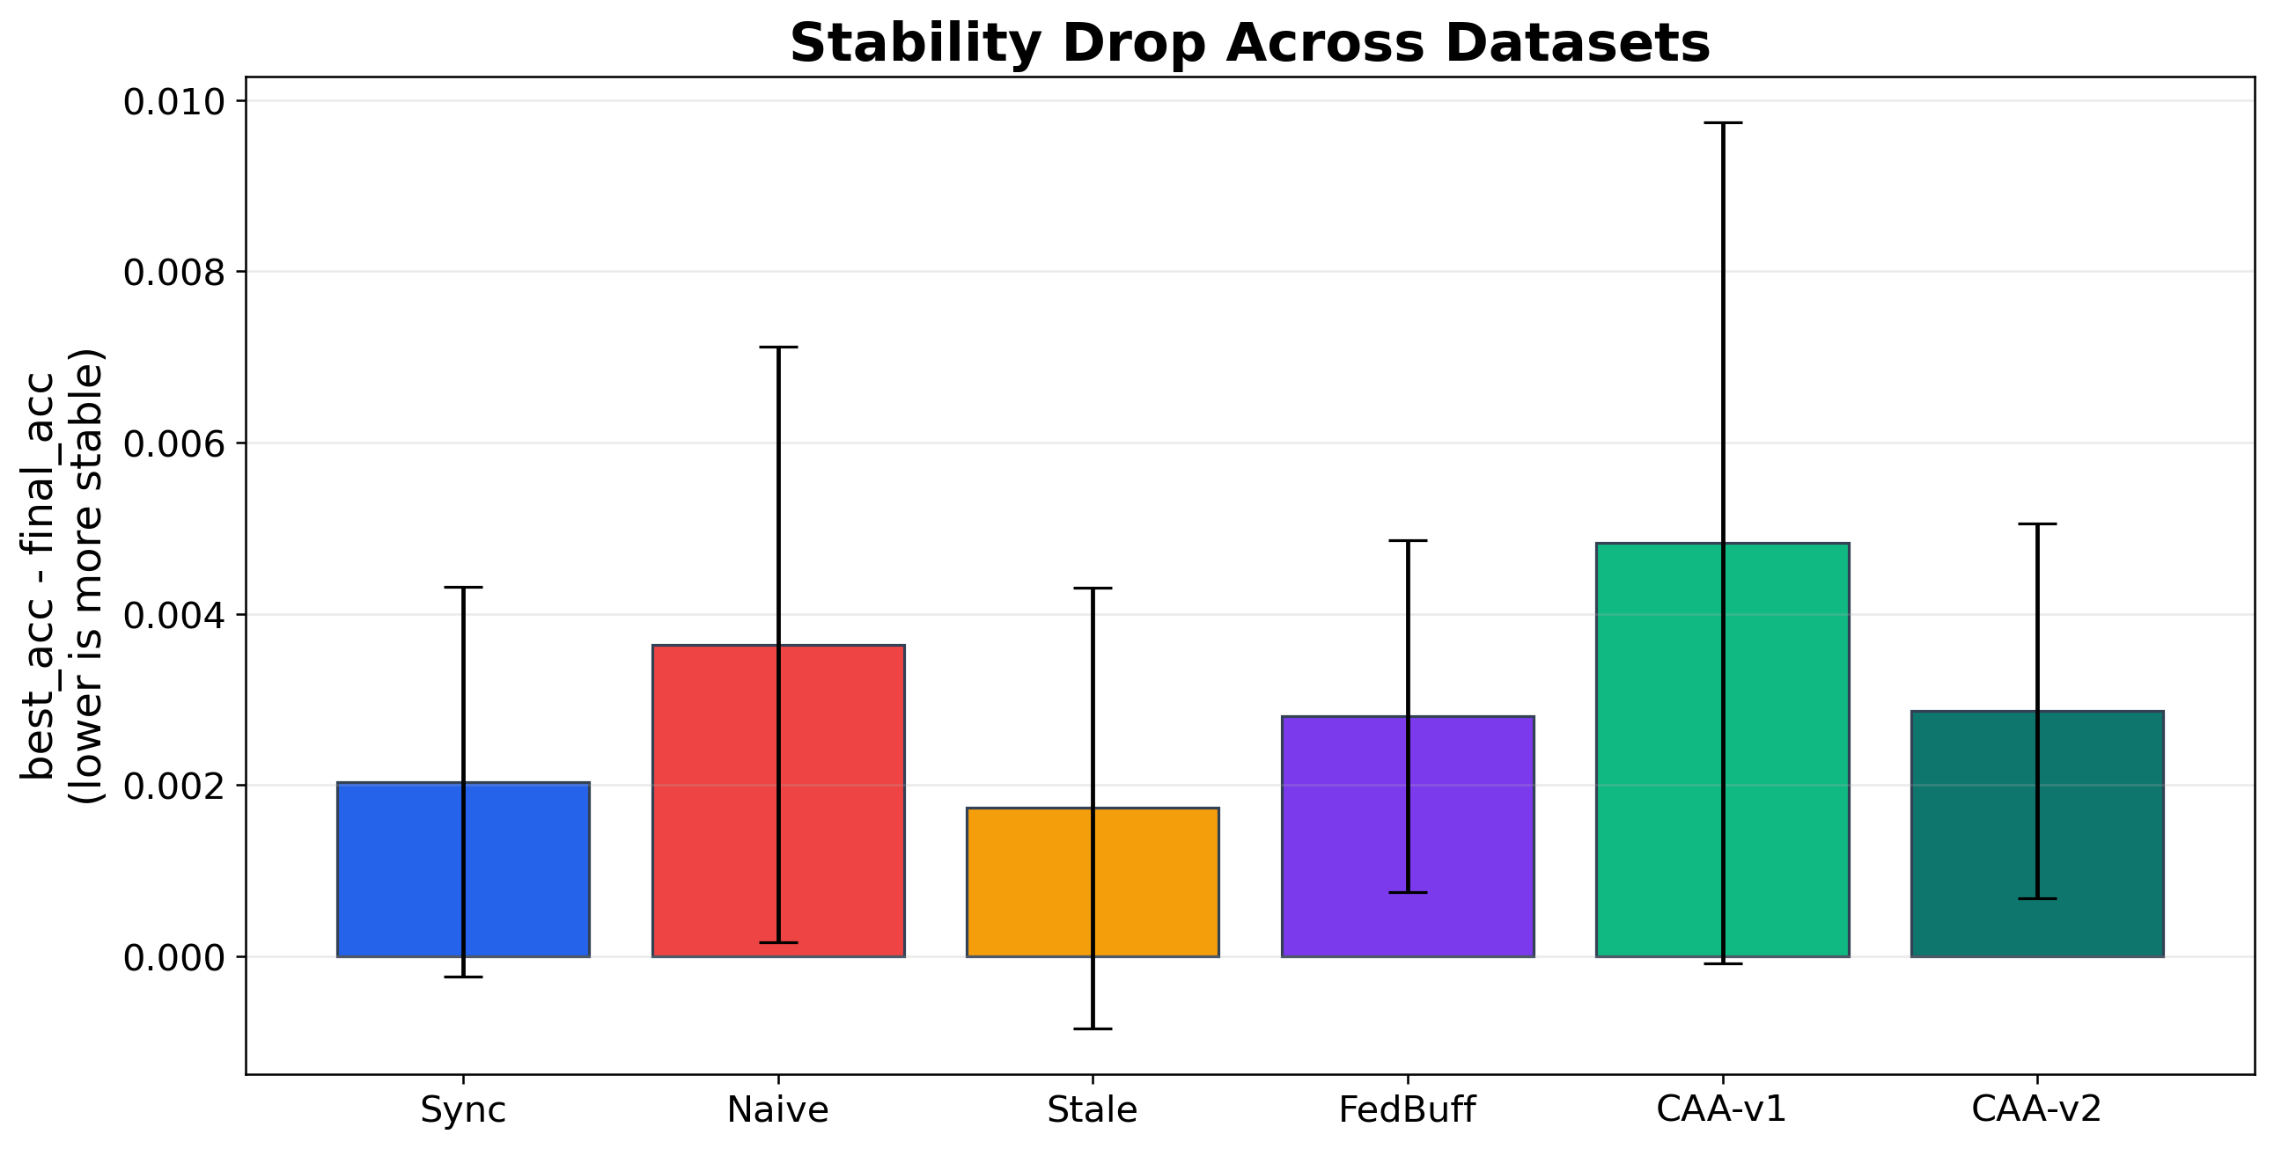
22 05 Experiment Results｜Stability Drop

Slide 23
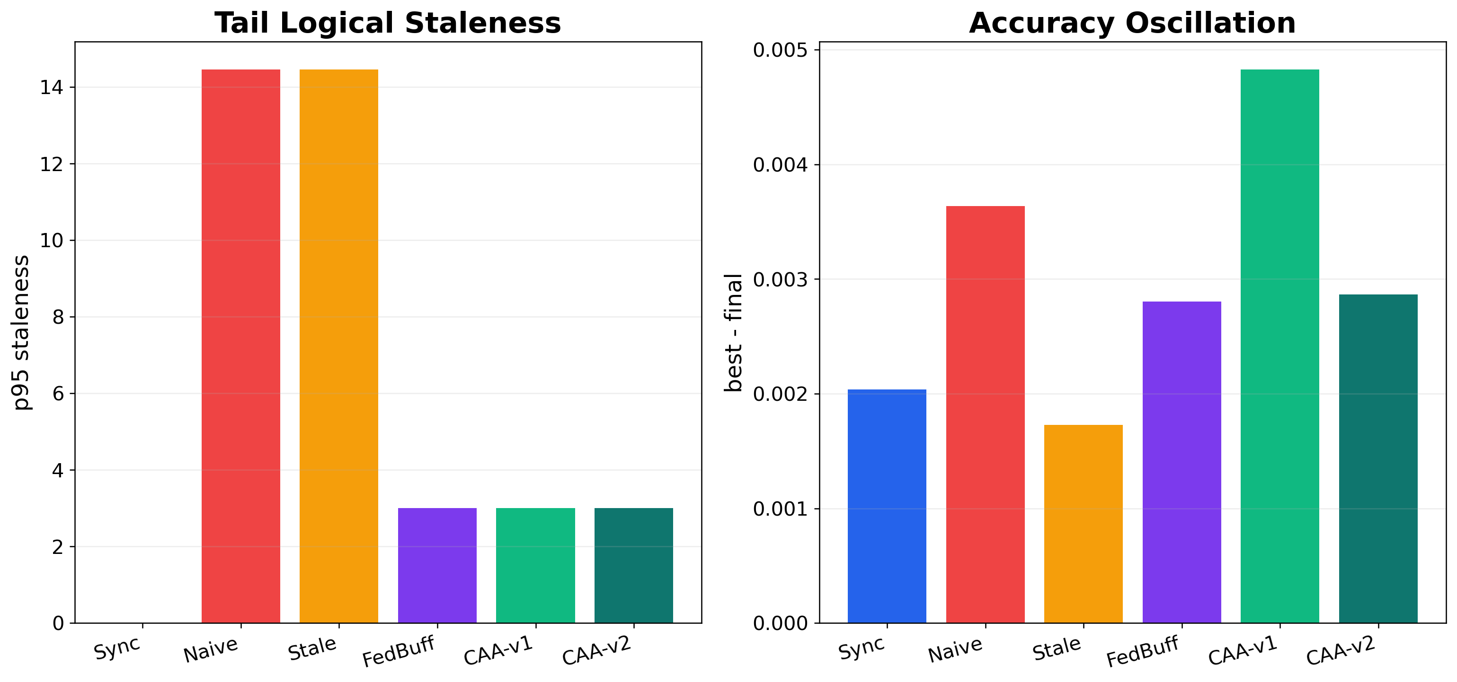
23 05 Experiment Results｜System Metrics

Slide 24
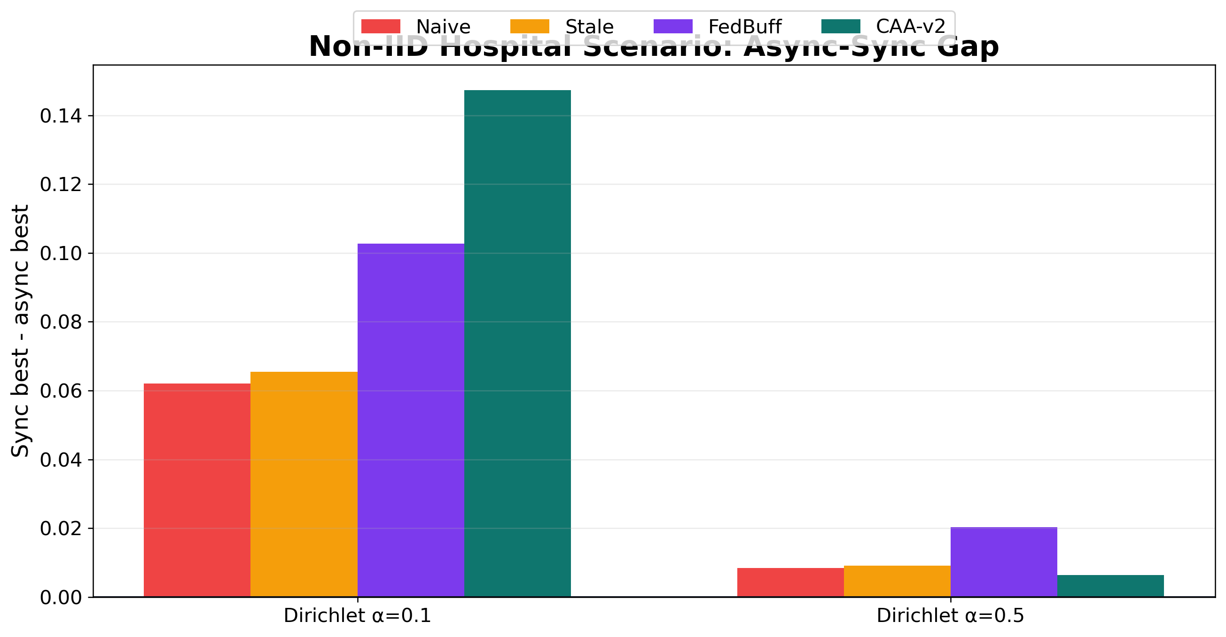
24 05 Experiment Results｜Non-IID Hospital Scenario

Slide 25
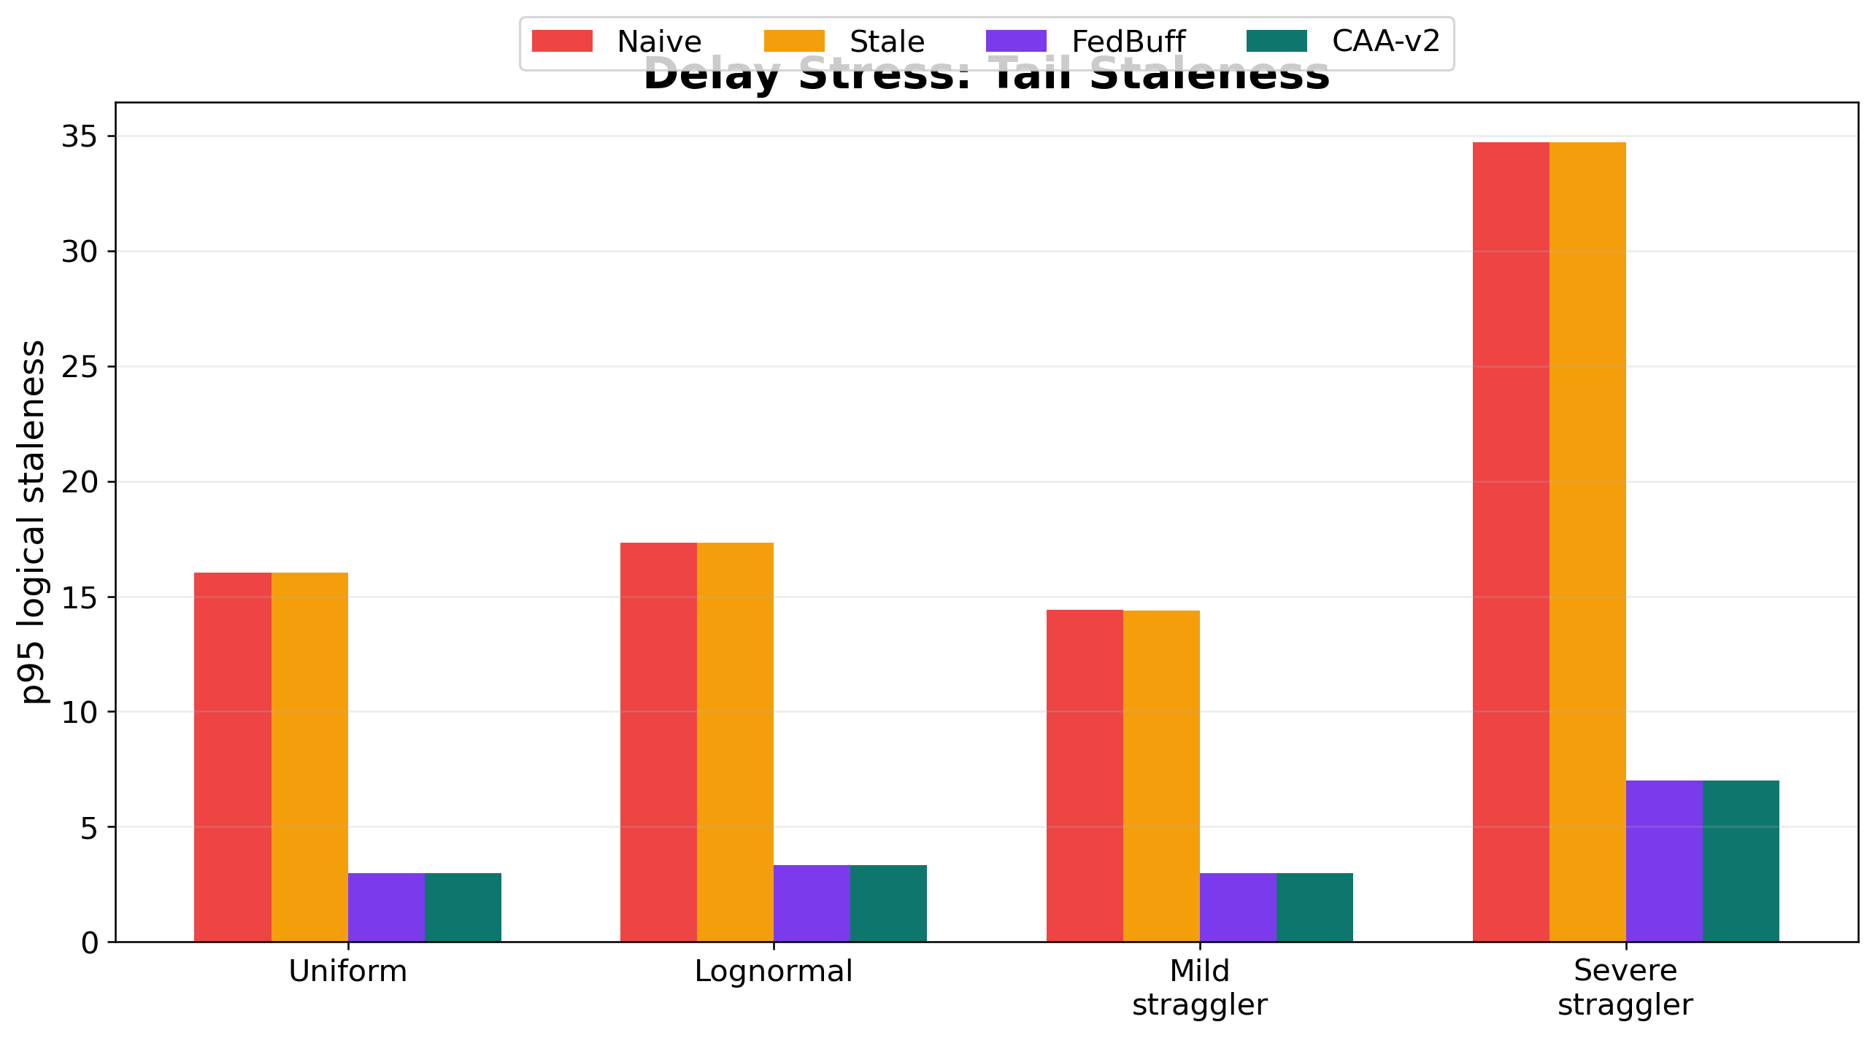
25 05 Experiment Results｜Straggler Stress

Slide 26
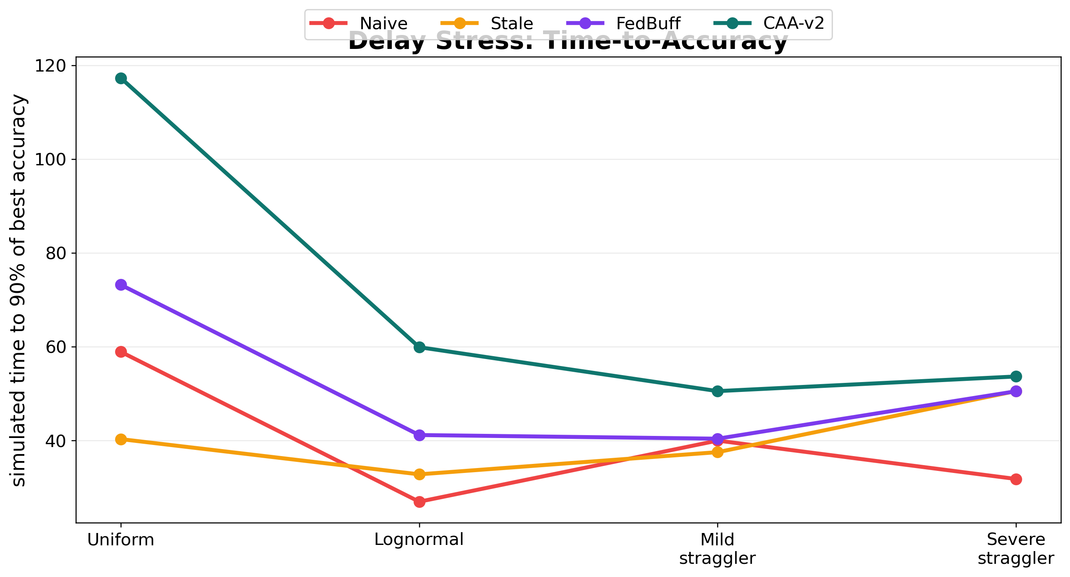
26 05 Experiment Results｜Simulated Time

Slide 27
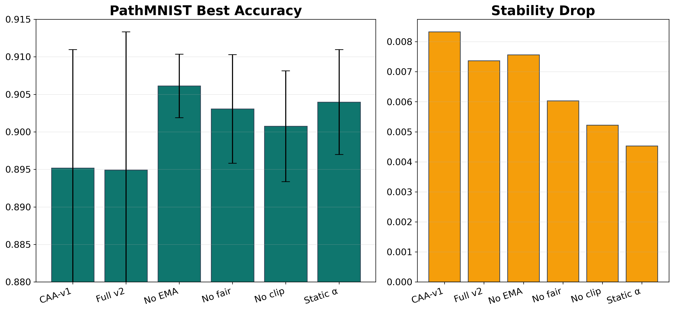
27 05 Experiment Results｜Ablation

Slide 28
28 05 Experiment Results｜Final Interpretation
正式 fair matrix：
CAA-v2 best = 0.7169 CAA-v2 final = 0.7140 Sync final = 0.7121 Naive final = 0.7096
結論：CAA-v2 不是 universal winner，但它比 Naive 穩、比 staleness-only 不保守，並且在多數資料集接近或超過 Sync。

Slide 29
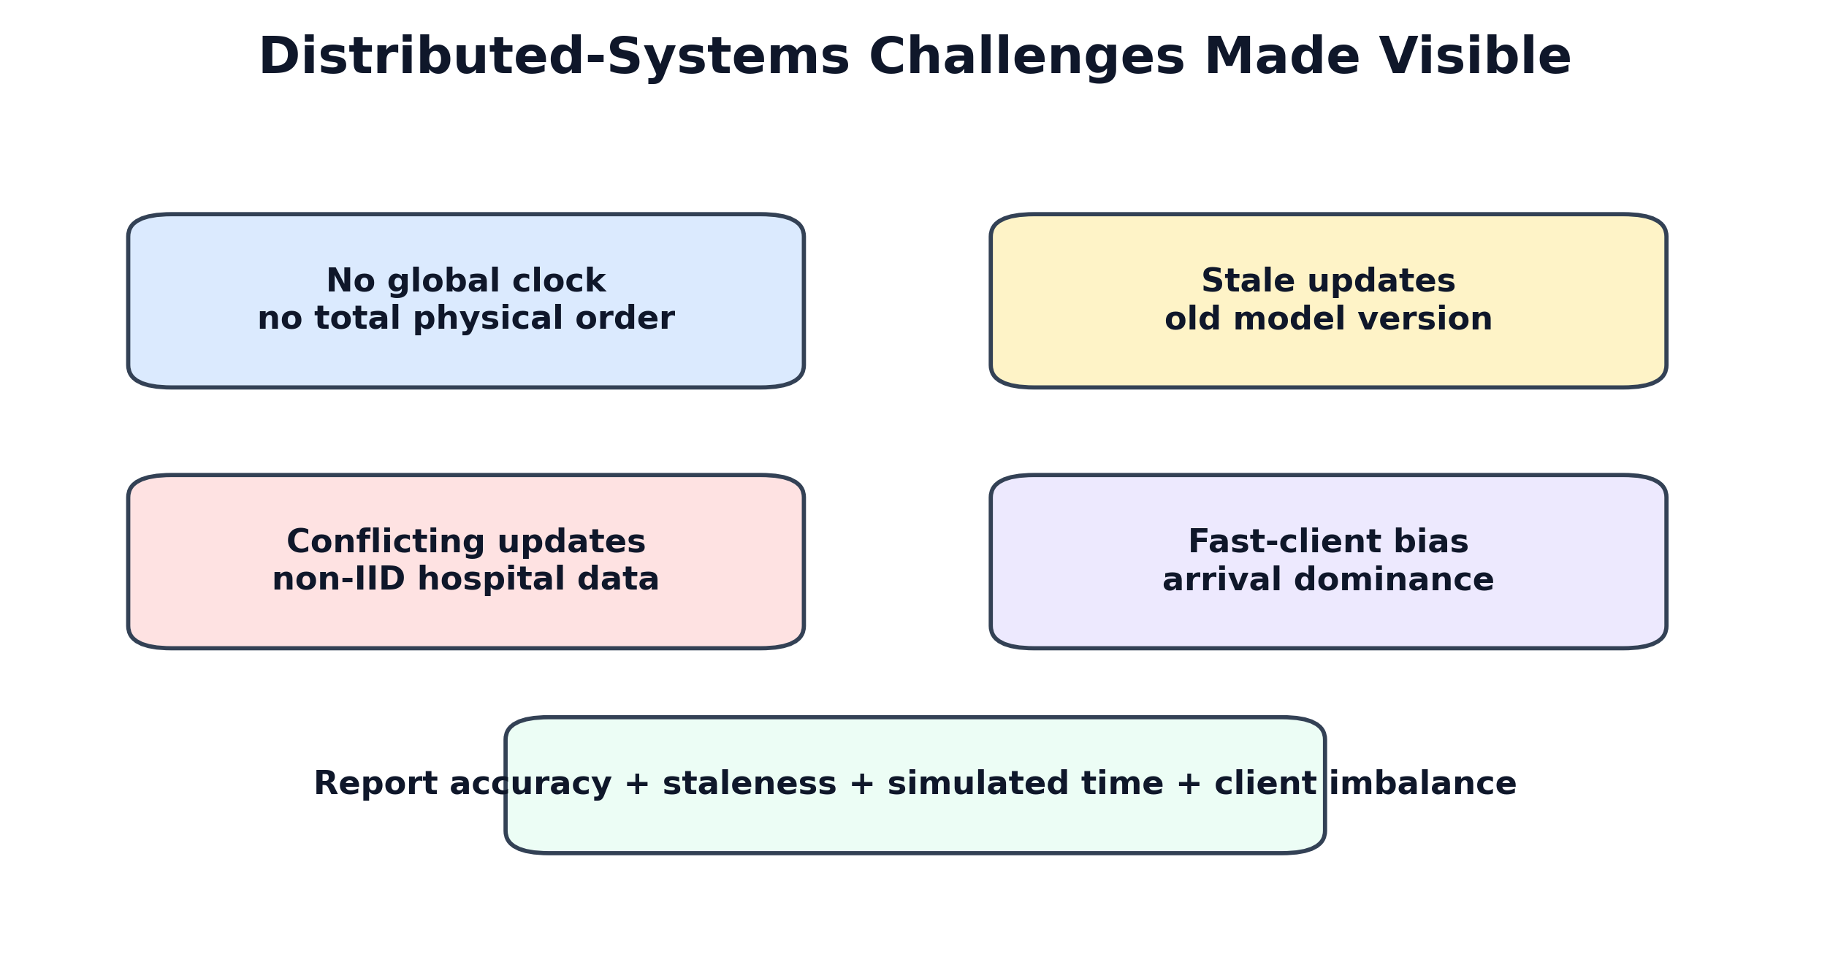
29 06 Challenges｜總覽

Slide 30
30 06 Challenges｜No Global Clock, Stale, Conflict
三個問題會同時發生：
No global clock -> cannot totally order distributed events Stale update -> trained from old global model Conflict update -> non-IID direction differs from others
CAA-v2 的設計：logical staleness + direction agreement + server trajectory。

Slide 31
31 06 Challenges｜Fast Clients 與 Privacy Tension
Fast-client domination：
快醫院 arrival rate 高 -> 可能長期主導 global model
Privacy tension：
CAA-v2 需要 delta direction / norm secure aggregation 相容性仍需未來設計
所以目前主張是 system simulator / design extension，不宣稱完整 privacy solution。

Slide 32
32 07 Conclusion｜貢獻總結
用 logical version 建立 no-global-clock async FL simulator。
補上 fair update-budget protocol。
提出 CAA-v2：agreement + server trajectory + fairness credit。
用 9 datasets × 6 methods × 3 seeds 驗證。
用 staleness、simulated time、client Gini 補足 distributed systems 分析。

Slide 33
33 07 Conclusion｜Final Claim
Under a fair update budget, CAA-v2 makes clockless asynchronous FL approach Sync FedAvg across diverse MedMNIST datasets, while reducing the instability of Naive Async and avoiding the over-conservatism of staleness-only aggregation.
中文：
CAA-v2 讓無全域時鐘的非同步 FL 接近 Sync FedAvg，同時比 Naive Async 穩、比 staleness-only 不保守。

Slide 34
34 07 Future Work
對比 FedStaleWeight、SEAFL、FedPSA、FedCompass。
non-IID / straggler stress 增加 multi-seed。
加入 real network / hospital-like traces。
補 balanced accuracy、macro-F1、minority recall、AUROC。
設計 secure-aggregation-compatible agreement statistics。
加入簡化 convergence / stability analysis。

Slide 35
35 References
Lamport, Time, Clocks, and the Ordering of Events in a Distributed System, CACM 1978.
McMahan et al., Communication-Efficient Learning of Deep Networks from Decentralized Data, AISTATS 2017.
Xie et al., Asynchronous Federated Optimization, 2019.
Nguyen et al., Federated Learning with Buffered Asynchronous Aggregation, 2021.
Ma et al., FedStaleWeight, 2024.
Yang et al., MedMNIST v2, Scientific Data 2023.

