Slide 1
CPU BENCHMARK
-- Microbenchmark
Bao

Slide 2
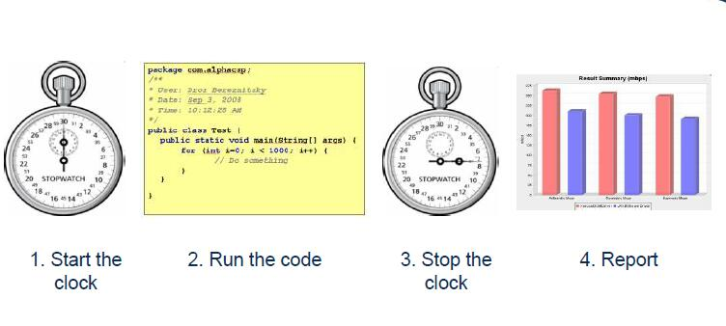
simple definition

Slide 3
Better definition
Small program
Goal: Measure something about a few lines of code
All other variables should be removed
Returns some kind of a numeric result

Slide 4
Problems – Dynamic compilation
Don’t know when the compiler will run
Don’t know how long the compiler will run
Notes:
dynamic compilation is a process used by some programming language implementations to gain performance during program execution. Although the technique originated in Self,^{[citation needed]} the best-known language that uses this technique is Java.

Slide 5
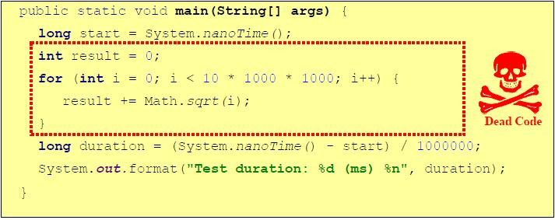
DCE – Dead Code Elimination
Dead code – code that has no effect on the outcome of the program execution

Slide 6
How to write the code
All classes should be loaded before benchmarking
Detect JIT compilations by using
CompilationMXBean.getToatalCompilationTime()
Measure classloading time
Use the ClassLoadingMXBean

Slide 7
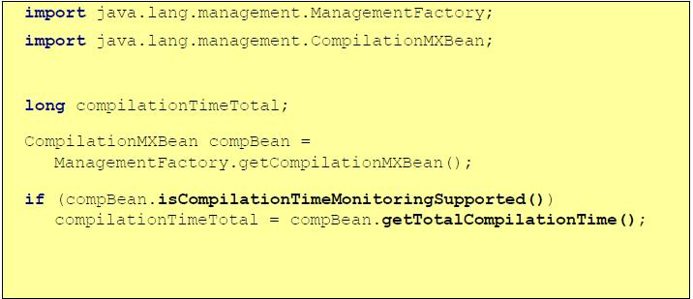
CompilationMXBean usage

Slide 8
Time Measurement
Use System.nanoTime()

Slide 9
Other issues
Use fixed size data sets
Too large data sets can cause L1 cache blowout

Slide 10
Report
Intel I5-2410M CPU @ 2.30GHz
L1 4*32KB
L2 2*256 KB
L3 3 MB
Float add 624 ns; sub 2722 ns
Double add 1695 ns; sub 1740 ns
AND 1388 ns
XOR 2007 ns

Slide 11
Report
Intel(R) Core(TM) i5-6300HQ CPU @ 2.30GHz
L1 8*32KB
L2 4*256 KB
L3 6 MB
Float add 355ns; sub 1244ns
Double add 1288ns; sub 1155ns
AND 933ns
XOR 1155ns

Slide 12
Report
Intel(R) Core(TM) i7-4790 CPU @ 3.60GHz
L1 8*64 KB
L2 8*256 KB
L3 8*8192 KB
Float add 172ns; sub 480ns
Double add 580ns; sub 1080ns
AND 496ns
XOR 603ns

Slide 13
Report
Intel I7-6700 CPU @ 3.40GHz
L1 8*32KB
L2 4*256 KB
L3 8 MB
Float add 360ns; sub 1111ns
Double add 1231ns; sub 1111ns
AND 1051ns
XOR 1021ns

Slide 14
Report(compare)
CPU | TIME(ns)
 | Float add | Float sub | Double add | Double sub | AND | XOR
Intel(R) Core(TM) I5-2410M CPU @ 2.30GHz | 624 | 2722 | 1695 | 1740 | 1338 | 2007
Intel(R) Core(TM) i5-6300HQ CPU @ 2.30GHz | 355 | 1244 | 1288 | 1155 | 933 | 1155

Slide 15
Report(compare)
CPU | TIME(ns)
 | Float add | Float sub | Double add | Double sub | AND | XOR
Intel(R) Core(TM) i7-4790 CPU @ 3.60GHz | 172 | 480 | 580 | 1080 | 496 | 603
Intel(R) Core(TM) I7-6700 CPU @ 3.40GHz | 360 | 1111 | 1231 | 1111 | 1051 | 1021

Slide 16
Some CPU Benchmark tools
SuperPi
test single threaded CPU performance by calculating Pi up to a maximum of 32 million digits after the decimal point using the Gauss-Legendre algorithm.
Wprime
test multi-threaded CPU performance by calculating square roots using a recursive call of Newton’s method for estimating functions
Cinebench
is capable of assessing both single thread and multi-thread performance
Notes:
The Gauss–Legendre algorithm is an algorithm to compute the digits of π. It is notable for being rapidly convergent, with only 25 iterations producing 45 million correct digits of π.

