Slide 1
CPU BENCHMARK
Microbenchmark

Slide 2
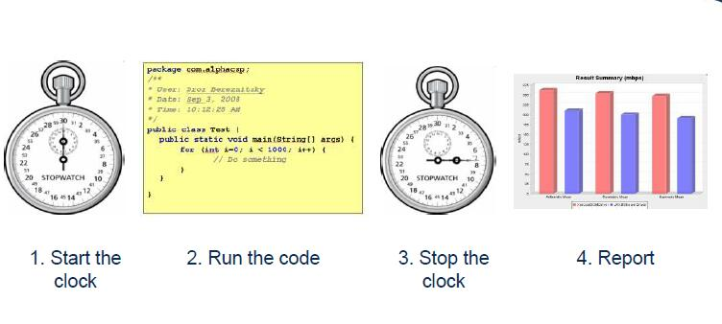
simple definition

Slide 3
Better definition
Small program
Goal: Measure something about a few lines of code
All other variables should be removed
Returns some kind of a numeric result

Slide 4
Problems – Dynamic compilation
Don’t know when the compiler will run
Don’t know how long the compiler will run
Notes:
dynamic compilation is a process used by some programming language implementations to gain performance during program execution. Although the technique originated in Self,^{[citation needed]} the best-known language that uses this technique is Java.

Slide 5
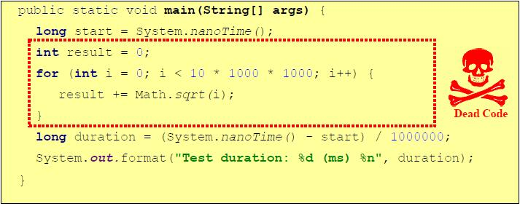
DCE – Dead Code Elimination
Dead code – code that has no effect on the outcome of the program execution

Slide 6
How to write the code
All classes should be loaded before benchmarking
Detect JIT compilations by using
  CompilationMXBean.getToatalCompilationTime()
Measure classloading time
  Use the ClassLoadingMXBean

Slide 7
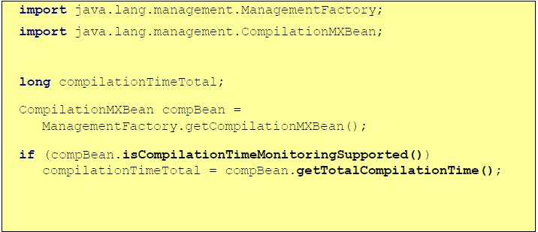
CompilationMXBean usage

Slide 8
Time Measurement
Use System.nanoTime()

Slide 9
Other issues
Use fixed size data sets
  Too large data sets can cause L1 cache blowout

Slide 10
Report
CPU | TIME(ns)
 | Float add | Float sub | Double add | Double sub | AND | XOR
Intel I5-2410M CPU @ 2.30GHz | 624 | 2722 | 1695 | 1740 | 1338 | 2007
Intel(R) Core(TM) i7-4790 CPU @ 3.60GHz | 172 | 480 | 583 | 1080 | 496 | 603
 | 165 | 794 | 1059 | 827 | 1920 | 629

Slide 11
Report(continue)
CPU | TIME(ns)
 | Float add | Float sub | Double add | Double sub | AND | XOR
Intel I5-2410M CPU @ 2.30GHz | 624 | 2722 | 1695 | 1740 | 1338 | 2007
Intel(R) Core(TM) i7-4790 CPU @ 3.60GHz | 172 | 480 | 583 | 1080 | 496 | 603
 | 165 | 794 | 1059 | 827 | 1920 | 629

Slide 12
Some CPU Benchmark tools
SuperPi
  test single threaded CPU performance by calculating Pi up to a maximum of 32 million digits after the decimal point using the Gauss-Legendre algorithm.
Wprime
  test multi-threaded CPU performance by calculating square roots using a recursive call of Newton’s method for estimating functions
Cinebench
  is capable of assessing both single thread and multi-thread performance
Notes:
The Gauss–Legendre algorithm is an algorithm to compute the digits of π. It is notable for being rapidly convergent, with only 25 iterations producing 45 million correct digits of π.

