Slide 1
Methodology
How to take usage of ingredients?
Conditional Generation instead of Causal Language Model
Loss Modification
How to improve the global coherence?
Construct a feature to represent coherence
Coherence Discriminate Module (CDM)
- By Multi-layer Perceptron or GRU

Slide 2
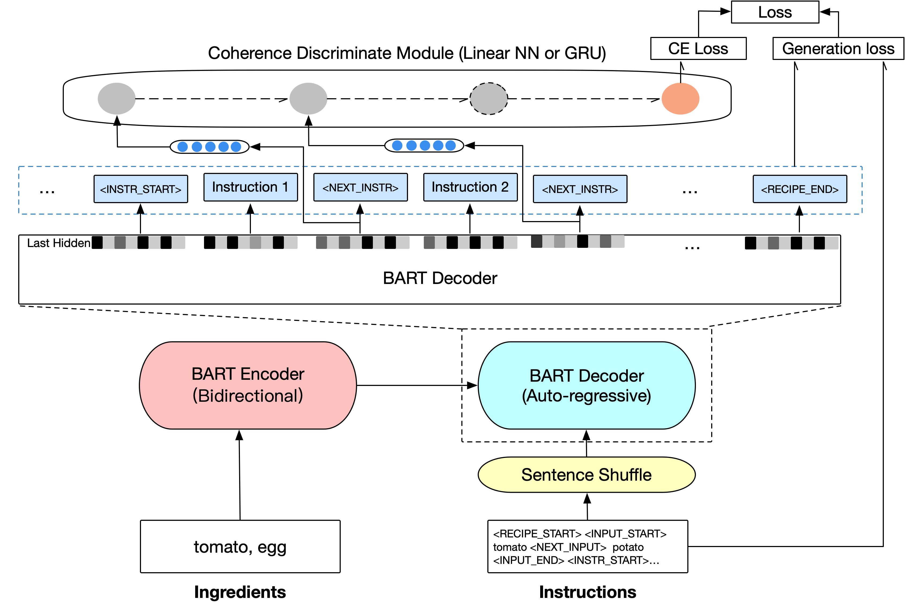
Proposed Model: BART with CDM

Slide 3
Conditional Generation
Conditional
Generation

Slide 4
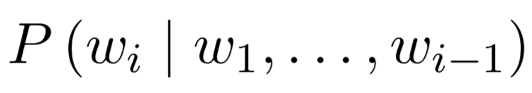
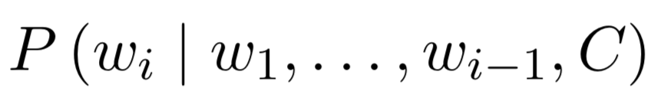
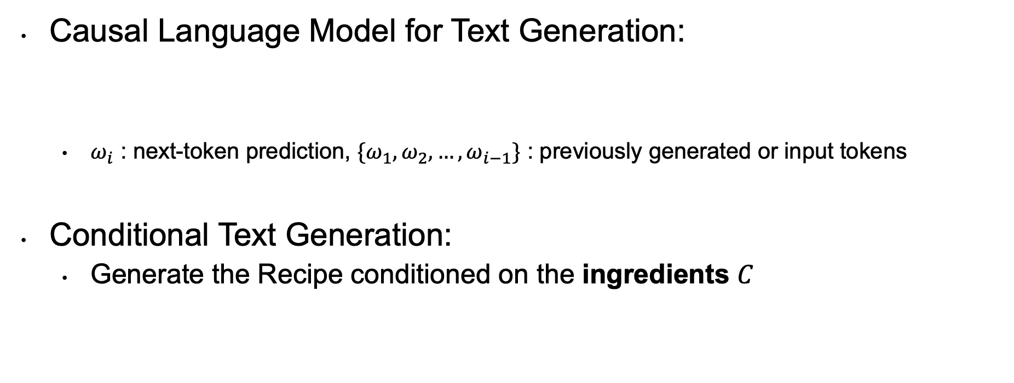
Conditional Generation Model
Causal Language Model for Text Generation:
$ω_{i}$ : next-token prediction, ${\{ω}_{1},ω_{2}, …, ω_{i−1}\}$ : previously generated or input tokens
Conditional Text Generation:
Generate the Recipe conditioned on the ingredients $C$
Ensure the model ‘remember’ the ingredients all the time

Slide 5
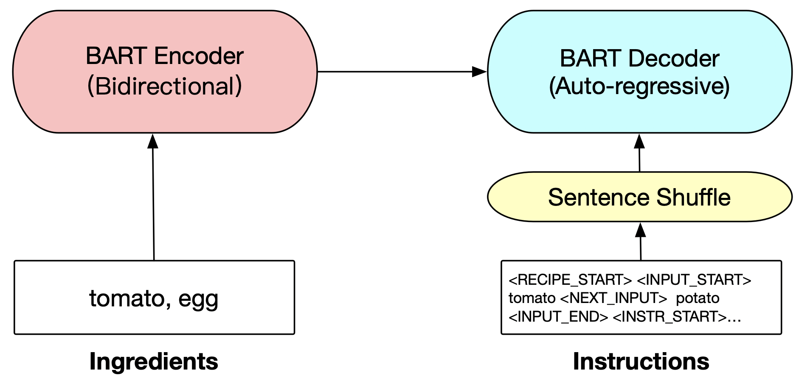

Conditional Generation Model
Generate the Recipe conditioned on the ingredients $C$
BART with Bidirectional Encoder

Slide 6
Proposed Model: BART with CDM
CDM

Slide 7
How to get the (Global) coherence feature?
Add control tokens to identify instruction steps
Randomly Shuffle the Sentence Order
Ask the model to do a binary classification task
- 1 for incoherent (Shuffled)
- 0 for coherent (Not Shuffled )
Dissolve gelatin
Add cold water
Chill until syrupy
<NEXT_INSTR> Dissolve gelatin
<NEXT_INSTR> Add cold water
<NEXT_INSTR> Chill until syrupy
<NEXT_INSTR> Add cold water
<NEXT_INSTR> chill until syrupy
<NEXT_INSTR> Dissolve gelatin
Notes:
A series pf special token (idea: Quick-thought)
Capture the coherence feature in consecutive segments of the text.

Slide 8
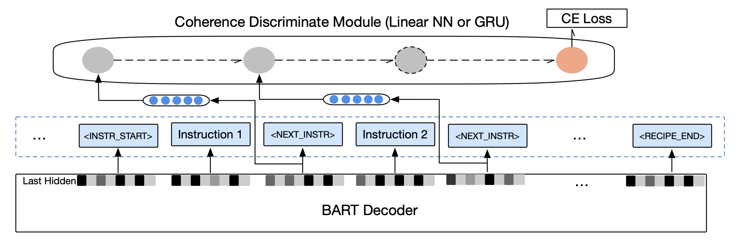
Coherence Discriminate Module (CDM)
Get the hidden state vector of <NEXT_INSTR>, feed it to CDM
Train the module to capture the coherence feature
GRU or MLP
Notes:
A series pf special token (idea: Quick-thought)
Capture the coherence feature in consecutive segments of the text.

Slide 9
Proposed Model: BART with CDM
Loss
Modification

Slide 10
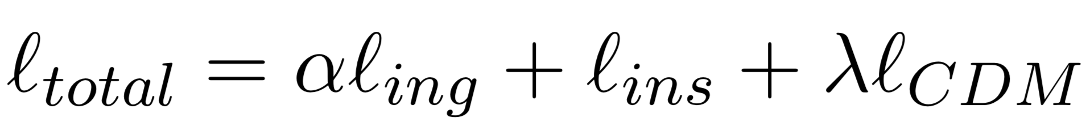
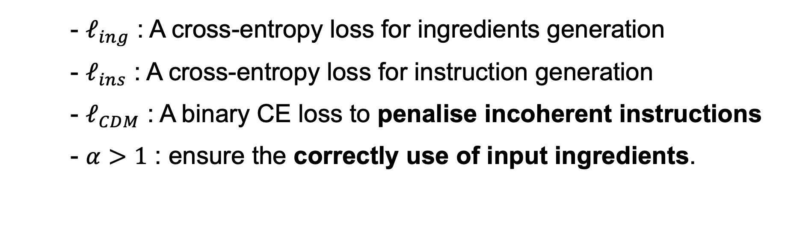
Loss Modification
- $ℓ_{ing}$ : A cross-entropy loss for ingredients generation
- $ℓ_{ins}$ : A cross-entropy loss for instruction generation
- $ℓ_{CDM}$ : A binary CE loss to penalise incoherent instructions
- $α>1$ : ensure the correctly use of input ingredients.

