Slide 1
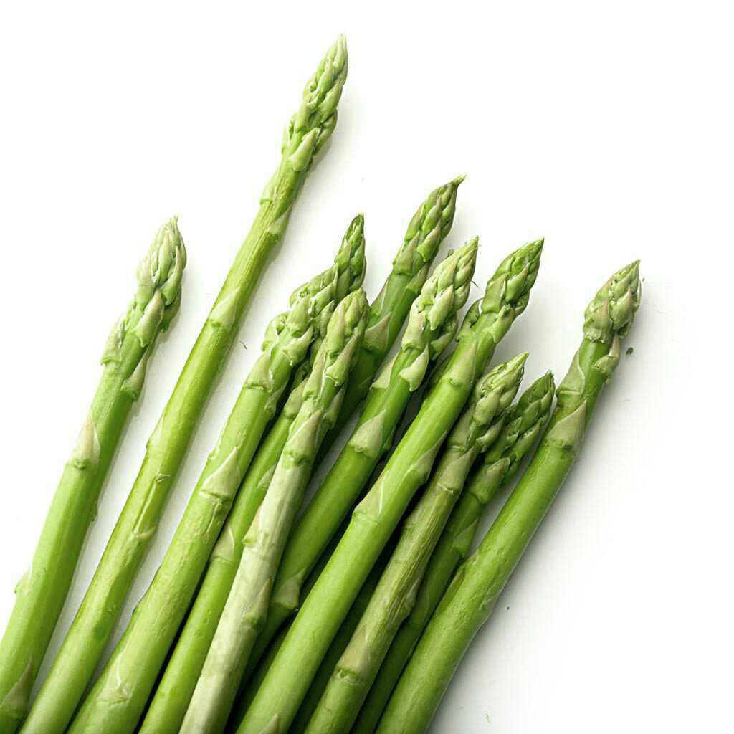
Coherence Improvement on Pre-Training Based Cooking Recipe Generation
Group 17053487

Slide 2
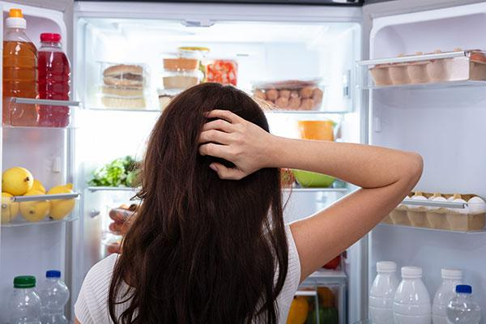
Background
Automatic recipe generations
Challenges

Slide 3
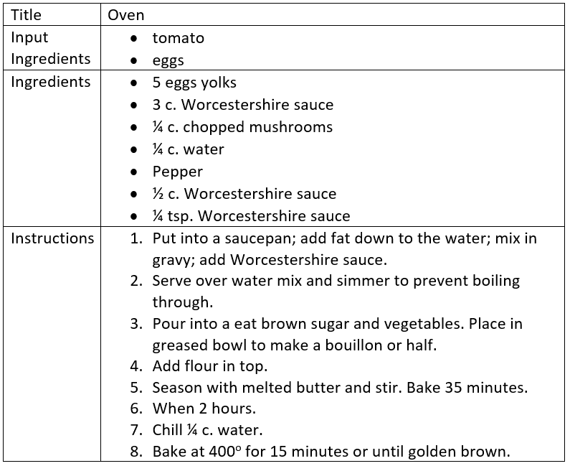
Background
RecipeNLG’s Recipe Generator

Slide 4
Research questions
Develop a model that could correctly utilise the input by taking full usage of ingredients given in its generation process.
Improve the global coherence of instruction steps compared to currently available RecipeNLG model.

Slide 5
Methodology
How to take usage of ingredients?
Conditional Generation instead of Causal Language Model
Loss Modification
How to improve the global coherence?
Construct a feature to represent coherence
Coherence Discriminate Module (CDM)
- By Multi-layer Perceptron or GRU

Slide 6
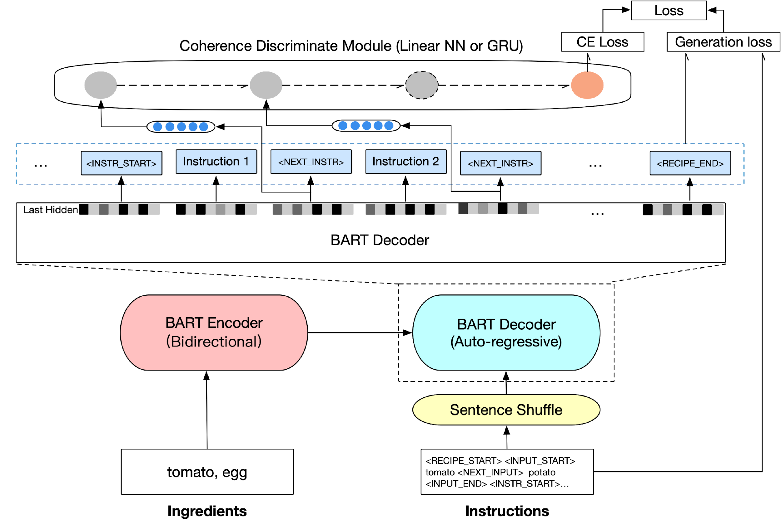
Proposed Model: BART with CDM

Slide 7
Conditional Generation
Conditional
Generation

Slide 8
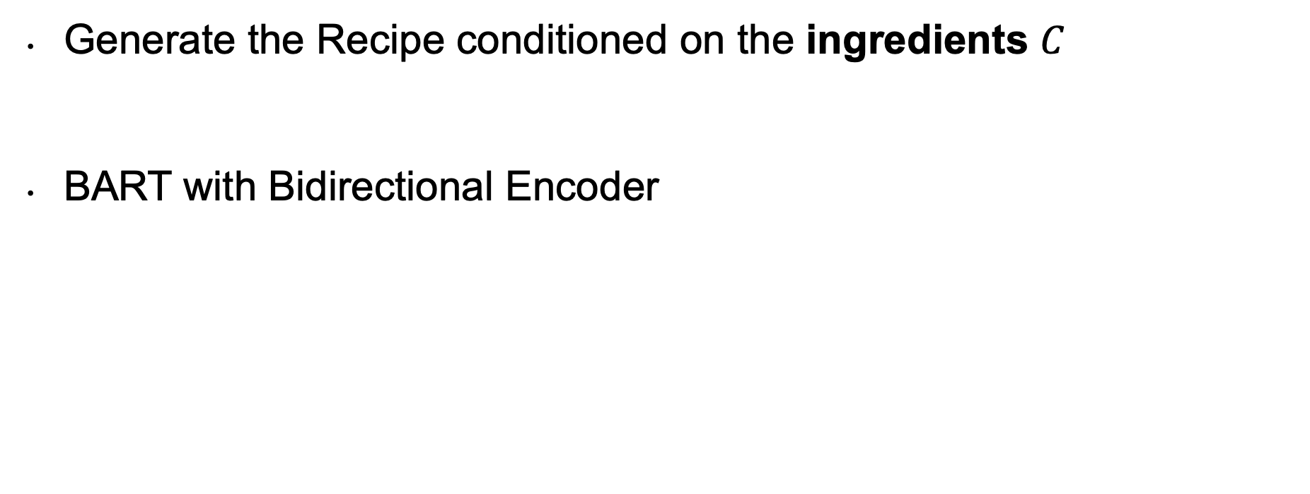
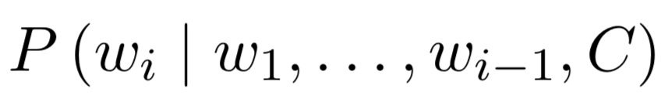
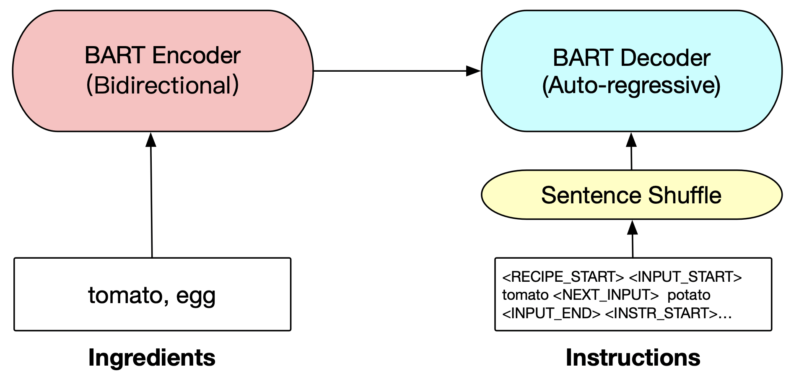
Conditional Generation Model

Slide 9
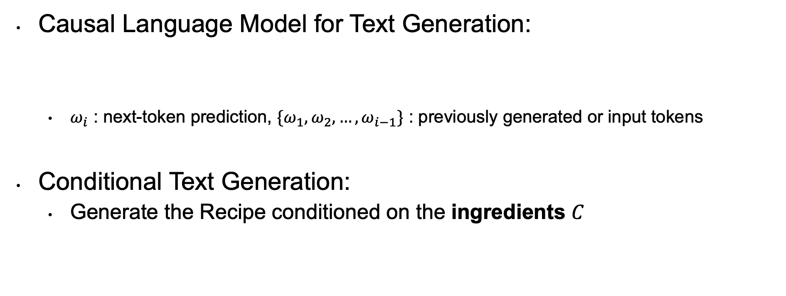
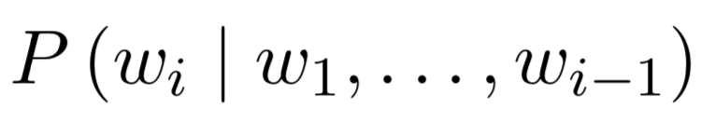
Conditional Generation Model
Ensure the model ‘remember’ the ingredients all the time

Slide 10
Conditional Generation Model

Slide 11
Proposed Model: BART with CDM
CDM

Slide 12
How to get the (Global) coherence feature?
Add control tokens to identify instruction steps
Randomly Shuffle the Sentence Order
Ask the model to do a binary classification task
- 1 for incoherent (Shuffled)
- 0 for coherent (Not Shuffled )
Dissolve gelatin
Add cold water
Chill until syrupy
<NEXT_INSTR> Dissolve gelatin
<NEXT_INSTR> Add cold water
<NEXT_INSTR> Chill until syrupy
<NEXT_INSTR> Add cold water
<NEXT_INSTR> chill until syrupy
<NEXT_INSTR> Dissolve gelatin
Notes:
A series pf special token (idea: Quick-thought)
Capture the coherence feature in consecutive segments of the text.

Slide 13
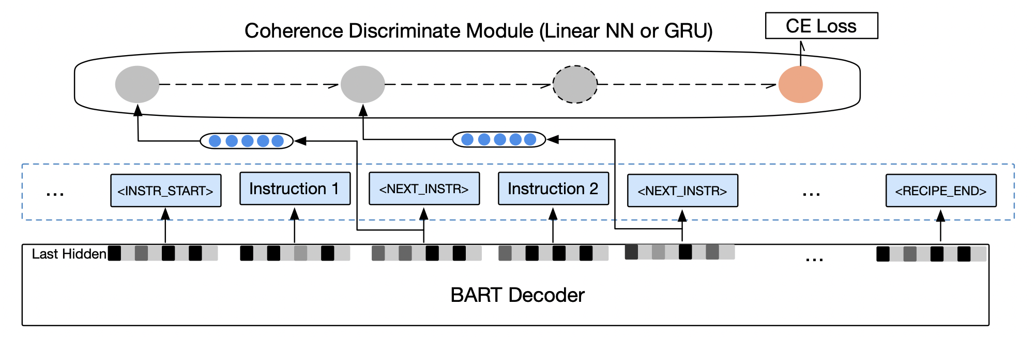
Coherence Discriminate Module
Get the hidden state vector of <NEXT_INSTR>
Train the module to capture the coherence feature
GRU or MLP
Notes:
A series pf special token (idea: Quick-thought)
Capture the coherence feature in consecutive segments of the text.

Slide 14
Proposed Model: BART with CDM
Loss
Modification

Slide 15

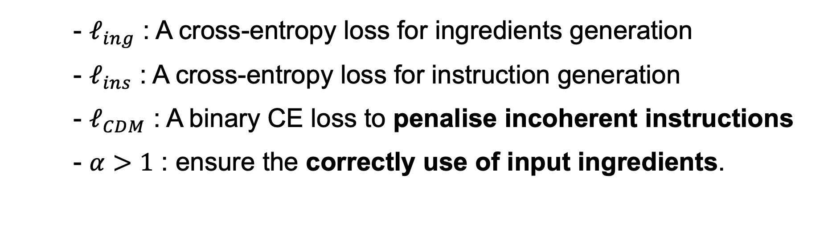
Loss Modification

Slide 16
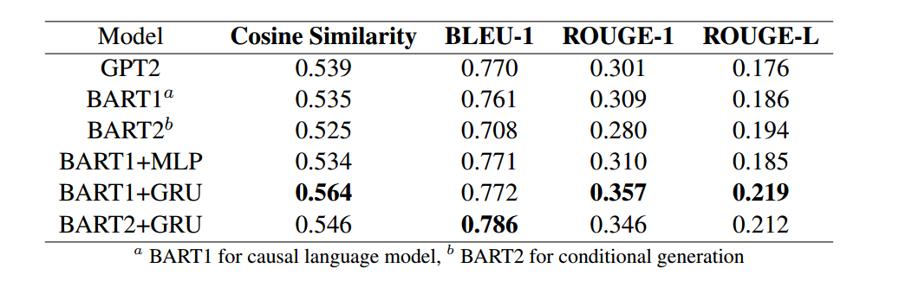
Evaluation
Notes:
This table shows different scores that measure similarities between the generated instructions and the ground truth. our model achieved better performance than GPT2 in these scores
outperforms GPT2 quantitatively
and it actuualy

Slide 17
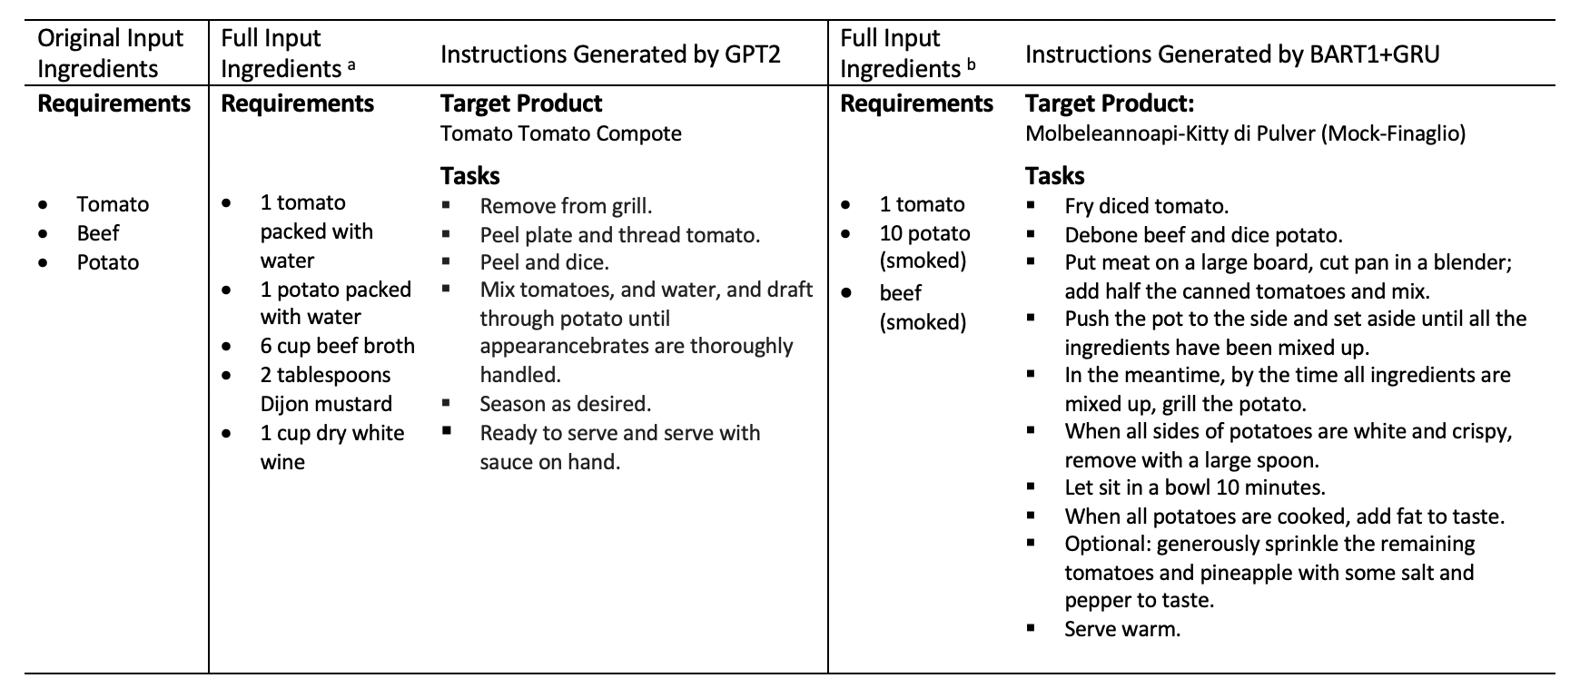
Qualitative Review
Notes:
this is a typical example of the output with the same input to the models. we can see the instructions generated by GPT2 don’t follow clear logic as the first instruction is nonsensical and they progress incoherently. In contrast, the recipe generated by our model follows clear logic and does not violate any common sense. so our proposed method does improve the coherence of the instructions and we indeed achieved our project goals
this is a typical example of the output with the same input to the models. we can see the instructions generated by GPT2 don’t follow clear logic. the first instruction is nonsensical and they progress incoherently.
In contrast, the recipe generated by our model follows clear logic and does not violate any common sense. so our proposed method does improve the coherence of the instructions and we indeed achieved our project goals
brings a very obvious
(we constructed a model that generate recipes and improved the coherence of instructions so we do achieve our project goals. )
.%%% we fined tuned several models using the same data and
%%%and A full list of ingredients was generated alongside cooking instructions.

Slide 18
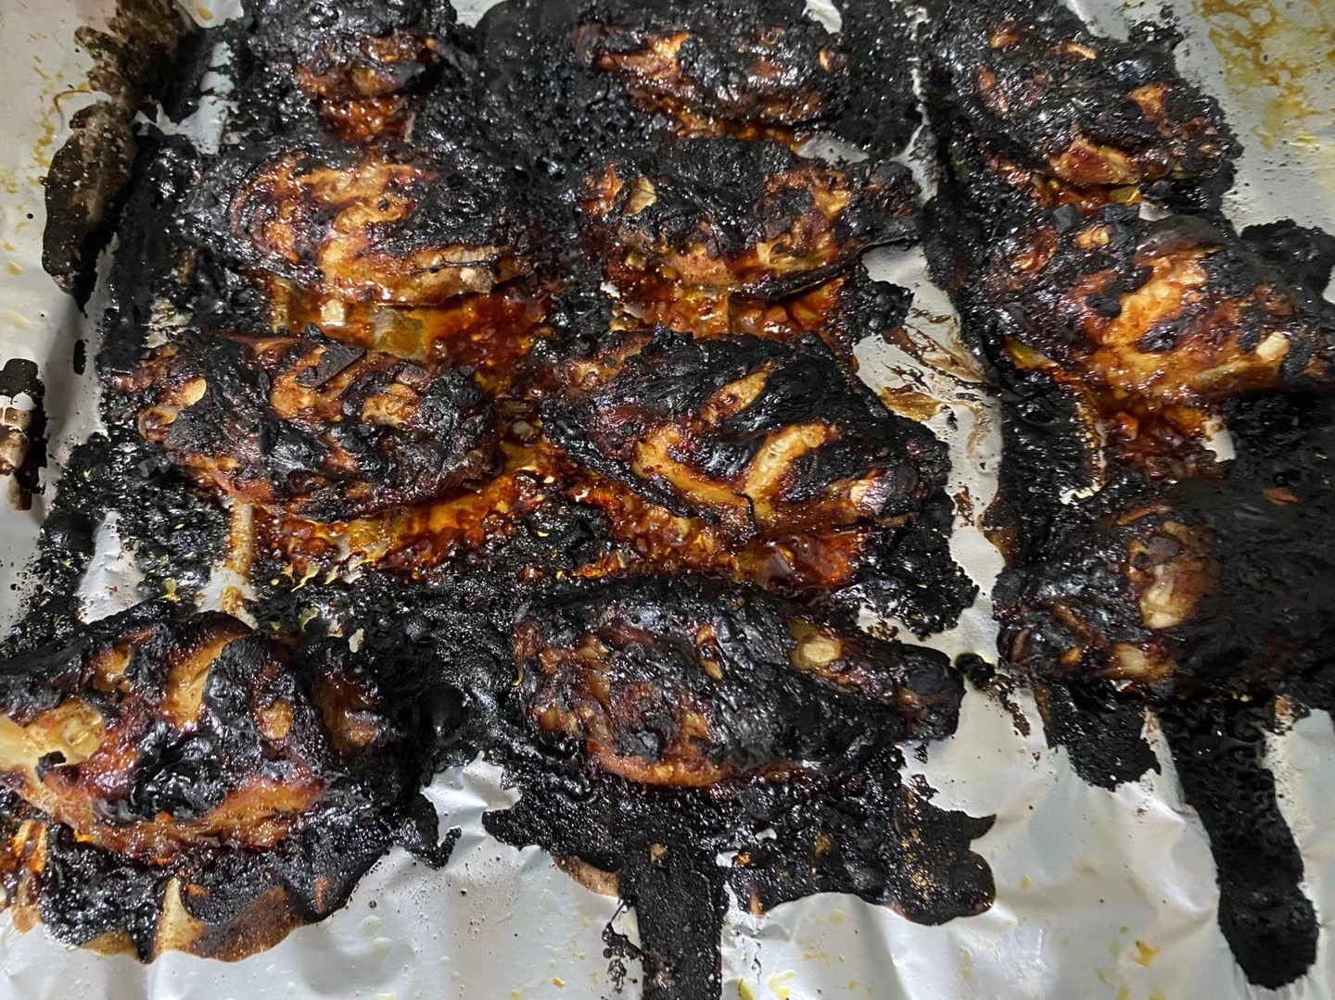
Thank you!
We tried our generated recipes and got this:

