Slide 1
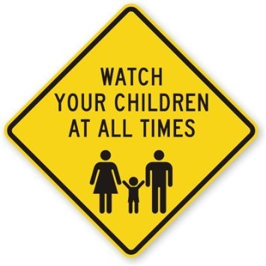
CHILDERN MONITORING SYSTEM

Slide 2
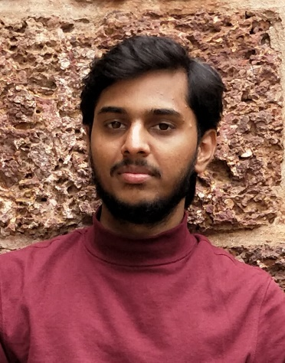
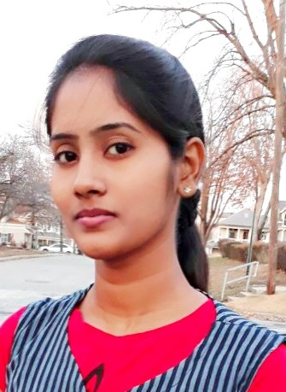

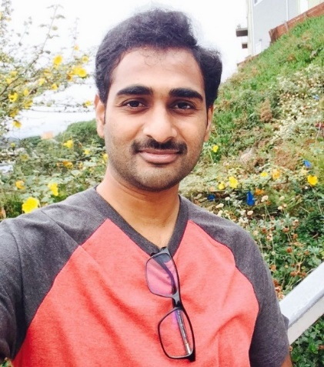

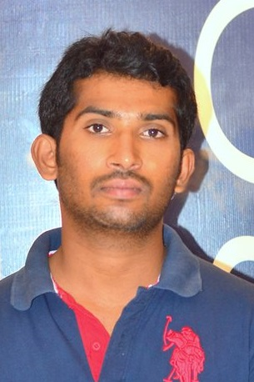

Android Team Members
Kamal Nadh
S528747
Jyothsna S528755
Sandeep S528752
Aditya S T P
S528763
Sai Devi
S528765
Anil Kumar
S528797
Yeshwanth S528759

Slide 3
Contents
Introduction
Developed Functionalities
Future work
Application
Challenges
Demo
Summary
Saidevi

Slide 4

Introduction
With growth of information technology and changed lifestyle, children are at high risk of bad exposure and abuse
As a parent you would always like to be protecting them from any risky or threatening elements in the surroundings
Saidevi

Slide 5
Requirements
Add Child
Delete Child
Records Management page
Track the location of the child
Record history
Settings page
Alerts page
Saidevi

Slide 6
Developed Functionalities
Add Child
Delete Child
Child Page / Records Management page
Track the location of the child
Saidevi

Slide 7
Developed Functionalities
Records Management page
Record history
Alert notifications
Settings
Saidevi

Slide 8
Application
Login page
Signup page
Jyothsna

Slide 9
Application
Forgot Password
Forgot Password
Jyothsna

Slide 10
Application
Home page
Add Child page
Jyothsna

Slide 11
Application
Add child page
Child page
Jyothsna

Slide 12
Application
Child page
Location page
Sandeep

Slide 13
Application
See History page
Settings page
Sandeep

Slide 14
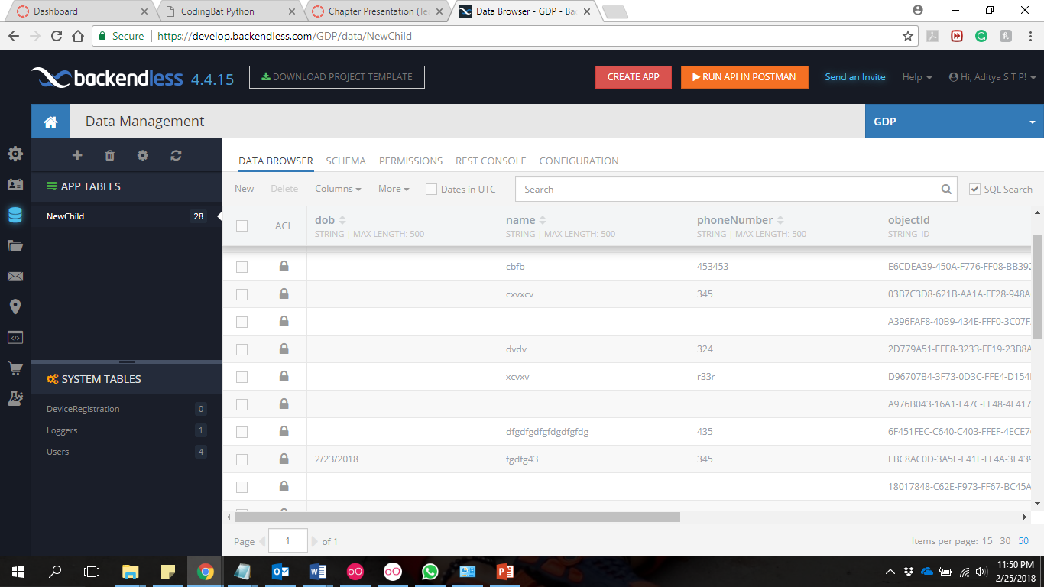
Application
Sandeep

Slide 15
Challenges
Database connectivity → Application
Functionality implementation
Adding multiple items to the ListViews
Adding location of the child
Sandeep

Slide 16


Slide 17
Summary
Child monitoring application is used to track the child location.
Functionalities for all the fields can be entered and retrieved efficiently.

Slide 18
Thank you & Questions ?
Kamal Nadh
S528747
Jyothsna S528755
Sandeep S528752
Aditya S T P
S528763
Sai Devi
S528765
Anil Kumar
S528797
Yeshwanth S528759

