Slide 1
Min-Cost Covering
Date: 2022/11/8
Due date: 2022/12/6

Slide 2
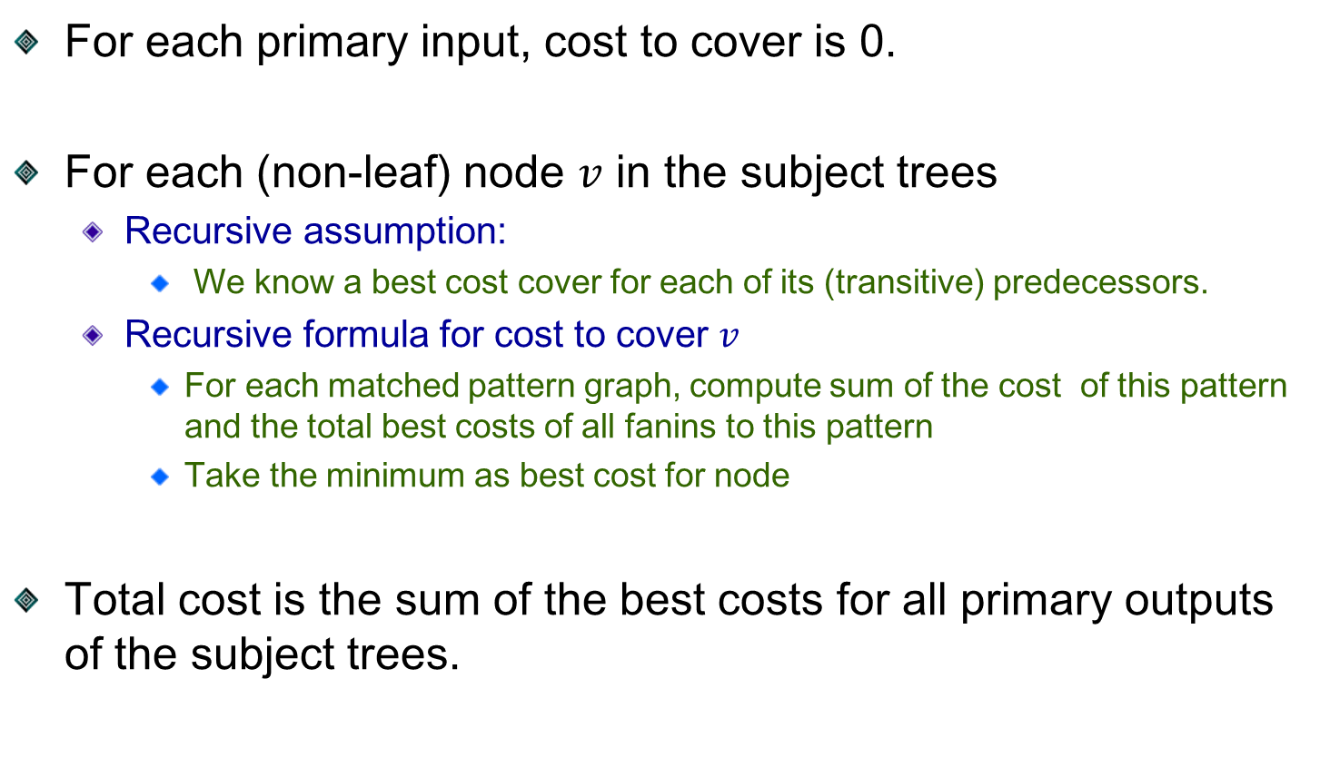
Min-Cost Covering by Dynamic Programming
For each primary input, cost to cover is 0.
For each (non-leaf) node $v$ in the subject trees
Recursive assumption:
We know a best cost cover for each of its (transitive) predecessors.
Recursive formula for cost to cover $v$
For each matched pattern graph, compute sum of the cost of this pattern and the total best costs of all fanins to this pattern
Take the minimum as best cost for node
Total cost is the sum of the best costs for all primary outputs of the subject trees.

Slide 3
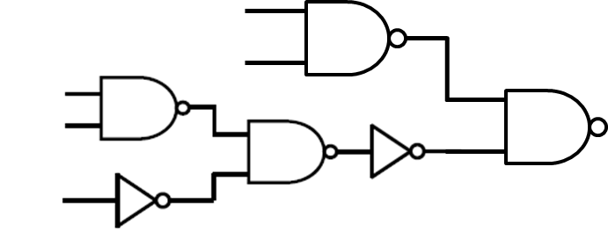
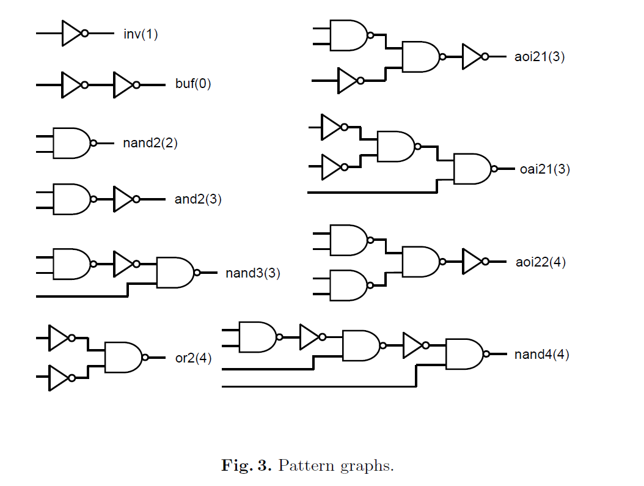
Example
Subject tree
Pattern trees

Slide 4
Example
Subject tree
Pattern trees
Mincost:2
Mincost:1

Slide 5
Example
Subject tree
Pattern trees
Mincost:5

Slide 6
Example
Subject tree
Pattern trees
Mincost:2
Mincost:3

Slide 7
Example
Subject tree
Pattern trees
Mincost:7

Slide 8
Homework
Input
A Verilog-like circuit file
Logic gates’ cost (Pattern Trees)
readme
Output
By using the pattern trees and dynamic programming algorithm, you should output the minimum cost on terminal.

