Slide 1
The Eye and Near-Field Optics in Hololens and Magic Leap
Andrew Jones, Numair Khan, and Eleanor Tursman
Notes:
How can we project virtual images for AR onto the eye while keeping the image in focus?

Slide 2
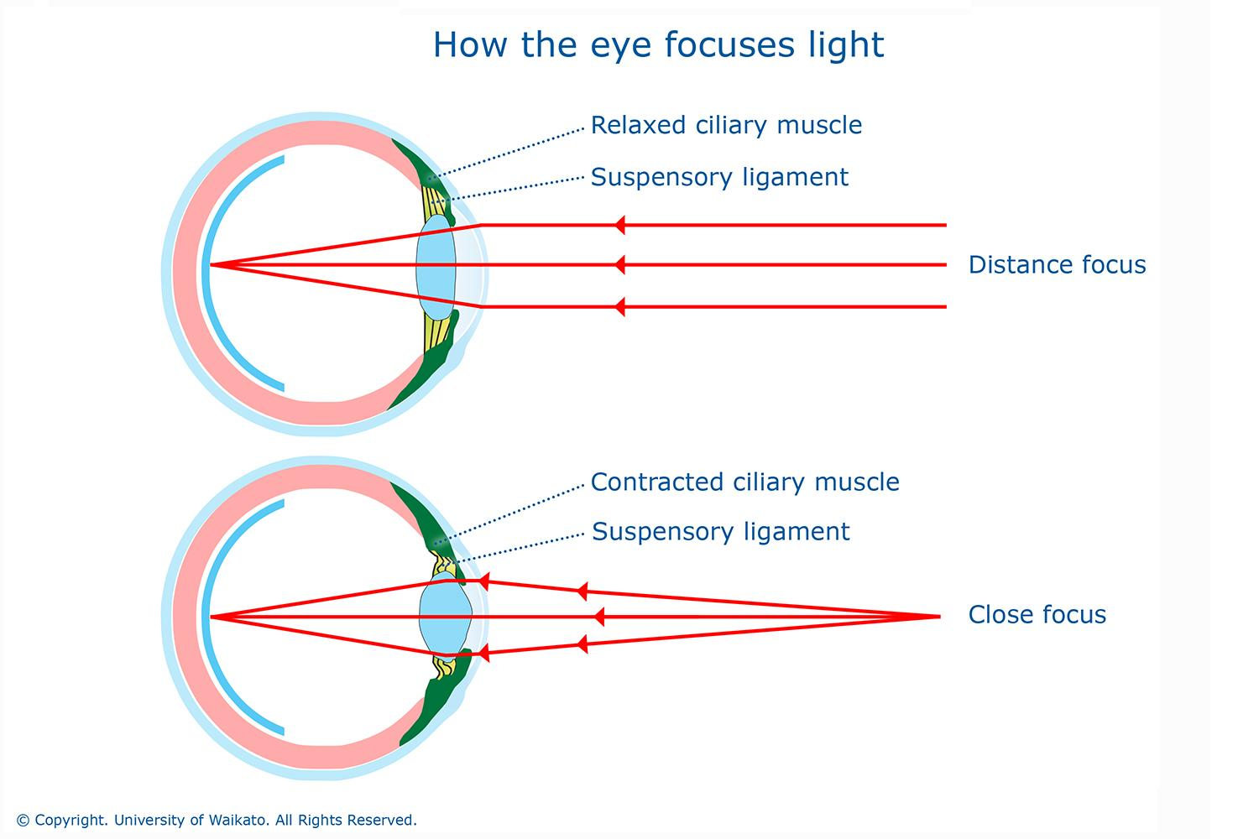
Optics of the Eye
The pupil is the aperture of the eye.
How does the eye change focus?
Vergence
Pupil on top of the lens
Muscles controlling the shape of the lens
Notes:
Pupil as aperture of the eye: light passes thru aperture in optical system, changes amount of light eye takes in
Vergence: relative pupil location changes depending on if you’re focusing on a close or far object
Pupil above lens: change focus by dilating pupil, etc to minimize spherical aberration, which causes blurriness at the edges
Muscles controls shape of lens: bring close objects into focus

Slide 3
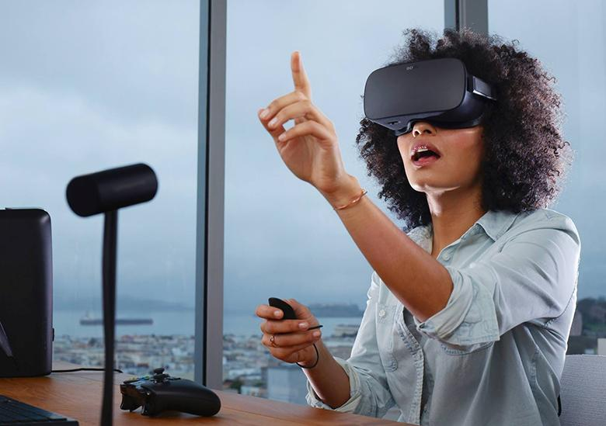
Head Mounted Displays (HMD)
A HMD is a headset that displays images to one or both eyes.
Types:
Only display virtual content
See-through (or optical HMD) for AR applications
Optical HMDs use a variety of waveguides.
Notes:
Here we look at binocular HMD, or HMD that display images to both eyes.
Virtual content- think oculus rift
Optical HMD- think hololens and probably magic leap

Slide 4
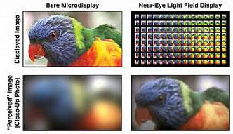
Near-field Optical HMD
Goal: want eye to be able to focus on the images projected on the lenses even though they are very close
Implementation options:
Magnifying optics setups
Light field displays
Lanman and Luebke, 2013.
Notes:
Optical HMD is near-field, because we are projecting images directly onto the eyes, veryyy close
Work by projecting image directly onto eye
Neg: can have narrow fov and be bulky depending on implementation (aka magnifying optics setups), spatial resolution is reduced for microlens designs (in light field displays)

Slide 5
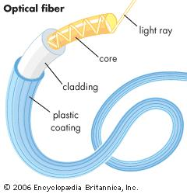
Waveguides
What: tool that controls movement of EM or sound waves while restricting power loss over travel time
Types:
Different shapes
Diffractive
Holographic
Polarized
Reflective, etc.
For AR applications: use diffractive or holographic techniques
Notes:
Example: optical fibers guide waves using principle of total internal reflection
TIR: incident wave hits material at angle > critical angle w respect to surface normal-- wave only reflects and doesn’t pass through the material
Shapes: probably have a planar waveguide for hololens lenses
Diffractive: uses slanted diffraction gratings
Holographic: 3 holographic optical elements put together for RGB light
Polarized: multi-layer coats of polarized reflectors put between glass
Reflective: guide with semi-reflective mirror
For AR applications: use diffractive or holographic.
Diff: expand image; place grating on waveguide where we want to extract the image. Grating makes interference pattern that enlarges image so that wherever you look, image still hits eye properly
Holograms intercept image rays and rotate 90 degrees (one makes rays go thru waveguide, other rotates from waveguide onto eye).

Slide 6
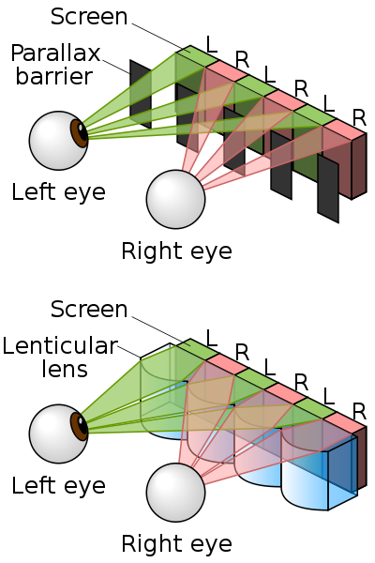
Autostereoscopic Displays
Autostereoscopic displays: 3D images that don’t require glasses. Types include:
Lenticular Displays
Light Field Displays
Holography
Notes:
Lenticular lens: array of magnifying lenses, so that depending on what angle you look at, different parts of the image are magnified (3D tvs from 2010)
Light field: function that defines light flowing in all directions at any given point in space; can change focus etc since you have all the light info for a scene. LFDisplays emit light rays in controlled clusters to create image.
Holography is about making holograms/recording light fields. Holograms can be used to route images from microdisplay to and from waveguide (holograms can act like lenses)
Holography: don’t need glasses to see 3d, requires laser light to view most precise holograms (can explain experiment/how to make and see these if ppl are interested), not lens based
Eg of non-autostereoscopic display are polarized glasses like the ones in 3d movies

Slide 7
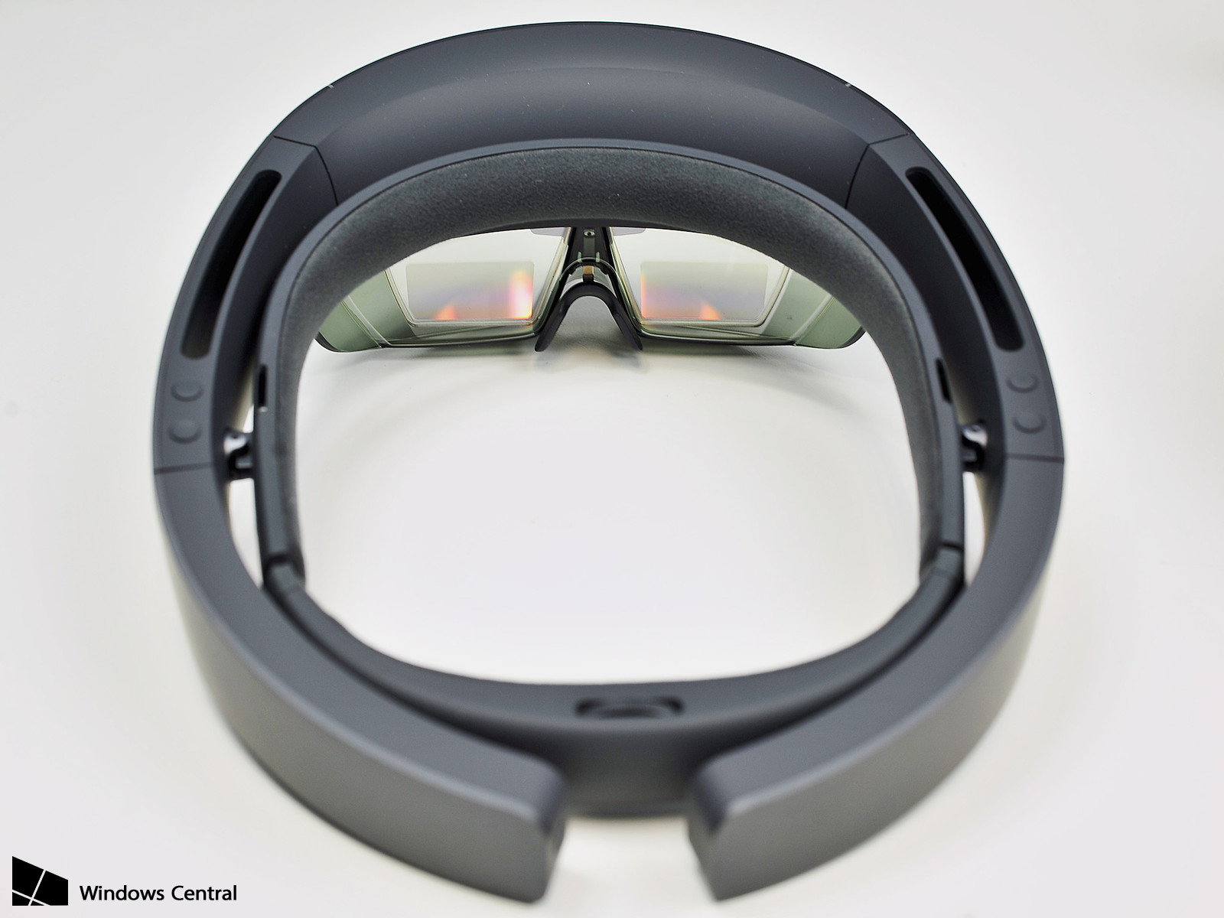
Hololens

Slide 8
Hololens
Top view
Waveguide
Diffraction grating
Projectors
Notes:
At a high level, works by showing stereo images

Slide 9
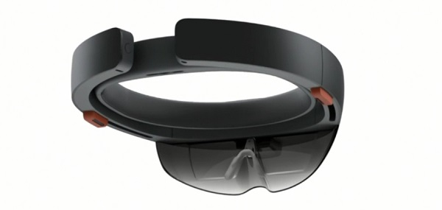
Hololens — light engines
2 HD 16:9 “light engines”
2.8 million light points
http://windowscomments.com/wp-content/uploads/2015/02/hololens-1.jpg
Notes:
Focus on “holographic density” instead of number of pixels
Resolution measured in light points per radiant instead of pixels
Light point: A single point of light emitted through the projection system and wave guide to appear at a fixed distance in your world
Holographic Resolution: Total number of light points emitted
Holographic Density: Minimum number of lights points per radian

Slide 10
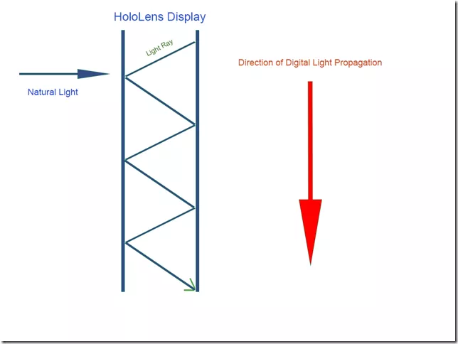
Hololens — waveguide
Lens = planar (holographic/diffractive) waveguide
Total internal reflection
http://www.imaginativeuniversal.com/blog/post/2015/10/17/how-hololens-displays-work.aspx
Notes:
In-coupling and out-coupling

Slide 11
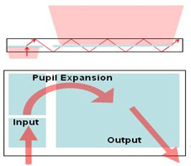
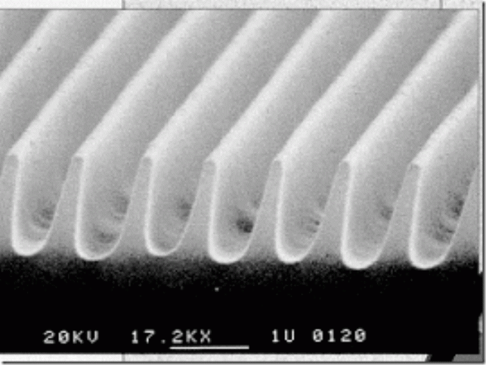
Hololens — diffractive extraction
Diffractive grating redirects light onto eye
Field of view
http://www.displaydaily.com/articles/446-sponsored-articles/14132-waveguide-based-displays-maturing-for-augmented-reality-applications
http://www.imaginativeuniversal.com/blog/post/2015/10/17/how-hololens-displays-work.aspx
Notes:
How do we extract image from waveguide?
Diffractive extraction under umbrella of “exit pupil expansion”
Talk about interpupillary distance
Nikon patented a lot of this — bought by Microsoft in 2014
Surface relief gradient is a series of nanometer-scale structures that are designed to:
Extract a full color image from the waveguide
Provide some lensing to create a virtual image (pupil expansion)

Slide 12
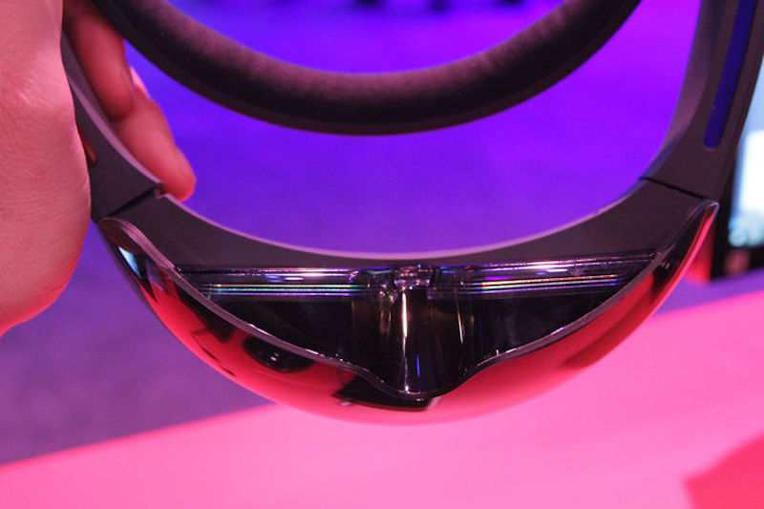
Hololens — diffractive extraction
Three diffractive elements for RGB
Maybe fourth for luminance
https://mspoweruser.com/secrets-of-hololens-optics-revealed/
Notes:
Their most recent filing (#8885997) for Microsoft uses multiple colored waveguides “optimized to different colors”

Slide 13
Hololens — diffractive extraction
Three diffractive elements for RGB
Maybe fourth for luminance
https://mspoweruser.com/secrets-of-hololens-optics-revealed/
Notes:
Their most recent filing (#8885997) for Microsoft uses multiple colored waveguides “optimized to different colors”

Slide 14
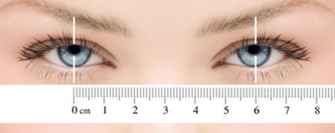
Hololens — interpupillary distance
Distance between pupils
Microsoft holds patent for 2D IPD
http://www.sportsprescriptionglasses.co.uk/images/Pupil-Measurement-diagram.jpg

Slide 15
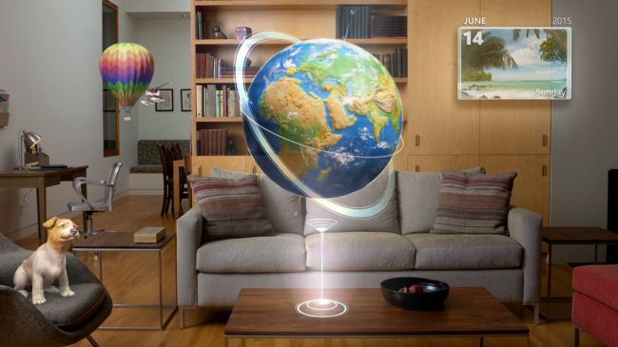
Hololens keeping every object in focus:

Slide 16
Magic Leap
What makes Magic Leap’s display unique?

Slide 17
Magic Leap
What makes Magic Leap’s display unique?
It resolves the vergence-accommodation conflict

Slide 18
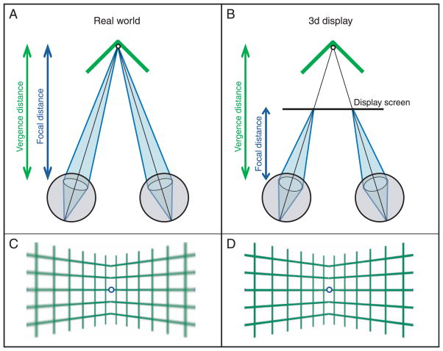
Vergence-Accommodation Conflict
Hoffman, D. M., Girshick, A. R., Akeley, K., & Banks, M. S. (2008). Vergence–accommodation conflicts hinder visual performance and cause visual fatigue.
Journal of Vision, 8(3), 33.1–3330. http://doi.org/10.1167/8.3.33

Slide 19
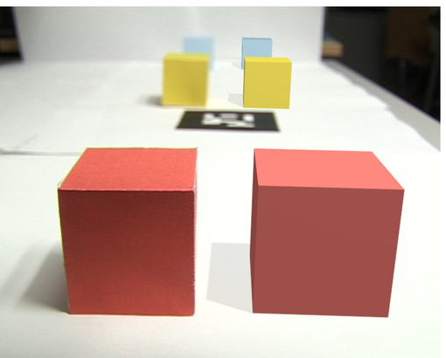
Vergence-Accommodation Conflict
http://www.peterkan.com/pictures/images_bluredg.jpg
Notes:
What makes magic leap unique...

Slide 20
Magic Leap & Vergence-Accommodation
~20% patents directly relate to accommodation
~51% to optics

Slide 21
Magic Leap & Vergence-Accommodation
Reviews & Interviews
“Magic Leap’s solution is an optical system that creates the illusion of depth in such a way that your eyes focus far for far things, and near for near, and will converge or diverge at the correct distances”
- Wired Magazine

Slide 22
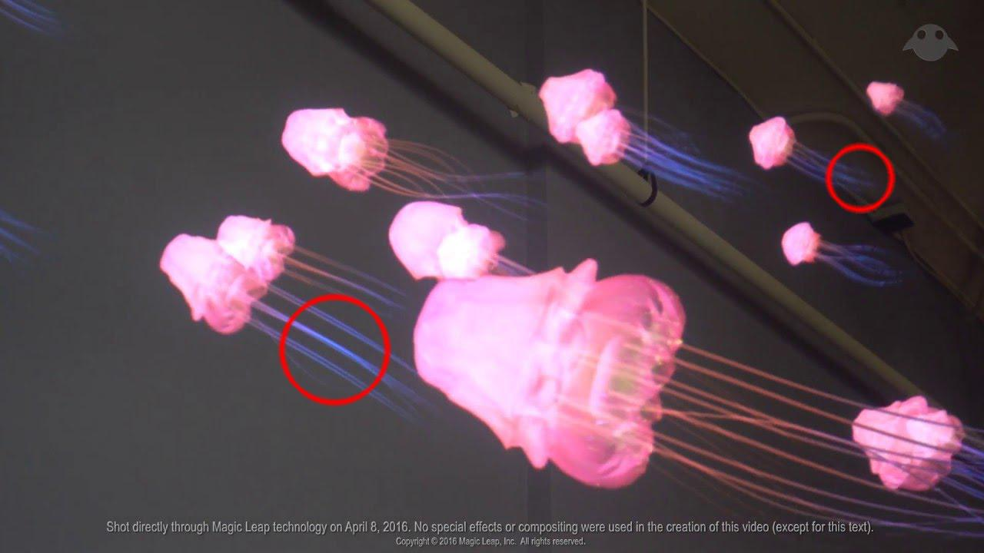
Magic Leap & Vergence-Accommodation
Visual Evidence

Slide 23

How Would it Work?

Slide 24
How Would it Work?

Slide 25
How Would it Work?
If instead...

Slide 26
How Would it Work?
Notes:
Lightfields...

Slide 27
How Would it Work?
Generate a light field in the eye-box

Slide 28
How Would it Work?
Generate a light field in the eye-box
Virtual rays will be indistinguishable from real rays

Slide 29
How Would it Work?
Generate a light field in the eye-box
Virtual rays will be indistinguishable from real rays

Slide 30
How Would it Work?
“Your brain is like a graphics processor. We basically tried to clone what that signal is, we made a digital version of that, and we talk to the GPU of the brain.”
Magic Leap CEO Rony Abovitz
Kelly, K. (2016, April). The Untold Story of Magic Leap, the World’s Most Secretive Startup. Wired.

Slide 31
What is a Light Field?
A function describing the radiance of light at every point (x, y, z) in space, in every direction (𝜃, 𝜙)

Slide 32
What is a Light Field?
“A light field encompasses all the light rays at every point in space travelling in every direction.”
Magic Leap Patent Application (2015)

Slide 33
The Hardware?
Diffraction Optical Elements

Slide 34
The Hardware?
Diffraction Optical Elements
“Inclusion of one or more DOEs… may advantageously allow steering of beams emanating from the face of the planar waveguide and control over focus or focal depth.”
US patent application no. 20,150,016,777

Slide 35
The Hardware?
Diffraction Optical Elements
Reflectors
Optical fibres
Mini-projectors
Eye-tracking

Slide 36

The Hardware?
https://www.wired.com/2016/04/magic-leap-vr/

Slide 37
Shameless Plug
Eleanor, and I are considering light field related projects for the course...

Slide 38
Q&A

