Slide 1
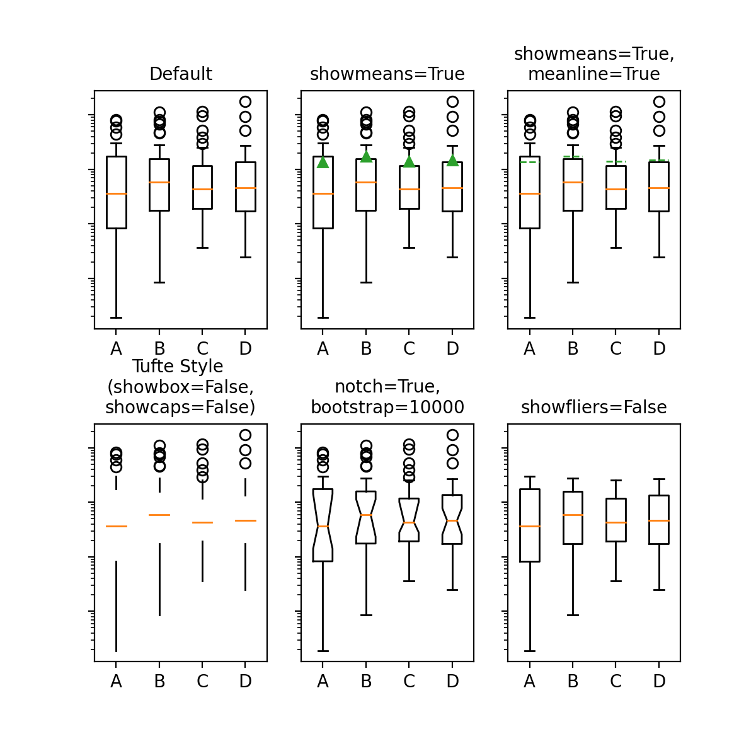
Hey,This is a Slide! How exciting!
Really?

Slide 2
Hey,This is a Slide! How exciting!
Really?

Slide 3
Hey,This is a Slide! How exciting!
Do you know how the Orcs first came into being? They were elves once,
taken by the dark powers, tortured and mutilated. A ruined and terrible form of life.
Now... perfected. My fighting Uruk-Hai. Whom do you serve?

Slide 4
Hey,This is a Slide! How exciting!
Do you know how the Orcs first came into being? They were elves once,
taken by the dark powers, tortured and mutilated. A ruined and terrible form of life.
Now... perfected. My fighting Uruk-Hai. Whom do you serve?

Slide 5
Hey,This is a Slide! How exciting!
Do you know how the Orcs first came into being? They were elves once,
taken by the dark powers, tortured and mutilated. A ruined and terrible form of life.
Now... perfected. My fighting Uruk-Hai. Whom do you serve?

Slide 6
Hey,This is a Slide! How exciting!
Do you know how the Orcs first came into being? They were elves once,
taken by the dark powers, tortured and mutilated. A ruined and terrible form of life.
Now... perfected. My fighting Uruk-Hai. Whom do you serve?

Slide 7
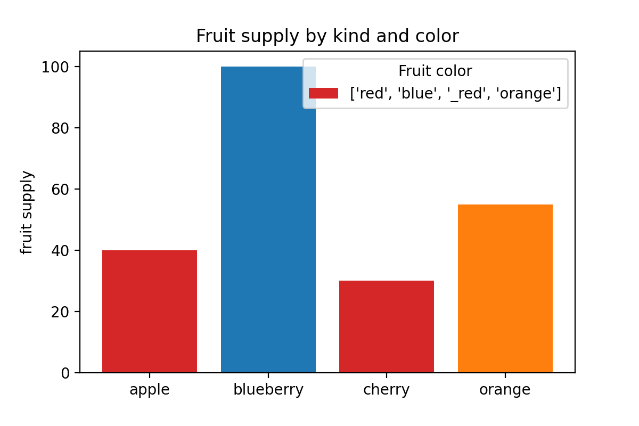
Hey,This is a Slide! How exciting!

