Slide 1
Wide color gamut display market firmly on growth path
Technology
Quantum Dot Display Technology & Market Report - H2 2015
Display Chemical Materials
August 2015
Richard Son, Senior analyst, +82 031 8039 8768, Richard.son@ihs.com
Kihyun Kim, Senior analyst, +82 031 8039 8715, .Kihyun.Kim@ihs.com

Slide 2
I. Executive summary 04
II. Wide color gamut introduction 06
1. Wide color gamut definition 07
2. Wide color gamut solutions 11
3. History of wide color gamut industry 12
III. Wide color gamut solutions and industry trends 15
1. QD solution 16
1.1. QD structure and characteristics 16
1.2. Application of QD to LED 20
1.3. QD LED application technologies 22
1.4. QD application technology for LCD BLU 24
1.5. QD applications in LCD BLU 26
1.6. On edge type (Tube) 28
1.7. On surface type (Film) 28
1.8. Development status and issues of QD-applied LCD BLU 29
1.9. QLED technology (versus OLED) 30
1.10. Driving principle and device structure of QLED 33
1.11. Manufacturing of QLED 35
1.12. QLED development status and outlook 37
2. LED/CF solution 39
2.1. Characteristics of wide color gamut LEDs 39
2.2. KSF phosphor 41
2.3. Color filter tuning 43
3. OLED solution 44
3.1. OLED technology and characteristics 44
3.2. Color gamut of the OLED solution 46
4. Other wide color gamut solution 49
4.1. Color gamut enhanced film 49
IV. wide color gamut display cost analysis 50
1. Method of production cost analysis 51
2. 55-inch TV_3840x2160 52
2.1. TV WCG BLU/Panel cost forecast 53
3. 27-inch monitor_1920x1080 55
3.1. Monitor WCG BLU/Panel cost forecast 56
4. 15.6-inch notebook PC_1920x1080 57
4.1. Notebook PC_WCG BLU/Panel cost forecast 58
5. 7-inch tablet PCs_1920x1080 59
5.1. Tablet PC WCG BLU/Panel cost forecast 60
6. 5.5-inch smartphone_1920x1080 61
6.1. Smartphone WCG BLU/Panel cost forecast 62
V. Supply chain analysis 63
1.QD solution 64
1.1. Overall 64
1.2. QD film structure 65
1.3. QD film production cost analysis_55 inches 66
1.4. Characteristics of QD solution supply chain in the TV market 67
1.5. Samsung Electronics 68
1.6. LG Electronics 69
1.7. Chinese TV brands 70
1.8. Monitors, notebook PCs, tablet PCs, and smartphones 71

Slide 3
2. LED solutions 72
2.1. Samsung Electronics 72
2.2. LG Electronics 72
3. OLED solution 73
3.1. Small- and medium-sized OLED display 73
3.2. Large-sized OLED display 74
VI. Wide color gamut market forecast 75
1. Overview 76
2. Wide color gamut market in unit 77
3. Wide color gamut market in area 78
4. By wide color gamut solutions 79
4.1. Wide color gamut market in volume 79
4.2. Wide color gamut market in area 80
5. By applications 81
5.1. Wide color gamut market in volume 81
5.2. Wide color gamut market in area 82
6. Penetration of wide color gamut display by applications 83
VII. QD display market forecast 84
1. Overall 85
2. By applications 87
2. By type 88
4. Penetration forecast for QD solution by application 89
5. TV 90
5.1. Overall 90
5.2. By type 91
5.3. By size 92
6. Monitor 93
6.1. Overall 93
6.2. By type 94
7. Notebook 95
7.1. Overall 95
7.2. By type 96
8. Tablet 97
8.1. Overall 97
8.2. By type 98
9. Smartphone 99
9.1. Overall 99
9.2. By type 100
10. Cadmium and cadmium-free QD display market forecast 101
10.1. Overview 101
10.2. Market forecast 102
Report introduction 103

Slide 4
I. Executive summary

Slide 5
QD solution leading the growth of the wide color gamut display market
The wide color gamut display market is expected to grow steadily from 2.8% of the total demand in terms of area in 2015 to 25% in 2020, expanding by nine times.
The wide color gamut display is most widely used in the smartphone market which applies large amounts of organic light-emitting diode (OLED) displays.
In addition, with TV brands aggressively promoting TVs using quantum dot (QD) solutions, large panel producers as well as small- and medium-sized panel makers started to opt for wide color gamut. With this, the wide color gamut display market is expected to grow from 2015.
In particular, the QD solution that is applied in large-sized wide color gamut displays boast comparable color gamut to OLED solution-based displays, while offering a relatively lower production cost. With its competitive edge, the QD has primarily targeted the high-end large display market, and the QD is expected to settle down as a key solution in the market.
As a result, the market share of the wide color gamut display employing QD solution will grow from less than 1% in 2015 to over 9% in 2020. The QD is forecast to be the growth engine of the market.

Slide 6
II. Wide color gamut introduction

Slide 7
1. Wide color gamut definition
Color gamut refers to the various levels of colors that can be displayed in a panel and quantified in values.
Color gamut is measured by an area ratio using the International Commission on Illumination’s (CIE) XY chromaticity coordinates. In general, the maximum peak points that can be expressed on color coordinates (red, green, blue) are used as each vertex of a triangle to measure the area, and the color gamut is measured in percentage of a certain standard. It can be also expressed in the number of colors that can be reproduced, such as 6-bit mode (260,000 colors), 8-bit (16.7 million colors), 10-bit (1 billion colors), 12-bit (68.7 billion colors), and 14-bit (4.4 trillion colors).
High or wide color gamut means a wider range of reproducible colors, reproduced colors that are close to true-color image quality, or the reproduced color close to the actual color perceived in human color vision. This is why color gamut is used as an indicator of image quality.
There are a variety of standards and terminology gauging the color gamut, and each manufacturer uses a combination of various standards for their convenience. If color gamut is expressed as 100%, it is important to know what standard this 100% is based on, and it is also important to understand the standard itself.
Following slides will look into the most common color gamut standards.

Slide 8
sRGB: It is a color space for monitors and printers made by Microsoft Corp. and Hewlett-Packard Development Company, L.P. in 1996, which has the same color area as Rec.709. Most PC monitors and TVs sold in the market can express 100% of the sRGB color space. This color space was used in commercial color matching systems until the mid-2000s and was designed to fit to home and office viewing conditions.
REC. 709: It is the standard broadcasting signal for high-definition (HD) TV recommended by the International Telecommunication Union (ITU) in 1990. It is also called BT-709, and its color space is the same as sRGB. HDTV broadcasting must operate 100% of the Rec.709 color space.
NTSC (NTSC 1953): National Television System Committee (NTSC) is the broadcasting standard for analog TVs in more than 50 countries in North and Central America, Latin America, Northeast Asia, and Southeast Asia. Generally, if the word color gamut is used alone, it refers to the color space based on the NTSC standard. Monitors and liquid-crystal display (LCD) TVs released in the 2000s are generally within 72% of the NTSC standard because they were made based on the Rec. 709 (sRGB) standard.
Color coordinates based on sRGB / Rec. 709
Chromaticity | Red | Green | Blue | White point
x | 0.64 | 0.3 | 0.15 | 0.3127
y | 0.33 | 0.6 | 0.06 | 0.329
Source: IHS |  |  |  | © 2015 IHS
Color coordinates based on NTSC (NTSC 1953)
Chromaticity | Red | Green | Blue | White point
x | 0.67 | 0.21 | 0.14 | 0.31
y | 0.33 | 0.71 | 0.08 | 0.316
Source: IHS |  |  |  | © 2015 IHS

Slide 9
Adobe RGB: Adobe Systems Software Ireland Ltd. suggested its own color space in 1998, complementing the loss in green and cyan colors that can’t be expressed in the sRGB. Compared to the sRGB color space, Adobe RGB was developed for the color space that can be ideally reproduced in printing machines, and it encompasses most colors of cyan, yellow, magenta, and black (CYMK). However, with the chromaticity near green being extremely high, there are color spaces that cannot be reproduced with printing equipment.
DCI-P3: It is a color space suggested by Society of Motion Picture and Television Engineers (SMPTE) in 2007, encompassing a wider color range than sRGB. Currently, all digital movies are created based on the color space of DCI-P3. In 2013, the first monitor adopting the DCI-P3 was released.
Rec. 2020: It is a broadcasting signal for ultra high-definition (UHD) TV (4K, 8K) suggested by the ITU in 2012. It is an extension of the Rec. 709, and it has a much wider color space compared to all other standards currently being used.
Color coordinates based on Adobe RGB
Chromaticity | Red | Green | Blue | White point
x | 0.64 | 0.21 | 0.15 | 0.3127
y | 0.33 | 0.71 | 0.06 | 0.329
Source: IHS |  |  |  | © 2015 IHS
Color coordinates based on DCI-P3
Chromaticity | Red | Green | Blue | White point
x | 0.68 | 0.265 | 0.157 | 0.333
y | 0.32 | 0.69 | 0.06 | 0.334
Source: IHS |  |  |  | © 2015 IHS
Color coordinates based on Rec.2020
Chromaticity | Red | Green | Blue | White point
x | 0.708 | 0.17 | 0.131 | 0.3127
y | 0.292 | 0.797 | 0.046 | 0.329
Source: IHS |  |  |  | © 2015 IHS

Slide 10
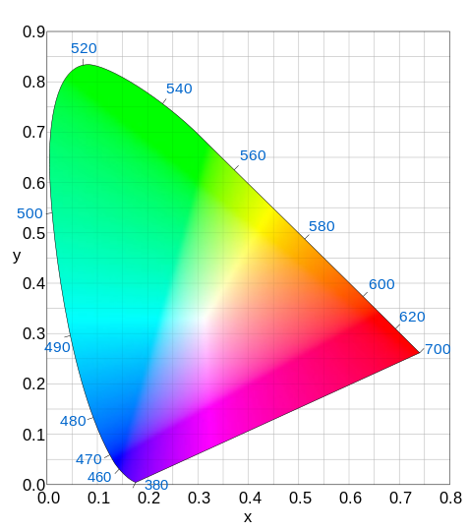
The five color gamut standards mentioned earlier can be found in the CIE color space chromaticity diagram on the right.
Most displays currently being used are produced based on the sRGB color space that can reproduce the narrowest color space in the triangle on the right. This can create 72% of color based on the NTSC 1953 and show soft level of cyan and low color depth to green.
The REC. 2020 with the widest color space has 34% more space than the NTSC 1953, and displays using QDs are considered to be able to show much of color gamut specified by the REC. 2020 of the ITU, bringing great attention to QD TVs.
QD can express depth in green and red colors and can even reach 90% of the NTSC 1953 standard.
QD is considered better than light-emitting diode (LED) or OLED display technology in reproducing such a wide color space.
CIE 1931 color space chromaticity diagram
sRGB / REC.709
NTSC 1953
Adobe RGB
DCI-P3
REC.2020
Source: IHS
© 2015 IHS

Slide 11
2. Wide color gamut solutions
There are largely four wide color gamut solutions including color filter-, LED-, QD-, and OLED-based technologies
In particular, the technologies involving color filters and LED phosphors, which are components of an LCD panel, have been applied to improve color gamut since 2004. The QD technology, which adds QD sheets or QD tubes on LCD modules, started being applied in 2013 to enhance the color gamut of LCD panels.
The OLED delivers nearly 100% NTSC color gamut. In the RGB OLED display, each red, green, and blue subpixel emits light without a color filter, so its color gamut rate is determined by the color density of emitting materials. The RGB OLED has a wide color gamut.
Wide color gamut solution
NTSC Ratio by TV technology
TV | Color gamut (NTSC %)
CRT | 78% ~ 82%
PDP | 90% ~ 95%
OLED | 100% ~ 110%
LCD (CCFL) | 54% ~ 73%
LCD (WCG CCFL) | 85% ~ 95%
LCD (White LED) | 68% ~ 78%
LCD (C/F improvement + LED) | 95%↓
LCD (RGB LED) | 95% ~ 100%
LCD (QD) | 100%↑
Source: IHS | © 2015 IHS
LCD
OLED
Color filter
LED solutions
QD
RGB OLED
Red, green, blue chip
QD applied LED package
WCG CCFL
(X)
Blue chip + RG phosphor
Tube
White OLED
Blue, green chip +
red phosphor
Sheet, film
Source: IHS
© 2015 IHS

Slide 12
3. History of wide color gamut display
With the end of the CRT era and the rapid growth of flat-screen TVs, TV makers have been seeking ways to differentiate their products from others on the market.
First, they have made difference in a response rate. Adjusting a response time is part of panel technology, and all TV makers have made efforts to reduce response times. LCD is known to have a slow response time, which is one of its structural drawbacks. The rate started at 40 milliseconds (ms) in the early 2000s, but was cut to 25 ms,16 ms, and 8 ms. Finally, it was lowered to 5 ms, an undetectable time with human eyes.
TV makers have also tried to increase scanning speed to produce a soft screen and lessen fatigue on the eyes. It started from 60 hertz (Hz) and then evolved to 120 Hz and 240 Hz. There are some products that went above 240 Hz, but those high scanning speed rates above 240 Hz are nothing more than numbers that are generally used in marketing by the manufacturers. So far, 240Hz is the highest.
Since the flat-screen TV first hit the market, design has emerged as a strong differentiation point. The overall design trends have moved from slim to narrow bezel, to ultra slim, and then to curved TV.
In the meantime, as resolution, which is closely linked to broadcasting and content, has developed in line with the changes in the broadcasting equipment technologies. The general trends are moving from standard definition (SD) to high definition (HD), to full high definition (FHD), and then to ultra high definition (UHD). More detailed information will be presented in the UHD TV chapter.
It is hard to define color gamut as an individual differentiation point. Rather, it is related with the development and the change in light source. However, ever since Sony released its QD TV in 2013, color gamut has been positioned as a differentiation point among the premium products. Samsung Electronics Co., the leader in the flat-screen TV market, released QD TVs in 2015, and QD TVs have emerged as the much-touted issue in the 2015 TV market along with UHD and curved TV.

Slide 13
Before 2004, the term of color gamut was hardly used in the flat screen TV industry, but some PDP makers had used color gamut as a differentiation tool to win in the competition against LCD TVs that had successfully eaten away at PDP share with better price and a wider range of sizes.
However, after LCD gained a competitive edge in brightness, price, and resolution over PDP, competition intensified among LCD TV makers, not between PDP and LCD TVs. In May 2004, Sony released the Qualia 005, a completely innovative product that could change the entire LCD TV paradigm. The Qualia 005 was released in 40 and 46 inches and sold around 10,000 units. However, with limitations in LED technology, the product that employed high-power LED suffered from heat radiation and RGB LED controlling issues and it was recalled in the end. Still, this helped LED to emerge as a key TV light source and led color or color gamut to be one of important marketing points.
LED not only made the concept of color gamut to gain attention but also built an image of premium product. Furthermore, it paved the way for advancements in CCFL technology. Hybrid of CCFL and LED, flat LED, HCFL, and external electrode fluorescent lamp (EEFL) were developed in a bid to enhance TV performance and helped facilitate the LED industry growth.
CCFL developed into a wide color gamut (WCG) CCFL, and this light source was first launched by Sony, later followed by rivals. White LED (blue LED + fluorescent material) was developed as a revolutionary solution that could replace RGB LED, shifting the industry’s focus to stability and reliability from color gamut. And then the birth of edge LED with white LEDs attached on the panel edges again shifted the TV industry’s focus to large size and design (form factor).
Later, with the improvements in color filters and pixels, TV makers started to roll out TVs with enhanced color gamut. However, price, brand awareness, design, resolution, and three dimension have become more important elements in choosing TVs, taking color gamut off the list of top considerations.
Nevertheless, with the TV market maturing without much differentiating factors, it is presumed that QD TVs with enhanced color gamut will likely draw much attention throughout 2015.

Slide 14
The picture below describes the development trends of wide color gamut TVs by maker. Starting with RGB LED-based TVs produced by Sony Corp., various wide color gamut TVs were released on the market. As color gamut began being recognized as a differentiator, products adopting wide color gamut (WCG) cold cathode fluorescent light (CCFL) were introduced. After that, Sharp Corp. released TVs using a four color (RGBY) pixel structure. Recently, wide color gamut TVs using QD solutions, improved LED packages, and enhanced color filter dyes are being produced.
Development trends of wide color gamut TV by maker
2004
2007
2010
2012
2013
2014
2015
RGB LED
4 Color Pixels
QD
technology
Qualia005
40”/46” by Sony
Quadtron series by Sharp
SUHD TV by Samsung
Color Prime TV by LG
LExxMxx
40”/46” by Samsung
LCD Module
47” by LG
By Hisense
By TCL
By Sony
Wide color gamut CCFL
LED solution + Color filter by LED/LCD panel makers
V/W/XBR Series by Sony
Mosel Series by Samsung
OLED TV
Source: IHS
© 2015 IHS

Slide 15
III. Wide color gamut solutions and industry trends

Slide 16
1. QD solution
1.1. QD structure and characteristics
A QD is a semiconductor nanocrystal composed of two or more elements. Generally, two elements among ZnS, CdS, CdSe, and gallium nitride (GaN), form a Wurtzite crystal structure. It is a very small particle with a size of several nanometers. It shows quantum mechanical properties, such as quantum limit effect and quantum size effect. Studies are underway for its application in various industries, such as biology and display devices. Depending on the application industry, QDs with slightly different structures and shapes are used for different functions. QD structure can be divided into core, shell, and ligand depending on functions.
First, core is the most important part that determines QD’s main properties. All the functions, such as absorption or emission of light, and injection and transportation of electrons are controlled by the core. Sometimes a QD is composed only of core without shell and the core can be regarded as the QD itself. The size of core plays a key role in determining light-emitting wavelength according to the size of QDs. It is mainly composed of II-VI group elements, such as CdSe or CdS, and for semiconductors with small band gap, PbSe and PbS are used. Recently, development of QD that uses III-V group elements, such as InP and GaP, is underway to avoid the use of heavy metals like cadmium and lead.
QD structure
Types of QD by band gap size and location of core and shell
2.Shell
1.Core
Type I
Type II
Reverse Type I
3.Ligands
Core
ZnS, ZnSe, CdS
Core
Core
Shell
Shell
Shell
Shell
Shell
Shell
Shell
CdSe, Inp
Shell
Core
ZnS
Source: IHS
Source: IHS
© 2015 IHS
© 2015 IHS

Slide 17
The basic role of shell is to protect the surface of QD core. The core crystal is very small, so its surface area compared to volume is much wider than bulk semiconductor’s. Also, the atoms on the crystal surface are unstable with many dangling bonds that haven’t fully combined, so it is easy to cause defects following external exposure. Defects on the core surface have fatal impact on QD semiconductor properties by forming traps and lowering light-emitting efficiency. Shell that protects core must be formed to reduce dangling bonds and prevent defects. Shell is mainly composed of II-VI group elements that have large band gap, such as ZnS. Ever since M. A. Hines and others reported core/shell structured QD in 1996 for the first time, the stability of QDs has improved rapidly.
QDs with a core/shell structure is divided into Type I, Type II, and Reverse Type I depending on the size and location of the band gap of the substance, which a QD is composed of. Type I structure is in the form of the core band gap completely being confined in between larger band gaps of the shell. By enhancing the stability of QDs and maximizing the exciton confinement effects in the core, high light-emitting efficiency can be gained. Thus, QDs used in displays or LEDs to emit light mostly use Type I core/shell structure. Its representative examples include CdSe/ZnS, CdSe/ZnSe, CdSe/CdS, and InP/ZnS. Type II structure is in the form of band gaps of core and shell being placed against each another to form a staircase like structure. According to the location of core/shell bands, electrons or holes’ confinement degree can be adjusted. In addition, sometimes core/shell boundary surface plays the role of a band gap. Its representative examples include CdTe/CdSe and CdSe/ZnTe. They are mainly applied to solar batteries. Reverse Type I is a structure that wraps core with shell whose band gap is smaller than core’s. The wave function of electrons or holes are located at the shell with a higher probability. There are QDs, such as CdS/HgS and CdS/CdSe, but they are not used frequently. In QDs, the shell protects the core, so as the shell gets thicker, the stability against external air or moisture will substantially improve and light-emitting efficiency will also rise. However, if a shell is too much thicker than the appropriate level, the light-emitting efficiency will fall. Also, core/shell boundary surface is a lamination between different substances, so it is inevitable to cause lattice mismatch stemming from different crystal intervals. Therefore, atoms of the core/shell boundary surface have such defects as dislocation and core deformation due to strong lattice strain. Such QD defects reduce stability and light-emitting efficiency.

Slide 18
To overcome disadvantages of the core/shell structure, several methods have been suggested, such as multishell structure and core/shell alloy structure as below. A multishell structure uses two ore more shell layers in a QD. If the lattice spacing and band gap between core and shell substances are too big, it reduces the difference between the lattice mismatch of the core/shell boundary surface and band gap by again wrapping the substance, which has the lattice spacing and band gap of around middle of the two substance, with a shell. As shown in the picture below, lattice mismatch is minimized by wrapping with a shell in the order that lattice spacing and band gap increases from core to shell. Through multilayers of a shell, excitons are stably confined in the core, improving QD’s stability and light-emitting efficiency. Also, it has an advantage of outstanding shell uniformity compared to when a single type of shell wraps the core thickly.
Alloyed QDs have a chemical composition in which the boundary between core and shell is ambiguous, and the core elements gradually fall in the direction of core to shell, But at the same time, shell elements gradually increase. This structure makes the energy difference between core and shell a funnel shape and not an abrupt junction shape. It also enables energy levels to naturally connect to shell from core, while reducing the boundary surface lattice mismatch. Also, the core size can be adjusted through the alloy process.
Multi-shell structure QDs and their characteristics
Core/Shell
Core/Shell/Shell
Alloyed Core/Shell
Core
Core
Core
Shell
Shell
Shell
Shell
Shell
Shell
Shell
Shell
Source: IHS
© 2015 IHS

Slide 19
Besides, QD properties can be controlled by doping metal substances, such as Cu or Mn, on the basic composition of QD core. Doping methods include nucleation-doping that inserts impurities in the early reaction process of QDs to grow doped QDs. Another method is growth-doping, which adds impurities after the core is formed. If QDs are doped with metal substances, light-emitting peak can vary upon the energy level of the doped substances. Its optical and chemical stability will also improve. However, light-emitting efficiency is somewhat low and spectrum’s full width at the half-maximum (FWHM) is wide, so they are more used in bio-application rather than application in displays.
Lastly, ligand, which is attached to the QD surface, is a very crucial factor, which enables stable diffusion of QDs to solvents in a colloidal state. It plays the role of the electric and chemical passivation for dangling bond that exists in the surface by combining with atoms on the QD surface. Also, it prevents agglomeration and growth of unwanted QDs and determines its solubility in the solvents. In addition, QDs can be used by changing types of ligand as appropriate or adding functional molecules. For example, in bio-application, QDs can be transported to certain proteins or cells and be observed using fluorescence. If applied in transistors, electrical conductivity can be raised with the use of metallic ligand. This is mainly achieved in the form of ligand exchange using the difference between QD surface and ligand anchor group’s reactivity.

Slide 20
1.2. Application of QD to LED
Recently, the color changing technology using QD as LED phosphor has been drawing attention. Existing phosphor has high luminous efficiency, but has just 100 nm FWHM due to the emission tail that is extended long towards the long wavelength after passing the main peak. It is hard to adjust the phosphor size and manufacture an uniform film using the phosphor. In addition, a large number of phosphors are made of rare earth elements, of which supply and price are unstable. Because of such disadvantages, there are many difficulties to extract dark color with high purity from phosphor-used LED and minutely adjust the color space. Even though a phosphor is packaged on LED, its uneven size and non-uniform distribution cause the light scattering and degrade transmittance.
By comparison, QDs have high luminous efficiency of higher than 80% in most of the visible wavelength range and a narrow spectrum width less than FWHM 30 nm. Because it is also easy to adjust the wavelength from the visible light to the infrared range, QDs can be an excellent LED phosphor. QD as an LED phosphor enables the reproduction of very dark colors and displays a broader array of colors (almost all colors) compared to the conventional LED or the LED using phosphor. Further, the size deviation of QDs is less than 5%, meaning excellent monodispersity. It also has excellent transmittance with even distribution within films and resins through surface modification.
There are various ways to apply QDs to LED. When used in the manufacturing of white LED, they have many advantages and great properties compared with white LED using the conventional phosphor. As a light source to emit QDs, GaN-based blue LED, which is cheap and easy to make, is used. If using red and green QDs as a phosphor, a white light source with three wavelengths can be simply created. These methods can be applied to create various types of white light sources with four or five wavelengths if needed. By adjusting the emission spectrum location of QDs and the ratio of each color, the lighting performance indicators such as CCT and CRI can be changed without difficulty. Another advantage is that it does not need to use Yttrium, a rare-earth element used in YAG. In the phase of LED packaging, QDs can be applied to LED in the way of coating them in colloidal state or fixing them by mixing with resin. They can use almost all of the existing phosphor packaging processes as they are, thus being manufactured without a big change in the production process.

Slide 21
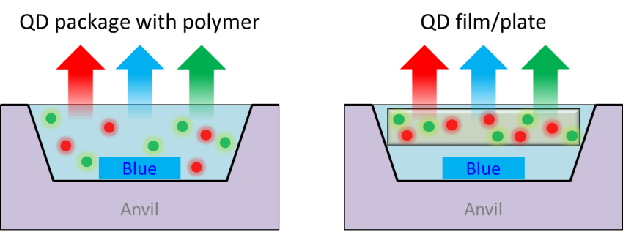
Given that the LED using the conventional phosphor can employ only a limited number of phosphors and has low luminescence efficiency, blue LED using InGaN and YAG are the most widely used to make white LEDs. When QDs are used as a phosphor, the LED is used as a high-power light source and QDs are used as excitation light. QDs are packaged together with resins as the conventional phosphors, or fabricated in the form of a thin film to be placed in front of the LED.
The control of the CCT of white light sources, which have low CCTs, is the most basic application of QDs. This is conducted by coating red QDs on the white LED lighting of the conventionally-used blue LED and YAG, which will lower the white LED’s CCT to 3,000–4,000 K and improve the CRI. It is not easy to distribute bulk phosphors and QDs on resins evenly, so it is more effective to use only QDs as phosphors.
When only blue LED and QD phosphor are used, it is possible to create a two-wavelength white LED with orange QD phosphors. If green and red QDs are used as phosphors, a white LED with three wavelengths can be produced. Packaging all of green, orange, and red QDs together can result in a white LED with four wavelengths. It is also possible to add other colors and mix them together. It requires the same process to form white LEDs in such a variety of structures. LEDs in various structures can also be tailored to the purposes. For example, a simple white LED with two wavelengths can be created, while a three-wavelength white LED can be made when RGB needs to be realized like display screens. If a high CRI is required as is for lighting, a white LED with more than four wavelengths can be produced.
Application of QD to LED
QD package with polymer
QD film / plate
Blue
Blue
Anvil
Anvil
Source: IHS
© 2015 IHS

Slide 22
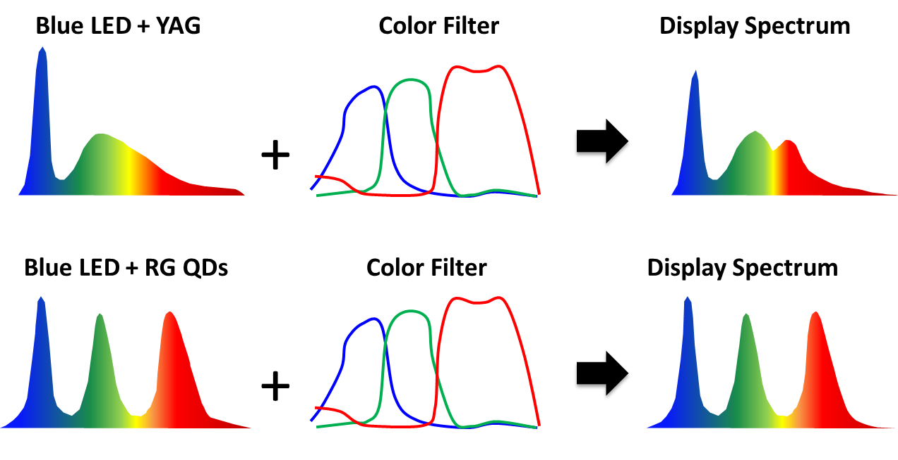
1.3. QD LED application technologies
Like the conventional LED, LED using QDs as phosphors can be used in various applications. They can be used wherever light is needed, ranging from display screens to electronic and direction boards, tiny flashlights, desk stands, indoor lighting, decorative illumination and display screens. In 2007, Evident Technologies Inc. introduced decorative lighting for Christmas illuminations, which emit new, various colors by using QDs.
In particular, display screen and lighting sectors are keen on QD technology because they can make good use of great optical properties of QDs. The display industry is aiming to use a white QD-based LED as an LED backlight. If a QD-based LED with three wavelengths is adopted as an LCD backlight, it can create a brighter and more efficient white color than the two-wavelength white LED using the conventional YAG. In addition, since the RGB spectrum has a far narrower FWHM than the transmittance spectrum of color filters that make RGB pixels, the RGB color purity in display screens increases, resulting in a rise in the whole color gamut.
Comparison of LCD display spectrum applying YAG and QD
Blue LED + YAG
Color Filter
Display Spectrum
Blue LED + RG QDs
Color Filter
Display Spectrum
Source: IHS
© 2015 IHS

Slide 23
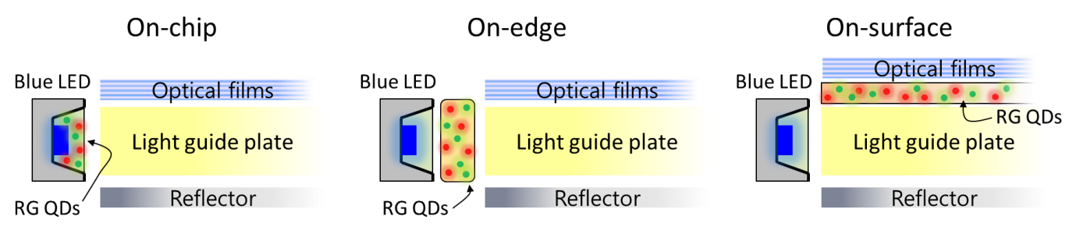
Other than packaging QDs with a blue LED to create white color, there are additional two ways to apply QD technology in LCD BLUs.
First, red and green QDs are fixed to a resin and then made in the form of a thin tube or rod. Then, they are put in between a blue LED of a BLU and a light guide panel (LGP) to create a white backlight. In the other method, a film coated with red and green QDs is placed on a LGP to absorb the blue light emitting to the front through the LGP in a blue LED and emit red and green light of QDs to create a white color.
Albeit in different forms, the QD application technologies in BLUs are all the same: Red and green QDs absorb blue light and create a white color composed of RGB. Depending on the location of QDs in BLUs, those technologies are divided into on-chip type (QDs packaged in front of LED), on-edge type (QDs placed between a LED located on the rim of the panel of an edge-type BLU and a LGP) and on-surface type (QD film placed above a LGP). The figure below briefly describes three ways of how to place QDs in BLUs. Pros and cons of each technology will be described in the later chapters.
Three methods of applying QDs to BLU
On-chip
On-edge
On-surface
Blue LED
D-BEF
Blue LED
D-BEF
Blue LED
D-BEF
BEF
BEF
BEF
RG QDs
(Film)
LGP
LGP
LGP
RG
QDs
Reflector
RG
QDs
(Tube)
Reflector
Reflector
Source: IHS
© 2015 IHS

Slide 24
1.4. QD application technology for LCD BLU
LCD is a display, in which liquid crystals are aligned in one side between the two sheets of glass. With liquid crystals that change the alignment direction when applied with the electric field, the display works by controlling whether to block or transmit light. The part below the glass that provides light source is called the backlight unit (BLU). BLU for displays are composed of a white light source, a LGP to evenly diffuse the light, the diffuser sheet, and functional optical film.
Cold cathode fluorescent lamp (CCFL) was used until a few years ago for the white light source. It has some advantages such as emitting superior white light and low prices, and that it can diffuse light evenly through the entire display as a line source. On the other hand, CCFL requires an inverter on the circuit to operate, has low brightness and low energy efficiency. In addition, since it includes mercury, it may have adverse effects on the environment. Recently, LEDs are used more widely than CCFL as a light source for BLU. LEDs can operate with low power, has high brightness and high energy efficiency, and its circuit is also extremely simple to design. However, since it is a point source, more development is needed for LEDs to be used on a wider surface, and if multiple LEDs are to be used, the price and heat emission also are factors to consider.
LCD BLUs can be classified by the location of the light source, into the direct-type, in which the light source is placed evenly behind the LCD panel, and the edge-type in which the light source is placed on the edges of the LCD. Since the light source is evenly distributed behind the panel on the direct-type, it is possible to enhance the brightness, color, and contrast. However, as for the direct-type BLU that uses CCFL, the LCD becomes thicker, and as for the BLU using LEDs, the price goes up and more heat is emitted. As for the edge-type, since it places the light source on the edges to diffuse the light on the overall surface, it is possible to produce a thin and light display. Therefore, most LCDs produced recently have been using edge-type BLUs.
The color gamut according to the type of backlight units is determined by the light source and the color filter spectrum. The color filter is composed of small pixels that each transmits red, green, and blue colors, and therefore controls the red, green, blue colors emitted from the white light source in the backlight unit. To produce dark and bright colors, the color filter needs to have high transmittance for the color applied while blocking the wavelength of other colors. As for the white light source, it is better for the spectrum to focus on the range of a color to be produced, and the light source needs to be bright and efficient.

Slide 25
The ultra violet rays that come out through the discharged mercury of the CCFL excites the phosphors on the lamp surface to create light. Although it depends on the type of phosphors, there are multiple narrow peaks composed of red, green, and blue areas. Previously, the color gamut ratio was low at about 70% of the NTSC standards, but there have been advancements in the area and now CCFL can express colors in a wider range compared to sRGB. However, CCFL lamps have lower efficiency than LED, which means that it consumes more energy compared to LED, and also have limitations in slimming down the thickness. Therefore, their usage has been on the decline these days.
White LED light sources have superior energy efficiency and can be made into small sizes, thus being used in a wide variety of devices such as mobile devices, laptops, and even TVs. White light sources are made by placing an amber-colored phosphor such as YAG onto a blue LED. Since the blue LED expresses a dark blue color while the amber-colored phosphor is distributed on a wide wavelength range from green to red, it is hard to achieve wide color gamut. To solve this problem, phosphors with various colors are mixed together.
Some companies released the products with BLU using red, green, and blue LEDs to improve the color gamut. After the release of the Qualia 005 by Sony, which failed to capture the market, Samsung Electronics and LG Electronics also introduced the products with improved RGB LED in terms of heat dissipation and performance. As a result, color gamut has emerged as an important factor that can determine the competitive edge of a product.
Comparison of LCD BLU light sources
 | CCFL | White LED | RGB LED | Blue LED + QD
Color gamut | Low-Mid: NTSC 70-90% | Mid: NTSC <90% | Wide: NTSC >100% | Wide: NTSC >100%
Available color space | sRGB | sRGB | sRGB, Adobe RGB | sRGB, Adobe RGB
Power consumption | High | Low | Mid | Low
BLU Size | Medium | Small | Small | Small
Thickness & Bezel | Medium | Very thin | Thin | Thin-Very thin
Cost | Low | Low-mid | Mid-high | high
Source: IHS |  |  |  | © 2015 IHS

Slide 26
1.5. QD applications in LCD BLU
The display industry, specifically the TV industry, needs innovative products every year, and innovation is naturally linked to marketing strategies. Considering the current status of the leading TV makers, it is highly expected that innovation for 2015 will be brought about by color gamut, and innovation in color gamut can be found in the BLU.
To overcome the drawbacks of the CCFL and LED backlights, methods using QDs to create white light sources are gaining attention. QDs have high luminous efficiency and very narrow luminescence spectrum, enabling the expression of dark colors. When green- and red light-emitting QDs are used as phosphors on cheap but good-quality blue LEDs, white light is created with all three red, green, and blue wavelengths at a low cost, which have higher efficiency and greater optical properties than the conventional white LEDs. If this is used in the LCD BLU, it is able to express a wide spectrum of colors, and the wavelengths can also be adjusted according to the display types and customer demands.
With QD Vision and Sony being the first movers to commercialize TVs using QDs in the display field, QD suppliers and film makers are working together with display panel makers to commercialize displays and TVs employing QD-based BLU.

Slide 27
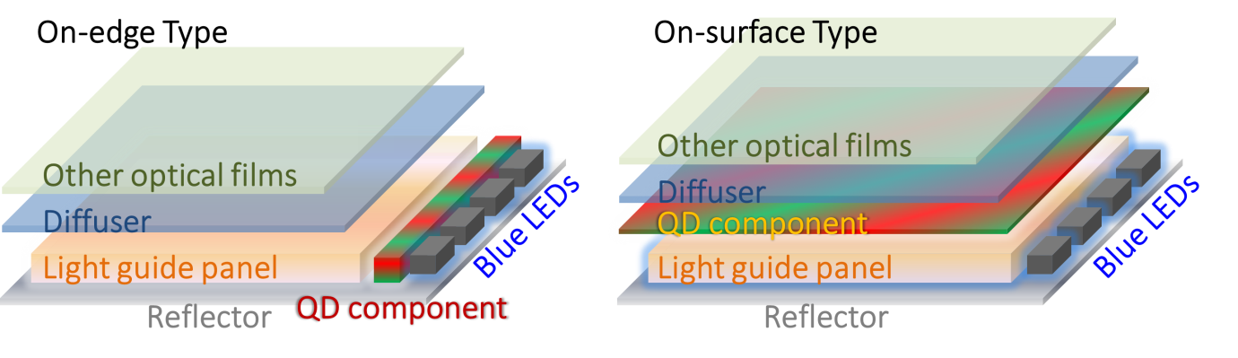
The QD-based BLU that had been released until now took the form of an optical component by putting red and green QDs in a transparent, thin tube, stick, or film and used resin to fixate the QD substance. Once this is put in front of a blue LED, it can make white light through color conversion by using all three colors.
Such QD optical components can be categorized into on-chip type, on-edge type, and on-surface type according to where the component is placed within the BLU structure. In the on-chip type, QDs are placed on top of the blue LED chip in the packaging stage, and as a result the LED device emits white light. However, the on-chip type is vulnerable to high heat, so it has yet to be commercialized.
As for the on-edge type, the QD component is placed in between the light guide panel and the LED light source on the edge to convey the white light made by the blue LED and QDs to the front part through the light guide panel, and the on-surface type is placing QDs on top of the light guide panel to transform the blue light into white light while passing through the QD film. Recently, a number of firms are preparing to commercialize the on-edge type.
QD application to BLU
Source: IHS
© 2015 IHS

Slide 28
1.6. On-edge type (Tube)
The on-edge type involves putting red and green QDs into a transparent tube or stick to fixate it with resin, then placing the tube between the blue LED and light guide plate of the BLU to create white light. It is thin and small, so the addition of a QD optical module barely change the entire size and thickness of medium- to large-sized displays, such as TVs. Also, this technology can be easily applied in the existing designing and production process. However, for mobile devices smaller than 10 inches, such as smartphones or tablet PCs where the bezel thickness and the overall size of the gadget is important, even the smallest increase of a couple of millimeters may make a huge difference, so this type has yet to be applied to them.
When compared with the on-chip type, where the QDs are packaged in the LED, the on-edge type consumes more materials. However, this type does not need to get the LED heat directly, and since the light flux that QDs receive is much lower, there is less degradation from heat and light. Compared to the on-surface type, the on-edge type consumes less QDs, thus relieving the burden on cost when producing in large volumes. Therefore, this type can be more widely applied on large panels of over 40 inches. Since the isotropic light coming out from the QD component may hinder the light emission in the direction of the LED and create losses, it is essential to use this light emission through optical designing reduce the loss in brightness.
1.7. On-surface type (Film)
The on-surface type refers to a film coated with red and green QDs. This is then placed on top of the light guide panel in the BLU, and then the blue light spread across the surface from the light guide panel is absorbed by the QD film, mixing with red and green light to create white light. Since the on-surface type QD component is a thin film, it can be applied on small LCD panels without altering the size or thickness and without any changes to the overall structure of the device, and it can be applied in the existing production process. However, this type may consume a lot of materials as it requires QDs to be applied uniformly across the entire film, and needs a film in the same size as the display. In addition, it is required to develop a barrier film that covers the QDs.
Compared to the on-chip and on-edge types, the component is placed the farthest away from the light source under this type. Therefore, the heat and light flux put on the QDs is the lowest, making this type the best choice in terms of stability. In addition, there is little loss in light, and since the component also takes the role of a diffusor, there is no need for additional film, such as the prism sheet. Given that a large amount QDs need to be uniformly spread across a wide area of film, the cost will be the key to whether to apply it to large-size display panels.

Slide 29
1.8. Development status and issues of QD-applied LCD BLU
Application of QD technology on LCD BLU enhances the color gamut of the existing LCDs to allow a more natural and lively expression of color. In addition, the bluish-green colors that were previously difficult to realize with CCFL and LED can now be expressed much naturally with QD technology. At the same time, the technology can provide set makers an opportunity to push ahead with marketing strategies of highlighting the innovative feature of the product. There are three methods of applying QDs to the BLU. The on-chip type is expected to be commercialized after its vulnerability to high heat is solved. However, it is the most cost-efficient method as it is applied with the same process as the one for LED application to the BLU. As for the on-edge type, it was the first method to be actually applied to the products including TVs. However, its current problems include uneven distribution of QDs, its vulnerability to high heat, and weak durability of the tube. The on-surface type is the most popular method among the set makers, such as Samsung Electronics. Although it still has some problems including the establishment of the SCM and enhancement of the reliability, products using the on-surface type will be launched in near future.
There are several issues that must be addressed when using QDs as phosphors. The most important is securing the photostability of QDs. When used as phosphors, most QDs are sealed in resin or film, so it is protected against the exposure to air, but when continuously emitting high power light, such as UV rays and blue light sources, the luminous efficacy of QDs will inevitably fall. Especially if the rate in which the efficacy falls differs when using two or more colors of QDs for displays, the color coordinates of the display may go awry. The QD stability released by the developers is around 30,000–50,000 hours depending on conditions, and the developers are raising the photostability of QDs through the development of synthesis and surface modification technologies. Another issue is the development of the ligand and resin to seal QDs. To uniformly spread QDs on the resin, the surface of the QDs needs to be modified. Given that the luminous efficiency may decline depending on the type of ligand or method of modification, it is important to develop the related technology. Moreover, the resin may damage the QDs in the curing process by light or heat, or due to the solvent. Apart from the above, researches are under way to increase the emitting efficiency of QDs and to develop cadmium-free QDs. Considering that there are some commercial TV products using QDs as phosphors, it is presumed that the major issues related to QDs have been resolved smoothly.

Slide 30
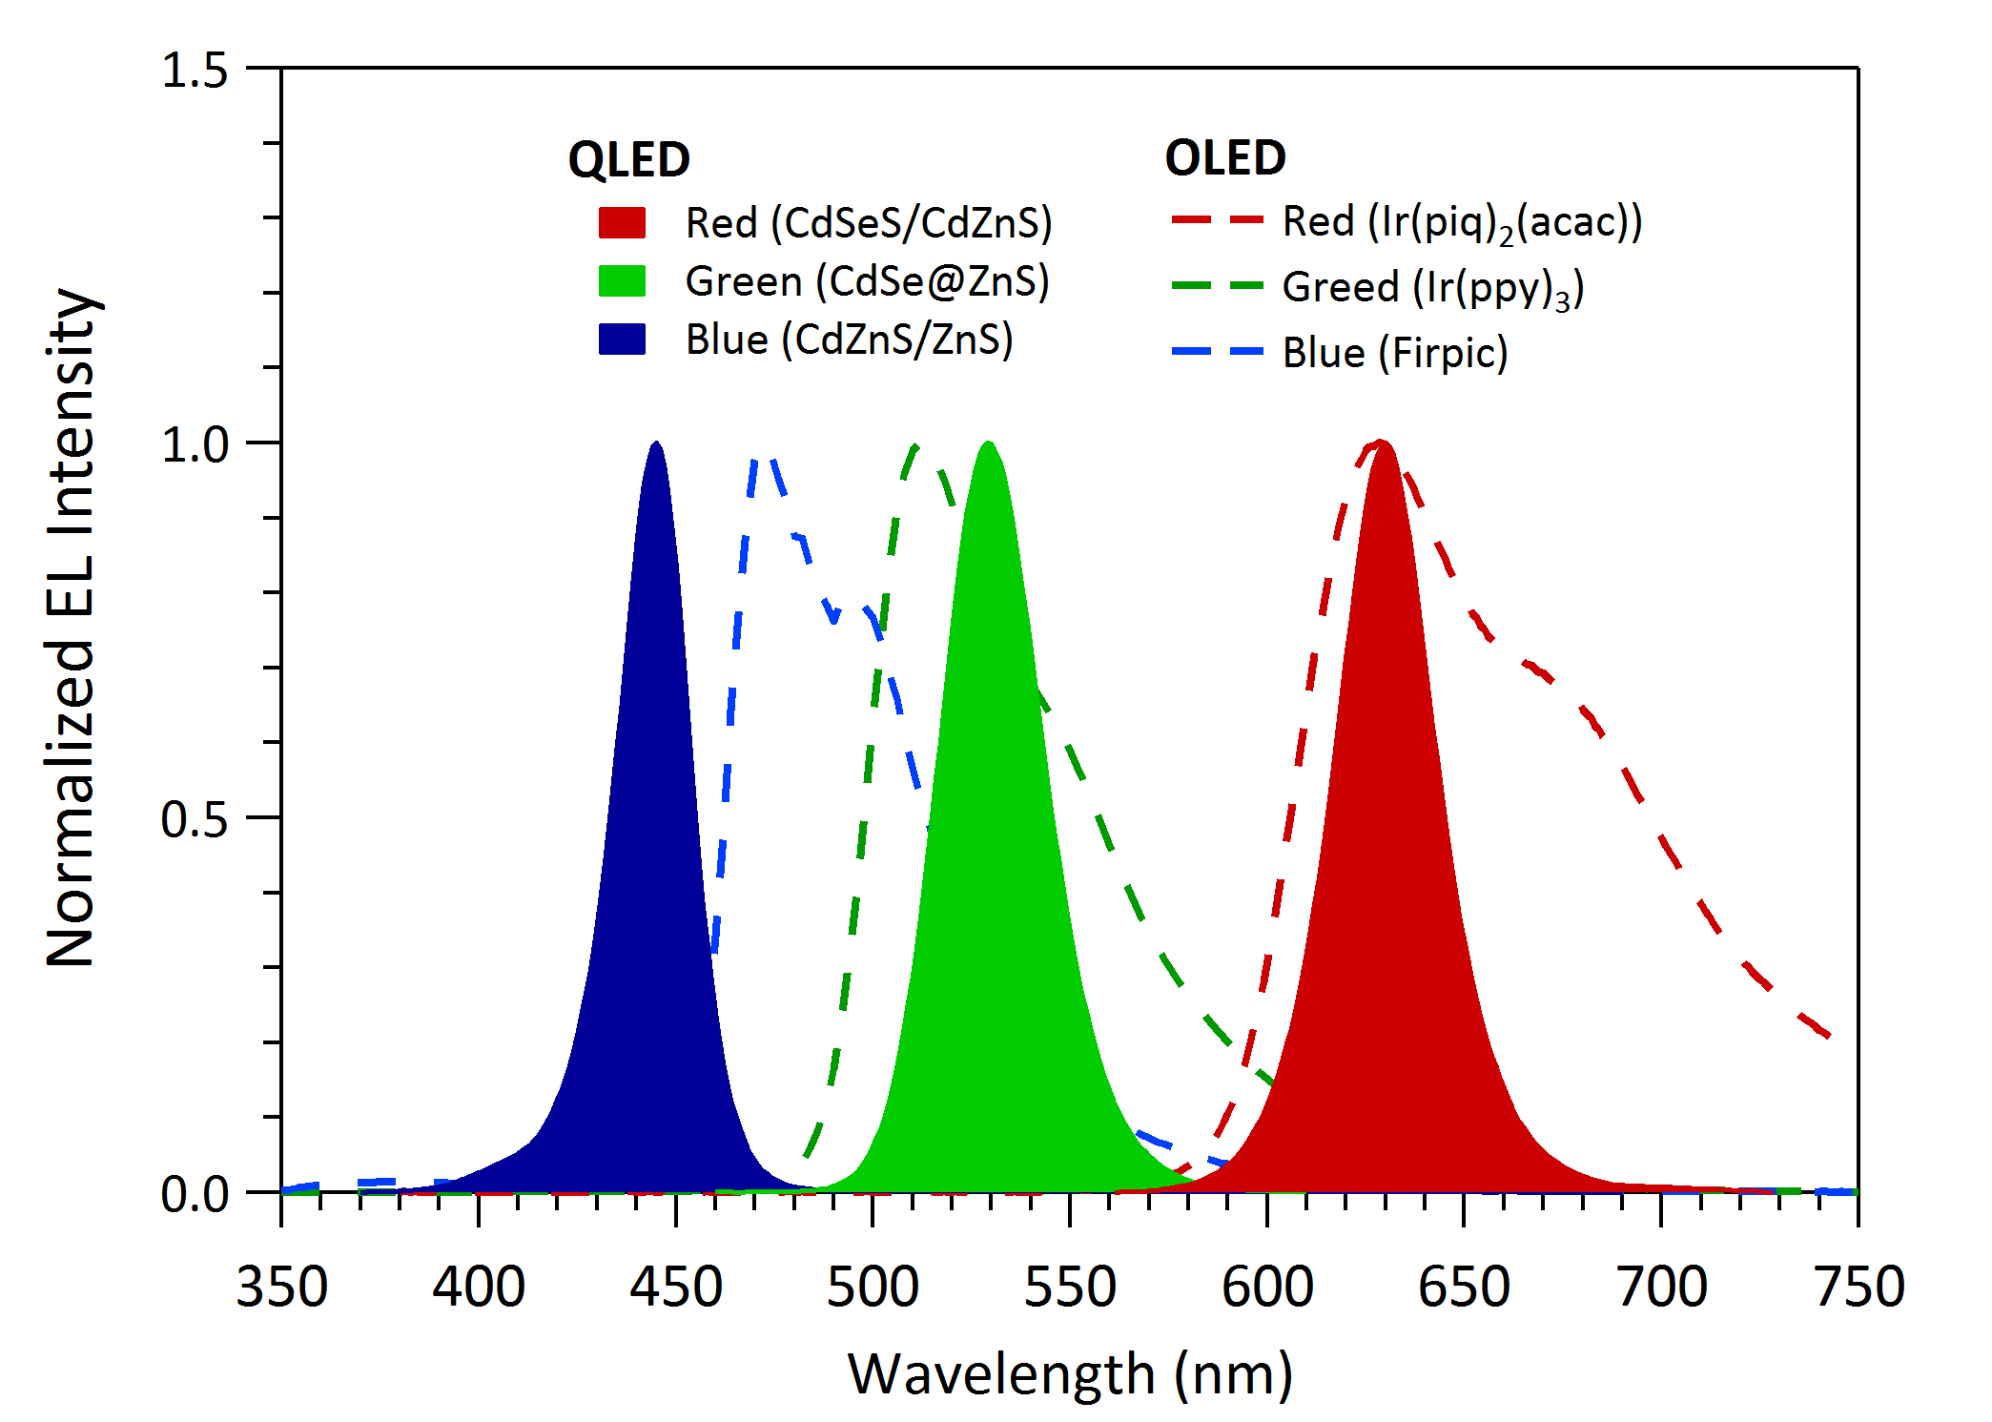
1.9. QLED technology (versus OLED)
QLED or QD-LED refers to QDLED, a technology that excites electroluminescence in QDs by injecting electrons and holes, similar to the OLED technology. It was developed based on the existing OLED technology. So its structure, manufacturing process, and operating mechanism are quite similar to those of OLED. In addition, QLED has a thin film structure and has most of OLED’s strengths, so it can be applied in flexible or transparent displays.
The biggest difference between QLED and OLED is found in their optical properties. The emission spectrum of QLED shows a very narrow line width. General organic lighting-emitting materials have slightly wide FWHM of 40–60 nm. The wider the FWHM is, the lower its color purity is. Because of this, OLED display sometimes uses more complex optical resonance structure for red, green, and blue, each, to show more vivid colors. On the other hand, the FWHM of QDs is very narrow at 20–30 nm, about half that of the organic materials as shown in the picture below. Therefore, QLED can show deeper and more vivid colors than OLED without additionally using a complex optical structure. It can also show a wider color gamut than when applied in full-color displays.
Comparison of EL spectrum of QLED and OLED
QLED
OLED
Red (Ir(piq)₂(acac)) Green (Ir(ppy)₃) Blue (Firpic)
Red (cdSeS/cdZns) Green (CdSe@ZnS) Blue (CdZnS/zNs)
Normalized EL intensity
Source: IHS
Wavelength (nm)
© 2015 IHS

Slide 31
Another advantageous property of QLED compared to OLED is that it can adjust the light-emitting color depending on the core size of QDs, which is quantum size effects. In case of OLED, a new organic compound needs to be developed to control emission spectrum’s peak location. If a new substance is applied, it will affect the entire structure of the device. On the other hand, in case of QDs, spectrum’s peak location can be controlled flexibly in the synthesis process without a large change in chemical composition of QDs. Even if the wavelength is adjusted, the device’s structure doesn’t need to change.
In particular, for the blue color, QLED can express much darker blue color than OLED. For phosphorescent substance that transits heavy metal used in OLED from triplet state to ground state and emits light, internal quantum efficiency reaches nearly 100%, but there is a limit to expressing dark blue color. Because of this, fluorescent substance, which can express dark blue color, is still mostly used in OLED panel manufacturing despite its relatively low efficiency. In addition, resonance structure or color filters are used to increase color purity and reduce spectrum’s FWHM. On the other hand, QDs can express darker blue color than OLED without using resonance structure or having a separate optical design.
The wavelength domain that QLED can express via synthesis of QDs isn’t limited to the visible light domain, but can expand to the infrared light domain. This is why QLED is superior to OLED, also. Infrared light-emitting diode is mainly used in telecommunications or sensor sectors. But recently, most devices from mobile applications to large-sized ones require for touch sensor-embedded displays. Infrared light can be used to make touch screen panels. Infrared light-receiving elements can also be made with QDs, so integration of displays, and infrared light emitting and receiving elements will become feasible by using QDs.

Slide 32
QDs only use solution processes, which makes patterning difficult. But solution process method has a better potential than vacuum evaporation method in terms of cost or scaling up. Research and development on manufacturing OLED using solution process is actively underway as well, so if technologies advance, solution process-based QD patterning can also be an advantage. Major features of QLED and OLED are stated in the table below .
Comparison of major properties of QLED and OLED
Feature | QLED | OLED
Efficiency | Low – Mid | High
Emission bandwidth (color saturation) | Narrow (FWHM <30 nm) | Broad (FWHM ~ 40-80 nm)
Color tunability | Excellent (By QD size & composition) | Low (Different emitter molecule)
Manufacturing process | Solution-based | Vacuum deposition / Solution-based
Large area display | Yes | Yes
Transparent & flexible display | Yes | Yes
Cost of emitter | Low | High
Color range | 420 – 1500 nm (Visible to Near IR) | 450 – 650 nm (Visible)
Source: IHS |  | © 2015 IHS

Slide 33
1.10. Driving principle and device structure of QLED
Research and development on QLED have been underway to change OLED’s emission layers to QDs. As a result, its device structures or research and development processes are largely similar to the initial development of OLED.
Driving principle of QLED devices is also similar to that of OLED. As shown below, the mechanism in which QD emits light includes optical excitation, charge injection, energy transfer, and ionization. Optical excitation method is a way to form excitons by absorbing photons that have energies greater than QDs’ optical band gap. This is a principle used in color changing devices, such as QD-packaged LED and QD film. Charge injection and energy transfer are main light-emitting mechanism of QLED. Excitons are formed at QDs by injecting electrons or transferring energy depending on device structures. If the energy levels of QD and peripheral electron/hole transport layers are aligned well, electrons and holes will be injected directly to the QD, and excitons can be formed efficiently at QD. If injection of charge is difficult, excitons will be formed at peripheral layers, which have bigger band gap than QD, and emit light from QD by transferring energy to QD.
Lastly, ionization is a principle in which energy level of a QD layer under the electric field is arranged in layers, moving electrons of valence band to another QD’s conduction band to form excitons. It is a principle that is mainly used for QD light-emitting diode that uses part of QLED’s structure and alternating current. Of this, the principle that emits light most efficiently is the formation of excitons at QD by directly injecting electrons and holes. It uses the electron/hole transport layer and the electron/hold injection layer near QD for efficient transportation and injection of electrons and holes.
Device structure of QLED has developed similar to OLED, but in case of cadmium-based QDs, used much in QLED, it is not easy to inject holes from organic HTL to QDs as its valence band’s energy level (-6 – -7 eV) is at a much deeper place than the organic matter’s highest occupied molecular orbital (HOMO) energy level (-5 – -6 eV). Accordingly, various device structures have been developed to enhance the injection of holes and as a result, efficiency of a device also increased significantly.

Slide 34
Device structures are largely divided into a normal structure that uses a substrate’s indium tin oxide (ITO) as anode, and an inverted structure that uses ITO as cathode. Normal structure is a device structure that is formed in the order of ITO, HIL/HTL, QD layer, ETL/EIL, and then cathode. This structure is the same as the general OLED structure. Through researches of OLED, electrons and holes can be balanced and the device’s overall efficiency can improve. Moreover, it is a structure that was formed after going through sufficient research and development in thickness and materials. But during the process of layering solution-based QDs above HTL, HTL can be damaged by QD solvent, so researches on the process to prevent this should be conducted at the same time.
The inverted structure is a device structure that was first reported by a research team in Seoul National University in 2012. It is a structure formed in the order of ITO, EIL/ETL, QDs, HTL/HIL, and then anode. This structure mostly uses inorganic substances (metallic oxide) as EIL/ETL, so it has an advantage of EIL/ETL substance not being damaged when laminating QDs. In addition, it can form HTL above QDs using the vacuum deposition method, so it can make more efficient device by choosing HTL substance, which has deeper and more various HOMO energy levels. Latest QLED researches have been largely on the inverted structure.
Device structure and energy level of QLED
Normal structure
Inverted structure
Cathode
-
Anode
ETL/EIL
HIL/HTL
Cathode
ETL/EIL
HIL/THL
ITO
ETL/EIL
-
HIL/HTL
+
HIL/HTL
ITO
Anode
ITO (Anode)
ITO (Cathode)
ETL/EIL
+
Source: IHS
© 2015 IHS

Slide 35
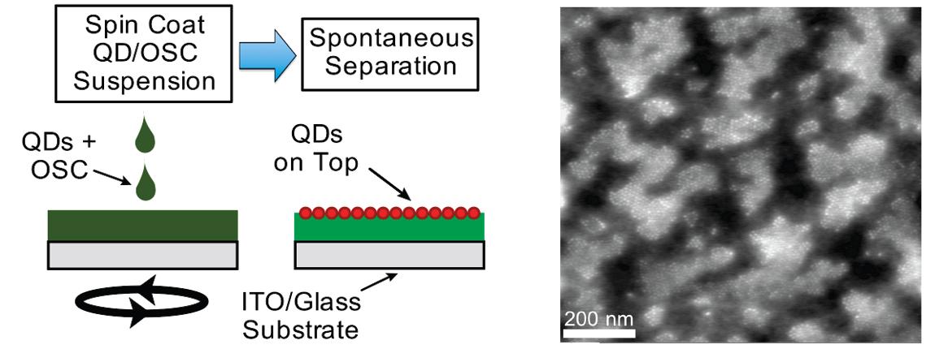

1.11. Manufacturing of QLED
As mentioned earlier, the basic structure of QLED is similar to that of OLED. Moreover, except for QD’s emission layer, electron/hole transport layer mostly use organic or inorganic nanoparticles, so its manufacturing process isn’t much different from that of OLED. In other words, formation of solution-based colloidal QD layer in between organic/inorganic transport layers is the key to QLED manufacturing process. Methods as mentioned below are introduced or being used.
First, the most basic and widely used method is spin coating. Spin coating allows the formation of uniform thin film in even relatively large area. But if QD solution is spin coated, the lower layer of QDs, which exist in a substrate, are highly likely damaged by physical force stemming from spin coating. To manufacture QLED with higher efficiency, functional organic layers, such as charge injection layer and charge transport layer, are essential, but too many of them can cause damages during the process of coating QD layers. To solve this problem, methods, such as phase separation, use of cross-linkable polymers, and use of inorganic substance, have been introduced. Phase separation, or self-assembly, method is a way of spin coating after mixing QDs and organic substance, placed below QDs, with one solvent. It is a principle of separating QDs and organic substance to be located in different layers, using the difference in properties of inorganic substance (QDs) and organic substance. But this method has limits in adjusting phase separation directions and degrees between QDs and organic substance. The quality of the thin film is not good either.
Phase separation method and AFM image of the formed QD thin film
Spin coat QD/OSC
suspension
Spintaneous
separation
QDs + OSC
QDs on top
ITO/glass
substrate
Source: IHS
© 2015 IHS

Slide 36
Cross-linkable polymers cure the layer placed below QDs, using heat or light to make the QD layer not damaged when going through spin coating. It can form multilayer thin films easily, but the types of substance to choose from are not wide and it isn’t easy to synthesize the substance that has properties needed for the device.
Atoms of oxide affiliated inorganic (ZnO, NiO) thin films formed by sputtering or the sol-gel method are linked by covalent bonds, so there is little damage occurring during the QD coating process that follows. But in case of inorganic thin films, excitons created at QDs are prone to quenching because of charge density. And efficiency of the device’s electroluminescence falls because of large leakage current. Recently, the inverted structure has been introduced and a method, in which oxide nanoparticles, not largely affected by additional processes, are formed first and then spin coat the QD layer above it, is mainly used.
As patterning can’t be conducted using the spin coating method, it is more widely used to unit elements. The paper released in Nano Letters in 2010 (Nano Lett. 10, 2368 (2010)) has introduced a concept, in which QD surface is substituted with molecules that have positive and negative charges; QDs are laminated in a layer-by-layer method; and then patterning is done using this. But this is not a highly efficient device structure.
Besides spin coating, a study was undertaken for a QD patterning process to apply the process to displays. Contact printing method is the representative method for this. Contact printing forms QD layer patterned by coating QDs on a patterned stamp and print it on a target substrate. It can also be done by coating QDs on a surface-processed Si wafer; printing it with a stamp; and transporting it to a target substrate. This kind of QD patterning technology has been reported by MIT and Samsung Electronics. Using this method, Samsung Electronics formed red, green, and blue QD layers to manufacture full-color AM-QLED.
Aside from this, there have been studies on the fabrication of patterned QD layer using ink jet printing or spraying. But these methods require more research and developments because of difficulties related to coffee ring effect, low uniformity of thin film, density of solution as well as adjustment of thickness. Therefore, for unit element QLED, spin coating is considered as the most effective process to be applied, while contact printing is considered as the one for displays.

Slide 37
1.12. QLED development status and outlook
In the last five years, QLED’s performance has rapidly developed. Maximum external quantum efficiency (EQE) has reached 18%, and maximum brightness exceeded 200,000 cd/m², while 4-inch quarter video graphic array (QVGA) resolution full-color AM-QLED has been demonstrated. In the early days, the performance of QLED in the bilayer structure was quite low. It is not until 2002 when the research group of the Massachusetts Institute of Technology (MIT) has reported its study on QLED using phase separation and when the studies on QLED have kicked into high gear. As mentioned earlier, phase separation is a method to overcome limitation the process has. But from the aspect of device structure and performance, it wasn’t efficient that phase separation of QDs and organic molecules could not be completed and luminescence has been observed in the peripheral layers. After that, more efficient device structures began to be developed as the lamination of QD became feasible using cross-linkable polymers. Various QLED device structures have been developed based on the OLED device structures much researched and developed previously. Their disadvantage is that injection of holes is not smooth because of the energy levels of QD’s deep valence band. In particular, when the band gap used large blue color QDs, hole injection efficiency gets very low, so device performance becomes low and dark blue QLED cannot be developed at all.
By using inorganic nanoparticles, these problems were solved. A research team led by Professor P. Holloway at the University of Florida dramatically enhanced the injection of charge into QDs, using ZnO nanoparticles with high charge density as an ETL. Also, using ZnO made red, green, and blue QLED all operate well at the same device structure, showing properties of high efficiency, low driving voltage, and high color purity. In 2012, a Seoul National University research team has advanced this structure one step further and developed the inverted QLED structure that uses ITO as cathode. Device performance has further improved as ZnO nanoparticles don’t have a problem in efficiently injecting electrons from ITO and can choose from various organic HTL that has deep energy levels to make injection of holes into QDs easier. In particular, it showed the best performance at that time, in terms of efficiency and brightness. For green QLED, it recorded the highest brightness of greater than 200,000 cd/m², showing a performance similar to that of phosphorescent OLED. Moreover, very dark blue device in the area of 430 nm operated with low voltage in the same structure, proving it is a device structure suitable for QLED.

Slide 38
As a result of the development of such device structure and characteristics enhancement in QD materials, QD Vision recently developed a device with the world’s top EQE of 18% in red QLED, while NanoPhotonica has developed a device that shows 10% or more EQE for all of red, green and blue QLED. From the aspect of device performance, there has been a substantial development, coveting to reach commercial OLED levels. Now, the remaining issues in QLED development are patterning and lifespan.
RGB pixel patterning should be conducted first to apply QDs to displays. But it is not easy to form thin and uniform film pattern of 10-20 nm using colloidal QDs based on solution process. A research team from MIT has reported contact printing method, while one at Arizona State University has conducted QD patterning using ink jet printing. In particular, Samsung Electronics has reported full-color AM-QLED, using transfer printing method. Samsung patterned red, green, and blue QDs under this method using polydimethylsiloxane (PDMS). But in order for this method to be applied in the manufacturing of commercial QLED, yield rates, large-area application, and damages in the organic layer below QD need to be considered. Also, the development of peripheral layer substance that enables QD patterning process has to take place at the same time.
Along with this, there should be many studies on driving safety and lifespan of electroluminescence devices that use QDs as active layers. Schools and research institutes are reporting hundreds of hours, while companies are reporting thousands of hours for lifespan of devices. But this is an experiment result mostly from device levels. The lifespan of panels manufactured in mass production should be considered differently. In particular, in order to guarantee stable driving of thousands to tens of thousands of hours, research and developments on QLED should continue for applications in displays and lighting.
Among display device technologies, QLED is regarded as the next generation technology that can follow the suit of OLED, based on its outstanding optical properties, such as reliability in adjusting wavelengths and narrow line width, as well as solution-based process and the compatibility with existing technologies. QLED continues to develop, with QD Vision and NanoPhotonica, the two largest research and development companies in QLED, renewing record high efficiencies each year in their respective device structure and Samsung Electronics introducing full-color AM-QLED. But as mentioned earlier, related problems also need to be solved.
When compared to the OLED technologies already commercialized in the market, the technological gap with QLED seems to be 5 to 10 years. In other words, commercial displays or lighting devices using full-color QLED technologies could enter the market after at least 5 to 10 years. Until then, technologies using QDs as phosphor are likely to prevail.

Slide 39
2. LED/CF solution
2.1. Characteristics of wide color gamut LEDs
White light can be obtained by combining three wavelengths of red, green, and blue, or two wavelengths of green (or blue-green) and orange. The RGB combination, in which the three colors individually emit the light, causes less fatigue for the eyes and delivers more vivid colors compared to the white light created by the two wavelengths. However, due to high prices, complicated structure, and low yields, most use a combination of blue GaN- or InGaN-LED chips with yttrium aluminium garnet (YAG) phosphors, which emit light over a wide wavelength range with full-width and half-maximum (FWHM) of 100 nm, creating a white spectrum that widely covers the RGB wavelengths.
As for the normal LED used in a backlight unit (BLU) for LCD panels, green and red colors create a spectrum with a slightly wide FWHM, lowering the color purity and color gamut. However, as the diagram below shows, many LED solutions that combine light sources and phosphors are being developed and applied on products.
However, LED solutions are deemed inferior to OLED or QD solutions in terms of color gamut, so research and development are still being conducted by LED package companies.
LED solutions for wide color gamut
Normal
Wide color gamut solutions for LED PKG
YAG phosphor
R,G,B chip
Blue chip
-G/R phosphor
Blue/green chip
-R phosphor
Blue/red chip
-G phosphor
Blue chip-
R phosphor
+ green chip
Blue Chip
NTSC 70%
100%
90~98%
85~95%
92~100%
90~100%
Source: IHS
© 2015 IHS

Slide 40
Phosphors used on LED packages can be categorized into nitride type and sulfide type. The former has better chemical stability compared to the latter, while the latter is superior to the former in terms of color gamut.
Comparison of nitride type and sulfide type
Code | SP-G1 | SP-R1 | SP-R3 (630 nm) | SP-R3 (650 nm)
Material | Sulfide | Sulfide | Nitride | Nitride
Peak wavelength (nm) | 539 | 653 | 626 | 647
Full width at half maximum (FWHM, nm) | 47 | 64 | 90 | 112
Chromaticity coordinate (X,Y) | (0.293,0.679) | (0.697,0.299) | (0.633,0.365) | (0.657,0.342)
Source: IHS |  |  |  | © 2015 IHS
LED solutions for wise color gamut
Chip | Phosphor | Lm% | NTSC | Reliability | Cost
Blue | Y560 | 100% | 75% | Normal | Cheap
 | Yn540 Rn630 | 95% | 78% | Good | Normal
 | Gn540 Rn650 | 85% | 84% | Good | Expensive
Blue + Red | Gn535 | 102% | 94% | Normal | Very expensive
 | Gn530 | 82% | 100% | Normal | Very expensive
 | Gn530 Rn650 | 76% | 98% | Normal | Very expensive
Source: IHS |  |  |  |  | © 2015 IHS

Slide 41
2.2. KSF phosphor
KSF (K₂SiF₆:Mn⁴+) has ben researched and developed for a long time. The KSF phosphor is known for its narrow FWHM, enabling to raise color gamut rates.
The KSF phosphor developed by General Electric Co. (GE) has superior specifications of 3–4 nm FWHM under 613, 631, 636, and 648 nm wavelengths, each. GE owns original patents related to KSF phosphor production and LED package production using the KSF. Many LED packaging companies are in patent cooperation with GE to produce KSF phosphors and LED packages.
Currently, the major companies supplying the KSF include GE, Mitsubishi Chemical Corp. (MCC), and Denki Kagaku Kogyo KK (Denka).
The KSF phosphor has a FWHM of 7 nm or below, which translates to high color purity. The KSF phosphor shows uniform characteristics regardless of its size, enabling to achieve uniform color gamut during manufacturing of packages.
In addition, other phosphors that are commonly used fall under rare earth elements, so there is always a fluctuation in materials supply and prices. Meanwhile, the KSF is categorized as a non-rare earth element, so the supply and demand is relatively stable.
Samsung Electronics Co. and LG Innotek Co., which are the biggest suppliers of LED packages for the BLU, are most eager to develop and mass produce LED packages using the KSF.
Phosphors used on displays feature a short decay time of 5 ms or below. However, the KSF has a decay time of 8 ms or higher, giving rising to afterglows in displays that use high-output LED and alternating current (AC).
Also, when manufacturing the KSF, a pollutant called fluorine is produced, limiting the production in average production facilities.

Slide 42
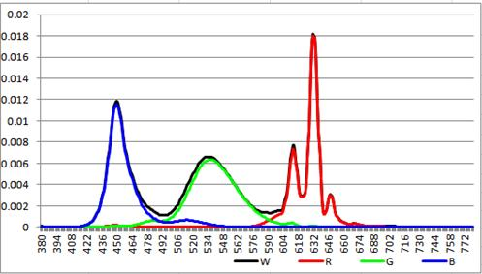
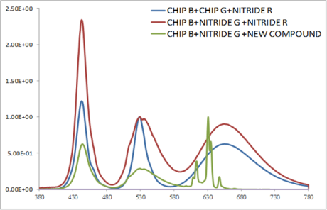
Patents list of KSF
 | Patent No. | Details
GE | 10-2013-7027761 | PKG application of K2SiF6 and others
MCC | 10-2010-7016473 | Process of manufacturing (simply) and PKG application (mostly)
Shinetsu | 10-2012-0035879 | Process of manufacturing (K2SiF6 and K2TiF6)
Source: IHS |  | © 2015 IHS
Property of KSF
Red Mn⁴⁺ phosphor
Green oxynitride
© 2015 IHS
Source: IHS

Slide 43


2.3. Color filter tuning
The color filter solution adjusts the thickness of the color filter to prevent some wavelengths from penetrating each color filter, improving color gamut.
For such reasons, LCD panel makers and LED solution providers are cooperating to achieve maximum color gamut, for example, by finding an optimal thickness of the color filter when some phosphors are used in an LED package.
Color filter solutions for wide color gamut
LED/CF solutions
 | LED PKG Structure | NTSC
Unity | Blue and green chip + red remote phosphor
AUO | Blue chip + QD phosphor Blue chip + red and green phosphor | 100%
Innolux (AOT) | Blue chip + red and green phosphor New color filter, color gamut | 100%
Samsung | New color filter, color gamut Blue and green chip + red phosphor
LGIT | B&R chip + green phosphor | 90%
SSC | UV + RGB phosphor | 98~105%
Everlight | B&R chip + green phosphor | 90%
Source: IHS |  | © 2015 IHS
Normal C/F
Thick C/F
Light from panels
Light from backlights
© 2015 IHS
Source: IHS

Slide 44
3. OLED solution
3.1. OLED technology and characteristics
OLED, which is regarded as one of the core technologies in the display sector, is a light-emitting diode that uses an organic compound semiconductor. Electrons and holes injected from cathode and anode form an exciton in the emission layer to emit lights of various colors such as red, green and blue depending on the pigments of emission layers. They consist of about 100 nm-thick multilayers of organic films. Each layer is subdivided into electron/hole injection layers (EIL/HIL), electron/hole transport layers (ETL/HTL), an emission layer (EML), and a buffer layer.
Thanks to its self-emitting property, it has an excellent contrast ratio of 1,000,000:1, a nearly 100% color gamut rate based on the NTSC 1953, and a quick response speed of 0.001 ms. It has a viewing angle of 180 degrees and can implement flexible or transparent displays.
Currently, AMOLED is manufactured based on vacuum evaporation. Vacuum evaporation involves heating organic materials in a high vacuum state of 10⁻⁷ torr or below and then sublimating it. This method enables forming a uniform film and minimizing inflow of impurities. To form multilayers of film, the substrate moves around chambers that deposit each organic material and form organic film of several to tens of nanometers. At that point, patterning takes place through fine metal masks (FMM) to classify display pixels and to connect back plane circuits. In particular, emission layers are comprised of different emission layers of red, green, and blue, so they must go through the FMM process. After that, they go through processes including electrode formation and encapsulation.
OLED is categorized into RGB OLED, which is applied to small- and medium-sized displays mass produced by Samsung Display, and white OLED, which is used to large-sized displays mass produced by LG Display. Two solutions offer a wide color gamut of more than 100% of NTCS.

Slide 45
RGB OLED light-emitting structure
The picture below shows a RGB OLED structure, in which red, green, and blue subpixels, each, individually emit light, and the three subpixels’ organic light-emitting materials, each, are deposited in different thickness to adjust the light-emitting efficiency. In addition, instead of the fluorescent materials used on AMOLED panels for mobile applications, phosphorescent materials with higher light emitting efficiency are expected to be used, but as of now, phosphorescent materials are only applied on red and green colors
White OLED light-emitting structure
Unlike the RGB OLED solution, this method creates white light source by combining OLED subpixels, and then transmitting the white light through a color filter to change the color. LG Display Co. applies this solution on its active-matrix organic light-emitting diode (AMOLED) TV panels. The white OLED light-emitting solution creates a three-tandem structure with the blue color in the top and bottom layers and yellow-green color in the middle layer.
RGB OLED light-emitting structure
White OLED light-emitting structure
RGB individual light-emitting structure
White OLED light-emitting structure
Color Filter
Cathode
EIL
ETL 3
Fl. Blue 2
HTL 4
p CGL 2
n CGL 2
ETL 2
Ph. YG
HTL 3
p CGL 1
n CGL 1
ETL 1
Fl. Blue 1
HTL 2
HTL 1
HIL
Cathode
EIL
Light
n- doped ETL
Light
BLUE
Fl.
GREEN
Ph. RED
OLED
CF
G’ HTL
R’ HTL
HTL
Light
HIL
WOLED
Anode
© 2015 IHS
© 2015 IHS
Source: IHS
Source: IHS

Slide 46
3.2. Color gamut of the OLED solution
Color filters and brightness are important in achieving the wide color gamut of LCD and white OLED displays. Since the color density and transmittance of the color filter are inversely proportional to each other, there is a limit in increasing the color gamut. As for the RGB OLED, red, green, and blue subpixels emit light independently without the color filter, the color gamut is determined by the color density of emitting materials. Also, each organic light-emitting material can offer color gamut of more than 100% of NTSC.
In AMOLED panels, some devices do not emit light to express black. In LCD, however, the light emitted from BLU is blocked by two polarizers, enabling black to be expressed. As for AMOLEDs, light-emitting efficiency of organic materials is not linear, so even when a current of nearly 0 uA passes through the devices, they have an output of 0.003 nit. Meanwhile, in LCD panels, the polarizers are not able to completely block the light from BLU, causing the light of 0.05 nit to leak from the light source.
Comparison of color gamut by panel
Present | Color gamut (sRGB standard)
By gray scale (%) | @10 | @50 | @100
LCD | 20% | 70% | 90%
White OLED | 98% | 101% | 105%
RGB OLED | 99% | 110% | 120%
Source: IHS |  |  | © 2015 IHS

Slide 47

Light source brightness is the brightness of devices that emit light before passing through the inner structure of a display panel, including a backplane. A higher brightness causes a greater power consumption.
Light source brightness is different depending on the transmittance and aperture ratio of the panel, when seen from outside the panel, so the light source brightness seen from the outside is called outward brightness.
Color filter solutions for wide color gamut
< LCD light source brightness and outward brightness>
< AMOLED light source brightness and outward brightness >
Light
source
brightness
Outward
brightness
Light
Source
brightness
Outward
brightness
Back
light
unit
Emitting
material
layer
Backplane
Color
filter
(White OLED)
Backplane
Liquid
crystal
Color
filter
Polarizer
Horizontal
polarizer
Vertical
polarizer
© 2015 IHS
Source: IHS
Comparison of light source brightness by panel technology, considering transmittance and aperture ratio
 | Transmittance | Aperture ratio | Brightness (unit)
 |  |  | Outward | Light source
LCD | 14% | 36% | 500 | 9920
White OLED | 46% | 58% | 400 | 1,503
RGB OLED | 60% | 52% | 400 | 1,288
Source: IHS |  |  |  | © 2015 IHS

Slide 48
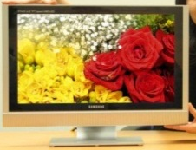
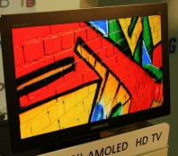
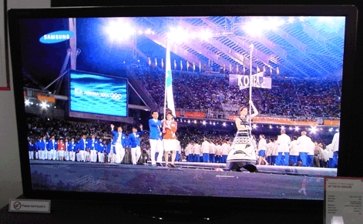
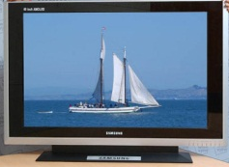
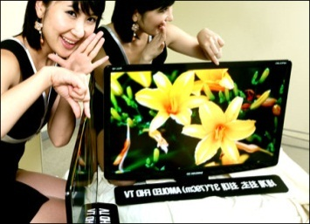
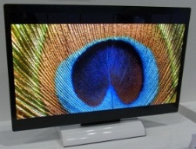
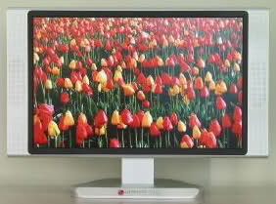
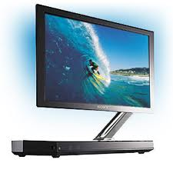
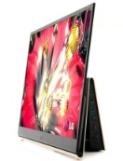
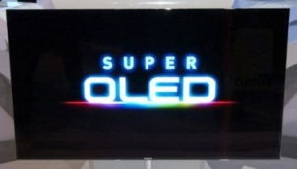
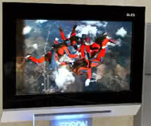
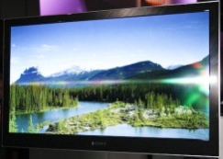
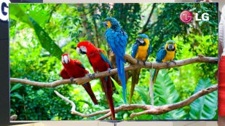
History of large-sized OLED panels (announced from 2004 to 2012)
SEC 21”
1920x1080
a-Si TFT
SDI 14”
1280x720
RGB FMM
LTPS TFT
SDI 40”
1920x1080
RGB FMM
LTPS TFT
SEC 40”
1280x800
RGB FMM
a-Si TFT
SDI 31”
1920x1080
RGB FMM
LTPS TFT
AUO 32”
1920x1080
WOLED+C/F
Oxide TFT
2004
2005
2006
2007
2008
2009
2010
2011
2012
LPL 20.1”
1280x800
LTPS TFT
Launched
Launched
Sony 11”
960x540
RGB+C/F
LTPS TFT
LGD 15”
1366x768
WOLED+C/F
LTPS TFT
SEC 55”
1920x1080
RGB SMS
LTPS TFT
Epson 40”
1280x768
inkjet RGB
a-Si TFT
Sony 27.3”
1920x1080
RGB+C/F
LTPS TFT
LGD 55”
1920x1080
WOLED+C/F
Oxide TFT
Source: IHS
© 2015 IHS

Slide 49
4. Other wide color gamut solution
4.1. Color gamut enhanced film
According to information gathered by IHS, Samsung Electronics employs a special filtering film technology designed to enhance color gamut in the low-cost JS7200 series of SUHD TV, which were released in June 2015, instead of QD Enhancement Film (QDEF) Technology. The film, so-called color gamut enhanced film, is known to block light with a certain wavelength range. The film is known to be made by coating special compound on the surface of a PET film.
SKC Haas Display Films Co. supplies the film to Samsung Electronics, and it offers the film at low prices compared to a general QD film. SKC Haas is believed to have developed the solution by tweaking its existing optical film technology that was applied to a plasma display panel (PDP) to block ultraviolet and infrared rays.
Thanks to such a low-cost solution, Samsung Electronics will be able to not only expand its SUHD TV lineup, but will also cut overall production costs by not using the high-cost QD film.
Color gamut enhanced film
White LED
2015 first half
2015 second half
White LED
QD film
CGEF
JS 9000 series
Color gamut enhanced film
(Supplier : SKC Haas)
SUHD TV line up
JS 7200 series
JS 8000 series
© 2015 IHS
Source: IHS

Slide 50
IV. Wide color gamut display cost analysis

Slide 51
1. Method of production cost analysis
The production cost analysis for wide color gamut display is based on the “Large Area Display Cost Model,” and “DisplaySearch Quarterly LED and CCFL Backlight Cost Model,” released by IHS, to determine the production costs of BLU and panels.
The current products applying QD solutions are mainly TVs, so the production cost analysis for other applications was based on the prices of QD components applied in TVs. As for QD solutions applied on TVs, the cadmium-free type QD film and cadmium-type QD tube are most widely used. The cadmium-free QD film is generally used by Samsung Electronics, while the cadmium type QD tube is widely applied by Chinese TV set makers. The cadmium-free QD film is supplied to Samsung Electronics under a strategic cooperation with the film suppliers. The exclusive supply chain of Samsung Electronics enabled the company to be more stably supplied with QD films at lower prices compared to other panel makers.
Therefore, the cost of the cadmium-free type QD film was applied only for the analysis of TV production cost. The cost of the commonly-used cadmium type QD film was used to analyze the production cost of QD film applied on monitors, notebook PCs, and tablet PCs.
In the products applying QD solutions, QD films and QD tubes are additionally used aside from normal BLU components, which is the main cause of the increase in production cost. Meanwhile, as for the LED that is used as a light source in QD TVs, blue LEDs without phosphors are applied instead of white LED, reducing the production cost of LED packages, but nevertheless the reduction is insignificant compared to the increase in cost caused by QD solutions.
Among LED/CF solutions, the KSF phosphor-based technology is most commonly used for wide color gamut displays. The supply cost of the LED package using the KSF phosphor is known to be 20–30% higher than that of the average LED package.
In the production cost analysis, many variables, such as depreciation, labor cost, and materials cost, were considered along with the elements mentioned above.

Slide 52
2. 55-inch TV_3840x2160
In 2015, the 55-inch cadmium-free type QD film is supplied at $53.10. The production cost of BLU using the film is 54% higher than that of the normal TV BLU. In addition, when producing panels using the cadmium-free type QD film, there is a 17.9% increase in production cost compared to when manufacturing panels applying the normal TV BLU.
LCD panels adopting QD solutions have the same color gamut with OLED panels, while the price of the former is much lower than the latter. Therefore, TVs employing QD solutions are expected to target the high-end TV market.
The production cost of wide color gamut displays using the LED/CF solution is a mere 2% higher than that of normal displays. However, due to significantly lower color gamut rates compared to QD and OLED solutions, the LED/CF solution is not suitable for high-end TV segments.
TV BLU and panel cost analysis by wide color gamut solutions in 2015_55 inches (3840x2160)
 |  | Normal | QD film (Cd free) | QD tube (Cd) | LED/CF | AMOLED
Wide color gamut | NTSC | 75% | 100% | 100% | 90% | 100%
BLU | Light source | $31.12 | $30.11 | $30.11 | $36.72
 | Optical films (QD solutions) | $38.89 | $92.03 | $56.45 | $38.89
 | Others | $39.31 | $44.46 | $40.94 | $39.86
 | Total sales cost | $109.32 | $166.60 | $127.50 | $115.47
 | WCG BLU/Normal BLU cost ratio | 100% | 152.4% | 116.6% | 105.6%
Panel manufacturing cost |  | $369.78 | $435.86 | $392.28 | $377.41 | $1,542.14
 | WCG panel/Normal panel cost ratio | 100% | 117.9% | 106.1% | 102.1% | 417.0%
Source: IHS |  |  |  |  |  | © 2015 IHS

Slide 53
2.1. TV WCG BLU/Panel cost forecast
In 2015, the BLU using QD films is 54% higher in production cost than the normal BLU, but with the improvement of manufacturing technologies and the increase in the supply volumes of QD films, prices continue to fall. As a result, the gap is expected to decrease to 36% in 2020.

Slide 54
In line with the increase in demand for QD solutions, the supply price is also forecast to fall, resulting in a decrease in production cost for QD panels.

Slide 55
3. 27-inch monitor_1920x1080
In the monitor market that is experiencing fierce price competition, as products employing the LED solution are usually produced at lower prices than ones using other wide color gamut solutions, the wide color gamut monitors adopting the LED solution are leading the market
When QD solutions are applied, the production cost of BLUs and panels significantly increases, so QD solutions will most likely be applied on high-end monitors.
The production cost of the monitors using QD tubes is only 11.5% higher compared to that of normal monitors, so the QD tube-based solution has a relative advantage in being applied to monitors over other ones.
Monitor BLU and panel cost analysis by wide color gamut solutions in 2015_27 inch (1920x1080)
 |  | Normal | QD film (Cd) | QD tube (Cd) | LED/CF
Wide color gamut | NTSC | 75% | 100% | 100% | 90%
BLU | Light source | $1.4 | $1.5 | $1.5 | $2.0
 | Optical films(QD solutions) | $5.9 | $34.1 | $14.1 | $5.9
 | Others | $5.8 | $8.6 | $6.6 | $5.9
 | Total sale cost | $13.0 | $44.2 | $22.2 | $13.7
 | WCG BLU/Normal BLU cost ratio | 100% | 339.4% | 170.6% | 105.3%
Manufacturing panel cost |  | $88.9 | $123.5 | $99.1 | $89.7
 | WCG panel/Normal panel cost ratio | 100% | 138.9% | 111.5% | 100.9%
Source: IHS |  |  |  |  | © 2015 IHS

Slide 56
3.1. Monitor WCG BLU/Panel cost forecast

Slide 57
4. 15.6-inch notebook PC_1920x1080
Notebook PC-use BLUs using QD film are about 114% higher in production cost compared to normal notebook PC-use BLUs. Notebook PC-use panels applying QD film are about 43% higher in production cost than normal panels used in notebook PCs.
The production cost of notebook PC-use BLUs employing QD films is more than double that of normal BLUs in the early stages. However, due to a bigger drop in the supply prices of BLUs with QD film than normal BLUs, the production cost of QD applied-BLUs will be 68% higher than that of normal BLUs in 2020.
In addition, the production cost of panels using QD films will also continue to fall, so it will be 18% higher than the production cost of normal panels in 2020.
Notebook PC BLU and panel cost analysis by wide color gamut solutions in 2015_15.6 inch (1920x1080)
 |  | Normal | QD film (Cd) | QD tube (Cd) | LED/CF
Wide color gamut | NTSC | 45% | 70% | 70% | 60%
BLU | Light source | $4.7 | $4.8 | $4.8 | $5.6
 | Optical films(QD solutions) | $6.1 | $20.6 | $10.8 | $6.1
 | Others | $3.4 | $4.9 | $3.9 | $3.5
 | Total sales cost | $14.1 | $30.3 | $19.6 | $15.2
 | WCG BLU/Normal BLU cost ratio | 100% | 214.4% | 138.4% | 107.6%
Manufacturing panel cost |  | $76.9 | $110.4 | $85.9 | $78.1
 | WCG panel/Normal panel cost ratio | 100% | 143.6% | 111.7% | 101.6%
Source: IHS |  |  |  |  | © 2015 IHS

Slide 58
4.1. Notebook PC_WCG BLU/Panel cost forecast

Slide 59
5. 7-inch tablet PCs_1920x1080
The cadmium-type QD film applied on 7-inch tablet PCs are estimated to be priced at $4.50, with the cost of the QD film causing the increase in production cost of BLUs.
The production cost of tablet PC-use panels applying the LED solution is 1.8% higher than that of normal panels.
Amid the supply price competition among wide color gamut solution providers, the production cost of tablet PCs applying wide color gamut display is expected to continue to fall.
Tablet PC BLU and panel cost analysis by wide color gamut solutions in 2015_7 inch (1920x1080)
 |  | Normal | QD film (Cd) | QD tube (Cd) | LED/CF
Wide color gamut | NTSC | 75% | 100% | 100% | 90%
BLU | Light source | $4.4 | $4.5 | $3.9 | $4.7
 | Optical films(QD solutions) | $1.4 | $5.9 | $3.4 | $1.4
 | Others | $1.1 | $1.5 | $1.2 | $1.1
 | Total sales cost | $6.8 | $11.9 | $8.6 | $7.2
 | WCG BLU/Normal BLU cost ratio | 100% | 175.4% | 126.6% | 105.6%
Manufacturing panel cost |  | $24.0 | $28.0 | $26.0 | $24.4
 | WCG panel/Normal panel cost ratio | 100% | 116.4% | 108.4% | 101.8%
Source: IHS |  |  |  |  | © 2015 IHS

Slide 60
5.1. Tablet PC WCG BLU/Panel cost forecast

Slide 61
6. 5.5-inch smartphone_1920x1080
Applying QD films or tubes on smartphones results in increased thickness and energy consumption, which goes against the growing demand for slimmer and lower energy-consuming smartphones.
In addition, the OLED display, which is the wide color gamut display most commonly used in the smartphone market, has good production competitiveness. The production cost of 5.5-inch (1920x1080) models is in the low $30 range, so the film- or tube-based QD solutions lose competitiveness in the smartphone segment.
The QD-chip types under development will most likely be the best solution for smartphones.
Smartphone BLU and panel cost analysis by wide color gamut solutions in 2015_5.5 inch (1920x1080)
 |  | Normal | QD film (Cd) | QD tube (Cd) | LED/CF
Wide color gamut | NTSC | 75% | 100% | 100% | 90%
BLU | Light source | $2.0 | $2.0 | $2.0 | $2.3
 | Optical films(QD solutions) | $1.4 | $5.3 | $3.1 | $1.4
 | Others | $0.9 | $1.3 | $1.1 | $0.9
 | Total sales cost | $4.2 | $8.6 | $6.2 | $4.6
 | WCG BLU/Normal BLU cost ratio | 100.0% | 202.2% | 145.5% | 107.6%
Manufacturing panel cost |  | $31.5 | $36.1 | $33.7 | $31.9
 | WCG panel/Normal panel cost ratio | 100% | 114.5% | 106.9% | 101.2%
Source: IHS |  |  |  |  | © 2015 IHS

Slide 62
6.1. Smartphone WCG BLU/Panel cost forecast

Slide 63
V. Supply chain analysis

Slide 64
1. QD solution
1.1. Overall
One of the key parts of the QD display is a QD film, which is made up of QD materials and a barrier film. QD material suppliers are divided into companies with manufacturing technology and QD materials producers. Likewise, key components for barrier film include the sputter equipment for manufacturing and manufacturing technology. There are also companies who do manufacturing only and procure QD materials and barrier films from outside. Blue LED uses different technology but still can be supported by existing suppliers.
Expected SCM based on the above information is as follows. All the potential candidates was listed.
Overall of QD industry status
LED
QD Material (technology)
QD Material
(Mass production)
Sputter Equipment
Barrier Film
QD Film
Samsung Electronics
LG Innotek
Lumens
Lextar
Nichia
Toyoda Gosei
Seoul Semiconductor
Everlight
Lite-on
GIO
…
QD Vision
Nanosys
Samsung Advanced Institute of Technology
Nanoco Technologies
LG Advanced Research Institute
Ocean NanoTech
Nanosquare
QD Solution
Evident Technologies
NN-Labs
Quantum Materials Corporation
Life Technologies
NanoAxis
Bayer Material Science
QD Vision
Nanosys
Dow Chemical
Hansol Chemical
Sigma-Aldrich
LG Electronics
Ocean NanoTech
Quantum Materials Corporation
…
Applied Materials
HIRANO
ULVAC
AVACO
…
3M
i-components
Toray
Konica Minolta
DNP
Toppan
Mitsubishi
Fuji Film
…
3M
MNtech
LMS
LG Electronics
…
© 2015 IHS
Source: IHS

Slide 65
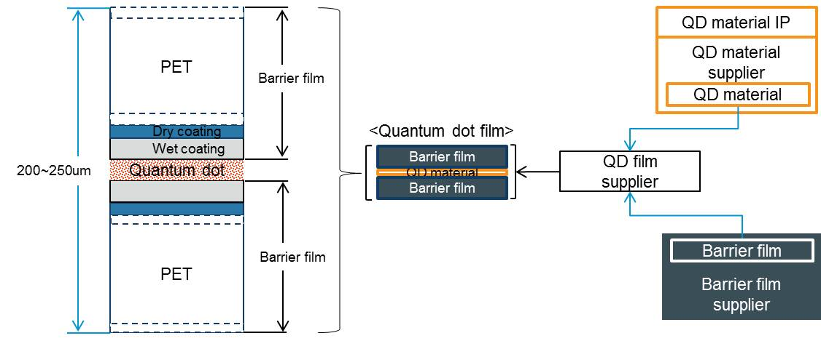
1.2. QD film structure
The QD film is covered by two sheets of barrier films, and these barrier films block moisture and air from penetrating into the film to protect QD materials.
To make QD films, red and green QD materials are coated onto a barrier film, and then another barrier film is placed on it.
QD film structure and barrier film supply chain
© 2015 IHS
Source: IHS

Slide 66
1.3. QD film production cost analysis_55 inches
The production cost analysis of the QD film was based on the average cost of cadmium-free type QD film in 2015, and the manufacturing cost of the QD film was calculated based on the coating and lamination yields of 96%.
The cost of barrier films and QD materials makes up 93.5% of the production cost of the QD film, so reduction in the production cost of the two elements is essential to lower the production costs of the QD film.
In particular, the barrier films are only supplied by a handful of companies, so the market is in need of newcomers and alternative technologies.
QD materials and components providers are also eager to come up with new QD films involving no barrier films, low-cost barrier films by improving manufacturing processes, and other ways of lowering production cost.
Cost analysis of 55-inch QD film for TV
 | Cost | Materials & components | Price
QD material | $19.5 | 39.2% | 36.7%
Barrier film (2 sheet) | $27.0 | 54.3% | 50.8%
Coating and lamination | $2.0 | 4.0% | 3.8%
Others | $1.2 | 2.4% | 2.3%
Material and component cost | $49.7 | 100.0% | 93.5%
Yielded manufacturing total cost | $51.8 |  | 97.4%
Margin | $1.4 |  | 2.6%
Supply price | $53.2 |  | 100.0%
Source: IHS |  |  | © 2015 IHS

Slide 67
1.4. Characteristics of QD solution supply chain in the TV market
Currently, QD film supply methods in the TV market are largely categorized into two: QD materials and barrier films are provided to QD film makers, and then manufactured as the QD film by them to supply it to TV set makers; and only QD materials are delivered to QD film suppliers with the skills to produce barrier films, and then manufactured as the QD film for supply to TV set makers.
Samsung Electronics and LG Electronics opt for the first method, while Hisense Electric Co. uses the second one. Samsung Electronics, however, has maintained a long-term strategic cooperation with QD film suppliers, working on technology development, thereby having a competitive edge in QD film production.
The third method is a business model of QD Vision Inc., which supplies QD tubes.
Quantum
TV set assembly
QD film supplier
QD film
supplier
Barrier film
supplier
QD tube
Material
supplier
Barrier film
supplier
Material
supplier
Material
supplier
Material IP
Material IP
Material IP
1
2
3
Surface type(sheet)
Edge type(tube)
© 2015 IHS
Source: IHS

Slide 68
1.5. Samsung Electronics
The Samsung Advanced Institute of Technology (SAIT) has been developing mass production technologies for QD materials over the past six years, and production is going on at Hansol Chemical Co. with the cadmium-free method. The QD materials production facilities of Hansol Chemical is located in Jeonju, capital of North Jeolla Province, in South Korea.
The barrier film is exclusively supplied by i-components Co., because it is the only company that can mass produce the barrier film with good performance at reasonable costs. This company is presumed to have bought sputter equipment from Applied Materials Inc. in the second quarter of 2012, and is maintaining its supply volumes by borrowing equipment from other companies when they cannot supply efficient volume and meet demand only with its own equipment.
Toray Industries Inc. also has sputter equipment that can be used for mass production, and since it has technologies and experiences in wet coating, Toray is deemed as a company that may become the first new entrant in the market. It also has the option of borrowing sputter equipment, such as a unit of AMAT and two units of ULVAC from Hansung Industry Co., which were previously used for producing Indium tin oxide (ITO) film.
The QD film is being supplied by Mntech Co., the major supplier for TV-use film to Samsung Electronics.
Samsung Electronics QD supply chain analysis
QD Material
IP
QD Material
supplier
TV Set
SAIT
Hansol Chemical
QD film
supplier
Samsung Electronics
<Cd free>
Barrier film
supplier
MN tech
i-components
LED package
supplier
Samsung Electronics
© 2015 IHS
Source: IHS

Slide 69
1.6. LG Electronics
LG Electronics released its QD TVs applying the QD film at the 2015 Consumer Electronics Show (CES). It showcased two models of 55 inches and 66 inches. Along with QD dot film-based models, LG Electronics is also releasing TVs using the LED solution to improve color gamut.
LG Electronics gets QD films from its Chemical & Electronic Material (CEM) division that manufactures QD film by using QD materials and barrier films supplied by Dow Chemical Co. and i-components, respectively.
An integrated task force team composed of LG Electronics, LG Chem Ltd., and LG Display Co. was formed to conduct R&D for QD supply chain management (SCM), but the team is not as aggressive as Samsung Electronics.
LG Chem and the CEM division at LG Electronics are known to be developing barrier films. Mass production is expected to be done through the sputter equipment of LG Chem, and when there is an increase in volumes to be supplied, the sputter equipment that was operated by LG Hausys Co. may also be used.
LG Electronics QD supply chain analysis
QD Material
IP
QD Material
supplier
TV set
Nanoco
Dow Chemical
LG Electronics
<Cd free>
QD film
supplier
Barrier film
supplier
LG CEM business
i-components
LED package
supplier
LG Innoteck
© 2015 IHS
Source: IHS

Slide 70
1.7. Chinese TV brands
TCL Corp. and Hisense have already showcased LCD TVs using QDs at worldwide display exhibitions, and their experience of applying both on-edge and on-surface types is expected to help them to build their own SCM. Moreover, since products for domestic use do not need to adopt cadmium-free QDs yet, there is a chance that QD materials of Nanosys Inc., which has partnered with 3M Co. applying Nanosys QDs to its film, as well as Color IQ technology developed by and QD Vision, may be used. However, when opting for on-surface types, it seems that companies except 3M will need some time to build their own SCM system for QD films.
Hisense showcased its QD TV using QDEF of 3M at the 2014 IFA show in Germany. Afterwards, Hisense released its 55-inch curved QD TV adopting Color IQ technology of QD Vision at the 2015 Society for Information Display (SID). Hisense is the only company that has rolled out TV models using both QD film and tube.
Analysis of Chinese TV set makers’ QD supply chain
QD Material
IP
QD Material
supplier
Barrier film
supplier
QD film
supplier
TV Set
Nanosys
3M
Hisense
QD Material
IP
QD Material
supplier
QD Tube
TCL
QD Vision
(Color IQ)
Konka
© 2015 IHS
Source: IHS

Slide 71
1.8. Monitors, notebook PCs, tablet PCs, and smartphones
These segments are all still in the fledgling stages of building their SCM compared to TVs, so they are grouped as one category.
MMD (Multimedia Displays) was the first in the world to release a monitor using Color IQ of QD Vision in June 2015. As for notebook PCs, Asus Corp. released its 4K UHD Zenbook NX500 in November 2014. This product employed the QD film of 3M. Xperia Z materials supplied from Nanosys were applied to the film.
As for the tablet PCs, the Amazon Kindle Fire HDX of 7.0 inches and 8.9 inches used QD solutions. The Kindle Fire HDX released in the second half of 2013 is no longer produced. The QD solution is expected to be applied on the Nexus 7, which is designed and developed by Google Inc. in conjunction with Asus, some products of Acer Inc., and high-end tablet PCs of Asus, but there are no concrete plans as of yet.
In the smartphone segment, the Xperia Z Ultra model of 6.4 inches, which was released by Sony Corp. in 2013, first used QDs, but the model failed to gain much popularity from consumers. The later models did not employ QDs. No other makers are developing smartphones adopting QD solutions at the moment.
As for the above-mentioned segments, the development of the LCD BLU using QD LEDs (on-chip type) is essential. The on-chip type is expected to be suitable for small- and medium-sized products in terms of price and thickness, and once the on-chip type technology is developed enough to be commercialized, all the above segments will most likely adopt BLUs employing QD solutions.

Slide 72
2. LED Solution
2.1. Samsung Electronics
Samsung Electronics use the patents owned by GE and pay licensing fees for using that patents to manufacture KSF phosphors and LED packages employing them.
Samsung Electronics is outsourcing the KSF phosphor to Daejoo Electronic Materials Co., an original equipment manufacturer (OEM).
2.2. LG Electronics
LG Innotek is provided with the KSF by Japan-based Denka, and the KSF supplied from Denka was applied on the G4 smartphones released in April 2015 by LG Electronics.
Samsung Electronics LED solution supply chain
LG Innotek LED solution supply chain
KSF materials
IP
LED package
supplier
Display panel makers
KSF materials
IP
LED package
supplier
Display panel makers
GE
Samsung Electronics
(LED Division)
Samsung Display
Sharp Display
GE
LG Innotek
(LED Division)
LG Display
KSF Material
supplier
KSF Material
supplier
Daejoo Electronic Materials
Denka
© 2015 IHS
© 2015 IHS
Source: IHS
Source: IHS

Slide 73
3.OLED Solution
3.1. Small- and medium-sized OLED display
Based on mass production, nearly more than 95% of the materials used on RGB pixel-based devices, or small- and medium-sized AMOLED panels, had been consumed by Samsung Display until 2014. Samsung Display is expected to use more than 90% of them in 2015.
Small- and medium-sized OLED materials providers
Layer | Supplier
CPL | DS Neolux, Doosan
EIL | Dow Chem, Doosan, Heesung
ETL | Dow Chem, SDI, LG Chem
Red | Dow Chem, DS Neolux, LG Chem
Red dopant | UDC
Green | UDC + NSCC, SDI, Doosan, Idemistu Kosan
Green dopant | UDC, Dow Chem
Blue | Dow Chem, Idemitsu Kosan, SFC
Blue dopant | Chisso, Idemitsu Kosan
G’ | DS Neolux
R’ | LG Chem, DS Neolux
p-dopant | Novaled, SDI
HTL | DS Neolux, Doosan, Merck, Idemitsu Kosan
Source: IHS | © 2015 IHS
RGB OLED device structure
Cathode
EIL/ETL
R
 |  | G
R'
 |  | G' |  | B
HTL
ITO
© 2015 IHS
Source: IHS

Slide 74
3.2. Large-sized OLED display
The white OLED (WOLED) device is mostly produced by LG Display for large-sized AMOLED panels.
There is a structural difference between RGB OLEDs and WOLEDs, but OLED materials providers also supply WOLED materials.
Large-sized OLED display materials providers
Layer | Supplier
CPL | LG Chem
EIL | TASCO (TAEWON SCIENTIFIC)
ETL 2 | Idemitsu Kosan, LG Chem
YGreen | Merck
YGreen dopant | UDC
HTL 4 | Merck
HTL 3 | Merck
p CGL | LG Chem, Idemitsu Kosan
n CGL dopant | Comet
n CGL | Toray
ETL 1 | Idemitsu Kosan
Blue | Idemitsu Kosan
Blue dopant | Idemitsu Kosan
HTL 2 | Merck
HTL 1 | Merck
HIL | LG Chem
Source: IHS | © 2015 IHS
White OLED device structure
Cathode
EIL
ETL 2
Ph. YG
HTL 4
HTL 3
p CGL
n CGL
ETL 1
Fl. Blue
HTL 2
HTL 1
HIL
© 2015 IHS
Source: IHS

Slide 75
VI. Wide color gamut display market forecast

Slide 76
1. Overview
Different standards are applied to wide color gamut displays according to applications and product specifications.
In the TV, monitor, tablet, and smartphone display markets, panels with 90% or higher color gamut based on the NTSC standard are generally categorized into the wide color gamut display while panels with 60% or higher the NTSC are considered the wide color gamut display in the notebook display market.
Major wide color gamut display technologies are OLED solutions, quantum dot solutions, LED solutions with improved LED, and improved color filter efficiency solutions.
Wide-color gamut display technology is adopted the most in smartphones with AMOLED panels, and the application in the AMOLED smartphone outnumbers others. However, after the release of wide-color gamut TVs embedded with the QD display in 2013 for the first time, major TV set makers have been actively introducing TVs using QD display technology starting 2015. And this has led TVs to become the main application that propels growth of the wide color gamut display market, which is expected to expand further with the adoption of wide color gamut technology in other applications including tablet PCs, monitors, and notebook PCs.
Wide color gamut market status
OLED display
WCG
(Wide Color Gamut)
LCD display - Quantum dot solutions
LED solutions/color filter
© 2015 IHS
Source: IHS

Slide 77
2. Wide color gamut market in unit
The wide color gamut display market is forecast to grow steadily at double-digit rates every year, at a compound annual growth rate (CAGR) of 20.2% from 2015 to 2020.
Demand for wide color gamut displays in volume is expected to reach 241.4 million units in 2015, taking 11.3% of total display demand. They are forecast to take 20.9% of the entire display market in 2020.
Wide color gamut display technology is expected to be applied mostly to high-end products, considering specifications that bring out color reproduction capacity.

Slide 78
3. Wide color gamut market in area
The wide color gamut display market by area is expected to grow at a rapid pace after wide color gamut technology that has been mainly applied to smartphone-use AMOLED panels started to be employed in TVs in 2015.
The wide color gamut display market in area terms is expected to expand at a CAGR of 62.1% from 2015 to 2020, which is a higher growth rate than that of the market in volume.

Slide 79
4. By wide color gamut solutions
4.1. Wide color gamut market in volume
Among wide color gamut solutions, OLED solutions absolutely outnumber others in unit terms because of the large number of OLED displays used in smartphones.
QD solution is expected to increase its market presence from 0.8% in 2015 to 6.7% in 2020, with an increase in the employment of QD technology starting from 2015 as a solution to implement wide color gamut by the TV market.

Slide 80
4.2. Wide color gamut market in area
Wide color gamut technology mainly applied to high-end TVs is expected to be mostly employed in large TVs with 50-inch or larger screes. In 2016, the share of the QD solution in the wide-color gamut market by area is expected to start to take over that of the OLED solution, with QD displays to be mainly applied to large TVs with 50-inch or bigger screens.

Slide 81
5. By applications
5.1. Wide color gamut market in volume
Among applications, the wide color gamut technology is largely taken by smartphones that employ OLED solutions, which outnumber others.

Slide 82
5.2. Wide color gamut market in area
In 2015, the TV market is forecast to make up 50% or more of the wide color gamut display market as wide color gamut display technology is mainly being applied to large TVs with 50-inch or bigger screens.
Even in the future, TVs are expected to play a crucial role in leading the wide color gamut display market.

Slide 83
6. Penetration of wide color gamut display by applications
In the market for smartphones that usually apply OLED displays, the penetration of displays with wide color gamut technology is forecast to grow steadily from 18.1% in 2015 to 25.3% in 2020.
In the TV market, which began applying QD, LED, and CF solutions, the penetration of wide color gamut displays is expected to grow rapidly, reaching 20.5% in 2020. In particular, the technology is expected to be adopted actively in the market, with its share by area reaching about 30.0% in 2020.

Slide 84
VII. Quantum dot display market forecast

Slide 85
1. Overall
The quantum dot (QD) display market in unit was forecast based on demand for QD-based LCD panels by QD solution types in different application markets.
Meanwhile, average selling prices of QD components were analyzed by types to estimate market size in value. The QD panel market in value refers to the size of the market for QD components used in QD-based LCD panels.
Quantum dot market forecast range
Quantum dot
Market
LCD display panel
(TV, monitor, notebook, tablet, smartphone)
BLU(Back Light Unit)
Volume
(Unit)
=
Edge type
+
Surface type
+
Chip type
QD price by type(US$/unit)
Value
(USD)
=
$Edge type
+
+
$Chip type
$Surface type
© 2015 IHS
Source: IHS

Slide 86
The market for QD components is forecast to reach $479.5 million in 2020 following the release of TVs applying QD technology in 2015. The market is expected to expand at a CAGR of 44.2% from 2015 to 2020.
QD display demand is projected to grow steadily with QD technology being adopted by other applications such as monitors and tablet PCs, following TV products.

Slide 87
2. By applications
QD technology demand will be robust especially in the TV market. In 2020, demand for QD displays in the TV market is expected to reach $416.3 million in value, taking more than 80% of overall QD demand.
The number of TVs with QD displays in 2015 is expected to reach about 1.4 million units. In 2020, it is forecast to exceed 24.5 million units after years of steady increase.

Slide 88
3. By type
The QD display market is expected to be dominated by surface-type QD solutions that are being applied to TVs. On average, the surface type is forecast to account for about 90% of the QD display market by type.
The market growth will be accelerated with the introduction of chip-type QD solutions that are easy to apply structurally to various applications.

Slide 89
4. Penetration forecast for QD solution by application
TV – In 2013, Sony Corp. released an edge-type QD TV, but failed to obtain notable results. And ever since, no other manufacturer has tried to apply the edge-type QD technology to TVs. In 2015, however, Samsung Electronics, a leader in the TV manufacturing industry, released a surface-type TV and has been aggressively promoting its sale ever since. Chinese TV set makers have also released QD TVs. The QD display market is expected to grow, led by the TV sector.
Monitor – Price competition is very fierce at the moment in the monitor display market, and the market is hit hard by cost increase. Nevertheless, there is a need for wide color gamut and specialized screens for graphic- and medical-use monitors. To this end, with QD technology being applied to TVs, QD displays are expected to slowly penetrate the monitor market as well mainly with high-priced models.
Tablet sector – QD technology was first applied to Amazon’s Kindle Fire HDX in the tablet PC market, but it failed to attract users. Also, with the slow growth momentum in the tablet market, QD technology will not penetrate highly the tablet market.
Notebook sector – Notebook screens have the poorest color gamut among large displays. It is generally the case that multiple monitors are used when working with color, so the applying of QD technology will come very slow in the notebook sector. Even though, there is a possibility
that the technology will be applied to some game-use notebooks with high-specifications.
Smartphone – Compared to the four sectors, a design (thickness) is considered the key factor in choosing smartphones, so applying surface-type QD technology to smartphones is not ideal. Still, challenges remain, such as QD’s vulnerability to high temperatures and unstable structure. However, once a chip-type QD technology is developed, it would be convincing to apply QD to smartphones.

Slide 90
5. TV
5.1. Overall
The QD TV display market in value (the market for QD components used in LCD TV panels) is forecast to grow every year with its value amounting to $416.3 million in 2020.

Slide 91
5.2. By type
Surface-type QD technology is expected to be the dominant type in the TV panel market with leading TV brands mass producing surface-type QD TVs. The market share of surface-type QD displays is forecast to take more than 90% every year.
TVs employing chip-type QD solutions will likely be released in 2018 for the first time when considering the speed of current technological development.

Slide 92
5.3. By size
In the early phase of growth, QD demand will be from TVs with 50-inch or larger screens as such large-sized TVs are the mainstream in the high-end TV market.
QD demand from TVs with smaller than 50-inch screens will gradually expand, with QD technology to be implemented in the small-sized TVs starting in 2016.

Slide 93
6. Monitor
6.1. Overall
For monitors, QD displays are expected to be selectively used in premium monitors for professional use. The QD monitor display market in unit is expected to grow from about 400,000 units in 2015 to 3.2 million units in 2020.

Slide 94
6.2. By type
In 2015, edge-type QD monitors are expected to take lead in early growth of the QD monitor market, and demand for surface-type QD monitor panels is expected to increase gradually.

Slide 95
7. Notebook
7.1. Overall
The QD notebook display market in value (the market for QD components applied to notebook panels) is expected to reach $4 million in 2020.

Slide 96
7.2. By type
The market for notebooks with surface-type QD display is forecast to grow to $4 million in 2020. The surface-type QD display is the only type that has been applied to notebooks.

Slide 97
8. Tablet
8.1. Overall
Because of the slow growth in the overall tablet PC market, it looks hard to expect any rapid growth in demand for tablet PCs with QD displays.
The QD tablet display market in value (the market for QD components used in tablet panels) is forecast to amount to $19.3 million in 2020.

Slide 98
8.2. By type
The market for surface-type QD displays used in tablet PCs is forecast to grow from $510,000 in 2015 to about $16 million in 2020.
Considering the speed of current technological development, chip-type QD displays are expected to be applied to tablets after 2018.

Slide 99
9. Smartphone
9.1. Overall
Smartphones with QD displays are expected to be released in 2018 for the first time, and the QD smartphone display market in value (the market for QD components for smartphone displays) is forecast to reach about $13 million in 2020.

Slide 100
9.2. By type
Smartphones with chip-type QD displays are expected to make debut in 2018.

Slide 101
10. Cadmium and cadmium-free QD display market forecast
10.1. Overview
Sale of home appliances that contain cadmium (Cd) is prohibited across Europe following the enforcement of Restriction of Hazardous Substances (RoHS) directive by the European Union.
The European Union’s RoHS directive has set a strict standard to most manufacturers of electrical and electronic goods in using materials and components that contain Cd. There is also a negative perception among consumers in using products that contain heavy metal Cd.
As previously mentioned, QD materials can be divided into Cd and Cd-free ones depending on what substances it is made of. Compared to Cd-free QD, Cd-based QD is known for its superb features, such as higher luminance efficiency and a more credible lifetime. However, inevitably, consumers have a negative perception on Cd. From the standpoint of manufacturers, they worry about their corporate image to get tainted so they feel burdened in taking Cd-based QD technology.
Reflecting such concerns, Samsung Electronics and LG Electronics, the two giant TV makers, have released Cd-free QD TVs. In particular, Samsung Electronics is focusing on expanding sales of Cd-free TVs by developing and mass producing Cd-free QD materials in strategic partnerships with Samsung Advanced Institute of Technology and Hansol Chemical Co.
The European Union once considered extending the exemption for the use of Cd QD technology until June 2018, citing concerns of QD-related manufacturers that the lifespan and efficiency of Cd-based QD materials are longer and superior to Cd-free ones and that it has been taking longer than expected to improve Cd-free QD performance. However, a bill for the extension of the exemption was rejected in a vote in June 2015, making it difficult for Cd QD products to enter the European market.
Therefore, with Cd substances that are fundamentally hazardous to human body and strict environment regulations enforced on Cd usage across the globe, Cd-free QD is forecast to dominate the QD display market.

Slide 102
10.2. Market forecast
The Cd-free QD display market is forecast to grow steadily in line with environment regulation guidelines and rising demand for environment-friendly materials by companies.

Slide 103
Report introduction
This report forecast the growth potential of the wide-color gamut display market through the analysis of wide-color gamut display technology and market trend. In particular, the report looked into the QD display market that top-tier set makers are aggressively taking initiatives. The report also examined QD manufacturing processes and possible applications. Also , it studied the QD supply chain management (SCM) to forecast the market from various areas.
Data in this report have been collected and analyzed with various methods. Base data is gathered directly from key players in the QD display supply chain. IHS also collected latest information on a regular basis from conferences and industry exhibitions; company earnings results and analysis documents; press releases; and internet searching.
The collected information was analyzed through a thorough fact-checking process, comparison with the analysis made in other reports, and both diachronic and synchronic study based on the exiting analysis data. In particular, the analysis on the past supply and demand conditions and technology comparison were based upon the forecasts on the specific sectors and periodic and topical reports released by IHS.
Market analysis method
Outlook for the wide-color gamut display market
Market forecast methodology
Wide color gamut market analysis
Wide color gamut technology analysis
Wide color gamut market forecast
By applications, By size, By Resolutions etc.
Technology and manufacturing cost analysis
Volume
Area
Value
Wide color gamut display penetration rate
By solutions, By applications, By type
Survey about supply price
by wide color gamut solutions
Supply chain
Source: IHS
© 2015 IHS

Slide 104
Definitions:
WCG: Wide color gamut
MBE: Molecular beam epitaxy
MOCVD: Metal organic chemical vapor deposition
CIE: Commission internationale de l'éclairage
ICP: Inductively coupled plasma
LCD: Liquid crystal display
OLED: Organic light emitting diodes
BLU: Backlight unit
EL: Electroluminescence
PL: Photoluminescence
AC: Alternating current
MRI: Magnetic resonance imaging
SPECT: Single photon emission computed tomography
PET: Positron emission tomography
CT: Computed tomography
MEG: Multiple exciton generation
CRI: Color rendering index
CCT: Correlated color temperature
YAG: Yttrium aluminum garnet
FET: Field-effect transistor
IR: Infrared ray
UV: Ultraviolet ray
FWHM: Full width at high maximum
LGP: Light guide panel
CCFL: Cold cathode fluorescent lamp
SCM: Supply chain management
EIL: Electron injection layer
HIL: Hole injection layer
ETL: Electron transport layer
HTL: Hole transport layer
FMM: Fine metal mask
HOMO :Highest occupied molecular orbital
ITO: Indium tin oxide
EQE: External quantum efficiency
UHD: Ultra high definition

