Slide 1
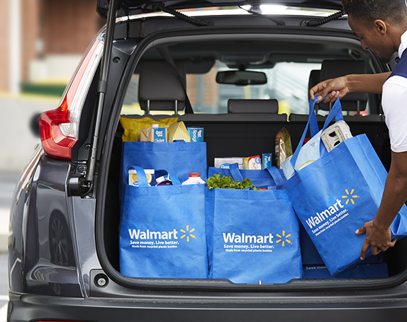
Inflation
Price Changes 2019-2020

Slide 2




Team Members
Jessica Mendoza
Gary Grisham
Maria Smith
Kristin Usry

Slide 3
Inflation
What does that word mean to your average consumer? How does inflation apply to my trip to Walmart? Were prices different between 2019 and 2020? If my paycheck remained the same from 2019 would I be doing better or worse? What can I afford in 2020?
Salaries, after inflation, are predicted to grow 2.1% globally next year, according to the new Korn Ferry 2020 Salary Forecast. That’s above the 1.0% growth that was projected for 2019. But the increase in wealth isn’t from companies being more generous, it’s because the rate of inflation is declining around much of the world.

Slide 4
Data
Our dataset is a set of data we found on Kaggle.com.
It represents prices for products found in Walmart USA for 2019 and 2020.
We chose Walmart data to represent purchasing choices found for your typical US shopper.
These prices are for on-line products.

Slide 5
Project Flow
Backend
Front End
Data ➔
Database ➔
HTML
CSS
JavaScript
D3
CanvasJS(JQuery)
Plotly
Bootstrap
Source Files CSV
Pandas – used to clean and populate DB
SQLAlchemy
SQL – PGAdmin
Python – used Flask and SQLAlchemy

Slide 6
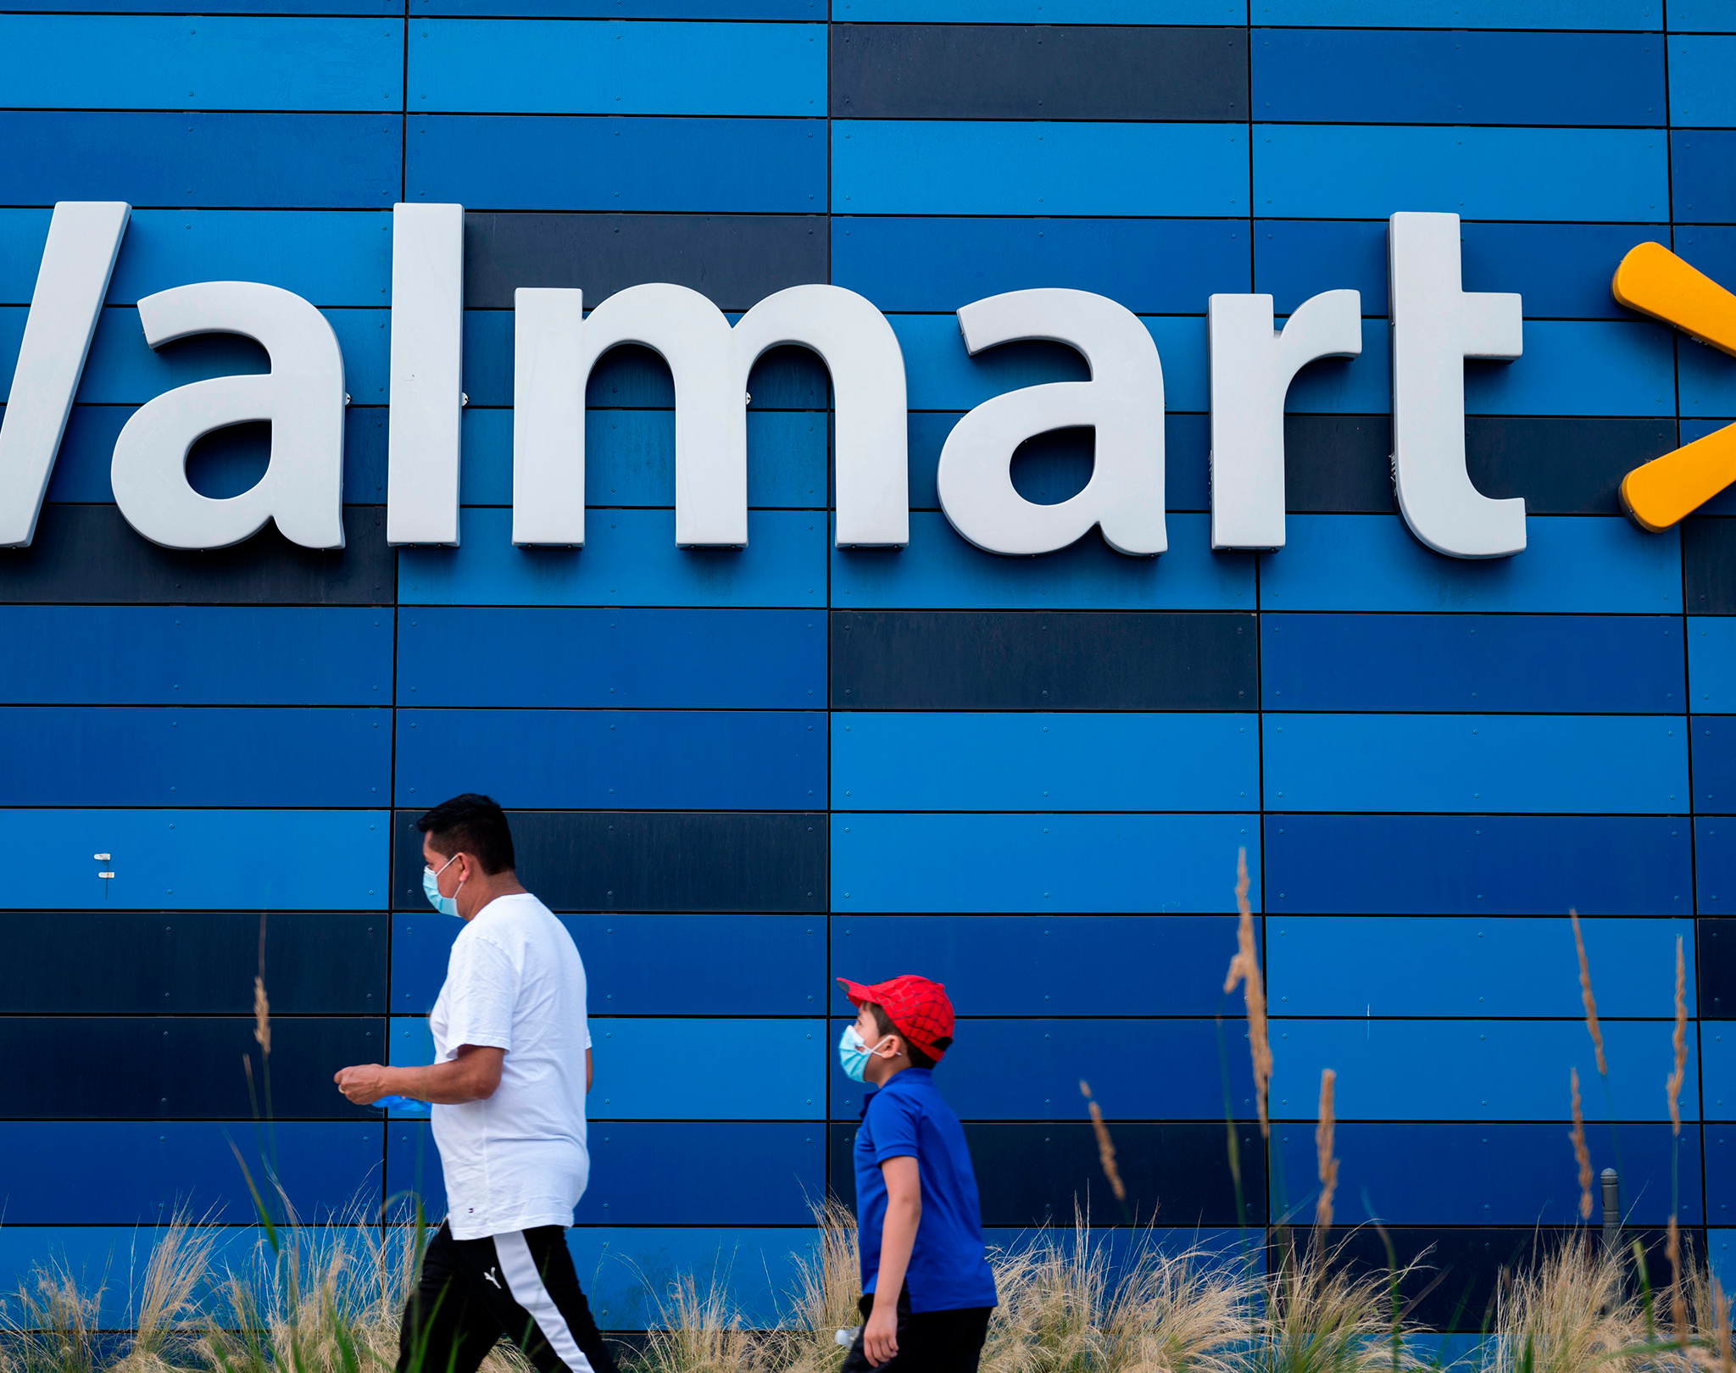
Parting Thoughts
Our purpose for this dashboard was to allow your average consumer the experience of jumping back and forth in time by examining price changes for products they can relate to and easily understand.
This dataset shows marginal changes in price for only a few products from season to season. The majority of prices remained steady .
It was difficult to see a case for inflation with 62% of the data showing no change and 19% of the data showing a relatively equal decrease to increase.
Next Steps
We were not able to find a dataset for prices comparing pre COVID prices with current COVID prices.
By comparing these two datasets and a third post COVID dataset you might be able to show price changes influenced by the pandemic.

Slide 7
Appendix

Slide 8
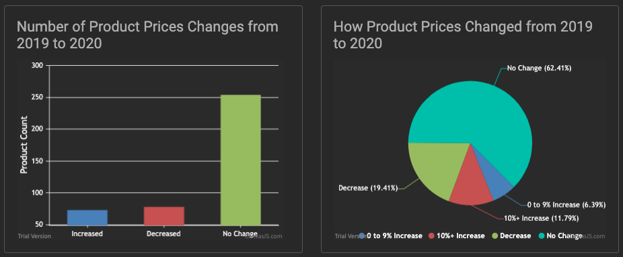
Web Features
CanvasJS Charts
We chose CanvasJS as our new library.
CanvasJS is usually chosen for its ability to run across multiple platforms without compromising your maintainability or functionality.
In these two charts we are comparing all product price changes in our data set between 2019 and 2020 showing count of product in the bar chart and then percent of change in the pie chart.

Slide 9
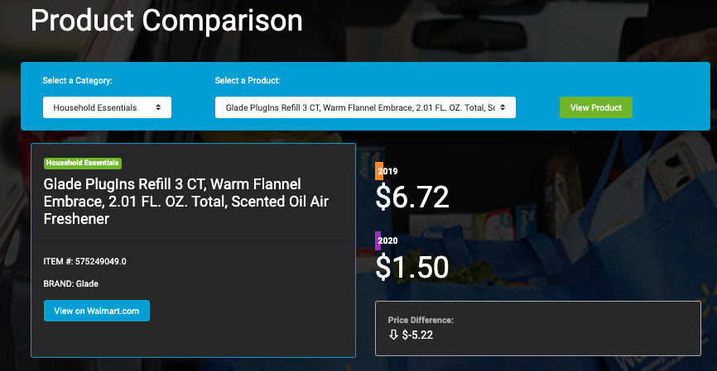
Web Features
Product Comparison
D3, JavaScript, and CSS were chosen for our product price comparison for their ability to adapt to different devices and for their ability to provide user interaction.
This chart allows the user to select a product by category and by product to allow for a price comparison.
Not only is the user able to see price comparisons between products for 2019 and 2020, but they are also able to see what brand it is and to find the product real time on line to see if the price has changed further.

Slide 10
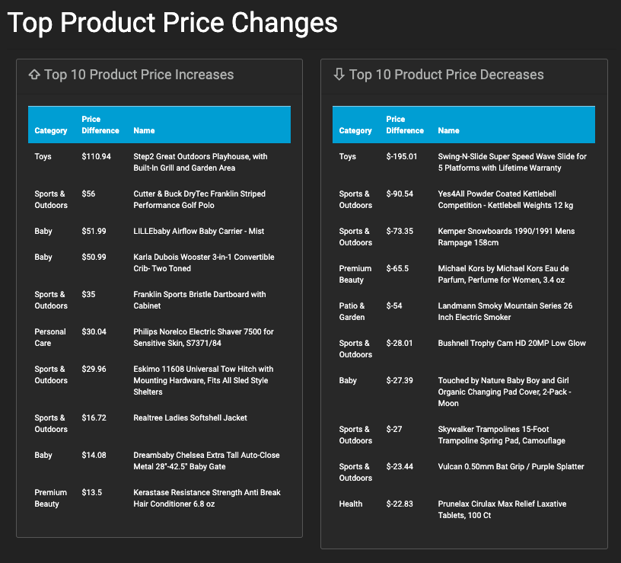
Web Features
Top Product Changes
Bootstrap tables are used to format your data to a grid using rows and columns. It allows you to improve the look of an HTML table.
In this table we are showing the top price changes for products – there increase and there decrease.

Slide 11
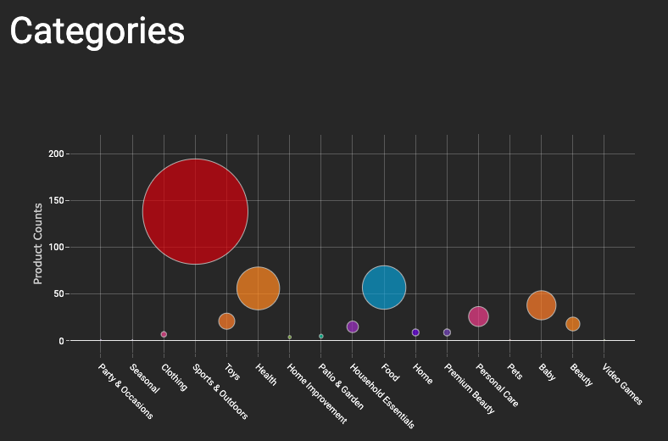
Web Features
Plotly Bubble Chart
Plotly is often chosen to take advantage of its ability to allow for creativity as complex plots only use three main concepts – layout, figure object, and data.
In this chart we are showing the categories of our data set and demonstrating the size of the data set in each category by circle size. The smaller the data set, the closer it will be to the x axis and the smaller the circle will be.

Slide 12
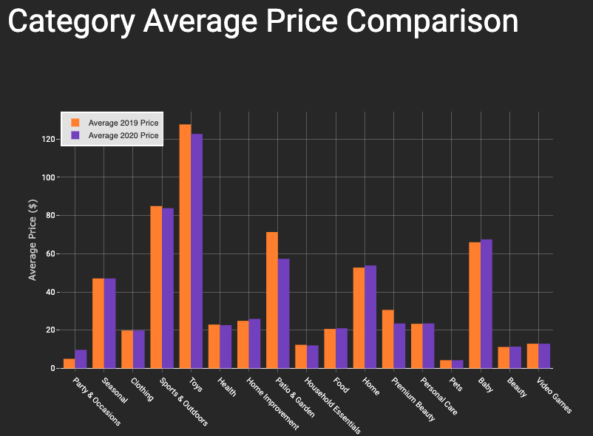
Web Features
Plotly Bar Chart
In this chart we are using bars to show comparison by categories and by price showing you which categories had the biggest changes as well as which had the largest data set.

Slide 13
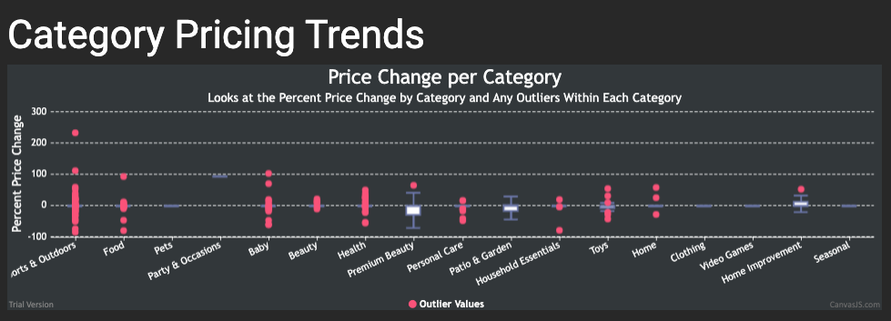
Web Features
Category Pricing Trends
CanvasJS was also used for our box and whiskers charts where we compared distributions of our categories showing category pricing trends and outliers.

