Slide 1
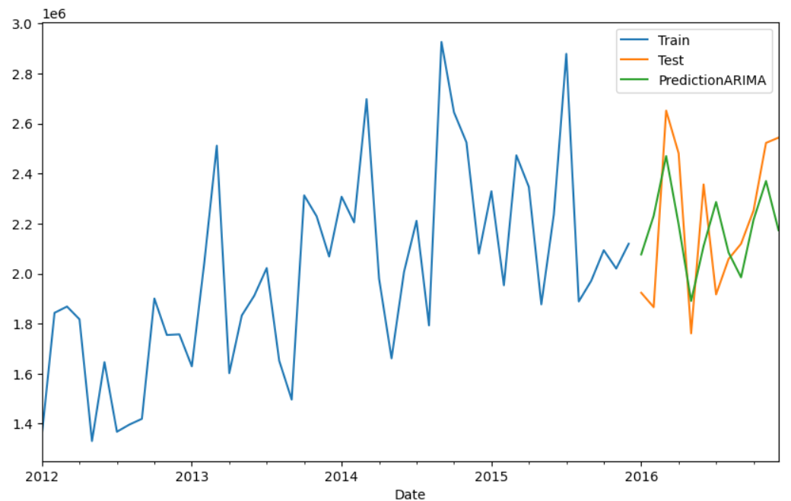
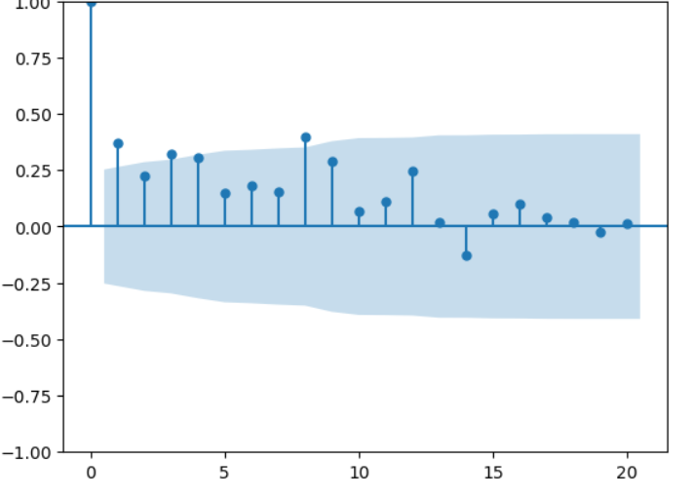
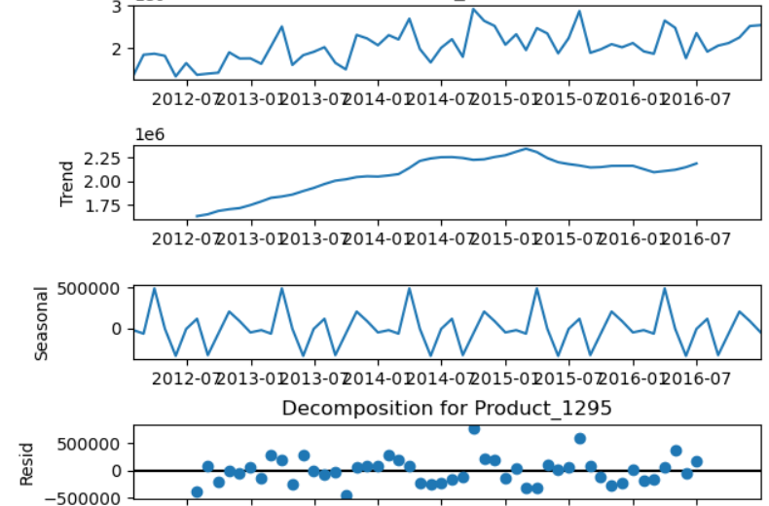
Demand Forecasting
Using ARIMA/SARIMAX Time Series Models
Garegin Manvelyan October 10th, 2023
Notes:
Today I will talk about demand forecasting and its positive impact on the business

Slide 2
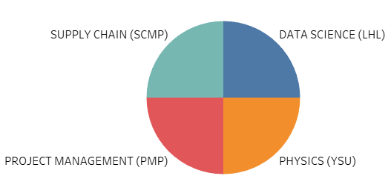
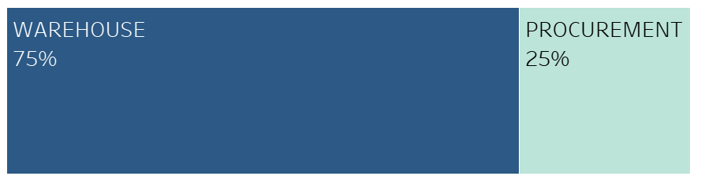
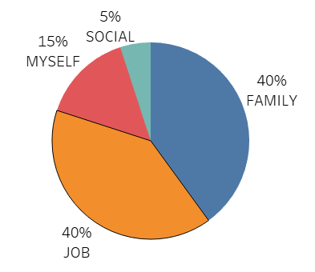
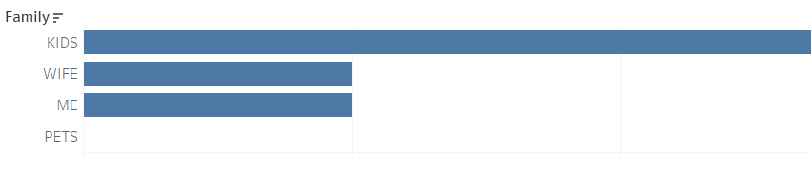
GAREGIN MANVELYAN
EDUCATION
JOB
LIFE
FAMILY
Notes:
A little bit about me. My name is Garegin Manvelyan. Most of my career, I have spent in the Supply Chain field, specifically in Warehouse and Procurement. I graduated with a Master's degree in Physics and obtained certifications in Supply Chain and Project Management. My latest passion is Data Science, which will help me implement my expertise in Supply Chain and bring more value to the business.

Slide 3
PROJECT EXECUTION STEPS
Business Value
[Preventing Overstocking & Stockouts]
Data Gathering
[Kaggle online platform]
Preprocessing
[Cleaning, EDA, Reduction, Splitting]
Model Application
[ARIMA/SARIMAX Time Series Models]
Interpretation & Challenges
[Results]
Documentation
[Readme, Presentation]
Notes:
Here's a brief overview of the execution steps: I will begin by describing the business values that demand forecasting can bring. Then, I will walk you through the model application process, starting with data gathering and ending with the results and future goals.

Slide 4
GOAL
Business Value
[Preventing Overstocking & Stockouts]
The Aim is to Develop an Improved Demand Forecast Model for Inventory Optimization and 10% Cost Savings.
Notes:
The Goal is to have a Model which will help to reduce inventory cost by 10%

Slide 5
DATASET SELECTION
Data Gathering
[Kaggle online platform]
The "Forecasts for Product Demand" dataset contains historical product demand for a global manufacturing company with thousands of products across various categories.
Records :
1 048 575
Time Period :
5 years / 60 months
Unique Products:
2 160
Warehouses:
4
Product Categories:
33
Dataset was downloaded from kaggle online platform
Notes:
The dataset contains more than a million records spanning over a 5-year time period.

Slide 6
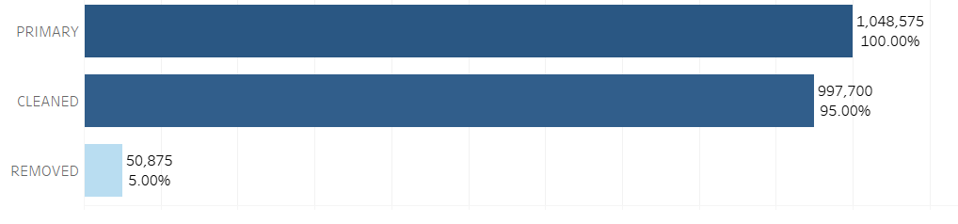
Data Preparation
Preprocessing
[Cleaning]
Null Values: 11 239 .…………………………removed
Data Types : 2 ..…………………………… converted
Single Negative Values: 26 …………………removed
Negative/Positive Pairs:11 746 …………….removed
—--------------------------------------------------------------------
Rows after cleaning : 997 700
Notes:
More than 50,000 rows were removed during the cleaning process, which accounts for 5% of all the data

Slide 7
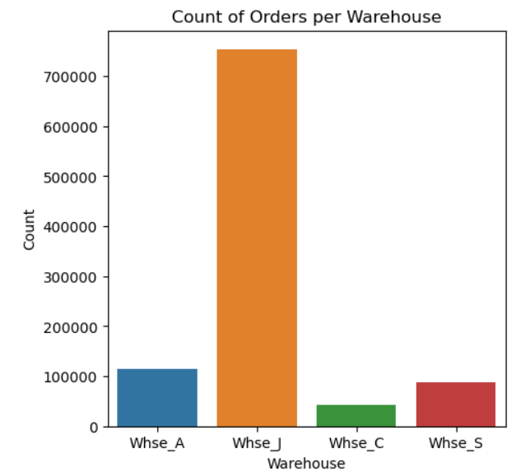
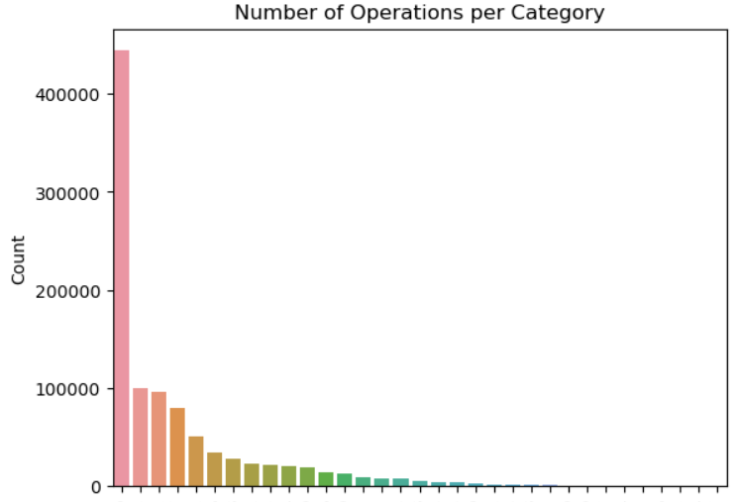
Data Preparation
Preprocessing
[EDA]
Busiest warehouse : “J” (76%)
Most used product category : “#19” (43%)
Notes:
Here are some graphs about the busiest warehouse and product category.

Slide 8
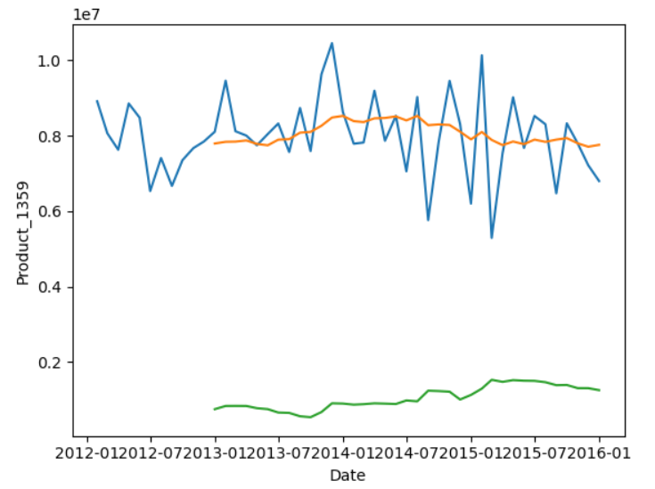
Data Preparation
Preprocessing
[EDA]
Demand monthly plot over 5 years & Stationarity Check
mean
variance
Notes:
On the graph, you can observe a visualization of the order demand over 5 years. As you can see, it's very difficult to discern any trend or pattern. Also,please note that Orange line on the right plot indicates the average and green line represents variance. The stability in mean and variance indicates that the data is stationary. That is precondition for ARIMA model that I am going to use.

Slide 9

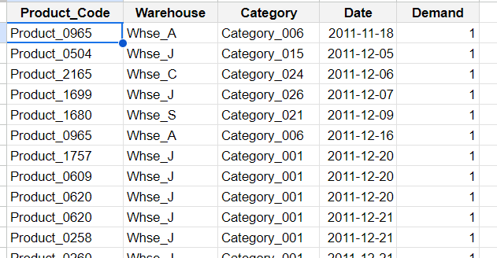
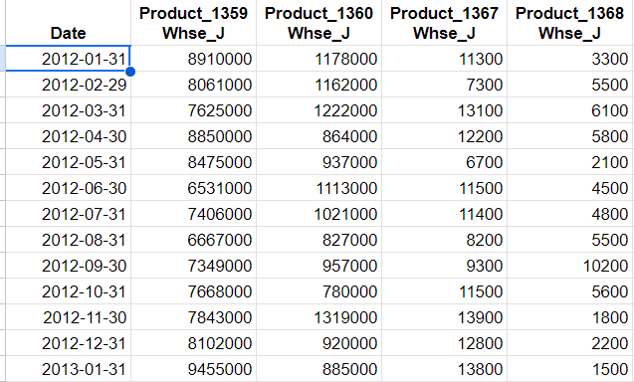
Data Preparation
Preprocessing
[reshaping]
Pivoting Data for Product-Level Analysis*
*drop NaN and 0 after transformation
Notes:
As part of the preprocessing, the original data has been transformed so that each column corresponds to a specific product. After pivoting, all columns with NaN and zero values have been removed

Slide 10
Data Preparation
Preprocessing
[splitting]
Split Data to Stationary and Non-Stationary Datasets*
Training Data: 80 %
Stationary Data:
537 products
Testing Data: 20 %
Pivot Table
Training Data: 80 %
Non-Stationary Data:
180 products
Testing Data: 20 %
Notes:
Then the data was split into stationary and non-stationary datasets. Splitting is important because different approaches are used for different datasets. The split datasets were further divided into training and testing datasets with an 80/20 proportion.

Slide 11
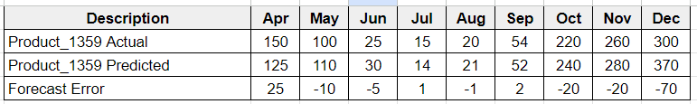
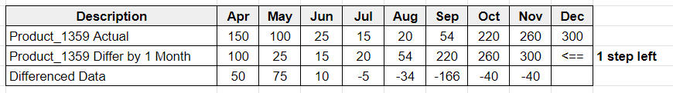
Time Series Model Application
ARIMA
time series model
[pdq -hyperparameters]
p,d,q hyperparameters (explanation)
p (AutoRegressive order): quantifies how many past time steps are used to predict the current value
p=2
q (Moving Average order): quantifies how many past forecast errors are used to predict the current value
q=5
d (Integration order): represents the number of differences needed to make the series stationary
d=1
Notes:
P, d, q are hyperparameters used in the ARIMA model, and you can see their brief descriptions on the screen.

Slide 12
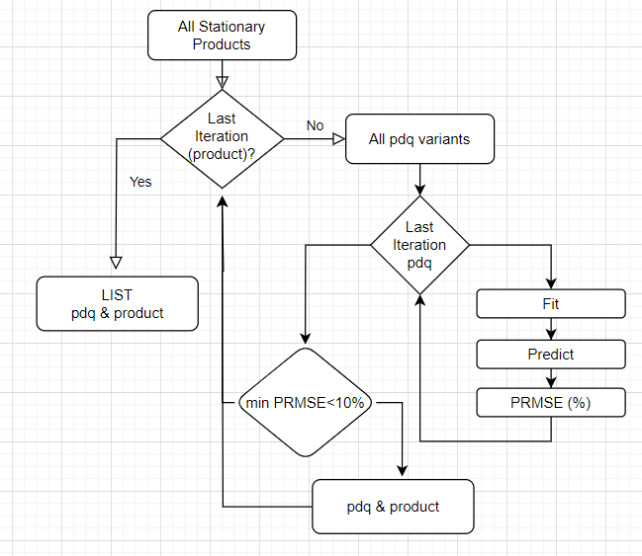
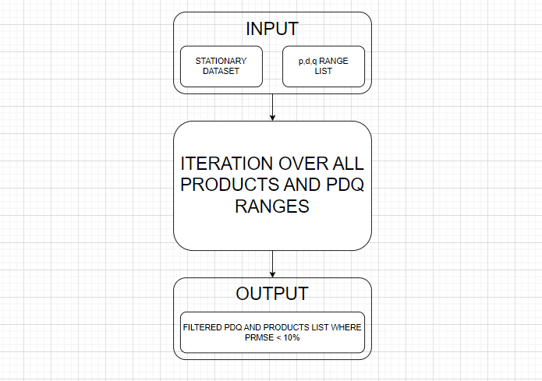
Time Series Model Application
ARIMA
time series model
[pdq -hyperparameters]
Get optimal p,d,q hyperparameters for all products in stationary data
Code Flowcharts
Notes:
To obtain the pdq parameters for the stationary dataset, we have to iterate through all possible pdq variants for all products and select only those with a small error, in our case, 10%. As a result, we obtain a list of products with their corresponding optimal pdq

Slide 13
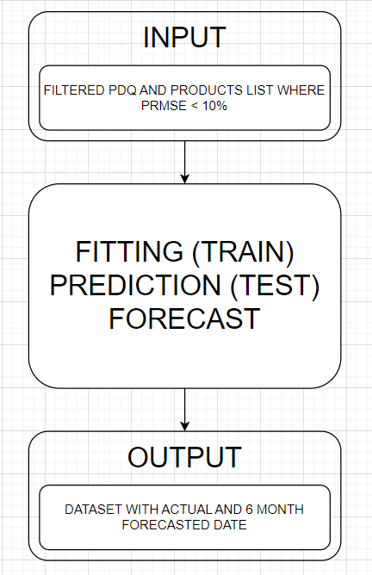
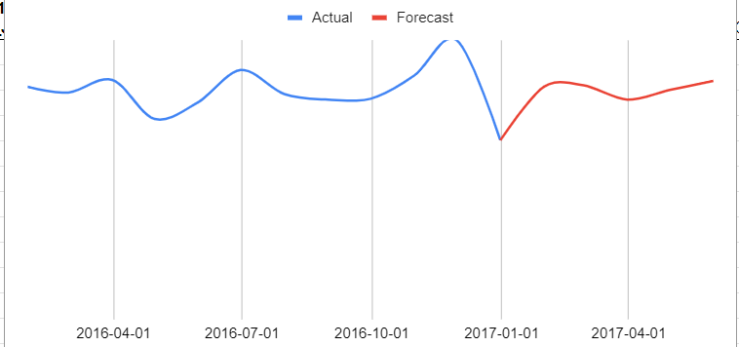
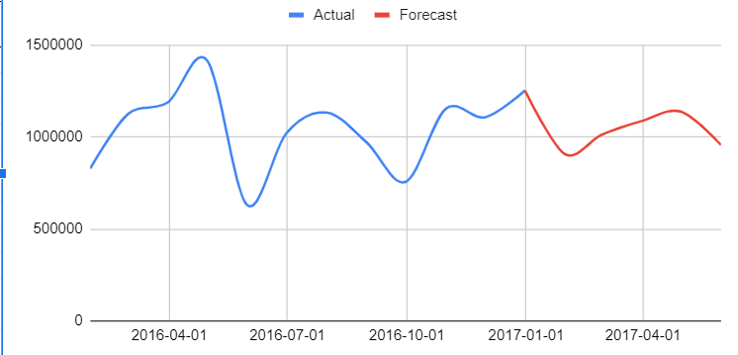
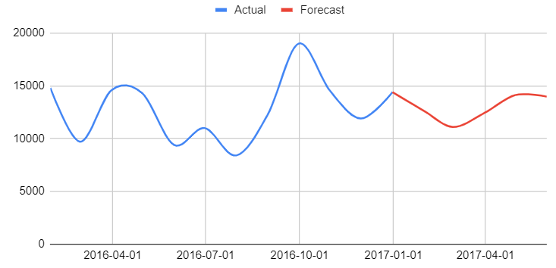
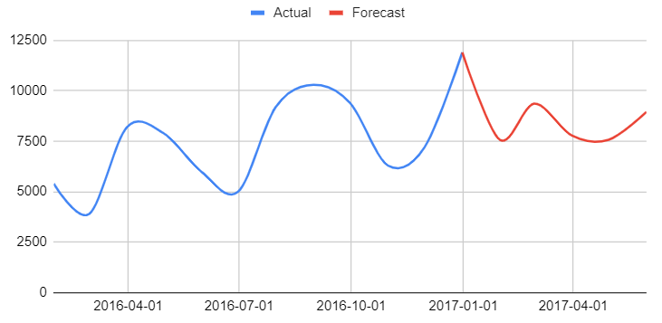
Time Series Model Application
ARIMA
time series model
[pdq -hyperparameters]
Initializing ARIMA model to Forecast Demand for Specified PDQ and Error<10%
Product_1359
Product_1360
Product_1367
Product_1368
Notes:
As a result of applying ARIMA model we are getting a dataset with 6 month forecast. You can see 4 visualization of randomly selected products with actual (blue) and forecasted (red) data

Slide 14
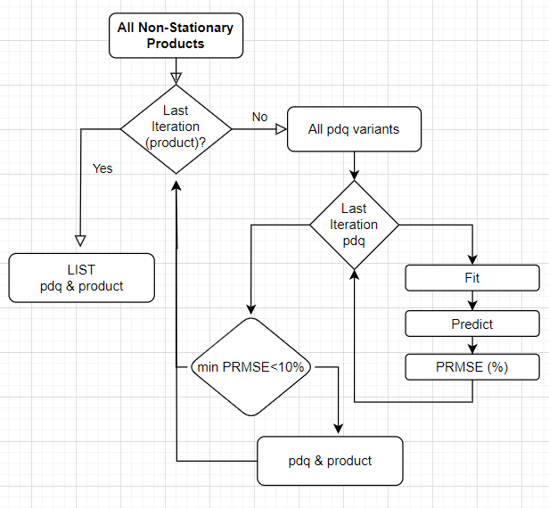
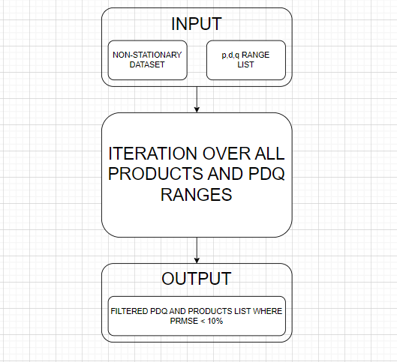
Time Series Model Application
SARIMAX
time series model
[pdq -hyperparameters]
Get optimal p,d,q hyperparameters for all products in NON-stationary data
Code Flowcharts
Notes:
The process of getting hyperparameters for SARIMAX model is IDENTICAL to ARIMA except that the other dataset is used.

Slide 15
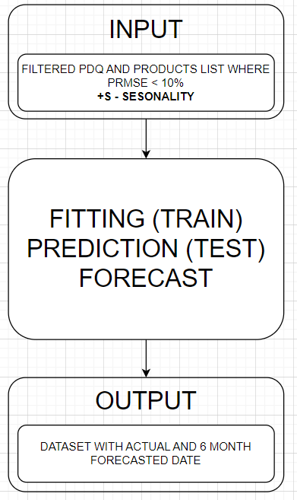
Time Series Model Application
SARIMAX
time series model
[pdq -hyperparameters]
Initializing SARIMAX model to Forecast Demand for Specified PDQSand Error<10%
Product_1359
Product_1360
Product_1367
Product_1368
Notes:
The result calculation for Sarimax is similar to ARIMA, except that there is a new parameter “s” for seasonality in Sarimax.

Slide 16
Results / Challenges
Arima and Sarimax models demonstrate positive performance and can provide a 10% improvement in forecast accuracy compared to a simple naive forecast.
Despite positive performance, the models gave accurate results for only 30% of the products.
Hyperparameters tuning required big amount of time.
ARIMA [580 items] : Elapsed time: 5 hours
SARIMAX [180 items] : Elapsed time: 57 hours
Notes:
Here's a brief overview of the results: The models demonstrate positive performance; however, only 30% of the products provided accurate results. The process is time-consuming, taking approximately 3 days for hyperparameter tuning.

Slide 17
Future Goals
Implementation of Models on the Provided Time Series Dataset
Random Forest Model
XGBoost Model
Multivariate Time Series Analysis
Notes:
As a next step, it would be valuable to evaluate the performance of different models using the same dataset and compare their outcomes.

Slide 18

Thank you!
Garegin Manvelyan
gareginm@gmail.com | Github | LinkedIn | 639-994-5999
Notes:
Thank you all for your attention and participation. I appreciate the opportunity to share this information with our students and coordinators. If you have any questions or would like to discuss further, please feel free to reach out. Thank you again.

