Slide 1
Suicides Prevention Analysis
Based on GDP and HDI Indices per Country
for the Period from 1985 to 2015
Garegin Manvelyan | Gurkiran Kaur September 3rd, 2023

Slide 2
Goal
The goal of this research is to analyze the relationship between suicide rates and socio-economic indicators, specifically GDP and HDI indices, for various countries over the period from 1985 to 2015. We aim to identify potential correlations and patterns to inform suicide prevention strategies.
We also aim to perform comparative analysis of data from Canada and Australia to find out if there is any significant difference in suicide rates between two countries across different ages and genders. The insight might help in deciding which country to migrate to.
2

Slide 3
Glossary
GDP (Gross Domestic Product):
GDP is a way to measure the total value of everything a country makes and does in a year, like goods, services, and more.
HDI (Human Development Index):
HDI is a measure that looks at how healthy, educated, and well-off people are in a country to see how developed it is.
3

Slide 4
Dataset Selection
The "Suicide Rates Overview 1985 to 2016" dataset was chosen because it intrigued us due to its interesting nature.
Upon initial examination, the data appeared to be effectively compiled, revealing interesting patterns.
Furthermore, the prospect of mitigating the increasing trend in suicide rates was found to be motivating.
Dataset was downloaded from kaggle online platform.
4

Slide 5






Dataset Description: 12 Fields / 27820 Rows
1.Country: The name of the country where the data was recorded.
7.Suicides_no: Indicates the number of suicides within a particular country, age group, and sex category.
2.Year: The specific year when the data was collected (e.g. 1985)
8.Suicides/100k pop: The number of suicides per 100,000 population.
3.Sex: The gender of the individuals being studied (e.g. male)
9.GDP per capita: Indicates the average economic well-being of an individual in the specified country.
4.Age: Age groups or ranges used for grouping individuals (e.g.5-14)
10.GDP for year: The Gross Domestic Product value for a specific year and country.
5.Population: The total number of individuals within a particular country, age group, and sex category.
11.HDI for year: The Human Development Index value for a specific year and country.
6.Country-year: A field that combines the country name and the year, providing a unique identifier for each data entry.
12.Generation: A categorical field that represents the generation to which an individual belongs (e.g.Generation X)
5

Slide 6
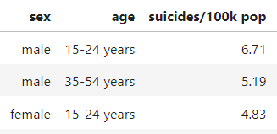
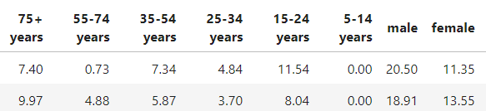
EDA: Cleaning
HDI for year: 19’456 nulls were replaced by mean values
Country-year: Removed, correlated with country and year fields
GDP for year: Removed, correlated with GDP per capita
Duplicates: Not detected
GDP per capita: range of data from 251 to 126352, was normalized
Age and Sex: pivoted, created columns for each age and sex categories with suicides rate as values
6

Slide 7
Regression Models : 6 Attempts on global data + 3 Attempts on data filtered for only Canada and Australia
Creating a predictive model that can help understand relationship between suicides rate and dependant values.
Linear model with all dependable variables : failed
Linear model with GDP and HDI : failed
Linear model with GDP only : failed
Linear model with GDP and dropped zeros for number of suicides: failed
Linear model with normalized GDP and HDI : failed
Logistic model with GDP only : failed
Linear model with GDP for both Canada and Australia: Weak correlation, R square values 0.016 and 0.010 and p values 0.017 and 0.062
Linear model with GDP and age for Canada and Australia : failed
Linear model with GDP, age and gender for Canada and Australia: failed
7

Slide 8
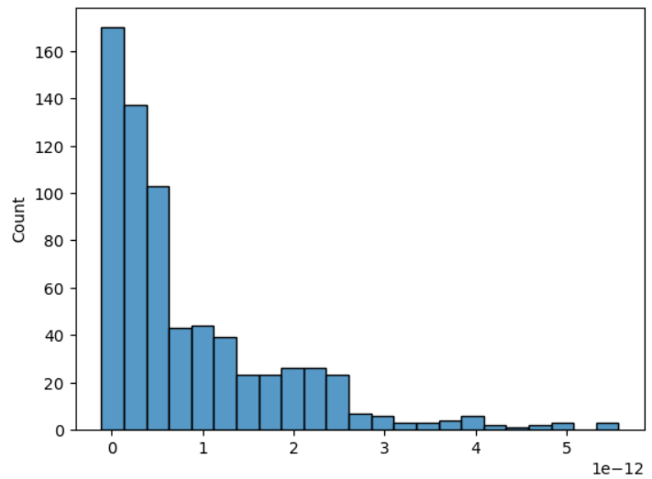
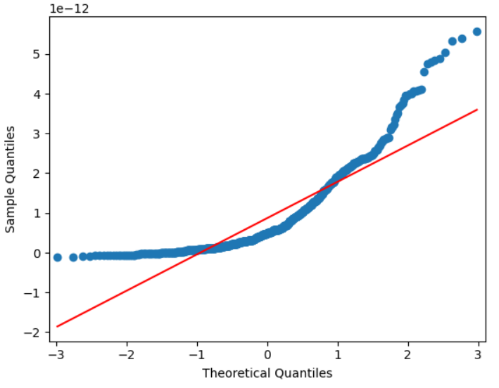
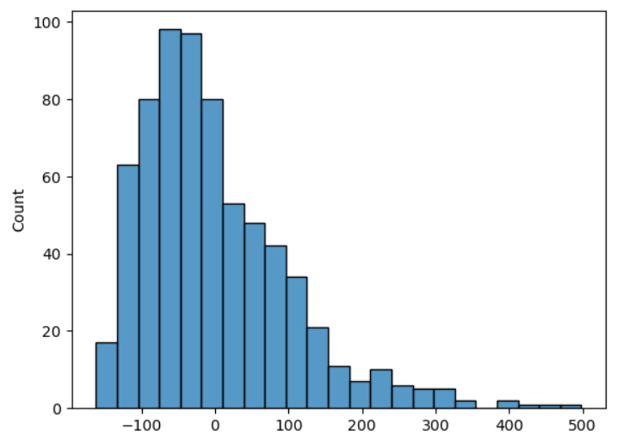
Visuals: Linear Regression Assumptions

Slide 9
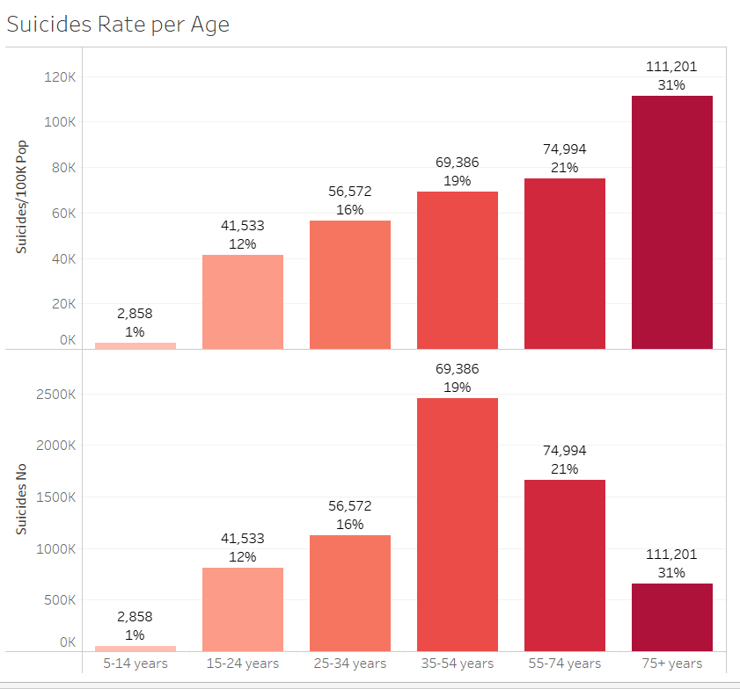
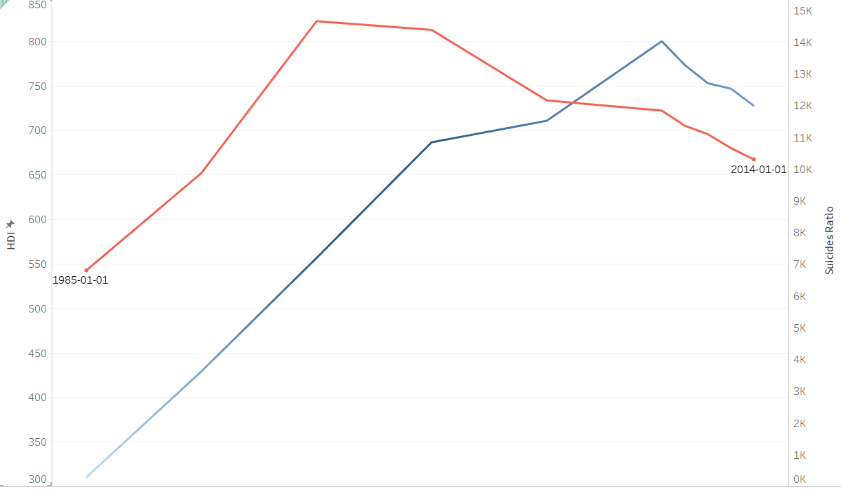
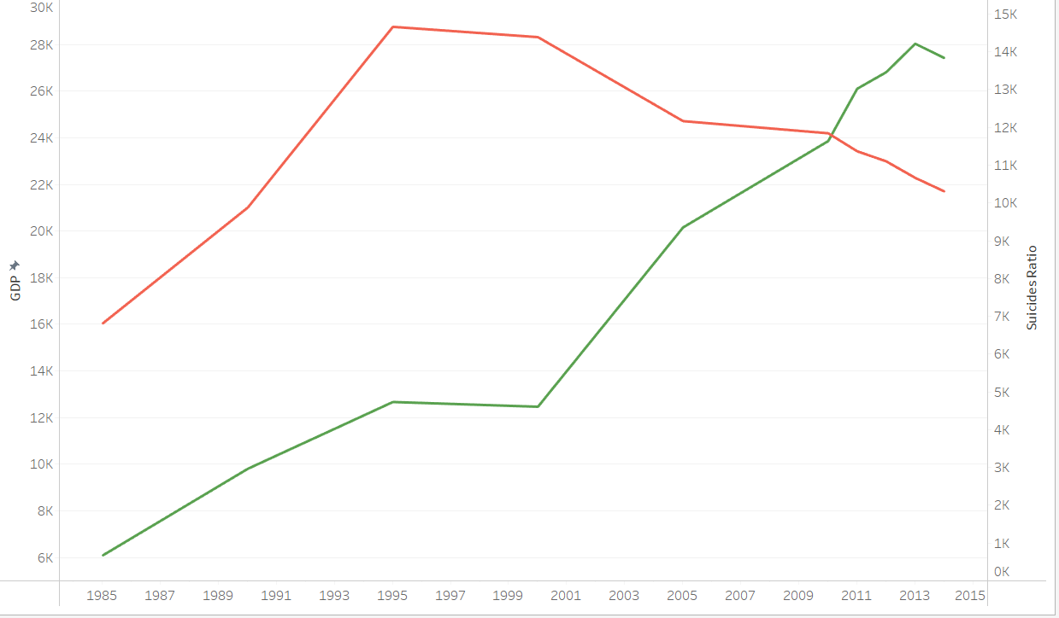
Data Visualizations
Suicides Rate VS HDI
Suicides Per Age
Suicides Rate VS GDP
8

Slide 10
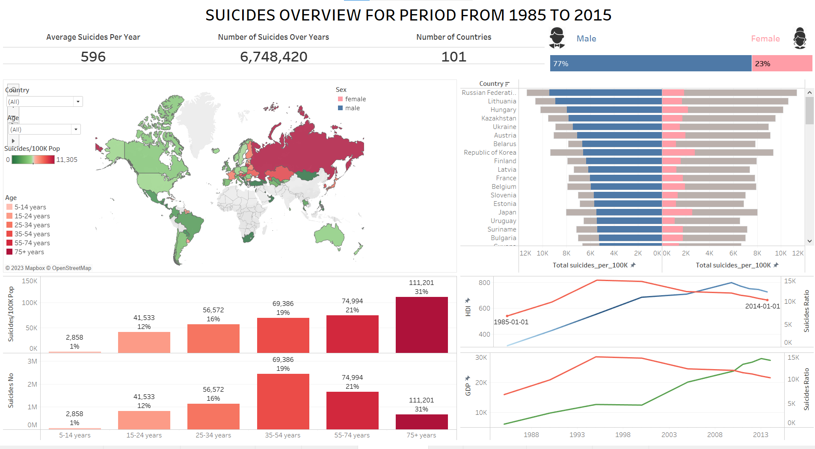
9

Slide 11
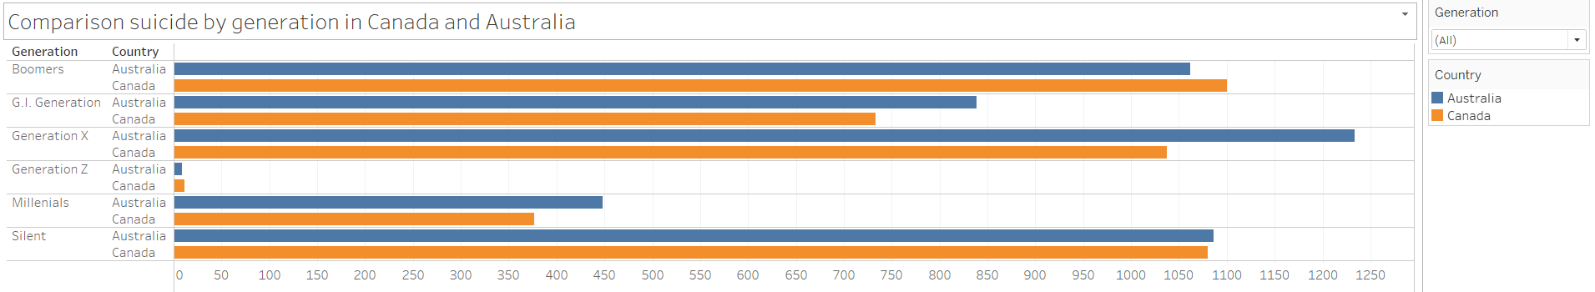
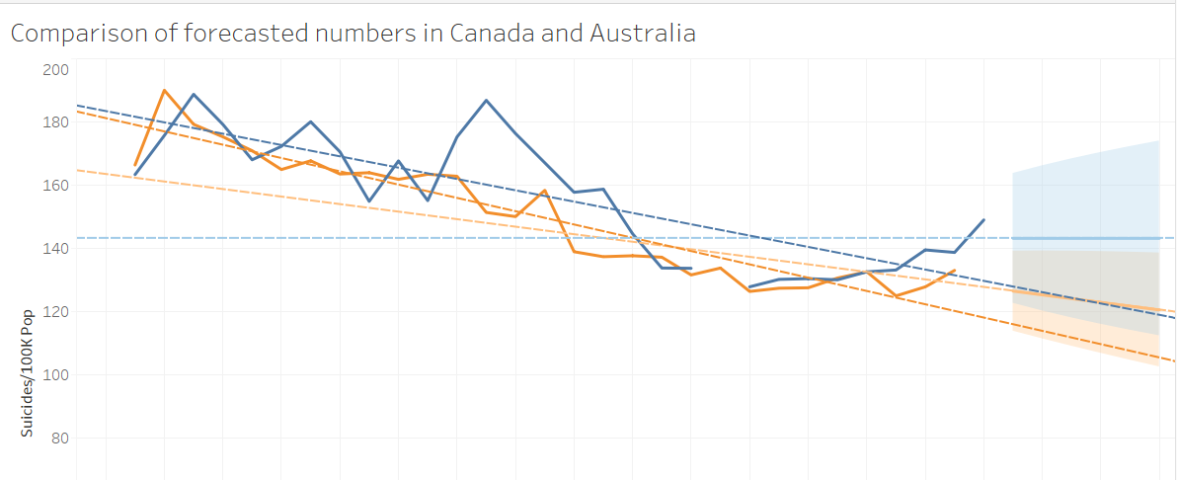
Data Visualizations: Canada and Australia
10

Slide 12
Conclusion:
Despite building six distinct models, none of them provided conclusive evidence of a relationship between the number of suicides and our chosen variables.
More in-depth analysis is required which includes checking for multicollinearity and exploring further the relationship between variables.
We can also consider incorporating additional parameters, such as ethnicity, religion, type of jobs, marital status into our research to gain a deeper understanding of this complex issue and improve our model.
11

Slide 13


Thank you!
Garegin Manvelyan
Gurkiran Kaur
12

