Slide 1
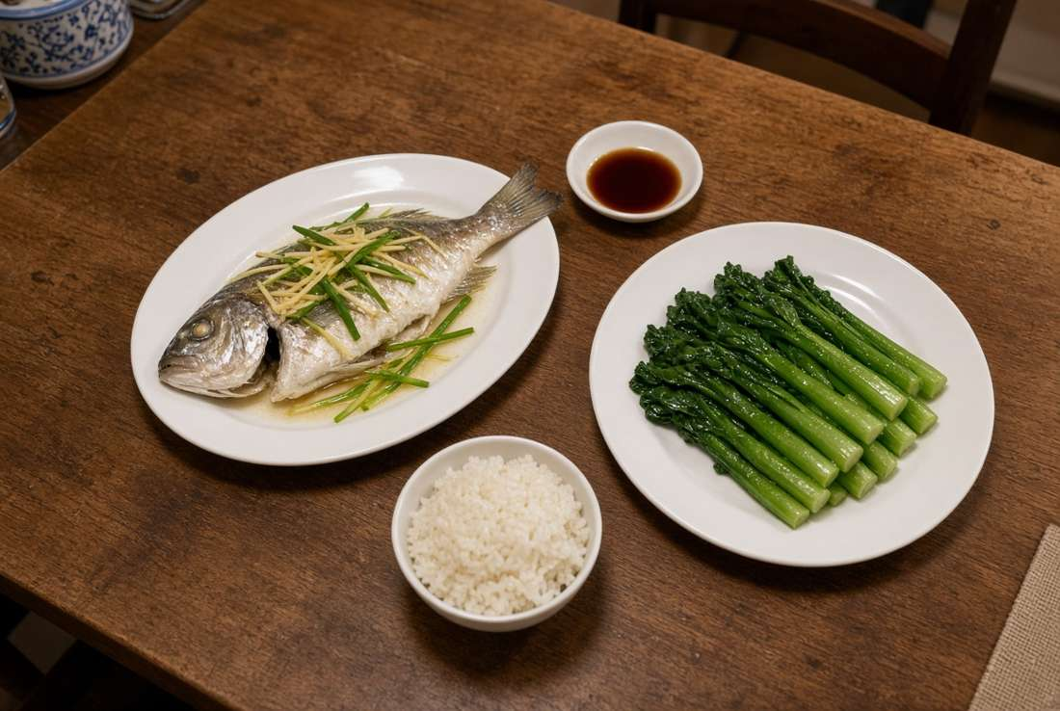
ISOM5240 · FALL 2026 · HOSPITAL AUTHORITY
Same Table
糖友同枱
One shared home dinner for a public-hospital
diabetes patient and the household.
The dish stays the same.
Only the patient plate changes.
Not a prescription
Not HA Go
Not a second meal
ha.org.hk · Education tool. Not a doctor.
Home table. Sauce in its own dish.
Not a patient. Not a result.

Slide 2
01 EXECUTIVE SUMMARY
The argument, before the proof.
先講論證。然後先證明。
01
02
03
04
Product
Imbalance
Patient
What we add
One shared dinner.
Same dish. Only the
patient plate changes.
Large spend after illness.
Thin spend on living.
Not our saving.
Wrong food from not
knowing. Or a diet the
family cannot share.
The hour before the wok.
Cook is the user.
Beside HA, not inside.
Rules count the dishes. Two models only tag and retrieve. No figure on this page is a result.
01 SAME TABLE · CLASSROOM PROTOTYPE · NOT A RESULT

Slide 3
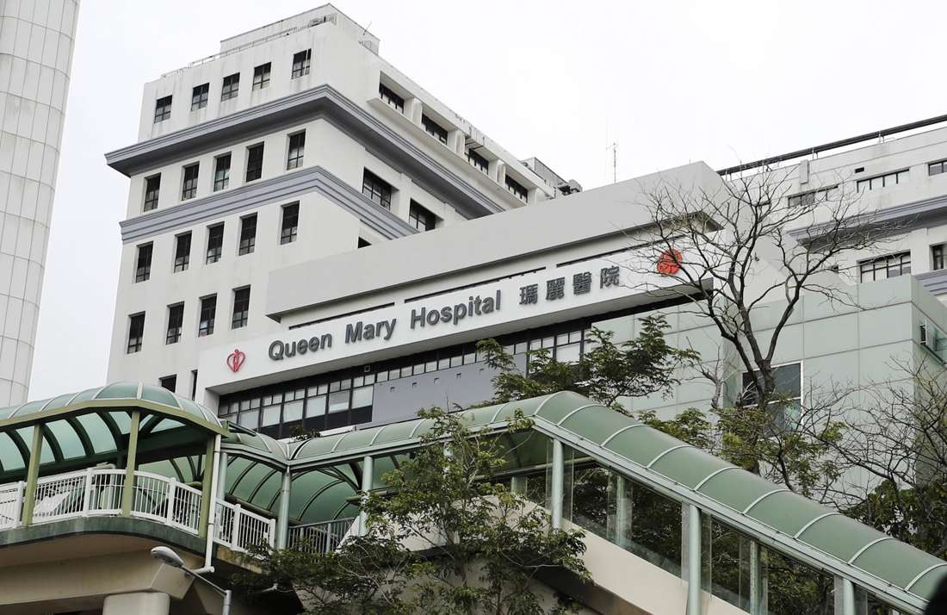
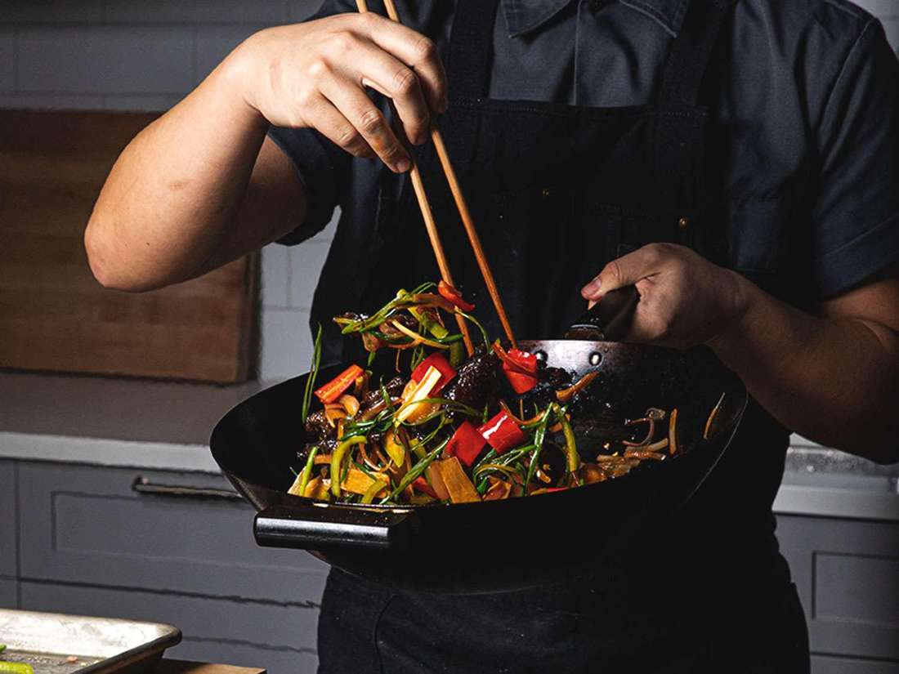
02 PAIN 1 · THE PUBLIC IMBALANCE
The bill is large. The living is thin.
病後花得多。健康生活嘅投入細。呢個對比唔係我哋會報嘅節省。
AFTER
BEFORE
The ward is already funded.
Government and HA spend heavily
after chronic illness.
Knowing how to live gets less.
Same Table sits in this hour.
It does not cut the hospital bill.
02 SAME TABLE · CLASSROOM PROTOTYPE · NOT A RESULT

Slide 4
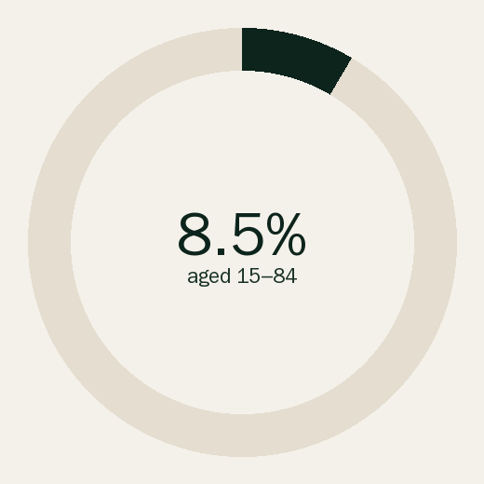
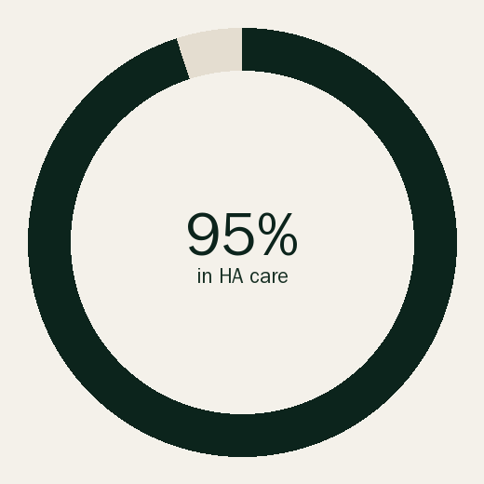
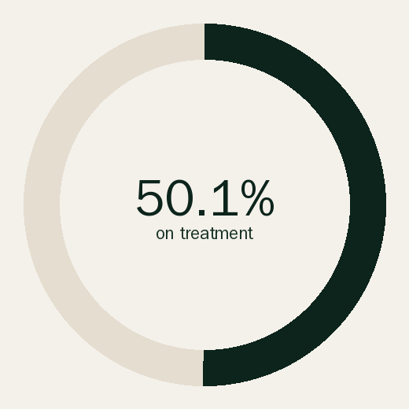
03 CONTEXT, NOT A RESULT
Care starts after the illness.
照顧由病發之後先開始。數字描述系統。唔係我哋會削減嘅數。
~12,400
Inpatient discharges
and deaths.
Principal diagnosis.
CHP 2024.
Not 12,400 deaths.
Persons aged 15–84 with diabetes
or raised glucose. PHS 2020–22.
Of people with diabetes in
Hong Kong are in HA care.
Liu et al. 2025.
On glucose treatment, this share
met the target. Same paper.
Half still miss it.
03 SAME TABLE · CLASSROOM PROTOTYPE · NOT A RESULT

Slide 5
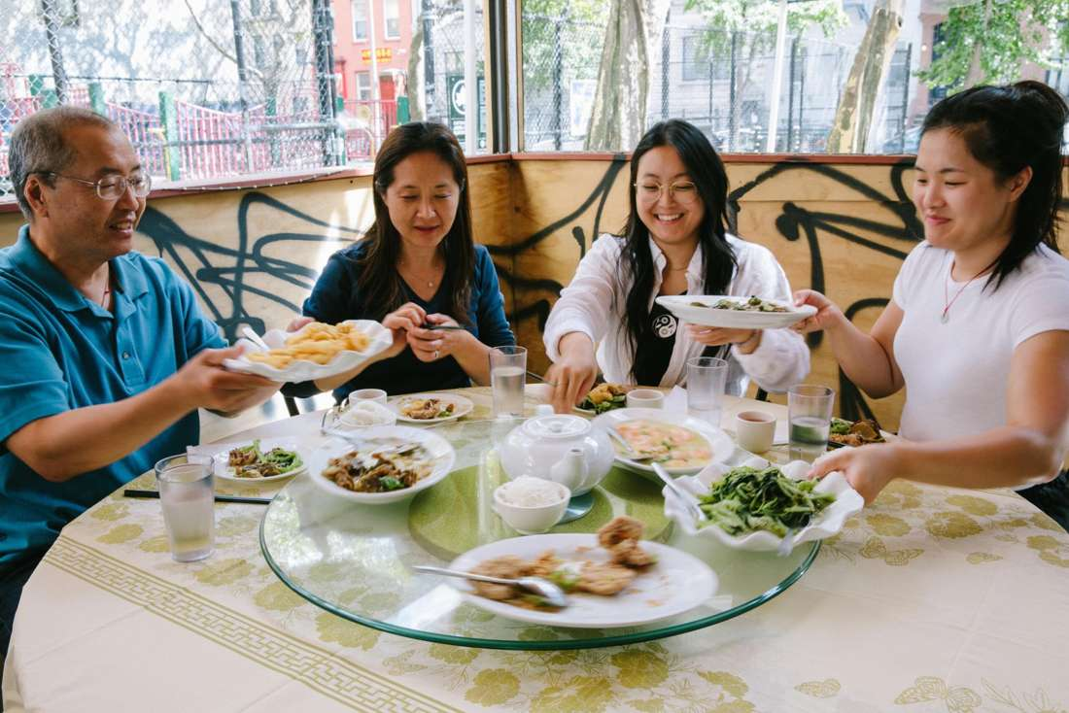
04 PAIN 2 · THE LONG-TERM PATIENT
The patient pays twice.
病人付兩次。呢頁命名代價，唔量度佢。
01
Not enough knowledge
Food and the condition are not connected.
Wrong eating. The illness gets worse.
This is a lack of usable knowledge, not of will.
02
A real dietary requirement
Hard to share the family meal for long.
Psychological pressure. An extra pot, shop, and cost.
A habit the household cannot share does not last.
A shared table. Not our patient.
Not a Hong Kong home we studied.
04 SAME TABLE · CLASSROOM PROTOTYPE · NOT A RESULT

Slide 6
05 MECHANISM
From the source. Not from the ward.
從源頭係落鑊之前嗰個鐘。唔係一個金額。然後停。
1 After
2 Before
3 Then stop
The ward.
Already funded.
We do not enter.
One shared menu,
before the wok.
This is what we add.
Patient plate changes.
Family plate does not.
No saving reported.
After. Not our site.
Before. The hour we add.
05 SAME TABLE · CLASSROOM PROTOTYPE · NOT A RESULT

Slide 7
06 FOR THE HOSPITAL AUTHORITY
Beside HA. Not inside HA.
客戶即係課堂 prototype。唔係合約。唔係登入。
Beside
Already running
Do not open HA Go,
write a record, or
replace a follow-up.
Wards, medicine,
follow-up, a diary
after the meal.
Classroom
prototype
What we add
Will not say
One shared menu,
before the wok,
three moves. Then stop.
No saved admissions.
No changed medicine.
No cut budget line.
06 SAME TABLE · CLASSROOM PROTOTYPE · NOT A RESULT

Slide 8
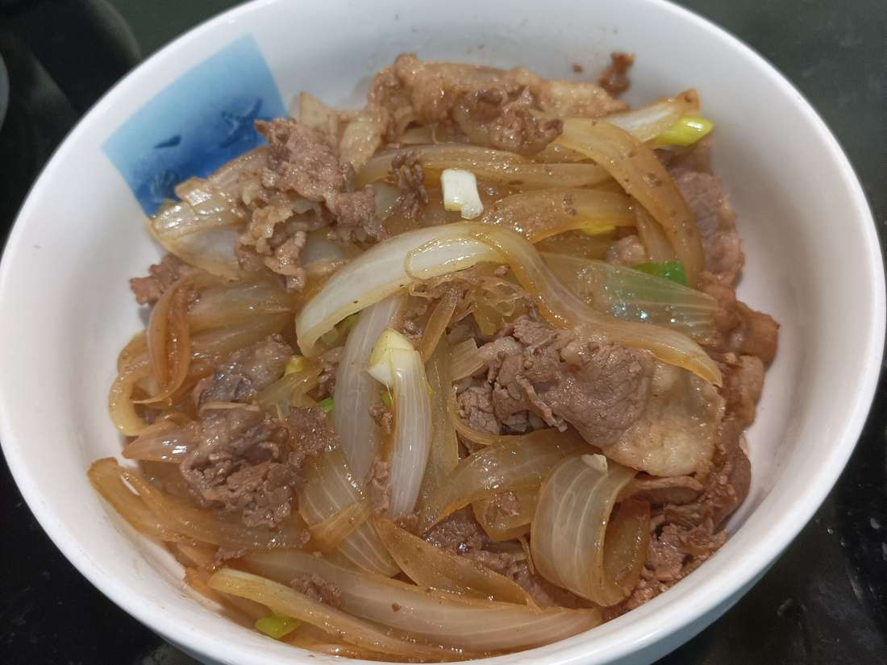
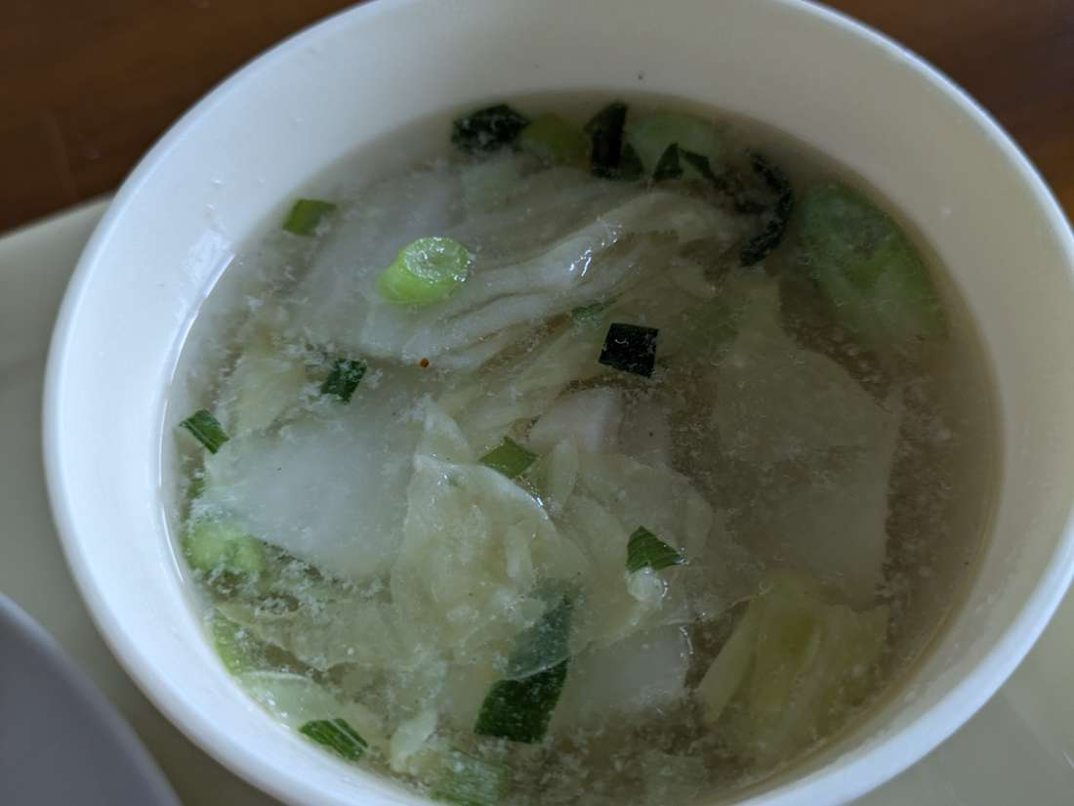
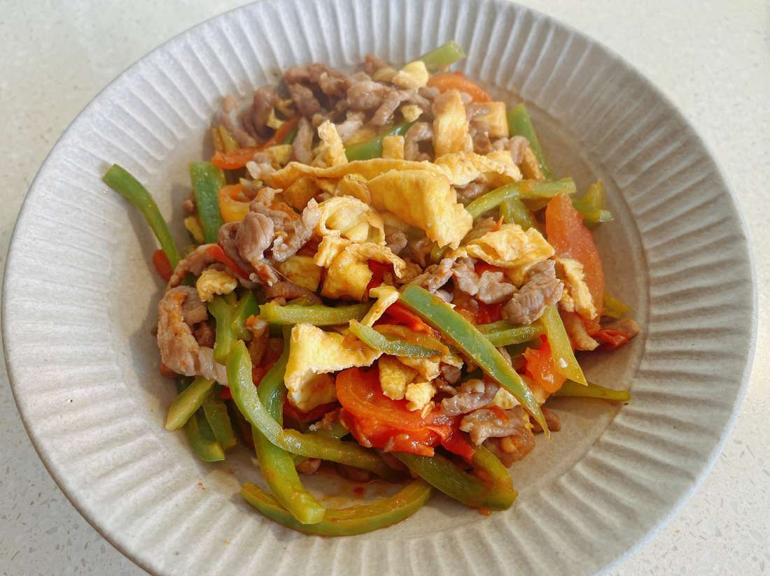
07 THE HOUSEHOLD
The cook is the user.
今晚煮飯嗰個先係用家。唔係醫生。
User
The person who cooks tonight.
Output
One menu. Shared names. Three moves.
List
Names to buy. No price. No checkout.
Limit
Stays at the table. Not a mood score.
Before the plate. Not a clinician.
Cola onion beef
Not a prescription
Cabbage soup
Not a diet score
Pepper tomato pork
Not a clinical label
07 SAME TABLE · CLASSROOM PROTOTYPE · NOT A RESULT

Slide 9
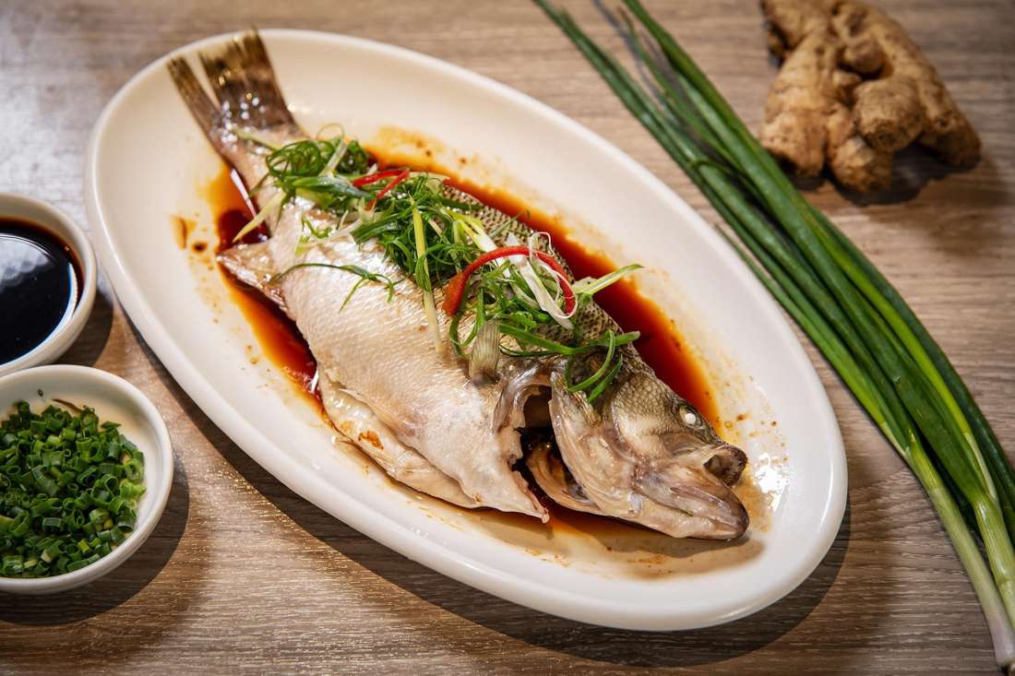
08 THE OBJECT IN THE HAND
Five pages. Each one job.
01
02
03
04
05
Tonight
Menu
How to cook
How to plate
List
People and one sentence.
The ring counts dishes.
Labelled library only.
Unlabelled stays a warning.
Only fields the dataset has.
No invented kcal.
Same dishes. Three moves
on the patient plate only.
Names to buy.
No price. No checkout.
Hardcoded, not a model score
Tonight should not repeat most of the last 14 days.
The 60% line is written down. The ring counts dishes, not a diet score.
Visual 4.0, function 3.4. A mock. Not a live app.
Sauce in its own dish. That is the product.
60% written rule
08 SAME TABLE · CLASSROOM PROTOTYPE · NOT A RESULT

Slide 10
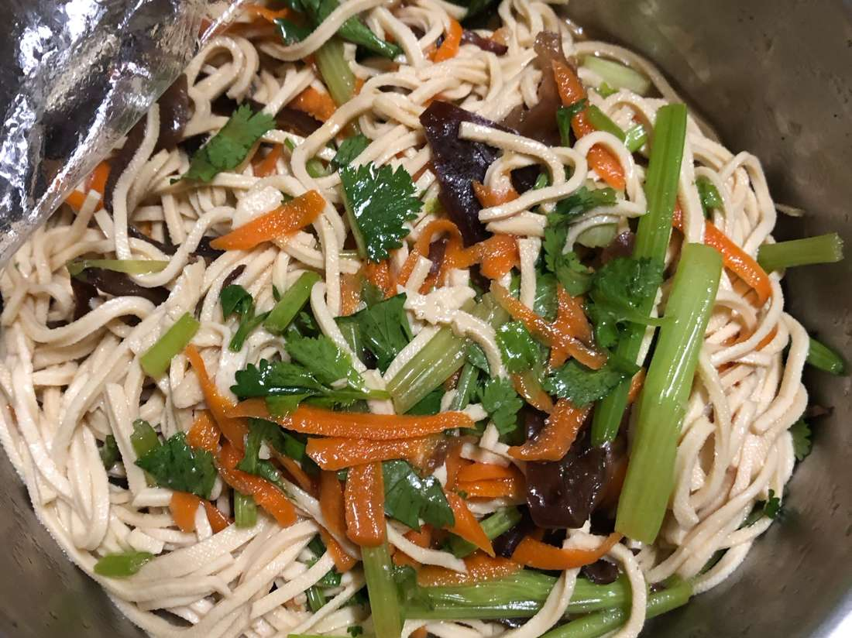
09 TECHNICAL PATH
Rules count. Models only tag and retrieve.
Cook
Pipeline 1 · fine-tune
Python rules
Pipeline 2 · no fine-tune
One sentence.
Optional voice
into the same box.
mDeBERTa-v3
mnli-xnli
method, meat-or-veg, time
Headcount → dishes
3 moves · 20 min
14-day ring · 60%
MiniLM-L12
retrieves dishes
already in the library
Written table. Not a model output. The case to remember: 4 people → 6 dishes.
1 people
2 people
3 people
4 people
5 people
6 people
2 dishes
3 dishes
4 dishes
6 dishes
7 dishes
8 dishes
Library preferred, not locked: about 100 of about 1,799. Counts TO_RUN. App loads the Hub id from the notebook, not the base id. Hub, app, GitHub: TBD.
Onion beef
Library candidate. Not a result.
Cold shreds
Library candidate. Not a result.
Cabbage soup
Library candidate. Not a result.
Pepper pork
Library candidate. Not a result.
09 SAME TABLE · CLASSROOM PROTOTYPE · NOT A RESULT

Slide 11
10 THE ONLY OBJECTIVE
Forty-five words. No more.
Help the family cook plate one shared home dinner for a public-hospital diabetes patient and the household. The dish stays the same. Only the patient plate changes, using simple portion rules. Classroom prototype for the Hospital Authority. Not a prescription. Not connected to HA Go.
Colab
Hub
Streamlit
Fine-tune
Pipeline 1
One model
leaves
Same model
enters
Education tool. Not a doctor.
Does not change medicine.
A mismatch is a penalty. Ids are locked. URLs and metrics stay TO_RUN.
10 SAME TABLE · CLASSROOM PROTOTYPE · NOT A RESULT

