Slide 1

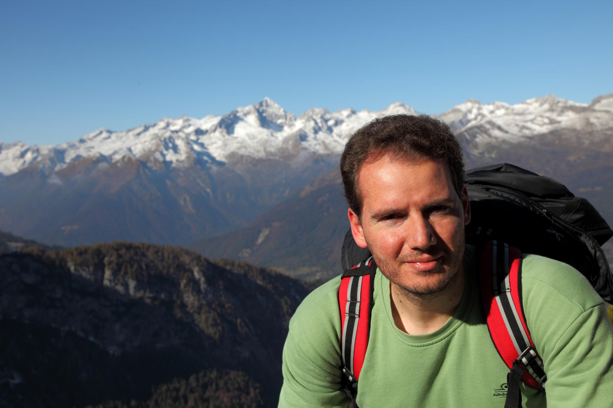
Eleftherios Garyfallidis, PhD
Sherbrooke Connectivity Imaging
Laboratory (SCIL)
Computer Science department
Université de Sherbrooke
http://scil.dinf.usherbrooke.ca
Notes:
Merci Gilles Kahn

Slide 2
Short Info
Education
BSc Technological Institution of Athens, Computer Science, GR
MSc Neuroscience and Robotics, University of Crete, GR
PhD, Medical Imaging, University of Cambridge, UK
Software
Lead software engineer at dipy.org (dMRI analysis)
Lead software engineer at fos.me (vizualization)

Slide 3
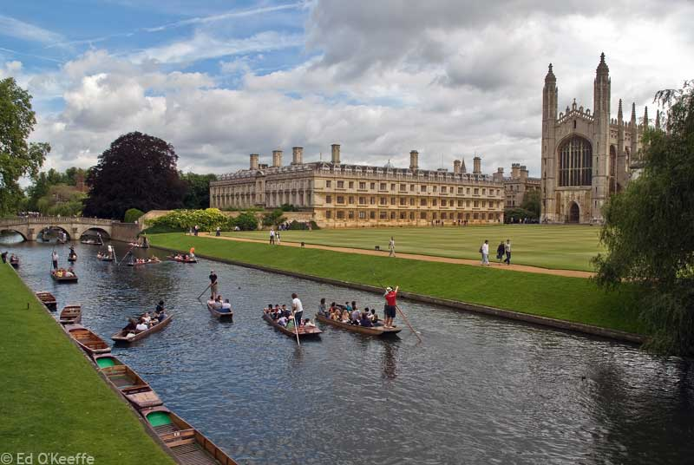


Slide 4



Slide 5
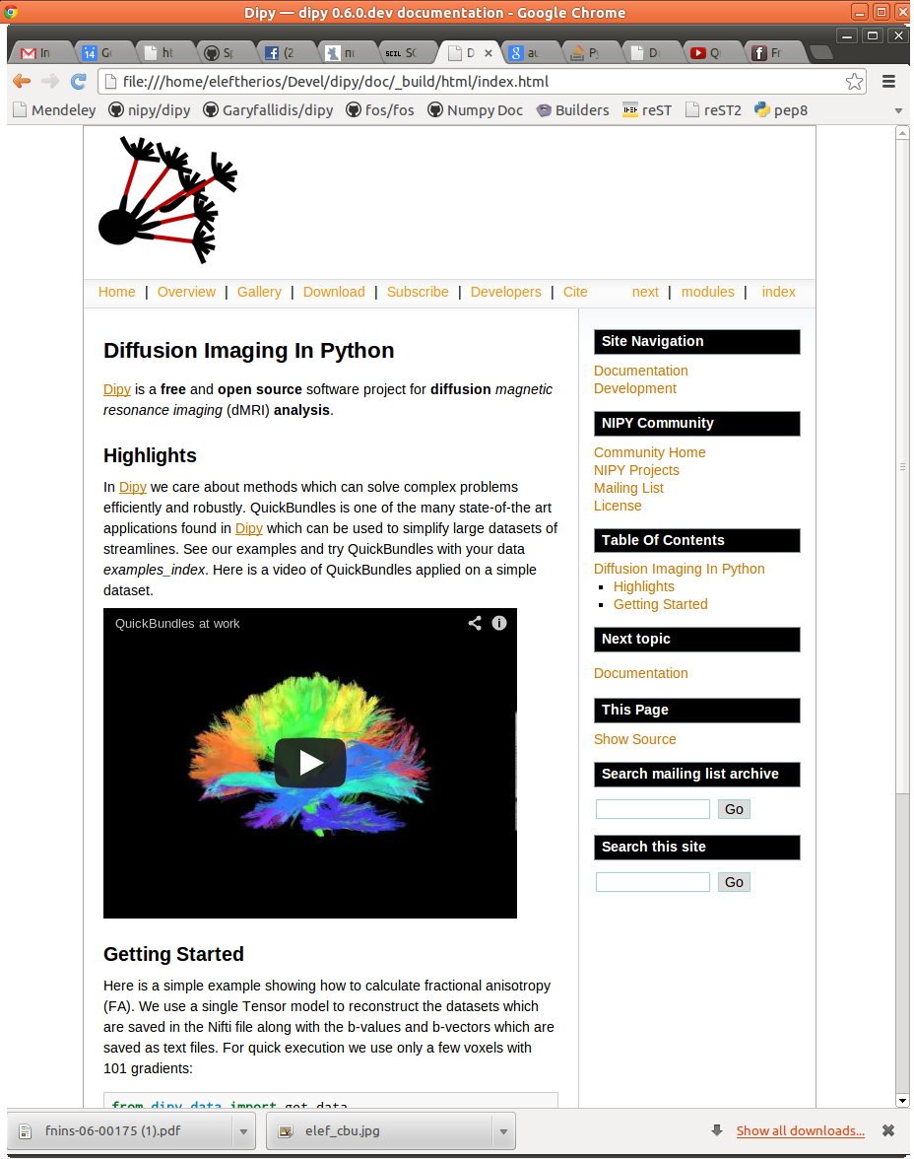

Slide 6
QuickBundles

