Slide 1


Team Tyranny

Slide 2

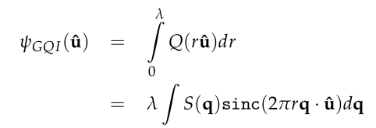
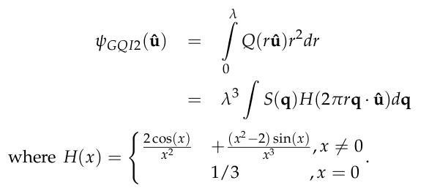
ODF calculated from Diffusion Spectrum Imaging
ODF calculated from Generalized Q-Sampling Imaging
ODF calculated from GQI with consideration of radial projection. We call this QGI2.

Slide 3



Simple analytical form:

Slide 4


