Slide 1


QuickBundles
Eleftherios Garyfallidis, PhD
Sherbrooke Connectivity Imaging
Laboratory (SCIL)
Computer Science Department
Université de Sherbrooke
http://scil.dinf.usherbrooke.ca
Notes:
Merci Gilles Kahn

Slide 2
The aim of QuickBundles
Simplify large datasets of streamlines
Efficient on memory and cpu usage
Stay linear on the number of streamlines
Clusters can be represented by a single centroid
Collectively these centroid streamlines can be taken as an effective representation of the streamlines (complete set)
Single distance threshold

Slide 3
Centroid example
Clustering of the CST

Slide 4
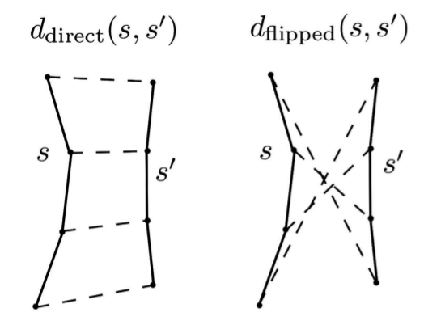
Distance metric
Minimum Direct Flipped
min(d_direct, d_flipped)
Fast to compute
Symmetric

Slide 5
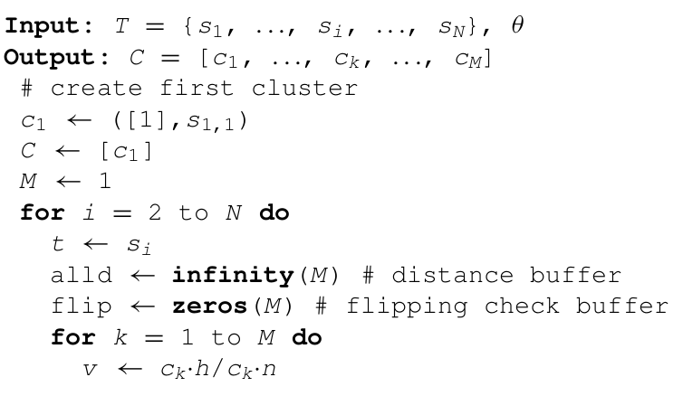
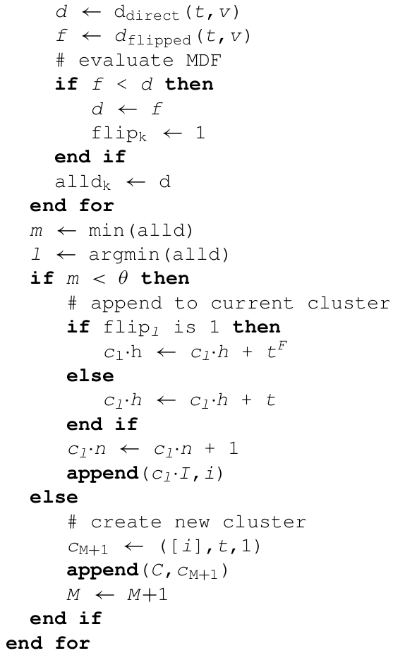
QB Algorithm
Short Description
M is the number of clusters
  First streamline becomes the first cluster
  For each remaining streamline
                i) calculate MDF distance between streamline and the centroids of all clusters
                ii) if any of the MDF values are smaller than a threshold then add the streamline to the closest cluster or create a new one.

Slide 6
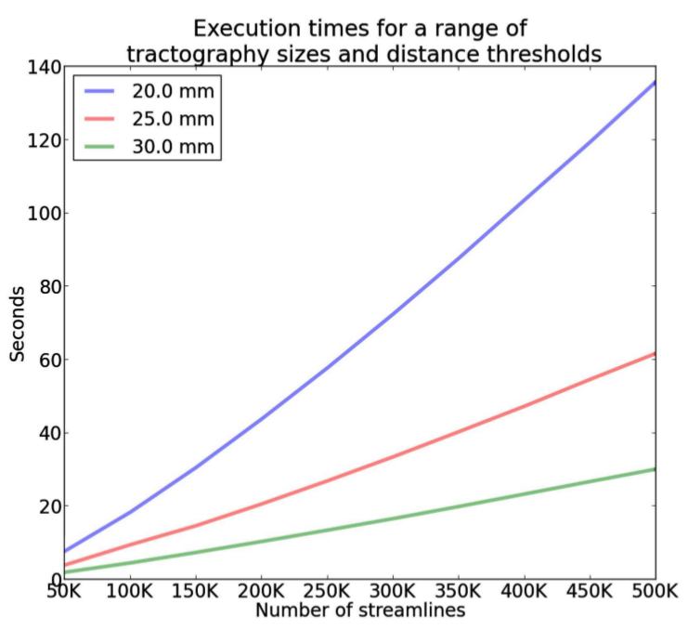
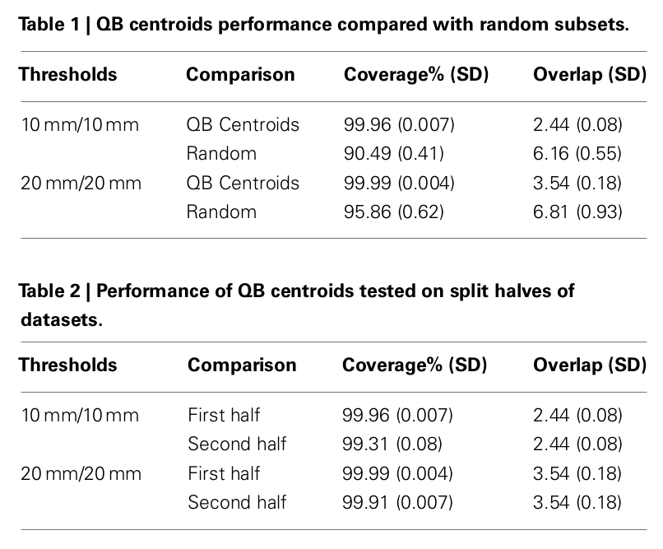
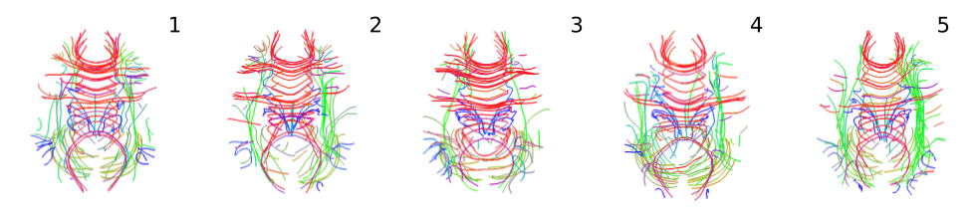
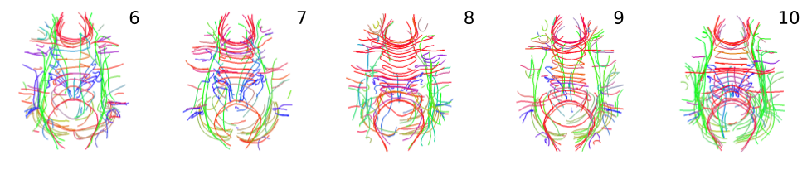
Results
Centroids for Biggest 100 clusters for 10 subjects.

Slide 7
Demo

Slide 8
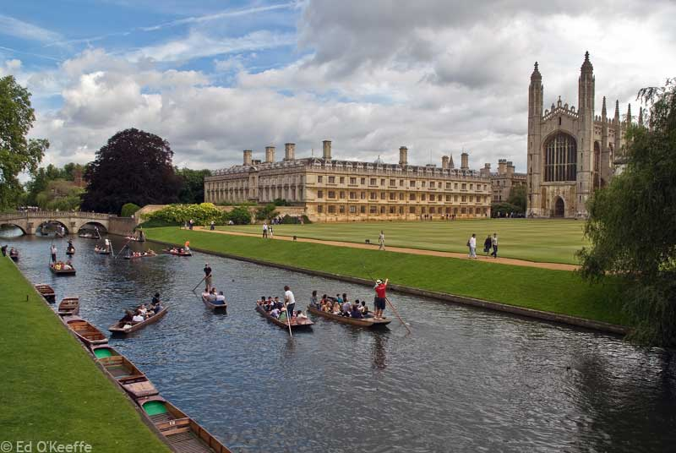
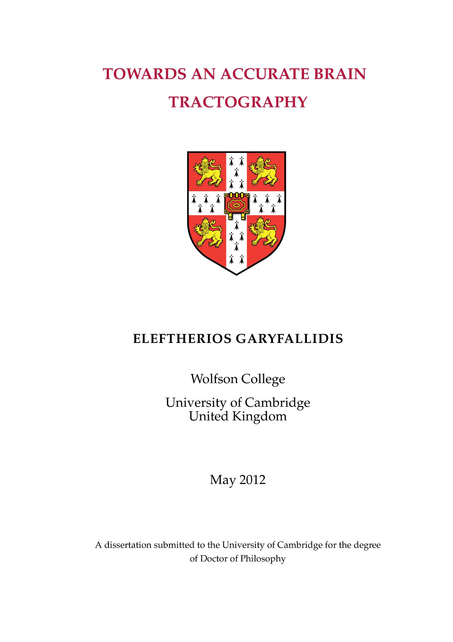
Download my the thesis from eleftherios.net or from the SCIL website.

Slide 9


Slide 10
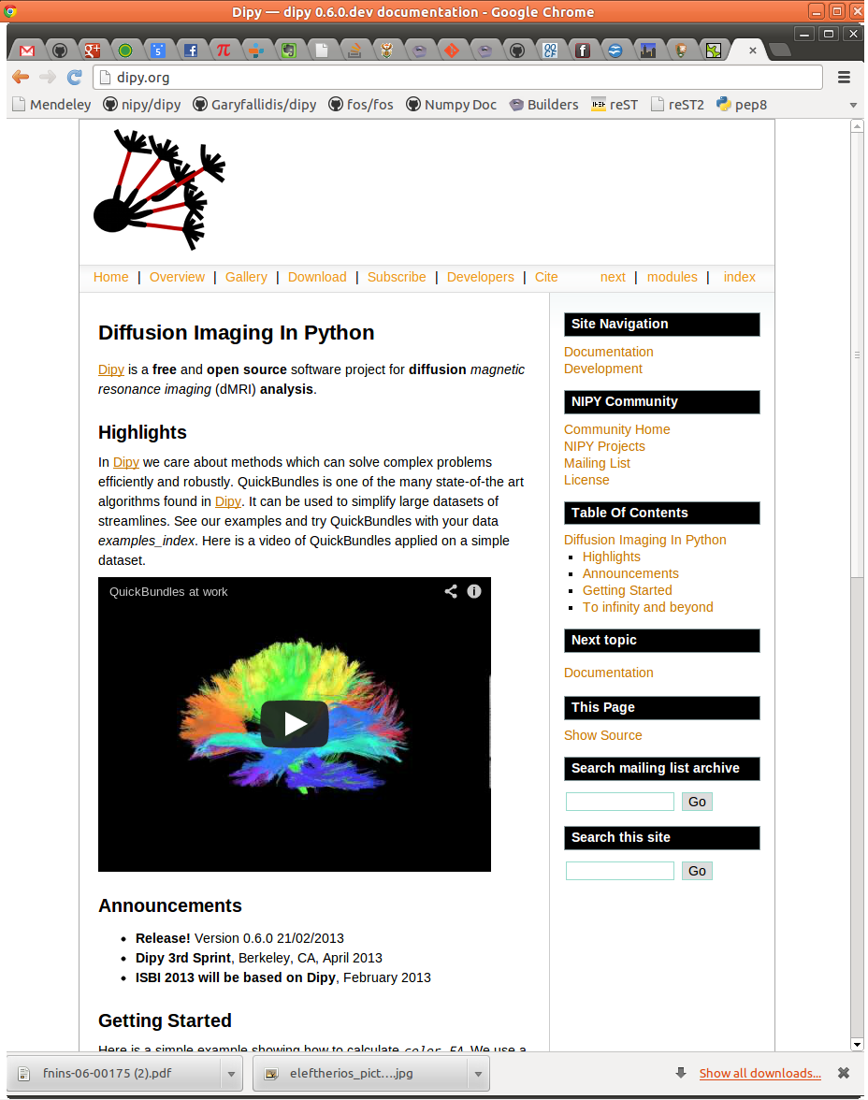
dipy.org

Slide 11


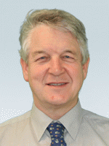

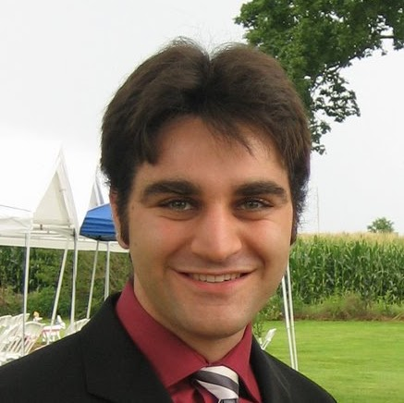
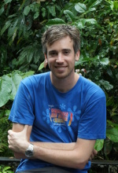
Dipy Developers (Core team)
Matthew
Berkeley
Eleftherios
Cambridge, UK
Ian
MRC CBU Cambridge, UK
Ariel
Stanford
Bago
UCSF
Stefan
South Africa

Slide 12
Dipy Developers (Full list)
- Eleftherios Garyfallidis, University of Sherbrooke, QC, CA
- Ian Nimmo-Smith, MRC Cognition and Brain Sciences Unit, Cambridge, UK
- Matthew Brett, University of California, Berkeley, CA, US
- Bago Amirbekian, University of California, San Fransisco, CA, US
- Ariel Rokem, Stanford University, CA, US
- Stefan Van der Walt, Stellenbosch University, ZA
- Maxime Descoteaux, University of Sherbrooke, QC, CA
- Michael Pacquette, University of Sherbrooke, QC, CA
- Christopher Nguyen, University of California, Los Angeles, CA, US
- Emanuele Olivetti, NeuroInformatics Laboratory (NILab), Trento, IT
- Yaroslav Halchenco, PBS Department, Dartmouth, NH, US
- Samuel St. Jean, University of Sherbrooke, QC, CA
- Your name here
We combine expertise in computer science, mathematics, psychology and medicine.

Slide 13
Mission
The purpose of dipy is to make it easier to do better diffusion MR imaging research.
- clearly written
- clearly explained
- a good fit for the underlying ideas
- a natural home for collaboration
We hope that, if we fail to do this, you will let us know and we will try and make it better.
Truly Open
BSD License
Documentation
Unit tests
Examples
Tutorials
Buildbots
Git/Github
Travis
Dependencies
Numpy
Scipy
Cython
Nibabel
(Optional)
Python vtk
Pytables

Slide 14
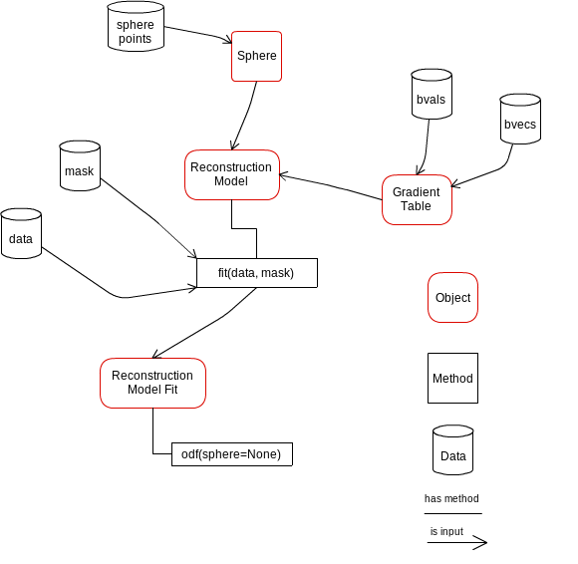
Design is important

Slide 15
List of algorithms
Reconstruction
- Diffusion Spectrum Imaging (Wedeen)
- Generalized Q-Sampling Imaging (Yeh)
- Diffusion Spectrum Imaging with Spherical Deconvolution (Canales-Rodriguez)
- Qball (Descoteaux)
- Constant Solid Angle (Aganj)
- Opdt (Tristan-Vega)
- Diffusion Tensor (Basser)
- Simulations
- ++ CSD + MultiTensor on their way.
Tracking
- Deterministic
- Probabilistic
- Statistics (length etc.)
- Streamline counts
Input / Output
- nifti
- dicom (partly supported)
- trackvis
- hdf5
- fast pickling
- numpy io
Segmentation
- QuickBundles
Volume
- Fast volume traversal (ndindex)
- Reslice volumes
Registration
- Warp streamlines

Slide 16
Get involved and share some code!
dipy.org
Thank you!

