Slide 1
SCIL: Evaluating different deconvolution methods in all three categories
Eleftherios Garyfallidis and Michael Paquette
Université de Sherbrooke,Quebec, Canada
scil.dinf.usherbrooke.ca

Slide 2
Training Data Flowchart
Data
Local
Reconstruction
Method
Deterministic
Tracking
Connectivity
Matrix
Score

Slide 3
CSD: Constrained Spherical Deconvolution
Tournier et al.
SDT: Spherical Deconvolution Transform
Descoteaux et al.
DSID: Diffusion Spectrum Imaging with Deconvolution
Canales-Rodriguez et al.
GQID: Generalized Q-sampling Imaging with Deconvolution
Garyfallidis PhD thesis
PSO: Multi-tensor with particle swarming.
Paquette et al.
Local Reconstruction Methods

Slide 4
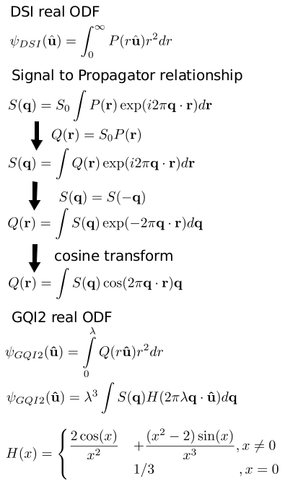
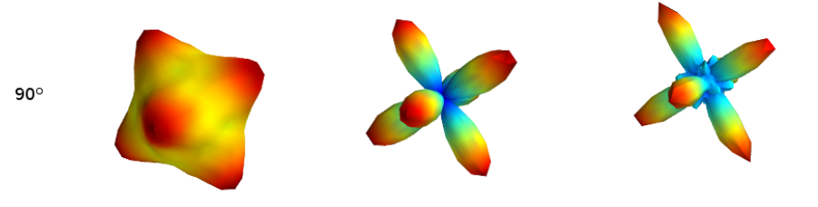
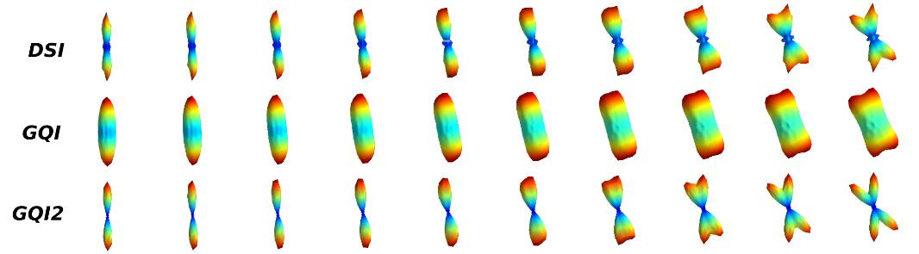
GQI2

Slide 5
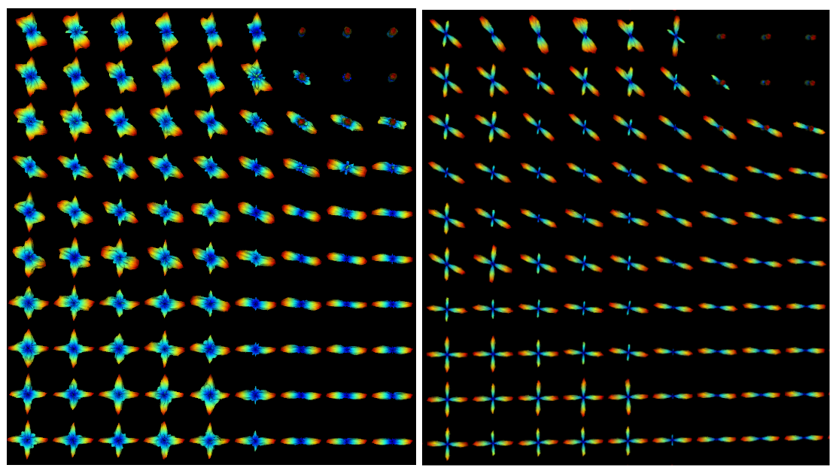
GQI2 vs GQID

Slide 6
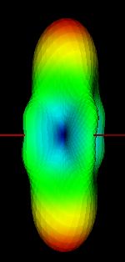
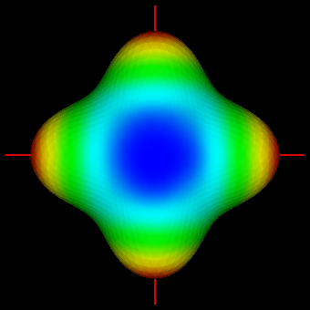
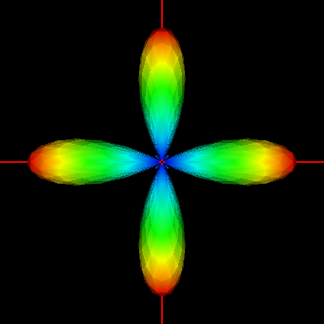
Spherical Deconvolution Transform
FRT
Diffusion
ODF
HARDI Signal
Fiber ODF
Deconvolution
sharpening
transform
c_{j}
2π P_{l(j)}(0)
1/ f_{j}

Slide 7

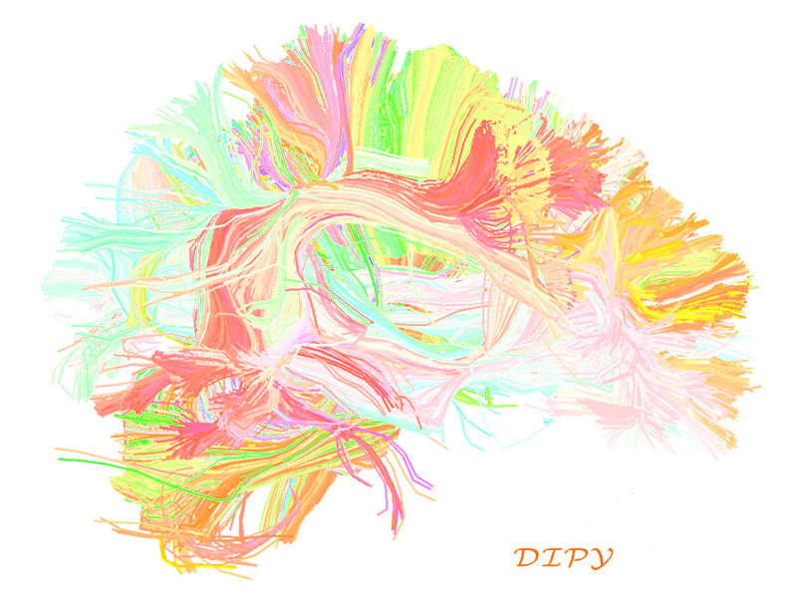

Slide 8
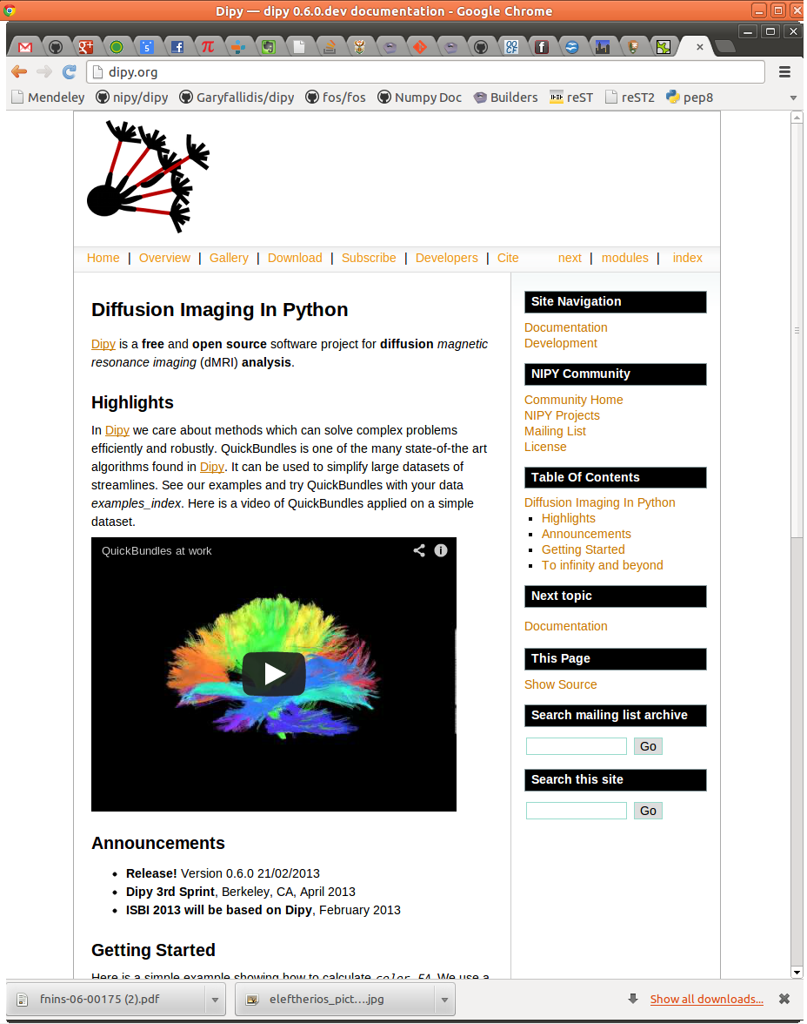
dipy.org

Slide 9
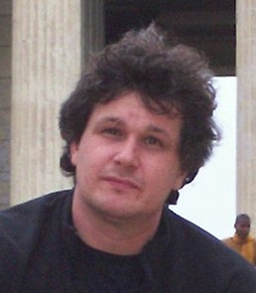
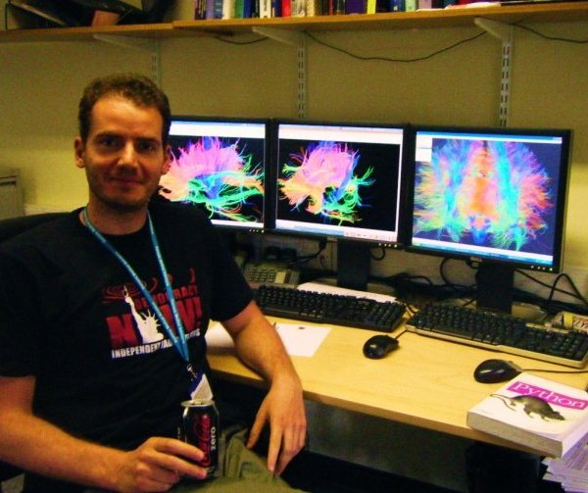
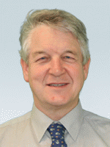
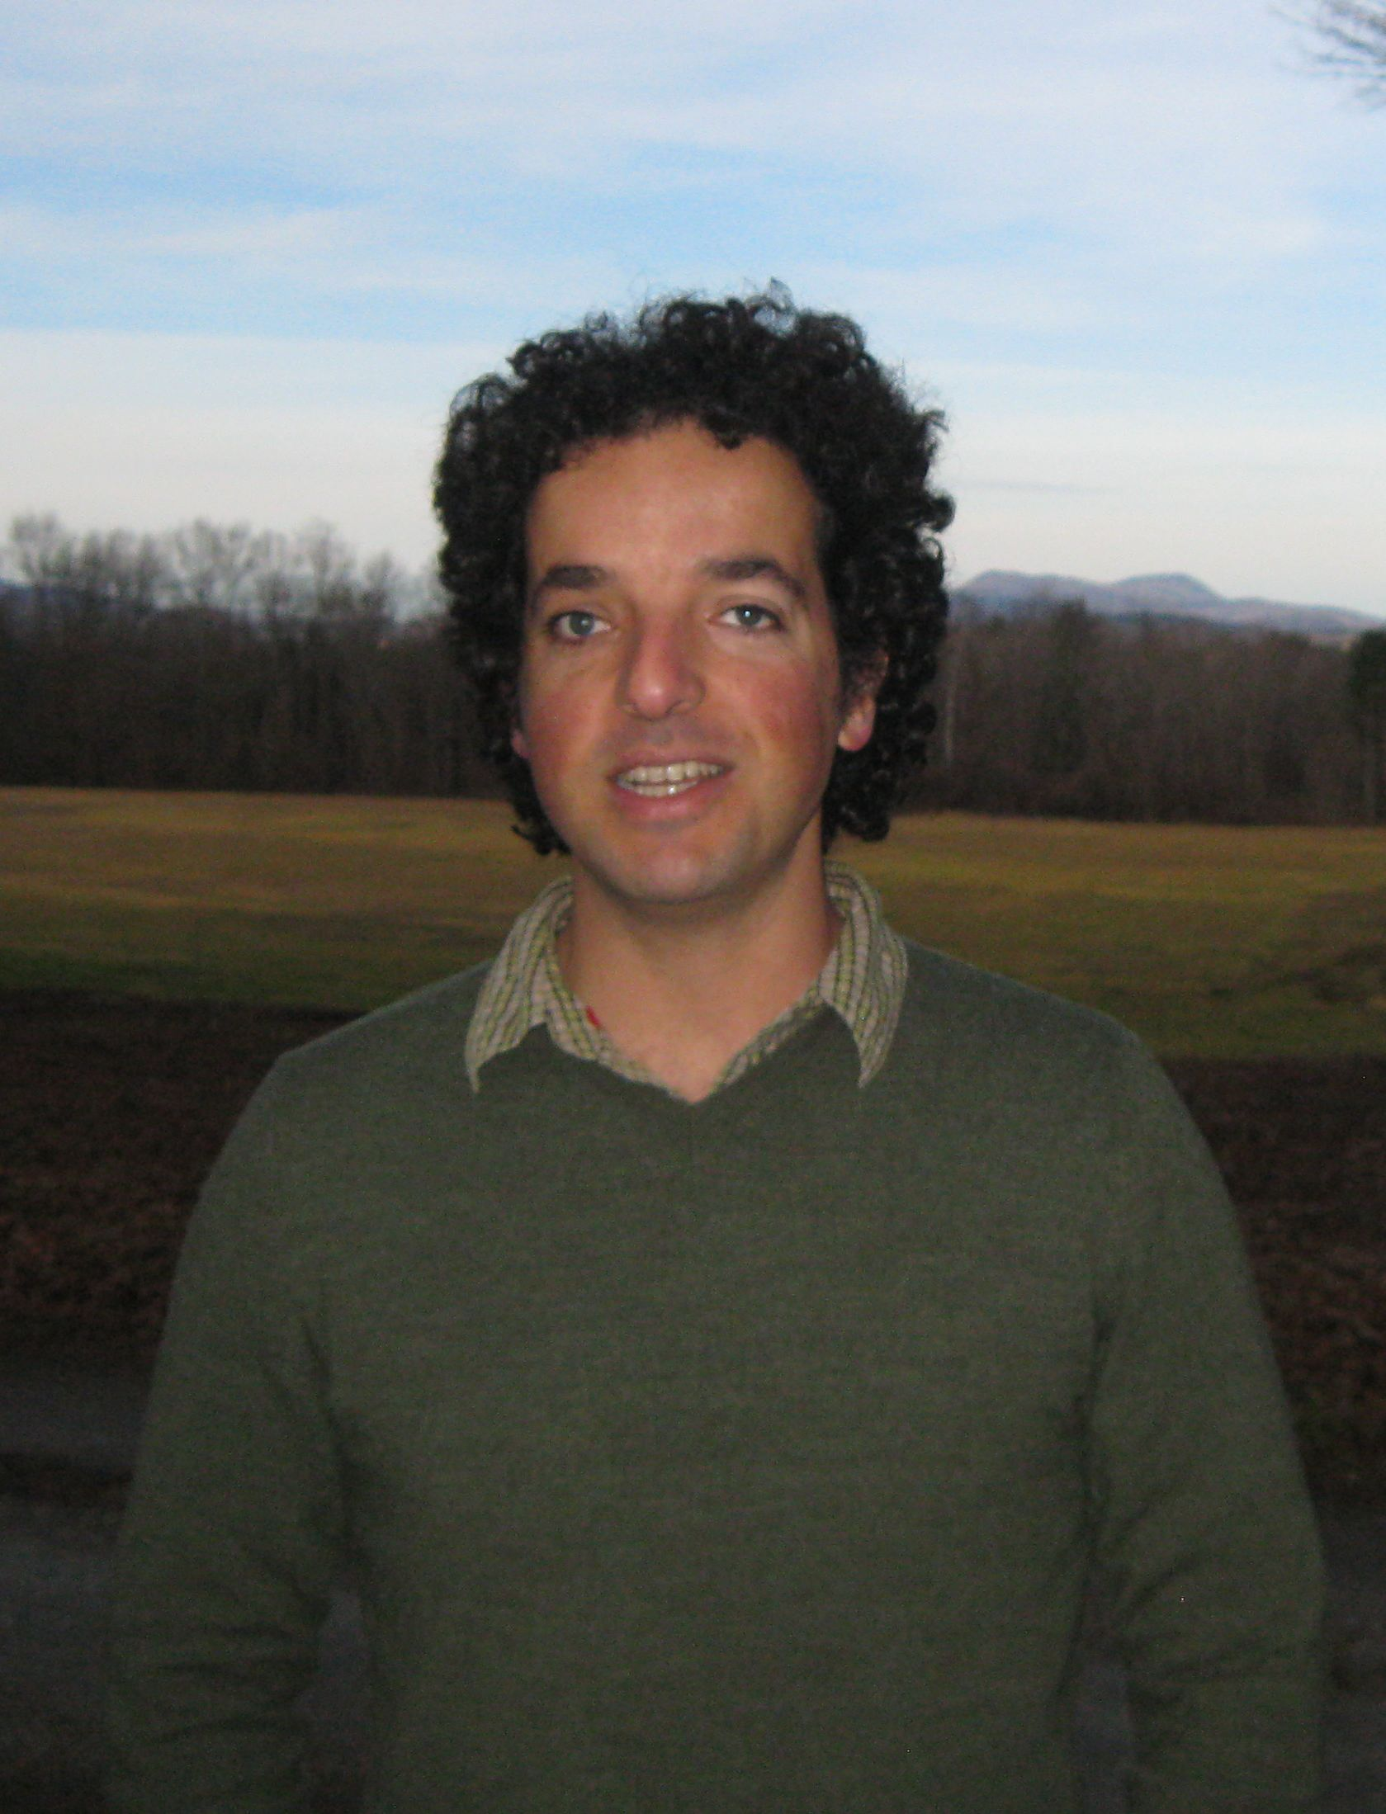
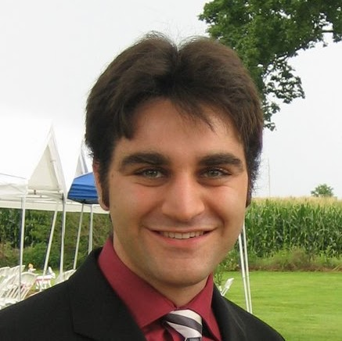
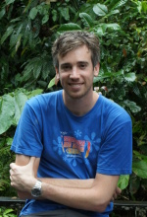
Dipy Developers (Core team)
Matthew
Berkeley
Eleftherios
Cambridge, UK
Ian
MRC CBU Cambridge, UK
Ariel
Stanford
Bago
UCSF
Stefan
South Africa

Slide 10
Dipy Developers (Full list)
- Eleftherios Garyfallidis, University of Sherbrooke, QC, CA
- Ian Nimmo-Smith, MRC Cognition and Brain Sciences Unit, Cambridge, UK
- Matthew Brett, University of California, Berkeley, CA, US
- Bago Amirbekian, University of California, San Fransisco, CA, US
- Ariel Rokem, Stanford University, CA, US
- Stefan Van der Walt, Stellenbosch University, ZA
- Maxime Descoteaux, University of Sherbrooke, QC, CA
- Michael Paquette, University of Sherbrooke, QC, CA
- Christopher Nguyen, University of California, Los Angeles, CA, US
- Emanuele Olivetti, NeuroInformatics Laboratory (NILab), Trento, IT
- Yaroslav Halchenco, PBS Department, Dartmouth, NH, US
- Samuel St-Jean, University of Sherbrooke, QC, CA
- Your name here
We combine expertise in computer science, mathematics, psychology and medicine.

Slide 11
Mission
The purpose of dipy is to make it easier to do better diffusion MR imaging research.
- clearly written
- clearly explained
- a good fit for the underlying ideas
- a natural home for collaboration
We hope that, if we fail to do this, you will let us know and we will try and make it better.
Truly Open
BSD License
Documentation
Unit tests
Examples
Tutorials
Buildbots
Git/Github
Travis
Dependencies
Numpy
Scipy
Cython
Nibabel
(Optional)
Python vtk
Pytables

Slide 12
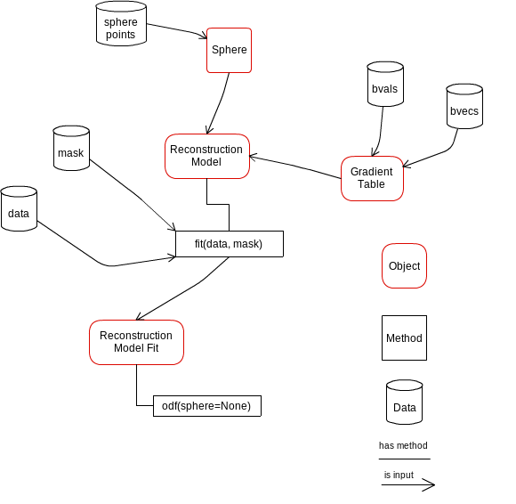
Design is important

Slide 13
List of algorithms
Reconstruction
- Diffusion Spectrum Imaging (Wedeen)
- Generalized Q-Sampling Imaging (Yeh)
- Diffusion Spectrum Imaging with Deconvolution (Canales-Rodriguez)
- Qball (Descoteaux)
- Constant Solid Angle (Aganj)
- Opdt (Tristan-Vega)
- Diffusion Tensor (Basser)
- Simulations
- ++ CSD + MultiTensor on their way.
Tracking
- Deterministic
- Probabilistic
- Statistics (length etc.)
- Streamline counts
Input / Output
- nifti
- dicom (partly supported)
- trackvis
- hdf5
- fast pickling
- numpy io

Slide 14
Segmentation
- QuickBundles
Volume
- Fast volume traversal (ndindex)
- Reslice volumes
Registration
- Warp streamlines
And your module here
List of algorithms

Slide 15
Get involved and share some code!
dipy.org
Thank you!

