Slide 1
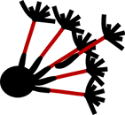


Diffusion Imaging in
Python Course @EPFL
Eleftherios Garyfallidis
Université de Sherbrooke, Quebec, Canada
http://scil.dinf.usherbrooke.ca

Slide 2
Overview
1. Installation Tips for Python software
2. Numerical processing with Python
- Numpy
- Scipy
- Matplotlib
- IPython
3. Neuroimaging
- Nibabel
    - Dipy

Slide 3
1. Installation Tips
General installation tools (eggs)
- easy_install whatever
- pip install whatever
Debian/Ubuntu/Mint
- sudo apt-get install whatever
Python Distributions
- pythonxy (Windows)
- enthought python distribution (MacOSX, Windows)
- Anaconda (MacOSX, Windows)
Install from source
- git clone git://github.com/nipy/dipy.git
- Update your PYTHONPATH in your .bashrc file
- (system) sudo python setup.py install
- (local) sudo python setup.py build_ext -i
For more information have a look at http://dipy.org/installation.html

Slide 4
1. Installation Rescue
Because there are many ways to install python packages some times people install multiple versions of the same package or they don't remove the previous version.
import dipy
dipy.__file__
/usr/lib/…/site-packages/.../python2.7/dipy
or
/usr/lib/…/dist-packages/.../dipy
or
/home/user/dipy
Remove the dipy folder and any other dipy files and then reinstall the version that you want.

Slide 5
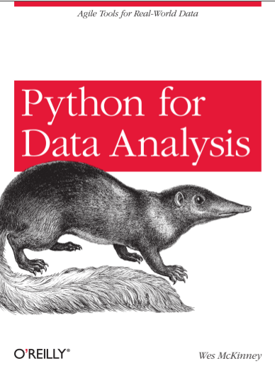
2. Numerical Processing in Python
Great book by
Wes McKinney!
Creator of pandas.
http://vimeo.com/59324550

Slide 6
2. Numerical Processing in Python
List of most useful Numerical Libs in Python (my view):
Numpy:
matrix, vector, tensor operations, linear algebra
Scipy:
optimization, ndimage operations, fft, convex hull,
Sympy:
symbolic computation
Matplotlib (pylab):
    2D & 3D plotting
Mayavi:
3D rendering
Scikits-learn:
Machine Learning

Slide 7
2. Running your code with IPython
IPython can be used in the console using:
ipython
run code.py
or you can use it from the browser by running in the console the command:
ipython notebook
Time for examples!

Slide 8
2. Debugging with IPython
Post-mortem mode: Use 1/0 as a break point in the place where you want to inspect some variables.
%pdb (python debugger)
run code.py
ipdb? help
p print
pp pretty print (objects)
n next (exit)
%debug back in debug mode

Slide 9
2. Debugging with IPython
Classic mode (step-by-step): Add breakpoints as line numbers in run.
run -d b9 code.py
Or add breakpoints from ipdb after running
run -d code.py
break code.py:11
break other_code:4
Press 'c' to start the script until the break point and then 'n' to go to next line.

Slide 10
2. Line profiling with kernprof.py
A simple decorator will do the job.
@profile
def foo():
...
kernprof.py -l -v code.py

Slide 11
3. Nibabel
This package provides read and write access to some common medical and neuroimaging file formats, including: ANALYZE (plain, SPM99, SPM2), GIFTI, NIfTI1, MINC, MGH and ECAT as well as PAR/REC. We can read and write Freesurfer geometry, and read Freesurfer morphometry and annotation files. There is some very limited support for DICOM.. Which is now being extended.
import nibabel as nib
Img = nib.load('file.nii.gz')

Slide 12
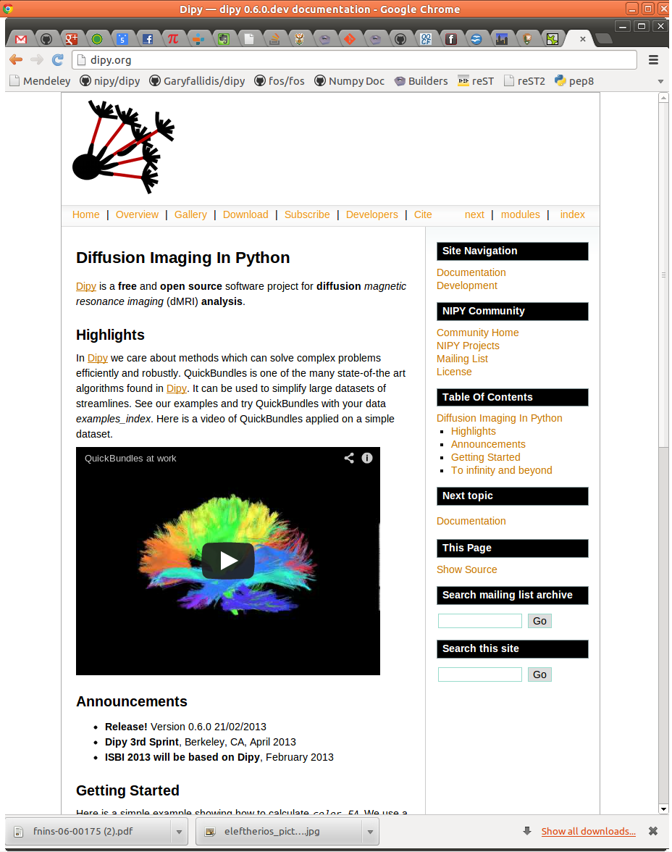
3. Dipy
http://dipy.org

Slide 13
3. Dipy Mission
The purpose of dipy is to make it easier to do better diffusion MR imaging research.
- clearly written
- clearly explained
- a good fit for the underlying ideas
- a natural home for collaboration
We hope that, if we fail to do this, you will let us know and we will try and make it
better.
Dependencies
- Numpy
- Scipy
- Cython
- Nibabel
(Optional)
- Python vtk
- Pytables
True Open Source
- BSD License
- Documentation
- Unit tests
- Examples
- Tutorials
- Continuous integration
- Git/Github
- Travis

Slide 14
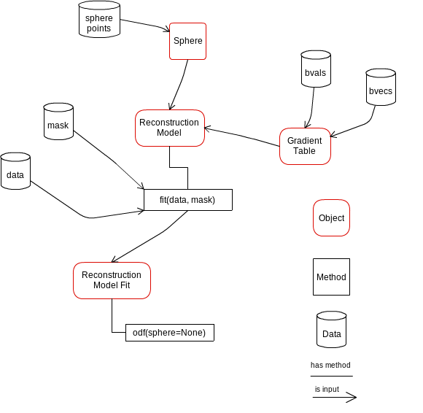
Design is important

Slide 15
Time for examples!

Slide 16
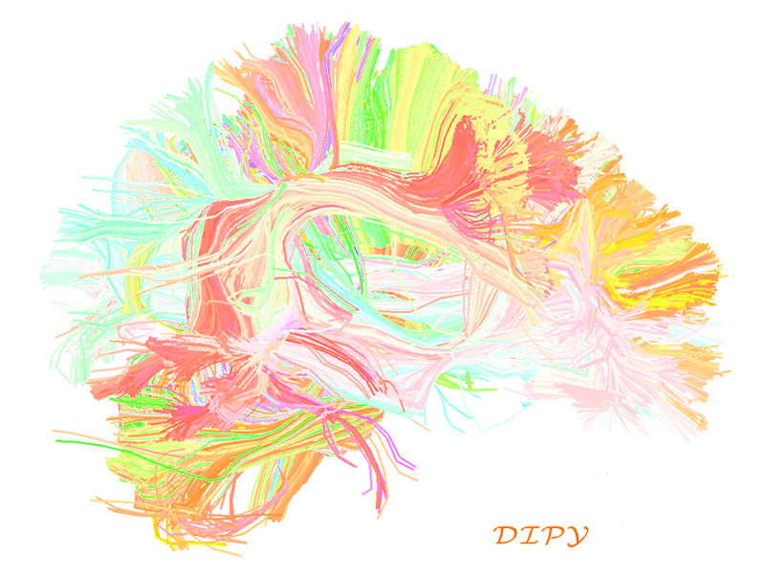
Get involved and share some code!
Thank you!

